Slide 1
Advancing Team-Based Care
Learning Collaborative
Wednesday June 19th, 2024
Notes:
Meaghan

Slide 2
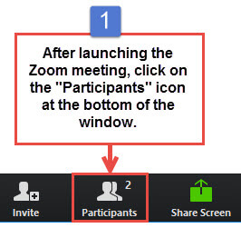
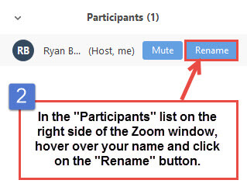
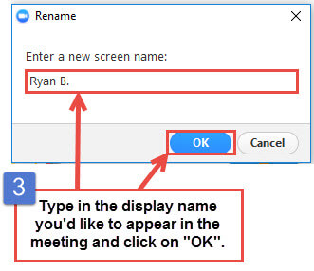
Get the Most Out of Your Zoom Experience
Please keep yourself on MUTE to avoid background/distracting sounds
Use the CHAT function or UNMUTE to ask questions or make comments
Please change your participant name to your full name and organization
“Meaghan Angers CHCI”
Notes:
Meaghan

Slide 3
Session Agenda
1:00 – 1:10 | Welcome
1:10 – 1:40 | Showcases – 10 minutes each 1:10-1:20 Brockton Neighborhood Health Center 1:20-1:30 Klamath Health Partnership Showcase 1:30-1:40 The Wright Center for Community Health
1:40 – 2:00 | Next Steps
Notes:
Meaghan

Slide 4
Learning Collaborative Faculty
NTTAP Faculty, Collaborative Design,
and Facilitation
Amanda Schiessl, MPP
Project Director/Co-PI, NCA
Amanda@mwhs1.com
Margaret Flinter, APRN, PhD, FAAN
Co-PI, NCA & Senior Vice President/Clinical Director
Margaret@mwhs1.com
Bianca Flowers
Program Manager
flowerb@mwhs1.com
Meaghan Angers
Program Manager
angersm@mwhs1.com
Mentors, Coaching Faculty
Deborah Ward, RN
Quality Improvement Consultant
WardD@mwhs1.com
Tom Bodenheimer, MD
Physician and Founding Director, Center for Excellence in Primary Care
Rachel Willard, MPH
Director, Center for Excellence in Primary Care
Evaluation Faculty
Kathleen Thies, PhD, RN
Consultant, Researcher
ThiesK@mwhs1.com
4
Notes:
Meaghan

Slide 5
National Training and Technical Assistance Partners
Clinical Workforce Development
Provides free training and technical assistance to health centers across the nation through national webinars, learning collaboratives, activity sessions, trainings, research, publications, etc.
Notes:
Meaghan

Slide 6
Collaborative Structure and Expectations
Eight 90-minute Zoom Learning Sessions
Session 1
Dec. 6th
Session 2
Jan. 17th
Session 3
Feb. 7th
Session 4
March 6th
Session 5
April 3rd
Session 6
May 8th
Session 7
May 29th
Session 8
June 19th
Between Session Action Periods
Meet weekly as a team
Conduct daily huddles
Complete deliverables and upload to the Google Drive
Use the Weitzman Education Platform to access resources and receive CME credit for learning sessions
Between Sessions
Coaches meet with coach-mentors weekly
Faculty support
Complete deliverables
Notes:
Meaghan

Slide 7
2023-2024 Cohort
Organization | Location
Brockton Neighborhood Health Center | Massachusetts
Brooklyn Plaza Medical Center | New York
Center for Family Health & Education | California
Klamath Health Partnership | Oregon
Migrant Health Center, Western Region, Inc. | Puerto Rico
The Wright Center for Community Health | Pennsylvania
Notes:
Meaghan

Slide 8
Showcase!
Notes:
Meaghan

Slide 9
Showcase Objectives
Tell the story of your health center’s work during this learning collaborative in a clean, crisp, visual format
Generate reflections among you and the other team members about your involvement in this learning collaborative
Share your work in future meetings with other health center staff including leadership and external stakeholders (i.e. health center board, community partners, and funders)
Notes:
Meaghan

Slide 10
Showcase Order
1:10-1:20 Brockton Neighborhood Health Center
1:20-1:30 Klamath Health Partnership Showcase
1:30-1:40 The Wright Center for Community Health
Notes:
Meaghan

Slide 11
Questions?
Notes:
Meaghan

Slide 12
Next Steps
Due Friday June 28th
Submit any drafted or completed materials to Google Drive
Post-Collaborative Surveys
Each team member: please complete the post-collaborative evaluation survey
As a team: complete post-collaborative Primary Care Team Practice Self-Assessment
Each team member: complete post-collaborative Team Skills Self-Assessment
Team Coach: complete post-collaborative Coaching Skills Self-Assessment
Reminders
Check-in Call: Wednesday September 18th 1:00-2:00pm Eastern / 10:00-11:00am Pacific
If you have questions or encounter barriers prior to September 18th, please reach out to via email to schedule 1-on-1 calls as needed.
Notes:
Meaghan

Slide 13
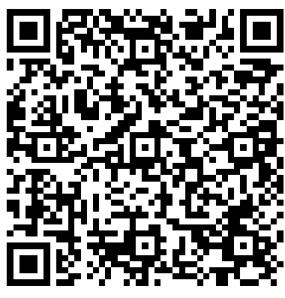
NTTAP Contact Information
CME and Resource Page
Access Code: TBC2023
https://education.weitzmaninstitute.org/content/nttap-comprehensive-and-team-based-care-learning-collaborative-2023-2024
Amanda Schiessl
Project Director/Co-PI
Amanda@mwhs1.com
Bianca Flowers
Project Manager
flowerb@mwhs1.com
Meaghan Angers
Project Manager
angersm@mwhs1.com
REMINDER: Complete evaluation in the poll!
Final Coach Call: Wednesday June 26th
Notes:
Meaghan

Slide 14
National Learning Library: Resources for Clinical Workforce Development
Weitzman Education Platform
https://www.weitzmaninstitute.org/ncaresources
https://education.weitzmaninstitute.org/
Notes:
Meaghan

