Slide 1
Learning Collaborative
Session #3:
Screening for Obesity
Notes:
Welcome everyone to the third Weight Management in Community Health learning collaborative live session “Screening for Obesity.”

Slide 2
Today’s Agenda
Welcome
Overview of Technology and Reminders
Screening for Obesity
Process Flow Chart
Next Steps and Q & A
Notes:
Our agenda today includes an overview of technology and reminders, a didactic presentation from Dr. Mandeep Brar on Screening for Obesity, a quick presentation from our QI Coaches on Process Flow Charts, and then our next steps and time for Q&A

Slide 3
Technology: Your Zoom Window
Sound
Muting/Unmuting
Press *6 to unmute phone audio
Webcam
Please share!
Chat
Questions
Sharing resources/ideas
Notes:
A few logistical reminders before we get started… Please keep yourselves on mute throughout the session to avoid background noise. We welcome you to use the chat function or coming off mute to engage with faculty and your fellow learners through out the session. And lastly, we love to be able to see all of you who join our learning community so if you’re able to, please share your camera with us.

Slide 4
Technology: Your Zoom Window
Closed Captioning & Live Transcript
Click on the caret or icon
Select ‘Show Subtitles’ for closed captioning on screen
Select ‘View Full Transcript’ for live transcript pop-out window
Change Your Name
Click on the three dots
Click ‘Rename’
Type in your name
Notes:
You may change your name at any time throughout the session by clicking on the three dots near your name, and selecting rename. Please use this function to change your name to include your first and last name – health care center name. We welcome you to use this feature to share your pronouns with us if you wish! To continue to make our activities more accessible, closed captioning and live transcription is also available to use as well.

Slide 5
Continuing Education Credits
In support of improving patient care, this activity has been planned and implemented by The France Foundation and Moses/Weitzman Health System, Inc. and its Weitzman Institute and is jointly accredited by the Accreditation Council for Continuing Medical Education (ACCME), the Accreditation Council for Pharmacy Education (ACPE), and the American Nurses Credentialing Center (ANCC), to provide continuing education for the healthcare team.
This series is intended for clinical leadership, primary care providers, behavioral health providers, dietitians, nurses, QI/Technical teams, and other members of the care team.
Please complete the post-session survey and claim your CE certificate on the WeP after today’s session.
Notes:
The Moses Weitzman Health System is jointly accredited to provide continuing education credits for your participation in these live Learning Collaborative sessions.

Slide 6
Disclosure
With respect to the following presentation, there has been no relevant (direct or indirect) financial relationship between the party listed above (or spouse) and any for-profit company in the past 12 months which would be considered a conflict of interest.
The views expressed in this presentation are those of the presenter and may not reflect official policy of Moses/Weitzman Health System and its Weitzman Institute.
We are obligated to disclose any products which are off-label, unlabeled, experimental, and/or under investigation (not FDA approved) and any limitations on the information that I present, such as data that are preliminary or that represent ongoing research, interim analyses, and/or unsupported opinion.
Notes:
And our faculty members have no disclosures to report.

Slide 7
Acknowledgements
This activity is supported by an independent medical educational grant from Lilly.
Notes:
We would like to acknowledge that this activity is supported by an independent medical educational grant from the Lilly Foundation.

Slide 8
At the Weitzman Institute, we value a culture of equity, inclusiveness, diversity, and mutually respectful dialogue. We want to ensure that all feel welcome.
If there is anything said in our program that makes you feel uncomfortable, please let us know.
Notes:
At Moses/Weitzman Health System, we value a culture of equity, inclusiveness, diversity and mutually respectful dialogue. We want to ensure that all feel welcome. If there’s anything said in today’s session that makes you feel uncomfortable, please let us know and if you have any questions regarding the program logistics I have mentioned today, please feel free to email me.

Slide 9
Series Learning Objectives
Ascertain metrics of your healthcare center against key performance measures related to the obesity care
Identify barriers to diagnosing and treating obesity for patients in your healthcare center
Formulate an improvement plan for establishing diagnostic and treatment plans for patients with obesity in your healthcare center
Develop an improvement plan for managing holistic care of patients with obesity in your healthcare center
Notes:
Here we have our series learning objectives.

Slide 10
Session Learning Objectives
Identify barriers to diagnosing and treating obesity for patients in your healthcare center
Evaluate various screening tools for obesity and determine their appropriateness in different clinical scenarios
Create a comprehensive obesity treatment plan that incorporates a multidisciplinary approach for management
Notes:
And now I would like to introduce one our Weight management expert faculty for the didactic presentation today, Dr. Mandeep Brar. Dr. Brar is a board-certified Clinical Endocrinologist with extensive experience in managing complex endocrine disorders. She currently works with Cigna Healthcare in Phoenix, Arizona, focusing on diabetes management and provider training. And now I am going to pass it over to Dr. Brar.

Slide 11
Guideline Recommendations
USPSTF:
Recommends screening all adults for obesity
Clinicians should offer or refer patients with a body mass index (BMI) of 30 kg/m² or higher to intensive, multicomponent behavioral interventions
The USPSTF found inadequate evidence on optimal screening intervals, but annual screening is commonly recommended
ACC/AHA:
Annual screening of all adults for obesity using BMI measurement and waist circumference
Consider using the Edmonton Obesity Staging System
ACA = American College of Cardiology; AHA = American Heart Association; USPSTF = US Preventative Services Task Force
Yao A. Ann Med Surg (Lond). 2012;2(1):18-21; Wharton S, et al. CMAJ. 2020;192(31):E875-E891.

Slide 12
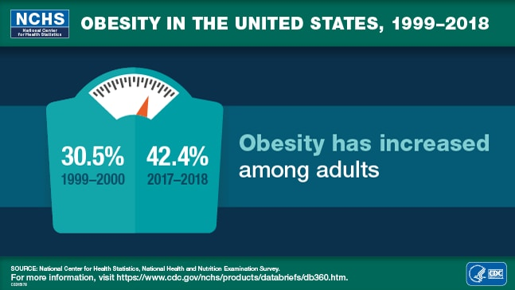
Demographics
US obesity prevalence (2017–March 2020): 41.9%
In 1999-2000, the prevalence was 30.5%
Severe obesity increased from 4.7% to 9.2%
By race
Non-Hispanic Black adults: 49.9%
Hispanic adults: 45.6%
Non-Hispanic White adults: 41.4%
Non-Hispanic Asian adults: 16.1%
By age
20 to 39 years: 39.8%
40 to 59 years: 44.3%
60 and older: 41.5%
Hales CM, et al. Hyattsville, MD: National Center for Health Statistics. 2020

Slide 13
Doctor Appointment Overview
Obesity screenings typically occur as part of routine checkups that include physical exams
Clinicians will review:
Medical history
Family history
Comorbidities
Current medications
Personal habits
Diet, stress, exercise, sleep quality
Ordering tests
HDL/LDL, triglycerides, HbA1c, TSA
MedlinePlus. Accessed May 21, 2024. https://medlineplus.gov/lab-tests/obesity-screening/

Slide 14
Screening Tools
BMI
Waist circumference
Waist-to-hip ratio
Skinfold measurements
Bioelectrical impedance analysis (BIA)
MedlinePlus. Accessed May 21, 2024. https://medlineplus.gov/lab-tests/obesity-screening/; Hu F. In: Hu F, ed. Obesity Epidemiology. New York City: Oxford University Press, 2008; 53–83.
Notes:
Possible Engagement: Can everyone please type into the chat, what screening tools does your clinic use to identify obesity?

Slide 15
Body Mass Index (BMI)
BMI is generally accepted as the 1st step to determine the degree of overweight and obesity
It is a practical and useful determinant for increased risk of morbidity and mortality on the population level
...but less so on the individual level
Body mass index (BMI) is the ratio of weight (kg) to height (m²)
If using lbs and inches, multiply by 703
Global BMI Mortality Collaboration, et al. Lancet. 2016;388(10046):776-786.

Slide 17
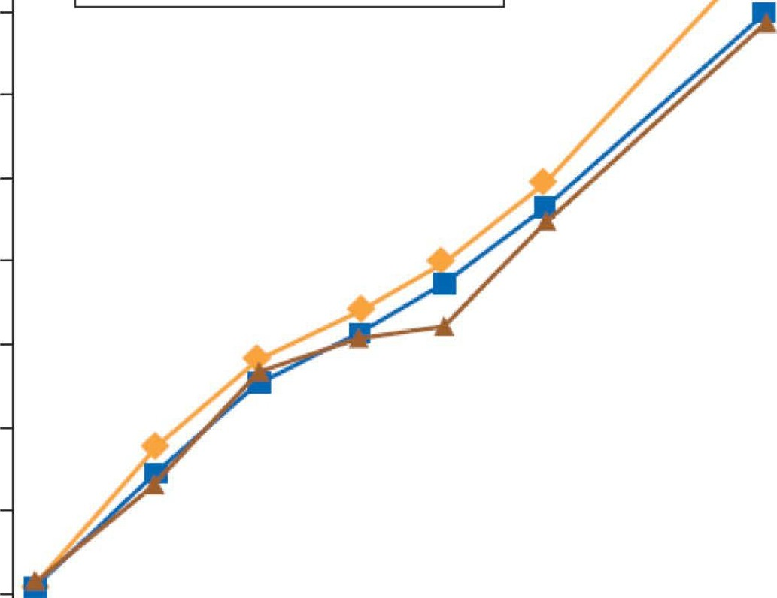
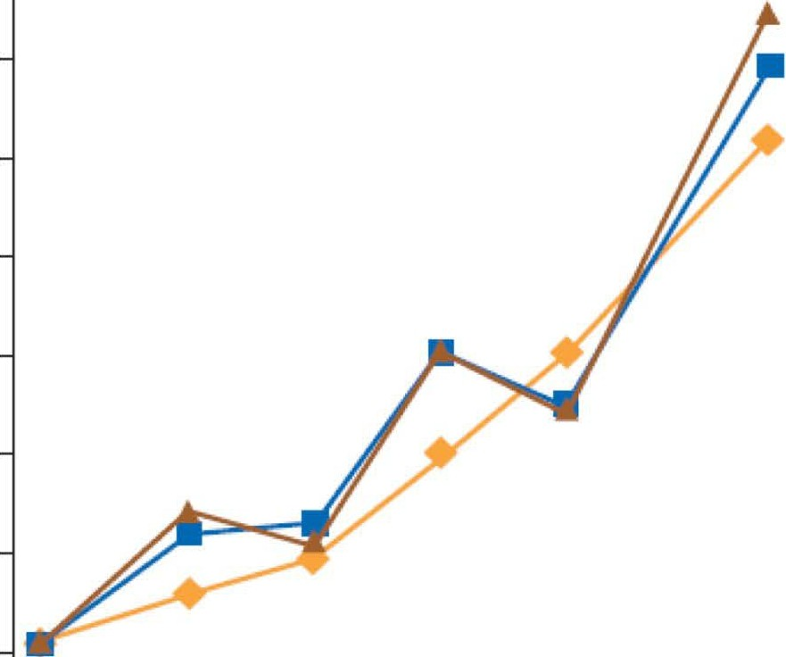
Hazard Ratios for Waist Circumference and All-Cause Mortality*
Men Women
1.9
-
1.9
-
-
All
Never smokers
Healthy never smokers
1.8
-
All
Never smokers
Healthy never smokers
1.8
-
1.7
1.7
1.6
1.6
-
1.5
1.5
1.4
1.4
Hazard Ratio
Hazard Ratio
1.3
1.3
1.2
1.2
1.1
1.1
1.0
1.0
-
-
-
-
-
-
0.9
-
-
-
-
-
-
-
-
0.9
85
90 95 100 105 110 115
65 70 75 80 85
90
95 100 105
Waist circumference (cm)
*Ratios adjusted for smoking status, physical activity, and BMI
Waist circumference (cm)
Cerhan JR, et al. Mayo Clin Proc. 2014.
Copyright 20230 Medical Learning Institute, Inc.

Slide 18
Classification of Overweight and Obesity by BMI
Waist Circumference and Associated Disease Risks
Disease Risk Relative to Normal Weight and Waist Circumference
BMI (kg/m²)
Men (≤102 cm) ≤40 in
Women (≤88 cm) ≤35 in
Men (>102 cm) >40 in
Women (>88 cm) >35 in
On Exam (Patient Example) Weight: 234 lbs
Height: 70" WC: 45" BMI: 34
Underweight
<18.5
Normal
18.5-24.9
Overweight
25.0-29.9
Increased
High
High
Very High
Patient above has a BMI of
34 and waist
Obesity Class l
30.0-34.9
circumference of 114.3 cm (45 inches)
Obesity Class ll
35.0-39.9
Very High
Very High
Obesity Class Ill
≥40
Extremely High
Extremely High
Clinical Guidelines on the Identification, Evaluation, and Treatment of Overweight and Obesity in Adults-The Evidence Report. Obes Res 1998;6(suppl 2).
Copyright 20230 Medical Learning Institute, Inc.

Slide 19
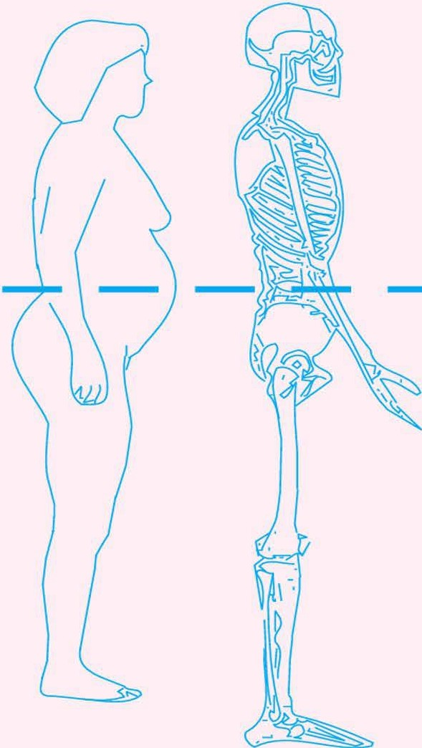
How to Measure Waist Circumference
Locate upper hip bone and top of right iliac crest
Place measuring tape in horizontal plane around abdomen at iliac crest
Ensure tape is snug, but does not compress the skin
Tape should be parallel to the floor
Record measurement at the end of a normal expiration
Women >35 inches
increased risk*
Men >40 inches
increased risk*
Measuring-Tape Position for Waist (Abdominal) Circumference in Adults
*Ethnic/age-related differences affect predictive validity of WC as surrogate for abdominal fat
NHLBI Obesity Education Initiative. NIH. 2000.
Copyright 20230 Medical Learning Institute, Inc.

Slide 20
Strengths and Limitations: Waist Circumference
Strengths:
Easy and inexpensive
Strongly correlates with body fat in adults
Predicts disease and death, as shown by studies
Limitations:
Measurement accuracy is operator-dependent and may vary
Lacks comparison standards for children
Less accurate for individuals with a BMI of 35 or higher
MedlinePlus. Accessed May 21, 2024. https://medlineplus.gov/lab-tests/obesity-screening/; Hu F. In: Hu F, ed. Obesity Epidemiology. New York City: Oxford University Press, 2008; 53–83.
Notes:
Possible Engagement Question: Have you encountered any strengths or limitations of Waist Circumference that are not mentioned here? Please share them.

Slide 21
Waist-to-Hip Ratio
Like waist circumference, the waist-to-hip ratio (WHR) is used to measure abdominal obesity
To calculate WHR, measure the waist and the hips (at the widest part of the buttocks), then divide the waist measurement by the hip measurement
Health risk | Men | Women
Low | 0.95 or lower | 0.80 or lower
Moderate | 0.96-1.0 | 0.81-0.85
High | 1.0 or higher | 0.86 or higher
MedlinePlus. Accessed May 21, 2024. https://medlineplus.gov/lab-tests/obesity-screening/; Hu F. In: Hu F, ed. Obesity Epidemiology. New York City: Oxford University Press, 2008; 53–83.

Slide 22
Strengths and Limitations: Waist-to-Hip Ratio
Strengths:
Correlates well with body fat measured by accurate methods
Inexpensive
Limitations:
Prone to measurement error due to requiring two measurements
Harder to measure hips than waist
Complex interpretation, as increased ratio can stem from abdominal fat or reduced muscle mass
Less accurate in individuals with BMI of 35 or higher
MedlinePlus. Accessed May 21, 2024. https://medlineplus.gov/lab-tests/obesity-screening/; Hu F. In: Hu F, ed. Obesity Epidemiology. New York City: Oxford University Press, 2008; 53–83.

Slide 23
Skin-Fold Measurements
Uses a special caliper to measure the thickness of a "pinch" of skin and the fat beneath it at specific body areas (trunk, thighs, front and back of the upper arm, and under the shoulder blade)
Equations are then used to estimate body fat percentage based on these measurements
Category | Males (% body fat) | Female (% body fat)
Essential Fat | 2%-5% | 10%-13%
Athlete | 6%-13% | 14%-20%
Fitness | 14%-17% | 21%-24%
Acceptable | 18%-24% | 25%-31%
Obesity | > 25% | > 32%
MedlinePlus. Accessed May 21, 2024. https://medlineplus.gov/lab-tests/obesity-screening/; Hu F. In: Hu F, ed. Obesity Epidemiology. New York City: Oxford University Press, 2008; 53–83.

Slide 24
Strengths and Limitations: Skin-Fold Measurements
Strengths:
Convenient
Safe
Inexpensive
Portable
Limitations:
Not as accurate or reproducible as other methods
Very difficult to measure in individuals with a BMI of 35 or higher
MedlinePlus. Accessed May 21, 2024. https://medlineplus.gov/lab-tests/obesity-screening/; Hu F. In: Hu F, ed. Obesity Epidemiology. New York City: Oxford University Press, 2008; 53–83.

Slide 25
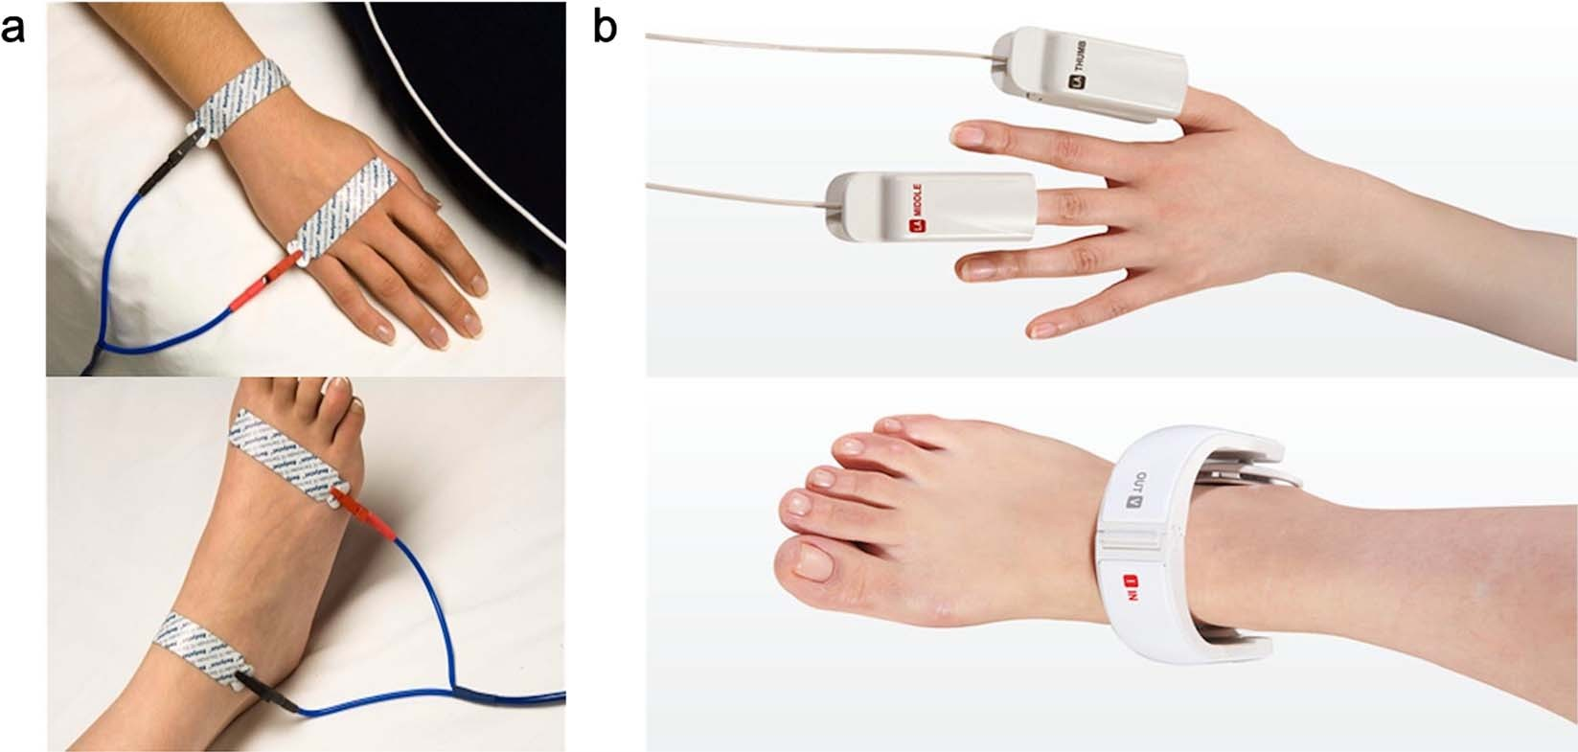
Bioelectrical Impedance Analysis
Lean body mass conducts electricity better than fat mass due to higher water content
BIA devices calculate body fat percentage by analyzing impedance alongside factors like height, weight, age, and gender
Coppini LZ, et al. Curr Opin Clin Nutr Metab Care. 2005;8(3):329-332; Hu F. In: Hu F, ed. Obesity Epidemiology. New York City: Oxford University Press, 2008; 53–83.

Slide 26
Strengths and Limitations: BIA
Strengths:
Convenient
Non-invasive
Safe
Relatively inexpensive
Limitations:
Accuracy is affected by factors like hydration status, recent food/fluid intake, and body position during measurement
Less accurate in individuals with BMI of 35 or higher
Coppini LZ, et al. Curr Opin Clin Nutr Metab Care. 2005;8(3):329-332; Hu F. In: Hu F, ed. Obesity Epidemiology. New York City: Oxford University Press, 2008; 53–83.

Slide 27
Imaging Methods
MRI:
Considered the reference standard for assessing total and regional adipose tissue distribution
Strengths: No ionizing radiation, excellent soft tissue contrast, quantifies ectopic fat
Limitations: Expensive, longer scan times, limited ability to accommodate severe obesity
Dual energy X-ray absorptiometry
CT:
Allows measurement of specific fat depots like visceral and subcutaneous abdominal fat
Strengths: High spatial resolution, quantification of ectopic fat
Limitations: Radiation exposure, limited ability in severe obesity
DEXA:
Utilizes two low-dose X-ray beams to estimate fat mass, lean mass, and bone mineral density
Strengths: Accurate, distinguishes fat and lean tissue
Limitations: Cannot differentiate subcutaneous and visceral fat, limited ability to accommodate severe obesity, radiation exposure
Hu F. In: Hu F, ed. Obesity Epidemiology. New York City: Oxford University Press, 2008; 53–83; Pereira et al. Sci Rep. 2023;13(1):11147; Silver HJ, et al. Diabetes Metab Syndr Obes. 2010;3:337-347.

Slide 28
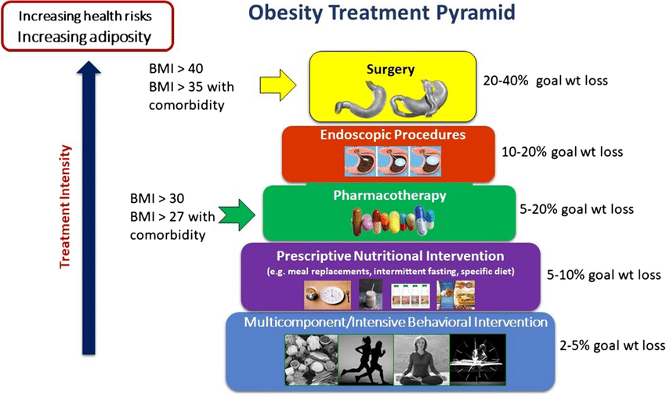
Introducing Interventions
Tucker S, et al. Curr Obes Rep. 2021;10(3):396-408.

Slide 29
Documenting Obesity Treatment Plans
Clearly indicate obesity status diagnosis
healthy weight; overweight; class I, II, or III obesity
Describe weight history
max weight, lowest weight, current weight
Describe previous interventions
degree of effectiveness, any adverse effects experienced
Summarize the plan
Behavioral goals, pharmacotherapy regimen, and/or bariatric surgery
Laboratory monitoring to be completed
Referrals to any other specialists recommended
State anticipated follow-up timeframe

Slide 30
Reframing the Conversation About Obesity: Language Matters
Approaches to Reframe the Conversation:
Avoid
Try Instead
"I’m sure the problems you’ve had are all related to your weight”
"Would you mind if we spoke about your weight? Where do you think you're at?"
Seek permission
Use person-first language
Use evidence-based information
Be empathetic, understanding, and collaborative
“Obese children…”
“Fat people...”
"Individuals with higher weight/BMI..."
“You just need to eat less”
“If you don’t lose weight, you will get diabetes”
"Obesity can affect our health in x, y, and z ways"
"What has been going on in your life since we last met?
Has this had an impact on what you eat?"
“Don’t you want to be a normal weight?”
https://obesitycanada.ca/wp-content/uploads/2020/10/Obesity-Language-Matters-_FINAL-2.pdf; https://www.worldobesity.org/downloads/healthy_voices_downloads/HV_Language_guidelines.pdf
Notes:
Possible Polling Question:
o How confident are you in discussing obesity with your patients?
§ 1. Very confident
§ 2. Confident
§ 3. Not confident, but I can do it
§ 4. Not confident, I avoid it
Slide 30 (after results of polling question) Possible Engagement Question: Can someone share a time they were successful in reframing a conversation about obesity?

Slide 31
Key Takeaways
Obesity is a chronic disease whose hallmark is excess adiposity resulting in structural, biomechanical, physiologic, metabolic, and psychosocial health effects
There are several different screening methods to assess and evaluate the presence and severity of obesity, each with distinct pros and cons
A comprehensive obesity treatment plan includes behavioral and lifestyle approaches as well as pharmacotherapy and/or bariatric surgery for those who meet criteria
Structured documentation of the obesity medical evaluation and treatment plan is vital for clarity and continuity of care
Notes:
Thank you Dr. Brar for a fantastic presentation. For the sake of time, we are going to ask that all questions be answered at the end. I am now going to pass it over to our QI coaches to discuss Process Flow Charts

Slide 32
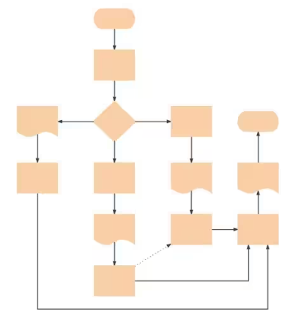
Process Flow Chart
Visual representation of a workflow
Typically focuses on current process
Can use to design optimized, future process
Helps to identify delays, bottlenecks, duplicate work, gaps, etc.
Begin by identifying start and end points

Slide 33
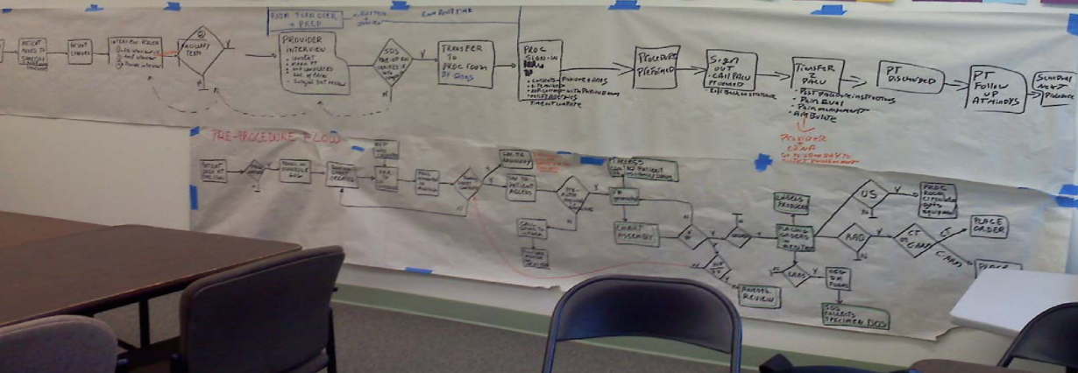
Process Flow Chart–Complicated!
Notes:
For pain patients having an outpatient procedure: Starting with deciding a procedure was needed, ended with patient checked in for procedure. P.s. the pain provider thought that late starts were all her fault – until we started diagramming the process!

Slide 34
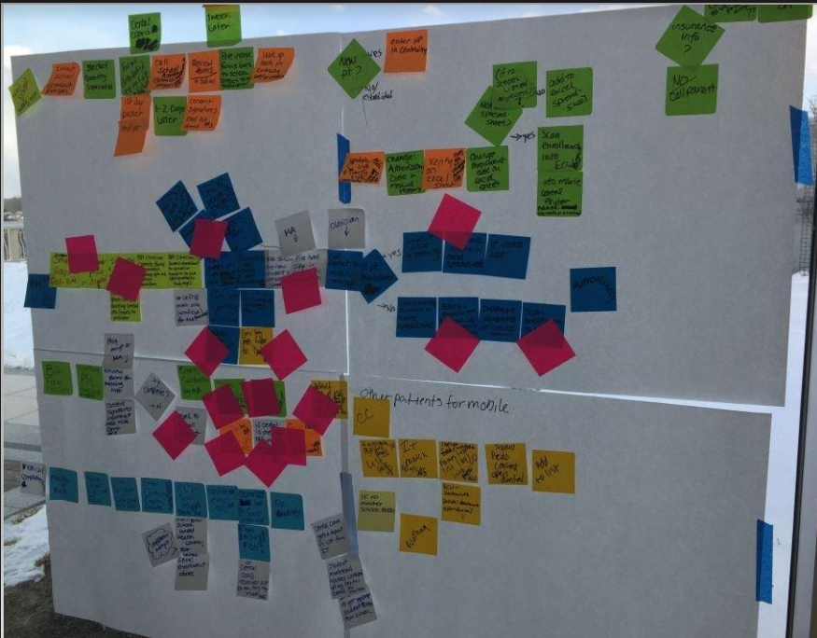

Slide 35
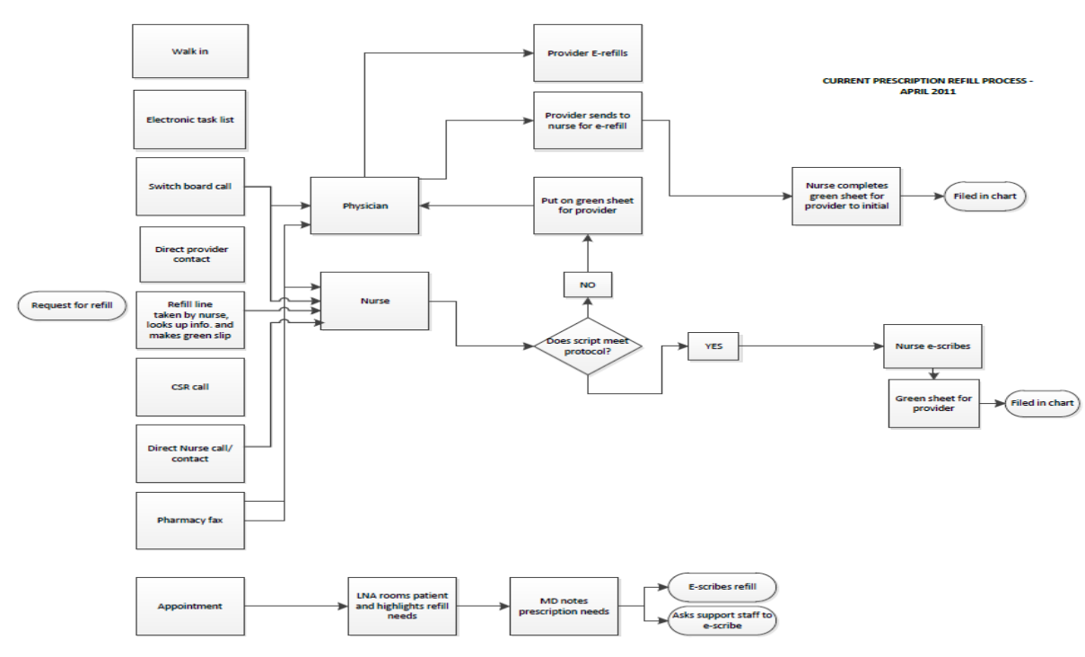
Notes:
Start with a request for a refill, ends with refill completed. Rx coming into the practice 9 different ways!

Slide 36
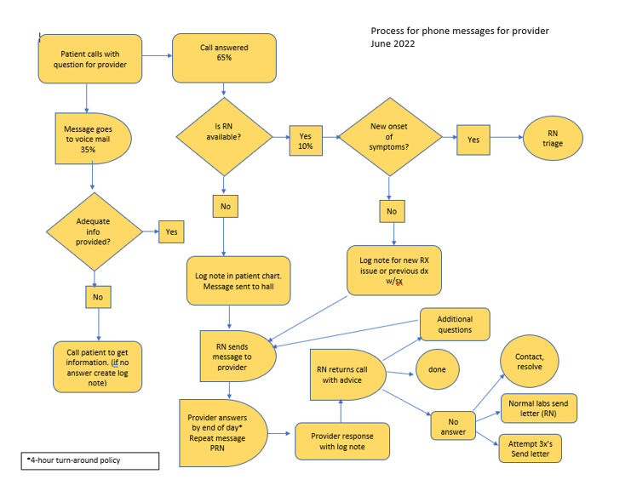
Notes:
Starts with patient calling with question for provider, ends with patients need being met (not just a return call)

Slide 37
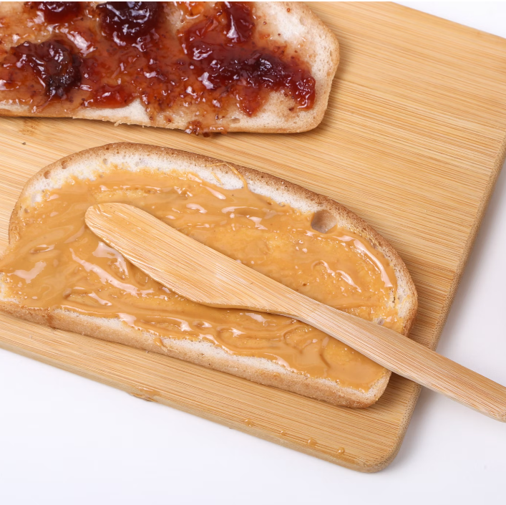
Details Matter
How to make a PB&J
Notes:
Only need to watch 1 minute.

Slide 38
Flow Chart Pro Tips
Consider staying high level–limit to 6-9 steps
Map out the most frequently occurring processes, stay out of the weeds by not mapping steps that occur infrequently
Expect the process to take several meetings
There will be disagreements, pull in other team members to clarify
Don’t worry about being messy
Stay curious, this is not a blaming exercise
Use shapes, colors, and symbols to ID delays, roles, etc.
Notes:
Shape information in prework handout

Slide 39
Thank You
Continuous learning and application throughout program
Office hours (we are here for you!)
Questions?
Notes:
Back up Questions for Dr. Brar
What are some key factors contributing to the increase in obesity prevalence across different demographic groups?
Among the various screening tools listed (BMI, waist circumference, waist-to-hip ratio, skinfold measurements, bioelectrical impedance analysis), which do you find most practical for use in a primary care setting and why?
What screening tools do you typically use in your clinic to identify obesity and the type of obesity?
What are some common pitfalls clinicians should avoid when discussing obesity with patients?
QI Coaches
- I understand that addressing a problem from a high-level perspective can feel overwhelming. What strategies can teams use to begin with smaller, manageable steps?

Slide 40
QI Coaching Office Hours
QI Coaching Office Hours for Module 3:
July 23, 2024
August 6, 2024
Please come prepared to the session…
Pick one of the following to report on:
What is one success your team has experienced? Please explain and show it in detail so others can try it with their groups.
What is one challenge your team is facing?
What is one question you have?
Notes:
As we wrap up, I would like to remind everyone that the QI Coaching office hours this module will be held on July 23rd and August 6th. We would love to hear from all of you during these sessions, so we are going to ask that you pick one of the following questions to report on:
What is on success your team has experience? Please explain and show it in detail so others can try it with their groups
What is one question you have?
What is one challenge your team is facing?
You should have all received an email from me last week announcing the availability of “rapid recaps” for each live module. These rapid recaps consist of a high level overview of the information presented during the module live session. Going forward, these recaps are going to be available within 2 weeks of each live session and can be found in the same place as the session recordings, slides, and resources. As always if you need additional help finding the recap you are more than welcome to reach out to me.

Slide 41
Post-Work Overview
Post-work completed as a team:
Using the flowchart template on page 4 of "QI Essentials Toolkit: Flowchart," create a flowchart listing all the steps in the process you are mapping
Be sure to include decision points, loops, handoffs between roles, etc.
Submit your flowchart (only team leads need to submit)
Post-work due by August 7th
Notes:
And now Melissa Glasner from The France Foundation will go over your postwork.
Thank you ALL again for coming. As always if you have any questions, please feel free to reach out!

