Slide 1
FIT Kit Compliance: A Quality Improvement Project
DePaul Community Health Center
Jamie Bothello
Courtney Jones
Shermese Ceaser

Slide 2
Introduction
Who should get screened: Adults between the ages of 45 and 75 years, even with no family history of colon cancer
Those with a family history may need to be screened sooner than age 45
Screening options:
colonoscopy, flexible sigmoidoscopy, CT colonography (Virtual Colonoscopy), stool tests (guaiac-based fecal occult blood test (gFOBT), fecal immunochemical test (FIT), FIT-DNA test

Slide 3
Statistics: Colon Cancer Screening in the South
Louisiana has the 6th highest colorectal cancer rate in the U.S.
Contributing factors include smoking, overeating, red meat consumption and eating processed foods.
Cases per 100,000, 44.9 in Louisiana and 38.1 in the U.S.
Mortality Rate per 100,000, 16.4 in Louisiana and 13.7 in the U.S.
AA and Cajun populations are more likely to get the disease.

Slide 4
Our Purpose
Since starting employment at our clinic we have noticed that colon cancer screenings are offered to patients; however, patients are often not sending their test back for results.
Our goal is to improve patient compliance for colorectal cancer screening by having staff contact patients to remind them of their FIT test.

Slide 5
The Process
The process starts by gathering all relevant data from Azara related to the problem and goals.
After this, a list of patients who have not returned fit kits from the Metairie and St Cecilia Depaul clinic locations will be given to the staff. Then we will call these patients to remind them about their colorectal cancer screening.
Once all the patients are contacted, results will be reevaluated in Azara regarding FIT tests to see if the results indicate an improvement in compliance with obtaining specimens.
We expect to improve colon cancer screenings and follow ups in our organization.
It is important to implement quality improvement now because colon cancer screenings promote early detection, which improves patient outcomes.

Slide 6
Data Collection
Measurement from Performance Improvement (PI) Goals were obtained through data in Azara and narrowed down to determine FIT test compliance among patients 45- 75 years old.
A chart was made to document who has been given a FIT kit, and who has and has not followed up on submitting the sample.
The last step involves reevaluating return rate of FIT kits in Azara to see if there was an improvement in compliance after changes were made and goals were implemented.

Slide 7
Challenges with Compliance
Failure to give patients Fit kits
Lack of transportation
Inconvenience of returning kit to clinic lab
Unpleasant weather
Lost of Fit kit by the patient
Patient forgets to return Fit kit
Unpleasant process of collecting specimen
Fear of bad test results
Lack of educational resources
Lack of trust in Healthcare

Slide 8
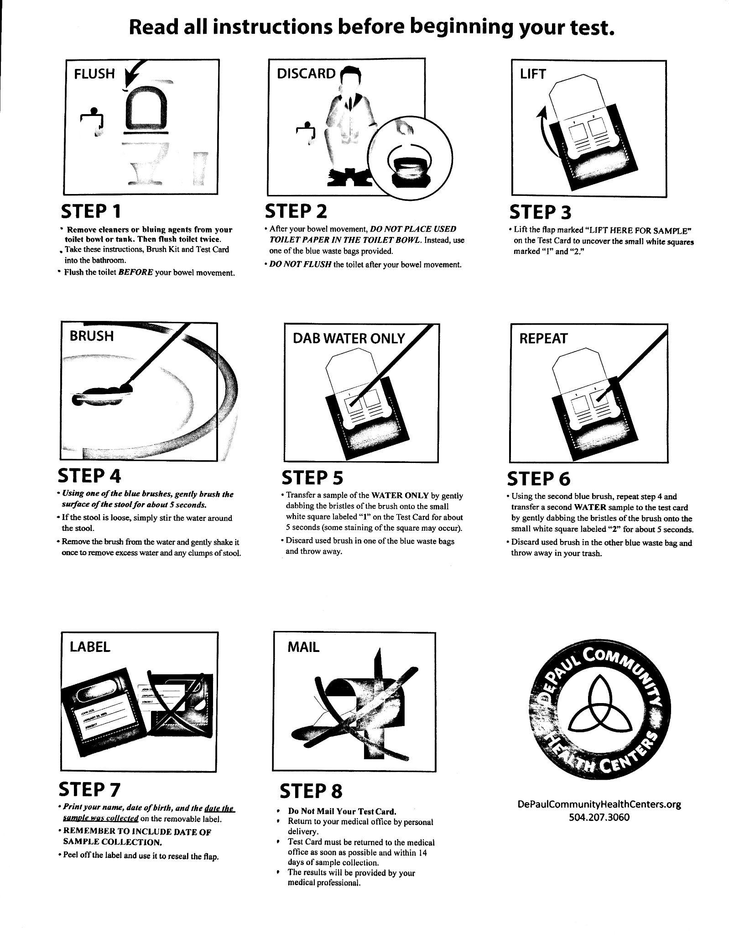

Slide 9
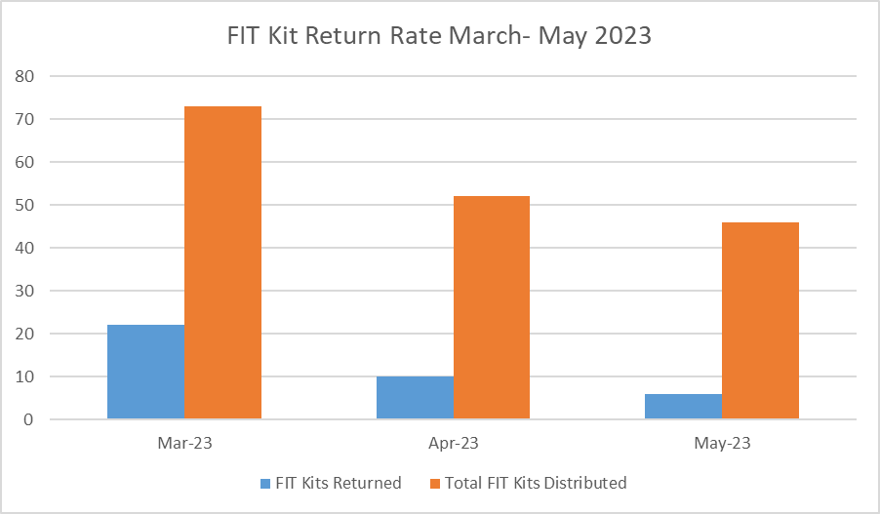
La silla

Slide 10
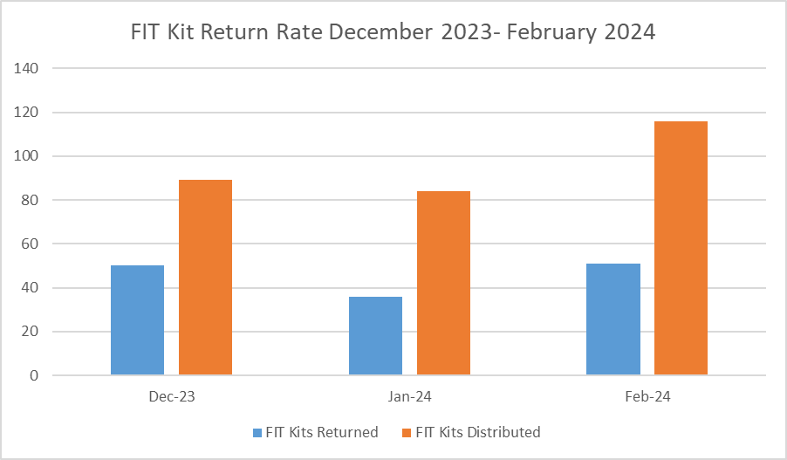
Real Time Data - Before QI

Slide 11
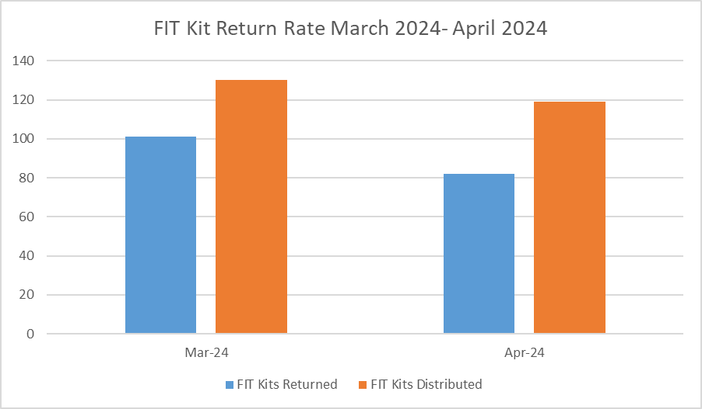
Real Time Data -after QI

Slide 12
Summary
-It's important to encourage patients to know their family history and to let their provider know if they have any first degree relatives who have been diagnosed with colorectal cancer. Also, encouraging healthy lifestyle and weight loss if overweight/obese. Exercise is important for reducing risk.
-Rates of colorectal cancer are increasing in the US and people are being diagnosed at younger ages, < age 50, contributing factors are being overweight/obese, diet, sedentary lifestyle

Slide 13
Summary
-We noticed a trend when calling patients, many patients had forgotten about the FIT kit, decided to do a colonoscopy instead, or didn't answer the phone.
- We noticed a significant increase in compliance with patients returning FIT kits after making calls to patients to remind them to return it.
-Incorporating a plan to make phone calls biweekly to patients who are noncompliant with the return of their FIT kit can make a big difference in early detection of colorectal cancer.

Slide 14
References
-cdc.gov/cancer/colorectal/basic_info/screening/tests.htm
-louisianacancer.org/cancers/colorectal-cancer/
-sttammany.health/upload/docs/Colorectal%20Cancer/ColorectalCancerFactSheet.pdf

