Slide 1
Move Your Body
Lift Your Mood
Irene Lopez, FNP-C, Valerie Fase, NP-C,
Erica Garver, FNP-BC, & Jenny Lopez-Alvarez, FNP-BC
May 23, 2024
HEALTHLINC VALPO AND MISHAWAKA
FNP RESIDENCY PROGRAM

Slide 2
Background
Obesity and Depression often coexist and need to be treated concurrently to be effective.
There has been an influx of patients with obesity that has been observed within both clinics (Valpo and Mishawaka). It has also been found that there is a correlation between obesity and elevated PHQ-9 scores/depression. Due to depressed feelings, patients have reported sedentary lifestyles and a lack of motivation. Because of these findings, our initiative is to encourage and incorporate an exercise program into these patients’ weekly activities in hopes of improving their depression and obesity.
2

Slide 3
We aim to improve
PHQ-9
In
The process begins with
HealthLinc Mishawaka & Valparaiso Clinics.
The process ends with
Working on this now we expect
PHQ-9 trends
It is important to work on this now because
Decrease PHQ-9
Simple Physical Activity Questionnaire (SIMPAQ)
Improve Mental Health
Improve Physical Health
Decrease BMI
Physical Activity & Resource Flyer
150 min of exercise weekly.
Global Aim Template

Slide 4
Aim Statement
“Encourage patients aged 20-64 with identified depression and BMI 30-35 to exercise for 150 minutes per week and lower their PHQ-9 scores.”
4

Slide 5
Fishbone Diagram
What factors did you consider related to the problem you are addressing in your project?
AGE
BMI
PHQ-9 Scores
Physical Activity
How did you narrow the focus of your project?
Inclusion criteria: adults aged 20-64, PHQ-9 ≥ 10, BMI 30-35
Exclusion: Elderly adults, adolescents, children. BMI<30 Or BMI >35 Physical/mental incapacities
5

Slide 6
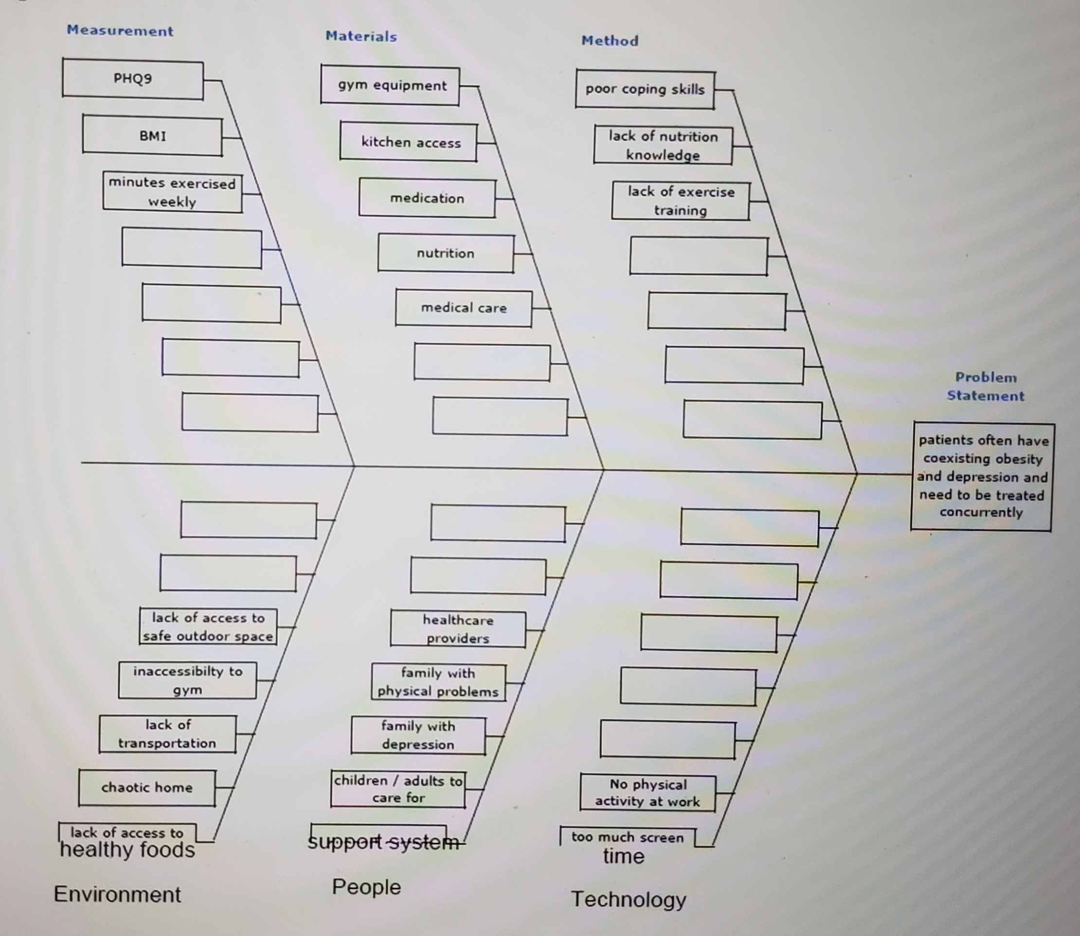
FISHBONE DIAGRAM

Slide 7
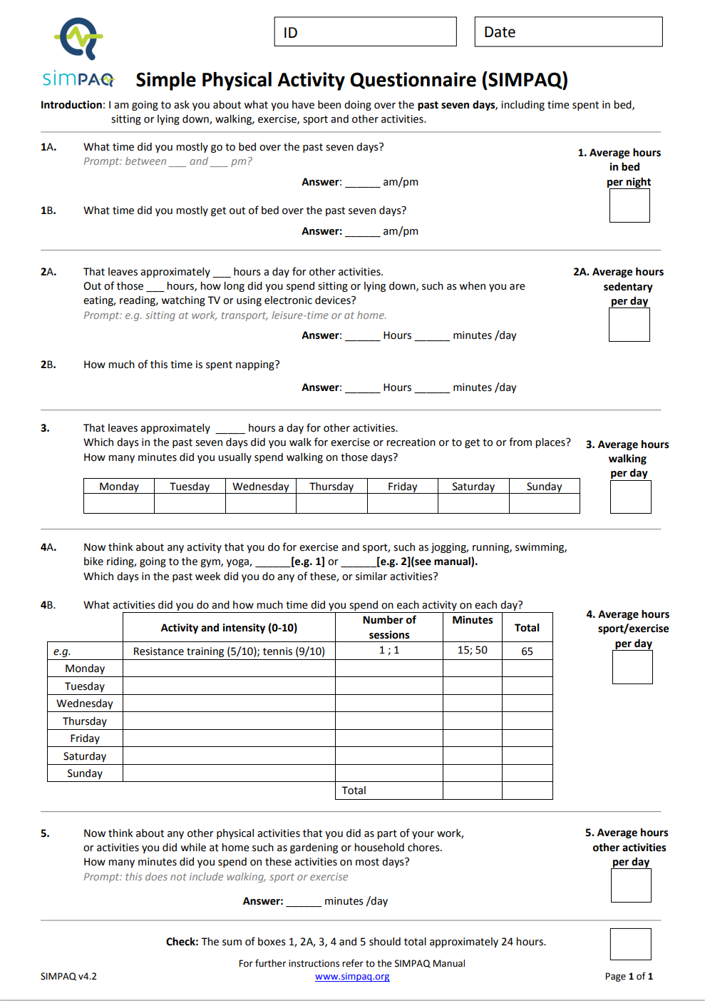
Notes:
Jenny created Spanish version of this form.

Slide 8
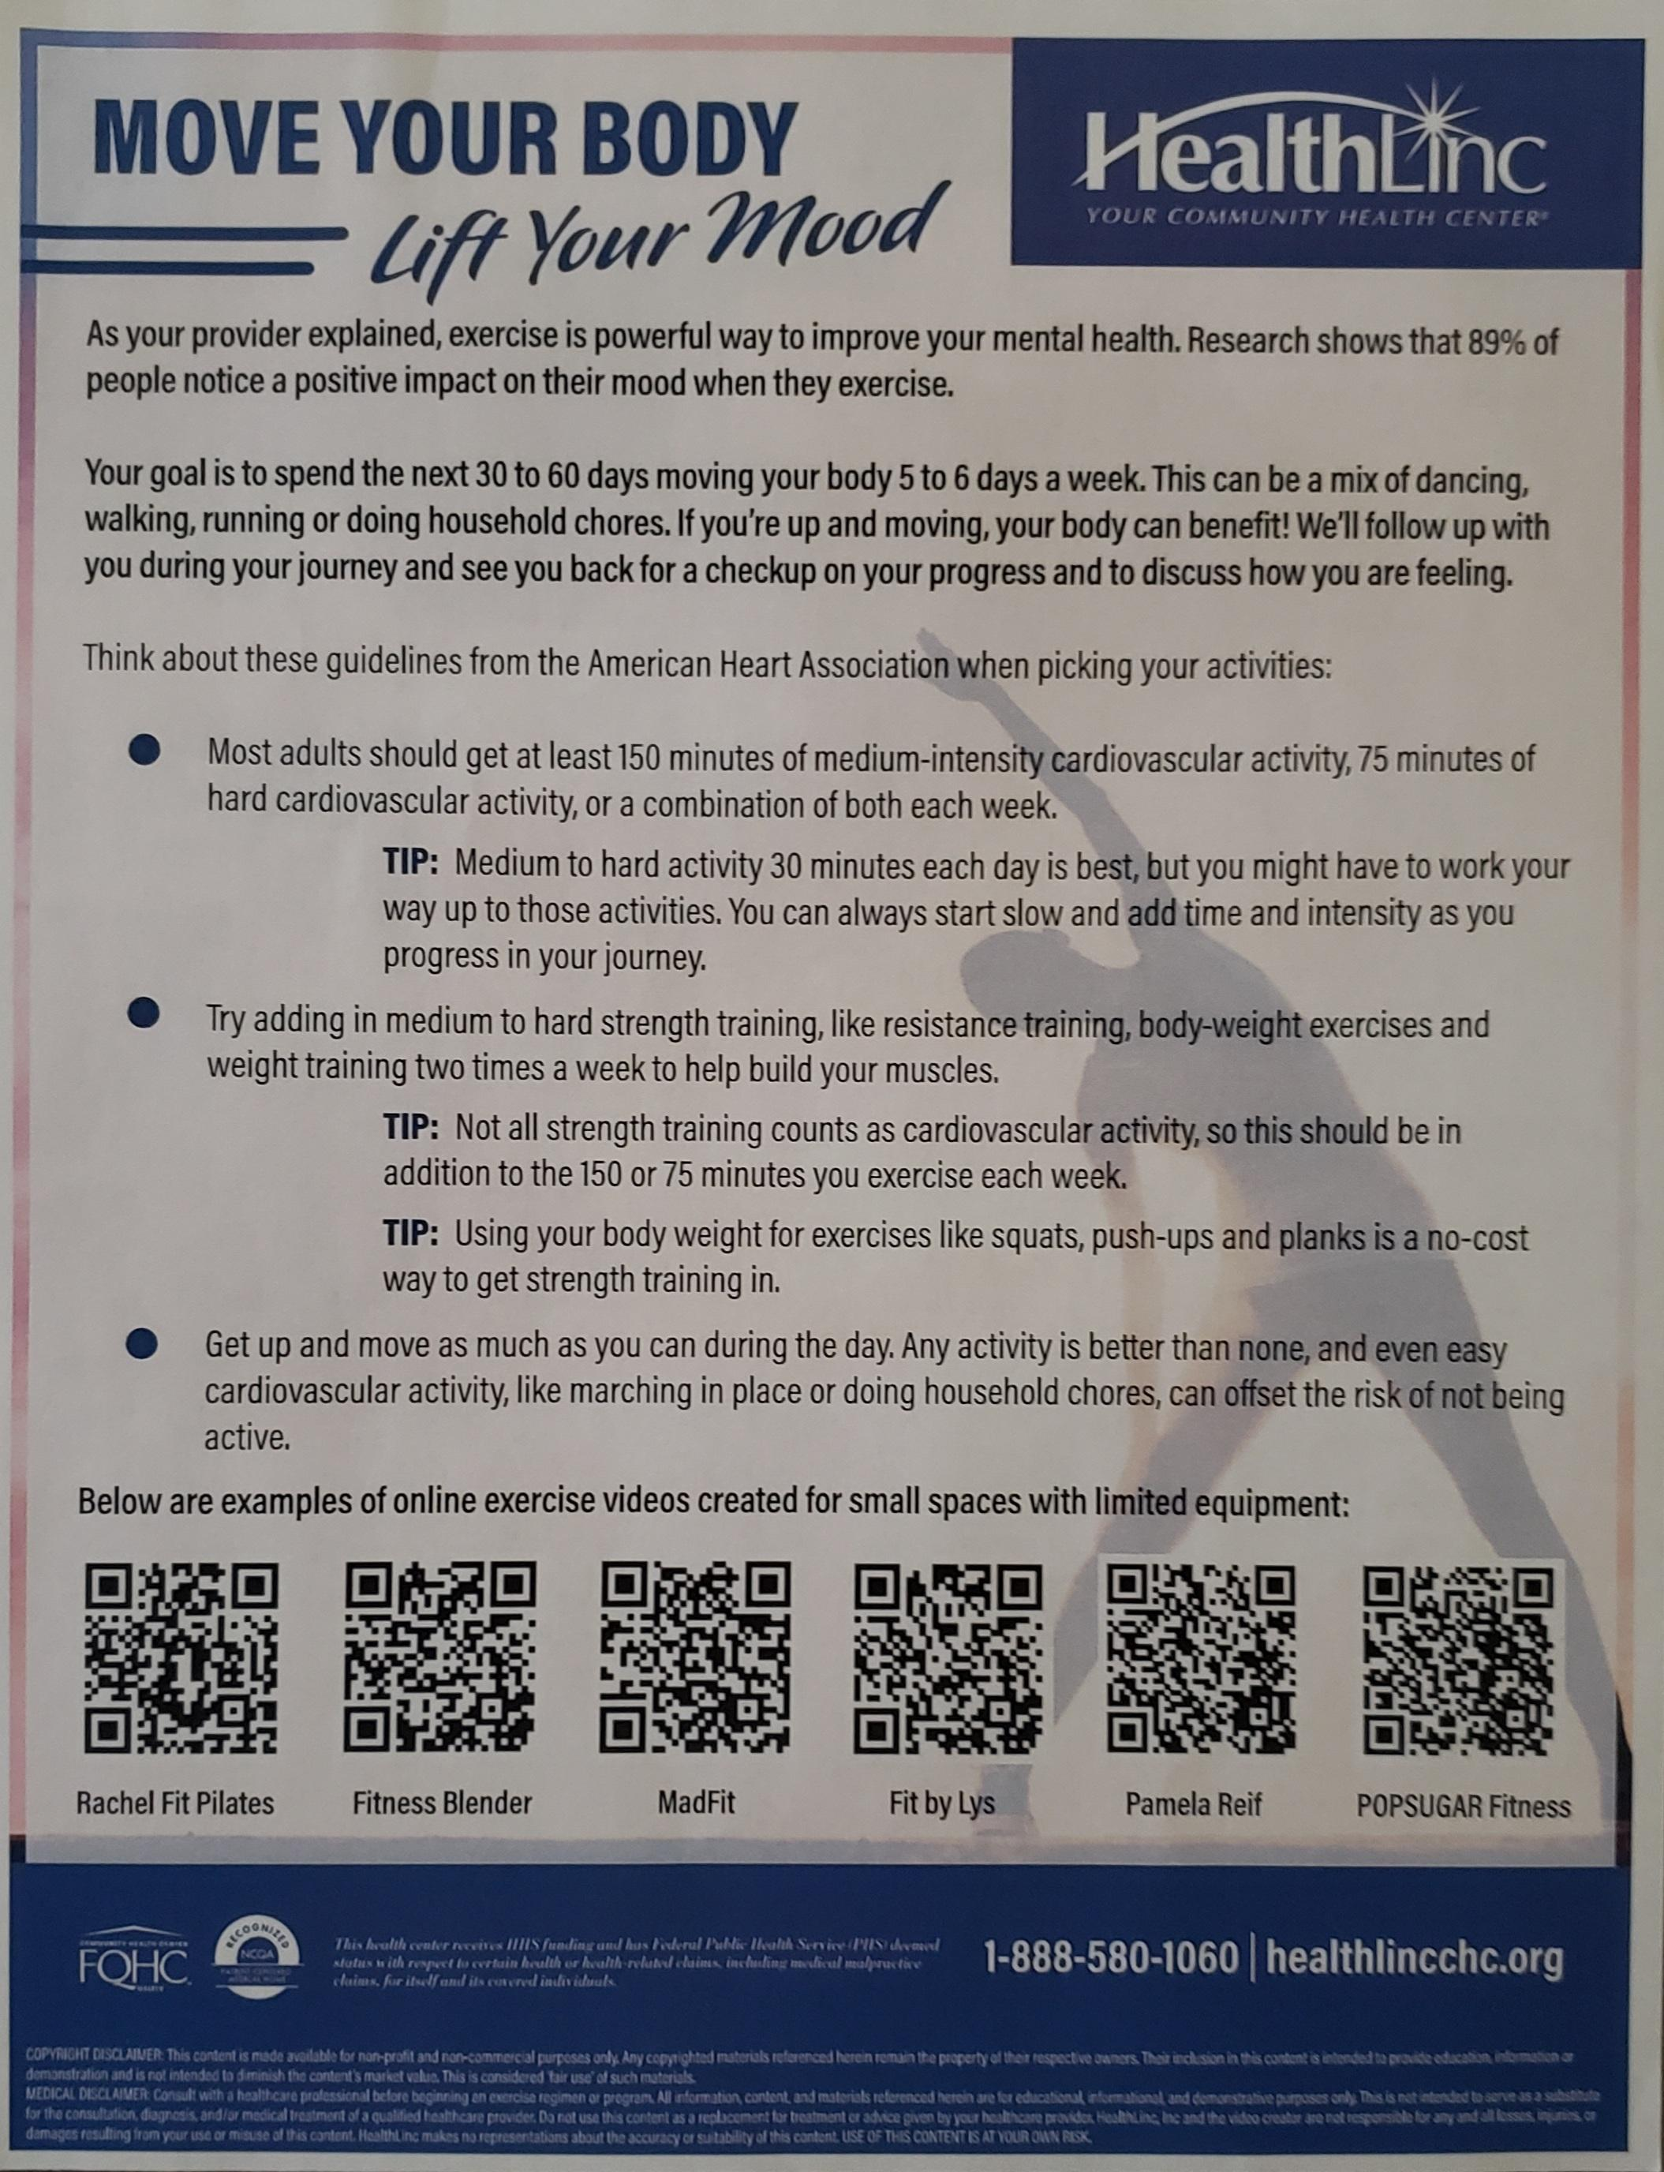
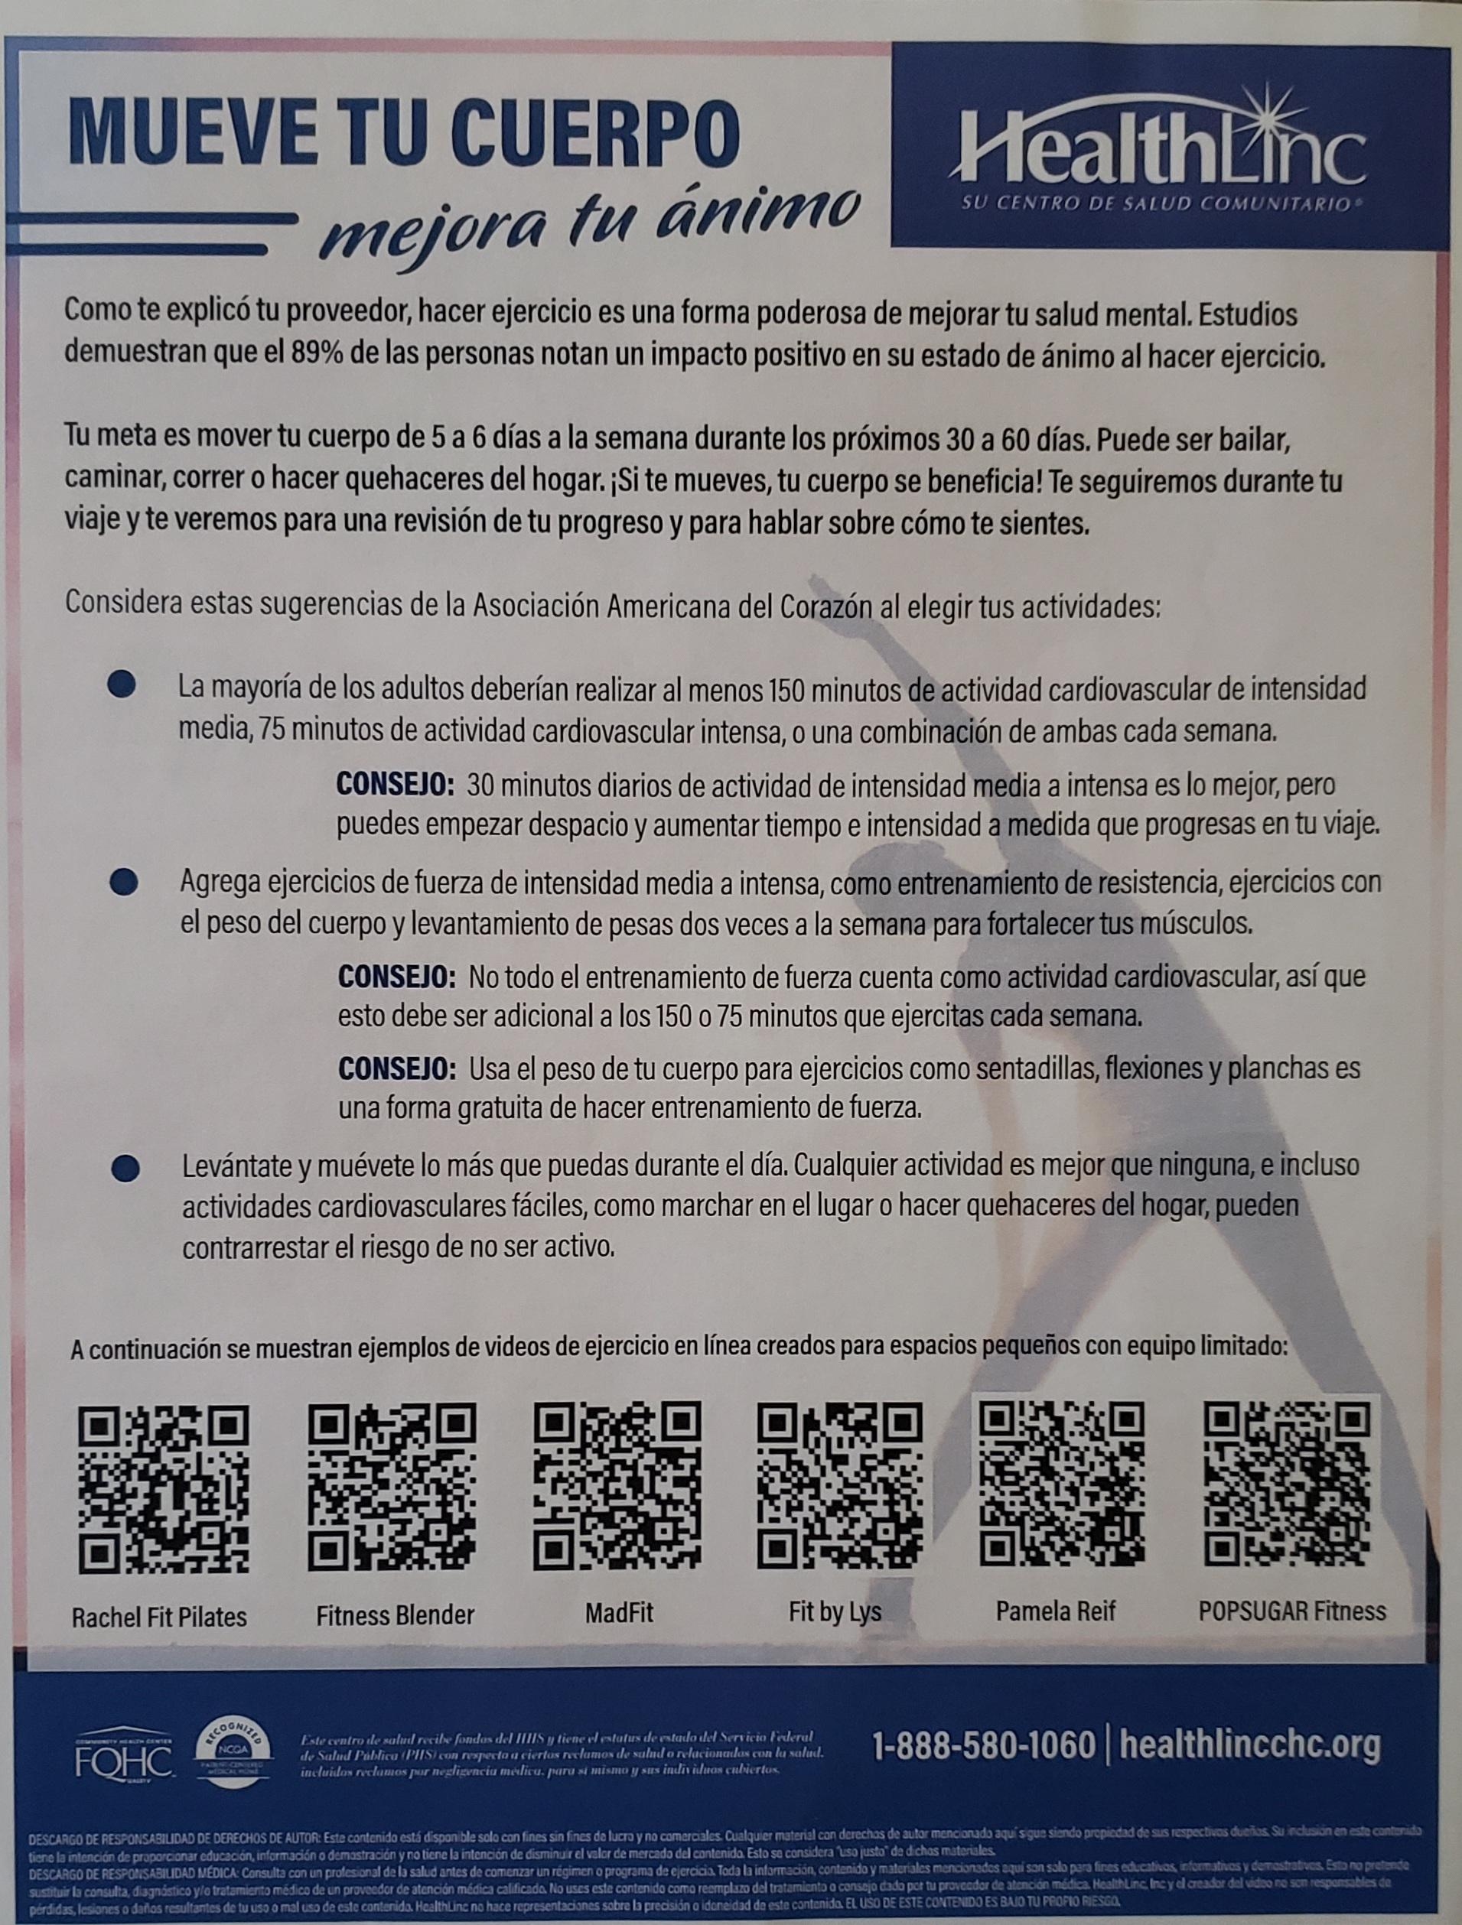
PATIENT HANDOUTS

Slide 9
Stakeholders
Stakeholders: Primary Care Providers (FNP residents and mentors), Patients that meet criteria, Quality Department, Marketing Department, Patient Service Representative (PSR)
Feedback:
Providers: Decreasing BMI requirements for better results 30-35
Marketing Department: pdf handout and magnets
PSR: Patient appointments not being successfully scheduled
Patients: Co-pay fee, compensation, PHQ9 negative on visit
Quality Department: Current scheduled visits reviewed for qualifying pts
9

Slide 10
Stakeholders
Interview results.
We adjusted BMI to 30-35
Then we included all BMI in overweight and obese categories
No patient calls
No separate visits for QI project
Excluded Physical Activity Questionnaire (time restrained)
Reimbursed Co-payments to patients
Incorporate QI project to patients already scheduled
10

Slide 11
Process –FLowchart
Perceived Need: Addressing Mental Health, Depression
Meeting: Quality Department, Marketing Department, Providers
Preliminary Clinical Info. Gathering: Articles that support our project. High rates of depression in Valpo and Mishawaka clinic
Confirmatory Test: Positive PHQ-9
Diagnosis & Plan: Depression diagnosis. Decrease depression (PHQ-9) with physical activity
11

Slide 12
Process
Implement Plan & Treat: Patient visits. Screening tests: PHQ-9, BMI, and Physical Activity Questionnaire. Increase physical activity. PDF handout provided with instructions and QR codes to YouTube videos. Motivational magnet
Follow-up: 2-week call from MA or PSR. 1-to-2-month follow up appointment with provider.
Outcome: Decrease PHQ9 and BMI
12

Slide 13
Data
Data collected included patients from Valparaiso, Mishawaka, and South Bend that met the criteria of age 20-64 , BMI 30-35, and elevated PHQ score, 20 patients were involved.
Although hundreds of patients met this criteria, when approached about this topic, many were unwilling to engage in our study. Some wanted compensated, some were not concerned about their weight or PHQ, many were just overwhelmed with other life issues.
Our biggest "data" was that patients are not always motivated to make changes that we as providers think will greatly improve their lives because: this is not a priority for them, they do not have the means: mentally, physically, or emotionally.
13
Notes:
I added our questionnaire (did patient's fill out questionnaire?) and our handouts

Slide 14
Approach to Change
List your ideas of things to change:
Initial BMI
Activity level
new PHQ at every appointment and overall PHQ criteria,
patients from residents panel and preceptors,
involving quality to call for separate appointment vs implementing into appointment, management decided to double book us for appointments for this project only
What change(s) did you want to try (or what happened when you tried them)?
Widening BMI allowed for more availability and focusing more on frequency of activity vs daily minutes
Completing PHQ at initial visit ended up with patients not fitting criteria (PHQ now <10)
Focused on our own patients as preceptors without full buy in (although BHC very enthusiastic)
Ultimately eliminating quality team from calling patients after multiple no shows, expectations of reimbursement, overall extra work for everyone, lead to adding on to patients seen same day that fit criteria
14

Slide 15
APPROACH TO CHANGE/RESULTS
Describe one or more PDSA cycles
Plan- patients who fit criteria of PHQ 10 or greater may rush questionnaire due to survey fatigue, leading to false improvements, we did see this happen, especially in those showing up believing they are receiving incentives.
Do – do not eliminate based on PHQ as all data could be useful even if qualitative
Study- Widened access to those looking to increase their mood regardless of official depression diagnosis, catches individuals who may noy be honest or rushing surveys
Act- Adopted this change to include those wanting flyers with a quick conversation not depending on billing, could be during BHC visit, clinical pharmacist or chiropractor.
What did you learn from your change efforts and doing this work?
You may not always gather the data you were hoping but that doesn’t make a project a failure as we still were able to motivate and help people wanting to exercise in their home and offer a variety of choices.

Slide 16
Results
Describe the results of your improvement effort
We successfully implemented an exercise flyer accessible to all providers for any patient interested in starting to exercise at home, this is used by multiple providers, BHC, clinical pharmacists, chiropractors and even some staff have utilized for themselves.
Main success- Due to the popularity of our cause we were asked in collaboration with our pharmacy residents to create an obesity standard of care policy for HealthLinc as an organization that was presented to and approved by our senior medical direction team.
16

Slide 17
Conclusions/Implications
What is/are the next steps for the work you initiated?
Continue to support patient population in improving physical and psychological well-being by increasing activity
What would you do differently if you were starting this effort again?
Widen the population being evaluated as no-shows and lack of patient engagement did not allow us to get a good sampling
What advice do you have for future NP residents doing improvement efforts at your site?
Consider all the aspects that inhibit patients of FQHCs from optimizing their health. Some are just getting by, unable to improve their lifestyle at the moment. For example, a homeless individual may not be capable of making these changes. But small encouragement can possibly help them make small changes.... incremental mental health care.
17

Slide 18
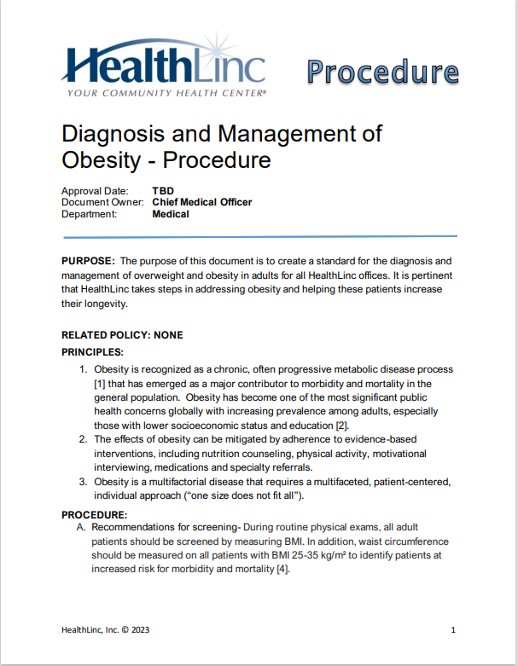
Policy Creation
Classification of disease
Diagnostic criteria
Treatment
Four Pillars
Nutrition
Physical Activity
Behavior Modifications
Medications
Follow up
Goal Setting

