Slide 1
Documentation of Diet and Exercise Counseling for
Pediatric Patients
Muriel Appram FNP-C
June 27, 2024
Holyoke Health Center Family Nurse Practitioner Residency Program

Slide 2
Background
Documentation is essential for both successful patient outcomes and a healthcare establishment’s financial compensation
At FQHC’s specific quality metrics are necessary for maintaining status and continued federal funding
  Preventative screenings (colon, breast, cervical, lung cancers), disease management (HTN, DM, obesity), mental health screenings, etc.

Slide 3
Focus Metric
BMI documentation to meet CMS measure
Child weight assessment / counselling for nutrition / physical activity (CMS 155v11)
  Patients ages 3-17 years who had an outpatient visit with a primary care provider (PCP) and who had evidence of height, weight, and body mass index (BMI) percentile, and nutrition and physical activity counselling documented during the measurement period.

Slide 4
Problem
Lack of BMI counseling, nutrition and physical activity documentation across all ages at Holyoke Health Center which has resulted in overall low performance for this specific CMS metric

Slide 5
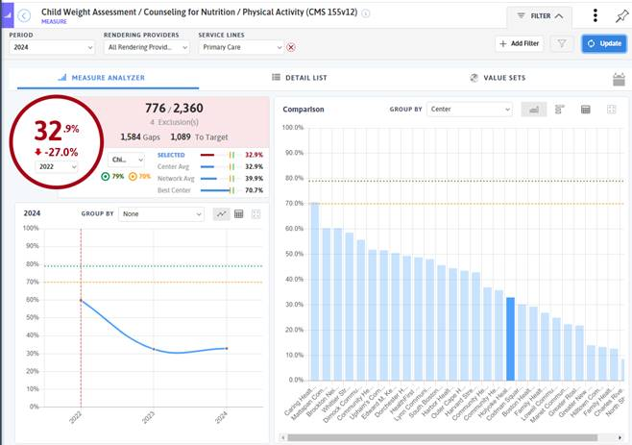
BACKGROUND Data
HHC vs. other FQHC’s in MA

Slide 6
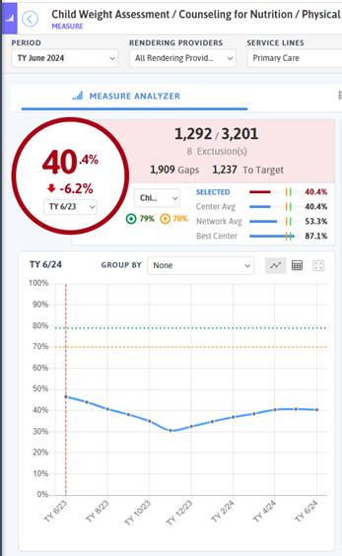

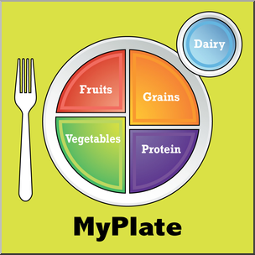
Background Data

Slide 7
Aim Statement
Goal of the project is to improve CMS requirement for nutrition and physical activity counseling documentation for my pediatric patients visits
I will improve the completion/documentation rate for children ages 3 to 18 for BMI and nutrition and physical activity counseling by 25%

Slide 8
Fishbone Diagram
Different documentation styles/requirements for adult patients vs. Pediatric patients ie. BPA for adult charts not available for pedi charts at this time
Resident’s limited schedule with only 2 clinic days/week.
Seeing pedi patients off mentor/specialty rotation schedules will not factor into my metric measure
Many ways to document in epic
How did you narrow the focus of your project? Focus on pedi population rather than both adult and pedi or adult only due to sample size

Slide 9
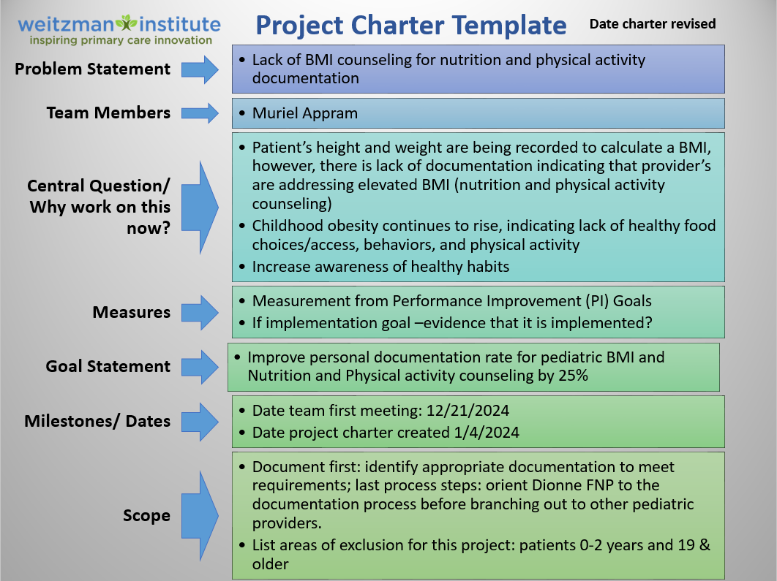
Holyoke Project Charter

Slide 10
Stakeholders
Kathryn English, RN Quality Director
  Documentation/workflow: screen shots of how to document in epic and measurement specific dx codes ( Z-codes)
  DRVS data for chart audits and measuring outcomes
Vinny Biggs MD. Director of Healthy Living Clinic (Pediatric/Family)
  Learned about Pedi Weight Clinic, it’s offerings and appointment structure
  Referral to program
  Prompted adding z-codes for required diagnosis
Emily Greaf, FNP
  Project support: allowing time for project work, sharing tips to improve her documentation as well.

Slide 11
Process
Identify acceptable documentation
Obtain specific diagnosis codes necessary to receive credit
Develop methods to assist in recall of diagnosis codes
Implement documentation style and assess personal measure improvement
If successful, involve other pediatric provider on blue team for implementation and track her measure improvement progress before involving all pediatric providers at the health center

Slide 12
Flowchart
MA obtains pt’s vitals (Ht & Wt) for auto calc of BMI
Scheduled Pedi visit
Provider reviews BMI
Provider adds visit dx codes for diet and exercise counseling using ICD-10 codes
Diet and nutrition discussed during visit
Metric requirements achieved

Slide 13

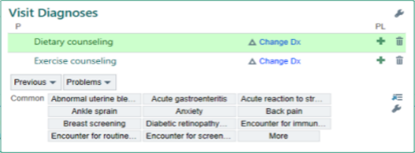
Approach to Change
Tape z-codes to computer monitor as a reminder
Save z-codes as a quick select on frequent diagnosis list
13

Slide 14


Approach to Change

Slide 15
ACT
PLAN
ID acceptable documentation for diet & exercise counseling
Include z-code in visit diagnosis
Review DRVS for change in progress
Include z-codes on frequent dx list
PDSA
STUDY
DO

Slide 16
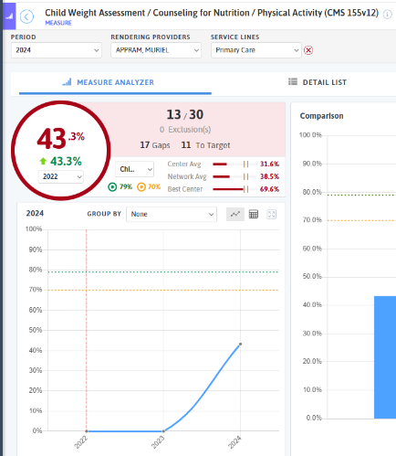
Results
Success:
  Understanding the metric and its requirements aids in effective documentation styles
  Allowing EMR to assist in documentation (quick lists, etc.)
Take-aways:
  Specific to this measure, simply documenting completion of counseling in plan will not satisfy the metric without the specific icd-10 codes

Slide 17

Results
Barriers:
  Project implementation delay (credentialing)
  Incomplete measurement of efforts (documentation completed during mentoring/specialty rotations not reflected in my progress)
Challenges:
  Learning the helpful EMR features (list of favorites)
  Differences in EMR advisories (BPA) for adult and pediatric charts
  Lack of documentation consistency given limited resident schedule for clinic days (time gaps in pedi visit types)
  Not being able to complete note in a timely fashion for progress to be measured in the DRVS update

Slide 18
Conclusions/Implications
Continue to improve upon my documentation to meet the measure
Provide guidance/framework for incoming resident on how to properly meet documentation requirements for diet and exercise counseling
Seek guidance from QI team/ EHR specialist on developing a BPA for diet & exercise counseling for pediatric BMI follow-up
Advice future NP residents
  Engage with QI team after 1st QI session to assist with topic brainstorming; keep project small, advocate sooner for scheduled time to work on improvement project

Slide 19

Thanks for listening ☺
Questions????

