Slide 1
Motivational Interviewing
Learning Collaborative Session #6

Slide 2
Today’s Agenda
Welcome
Overview of Technology and Reminders
Motivational Interviewing
Celebrate Your Achievements
Next Steps and Q & A

Slide 3
Technology: Your Zoom Window
Sound
Muting/Unmuting
Press *6 to unmute phone audio
Webcam
Please share!
Chat
Questions
Sharing resources/ideas
Notes:
A few logistical reminders before we get started… Please keep yourselves on mute throughout the session to avoid background noise. We welcome you to use the chat function or coming off mute to engage with faculty and your fellow learners through out the session. And lastly, we love to be able to see all of you who join our learning community so if you’re able to, please share your camera with us.

Slide 4
Technology: Your Zoom Window
Closed Captioning and Live Transcript
Click on the caret or icon
Select ‘Show Subtitle’ for closed captioning on screen
Select ‘View Full Transcript’ for live transcript pop-out window
Change Your Name
Click on the three dots
Click ‘Rename’
Type in your name
Notes:
You may change your name at any time throughout the session by clicking on the three dots near your name, and selecting rename. Please use this function to change your name to include your first and last name – health care center name. We welcome you to use this feature to share your pronouns with us if you wish! To continue to make our activities more accessible, closed captioning and live transcription is also available to use as well.

Slide 5
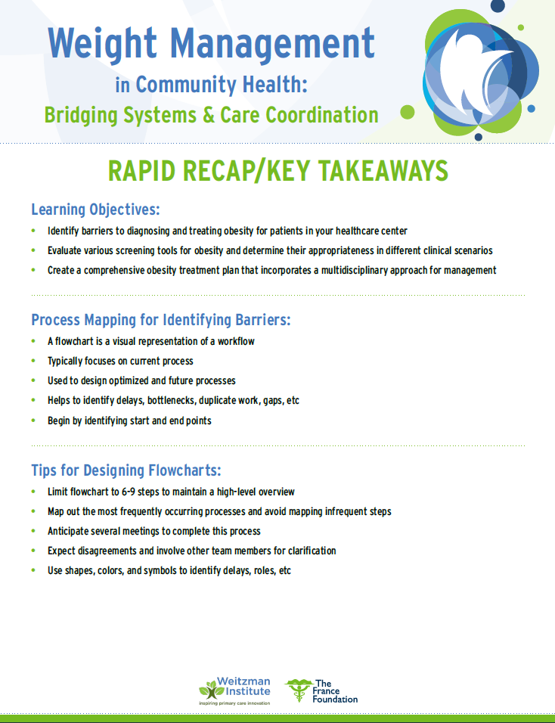
Rapid Recaps
Return to the Overview tab of the live activity, Live Session–Module 4: Prevention, Management, and Treatment
Scroll down to the Rapid Recap header
You will then be able to click on Rapid Recap listed below the headers to access the resources
Notes:
We would like to announce that The Module 4 rapid recap is now available on the Weitzman Education platform. These rapid recaps consist of a high level overview of the information presented during the module live session. Rapid recaps are going to be available within 2 weeks of each live session and can be found by going to the live session activity overview tab and scroll down to the header labeled “rapid recap”. Once you reach the rapid recap header, you will be able to click on the rapid recap listed below to access the resource. As always if you need additional help finding the recap you are more than welcome to reach out to me.

Slide 6
Continuing Education Credits
In support of improving patient care, this activity has been planned and implemented by The France Foundation and Moses/Weitzman Health System, Inc. and its Weitzman Institute. The activity is jointly accredited by the Accreditation Council for Continuing Medical Education (ACCME), the Accreditation Council for Pharmacy Education (ACPE), and the American Nurses Credentialing Center (ANCC) to provide continuing education for the health care team.
This series is intended for clinical leadership, primary care providers, behavioral health providers, dietitians, nurses, QI/technical teams, and other members of the care team.
Please complete the post-session survey and claim your CE certificate on the WeP after today’s session.
Notes:
The Moses Weitzman Health System is jointly accredited to provide continuing education credits for your participation in these live Learning Collaborative sessions.

Slide 7
Disclosure
With respect to the following presentation, there has been no relevant (direct or indirect) financial relationship between the party listed above (or spouse) and any for-profit company in the past 12 months that would be considered a conflict of interest
The views expressed in this presentation are those of the presenter and may not reflect official policy of Moses/Weitzman Health System and its Weitzman Institute
We are obligated to disclose any products that are off-label, unlabeled, experimental and/or under investigation (not FDA-approved) and any limitations on the information that I present, such as data that are preliminary or that represent ongoing research, interim analyses, and/or unsupported opinion
Notes:
And our faculty members have no disclosures to report.

Slide 8
Acknowledgements
This activity is supported by an independent medical educational grant from Lilly
Notes:
We would like to acknowledge that this activity is supported by an independent medical educational grant from the Lilly Foundation.

Slide 9
At the Weitzman Institute, we value a culture of equity, inclusiveness, diversity, and mutually respectful dialogue. We want to ensure that all feel welcome.
If there is anything said in our program that makes you feel uncomfortable, please let us know.
Notes:
At Moses/Weitzman Health System, we value a culture of equity, inclusiveness, diversity and mutually respectful dialogue. We want to ensure that all feel welcome. If there’s anything said in today’s session that makes you feel uncomfortable, please let us know and if you have any questions regarding the program logistics I have mentioned today, please feel free to email me.

Slide 10
Series Learning Objectives
Define metrics of your health care center against key performance measures related to the obesity care
Identify barriers to treating obesity for patients
Formulate an improvement plan for establishing treatment plans for patients with obesity
Develop a holistic care plan for patients with obesity

Slide 11
Session Learning Objectives
Determine the impact of patient motivation on achieving health-related goals
Utilize motivational interviewing to facilitate shared decision-making for patients with obesity
Implement person-first language when discussing obesity with patients

Slide 12
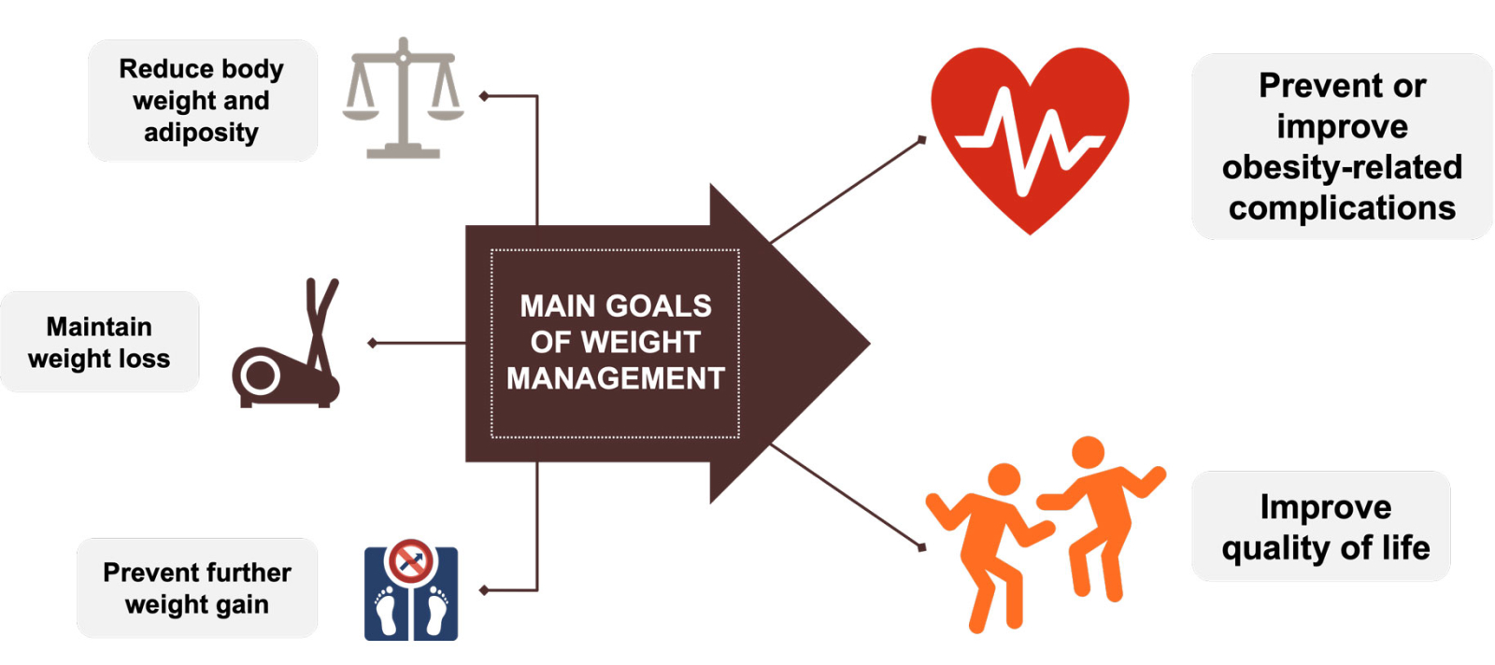
Goals of Weight Management
Wharton S, et al. CMAJ. 2020;192(31): E875-E891.
Notes:
When treatment planning with a patient, goals are patient-centered, agreed upon, and clearly determined.

Slide 13
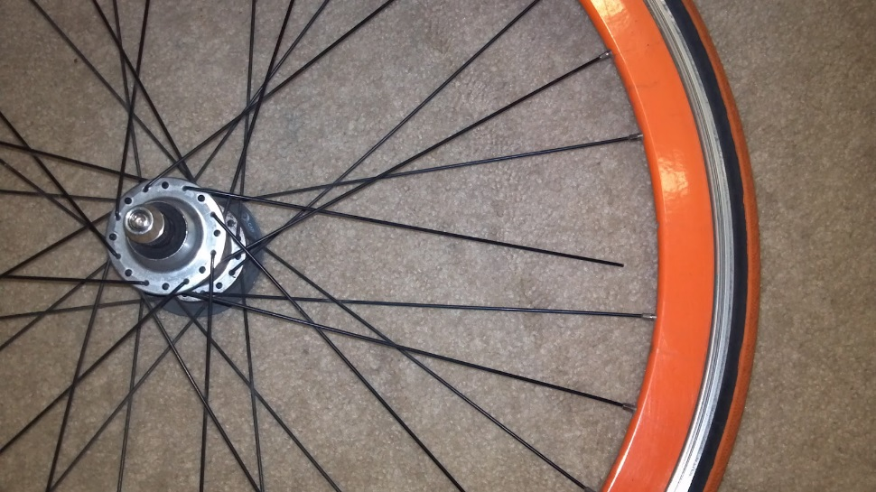
Whole Person Health
Environment
Medical Care
Genetics and Biology
Social Circumstances
Individual Behavior
HEALTH
Notes:
Health factors are like spokes on a bike wheel (stress, movement, living environment, eating pattern, support/connection) they have to have even tension. Weight is not the only spoke on the wheel and certainly not the largest spoke. When one gets out of balance, it puts stress on the entire system. The goal is not to be 'perfect,' but only to keep those factors in alignment overall to the best of one's ability. By prompting these types of discussions, the patient is encouraged to do their best, and avoid all/nothing thinking. All or nothing thinking can easily take someone who is making progress into a downward spiral (e.g., "I ate dessert twice this week, which was over my goal, so I might as well eat the whole gallon of ice cream."

Slide 14
Perceived Patient Barriers to Change in Obesity
Insufficient self-control
Physical pain
Poor self-esteem
Emotional states
Time constraints
Dietary restrictions
Lack of support
Apathy/insufficient motivation
Binsaeed B, et al. Cureus. 2023;15(11):e49040; Trujillo-Garrido N, et al. Nutrients. 2022;14(14):2928.
Notes:
Just because a barrier is perceived does not make it real—it is helpful for the healthcare provider to help the patient think about what emotional and physical barriers make it difficult to lose weight (is it self-control, emotional stress eating? Mind-less-ness? By encouraging the patient to be more intentional and aware of the triggers and barriers, they are more able to change behaviors

Slide 15
Types of Motivation
Extrinsic motivation—Motivation from outside oneself based on:
Guilt avoidance
Desire for approval
Intrinsic motivation—Motivation internal to oneself based on:
Autonomy
Relatedness
Competency
Extrinsic motivation serves to get people energized about making change but often does not lead to long-lasting changes
Intrinsic motivation serves to maintain long-term change by aligning a person to personal goals and accountability
Teixeira PJ, et al. Int J Behav Nutr Phys Act. 2012;9:22.
Notes:
Small and long term goals lead to different types of motivation
Have patient give example of other accomplishments and motivations
Encouraging self-efficacy can lead to sustained motivation (i.e. watching grandson graduate from high school).

Slide 16
Motivational Interviewing
Patient-centered counseling that aims to boost motivation and commitment for behavioral change by aligning patient goals with personal values
Resisting the righting reflex
Understanding and exploring patient motivations
Active listening
Empowering the patient
Pillars of Motivational Interviewing
Clinicians can integrate motivational interviewing to encourage healthy eating and active living habits for achieving and maintaining healthy weight
Kahan SI. Mayo Clin Proc. 2018;93(3):351-359.
Notes:
Resisting the Righting—not what they 'should' or 'ought' to do—its up to them, not us
Motivations—what keeps them going/past successes--
Listening—what are they saying, what are they not saying
Empowering-their cheerleader—the fun part.. Small success leads to greater success

Slide 17
Benefits of MI
Changes high-risk lifestyle behaviors
Increases patient engagement in treatment
Builds confidence and self-esteem
Increases confidence between patients and health professionals
Hogden A, et al. J Med and the Person. 2012.
Notes:
Self-sustaining cycle
Physical reminders of why they are doing what they are doing
Finding help/support and identifying key factors in success

Slide 18
Criticism of MI
Requires time to build a relationship with patients
Requires cognitive clarity
Follow-up is crucial
Requires patient engagement and awareness
Hogden A, et al. J Med and the Person. 2012.
Notes:
Not all MI tools work for various reasons—changing providers, regular follow-up provider willingness to follow-up via notes/EHR records

Slide 19
Theory of MI
Motivational interviewing assumes that behavior change is stimulated by motivation as opposed to information
Ambivalence to change and benefits of change are explored
MI interventions have shown efficacy for many health-related areas where patient behavior is key to achieving long-term behavior change, such as:
Substance abuse
Medication adherence
Domestic violence
Mental health, eating disorders
Bischof G, et al. Dtsch Arztebl Int. 2021;118(7):109-115; Morton K, et al. Health Psychol Rev. 2015;9(2):205-223.
Notes:
Start of MI with behavioral health in 1970's—ach and veterans

Slide 20
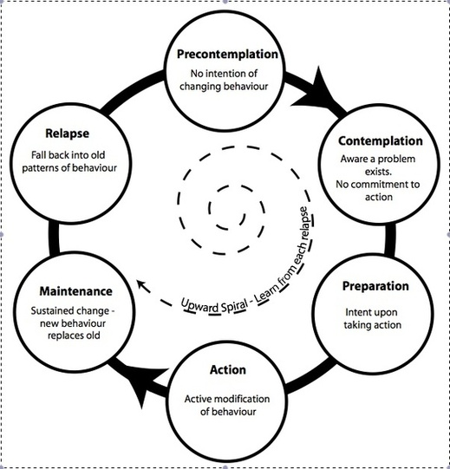
Stages of Change
Change is a multi-step process
Individuals are in one stage of change at a time
Stages of change can help inform and guide interventions
Beckwith VZ, et al. NASN Sch Nurse. 2020;35(6):344-351.

Slide 21
Description and Examples of the Five A’s
"A" | Description | Example
Ask | Clinician asks the patient about weight, nutrition, and exercise. | “What do you like to do for exercise?“ "What do you typically eat for breakfast?"
Advise | Clinician provides the patient with clear, strong advice. | "You need to get 30 minutes of exercise a day, 5 days a week." "Because of your diabetes and hypertension, it is really important that you exercise."
Assess | Clinician verbally assesses patient readiness to change. | "Is attaining a healthier weight something you might want to do in the near future?“
Assist | Clinician assists by providing brief counseling or self-help materials | "What might get in the way of your plans to exercise three times a week?“ "How are you feeling about being able to make this change?“
Arrange | Clinician arranges for follow-up with health care professional or community-based resource | "I will make a referral to (community resource); they have an excellent program to help you attain a healthier weight."
Agency for Healthcare Research and Quality, Rockville, MD. https://www.ahrq.gov/ncepcr/tools/obesity/obpcp3.html

Slide 22
Treating the Obesity: Therapeutic Weight Loss Reduces Complications
Gather Information
Ask leading questions
Clarify information by repeating back what patient said
Do not interrupt patient
Assess motivation confidence
Establish Relationship
Communicate intention to help
Acknowledge emotions/ feelings
Use layman's terms to explain
Collaborate to identify the next step
Use weight neutral terms
Instill confidence
Education and Counseling
Ask questions to make sure patient understood
Discuss specific diet, exercise, and monitoring goals
Elicit and address barriers to change
Explain the nature of obesity
US Preventative Task Force. JAMA. 2022; Politi MC, et al. BMJ. 2013:347:f7066..

Slide 23
Using Person-First Language
Obesity
Obesity
“Obese Patient”
“Patient with obesity”
Person before the disease
Notes:
Language matters—already feeling shamed and vulnerable-don't want to add to stigma.
If time/relationship--ask them about their feelings around body image

Slide 24
Preferred Terms to Discussing Obesity
Certain words to describe body weight may be perceived by patients to be stigmatizing and blaming, whereas other terminology may be viewed as motivating and encouraging:
Least Motivating
Most Motivating
Fat
Chubby
Extremely obese
Unhealthy weight Overweight
Most Blaming/Stigmatizing
Least Blaming/Stigmatizing
Fat
Morbidly obese
Extremely obese
Obese
Weight
High BMI
Unhealthy weight
Notes:
Self-explanatory

Slide 25
Be Aware of Unconscious Bias
Consider that patients may have previously experienced weight bias from other providers
Focus on health, rather than weight
Strategies and considerations when speaking to patients with obesity
Provide continuous and nonjudgmental feedback on progress
Recognize that many patients have tried to lose weight repeatedly
Recognize that obesity
has many factors; many
are outside of the
person’s control
Explore all causes of the patient’s presenting problems
Discuss and identify achievable, sustainable goals for your patient

Slide 26
Reframing the Conversation About Obesity: Language Matters
Approaches to Reframe the Conversation:
Avoid
Try Instead
"I’m sure the problems you’ve had are all related to your weight”
"Would you mind if we spoke about your weight? Where do you think you're at?"
Seek permission
Use person-first language
Use evidence-based information
Be empathetic, understanding, and collaborative
“Obese children…”
“Fat people…”
"Individuals with higher weight/BMI..."
“You just need to eat less”
“If you don’t lose weight, you will get diabetes”
"Obesity can affect our health in x, y, and z ways"
"What has been going on in your life since we last met?
Has this had an impact on what you eat?"
“Don’t you want to be a normal weight?”
https://obesitycanada.ca/wp-content/uploads/2020/10/Obesity-Language-Matters-_FINAL-2.pdf; https://www.worldobesity.org/downloads/healthy_voices_downloads/HV_Language_guidelines.pdf
Notes:
Ask them if we can talk about it
Be aware of your own biases/struggles/experiences

Slide 27
Promoting Health Benefits Positively
Many benefits of exercise that do not entail manipulating body size:
Improves sleep
Decreases anxiety/depression
Fun
Increases mobility and decreases pain
Improves bone density
Improves balance/decreases falls
Decreases constipation
Improves blood pressure readings
Decreases pain
Promotes socialization
Talk about diet in terms of the patient’s specific diagnosis
Reduce salt intake for HTN, CAD
Reduce protein for CKD
Food in terms of fullness and energy level
Sharma A, et al. Prim Care Companion J Clin Psychiatry. 2006;8(2):106; https://medlineplus.gov/benefitsofexercise.html; https://nutritionsource.hsph.harvard.edu/intuitive-eating/
Notes:
Add social aspect/energy aspect—incorporate long term goals

Slide 28
Reassuring Patients
Patients want to feel like they are in a safe and comfortable environment. It is important for providers to:
Stay present
Actively listen
Challenge from a state of curiosity (in non-confrontational way)
Check in (i.e., “does this feel ok?”)
Corrigan FM, et al. J Psychopharmacol. 2011;25(1):17-25; https://www.nicabm.com/trauma-how-to-help-your-clients-understand-their-window-of-tolerance/; Geller SM, et al. J Psychother Integr. 2014;24(3):178-192.
Notes:
a patient’s window of tolerance is the zone in which he or she can readily receive, process, and integrate information and respond to the demands of daily life without much difficulty

Slide 29
Goal Setting
Clinicians should establish goals with the patient by:
Expressing empathy
Developing discrepancy
Avoiding arguing
Rolling with resistance
Supporting self-efficacy
Questions that support “change”
Questions that highlight the disadvantages of maintaining the status quo
E.g., How has your weight stopped you from doing what you want to do in life?
Questions that focus on the advantages of change
E.g., What would be good things about attaining a healthier weight?
Agency for Healthcare Research and Quality, Rockville, MD. https://www.ahrq.gov/ncepcr/tools/obesity/obpcp3.html
Notes:
Practice—people already use MI without calling it that...

Slide 30
SMART Goal Example
 | Simple Goal | SMART Goal
S – Specific | “I want to improve my health.” | “I want to increase my activity level and introduce vegetables into my diet, in order to help me lead a healthier life.”
M – Measurable | “I want to lose weight.” | “I want to have a BMI < 30 by the end of 2025 by increasing my activity level and decreasing my calorie intake.”
A – Achievable | “I want to eliminate sugar from my diet.” | “I will gradually reduce my sugar intake from my diet by replacing a daily soda with sparkling water.”
R – Relevant | “I want to change my lifestyle.” | “I will improve my lifestyle by increasing my activity level by going for 30-minute walks three times a week.”
T – Time Bound | “My New Year’s resolution is to get in shape.” | “I will take 30-minute walks three times a week for the next three months. After that, I will gradually increase the duration of my walks to 45 minutes and then 60 minutes over the year.”

Slide 31
Questions?

Slide 32
Key Takeaways
Motivational interviewing is a health communications tool that helps patients facilitate change behavior
The provider can use various approaches that help empower the patient to make long-lasting changes in weight management
Helping patients recognize emotional/physical triggers can help build awareness, leading to behavior change
The setting of short- and long-term goals can help sustain weight management success

Slide 33
Celebrate Your Achievements

Slide 34
Celebration Strategies
Identify and Define Wins:
Small and large victories
Use metrics to identify and time celebration
Create a Culture of Celebration:
Embed celebration into the project’s culture
Encourage peer recognition
Incorporate Wins Into the PDSA Cycle:
Celebrate what worked well before moving to the next iteration
Reflect on successes to reinforce positive behaviors
Patient-Centered Celebrations:
Involve patients in celebrating their successes
Share patient success stories to inspire others
Link Celebrations to Broader Goals:
Connect individual and team wins to the project's larger goals
Reinforce the importance of each success in achieving overall objectives

Slide 35
Show Stoppers
Notes:
What NOT to do. What is the correct placement for this slide?
Only the team comes to the celebration, achievement not recognized, no statements of appreciation or gratitude are offered. A lost opportunity.

Slide 36
Celebration Tools
Data Dashboards:
Use dashboards to display progress and wins visually
Highlight key milestones in real time
Storytelling:
Develop a repository of success stories
Share stories during meetings or in newsletters
Recognition Platforms:
Implement a formal recognition platform for team members
Create certificates, badges, or incentives for milestones
Regular Check-Ins:
Schedule regular check-ins to share and celebrate wins
Use these sessions for team reflection and improvement
Virtual Celebration Events:
Organize virtual events to celebrate collective wins
Focus on team bonding and shared success

Slide 37
Supporting Books and Articles
Books:
The Power of Moments by Chip Heath and Dan Heath
Switch: How to Change Things When Change Is Hard by Chip Heath and Dan Heath
Drive: The Surprising Truth About What Motivates Us by Daniel H. Pink
Atomic Habits: An Easy & Proven Way to Build Good Habits & Break Bad Ones by James Clear
Articles:
The Power of Small Wins by Teresa M. Amabile and Steven J. Kramer (Harvard Business Review) https://hbr.org/2011/05/the-power-of-small-wins
Celebrate to Win by Whitney Johnson (Harvard Business Review) https://hbr.org/2022/01/celebrate-to-win

Slide 38
Thank You
Continuous learning and application throughout program
Office hours (we are here for you!)
Questions?

Slide 39
QI Coaching Office Hours
QI Coaching Office Hours for Module 6:
October 29, 2024
November 12, 2024
Please come prepared to the session…
Pick one of the following to report on:
What is one success your team has experienced? Please explain and show it in detail so others can try it with their groups.
What is one challenge your team is facing?
What is one question you have?
Notes:
The QI Coaching office hours this module will be held on July 23rd and August 6th. We would love to hear from all of you during these sessions, so we are going to ask that you pick one of the following questions to report on:
What is on success your team has experience? Please explain and show it in detail so others can try it with their groups
What is one question you have?
What is one challenge your team is facing?
As always if you have any questions, please feel free to reach out to me.

Slide 40
Post-Work Overview
Post-work completed as a team:
Read Patient perceptions of success in obesity treatment: An IMI2 SOPHIA study
Reflect and fill out the reflection questions with your team
Submit your reflection question responses (only the team leads need to submit)
Post-work due by November 13, 2024

