Slide 1
Experiences from a Quality Improvement Effort
Julia Donovan and Emily Spraggs
June 13, 2024
Nurse Practitioner & Post-Doctoral
Training Programs

Slide 2
Background
Sudden infant death syndrome (SIDS) is the leading cause of infant mortality between one month and one year of age in the United States (Corwin, 2024).
Although SIDS is uncommon, it is important to note that the risk of a child dying from SIDS during the first year of life is more than 20-fold higher than the risk of death during any of the subsequent 17 years of life due to any other cause, including motor vehicle traffic accidents, firearms, drugs and overdose, and suicide (Corwin, 2024).
In the United States, the incidence of SIDS has declined by more than 50 percent since the mid-1980s (Corwin, 2024).
2
Notes:
JD
and this is because in 1992, the American Academy of Pediatrics (AAP) issued a recommended placing infants in a supine position for sleep to reduce the incidence of SIDS.

Slide 3
Aim Statement
To provide safe sleep resources to infants between May 10th and June 7th, 2024 by distributing safe sleep pamphlets and cribs to families in need.
3
Notes:
JD

Slide 4
The Problem
Safe sleep resources were not being provided at CHC, Inc. in Hartford, CT.
Factors contributing to the problem included a lack of:
Formal workflow/process
Time
Resources available to provide
4
Notes:
A family reported that their baby was cosleeping with them and we identified a problem when we realized that there were no safe sleep resources available to provide to them in clinic. Contributing factors to the problem included a lack of a formal process to disperse resources, the thought that there was not enough time to provide any resources, and the lack of resources themselves.

Slide 5
Stakeholders
Stakeholders
Chief of pediatrics, RN Manager, Operations Manager, Social workers, Providers, PSAs, MAs, RNs, Charlie's Kids, Cribs for Kids.
Social Workers: Had insight into how to help coordinate dispersal or identify potential families in need.
Leaders in clinic: Discussed roles for different team members in this project.
In general, all team members seemed happy to help!
5
Notes:
ES
How did you narrow the focus of your project?

Slide 6
Approach to Change
Ideas for change: Safe sleep book, safe sleep pamphlet, crib, or other resource distribution.
PDSA Cycle:
Plan: Collect data, create workflow to distribute resources.
Do: Distribute pamphlets and cribs when needed.
Study: Monitor distribution of resources and language of resources.
Act: To be decided per discussion with team.
6

Slide 7
Outcome measures
Number of safe sleep resources provided including:
Cribs
Safe Sleep Pamphlets
7
Notes:
The way we decided to measure the effectiveness of our project was based upon the number of cribs and safe sleep pamphlets that were distributed over a specified time frame.

Slide 8
Data Collected Prior to Implementation
Number of well visits, over a 3 month period, of newborn to 1 year olds at Hartford
Preferred language of families (English/Spanish)
8
Notes:
Data we collected prior to the implementation of our project included the number of well visits that were performed for children up to the age of 1 during a 3 month time period. The list that we were provided included the patient's age, the provider that saw them, as well as the date of the visit. We needed to review this data prior to the implementation of our project, so that we knew how many cribs, as well as safe sleep pamphlets to order. We also wanted to know what the primary language was for the families seen during this 3 month time period, to ensure an accurate order of safe sleep pamphlets in English and Spanish was placed. This information was also valid when we considered what cribs to order because the cribs could come with an instruction manual in Spanish.

Slide 9
Process
Education:
Safe Sleep pamphlet given at each newborn visit, distributed in the newborn packet by PSAs. Dispersal recorded by PSAs on chart at PSA desk.
Pamphlets were available in each pod with other handouts so if a family is identified in need of safe sleep information, they can be given a pamphlet. Dispersal recorded by person distributing resource on chart with pamphlets in folder.
Resource provision:
Crib distribution flow chart.
9
Notes:
ES

Slide 10
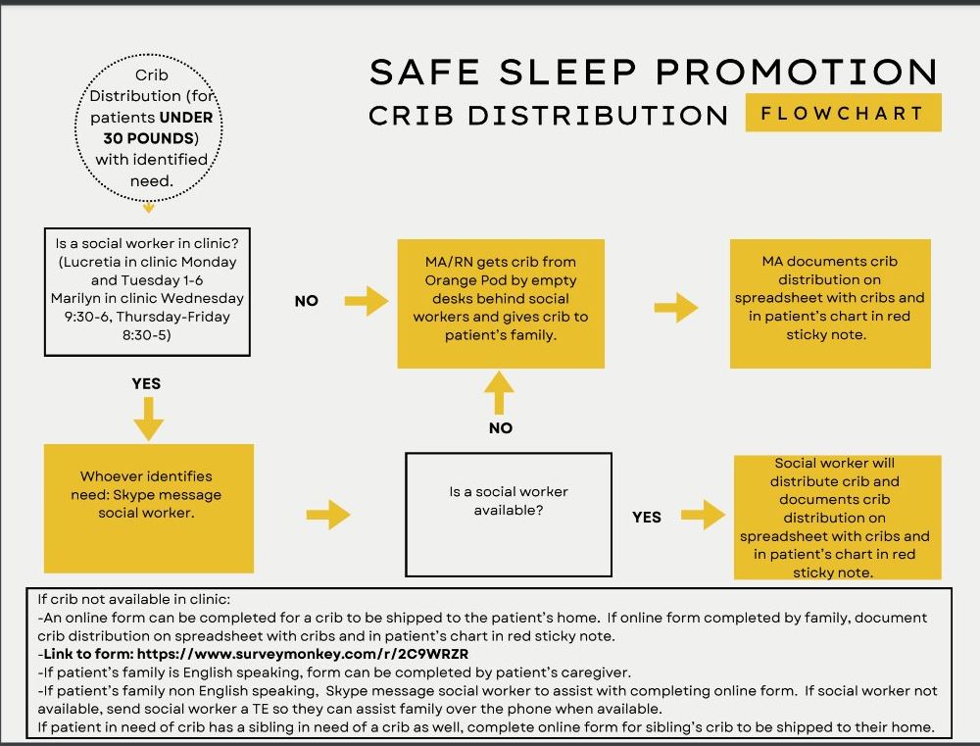
Crib Distribution
Notes:
ES

Slide 12
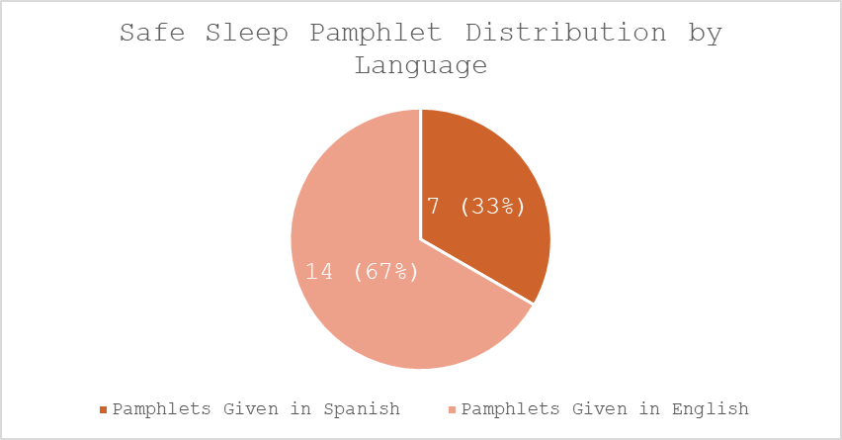
Results
12
Notes:
A total of 21 safe sleep pamphlets were distributed over the 4 weeks that we collected data. 67% were provided in English and 33% were provided in Spanish. These findings align with the data we collected prior to implementation of the project. It was identified that over a 3 month time period that there were 52 newborn visits and 69% of the families were English speaking and 31% spoke Spanish, which this language data correlates with our findings.

Slide 13
Results (cont.)
Challenges:
Time
Communication amongst leadership
Delegation of roles
Limitations:
Small sample size
Collecting data through paper sheets
13
Notes:
It was very apparent that time was the biggest challenge in the implementation of our QI project. Trying to find time outside of leadership's and staff's already very busy schedule was difficult. This led to another challenge of deciding who the distribution of resources would be delegated to. Eventually we found a way for them to be distributed as a part of an already working process.
Limitations for our study included a small sample size, which can also be associated with a challenge, which was time. During the 4 week time frame that data was collected, no cribs were provided to families. Of note, the month prior to us collecting data, a crib was provided to a family in need. Our small sample size limitation is likely related to the fact that we only collected data over a 4 week time frame. Another limitation to our project was the margin for error was increased due to the hand written collection of data.

Slide 14
Key Takeaways
Dispersal of safe sleep resources is possible when a workflow is implemented.
Team members were eager to help and hear about the project.
Figuring out the process for acquiring resources is time consuming, but beneficial long term.
14

Slide 15
Conclusions/Implications
Next steps: Apply again for Safe Sleep book grant.
Next time: Set aside more time to speak with others in clinic about the project, small end goals.
Advice for future QI projects in Hartford: Provider meetings are an opportunity to hear concerns for workflow/processes in clinic to help identify project topic.
15
Notes:
What did you learn

Slide 16
References
Corwin, M. J. (2024). Sudden infant death syndrome: Risk factors and risk reduction
strategies. UpToDate, Inc.
https://www.uptodate.com/contents/sudden-infant-death-syndrome-risk-factors-and-risk-reduction-strategies?search=safe%20sleep&source=search_result&selectedTitle=1%7E150&usage_type=default&display_rank=1
16
Notes:
What did you learn

