Slide 1

Increasing Portal Use by Patients at CHC Stamford
Loraine Richards, MSN, APRN, FNP-BC
Drew Walker, DNP, APRN, FNP-C
CHC of 5th Street, Stamford, CT

Slide 2
Background
Benefits of Patient Portals for Patient and Providers
  Save time and cost
  Patients will be more involved in managing their own health
  Improved treatment and medicine compliance
  Patient portals improve access to providers and health records
Met with leadership at CHC Stamford
Compared 5th Street Stamford to other sites
Notes:
Leadership noted that portal use at Stamford site was well below other sites
Patient portals are an effective way of engaging patients to become active participants in their health by using secure online platforms to connect 24/7 access to their personal health records
Save time and cost by streamlining your care services and clinical processes.
Patients will be more involved in managing their health, make appts, complete visits, request refills, complete forms, view lab results, review provider notes, message staff, billing and education.
Improved treatment and medicine compliance, bettering health outcomes by convenience

Slide 3
Global Aim Statement
We aim to improve
Access to and usage of the patient portal at the Stamford location
In
The process begins with
The reception area and the second floor medical PODS
The process ends with
Working on this now we expect
The end of visit summary card being handed out / check-out
It is important to work on this now because
Increase awareness and use of the CHC portal by patients
Improving patient awareness of the portal may help to increase responsibility patients feel for their own health. Additionally, it may help to reduce cancellation rates while improving patient ability to request refills, schedule appointments, review labs, and send secure messages to providers
The check-in process and digitally in the lobby

Slide 4
Questions
How does Stamford compare to other sites in the data?
How can we get the data and interpret it?
Which staff should we aim to include? How can we gain buy-in?
Patient buy in?
What would be the best implementation strategy given the limited time frame?
Notes:
Patient portal use was only 5% in Stamford versus ***% at other sites

Slide 5
Data
Notes:
Stamford Q3 16106
Norwalk Q3 7902
Stamford Q4 15112
Norwalk Q4 7973

Slide 6
Flowchart
Process Begins: At patient check-in
Process Ends: At patient check-out
Patient Checks In for Visit with PSA
Stakeholders: Patients, PSA, OPS Manager
Patient returns to lobby to check-out with PSA and schedule follow up appointments as necessary
Stakeholders: Patients, PSA, OPS Manager
MA brings patient to room for visit
Go to waiting room
Provider conducts visit, gives After Visit Summary Card
Stakeholders: Provider, Patients

Slide 7
Data
Row Labels | Sum of Portal Usage - Previous 3 months (Dec, Jan, Feb)
Fifth Street Stamford | 13483
Asunto MD, Ann FP | 1831
Gellrich MD, Gabriella-FP | 922
Koh DO, Yumi ADULTS ONLY | 2592
Matlick APRN, Garrett FP | 1078
Merritt APRN, Kerri FP | 2104
Pryce APRN, Tatianna ADULT ONLY | 4352
Richards APRN, Loraine Resident | 202
Tran MD, Duyet PEDS | 402
Fifth Street Stamford Medical | 452
Walker APRN, Drew Resident | 452
 | 0
CHC of Norwalk | 5939
Ehrenfeld APRN, Lucy FP | 811
Fletcher MD, Justin FP | 3248
John PA, Keren | 1771
Seagriff APRN, Nicole FP | 44
zzzBellamy APRN, Shanna | 62
zzzCarlucci APRN, Kate E | 3

Slide 8
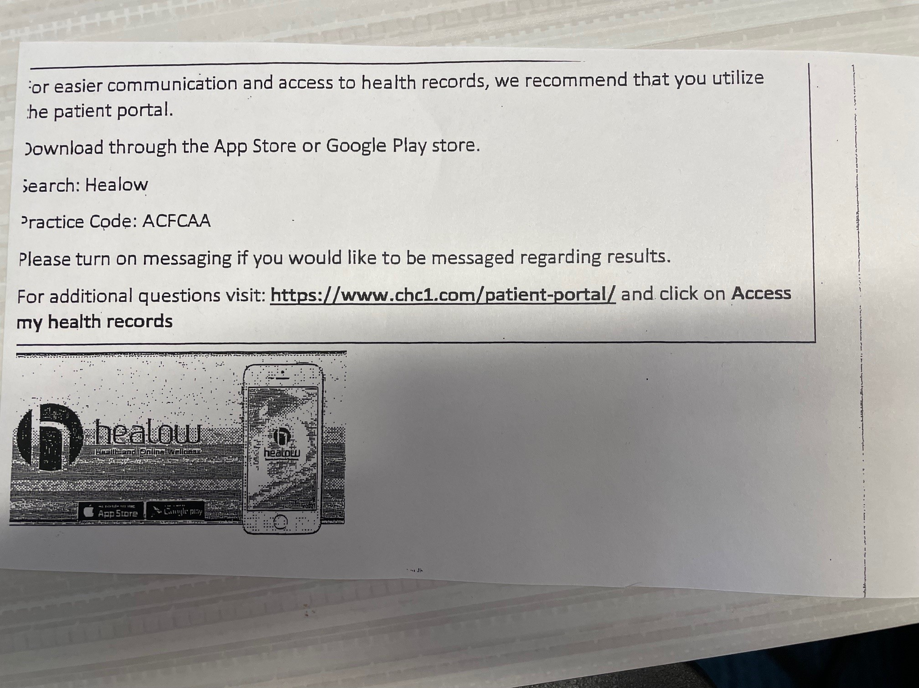
Handout

Slide 9
Stakeholders
Nicole Seagriff - VP Western Region
Garrett Matlick - OSMD and Clinical Program Director
Tatianna Pryce - AGNP
Leslie Gianelli - VP of Communications
Stephanie Ivers Heine - Creative director of Communications
Adam Bente - Data Analyst, Population Health
Jassenia Palma - Operations Manager and PSA Manager
Stephanie Jean –Louis – Medical Assistant
Notes:
Tatianna: Created a concise one page form for accessing and navigating Healow
Stephanie: for Postcard introducing the Healow portal in English with a video

Slide 10
Approach to Change
Identify possible change points
PSA vs MA vs Provider
Handout vs Kiosk
Language
Site-wide vs Residents

Slide 11
Data
Notes:
5/8/24 -> Drew used MA to give out handouts and had a better handout day than average
-> Dates Loraine was not able to use her table and had lower than usual handout days

Slide 12
Data
Loraine | 92% increase Q4 to Q2 | 12% increase Q1 to Q2
Drew | 56% increase Q4 to Q2 | 34% increase Q1 to Q2
Notes:
Loraine: :118 end of Q4 up to 227 at end Q2
Drew: 389 end Q4 up to 607 at end Q2

Slide 13
Data
Row Labels | Sum of Portal Usage - Previous 3 months (Dec, Jan, Feb) | Sum of Portal Usage -Last 3M (March, April, May) | Sum of Portal Usage -Last 6M (Dec, Jan, Feb, March, April, May)
Fifth Street Stamford | 13483 | 13466 | 26949
Asunto MD, Ann FP | 1831 | 2070 | 3901
Gellrich MD, Gabriella-FP | 922 | 1015 | 1937
Koh DO, Yumi ADULTS ONLY | 2592 | 3014 | 5606
Matlick APRN, Garrett FP | 1078 | 1123 | 2201
Merritt APRN, Kerri FP | 2104 | 1671 | 3775
Pryce APRN, Tatianna ADULT ONLY | 4352 | 4134 | 8486
Richards APRN, Loraine Resident | 202 | 227 | 429
Tran MD, Duyet PEDS | 402 | 212 | 614
Fifth Street Stamford Medical | 452 | 607 | 1059
Walker APRN, Drew Resident | 452 | 607 | 1059
 | 0
CHC of Norwalk | 5939 | 6272 | 12211
Ehrenfeld APRN, Lucy FP | 811 | 1086 | 1897
Fletcher MD, Justin FP | 3248 | 3648 | 6896
John PA, Keren | 1771 | 1486 | 3257
Seagriff APRN, Nicole FP | 44 | 29 | 73
zzzBellamy APRN, Shanna | 62 | 20 | 82
zzzCarlucci APRN, Kate E | 3 | 3 | 6

Slide 14
Data
Notes:
Stamford Q3 2023 16400, Q4 2023 15245, Q1 2024 13533, Q2 2024 13861; From Q1 to Q2 increase in 328
Norwalk Q3 2023 4239, Q4 2023 3751, Q1 2024 4059, Q2 2024 4734

Slide 15
Results
Increase in number of patients engaged by residents
Increase in patient portal usage when compared to previous months by residents
Improvement in overall Stamford engagement
Barriers and Limiting factors
  No control over patient seen
  No comparison vs other sites in their engagement attempts
  No control over whether patient already had access
  Language
  App (handout) vs Website portal
Notes:
Loraine had consistently higher %s for patients engaged (first graph), but both residents increased engagement
Loraine 12%, Drew 34% from Q1 to Q2 20024, Larger increases when compared to Q4 2023 as well.
Barriers: Our pts vs other providers, we don’t really know what other sites do so hard to compare engagement attempts, no control over patients with or w/o access prior to appointment which may impact numbers, handout only in English so Loraine had to use interpreter to try to help explain and Drew could explain in person
Handout specifically directed patients to the App, but some anecdotal evidence suggests that the website portal is easier to use

Slide 16
Conclusions
Consider implementation of simple handout site-wide given our data and Tatianna’s numbers
Consider printing in Spanish and English
Handouts in rooms or part of check out card (QI code)

Slide 17
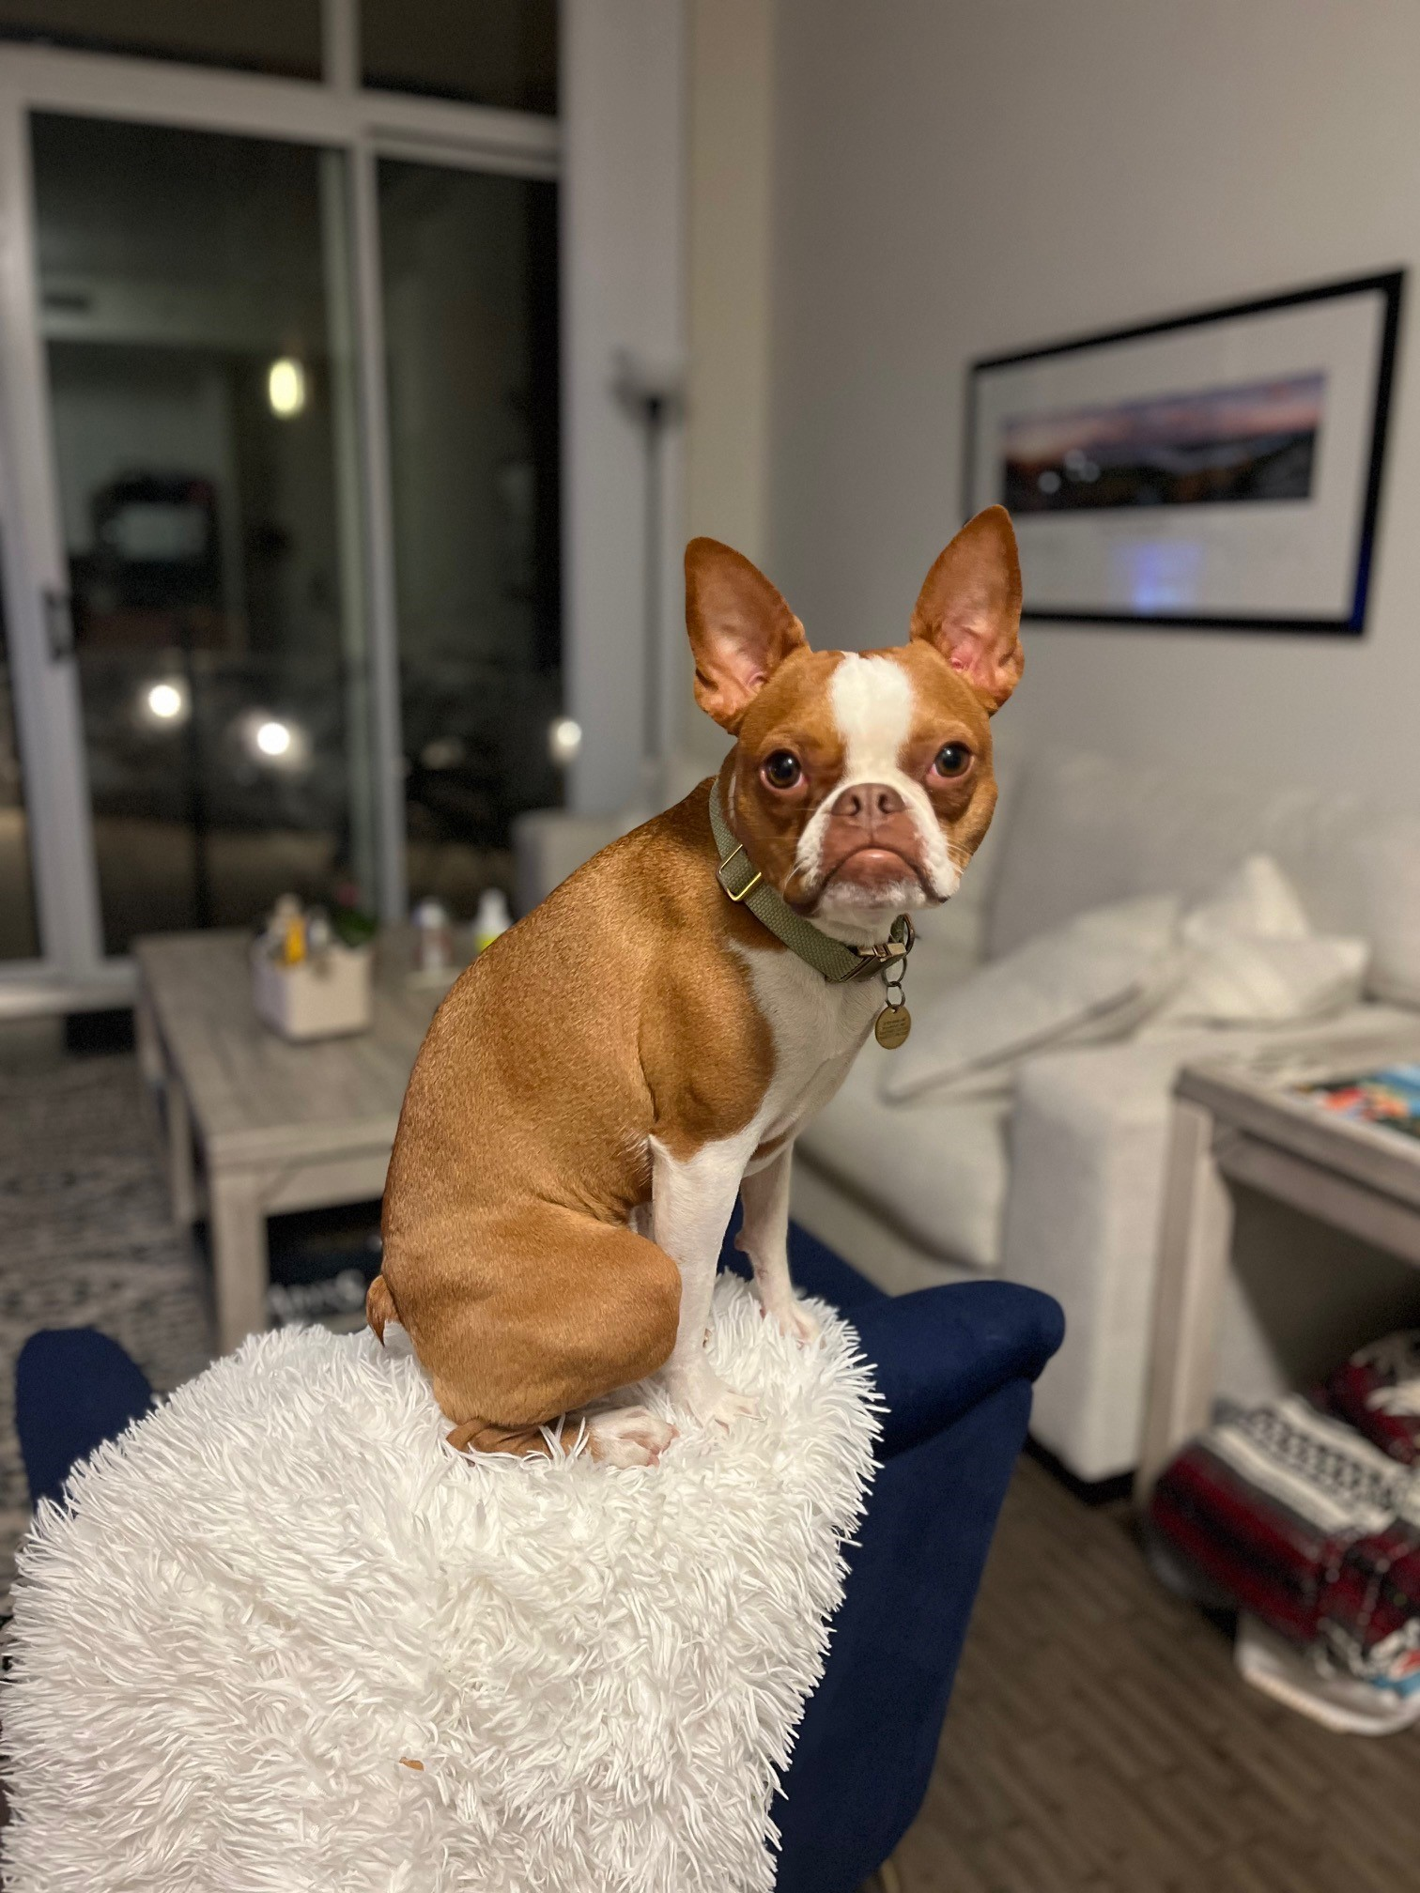
Thank you

