Slide 1
The Pain of Trauma, The Trauma of Pain: The opioid crisis is not what you think
STRESS and PAIN
The Pain of Trauma, The Trauma of Pain
-
Mind
Body
Bennet Davis, M.D.
Director, Sierra Tucson Pain Recovery Program
Medical Director, Weitzman Pain ECHO Telemedicine Program
Senior Associate, International Foundation for Integrated Care
Adjunct Professor, University of Arizona

Slide 2
The next two slides describe a patient who was caught up in a hostage situation 3 years ago. She was unharmed – physically. She presented to IPCA in referral from her PCP with complaints of 3 years of diffuse pain that was not responding to opioid at high doses. Referring diagnosis was “fibromyalgia”
School teacher and mother of 3 young children, on disability for pain, who presented to IPCA in referral from her PCP with “medical” complaints of 3 years of diffuse pain, variable numbness and weakness, fatigue, insomnia, nausea that was not responding to opioid at high doses, gabapentin, pregabalin, and duloxetine. Psychiatry treating depressions with medications.
Oxycodone daily dose was 120 mg/day
Labelled a “drug addict” by family
Referring diagnosis was “fibromyalgia”, She had also been dx with Lupus, multiple sclerosis, POTS, neuropathy, and chronic Lyme disease for which antibiotic treatment at 15,000 dollars had failed.
CASE STUDY

Slide 3
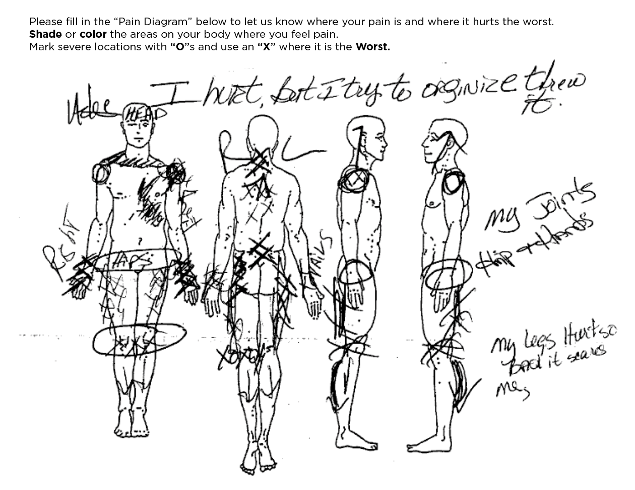
CASE STUDY

Slide 4
The next two slides describe a patient who was caught up in a hostage situation 3 years ago. She was unharmed – physically. She presented to IPCA in referral from her PCP with complaints of 3 years of diffuse pain that was not responding to opioid at high doses. Referring diagnosis was “fibromyalgia”
CASE STUDY
1 month before the pain started, this patient was caught up in a hostage situation. She was unharmed (physically).
ACE score: 6/10

Slide 5
The next two slides describe a patient who was caught up in a hostage situation 3 years ago. She was unharmed – physically. She presented to IPCA in referral from her PCP with complaints of 3 years of diffuse pain that was not responding to opioid at high doses. Referring diagnosis was “fibromyalgia”
CASE STUDY
Treatment started 1 week after initial visit with somatic experiencing followed by EMDR when she was ready
She recovered and went back to work
At the beginning of her 4 month follow up visit she casually mentioned “By the way I stopped the pain meds (opioid) on my own”

Slide 6
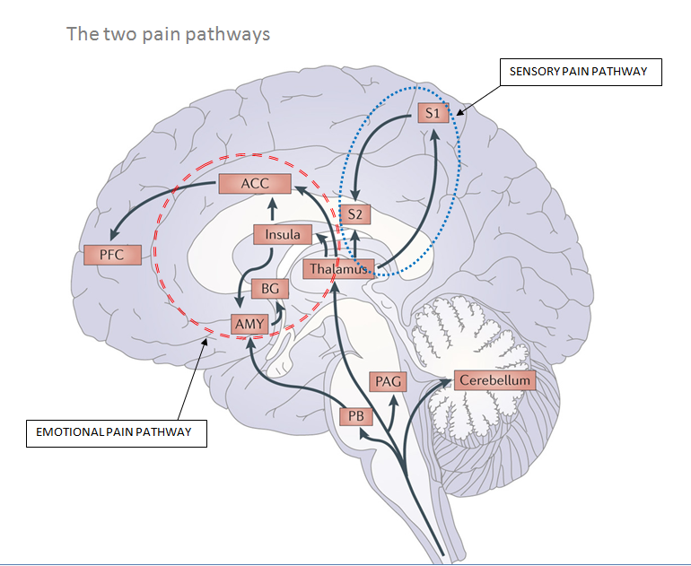
DEFINITIONS: PAIN
Anything that activates the pain circuits
1
2
3
4

Slide 7
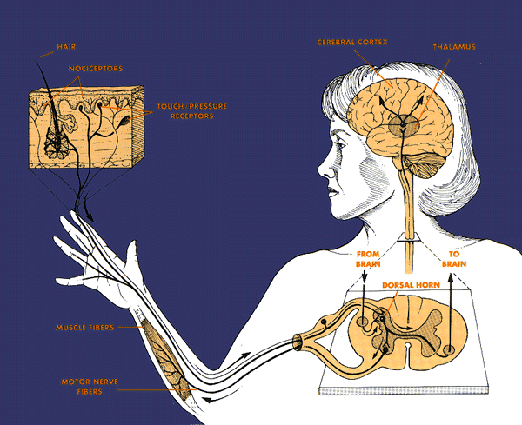
Pain Pathways
Nociceptive Pain
0
Somatosensory
Cortex
C & Aδ Fibers
Thalamus
From
Brain
To
Brain
Spinal
Cord

Slide 8
Nociceptive Pain
Transduction (Nociceptors transduce a stimulus)
Transmission (Peripheral nerve)
Processing and Construction (e.g., Spinal Cord, Affective, Threat, and Motivational Circuits)
Perception and Interpretation
Behavior

Slide 9
Nociceptive Pain
Pain Stimulus (trauma, inflammation, heat, etc.)
Sensory processing
of pain stimulus
Emotional processing
of pain stimulus
Emotional Distress and Unpleasantness
PAIN AND DISABILITY

Slide 10
Examples
Nociceptive Pain
Arthritis (degenerative or inflammatory)
Burns
Cuts and bruises and toothaches
Fractures
Described as: “sharp, dull, aching”

Slide 11
2. Neuropathic Pain from nerve injury
Transduction (Nociceptors)
Transmission (Peripheral nerve)
Processing and Construction (e.g., Spinal Cord, Affective, Threat, and Motivational Circuits)
Perception and Interpretation
Behavior

Slide 12
Neuropathic pain from nerve injury
Physical injury to the nervous system, or modification of the nervous system by chemicals, inflammation…
Pain Stimulus (trauma, inflammation, heat, etc.)
Sensory processing
of pain stimulus
Altered Nervous System Processing of Sensory Stimuli

Slide 13
Neuropathic pain from nerve injury
CENTRAL SENSITIZATION FROM NERVE INJURY
Non-painful
stimuli
Emotional processing
of pain stimulus
Emotional Distress and Unpleasantness
Altered Nervous System Processing of Sensory Stimuli
PAIN AND DISABILITY

Slide 14
Neuropathic pain from nerve injury
Altered Nervous System Processing of Sensory Stimuli
Emotional processing
of pain stimulus
Emotional Distress and Unpleasantness
PAIN AND DISABILITY

Slide 15
Examples
Neuropathic pain from nerve injury
Diabetic and other neuropathies
Post herpetic neuralgia
CRPS
Phantom limb pain
Spinal cord injury and post stroke pain
Brachial plexus injury
Opioid induced hyperalgesia
Described as: “burning, shooting, electrical” with heightened sensitivity to stimuli

Slide 16
International Association for the Study of Pain (IASP) updates their definition of pain
15 years ago:
Many people report pain in the absence of tissue damage or any likely pathophysiological cause; usually this happens for psychological reasons.

Slide 17
3. Neuropathic Pain From Threatening
Experience (central pain, nociplastic pain)
No physical nerve injury
Pain Stimulus (trauma, inflammation, heat, etc.)
TRAUMATIC EXPERIENCE /TOXIC STRESS (War, abuse, assault, neglect, environment)
Sensory processing
of pain stimulus
Altered processing
of sensory stimuli

Slide 18
Neuropathic Pain From Threatening
Experience
Neuropathic pain from experiential nerve injury
Non-painful
stimuli
CENTRAL SENSITIZATION FROM TRAUMA
Emotional processing
of pain stimulus
Emotional Distress and Unpleasantness
Altered processing
of sensory stimuli
PAIN AND DISABILITY

Slide 19
Neuropathic Pain From Threatening
Experience
Neuropathic pain from experiential nerve injury
TRAUMA INDUCED SPONTANEOUS PAIN
Altered processing
of sensory stimuli
Emotional processing
of pain stimulus
Emotional Distress and Unpleasantness
PAIN AND DISABILITY

Slide 20
Neuropathic Pain From Threatening
Experience
Pain described as: “cruel, punishing, fearful, horrible”

Slide 21
Why do emotional responses/behaviors predominate in NPP resulting from threatening experience?

Slide 22
TRAUMA/
TOXIC STRESS
Fatigue
Addiction
Depression
Obesity
Consequences
Anxiety
Short lifespan
Personality disorder
Insomnia
Chronic pain
Chemical coping
Biological Changes
in the “Stress/Threat
Adapted Nervous System”:
Altered neurohumoral system
Inflammation
Altered immune system
Altered endocrine system: increased stress hormone levels
Changes in the way DNA is read
Healthy Nervous System

Slide 23
What is the evidence that trauma can cause neuropathic pain?
Plausibility
Association
Dose response
Temporality
Reversibility

Slide 24
Experimental evidence that psychological trauma correlates with altered sensory processing
Deep pain (pressure) thresholds were found to be lower in the back AND the hand in subjects with LBP who had a history of psychological trauma; “…suggests trauma induced abnormalities in central pain processing…” ¹
1. Tesarz J. Distinct quantitative sensory testing profiles in nonspecific chronic low back pain
subjects with and without psychological trauma. Pain 2015; 156: 577-86

Slide 25
Experimental evidence that psychological trauma correlates with altered sensory processing
Deep pain (pressure) thresholds were found to be lower in the back AND the hand in subjects with LBP who had a history of psychological trauma; lower only in the back in subjects w/o psychological trauma, “…suggests trauma induced abnormalities in central pain processing…” ¹
Higher pain ratings to hand immersion in cold water in psychological trauma exposed women compared to non-trauma exposed controls. ²
1. Tesarz J. Distinct quantitative sensory testing profiles in nonspecific chronic low back pain
subjects with and without psychological trauma. Pain 2015; 156: 577-86
2. Gomez-Perez L. Association of trauma, post traumatic stress disorder, and experimental
pain response in healthy young women. Clin J Pain 2013; 29: 425-34

Slide 26
Experimental evidence that psychological trauma correlates with altered sensory processing
Deep pain (pressure) thresholds were found to be lower in the back AND the hand in subjects with LBP who had a history of psychological trauma; lower only in the back in subjects w/o psychological trauma, “…suggests trauma induced abnormalities in central pain processing…” ¹
Higher pain ratings to hand immersion in cold water in psychological trauma exposed women compared to non-trauma exposed controls. ²
Lower ischemic pain threshold in women with psychological trauma history compared to women without trauma history. ³
1. Tesarz J. Distinct quantitative sensory testing profiles in nonspecific chronic low back pain
subjects with and without psychological trauma. Pain 2015; 156: 577-86
2. Gomez-Perez L. Association of trauma, post traumatic stress disorder, and experimental
pain response in healthy young women. Clin J Pain 2013; 29: 425-34
3. Creech S. Written emotional disclosure of trauma and trauma history alter pain sensitivity.
J Pain 2011; 12: 801-10

Slide 27
Evidence that psychological trauma causes chronic pain: Association 1/2
There Is Consistent Evidence That Chronic Pain Is Associated with PTSD (and the BH symptoms of trauma): An Evidence-Based Structured Systematic Review
Fishbain D. Pain Medicine. 2017; 18: 711–735

Slide 28
Evidence that psychological trauma causes chronic pain: Association 2/2
PREVALENCE OF PTSD IN:
The general population: 6.8%
Combat veterans: 13.2%
Chronic pain patients: 42%
With a range of 4-95% in the 10 studies evaluated by Lopez in 2019
Sharp T. CHRONIC PAIN AND POSTTRAUMATIC STRESS DISORDER: MUTUAL MAINTENANCE?
Clinical Psychology Review. 2001;21(6): 857–877
Lopez A. Chronic pain, post traumatic stress disorder, and opioid intake: a systematic review.
World J Clin Care 2019;7(24):4254-69

Slide 29
Evidence that psychological trauma causes chronic pain: Temporality and Association
Developmental trauma: Are Reports of Childhood Abuse Related to the Experience of Chronic Pain in Adulthood? A 2005 Systematic review of the literature (Davis)
Individuals who reported being abused or neglected in childhood reported more pain symptoms and related conditions than those not abused or neglected in childhood
Patients with chronic pain were more likely to report having been abused or neglected in childhood than controls with no chronic pain
Patients with chronic pain were more likely to report having been abused or neglected in childhood than nonpatients with chronic pain identified from the community
Individuals from the community reporting pain were more likely to report having been abused or neglected than individuals from the community not reporting pain.
Developmental trauma and pain: A 2005 Systematic review of the literature
Adults who reported being abused or neglected in childhood reported more pain symptoms and related conditions than those not abused or neglected in childhood
Adults patients with chronic pain were more likely to report having been abused or neglected in childhood than controls: chronically ill patients with no chronic pain
Adult patients with chronic pain were more likely to report having been abused or neglected in childhood than nonpatients with chronic pain identified through community sampling
Adult non-patients with chronic pain were more likely to report having been abused or neglected than individuals from the community not reporting pain.
Davis B, et al. Clinical Journal of Pain. 2005 21(5):398-405

Slide 30
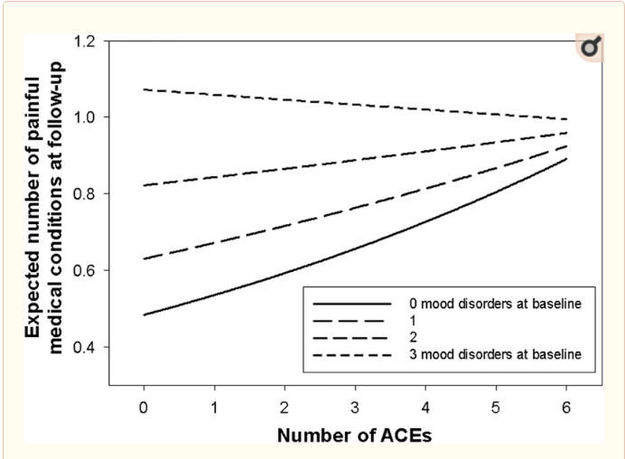
Evidence that psychological trauma causes chronic pain: Dose- Response between trauma and pain 1/2
Developmental trauma: Are Reports of Childhood Abuse Related to the Experience of Chronic Pain in Adulthood? A 2005 Systematic review of the literature (Davis)
Individuals who reported being abused or neglected in childhood reported more pain symptoms and related conditions than those not abused or neglected in childhood
Patients with chronic pain were more likely to report having been abused or neglected in childhood than controls with no chronic pain
Patients with chronic pain were more likely to report having been abused or neglected in childhood than nonpatients with chronic pain identified from the community
Individuals from the community reporting pain were more likely to report having been abused or neglected than individuals from the community not reporting pain.
Sachs-Erickson N et al. When Emotional Pain Becomes Physical: Adverse Childhood Experiences, Pain, and the Role of Mood and Anxiety Disorders. Clinical Journal of Psychology 2017; 73(10): 1403-1428

Slide 31
Evidence that psychological trauma causes chronic pain: Dose- Response between trauma and pain 2/2
“Trauma symptom severity seems to correlate with the magnitude of hyperalgesia (augmented central pain processing)”
Tesarz J. Distinct quantitative sensory testing profiles in nonspecific chronic low back pain subjects with and without psychological trauma. Pain 2015; 156: 577-86

Slide 32
Evidence that psychological trauma causes chronic pain: Reversibility i.e., Does trauma treatment decrease pain? YES
2016: EMDR and reprocessing vs care as usual for chronic back pain in 40 people with a history of psychological trauma:
No improvement in the care as usual group
50% of the treatment group reported clinically significant pain decrease that sustained at 6 month follow up.
2019: There are now also six randomized controlled clinical trials available that demonstrate the efficacy of EMDR in the treatment of different pain conditions.
EAET and PRT results better than CBT and care as usual for chronic pain
Focus of this and other research is to address trauma to eliminate pain, not teach people to live with it.
Grehardt A e al. Eye Movement Desensitization and reprocessing vs. treatment-as-usual for non-specific chronic back pain patients with psychological trauma : a randomized controlled pilot study. Front. Psychiatry 2016; 7:201
Tesarz j, et al. EMDR Therapy's Efficacy in the Treatment of Pain. Journal of EMDR Practice and Research 2019; 13(4)
Lumley R. Trauma matters: psychological interventions for comorbid psychosocial trauma and chronic pain. Pain 2022;163(4):599-563
Ashar Y et al. Effect of Pain Reprocessing Therapy vs Placebo and Usual Care for Patients With Chronic Back Pain: A Randomized Clinical Trial. JAMA Psychiatry; 2022;79(1):13-23
Emotional Expression Therapy vs Cognitive Behavioral Therapy for Chronic Pain in Older Veterans: A Randomized Clinical Trial. Yarns B et. al. JAMA Netw Open. 2024;7(6)

Slide 33
Evidence that psychological trauma causes chronic pain: Reversibility i.e., Does trauma treatment decrease pain? YES
“Can a psychological treatment based on the reappraisal of primary chronic back pain as due to nondangerous central nervous system processes provide substantial and durable pain relief?” - YES
In this randomized clinical trial, 33 of 50 participants (66%) randomized to 4 weeks of pain reprocessing therapy were pain-free or nearly pain-free at posttreatment, compared with 10 of 51 participants (20%) randomized to placebo and 5 of 50 participants (10%) randomized to usual care, with gains largely maintained through 1-year follow-up.
Used fMRI to show that areas of the brain involved in threat processing and known to be dysfunctional in people with trauma changed in response to the treatment, but did not change in care as usual group
Ashar Y et al. Effect of Pain Reprocessing Therapy vs Placebo and Usual Care for Patients With Chronic Back Pain: A Randomized Clinical Trial. JAMA Psychiatry; 2022;79(1):13-23

Slide 34
How do we know that “Central sensitization” of the pain circuits is not the result of the anxiety or depression that usually co-occur with trauma ??

Slide 35
Experimental evidence that chronic “pain for psychological reasons” occurs independent of Anxiety or Depression
The changes in sensory processing just reviewed are present EVEN WHEN WE ADJUST FOR ANXIETY AND DEPRESSION based on multiple studies looking at:
Cerebral activation
CNS Connectivity
CNS Morphology
Barad M, J Pain. 2014;15:197-203 CRPS and CNS morphology
Ivo R. Eur Spine J. 2013;22:1958-64 Correlation of CNS structure and psychometric testing
Jensen KB, Arthritis Rheum 2010;63:3488-95 Anxiety and depression not related to CNS pain processing
Jensen KB Arthritis Rheum 2013;65:3293-3403 Fibromyalgia brain morphology
Lutz J. Arthritis Rheum 2008;58:3960-69 Fibromyalgia brain morphology

Slide 36
Experimental evidence that depression does not lead to central sensitization
Meta-analysis compared pain perception of depressed and control participants.
32 experimental pain studies examined.
Overall pain threshold was higher in depression but strong heterogeneity was evident.
No differences in pain tolerance were found.
Thompson T. The Journal of Pain. 2016; 17(12): 1257-72

Slide 37
Experimental evidence that anxiety does not lead to central sensitization
Study comparing veterans with anxiety to
those with PTSD
“PAIN”
Response
ANXIETY and CONTROL
“PRESSURE”
PTSD
Pressure on bony prominence
Defrin R, et al. Quantitative testing of pain perception in subjects with PTSD—implications for the mechanism of the coexistence between PTSD and chronic pain. Pain 2008 138: 450–459

Slide 38
More than trauma induced neuropathic pain Triggered trauma memories of pain Sometimes triggers also call up pain memories, and pain focus can serve as a means of coping
The Living Legacy of Trauma

Slide 39
TRAUMA REORGANIZED CNS
More than trauma induced hyperalgesia Focus on pain as a means of coping
OVERWHELMING EMOTIONS:
Fear, Panic, Helplessness.
Flight, Fight, Freeze behaviors
PREDICT
NOT THREAT
Focus on Pain
Hypervigilance, but also perhaps to cope with overwhelming emotions
PREDICT
THREAT
Mild PAIN
From any of the 4
PAIN

Slide 40
Review: How trauma induced reorganization of the CNS may cause pain in the absence of tissue damage
Trauma Induced Central sensitization: altered sensory processing
Triggered trauma memories of Pain
Trauma may also cause innocuous pain to be misinterpreted, because of Pain – Threat confusion

Slide 41
How often does trauma cause pain?

Slide 42
Psychological Trauma (PTSD) Prevalence
The general U.S. population 6.8%
Chronic back pain* patients 20-42%
* chronic back pain prevalence in U.S. adults
2000 = 16,000,000 people
Sharp T. CHRONIC PAIN AND POSTTRAUMATIC STRESS DISORDER: MUTUAL MAINTENANCE?
Clinical Psychology Review. 2001;21(6): 857–877
CHRONIC BACK PAIN Georgetown University health Policy Institute 2000

Slide 43
History Clues
Neuropathic Pain From Threatening Experiences That Re-organize the Nervous System
Multiple somatic complaints
symptoms rotate and or shift from place to place in the body
diffuse whole body pain, numbness or weakness
Treatment and diagnosis resistant symptoms (multiple providers, treatments, and multiple diagnoses often in mutually exclusive)
onset after traumatic event
anxiety, depression, bipolar disorder present
PTSD diagnosis
use of benzodiazepine, opioid, THC
“I cry in pain”

Slide 44
Neuropathic Pain From Threatening Experiences That Re-organize the Nervous System
Medical exam
non organic neurological findings
Crying during the visit
After medical exam and work up
No clear physical explanation of patient symptoms is evident, Or physical findings don't completely explain patient symptoms

Slide 45
Neuropathic Pain From Threatening Experiences That Re-organize the Nervous System
Response to pain relieving procedures
Unexpected pain
Unexpected emotional responses
Too quiet
Nothing shows any sustained benefit

Slide 46
"I get so irritated with people who don't believe fibromyalgia is real. For me, and I think for many others, it's really a cyclone of anxiety, depression, PTSD, trauma, and panic disorder, all of which sends the nervous system into overdrive, and then you have nerve pain as a result,“ Gaga: Five foot two
https://globalnews.ca/news/4438236/what-is-fibromyalgia-lady-gaga/#:~:text=%E2%80%9CI%20get%20so%20irritated%20with,nerve%20pain%20as%20a%20result.%E2%80%9D

Slide 47
4. Emotional Pain
Social rejection
Grief
Isolation

Slide 48
Social interactions mediate pain perception
Socially isolated people have a lower pain threshold
Degree of social support at diagnosis of RA predicts pain intensity at 3 year follow up
Pain scores correlate positively with perceived social support in people with chronic musculoskeletal pain
Eisenberg N. Pain 2006;126:132-8
Evers A. Beh Res Ther. 2003;41:1295-1310
Hsu. Clin J Pain 2014;30:713-23

Slide 49
What is Pain 2022 ?
An experience produced by any combination of the 4 phenomena that can activate brain pain circuits
Nociception
Neuropathic central sensitization from physical nerve damage or disease
Neuropathic from the stress of threat exposure
central sensitization
triggered trauma memories
Grief, Rejection, Isolation

Slide 50
What is Pain 2022 ?
Nociplastic Pain is the name given to what this presentation calls “neuropathic pain from trauma/stress”
“Pain that arises from altered nociception despite no clear evidence of actual or threatened tissue damage causing the activation of peripheral nociceptors or evidence for disease or lesion of the somatosensory system causing the pain.”
International Association for the Study of Pain. 2017
https://www.iasp-pain.org/Education/Content.aspx?ItemNumber=1698#Nociplasticpain

Slide 51
What is Pain 2022 ?
An experience produced by any combination of the 4 phenomena, interpreted through the lens of the individual’s life experience:
Culture, Beliefs, Values, Assumptions
Past Painful experience
Trauma

Slide 52
PAIN AS A MEANS OF COPING
COGNITIONS, EMOTIONS
GRIEF, REJECTION, ISOLATION
NEUROPATHIC-TRAUMA/STRESS
NEUROPATHIC-TISSUE INJURY
NOCICEPTION

Slide 53
Mind - Nervous System - Body approach to treatment of chronic pain
Behavioral Health – Medical Integrated evaluation
Determine which combination of the 4 mechanisms are in play
Determine priorities in medical intervention vs addressing altered nervous system processing of pain Consider early BH intervention.
Education and Behavioral Health and Medical treatment
Graded exposure to non-damaging activity – reprocessing pain as not threat (all pain does not predict tissue injury)
Re-connect with purpose and meaning
Behavioral Health – Medical Integrated care planning
Teach that pain can come from the nervous system
Treat Trauma, Mood, Grief, Use disorders, Sleep, Diet,
and Medical treatment ( meaning the biomedical approach)
Physical activation, often requiring skilled PT
Experiential Therapy, Therapeutic Milieu

Slide 54
Mind - Nervous System - Body approach to treatment of chronic pain
Is there a clearly defined medical disorder that explains the symptom? And, has standard treatment failed?
Is there a history of other psychophysiological disorders? And other evidence of trauma symptoms (screeners: PCL 5, GAD 7, PHQ, etc)?
Is there a history of significant stressful events, particularly early in life? (Screener: ACE)
Were there significant life events occurring at the onset of the symptom(s)?
Howard Schubiner, M.D.
Bennet Davis, M.D.

Slide 55
Psychoeducation: Definition of trauma that helps ground patient experience in familiar terms
An evolutionary biology definition of trauma: “Predator Proofing”
A long lasting neuroplastic (changes in neuronal connection and function) adaptation to threat(s) which the individual could not master at the time the threat(s) occurred.
The threat response system becomes hyperfucnctional (which makes sense and is protective)
The pain sensing system is part of our threat response system, and it often becomes hyperfunctional

Slide 56
Psychoeducation: Introducing the trauma Mind-Nervous System-Body connection
Normalize and physicalize the experience:
Your past DOES matter: We are all physically the product of our experience: language shapes and organizes our brain and so does threat.
Threat reorganization of the CNS is normal predator proofing, inherited from our distant ancestors.
A threat re-organized CNS focuses on the now when triggered, it motivates behavior in the now, even if that behavior is harmful to us in the long run.
h

Slide 57
“Its just biology: Experiences have changed your nervous system and your nervous system controls your body’s physical functions”
This is How Pain is Most Often Conceptualized
The Body
Sensing
The Nervous System
Modulating, Processing, and transmitting
The Mind
Perceiving & Adding meaning
1. Nociceptive pain
2. Neuropathic pain due to physical nerve injury
3. Neuropathic pain due to threatening experiences (trauma)
4. Emotional, Spiritual, existential pain
Anxiety, Depression. PTSD
GI disturbances, Brain fog, Insomnia, Fatigue, Autoimmune disorders
Resources: “The Living Legacy of Trauma” by Janina Fisher
“The Way Out” by Alan Gordon
Notes:
Click for Nervous System
Click for Mind
Click for reverse arrows

Slide 58
“Its just biology: your experiences have changed your nervous system, which controls the immune system“
This is How Pain is Most Often Conceptualized
The Body
Sensing
The Nervous stem
Modulating, Processing, and transmitting
The Mind
Perceiving & Adding meaning
Psychiatry and Clinical Neurosciences 73: 143–153, 2019
Notes:
Click for Nervous System
Click for Mind
Click for reverse arrows

Slide 59
Pain informed trauma recovery The Goal is Wellbeing
Emotional regulation, awareness, and experiencing
Help the patient develop as sense that pain and other consequences of trauma are
Understandable/comprehensible
Manageable
Education, self management techniques, pain informed physical/occupational therapy
Existential recovery: discovering purpose and meaning
Antonovsky A. The salutogenic model as a theory to guide health promotion. Health Promotion International. 1996; 11: 11-19

