Slide 1
STRATEGIC
FOCUSED
Quality Improvement Seminar
Mark Splaine & Emma Warshauer
October 24, 2024
RELEVANT
INTERACTIVE
TEAM WORK
INFORMATIVE
FUN
SKILL BUILDING
Nurse Practitioner & Physician Assistant
Training Programs

Slide 2
Session Goals
Hear about and discuss many of the things you are noticing and wondering about
Review the evidence for the team-based care approach in primary care
Share some examples of team-based care in your setting
2

Slide 3
Roles
Theory burst presenter
Mark
Facilitator, timekeeper & technical genius
Emma
Take-home thoughts
Emma and Mark
3

Slide 4
Agenda
Welcome and announcements (10 mins)
Theory burst on team-based care (20 mins)
Examples of team-based care (15 mins)
Brief break (5 mins)
Assignment small group discussion (30 mins)
Summary and take-home points (5 mins)
Preview of next session (5 mins)
4

Slide 5
Curriculum Plan
An overview of Quality Improvement (10/10/24)
Care Observations & Stakeholder Considerations (10/24/24)
Organizing your Improvement Project (11/14/24)
Global Aim and Fishbone Diagram (12/12/24)
Process Mapping (Flowcharts) (1/9/25)
Measurement to Inform Change (1/23/25 & 1/30/25)
An Approach to Testing a Change (2/13/25)
Communication about your Improvement Effort (2/27/25)
Stakeholder Analysis & Conflict Management (3/13/25)
Managing Up and Gaining Leadership Buy-In (3/27/25)
Negotiation (4/10/25)
Negotiation and More About Cycles of Change (4/24/25)
Sustaining your Improvement Effort (5/8/25)
Resident Presentations (5/22/25, 6/12/25, 6/26/25)

Slide 6
Office Hours
Mark will hold office hours for all residents on the 1st Thursday of each month from 11:00am-12:00pm ET
Mark is available to meet with any resident or team if you need an alternative time – just email to set up a time
6

Slide 7
More About Projects
Nov-Jan
Charter
Jan-Feb
Data
Feb-Apr
Planning & Making Change
Aim
Fishbone
Stakeholders
Flowchart
Change Ideas
Apr-Jun
Assess/revise changes
Collect data
Prepare presentation
Two expectations – periodic sharing & presentation
As much about the journey as the product
7

Slide 8
Quality Improvement:
Implementing Diabetic Retinopathy Screening
Presented by: Katy Kellogg, FNP & Tatsiana Franco, PA-C

Slide 9
Aim Statement
Our goal is to improve the rate for in-house diabetic retinopathy exams in Eureka Community Health Centers, Family Medicine

Slide 10
Stakeholders
(MAs, LVN, RN, Clinic Coordinator, Front Desk Clerk, Clinic Manager, NP)
During QI meeting, stakeholders provided with feedback on current screening and future QI plan, discussed barriers in screening process and possible solutions.
Challenges from Stakeholders Perspective
previously tried to implement in-clinic retinal screening with minimal success
screening required trained operators
time consuming process that takes 15-30 minutes
limited access to warm handoffs due to staffing
required additional space and specific environment for screening
needed community partners to read the images

Slide 11
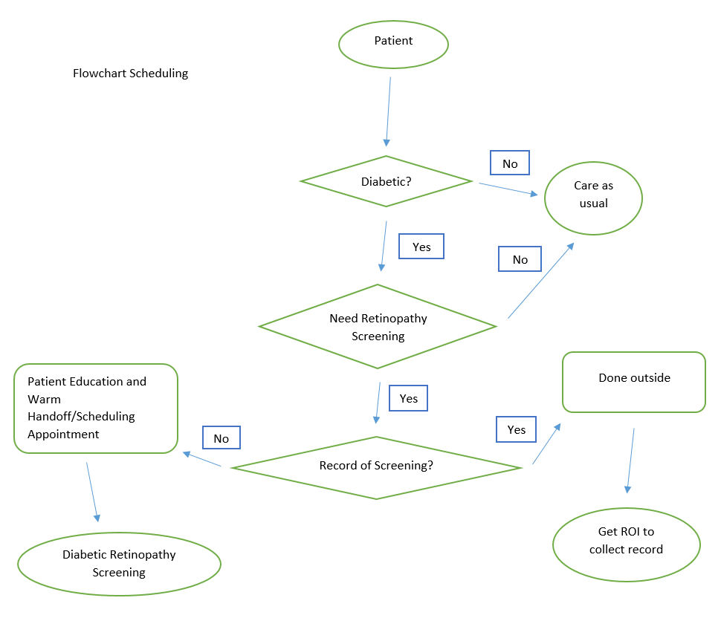
Initial Process

Slide 12
PDSA Cycle
Plan/Do:
Identify diabetic patients that are due for diabetic retinal exam
Do robust calls and assess the need for screening
Educate patients on importance of retinal screening
Place educational DM retinopathy posters in rooms
Create dot phrase and visual images for outreach
Obtain record If patient had screening done elsewhere
Provide options for exam, either through warm handoffs same day or in the future
Add additional 2 additional clinics for diabetic retinal screenings
Train supportive staff to do screening

Slide 13
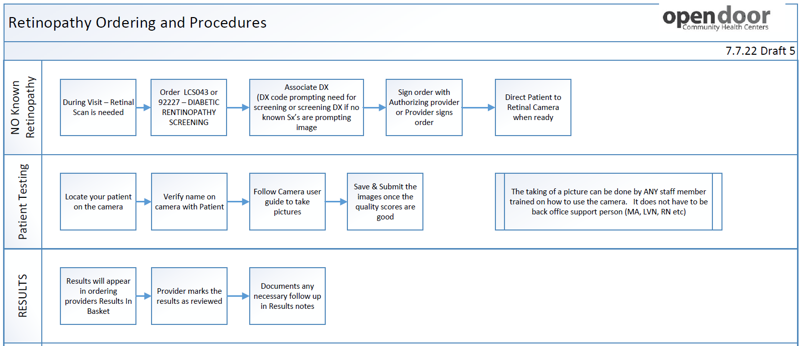
Diabetic Retinal Screening Workflow - WHO

Slide 14
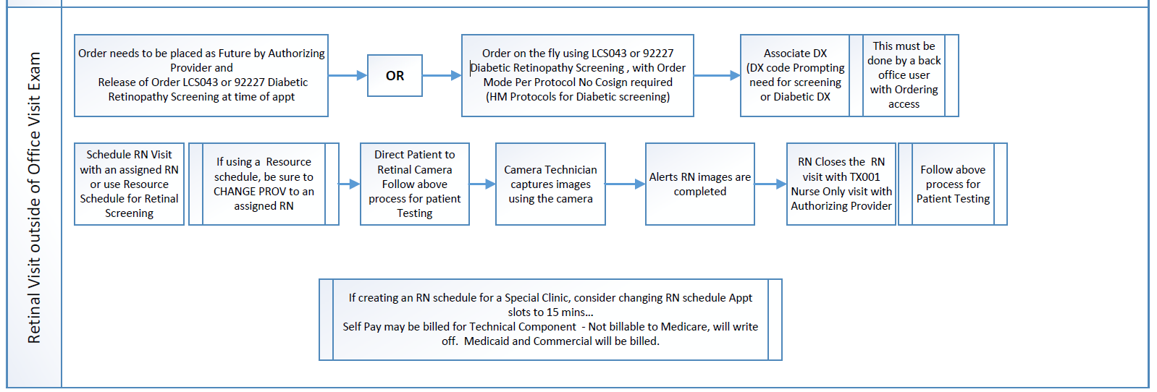
Diabetic Retinal Screening Workflow - Scheduled

Slide 15
Data Over Time
Observations: More patients had retinal screening done during their appointments with providers. Patients were scheduling future appointments. More appointment slots are needed. Completion rate increased.
October – 23%
November – 23%
December – 24%
January – 26%
February – 29%
March – 32%
April – 35%
May – 36%

Slide 16
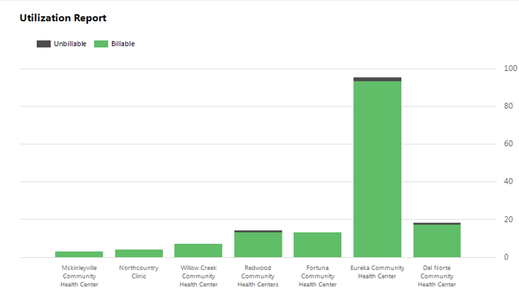
Results
1/2/2023-3/14/2023
Implemented Retinal Clinic

Slide 17
Lessons Learned
Challenging due to different levels of administrative buy-in and available resources
Difficulty with image capture (staying in dark room for 5 minutes to allow eyes to dilate)
Some patients more challenging than other to take images (history of cataract/glaucoma, eyelid problem, older patients, patients with tremors, smaller and less responsive to light pupils with opiate use, lighter eyes)
Warm handoffs (WHOs) challenging if only limited staff trained (need someone not rooming patients or having a few designated people to take pictures)
Scrub the schedule for possible WHOs for patients being seen in clinic that day
Need to educate patients about why this is important
Along with increased efforts at retinal imaging, also increased efforts to obtain retinopathy reports from specialists for patients with established retinopathy
Notes:
Pace of busy clinic can mean patients leave without getting their pictures done if no one can take images right before/after their visit.

Slide 18
High Performing, Patient-Centered, Team-Based Primary Care
What does the evidence tell us?

Slide 19
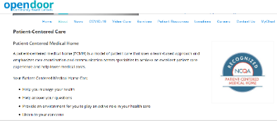
Patient-Centered Medical Home
19

Slide 20
High Performing Primary Care
Bodenheimer T, et. al. Ann Fam Med 2014;166-171. doi:10.1370/afm.1616

Slide 21
High Performing Primary Care

Slide 22
National Cooperative Agreement (NCA) Webinars
https://vimeo.com/635689772/3b16008074
22

Slide 23
Advancing Team-Based Care Webinar
Why are teams important?
What do the data show about impact of teams?
What lessons were learned from studying 30 high-performing practices?
What is the composition of teams?
How do teams enable practices to become high performing?
What are the key functions/competencies of excellent primary care?
Additional webinars on many of the above topics can be accessed using the link below
https://learn.chc1.com/course/view.php?id=6
23

Slide 24
24

Slide 25
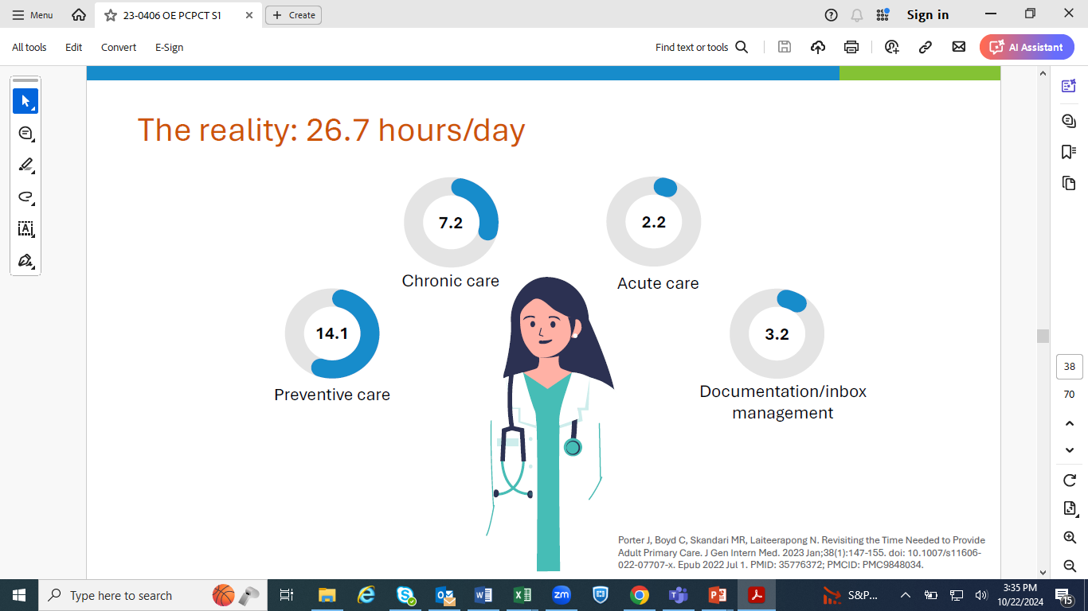
25

Slide 26
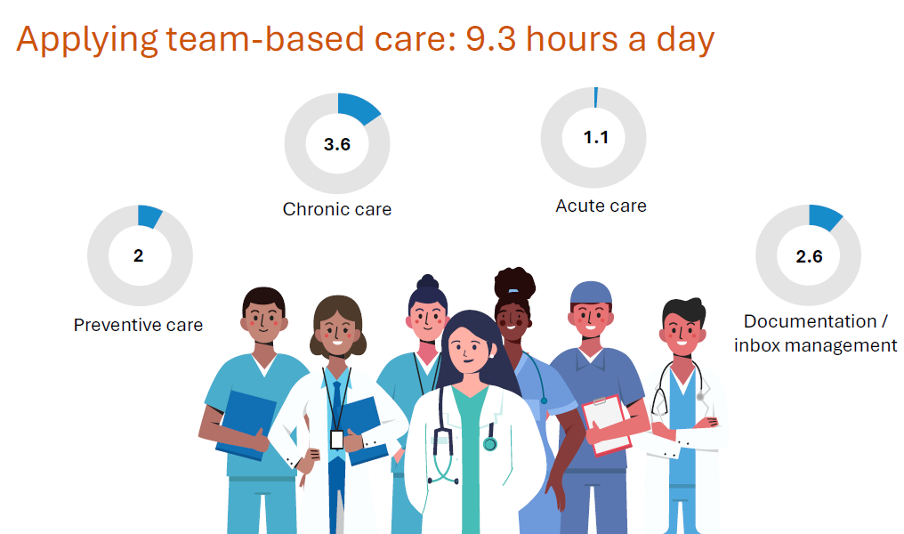
26

Slide 27
27

Slide 28
28

Slide 29
29

Slide 30
30

Slide 31
https://improvingprimarycare.org
31

Slide 32
Poll Questions
Have you experienced team-based care at your health center? (choose one)
Yes, No, Maybe, but not sure
In your clinical work, do you work with any of the following (select any that apply)
Medical Assistant, Nurse, Behavioral Health Provider, Nutritionist, Pharmacist, Social Worker, Other
32

Slide 33
Examples from Sites
We will ask for volunteers to share an example of team-based care you have seen at your site
DePaul
CHC Middletown
Yakima
Montefiore
CHC Hartford
In your response, please include any information you may have regarding:
Who you work with directly when you provide care
Which health professional disciplines are available at your site
We will hear from as many sites as time allows
33

Slide 34
Break!
Take five minutes to recharge and refresh.
34

Slide 35
Session II Assignment
Now we will focus on your assignment for today’s session
We will divide into two breakout rooms
Emma and Mark will facilitate the discussion in each room
When in your group please share about either
A quality improvement priority for your organization
An example of something you noticed and are wondering about in their clinic setting
Each group will ask for a volunteer to report on highlights of the discussion
After the small group discussion, we will return to the large group to hear each reporter’s summary ideas
35
Notes:
www.clinicalmicrosystem.org
35

Slide 36
What haven’t we figured out yet?
Questions or issues that remain unclear?
36

Slide 37
Take-home Thoughts
Mark & Emma – share 1 or 2 ideas you will take away from our small group discussion
37

Slide 38
Summary
You have learned about frameworks to guide your thinking about how to organize improvement work
You have identified some of your organization’s priorities for improvement
You have begun to investigate processes in the clinical environment that you think can be improved with quality improvement interventions
Consider using one of these processes for your team’s QI project
We have discussed the person-centered, team-based approach to primary care and emphasized the great opportunity at health centers to provide integrated care
38

Slide 39
Assignment for Session III
Send a list of who you will be working with and what you will focus on for your QI project to Mark & Emma by 11/8/24
Work with your project team to make a draft of the project charter
Send your draft project charter to us by Wednesday, 11/8/24 at 6pm EST
39
Notes:
www.clinicalmicrosystem.org
39

Slide 41
A PROJECT CHARTER adds structure as you plan
What are we trying to accomplish? & Why?
Will we know if the change made an impact?
A tool for training and/or communication
Baseline data
Goals
Measures
Stakeholders
Barriers
Expectations
Ideas
41

Slide 42
Date charter revised
Problem Statement
Create this statement with team
Team Members
Central Question/ Why work on this now?
Include coach, sponsor and each member (core and extended)
Measures
What is the impact anticipated OR what are the current losses
Scope
Goal Statement
Measurement from PI Goals
Milestones/ Dates
Goals from PI Goals spreadsheet – baseline and follow up.
Date team first meeting and date project charter created
Document first & last process steps.
Deliverables and when they are due
If implementation goal –evidence that it is implemented?
List areas of exclusion for this project
Create this statement with team
Date each PDSA launched, completed.
Project Charter Template

Slide 43
Session III Highlights
We will hear reports from several groups about their draft project charter for their project idea
We will introduce and briefly discuss the templates for creating:
A global aim statement
A fishbone diagram
43
Notes:
www.clinicalmicrosystem.org
43

Slide 44
References
The Primary Care Team Guide (https://improvingprimarycare.org)
Bodenheimer T, Ghorob A, Willard-Grace R, Grumbach K. Ann Fam Med 2014;166-171. doi:10.1370/afm.1616
NCA Implementing Team-Based Care Webinar (https://vimeo.com/635689772/3b16008074)
Batalden PB, Davidoff F. Qual Saf Health Care. 2007; 16:2-3
44
Notes:
www.clinicalmicrosystem.org
44

