Slide 1
Low Back Pain in Primary Care 2024-2025 Residency Cohort
Dan Wilensky, MD
Chief Preceptor

Slide 2
Disclosure
With respect to the following presentation, there has been no relevant (direct or indirect) financial relationship between the faculty listed above or other activity planners and any ineligible company in the past 24 months which would be considered a relevant financial relationship.
The views expressed in this presentation are those of the faculty and may not reflect official policy of Moses/Weitzman Health System and its Weitzman Institute.
We are obligated to disclose any products which are off-label, unlabeled, experimental, and/or under investigation (not FDA approved) and any limitations on the information that are presented, such as data that are preliminary or that represent ongoing research, interim analyses, and/or unsupported opinion.

Slide 3
Learning Objectives
Develop greater comfort with one of the most common complaints that a PCP will manage
Recognize different back pain patterns and get an idea of different pain generators
Understand that the presence or absence leg pain often tells us more than the back pain
Recognize when to consider psychosocial impacts on back pain

Slide 4
First question:
Which is worse, back pain or leg pain?
LEG PAIN

Slide 5
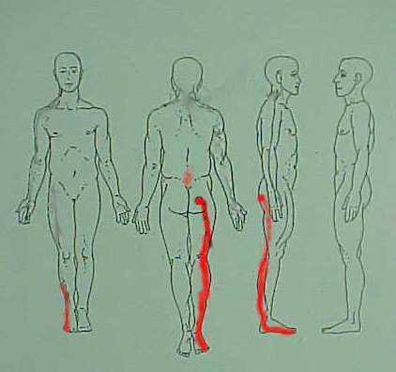
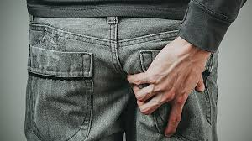

Slide 6
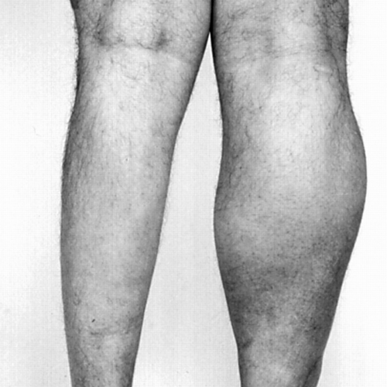
Radiculitis Versus Radiculopathy
Radiculitis
Shooting pain, pins and needles, tingling and numbness down the leg (or arm) in a nerve root distribution without focal neurologic changes.
Not for sure neuropathic, so we will be looking at MSK and visceral referred pain possibilities in our work up
Radiculopathy
Shooting pain, pins and needles, tingling and numbness down the leg (or arm) in a nerve root distribution with focal neurologic changes.
Motor (Atrophy> weakness/fasciculations) > DTR > Sensory]
For sure neuropathic

Slide 7
When leg pain is greater than backpain What could it be?
< 60 crowd
Herniated nucleus pulposus
Spondylolisthesis with foraminal stenosis
>60 crowd
Degenerative Spinal stenosis
Canal
Foraminal
Herniated nucleus pulposus
Other
Pseudoradiculitis
Plexopathy Ex: viral, diabetic, retroperitoneal growth
Non-compressive nerve root disease Ex: diabetic mononeuritis
Entrapment of sciatic nerve Piriformis syndrome and others
Nerve root sheath tumors (Schwannoma, etc)
Vascular disease
Referred pain from back/pelvic tissues

Slide 8
Hickam’s Dictum
Occam’s Razor:
also known as the principle of Maximum Parsimony is interpreted as requiring that the simplest of competing theories be preferred to the more complex or that explanations of unknown phenomena be sought first in terms of known quantities.
Some will misquote this to say that when one disease can explain all of the presention, it must be correct.
Hickam’s Dictum:
after John Hickam (1914-1970), an American physician who quipped that “a patient can have as many diagnoses as he darn well pleases”
https://www.amjmed.com/action/showPdf?pii=S0002-9343%2820%2930801-9
Kelly, “The Diagnostic Approach in Complex Patients: Parsimony or Plenitude? The American Journal of Medicine; Vol 134, No 1, January 2021; pp 11-12
That is: you can have back pain and leg pain.

Slide 9
Initial response at first contact
Clearly identify the pain pattern – use a pain diagram
Screen for red flags that mandate urgent response:
Loss bowel/bladder control/saddle anesthesia
Motor loss >> DTR loss
Severe pain
Fever
Vascular? (loss of distal pulse, pulsatile mass, bruit)
DVT suspicion? (unilateral edema, tender cords, + Homan’s, h/o VTE)
Unexplained constitutional sxs
Active malignancy
Determine if its ‘itis or ‘opathy
or not spinal
Hip, myofascial, shingles, other.
Gestalt
Part of multiple somatic complaints?
Other complaints that might make you move in a different direction
Are opioids the patient’s priority?
Overdose risk?
Workers’ Comp?

Slide 10
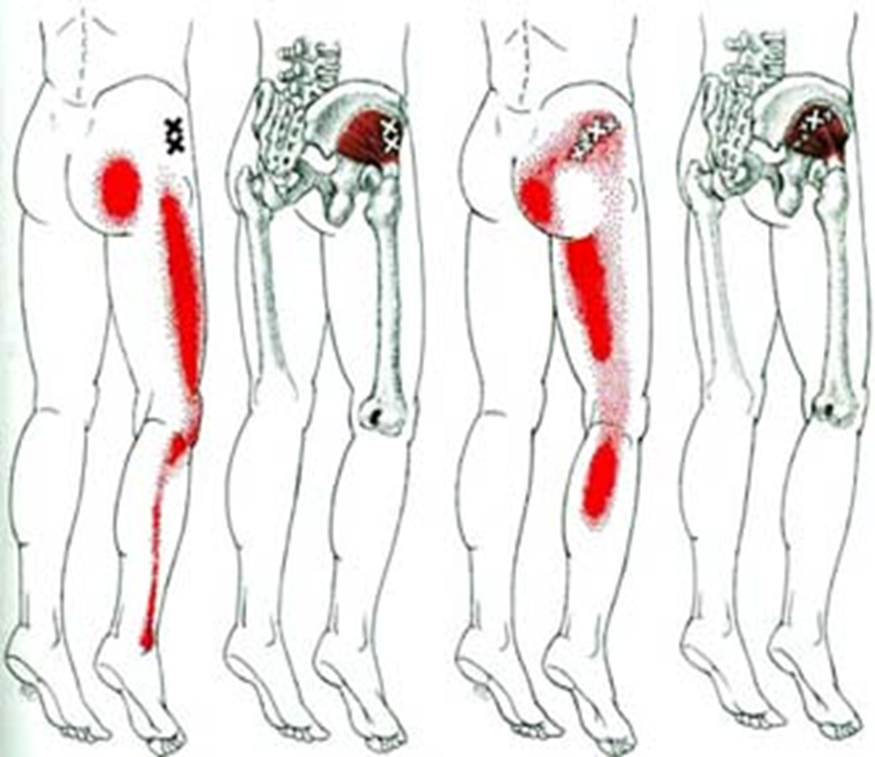
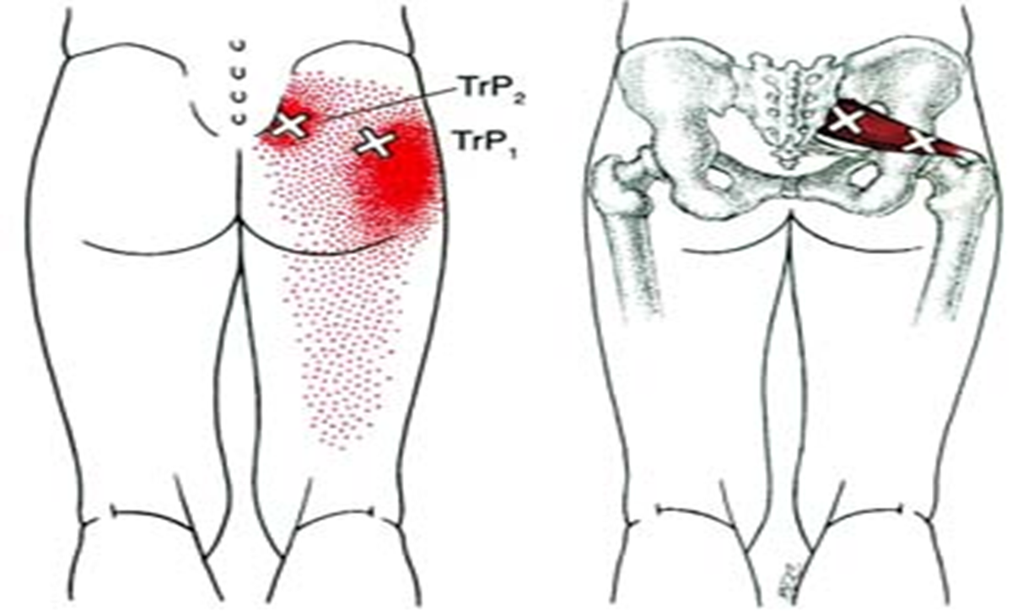
Pseudoradiculitis
Hip joint
Pain usually travels medially down thigh to knee (not below)
Myofascial

Slide 11
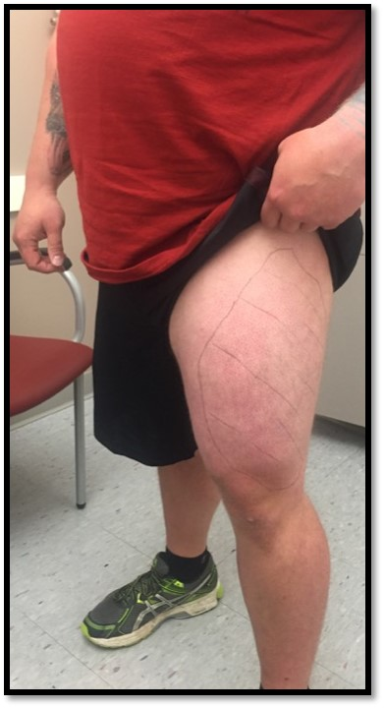
Meralgia Paresthetica No back pain. Sensory only

Slide 12
What does a + SLR (Straight Leg Raise) test mean
Inflammation/compression of nerve: Usually nerve root, occasionally other nerve structure like plexus, sciatic nerve
Suggests anti-inflammatory (oral or epidural) may well help a lot

Slide 13
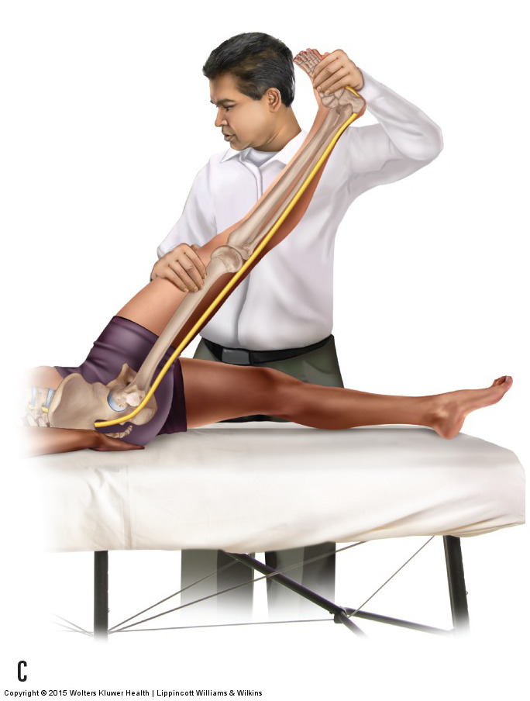
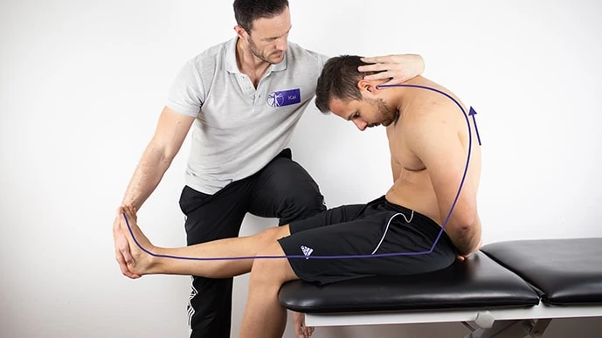
SLR
Slump

Slide 14
Not Every Provider’s SLR is equal
My view of a true positive SLR. Defining it differently will increase the sensitivity at the expense of specificity
Passively lifting the leg above 30 degrees causes neuritic, radicular pain
Lower leg until the moment that the patient tells me that the neuritic leg pain went away (or eased).
Dorsiflex the foot and the symptoms return
Anything less than that I would describe as ‘equivocal’ and describe the findings in my exam
Contralateral + SLR is even more specific
A neg sitting SLR with a + supine SLR is a positive Wadell’s sign
https://www.ncbi.nlm.nih.gov/books/NBK519492/

Slide 15
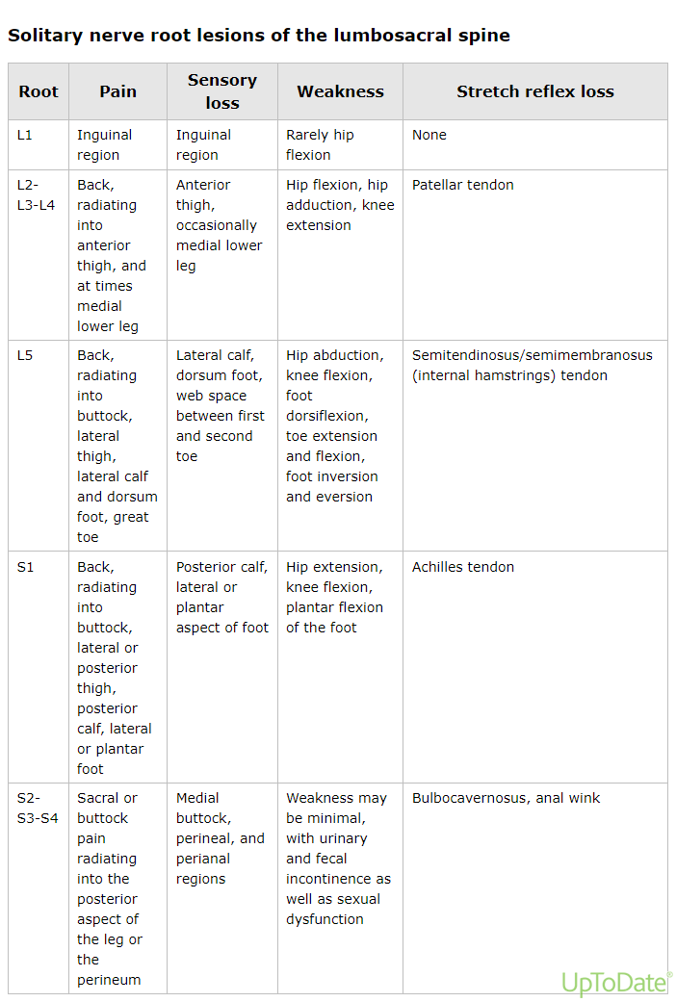
A nerve-root focused H&P
Can they get up from chair without arms?
Do the knees buckle?
Foot drop?/dragging toe?

Slide 17
Brief Intervention Radiculitis and mild Radiculopathy
Consider oral steroids (8-10 day taper, 40-60mg start) especially when there is + SLR
Consider gabapentin, pregabalin, TCA; at least at bedtime to help sleep
Muscle relaxant if there is a component of paraspinous spasm
Consider opioids (short course), at least at bedtime when pain interferes w/ sleep.

Slide 18
Brief Intervention Radiculitis and mild Radiculopathy
Physical therapy referral for their diagnostic eval, report on pt engagement, and care
Consider engaging massage, acupuncture, chiropractor for sx control
Plan for the worst, hope for the best: next step(s) if the pain persist? (using feedback from PT, if feasible)

Slide 19
At 1-6 week follow-up
Improving
consider continuing physical therapy and also consider adding modalities such as acupuncture, massage, and chiropractic if not already doing
Not improving: Image or refer
Study of choice: MRI without contrast lumbar spine
Spinal surgeons: Ortho or Neurosurg
Spine pain centers: injection therapy?

Slide 20
Imaging: ins and outs
Decide what you’re looking for first
If clinically you suspect a Right L4-5 compression, don’t send to Neurosurgery for a Left L2-3
If there’s a suspicion of tumor, use contrast
If a standing MRI is available, it will give you a better functional view
Even if you want to refer, the specialist may require you to get an MR first
Xrays aren’t very helpful, but…
Insurance doesn’t fight the order
Sometimes you need to start with an x-ray to get an MR approved

Slide 21
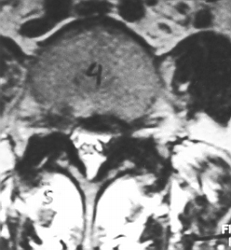
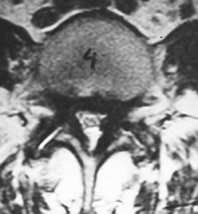
Why is pain in the legs present with standing and walking?
Supine, standard technique
Axial loaded

Slide 22
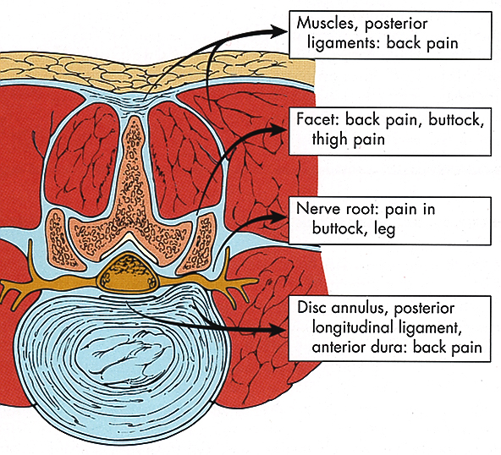
Disc Herniation

Slide 23
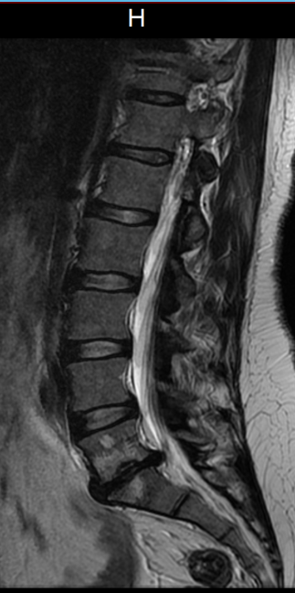
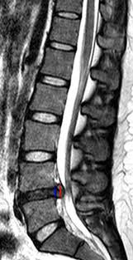
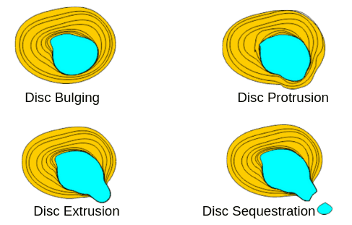
Disc extrusion
Disc protrusion

Slide 24
Treatment Algorithm for Radiculitis from HNP
Leg pain > back pain, no significant neurological compromise
debilitating
Oral steroids
Physical therapy modalities
Analgesics/TCA/Gabapentin
Imaging
no better
Epidural steroid¹
Percutaneous disc decompression
Diskectomy

Slide 25
Spinal Stenosis
NOT a cause of back pain
But the arthritis that causes it can cause back pain
The clinical presentation is neurogenic claudication
Classical presentation:
Bilateral thigh and or lower extremity pain for canal stenosis
Unilateral dermatomal radicular pain for foraminal stenosis
Variant presentation:
Buttock pain only with standing and walking

Slide 26
Claudication: Neuro vs. Vascular?
Neurogenic: It’s the weight and the position that cause the leg symptoms
Vascular: It’s the increased demand for blood flow from working muscles that causes them
Walking in the mall?
If you have to stop to rest, vascular
If you have to sit to recover, spinal stenosis
Shopping?
“I can walk forever when I lean over my shopping cart”…….spinal stenosis

Slide 27
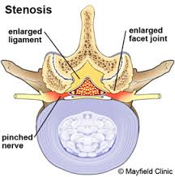
(FORAMINAL STENOSIS)
BACK PAIN
LEG PAIN
CANAL STENOSIS

Slide 28
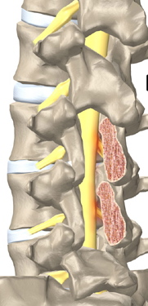
Decompression laminectomy for spinal stenosis, without fusion

Slide 29
Back pain > Leg pain

Slide 30
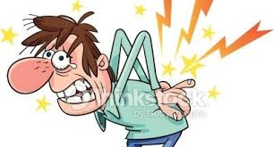
Oh my aching back!
2nd most common reason for PCP visit, 3rd most surgical procedures, 5th hospitalizations
Pai S Low back pain: an economic assessment in the united states. Orthop Clin N Am. 2004;35:1-5.
3rd largest portion of national health spending
Dieleman JL. US spending on personal health care and public health, 1996-2013 JAMA. 2016;316(24):2627-2646.
$240-480,000,000,000 annual cost to the U.S.
Dutmer A. Personal and Societal Impact of Low Back Pain SPINE. 2019;44(24)

Slide 31
Three facts that should help frame our approach
Low back pain is recurrent in 33-70% of patients
1/3 of primary care patients who presented with acute back pain reported back pain on at least 50% of the days of the year at 1 and 2 year follow-up
Expectations fail to reflect this: Patients want a cure, medical providers pursue curative treatment, yet many times there is none
Von Korf, Spine 1996 21(24):2833-37 /// Haestbaek L European Spine Journal 2003 Apr;12(2):149-65
Psychosocial issues often contribute to, and many times are the main cause of disability
Only psychosocial factors predict chronicity. Poor coping skills: 3-fold increase
Carragee EJ Spine 2005 May 15;29(10):1112-7 /// Niemisto L J Rehab Med 2004 May; 36(3):104-9
Physical therapists are a vastly underutilized yet readily available resource

Slide 32
Zebras: You only see what you look for and you only look for what you know
Tumor (of bone or viscera)
Infection
Fracture
Any process resulting in severe compromise of nervous tissue
Systemic illnesses affecting joints
Leaking abdominal aortic aneurysm

Slide 33
When might those hoofbeats not be from horses?
History of prostate, lung, renal, thyroid, breast cancer?
i.e. cancers that metastasize to bone
Pain worse at night?
Fever?
Recent trauma?
New focal weakness, numbness, or loss of bowel or bladder control?
Pain in other joints? True morning stiffness?
Findings on physical/labs/imaging that point toward any of the previously mentioned concerns

Slide 34
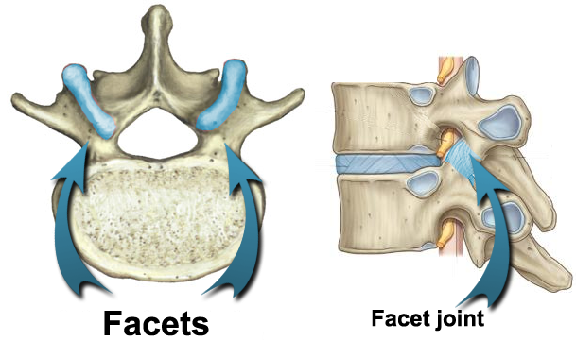
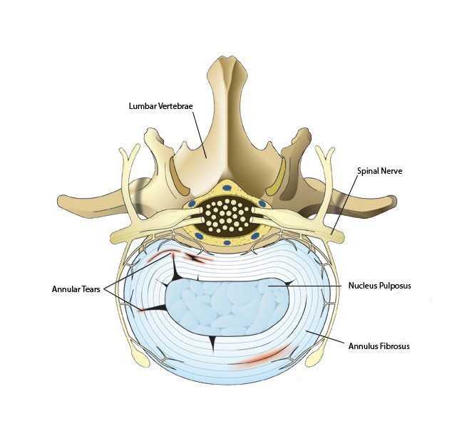
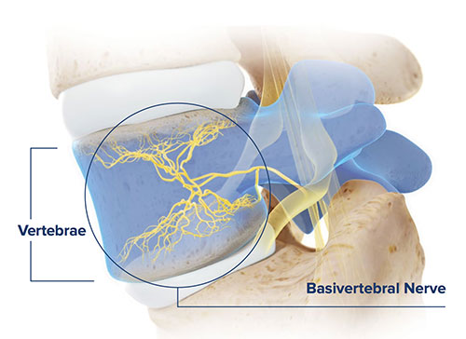
Some Pain Generators

Slide 35
General Principles
A specific anatomic diagnosis is usually not necessary, perhaps impossible
Diagnostic efforts are directed at identifying those who have diagnoses that require urgent referral (red flags are present)
Use both pain and function as your measure of disease severity and as endpoints for therapy.
Patients with significant functional impairment need to be flagged for more aggressive symptom palliation as well as BH eval

Slide 36
IMAGING FOR ACUTE BACK PAIN
“Because acute low back pain typically does not have a serious etiology, and because most cases resolve with conservative treatment, immediate imaging is rarely indicated. All major guidelines on the treatment of acute low back pain have similar recommendations regarding imaging. In the absence of red flag findings, four to six weeks of conservative care is safe and appropriate, and imaging is not indicated. “
Evaluation and Treatment of Acute Low Back Pain Am Fam Physician 2007 Apr 15;75(8):1181-1188

Slide 37
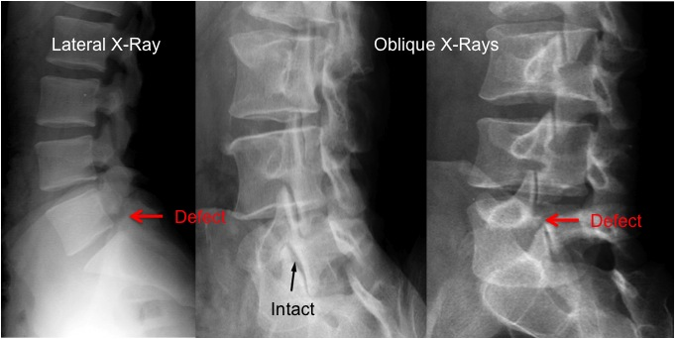
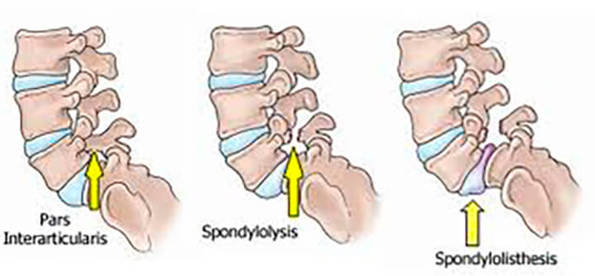
Spondylolysis: an imaging exception
A stress fracture through the pars interarticularis of the lumbar vertebrae.
Prevalence 6% by age 14, males>females
Repetitive trauma to the growing spine in genetically susceptible people
repeated activities involving lumbar hyperextension with rotation
gymnastics, dance, football (particularly linemen), rugby, wrestling, martial arts, soccer, basketball, cheerleading, pitching, golf, tennis, volleyball servers, weightlifting, and butterfly and breaststroke swimming
Stork Standing test: https://www.youtube.com/watch?v=9AeHMONQpeA
https://www.ncbi.nlm.nih.gov/books/NBK513333/

Slide 39
Principles of treatment
Making the right referrals at the right time
Physical therapy/Chiropractic/OMT/Physiatry/Back program
Behavioral Health
Stress Reduction program/Pain Psychology/?Trauma-informed
Registered Dietician
Integrative Med?
Accupuncture, “Body worker,” Myofascial, Craniosacral
Going to be more based on what’s acceptable
Therapeutic exercise
Swimming or other aquatic, Tai Chi, Yoga, Pilates, Back classes
Sherman, A randomized trial comparing yoga, stretching and a self-care book for chronic low back pain. Arch Intern Med 2011 Dec 12/26;171:2019

Slide 40
Evaluate Function
BPI, Roland-Morris, WHODAS, patient specific questions
Minimal impairment
Significant impairment
Evaluate psychosocial risk factors
McGill, Mental health hx, ACE, etc.
Minimal
Significant
Treatment Failure
(Don’t delay)
Health psychology evaluation
Integrated behavior-medical tx planning
Medical evaluation and treat

Slide 41
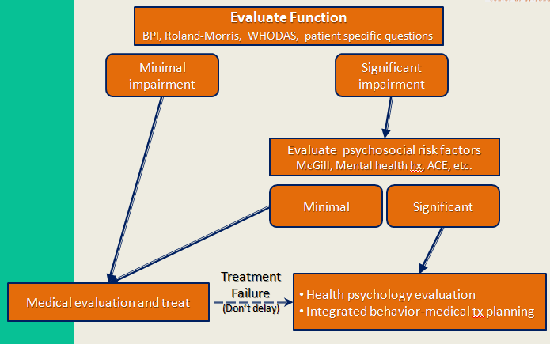
Significant psychosocial factors on screening: now what?
Aggressive tx depression, anxiety, and trauma
CBT
Coordinate these with attempts at physical rehab, pain relieving treatments, and invasive procedures, in an ideal world: don’t start PT until behavioral health team says “patient is ready”
Back off on non-essential specialty evaluations that focus on tissue pathology

Slide 42
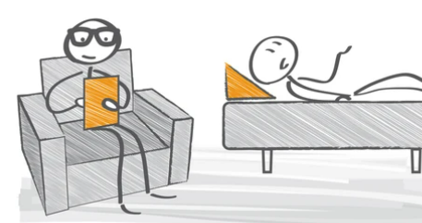
Address any BH, especially trauma while addressing Medical dx if any Means there has to be collaboration between BH and medical providers, it means breaking down the silos

Slide 43
BH Communication

Slide 44
Physical Therapy Communication
What do you suspect is the medical diagnosis causing pain (please include “pain for psychological reasons” if that is a possibility)?
What do you think the patient’s prognosis is for achieving their goals with PT, and if it is good – how long should we tell the patient it is likely to take to reach those goals?
☐ Great! - How long should the patient give it? _______________________
☐ Fair/guarded - How long should the patient give it?__________________
☐ Not good, because: _____________________________________________
3. Do you need the PCP to refer for any pain relieving procedures to help reduce pain to facilitate the rehabilitation program that you are managing?
☐ Not at this time
☐ Yes, not sure what exactly…consider a referral to ____________________
☐ Yes, would you consider :_______________________________________
4. Is the patient engaging in the home exercise? If not, do you have an idea of why not?

Slide 45
Exercise for back pain
Graded activity program improves absenteeism. Exercise improves pain/function
Hayden J, “Exercise therapy for the treatment of non-specific low back pain” Annals of Internal Medicine 2005 May 3;142(9):776-85
Strengthening + (stretching or aerobic) 2-3x/week reduced chronicity and disability
Shiri R, Exercise protects against low back pain: systematic review and meta-analysis of controlled trials British J Sports Med 2017; 74(1)
Other benefits: Life expectancy increases as aerobic fitness improves with no upper limit of benefit at any age
Mandsager, Association of cardiorespiratory fitness with long-term mortality among adults undergoing exercise treadmill testing. JAMA Netw Open 2018 Oct 19; 1:e183605

Slide 46
Acupuncture
Acupuncture has a clinically relevant (good) effect on chronic pain that persists over time
The effect of acupuncture cannot be explained by placebo effects alone
Referral for acupuncture is a reasonable and evidence-based option for chronic pain patients
Vickers, A et al. Acupuncture for Chronic Pain: Update of an Individual Patient Data Meta-Analysis. The Journal of pain. 2018; 19(5): 455-474

Slide 47
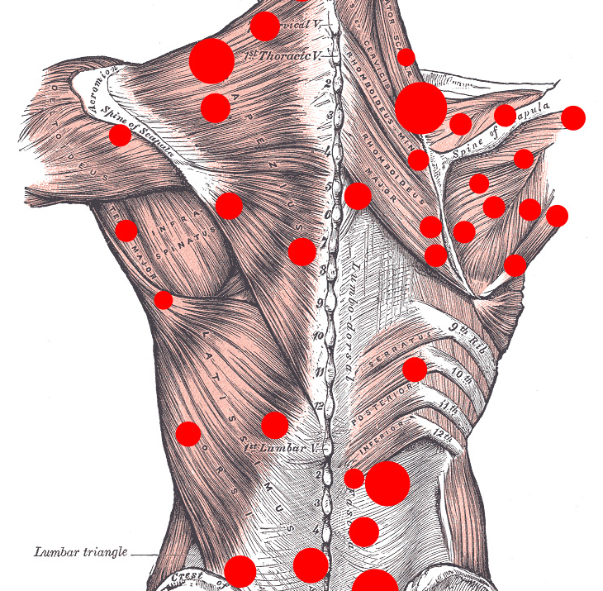

Slide 48
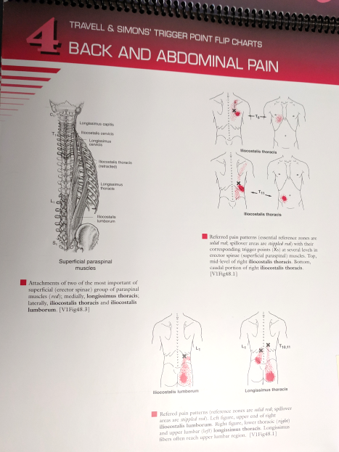
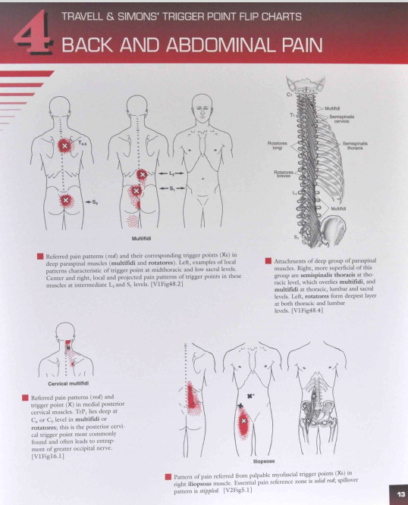
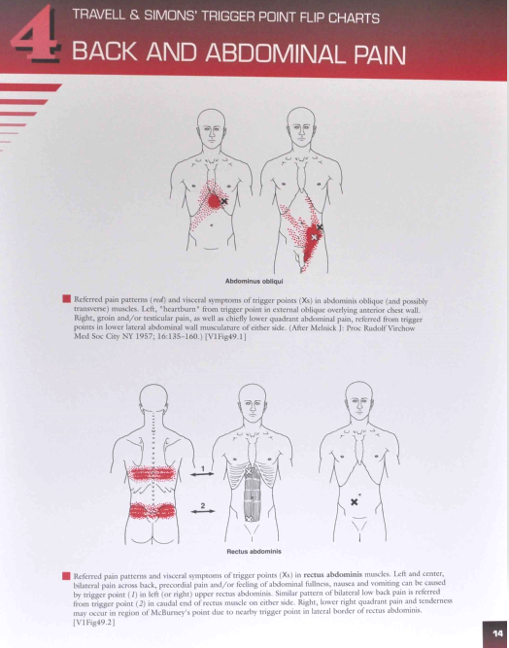
Myofascial trigger points

Slide 49
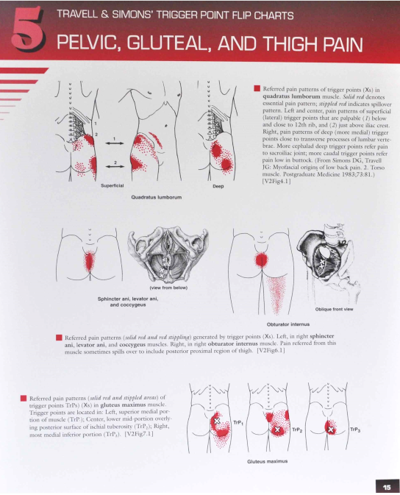
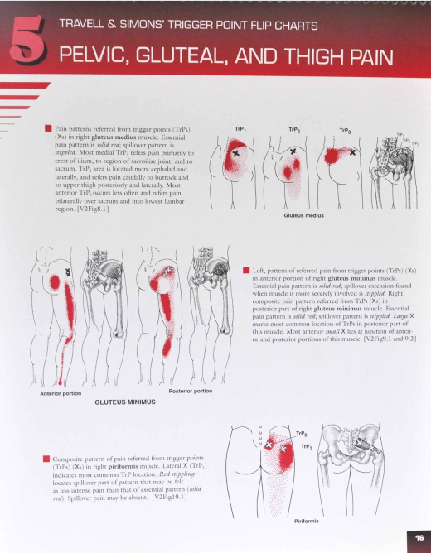
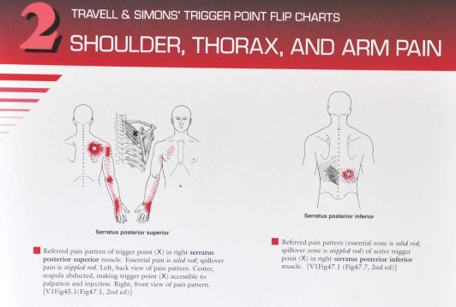

Slide 50
Spinal manipulation for chronic LBP
There is moderate-quality evidence that manipulation and mobilization are likely to reduce pain and improve function for patients with chronic low back pain; manipulation appears to produce a larger effect than mobilization. Both therapies appear safe. Multimodal programs may be a promising option.

Slide 51
Pharmacotherapy
To reduce pain and support physical rehab
Just one of many possibilities for this
Evidence for effectiveness of long term treatment of low back pain with medications is non-existent

Slide 52
Pharmacotherapy: Opioids
Effective in reducing pain and disability, without significant side effects or addiction issues - sometimes.
End point for titration must be related to function.
Is this visit a Suboxone induction dying to get out?

Slide 53
Opioids for back pain > 8 wks
In general, people that received opioids self- reported more CLBP pain relief and less difficulty performing their daily activities in the short-term than those who received a placebo. However, there is little objective data about the benefits of opioids for back pain based on semi-objective measures of physical functioning.
We have no information from randomized controlled trials supporting the efficacy and safety of opioids used for more than four months.
This review supports the effectiveness of several opioids for CLBP relief and function in the short-term, in well selected patients. (15 studies)

Slide 54
Pharmacotherapy: NSAIDs
Review of 50 RCTs:
Available evidence supports their use in acute and chronic back pain
But don’t underestimate the risks of chronic NSAIDS

Slide 55
Pharmacotherapy: Muscle relaxants
Review of 50 RCTs:
NO QUALITY EVIDENCE supports their use in chronic back pain
Special caution: Carisoprodol

Slide 56
Pharmacotherapy: Topical lidocaine
They might lower the need for opioids
At least they’re safe
Even if you use up to 3 patches and leave them on all day
I like to ask myself: “is the pain generator close to the surface of the skin?”
Formulary trouble is common
Can use off label lidocaine gel if the patch is not covered
No choices are cheap on 340B

Slide 57
Pharmacotherapy: Antidepressants
“There is no clear evidence that antidepressants are more effective than placebo in the management of patients with chronic low-back pain. ”
Tricyclic antidepressants
Effective analgesics when radicular symptoms are present (effective for “neuropathic pain”)
Effective for improving sleep in chronic back pain with or without radiculopathy
SSRIs
No analgesic effect

Slide 58
Pharmacotherapy: Duloxetine
Has some evidence of efficacy and carries approval by the US Food and Drug Administration for this
In a 2021 meta-analysis including four randomized trials and over 1400 patients with chronic low back pain,
It was more effective than placebo in reducing pain and disability at three months.
The analgesic effects of duloxetine are independent of depression.

Slide 59
Smoking cessation
5,333 smokers who presented for LBP treatment followed over 8 months
Compared with patients who had continued to smoke, those who had quit smoking during the course of care reported significantly greater improvement in pain in visual analog scale pain ratings.
Those who did not quit had no improvement

Slide 60
Weight loss as back pain treatment
There is an association between obesity and low back pain, but…
Causation has not been established, for example:
Low back pain may cause obesity, not the other way round
Obesity and low back pain may be markers for lack of adequate exercise and inflammation, both caused by lack of exercise and poor nutrition
Observation that patients who lose weight have less back pain may reflect the increase in exercise and better diet, not weight loss per se

Slide 61
“Sending to Pain”
Unless you can send your patient to Arizona, you are unlikely to find a resource that will get the patient the multi-disciplined approach your patient needs
Integrated w/ manual medicine, behavioral medicine, a team of different disciplines, willingness to manage meds, capable of advancing a diagnosis, willing to initiate, coordinate, and f/u on care when procedures are necessary.
Use your FQHC BH resources to create the backbone of pain management, particularly when psychosocial issues define or worsen the situation
“Pain Management” came to mean the guy in town who wrote the most opioids
Now none of them see Medicaid patients
Some have lost their licenses to prescribe
Plan to manage the meds yourself
Get to know your local/regional resources and utilize those who seem to help your patients the most.
Ask those who’ve been in your facilities longer
Ask the Physical Therapists

Slide 62
What might they try? Procedural possibilities for persistent problems
Epidural steroid injections
SI joint injections
Facet joint injection and then denervation
Median branch blocks
Disc replacement/fusion

Slide 63
