Slide 1

STRATEGIC
FOCUSED
Quality Improvement Seminar
Mark Splaine & Emma Warshauer
December 12, 2024
RELEVANT
INTERACTIVE
TEAM WORK
INFORMATIVE
FUN
SKILL BUILDING
Nurse Practitioner & Physician Assistant
Training Programs

Slide 2
Session Goals
Hear about and discuss your efforts to draft a global aim statement from your project idea
Draft a problem statement related to a global aim example
Brainstorm ideas to begin populating a fishbone diagram
2

Slide 3
Roles
Theory burst presenter
  Mark
Facilitator, timekeeper & technical genius
  Emma
Take-home thoughts
  Emma and others
3

Slide 4
Agenda
Welcome (10 minutes)
Theory burst (5 minutes)
  Global aim tips
Global aim examples (25 minutes)
Break
Theory burst (5 minutes)
  Fishbone diagrams
Fishbone example & discussion (30 minutes)
Summary and take-home points (5 mins)
Preview of next session (5 minutes)
4

Slide 5
Curriculum Plan
  An overview of Quality Improvement (10/10/24)
  Care Observations & Stakeholder Considerations (10/24/24)
  Organizing your Improvement Project (11/14/24)
  Global Aim and Fishbone Diagram (12/12/24)
  Process Mapping (Flowcharts) (1/9/25)
  Measurement to Inform Change (1/23/25 & 1/30/25)
  An Approach to Testing a Change (2/13/25)
  Communication about your Improvement Effort (2/27/25)
  Stakeholder Analysis & Conflict Management (3/13/25)
  Managing Up and Gaining Leadership Buy-In (3/27/25)
  Negotiation (4/10/25)
  Negotiation and More About Cycles of Change (4/24/25)
  Sustaining your Improvement Effort (5/8/25)
  Resident Presentations (5/22/25, 6/12/25, 6/26/25)

Slide 6
Global Aim Statements (Tips)
Some things to consider (from NICHQ):
  The concrete goals you want to achieve
  Who will benefit from this improvement? Whose interests are served?
  What will be done? Is it supported by evidence or experience?
  Where will the change occur?
  When will it start and stop?
  What are the boundaries of the processes? What is in, what is out?
6
https://www.nichq.org/insight/qi-tips-formula-developing-great-aim-statement

Slide 7
Global Aim Assignment
Decide on the topic for the project you would like to develop at your site (agree together as a group on this)
Session preparation:
  Review templates
  Watch the two videos on brainstorming
Work with your site colleagues to generate a draft of a global aim statement for your project topic
If you have time, draft a problem statement and begin filling in your fishbone diagram
7
Notes:
www.clinicalmicrosystem.org
7

Slide 8

Reports on Assignment
  We will hear from three teams:
    CHC Hartford (Sarah & Fiona)
    CHC Meriden (Hillary & Martha)
    Yakima NHS (Salvador & Thomas)
  Share your global aim draft as well as anything your group learned when considering project ideas

Slide 9

CHC Hartford Project Charter
11/2024
Problem Statement
Parents experience many obstacles when it comes to their breastfeeding journeys, often leading to early discontinuation.
Team Members
Central Question/ Why work on this now?
Fiona Hart, CPNP-PC & Sarah Mitchell CPNP-PC
Measures
Babies are losing the benefits of breastfeeding and breastmilk.
Scope
Goal Statement
Survey questions aimed towards finding out if parents are still nursing and if not, why and when did they stop?
Milestones/ Dates
Data and survey answers will help us to get an idea of where our patients are switching to formula so we can see where and when extra support may be needed
11/13 – Date of first meeting
First step: Choose project topic – Discuss with different providers ideas they may have for QI projects
Deliverables and when they are due
If implementation goal –evidence that it is implemented?
Many parents are lacking support and discontinuing breastfeeding before they want to.
Date each PDSA launched, completed.
Last step: Provide education to providers regarding where parent knowledge may be lacking and what interventions may be most helpful
Notes:
Tierney and Sarafina

Slide 10
Hartford Global Aim
We aim to improve
Rates of continued breastfeeding in mothers of newborns
In
The process begins with
Hartford – Connecticut Children’s at CHC
The process ends with
Working on this now we expect
Pinpointing the main barriers the mother’s of patients in Hartford come across and providing education/resources
It is important to work on this now because
Increase the support services for mothers in our clinic
In a low income area breastmilk is the healthiest source of nutrition for baby and also free, it just takes a lot of work, so we want to find ways to provide moms with the assistance they need so their funds can go to other needs
Asking fellow providers what barriers they often hear about from patients
Increase rates of breastfed babies in clinic
Decrease rate of issues patients come across with WIC and formula needs
Crafting a survey to use with new mothers

Slide 11
CHC Meriden Project Charter
11/2024
Problem Statement
Lack of consistent process to manage the mediation management and administration of sublocade injections
Team Members
Central Question/ Why work on this now?
Hillary Miller, Martha Darnall, medical providers, pharmacy staff, nursing team
Measures
Increase in need for streamlined ordering and administration processes for sublocade injection
Scope
Goal Statement
How many new patients at the Meriden site are able to be prescribed and maintained on sublocade?
Milestones/ Dates
Define the process to both order and administer sublocade to increase the number of patients able to receive sublocade injections at Meriden CHC
First Team Meeting-TBD Late November 2024
Meriden CHC Sublocade Management Process-starting January/February 2025
Pharmacy changes and ECW prescription updates have made it difficult for streamlined access for providers to both prescribe and administer sublocade
Standardized prescriber ordering processes to allow for streamlined connection with pharmacy team and support staff to allow for increased access to sublocade for patients
Starting at patient eligible for sublocade and ending with provider being able to have sublocade ordered and patient being able to receive sublocade
Notes:
Tierney and Sarafina

Slide 12
Meriden Global Aim
We aim to improve
Sublocade ordering and management practices
In
The process begins with
Meriden CHC Location
The process ends with
Working on this now we expect
To have a more increased flow and work flow for sublocade prescribing and availability of the sublocade injection for administration to patients
It is important to work on this now because
Reduce the number of difficulties/barriers associated with prescribing sublocade. Increase the number of sublocade prescriptions for eligible patients at CHC Meriden
Reducing rates of substance use (Ling et al., 2019) and overdose related to opioid use. Reduction in barriers to receive sublocade has the potential to increase rates of abstinence from non-prescribed opioid use (Poliwoda et al., 2022).
Meetings with stakeholders and staff to determine the current barriers and processes to figure out best ways for improvement and future sustainability of the new process
Notes:
Reference
Ling, W., Shoptaw, S., & Goodman-Meza, D. (2019). Depot Buprenorphine Injection In The Management Of Opioid Use Disorder: From Development To Implementation. Substance abuse and rehabilitation, 10, 69–78. https://doi.org/10.2147/SAR.S155843
Poliwoda, S., Noor, N., Jenkins, J. S., Stark, C. W., Steib, M., Hasoon, J., Varrassi, G., Urits, I., Viswanath, O., Kaye, A. M., & Kaye, A. D. (2022). Buprenorphine and its formulations: a comprehensive review. Health psychology research, 10(3), 37517. https://doi.org/10.52965/001c.37517

Slide 13
Yakima NHS Project Charter
Nov 2024
Problem Statement
Team Members
Central Question/ Why work on this now?
Medical director, pharmacy, NP residents
Measures
Scope
Goal Statement
Measurement from PI Goals
Milestones/ Dates
Does the proportion meet the clinical quality target for HTN by the end of the year?
First team meeting 10/31, Meet with QI team 11/7, meet with pharmacy dept by 12/1
Document first & last process steps.
Deliverables and when they are due- TBD
List areas of exclusion for this project
Increased numbers of patients at target blood pressure
Date each PDSA launched, completed.-TBD
The goal at YNHS is to achieve blood pressure control of under 140/90 mmHg. Despite having protocols in place for a second blood pressure check, the target blood pressure is still not met for a certain number of patients by the end of the year. This indicates gaps in blood pressure management, which may include issues related to education and procedures.
Higher quality performance indicators for the clinic
Improved health outcomes associated to blood pressure control
If implementation goal –evidence that it is implemented? Proportion of patients that meet the target blood pressure of less than 140/90 by the end of the year.
Notes:
Tierney and Sarafina

Slide 14
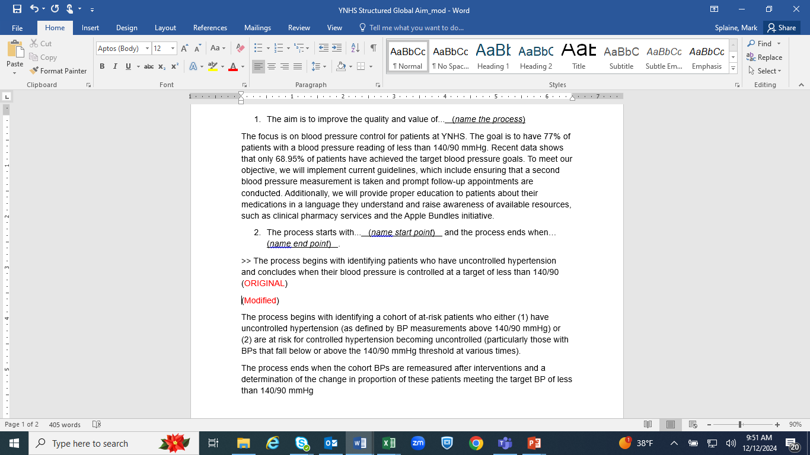
Yakima NHS

Slide 15



Break!
Take five minutes to recharge and refresh.
15

Slide 16
Poll Questions
Check-in on global aim
Experience with fishbone diagrams
Thanks for sharing your information!

Slide 17
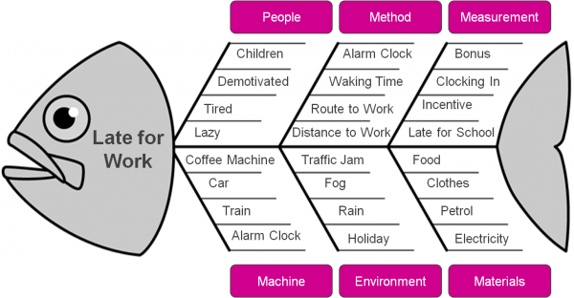
Fishbone Diagram or
Cause & Effect Diagram
A tool to help a team work together using a structured approach to brainstorming a list of causes of a problem
The head of the fish is the problem:
Late for work
The bones are causes grouped by category.

Slide 18
Steps to Follow
Team must agree on the problem statement related to the global aim first
Decide on which general categories you will use. Typical ones include:
  Equipment/supplies
  Technology
  Staff
  Processes/procedure
  Environment
  Patients
Begin brainstorming contributing causes (within a category or as a whole)
Focus on current state!! No solutions yet!
Don’t worry about messiness

Slide 19
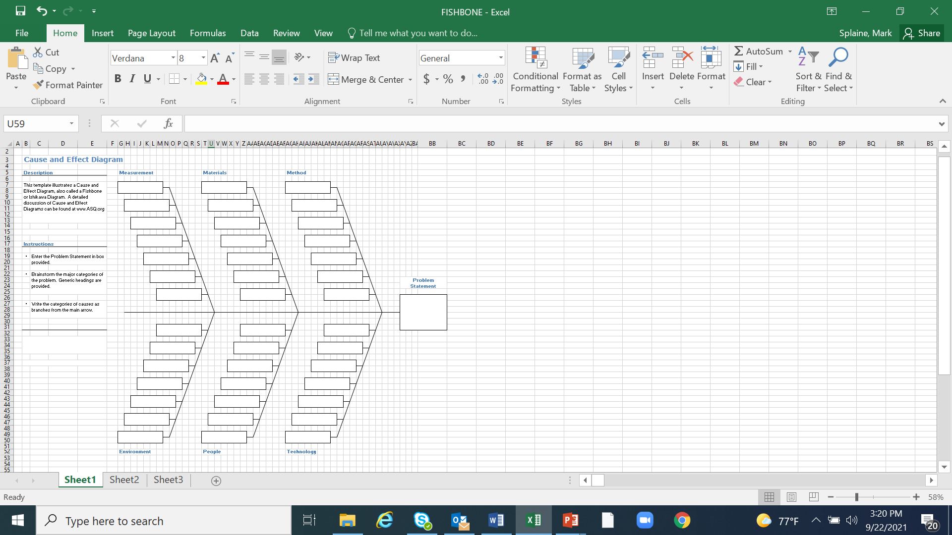
Template

Slide 20
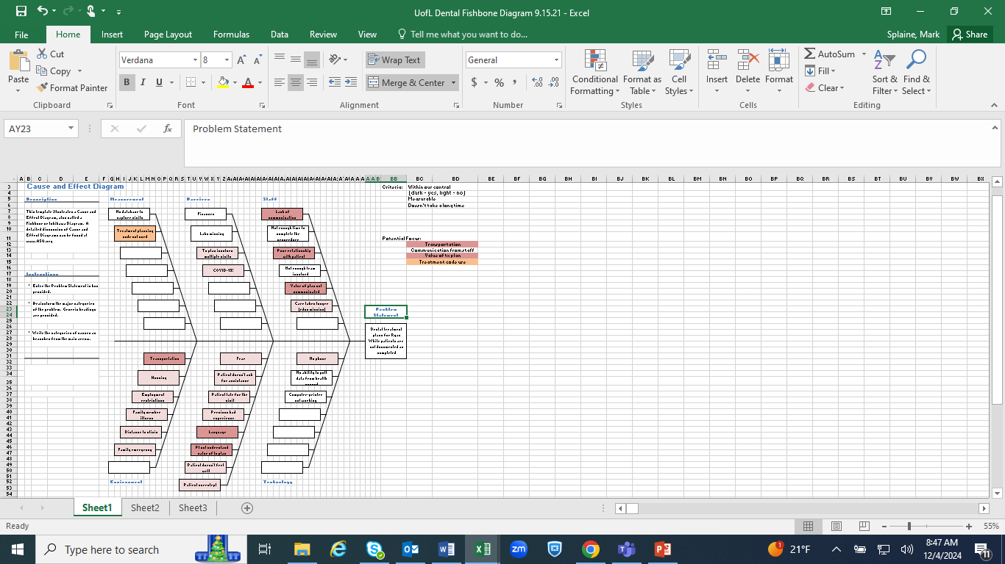
Completed Template

Slide 21
Yakima Example

Slide 22
Work on a Fishbone
We will as a large group on completing the fishbone template for one team’s project
For this activity, we will do the following:
  Identify a team (we need a volunteer)
  Select a problem statement based on the team’s aim statement (goal)
  Brainstorm contributing causes and place the ideas in the template
22

Slide 23
Take-home Thoughts
Emma and others – share 1 or 2 ideas you will take away from our discussion
23

Slide 24
What haven’t we figured out yet?
Questions or issues that remain unclear?
24

Slide 25
Summary
You have learned about a framework to guide your thinking about how to organize improvement work
Also, we have reviewed some important tools for quality improvement work – global aim and fishbone diagram
Based on your submissions, it is clear you are already formulating some very good ideas for your projects.
Our next step will be to better understand the process related to your project topic.
25

Slide 26
Upcoming Office Hours & Teams
The next office hours will be on 1/2 and 2/6 all from 11:00am-12:00pm EST.
We would like to meet with each project team once during December or January. Please let us know when your team would like to confer.
Email us if none of the times work for your team and you would like to meet at another time.
This discussion will be for us to learn a bit more about your project plan and to think together how we can assist you in your work.
26
Notes:
www.clinicalmicrosystem.org
26

Slide 27
Session V Highlights
We will discuss tips and strategies for using flowcharts to enhance your understanding of an improvement effort
We will break into small groups to discuss draft examples of flowchart related to your projects
27
Notes:
www.clinicalmicrosystem.org
27

Slide 28
Assignment for Session V
Revise your global aim statement, if needed, based on today’s discussion or additional ideas you have about your project
Next, review your initial fishbone diagram draft, and brainstorm as a group about additional factors that contribute to your problem statement
Session preparation (background on flowcharting):
  Watch the two videos on flowcharting
  Read the document on flowcharting
Work with your site colleagues to generate a draft of the actual process for your project topic
If you have time, review your ideas about the process with others involved in the process for their feedback
Contact Emma or Mark if you have questions or need assistance
Send a summary of your draft process by Tuesday (1/7/25)
Our next session will be on Thursday, 1/9/25
28
Notes:
www.clinicalmicrosystem.org
28

Slide 29
Resources to Review
The two video links provided below will give you a brief but helpful introduction to developing a process map (flowchart)
  https://www.youtube.com/watch?v=GoEP4dTAmAQ (simple overview, roughly 4 minutes)
  https://www.youtube.com/watch?v=JENOhSXzi2U (more detailed info, roughly 8 minutes)
We will send you an additional reading to provide more detailed insights about flowcharting
29
Notes:
www.clinicalmicrosystem.org
29

Slide 30
Additional Template
Process Map / Flowchart
30

Slide 31
References
Science of Improvement: Setting Aims. Institute for Healthcare Improvement Website. (http://www.ihi.org/resources/Pages/HowtoImprove/ScienceofImprovementSettingAims.aspx)
Global Aim Statement Document. Society of Teachers of Family Medicine Resource Library Website. (https://resourcelibrary.stfm.org/HigherLogic/System/DownloadDocumentFile.ashx?DocumentFileKey=27fc6113-ab04-4100-966c-8d2349b4494c&forceDialog=1)
QI Tips: A Formula for Developing a Great Aim Statement. National Institute for Children’s Health Quality Website. (https://www.nichq.org/insight/qi-tips-formula-developing-great-aim-statement)
American Society for Quality Website. (https://asq.org/quality-resources/fishbone)
31
Notes:
www.clinicalmicrosystem.org
31

