Slide 1

Postgraduate NP and/or PA Training Programs Learning Collaborative
Session Four: Tuesday January 21st, 2025
Notes:
Meaghan

Slide 2
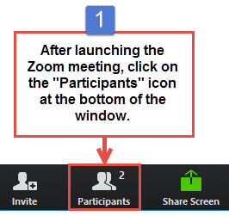
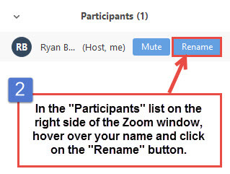
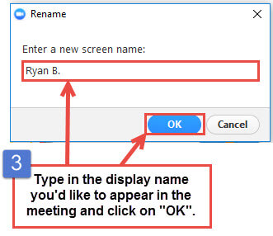
Get the Most Out of Your Zoom Experience
Please keep yourself on MUTE to avoid background/distracting sounds
Use the CHAT function or UNMUTE to ask questions or make comments
Please change your participant name to your full name and organization
“Meaghan Angers CHCI”
Notes:
Meaghan

Slide 3
Session 4 Agenda
1:00-1:05pm Introduction
1:05-1:35pm Preceptors, Mentors, and Faculty: Roles and Responsibilities
1:35-2:00pm Preceptor Panel
2:00-2:05 Program Policies & Procedures
2:05-2:25pm Curriculum Development Overview
2:25-2:30pm Q/A, Wrap-Up, Evaluation
Notes:
Meaghan

Slide 4
Learning Collaborative Faculty
Margaret Flinter, APRN, PhD, FAAN
Co-PI, NTTAP
CHCI’s Senior Vice President/Clinical Director
Founder of America’s first nurse practitioner residency program
Kerry Bamrick, MBA
Executive Director, Consortium for Advanced Practice Providers
Coach Mentor
Charise Corsino, MA
Program Director, CHCI Postgraduate NP Residency Program
Coach Mentor
Amanda Schiessl, MPP
Chief of Staff, MWHS
Co-PI & Project Director, NTTAP
Meaghan Angers
Senior Program Manager, NTTAP
Bianca Flowers
Program Manager, NTTAP
Notes:
Meaghan

Slide 5


Community Health Center, Inc.
A leading Federally Qualified Health Center based in Connecticut.
ConferMED
A national eConsult platform improving patient access to specialty care.
The Consortium for Advanced Practice Providers
A membership, education, advocacy, and accreditation organization for
APP postgraduate training.
National Institute for Medical Assistant Advancement
An accredited educational institution that trains medical assistants for
a career in team-based care environments.
The Weitzman Institute
A center for innovative research, education, and policy.
Center for Key Populations
A health program with international reach, focused on the most vulnerable among us.
Notes:
Meaghan

Slide 6

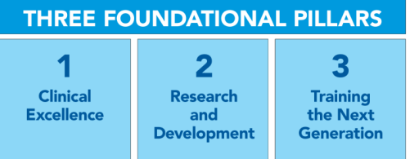
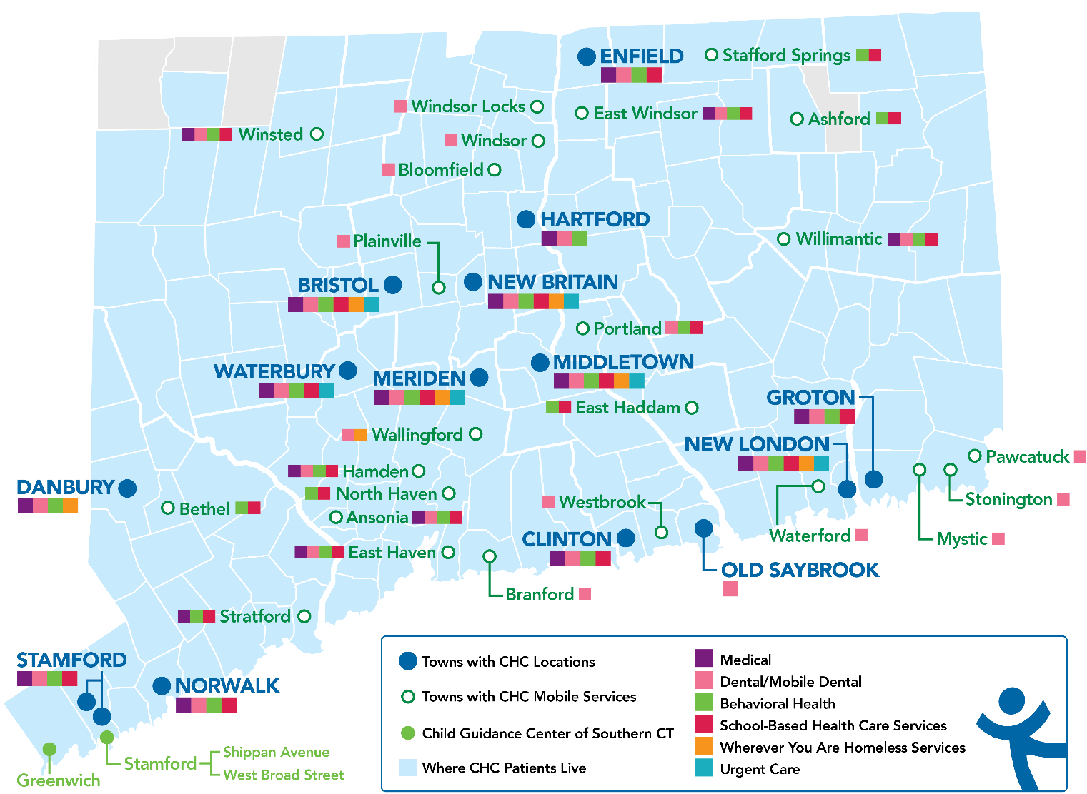
Locations & Service Sites
Profile
Founded: May 1, 1972
Staff: 1,400
Active Patients: 150,000
Patients CY: 107,225
SBHCs across CT: 152
Year | 2021 | 2022 | 2023
Patients Seen | 99,598 | 102,275 | 107,225
Notes:
Meaghan

Slide 7
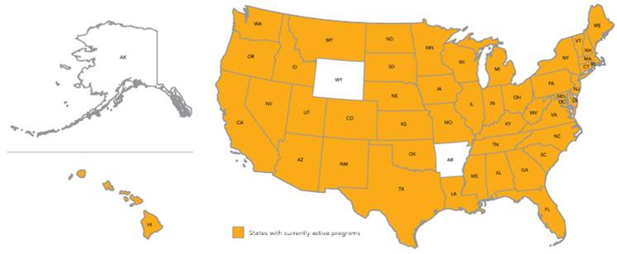
Primary Care, Psychiatric/MH and Specialty Postgraduate Training Programs – Total: 548 Programs Nationally
7
Notes:
Meaghan

Slide 8

National Training and Technical Assistance Partners (NTTAP)
Clinical Workforce Development
Provides free training and technical assistance to health centers across the nation through national webinars, learning collaboratives, activity sessions, trainings, research, publications, etc.
Notes:
Meaghan

Slide 9
Learning Collaborative Structure
Six 90-minute Learning Collaborative video conference sessions
Bi-weekly 60-minute calls between coach mentors and team coach
Internal team workgroup meetings
Access resources via the Weitzman Education Platform
Use Google Drive to share your work
Learning Session Dates
Learning Session 1 | Tuesday October 8th
Learning Session 2 | Tuesday November 12th
Learning Session 3 | Tuesday December 10th
Learning Session 4 | Tuesday January 21st
Learning Session 5 | Tuesday February 11th
Learning Session 6 | Tuesday March 11th
Notes:
Meaghan

Slide 10
2024-2025 Cohort
Alivio Medical Center | Chicago, Illinois
Arkansas Primary Care Association | North Little Rock, Arkansas
Blue Ridge Community Health Services, Inc. | Hendersonvlle, North Carolina
Brockton Neighborhood Health Center, Inc. | Brockton, Massachusetts
Children’s Primary Care Medical Group | San Diego, California
Esperanza Health Center | Philadelphia, Pennsylvania
Family Health Centers of San Diego | San Diego, California
Greater Philadelphia Health Action, Inc. | Philadelphia, Pennsylvania
Indian Health Service Headquarters | Rockville, Maryland
Marin Community Clinic | Novato, California
ND Systems Inc. | Fairbanks, Alaska
Ozark TriCounty Healthcare Consortium dba ACCESS Family Care | Neosho, Missouri
Tennessee Primary Care Association | Nashville, Tennessee
Umpqua Community Health Center dba Aviva Health | Roseburg, Oregon
Notes:
Meaghan

Slide 11
Preceptors, Mentors, and Faculty: Roles and Responsibilities
Garrett Matlick
Community Health Center, Inc. Postgraduate NP Residency Clinical Program Director
Notes:
Garrett

Slide 12
Polling Question
Have you identified your preceptors and mentors
for your program?
Notes:
Garrett

Slide 13
Precepted vs. Mentored Clinic
Precepted Continuity Clinics (40%): Residents develop and manage a panel of patients with the exclusive attention of an expert preceptor (NP, PA or Physician)
Mentored Clinics (20%): Work within a primary care team focusing on diversity of chief complaints, efficiency, episodic and acute care
 | Precepted Continuity Clinic | Mentored Clinic
Percent of Program Time | 40% | 20%
Frequency | 4 sessions/week | 2 sessions/week
Type of patient | Starting with initial visits, then including all visit types | Episodic/acute care
Faculty | Preceptor | Mentor
Documentation in EHR | Preceptor reviews resident’s documentation, then resident closes and locks the note. | Mentor reviews resident’s documentation, then Mentor closes and locks the note.
Notes:
Garrett

Slide 14
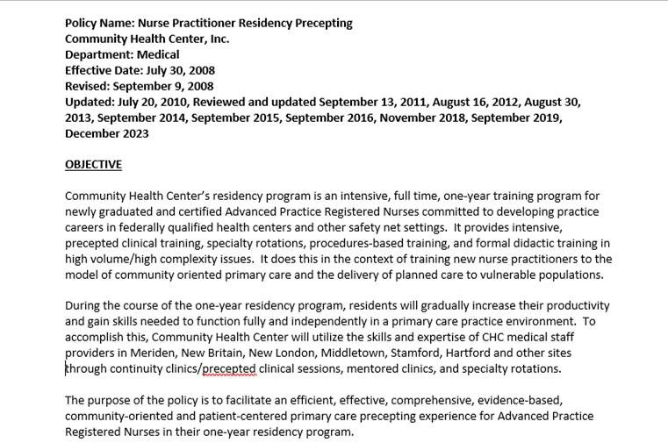
CHCI’s Precepting Policy
Notes:
Garrett

Slide 15
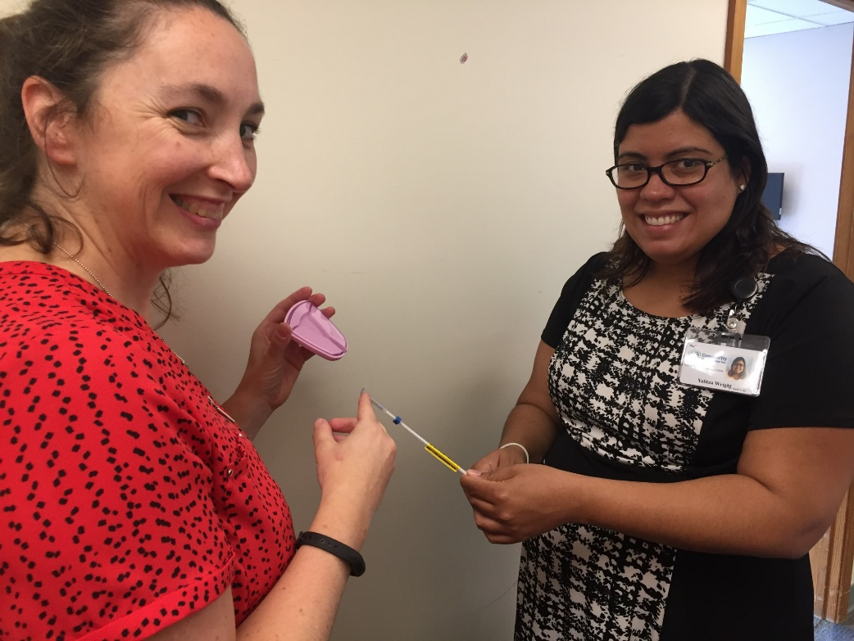
Selecting Your Preceptors
Precepting is a privilege granted to providers who are skilled, experienced, motivated, productive and have demonstrated clinical excellence and high quality care with good outcomes
Preceptors are selected annually by leadership Staff and Postgraduate Training Program staff
Notes:
Garrett

Slide 16
Preceptor Recruitment & Training
Start having conversations with providers about the launch of your program
Describe the role and give providers an opportunity to express interest
Your team should decide on the kinds of qualities you want in your preceptors
Should be expert providers, in good standing with the organization, commitment to training
Provide preceptors with initial orientation/training
Overview of residency program, roles and responsibilities of the preceptor, expectations of resident and preceptor, evaluation expectations
Include additional points of check in and training for preceptors during the year
Notes:
Garrett

Slide 17
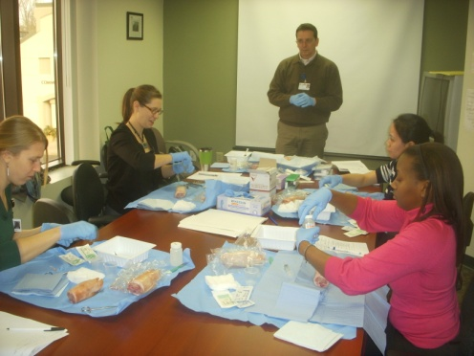
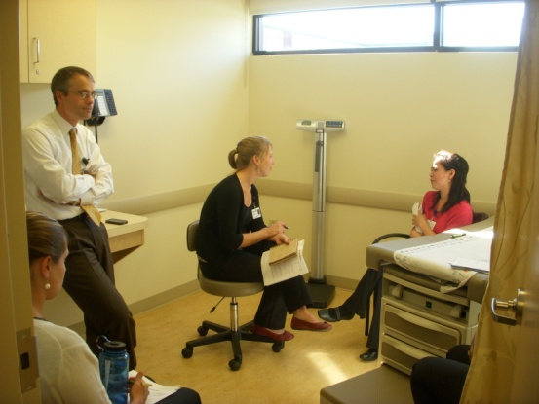
Preceptor Roles & Responsibilities
Be dedicated to teaching and supporting the postgraduate trainees during your assigned precepted sessions:
Utilize leadership skills by assisting in and providing direction, when needed, for all aspects of patient care
Be present and fully available to the postgraduate trainees until the last scheduled patient is seen
Employ teaching strategies during the sessions
Advocate for other providers to inform postgraduate trainees when good teaching opportunities arise (physical findings/procedures, etc.)
Review notes and create addendums to notes
Notes:
Garrett
Encourage the organization’s goal of providing fully integrated care
Advocate for other providers to inform residents when good teaching opportunities arise (physical findings/procedures, etc.)

Slide 18
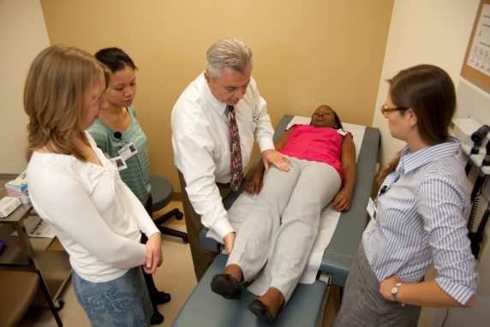
Preceptor Roles & Responsibilities
Encourage critical analysis and evidence-based reasoning in the ordering of tests and laboratory studies
Discuss clinical issues as well as lab and diagnostic imaging results and ensure timely and efficient review
Supervise and assist with procedures when applicable (with which the preceptors are comfortable themselves)
Support the organization’s model of providing fully integrated care
Notes:
Garrett

Slide 19
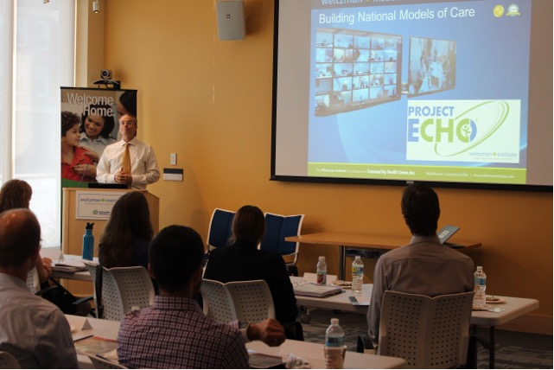
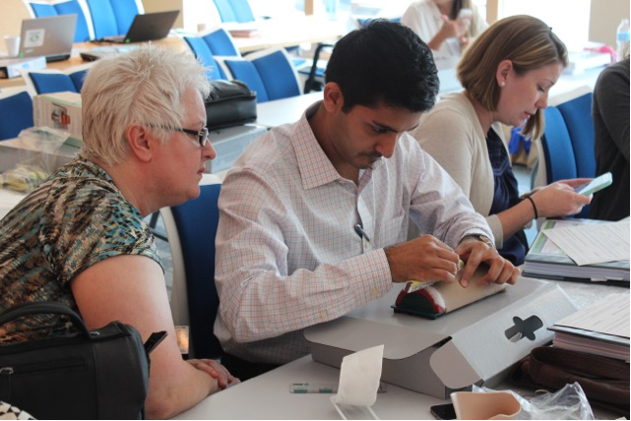
Preceptor Roles & Responsibilities
Assistance in time management skills of balancing a panel and other clinical demands (example: phone calls, paperwork, urgent results)
Provide direct patient care in the event that a postgraduate trainee falls behind in the schedule or needs assistance
Assist postgraduate trainees in achieving mastery of the general competencies and areas of particular interest of the postgraduate trainees
Notes:
Garrett

Slide 20
Specific Roles and Responsibilities (timing)
Early Months (September through January)
(or at Stage of 1-2 patients per hour):
The preceptor should see all patients with the residents initially, for the first few weeks (3-4 weeks)
After the first few weeks, the preceptor should see the patient at some point during the visit, observing and repeating physical exams and relevant history taking, as needed
Provide guidance and instructions on all aspects of the patient visit, including charting, the verbal presentation and the written note
Create an addendum in the patient’s progress notes or co-sign the note after the resident has completed the note.
Notes:
Garrett

Slide 21
Specific Roles and Responsibilities (timing)
Later Months (February through August)
Reassess the resident’s comfort and mastery with clinical decision-making, physical exams, concise history taking and develop a precepting plan that meets the needs of the resident
Help the residents with time management and efficient practice skills in an ongoing fashion
Review all cases with the resident and repeat/observe history and physical exams, as needed
Provide guidance and instruction on all aspects of the patient visit (review entire written note and provide feedback as indicated)
Create an addendum or co-sign the patient’s progress note after the resident has completed the note
As the residents become more skilled, the preceptor should become more focused on guidance with time management, practice and panel management
Notes:
Garrett

Slide 22
Reviewing Postgraduate Trainee Notes
Great opportunity to support learning
Clinical level:
Insight into their understanding
Organizational level:
Train to your organization- especially if plans to stay a second year
Recommended throughout the year
Important to sign off on notes
Helps people know who helped them with the case (residents and those following up)
Notes:
Garrett

Slide 23
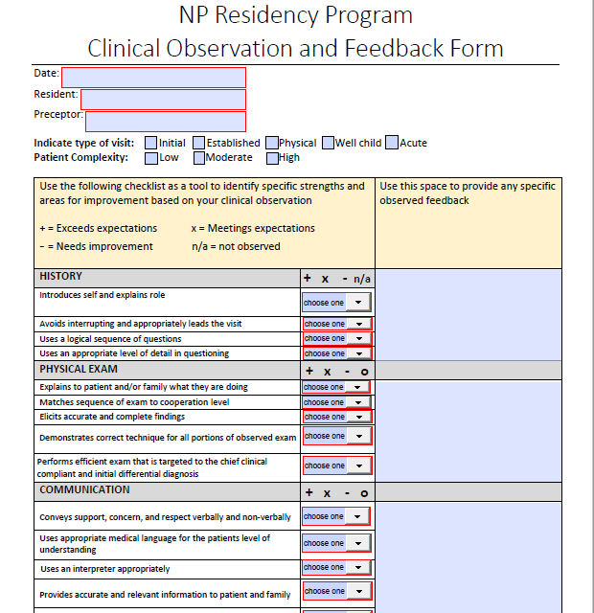
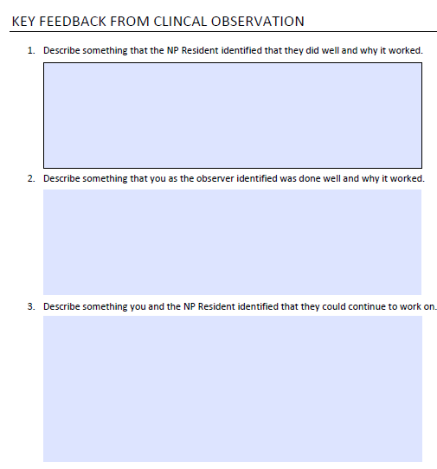
Residency Program Clinical Observation & Feedback Form
Notes:
Garrett

Slide 24
Preceptor Evaluation
Important to have residents evaluate your preceptors
Allows you to identify strengths and areas for continued development for individuals and the group
Allows the opportunity for residents to share feedback
Outline clear expectations about how and when evaluation will be collected and shared
Important for preceptors to get direct feedback about how they are doing
Concerns about anonymity and confidentiality
Have another way for residents to share more sensitive or critical feedback about a preceptor with your team
May want to do more frequent evaluations in the first few years of the program
Have a plan for addressing remediation concerns
Notes:
Garrett

Slide 25
Mentored Clinic
20% of NP residents’ time, for two sessions each week
During mentored clinics, the NP residents work alongside a primary care provider mentor—a very experienced physician, NP or PA—with a focus on the practice of episodic and acute care and additional mastery of procedures.
The residents generally do not have their own schedule of patients during Mentored Clinics but instead see patients at the delegation of the primary care providers, who remain available for consultations.
This is also an opportunity to schedule some follow up visits for a patient seen during the week in precepted clinic who must be seen again before the next scheduled precepted session.
Notes:
Garrett
More information if needed:
During the “huddle” at the beginning of the mentored clinical session, the clinical mentor will select patients from his or her own schedule for the resident to see. The resident will see the patient independently and report back to the mentor before the patient leaves. The resident documents in the EHR but it is the mentor who reviews, closes and locks the note since they are the primary care provider. The goal of the mentored clinics is to provide the NP residents with a supervised clinical experience in order to obtain knowledge and skills to be able to practice in an outpatient family practice, community health setting. The days of the mentored clinics are determined after the schedule for the Precepted Clinic sessions, Specialty Rotations and indirect clinical learning experiences has been finalized.

Slide 26
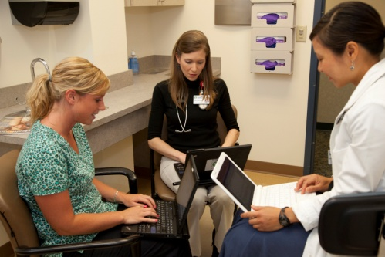
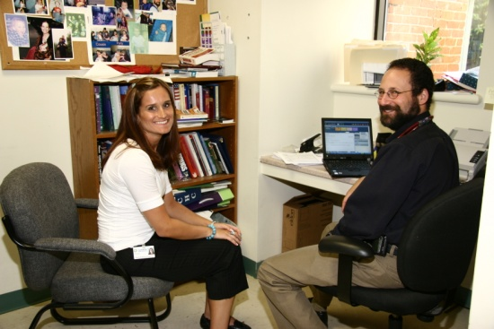
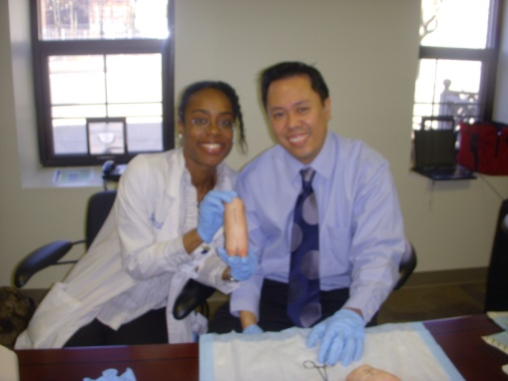
Mentored Clinic Providers
The postgraduate trainees work along side the provider as part of the medical team.
Providers* should pick patients in their schedule for the postgraduate trainee (acute visits, overbooks, brief follow up appointments).
Initial visits should not been seen by the postgraduate trainees during mentored clinic, unless they will become the patient’s PCP.
The postgraduate trainees will see the patient and report the plan back to the provider, which should be documented in the electronic health record, but provider is billing for the visit.
The provider will agree/disagree with patient plan, and see the patient before they leave the office, the provider closes the note.
Notes:
Garrett
Shorten content; see below for full content
The postgraduate trainees work along side the provider as part of the medical team, seeing patients off of the provider’s schedule.
Providers* should hand pick patients in their schedule for the postgraduate trainees to see (acute visits, overbooks, brief follow up appointments).
Initial visits should not been seen by the postgraduate trainees during mentored clinic, unless the postgraduate trainees will become their PCP.
The postgraduate trainees will see the patient and report the plan back to the provider, the postgraduate trainees should be documenting everything in the electronic health record but provider is billing for the visit.
The provider will agree/disagree with patient plan, and see the patient before they leave the office, the provider closes the note.

Slide 27
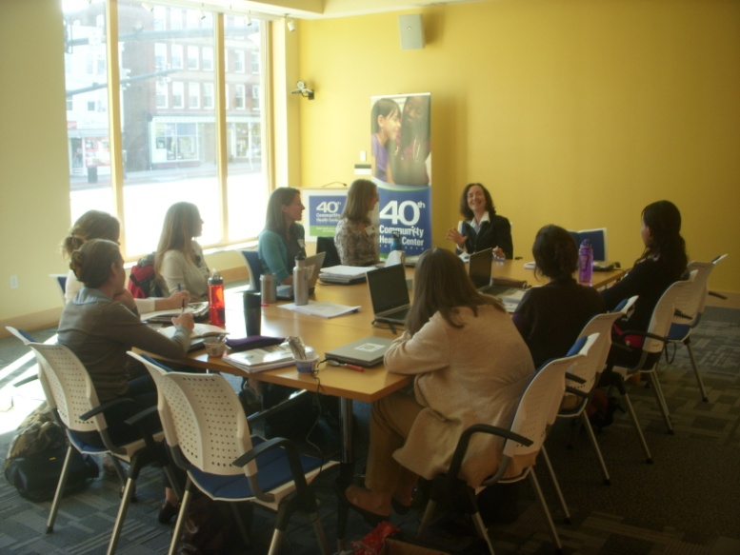
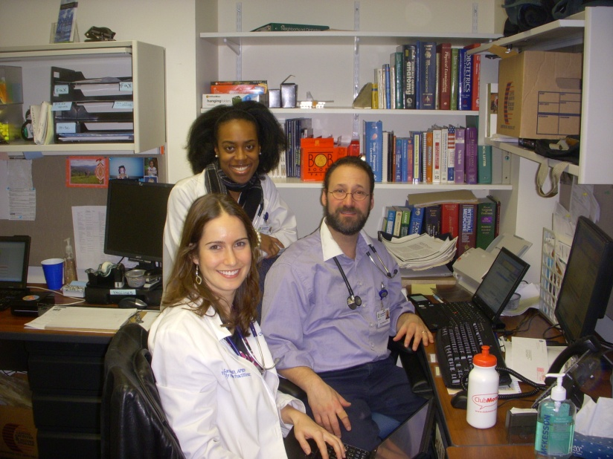
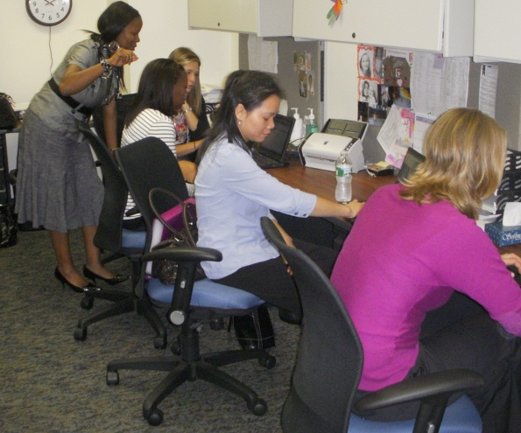
Mentored Clinic
As the postgraduate trainees become more independent, they will be able to schedule additional follow-ups of their own patients during this time.
CHCI providers prefer to have the postgraduate trainees complete, bill, and lock the progress notes and then have the provider place a brief addendum.
Other organizations may structure the feedback and notes differently.
Notes:
Garrett
Shorten content; see below for full content
As the postgraduate trainees become more independent, they will be able to schedule additional follow-ups of their own patients during this time (this responds to the feedback that more openings for simple follow up are needed).
CHCI providers prefer to have the postgraduate trainees complete, bill, and lock the progress notes and then have the provider place a brief addendum.
Other organizations may structure the feedback and notes differently.

Slide 28
Preceptor Panel
Tanya Theriault, FNP- BC, DePaul Community Health Centers
Lindsey Anagnostopoulos, ARNP, Nurse Practitioner Residency Site Director, Sea Mar Community Health Centers
Mary Rose, PMHNP, MS, CCM, Medical Director, Psychiatric NP Fellowship, Thundermist Health Center
Notes:
1:35-1:40pm [about 2 minutes each] (1) Introductions: Each of you will provide a short introduction – Name, Health Center, Role, Year(s) as a preceptor, and if you were a resident/where you completed your residency – overall background of yourself and experience!
1:40-1:50pm [about 3 minutes each] (2) Experience as a Preceptor: Can you describe your experience precepting, including the value you see in serving as a preceptor, any challenges you've encountered/how you navigated those challenges, and how you would encourage a colleague to take on this responsibility?
If you don’t have any answer to all of those, no worries! Just looking for you to provide an overall background of your experience as a preceptor!
1:50-2:00pm (4) Open Discussion: Q/A from our participants!

Slide 29
Program Policies & Procedures
Notes:
Charise

Slide 30
Program Policies & Procedures
Stepwise Increase of APRN Resident Clinical Scheduling Policy
NP Residency Program Precepting Policy
NP Residency Program Assessment of Training Sites
CHCI Clinical Guidelines for Medical Providers
CHCI Formal Residency Agreement
CHCI HR Personnel Records Policy
CHCI Disciplinary Action Process Policy
CHCI Grievance and Due Process Policy
Applicant Process for CHCI’s Nurse Practitioner Residency Training Program
CHCI Benefits Overview
CHCI Employment Health Documentation Requirements
Employee Infection Control Levels Policy
Universal Flu Prevention Policy
IC HR Employee Tuberculosis Screening Policy
Non Discrimination Policy
*Items highlighted are policies that come from your organization and can be used in full or modified to meet the program needs
Notes:
Charise

Slide 31
Precepting
Policy
Notes:
Charise

Slide 32
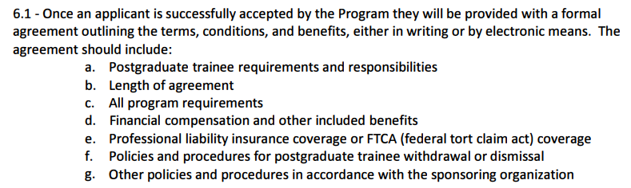
Formal Agreement
Notes:
Charise

Slide 33
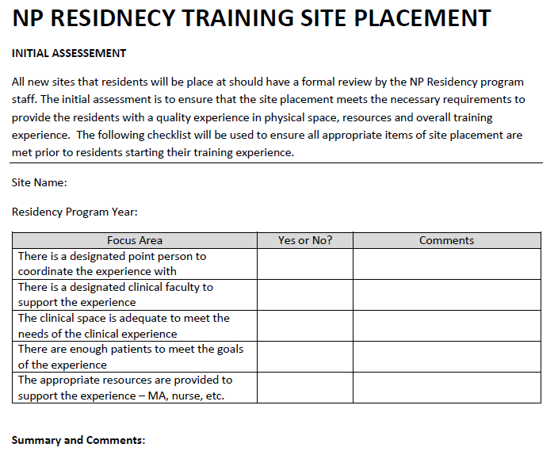
Assessment of Training Sites
Notes:
Charise

Slide 34
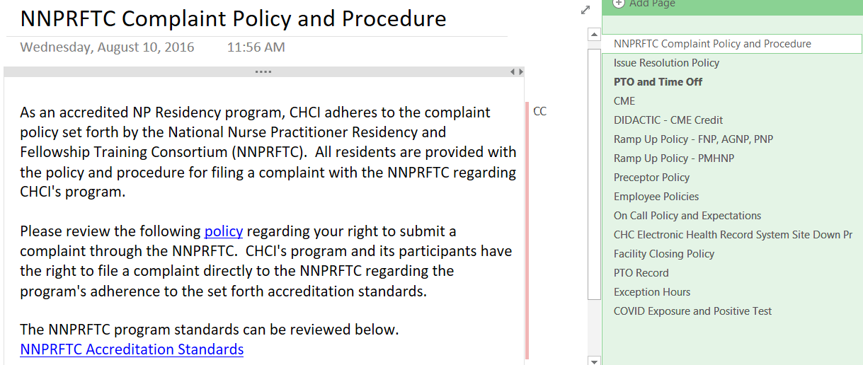
Sharing Policies and Procedures with your Trainees
Notes:
Charise

Slide 35
Curriculum Development:
Program Goals and Objectives
Notes:
Charise

Slide 36

Consortium for Advanced Practice Providers The Standards
Standard 1 – Mission, Goals and Objectives
Standard 2 – Curriculum
Standard 3 – Evaluation
Standard 4 – Program Eligibility
Standard 5 – Administration
Standard 6 – Operations
Standard 7 – Staff
Standard 8 – Postgraduate Trainee Services
https://www.apppostgradtraining.com/wp-content/uploads/2023/02/Accreditation-Standards-2023.pdf
Notes:
Charise

Slide 37

Consortium for Advanced Practice Providers Standard 2: Curriculum
Clinically based practice and patient care experience
Regularly scheduled didactic sessions
System-based learning and quality improvement
Population-based health focus
Technology
Equity and social justice
Leadership and professional development
Social Determinants of Health (SDOH)
Certificate of Completion
https://www.apppostgradtraining.com/wp-content/uploads/2023/02/Accreditation-Standards-2023.pdf
Notes:
Charise

Slide 38

Consortium for Advanced Practice Providers
Competency Domains
Patient-centered Care
Knowledge for Practice
Practice-Based Learning and Improvement
Interpersonal and Communication Skills
Professionalism
Systems-Based Practice
Interdisciplinary Collaboration
Personal and Professional Development
Technology and Telehealth
Diversity, Equity, and Inclusion
https://www.apppostgradtraining.com/wp-content/uploads/2023/02/Accreditation-Standards-2023.pdf
Notes:
Charise

Slide 39

Core Elements of a Postgraduate NP Residency
12 Months Full-time Employment | Training to Clinical Complexity and High Performance Model of Care team-based care, inter-professional collaboration, integrated care, data driven QI ,expert use of technology | Full Integration into Home Site and Organization
Precepted Continuity Clinics (40%); Residents develop and manage a panel of patients with the exclusive attention of an expert preceptor (NP, PA or Physician) Specialty Rotations (20%); Experience in primary care specialty areas to expand and enhance resident practice knowledge and skills Mentored Clinics (20%); Work within a primary care team focusing on diversity of chief complaints, efficiency, episodic and acute care Didactic Sessions (15%); Topics that are high volume, complexity and/or burden topics in primary care. Includes participation in Project ECHO sessions for managing chronic pain, treating HIV/Hep C, opioid addiction, complex pediatrics Quality Improvement Training (5%); Training to a high performance QI model, including front line QI improvement, data driven QI, and leadership development.
Notes:
Charise

Slide 40
Program Mission
Program Goals and Objectives
Learner Outcomes
Competencies and Curriculum Objectives
SPECIFICITY
Notes:
Charise

Slide 41
Goals and Objectives: Program Level
Program Goals: broad, long-term
What the program aims to achieve as its end point.
Not intended to be measured; must clearly lead to objectives and outcomes that are measurable
Program Objectives
The specific activities, strategies, actions, content the program will offer to achieve the program goals
Measurable
Curricular elements: Types of activities, used to meet the Program Objectives, e.g., clinical rotation, didactics, seminars.
Notes:
Charise
SUPPORT the achievement of competence, confidence, and mastery in all domains of primary care that are needed to serve as a full scope, primary care provider in a complex FQHC setting through a highly structured transition experience that includes the necessary depth, breadth, volume and intensity of clinical practice.

Slide 42
Putting it together
Program Goal #2 | SUPPORT the achievement of competence, confidence, and mastery in all domains of primary care that are needed to serve as a full scope, primary care provider in a complex FQHC setting……
Program Objective(s) for Goal #2 | Establish and meet targets for each NP resident panel for diversity of patients by age, gender, clinical complexity and challenges, and cultural diversity Require residents to complete rotations in 10 specialty areas Require accomplishment in a specified number of clinical procedures by each resident
Curricular Element linked to Objective | Clinical-based practice and patient care experiences
Curriculum objective at the competency level | Clinical Learning Objective for curriculum element precepted clinic: Provide patient-centered care that is compassionate, valued, appropriate and effective for the treatment of health problems and the promotion of health (competency #1)
Learner outcome | 1. Assess for, diagnose, treat and manage over time common medical conditions experienced in primary care (subdomain of competency #1): Hypertension, diabetes…..
Notes:
Charise

Slide 43
Curriculum Development:
Elements and Learning Objectives
Notes:
Charise

Slide 44
Developing Learner Goals and Objectives
Common conditions to assess your trainees during precepted clinic
List of procedures for your trainees to develop competency in
Specialty Rotations learning objectives
Didactic sessions and corresponding learning objectives
Other educational components to assess
Notes:
Charise

Slide 45
Common Conditions to Assess Learner
Hypertension | Chronic Pain | Hepatitis C
Diabetes | COPD | Alcoholism
Depression | Chronic rental failure | Substance use
Obesity | Heart failure | Women’s Health
Asthma | HIV | MAT
Notes:
Charise

Slide 46
Example of Procedures for Learner
PROCEDURE | TARGET #
IUD | 10
NEXPLANON | 5
EKG INTERPRETATION | 20
JOINT INJECTIONS | 10
BIOPSY | 10
SUTURING | 10
Notes:
Charise

Slide 47
Specialty Rotations
Adult Psychiatry | Healthcare for the Homeless
Child and Adolescent Psychiatry | Center for Key Populations
Women’s Health | Urgent Care
Orthopedics | School Based Health Center
Pediatrics | Newborn Nursery
Notes:
Charise

Slide 48
Developing Learning Objectives Specialty Rotations
Each specialty rotation should have its own specific learning objectives
What are the clinical knowledge and skills you want your trainees to obtain by participating in the rotation
Tie in competency domains when possible
Use objectives to build your evaluation
Example outline for specialty rotation objectives
Perform comprehensive history and physical exam
Know the appropriate screening and diagnostic tests to order including…
Identify clinical situations when appropriate to order a consult or e-consult
Know the appropriate medications commonly used in (specialty) including…
Assess for, diagnose, treat and manage common medical conditions experienced in (specialty) including…
Perform clinical procedures commonly see in (specialty) including…
Notes:
Charise

Slide 49

Example: Healthcare for the Homeless Specialty Rotation
Overview
The rotation is a 4 week longitudinal experience in health care for the homeless. During this rotation residents will have the opportunity to work within homeless shelters and domestic violence shelters to provider comprehensive primary care to a highly complex and vulnerable patient population.
Learning Objectives:
Perform relevant history and physical exam understanding the complex health problems associate with the homeless experience
Know the appropriate screening tests to order
Understand and utilize the role of government, social agencies, health service providers and community resources in providing services to persons experiencing homelessness and under-housing
Provide cost effective treatment plans while being sensitive to patients housing status, social and economic resources, and ensure treatment compliant
Assess for, diagnose, and treat common medical conditions experienced by the homeless population including mental health, substance abuse, infectious diseases, wound and skin infections, Understand various social determinants of health that can impact the patients health and well-being, including the connection between health, housing and poverty
Notes:
Charise

Slide 50
Didactics
Topic | Presenter | Credentials | Title | Learning Objectives
Performing the Pre-Op Physical | Dan Wilensky | MD | Chief Preceptor and Medical Consultant to NP residency, CHC Clinician | Gain comfort with the pre-op consultation Learn recognized language for the progress note Be able to decide on testing Anticipate lesser-considered issues and their implications
Notes:
Charise

Slide 51
Questions?
Notes:
ALL

Slide 52
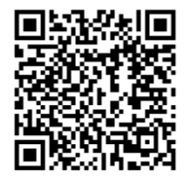
Assignments
Continue to work on Progress Checklist
Draft didactic curriculum
Access the Google Drive to upload deliverables:
Notes:
Meaghan

Slide 53
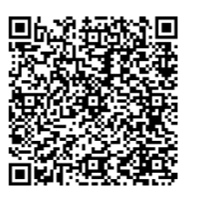
Next Steps
Coach Calls
Tuesday January 28th 1:00pm Eastern / 10:00am Pacific
Tuesday February 4th 1:00pm Eastern / 10:00am Pacific
Session 5: Tuesday February 11th 1:00pm Eastern / 10:00am Pacific
Evaluation of the postgraduate residency program and of the resident learner
Orientation
Graduation
Introduction to Accreditation by the Consortium for Advanced Practice Providers
Register for the Weitzman Education Platform to receive CME, resources, and more!
Notes:
Meaghan

Slide 54
Wrap-Up
Notes:
Meaghan

Slide 55
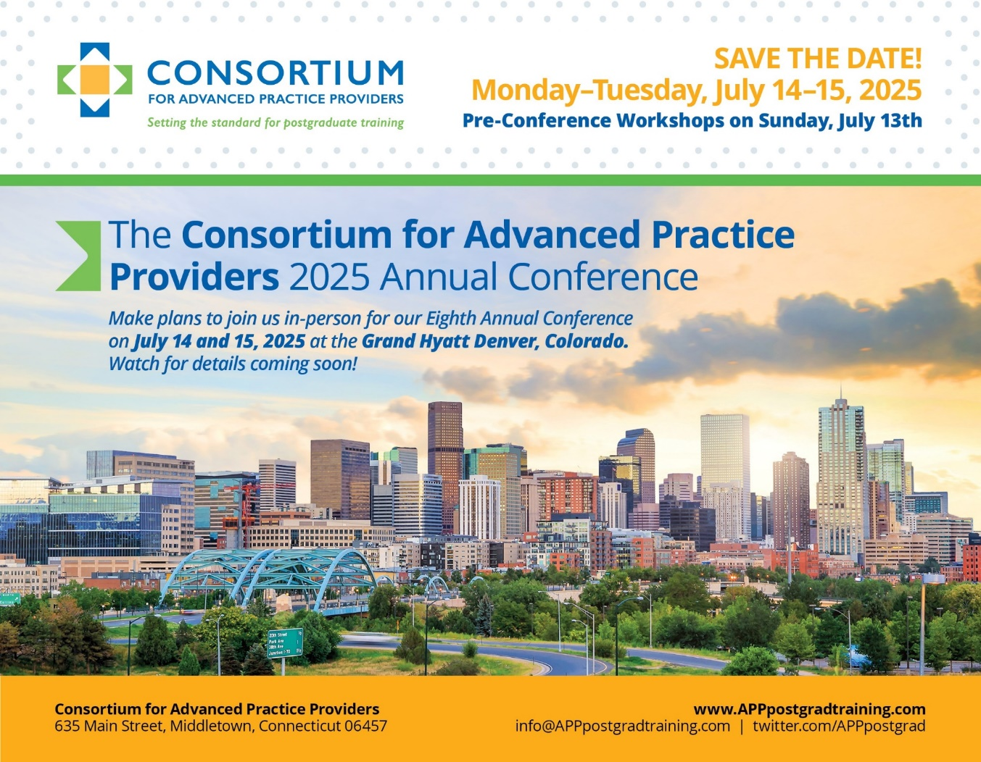
2025 Annual Conference
Mark your calendars and “Save the Date”!
Dates: July 13 – 15, 2025
Location: Grand Hyatt Denver, CO
Pre-Conference Workshop Offerings on 07/13
APP Leadership Workshop
Administration and Operations Workshop
Preceptor Development and Training Workshops
2 Day General Conference on 07/14 – 07/15
Notes:
The Annual Conference is designed to bring together a community of 250+ innovators, leaders, and emerging leaders in leading and developing formal postgraduate programs as well as a cadre of tomorrow’s leaders (today’s NP/PA trainees and students) to learn from each other, but also from external stakeholders and experts in healthcare systems and policy.
This conference is an opportunity for a relatively short but intense burst of continuing education in evolving best practices in APP postgraduate training, strategies for the planning, implementation, and success of service-delivery based postgraduate training, anticipated relevant future policy developments, and health care trends related to the movement. Breakout sessions will provide opportunity for specialized focus on critical elements of curriculum, evaluation, faculty development and accreditation.
Join us with program directors, managers, coordinators, and trainees from postgraduate APP training programs across the country. The Consortium’s 8th Annual Conference will provide valuable insights and resources to elevate your programs and enhance your impact in the field.
This is a great highlights video from the conference you could also share with NTTAP participants. Its talks about new programs and getting support. J Thanks for your help promoting. Kerry
https://vimeo.com/1002782981/a40432e368?share=copy

Slide 56

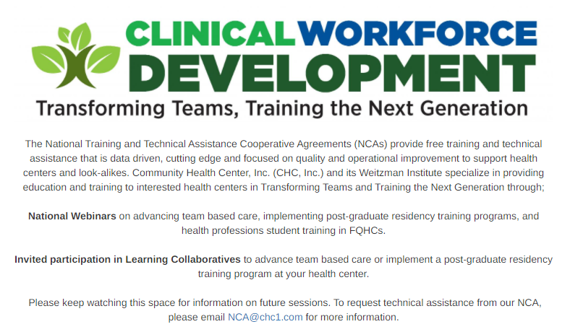

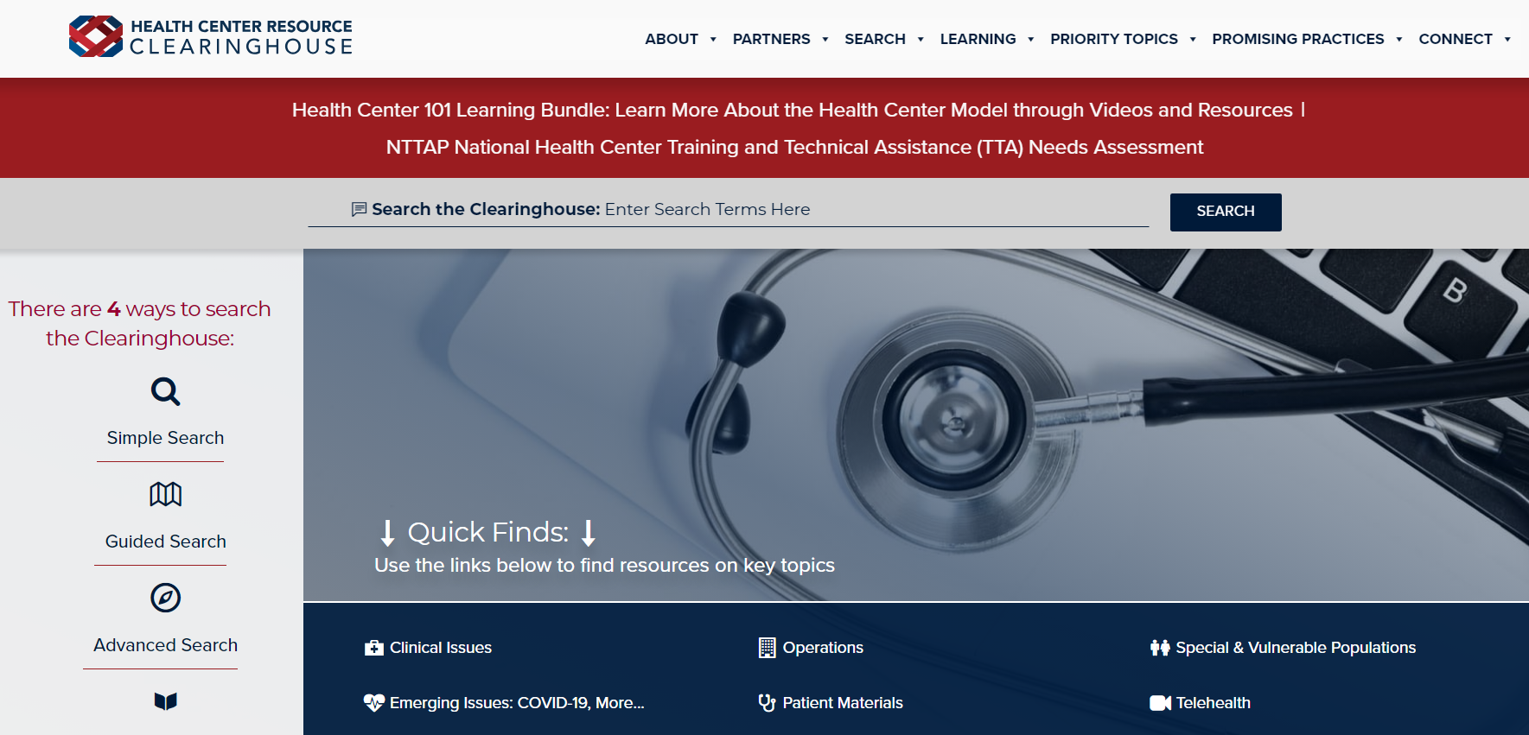
Explore more resources!
National Learning Library: Resources for Clinical Workforce Development
Health Center
Resource Clearinghouse
https://www.weitzmaninstitute.org/ncaresources
https://www.healthcenterinfo.org/
Notes:
Meaghan

Slide 57
Contact Us!
Amanda Schiessl
Program Director/Co-PI
Amanda@mwhs1.com
Meaghan Angers
Senior Program Manager
angersm@mwhs1.com
Bianca Flowers
Program Manager
flowerb@mwhs1.com
REMINDER: Complete evaluation in the poll!
Next Learning Session is Tuesday February 11th!
Notes:
Meaghan

