Slide 1
Psychotropics in Pain Treatment
Amy K. Kennedy, PharmD, BCACP
She/her/hers
University of Arizona College of Pharmacy/El Rio Health

Slide 2
Learning Objectives
Describe the psychotropic agents available for pain treatment
Describe the effectiveness of psychotropic medications for various pain syndromes
Discuss clinical pearls for the use of these medications

Slide 3
Zoom poll
Why do we see high doses of opioids in 2025?

Slide 4
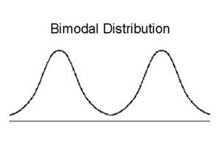
High doses of Opiates: Why?

Slide 5
Nervous system pain differential
Depression
Bipolar disorder
PTSD
Fibromyalgia?

Slide 6
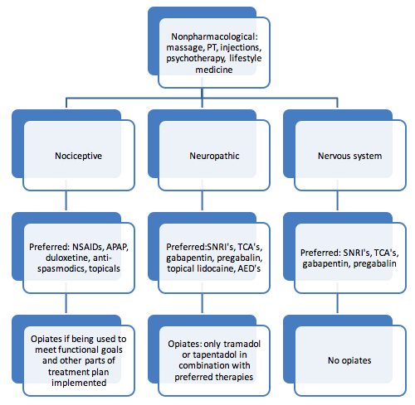

Slide 7
Pain Questions
SCHOLAR or “PQRST” Mnemonic
Function?
Weakness?
Swelling?
Range of motion?

Slide 8
Pharmacologic Agents Affect Pain Differently
BRAIN
Descending Modulation
Anticonvulsants
Opioids
Tricyclic/SNRI Antidepressants
Spinal
Cord
CNS
Dorsal
Horn
Central Sensitization
PNS
Anticonvulsants
Opioids
NMDA-Receptor Antagonists
Tricyclic/SNRI Antidepressants
Peripheral
Sensitization
Local Anesthetics
Topical Analgesics
Anticonvulsants
Tricyclic Antidepressants
Opioids

Slide 9
SSRI antidepressants
Mechanism of action
Inhibit serotonin reuptake so increase synaptic serotonin levels
Many SSRIs affect other receptors especially at high doses
Clinical effect usually takes weeks so mechanism goes beyond simply increasing synaptic serotonin levels
Several serotonin (5-HT) receptor subtypes
Serotonin receptors are located throughout the body (especially GI tract)

Slide 10
SSRI antidepressants
Side effects
Decreased sex drive and impaired sexual function tend not to resolve with time
Nausea, diarrhea, anorexia, vomiting
- all increase with dose and can resolve with time
Weight gain (esp. paroxetine) after initial GI effects
Headache, dizziness, anxiety (esp. fluoxetine), rash, insomnia, sedation, sweating, vivid dreams, tremor, dry mouth (esp. paroxetine), bruising, ↑ prolactin

Slide 11
SSRI antidepressants
Drug-drug interactions (DDI)
Luvox > Prozac > Paxil > Zoloft > Celexa > Lexapro
Interacting effects may be dose dependent (Zoloft)
SSRI levels tend not to be altered by other drugs but can potentially increase levels (inhibit metabolism) of certain drugs
Examples:
paroxetine > ↑ risperidone
fluoxetine > ↑ buspirone
fluvoxamine > ↑ olanzapine

Slide 12
SSRI antidepressants
Cautions
Serotonin syndrome (SSRI + MAOI, possibly lithium, others)
>> diarrhea, tremor, sweating, restlessness, hyperreflexia
progression of symptoms if untreated ► ► ►
>> disorientation, rigidity, fever >> coma, seizures >> death (approximately 10% mortality rate)
Many medications/substances have serotonin activity:
dextromethorphan, fentanyl, meperidine, sumatriptan,
St John’s Wort, MDMA (ecstasy), LSD, many others…

Slide 13
SSRI antidepressants
citalopram (Celexa)
Few drug-drug interactions (DDIs)
High serotonin specificity
Typical or less SSRI side effects
10-40 mg/day (hepatic impairment consider 20 mg/day)
escitalopram (Lexapro) – no generic available
Simple dosing (10-20 mg/day)
“S” molecule of the “S” & “R” mirror-image mixture of citalopram molecules
fluoxetine (Prozac, Sarafem, Symbyax- with Zyprexa)
Very long half-life
Significant DDIs
Can be activating
Conflicting data on use in painful diabetic neuropathy and headache
10-80 mg/day (lower doses in hepatic impairment)

Slide 14
SSRI antidepressants
fluvoxamine (Luvox)
OCD indication
Multiple significant DDIs
Conflicting evidence for migraine
100-300 mg/day (lower dose or longer dosing interval in hepatic impairment
paroxetine (Paxil)
Significant DDIs
Some reports of associated weight gain
“Withdrawal” symptoms with missed doses
10-75 mg daily (max of 40 mg in renal or hepatic impairment)
sertraline (Zoloft)
Moderate DDIs
Multi-step dosing
25-200 mg/day (hepatic impairment consider lower doses)

Slide 15
Atypical antidepressants
Mechanism of action
venlafaxine , duloxetine, milnacipran are serotonin and norepinephrine reuptake inhibitors- “SNRIs”
mirtazapine has serotonin subtype & norepinephrine activity
trazodone, nefazodone have different serotonin activity than SSRIs
bupropion has dopamine and norepinephrine activity

Slide 16
Atypical antidepressants
Side effects
Similar to SSRI’s
Suspect less serotonin syndrome
Bupropion and trazodone do not usually have associated sexual dysfunction

Slide 17
Atypical antidepressants
venlafaxine (Effexor)
Similar to TCAs with less safety & side effect concerns
Can increase blood pressure
Minimal DDI
SE with missed doses
Class B effectiveness in pdn and migraines, unclear in LBP
Dosing: 75-225 mg/day, reduce dose by 25-50% in renal or hepatic impairment
duloxetine (Cymbalta)
SNRI profile minimally dose dependent
Class B effectiveness for pdn, conditionally recommended for hip and knee OA, FDA approval for fibromyalgia
Dosing: 60-120 mg/day (caution in hepatic impairment, do not use if CrCL<30 ml/min

Slide 18
Atypical antidepressants
bupropion (Wellbutrin, Zyban)
NE, dopamine reuptake inhibition
Can be activating
Dosing: 150-450 mg/day (consider reduction in renal and hepatic impairment)
Seizure risk in certain patients (↑ risk at ↑ dose)
Potential DDIs not often significant (except MAOIs)
Milnacipran (Savella)
Complex serotonin, NE (α2) activity
Increased bp and heart rate, headaches, significant GI AE
FDA approved for the treatment of fibromyalgia
Dosing: 50-100 mg bid, no adjustments for hepatic impairment, reduce dose after CrCl <30 ml/min

Slide 19
Atypical antidepressants
Trazodone (Desyrel)
Sedation, weight gain, low blood pressure
Used most commonly (off label) for insomnia
Rare reports of sustained painful erection (priapism) that should be treated in ER (can lead to impotence)
Shown to be ineffective for low back pain
Dosing: 50-600 mg/day

Slide 20
Tricyclic antidepressants
Mechanism of action
Norepinephrine, serotonin, histamine, muscarinic (cholinergic) and α-adrenergic receptor activity although in differing ratios
Anticholinergic activity leads to many of the side effects of these drugs
Indications & off-label uses
Depression and similar spectrum of disorders as SSRIs
Especially helpful with chronic pain and depression
enuresis, narcolepsy, premature ejaculation, insomnia, migraine prophylaxis

Slide 21
Tricyclic antidepressants
Drug-drug interactions (DDI)
Multiple significant interactions in each direction with potentially serious consequences
Side effects (SE)
Anticholinergic SE include: dry mouth, constipation, blurred vision and urinary retention
Cardiac arrhythmias and conduction changes
Orthostatic hypotension
Sedation
Weight gain
Cautions
Overdose is frequently fatal
Pts with bipolar d/o may be pushed into mania or rapid cycling

Slide 22
Tricyclic Antidepressants: Adverse Effects (AE)
Fewest AEs
Commonly reported AEs (generally anticholinergic):
blurred vision
cognitive changes
constipation
dry mouth
orthostatic hypotension
sedation
sexual dysfunction
tachycardia
urinary retention
Desipramine
Nortriptyline
Imipramine
Doxepin
Amitriptyline
Most AEs

Slide 23
Tricylic antidepressants
Desipramine
Effective for postherpetic neuralgia, insufficient evidence for PDN
Dosing: 100-200 mg/day, (geriatrics and hepatic impairment, start low and go slow)
Nortriptyline
Effective in postherpetic neuralgia, insufficient evidence for PDN
Max dose of 150 mg/day (geriatrics consider 30-50 mg/day)
Imipramine
Insufficient evidence for PDN
Dosing: 50-75 mg daily
Amitriptyline
Dosing: 75-100 mg daily
Probably effective for migraine prophylaxis, PDN,

Slide 24
Carbamazepine
Used in trigeminal neuralgia since the 1960’s!
Starting dose is 200mg po bid. Effective dose is usually 400-1000mg per day.
Mechanism of action potentially inhibition of repeated neuronal discharges
GI: nausea, constipation, diarrhea, appetite loss
CNS: sedation, dizziness, unsteadiness, confusion
benign rashes common, catastrophic rashes rare
many possible serious abnormalities in CBC
multiple significant drug-drug interactions (DDI) affecting both other medications (reducing their levels) & other medications affecting it (increasing carbamazepine levels)
induces its own metabolism so may need to adjust dose over several weeks

Slide 25
Oxcarbazepine
Possibly ineffective for migraine prophylaxis, not recommended by AAN for PDN, similar efficacy to carbamazepine for trigeminal neuralgia
An analog of carbamazepine that retains many therapeutic properties of the drug while avoiding toxicities. (No bone marrow suppression or induction of P450 system)
Start with 300mg at HS. Increase weekly by 300-600mg until effective up to a maximum of 1200-2400mg per day.

Slide 26
Lamotrigine
Demonstrated efficacy in trigeminal neuralgia.
Utility in vascular HA’s and PDN suggested by open label studies
Possibly ineffective for migraine prophylaxis
Minimally sedating unlike most other mood stabilizers
Initiating lamotrigine is done very slowly to decrease rash risk
valproate greatly increases lamotrigine levels
carbamazepine greatly decreases lamotrigine levels

Slide 27
Topiramate
Studies demonstrate utility in management of cluster headache and diabetic neuropathy
Level A recommendation from AAN for migraine prophylaxis
Poor choice for low back pain
Effective dose range is 200-400mg daily in divided (2) doses
Associated with weight loss
Side effects may include abnormal thinking, delusional and psychotic thinking, kidney stones.

Slide 28
Gabapentin
FDA approved for postherpetic neuralgia, conflicting data in migraines, level B recommendation in PDN, short term benefit in radiculopathy
Anticonvulsant: uncertain mechanism, gaba mimetic
Limited intestinal absorption
Usually well tolerated; serious adverse effects rare
dizziness and sedation can occur
No significant drug interactions
Usual dosage range for neuropathic pain up to 3,600 mg/d (tid–qid)*
*Not approved by FDA for this use.

Slide 29
Pregabalin
Gaba mimetic
More reliable oral absorption
Slightly different side effect profile
Doses: 75-300mg BID
Advantages include predictable absorption across the GI tract. Not metabolized or protein-bound. Minimal drug-drug interactions.
Multiple studies demonstrate effective pain relief and decreased sleep interference in PHN and PDN

Slide 30
Ketamine
Acute pain
Chronic pain
IV ketamine
Recommended for the following:
Large painful procedures
Patients who are opioid-dependent
Opioid tolerant patients with chronic pain that have an acute exacerbation
Patients at risk for AE from high dose opioids (e.g. OSA etc.)
Inconsistent evidence
Refractory neuropathic or inflammatory pain with or without depression
Treatment resistant depression
PTSD
Acute suicidal ideation

Slide 31
Antispasmodics
Baclofen
Dosing
5 mg orally TID
Can increase by 15 mg/day every 3 days
Max 80 mg/day
ADE: dizziness, N/V, fatigue
Tizanidine
Dosing
2 mg orally
Can repeat every 6-8 hours
Can increase by 2-4 mg/dose every 1-4 days
Max 36 mg/day
ADE: xerostomia, dizziness, somnolence
Painful muscle spasm, myoclonic jerks can accompany a variety of pain conditions (and opioids)
toxicity of morphine
Mechanism of action may reflect their sedative effects more than direct muscle effect
If use is necessary, consider baclofen or tizanidine or metaxolone
Less ideal options include cyclobenzaprine, carisoprodol and methocarbamol

Slide 32
Zoom poll
Which of the following is the most effective choice for the treatment of trigeminal neuralgia?
A. tramadol
B. carbamazepine
C. ibuprofen
D. oxcarbazepine

Slide 33
Zoom poll
Which of the following is correctly paired?
A. Oxycodone: Exposure linked to dementia
B. TCA's: targets ORLx-1
C. Duloxetine: Evidence for benefit in OA
D. Gabapentin: preferred over oral steroids in radiculopathy

Slide 34
Days ago | Weight | Height
-- | 283 | 5’5”
 | BMI | 47.1
7 | Lipids (F) | TC 185
 |  | TRG 225
 |  | LDL 102
 |  | HDL 38
 |  | Non-HDL 147
Patient Example 1
CC: “my feet are burning up
HPI: See chart→
PMH: DM II; Peripheral neuropathy; HTN; Dyslipidemia; Obesity; Hypothyroid, insomnia
ROS: BP 122/78, HR 92, RR 26, 97% ORA
PE: WNL except obesity, responds well to questions
Allergies: NKDA
Labs: others WNL
Medications: Lantus 10 units subcut nightly, Lisinopril 20mg po daily, Simvastatin 10 mg po daily, Hydrocodone 5mg/acetaminophen 325 mg 1-2 tabs po four times daily prn, Synthroid 25mg po daily, Ec ASA 81mg po daily
SH: retired, (-) etoh and tobacco, loves OJ
Na 141 | Cl 101 | BUN 20 | Glucose 215 A1c 9.1%
K 4.2 | HCO3 29 | SCr 0.9
Interview: Up-to-date on immunizations including influenza, no exercise

Slide 35
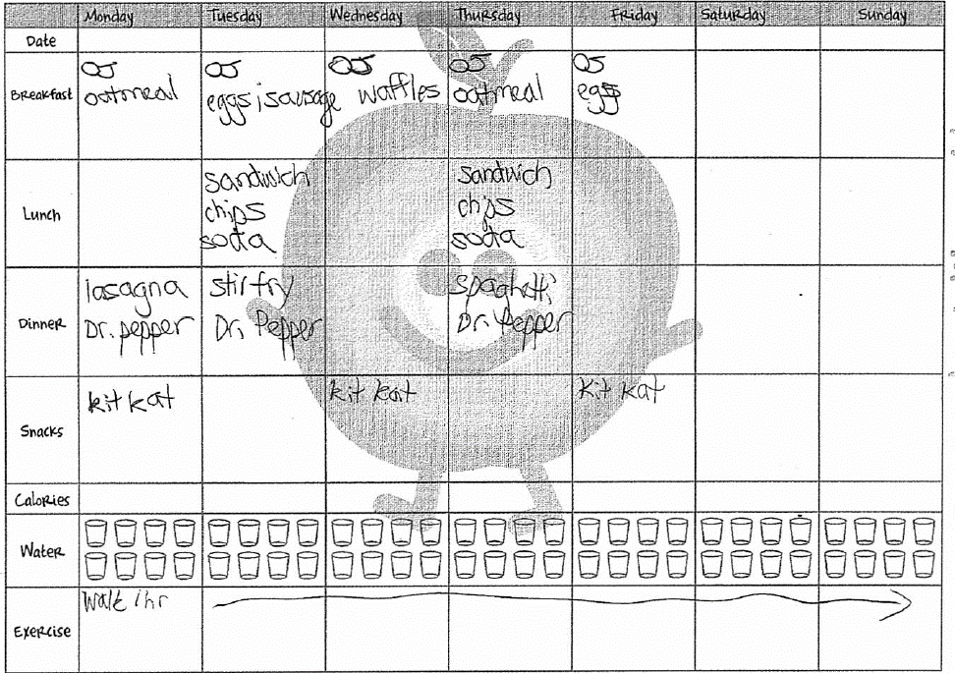
Food diary

Slide 36
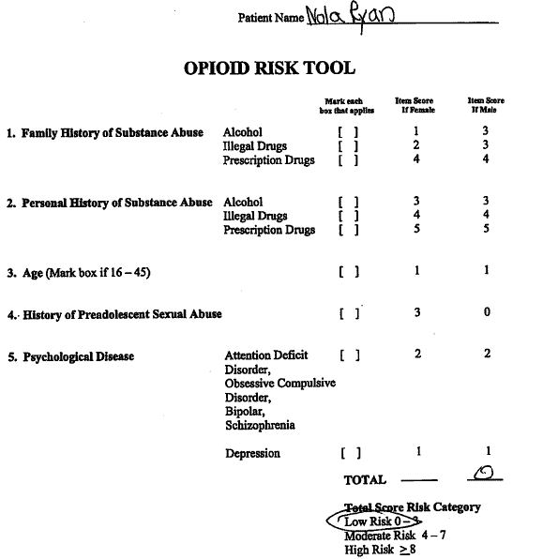

Slide 37
Zoom poll
Sertraline can cause a false positive for benzos on a UDS
True
False

Slide 38
Zoom poll
The "unholy trinity" is characterized by a short-acting opiate, benzodiazepine, and muscle relaxant.
True
False

Slide 39
Example patient 2
Days ago | Weight | Height
-- | 115 | 5’4”
 | BMI | 19.7
7 | Lipids (F) | TC 197
 |  | TRG 195
 |  | LDL 110
 |  | HDL 48
 |  | Non-HDL 149
CC: “I need more medications”
HPI: See chart→
PMH: LBP, pelvic pain
ROS: BP 128/64, HR 96, RR 24, 96% ORA
PE: significant guarding on exam
Allergies: NKDA
Labs: others WNL
Medications: prozac 60 mg, xanax 1 mg prn, vyvanse 40 mg, oxycodone 20 mg q 2 hrs, oxycodone 30 mg q 3 hrs, oxycontin 60 mg 2 bid
SH: has state qualifying disability, (-) etoh, former smoker
Na 137 | Cl 98 | BUN 18 | Glucose 96 A1c 4.9%
K 3.9 | HCO3 28 | SCr 0.7
Interview: Up-to-date on immunizations including influenza, “I hate to sweat”, loves eegee’s for lunch

Slide 40
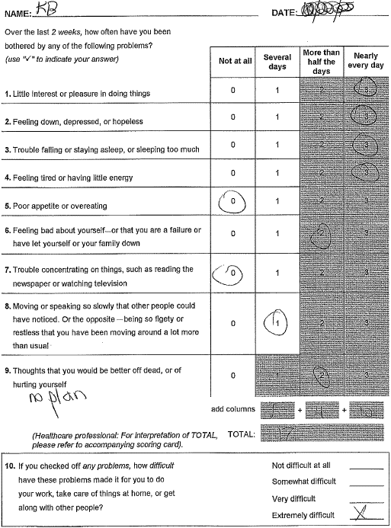

Slide 41
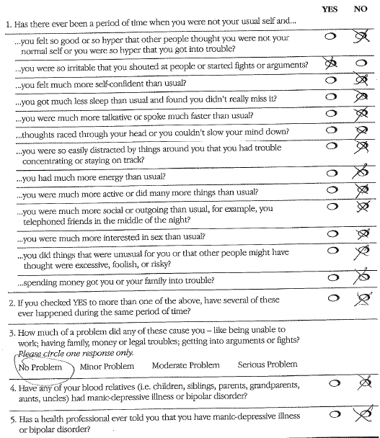

Slide 42
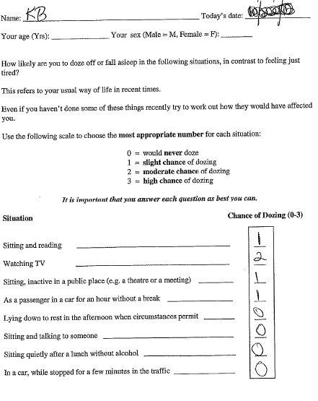

Slide 43
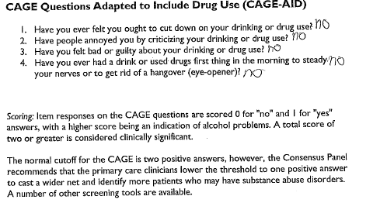

Slide 44
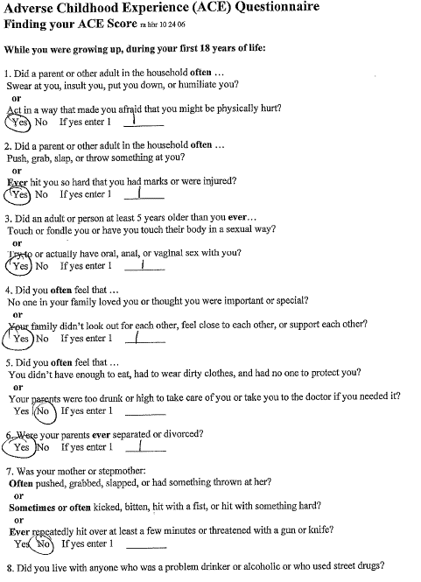

Slide 45
Patient Example 2, 1 MO follow up
Days ago | Weight | Height
-- | 119 | 5’4”
 | BMI | 20.4
37 | Lipids (F) | TC 197
 |  | TRG 195
 |  | LDL 110
 |  | HDL 48
 |  | Non-HDL 149
CC: “I need go back to my old regimen”
HPI: See chart→
PMH: LBP, pelvic pain
ROS: BP 124/74, HR 96, RR 24, 96% ORA
PE: significant guarding on exam
Allergies: NKDA
Labs: others WNL
Medications: prozac 80 mg, xanax 1 mg prn, oxycodone 20 mg q 2 hrs, oxycontin 60 mg 2 bid
SH: disabled, (-) etoh, former smoker
Na 137 | Cl 98 | BUN 18 | Glucose 96 A1c 4.9%
K 3.9 | HCO3 28 | SCr 0.7
Interview: Up-to-date on immunizations including influenza, “I hate to sweat”, loves eegee’s for lunch”

Slide 46
Take home MED Points
Keep functionality as the goal
Assess and address psychosocial factors contributing to pain
When approaching medication changes keep the following in mind…
Assess for safety first (stop or remove dangerous medications or medications that the pt is not taking (by report or negative UDS))
For medications that are appropriate, optimize doses to effect
After medication doses have been titrated to effect, continue to optimize the patient’s medication regimen by lowering doses or changing medications
The purpose in the above order is to reduce patient anxiety and push back to changes in their medication regimen. This anxiety is often being masked by the use of opiates, benzodiazepines or muscle relaxants and should be addressed via other means before adjusting these medications.

Slide 47
Questions?

Slide 48
References
Browning R, Jackson JL, O'Malley PG. Cyclobenzaprine and back pain: a meta-analysis. Arch Intern Med. 2001;161:1613-20.
van Tulder MW, Touray T, Furlan AD, Solway S, Bouter LM. Muscle relaxants for non-specific low back pain. Cochrane Database Syst Rev. 2003(2):CD004252.
Beebe FA, Barkin RL, Barkin S. A clinical and pharmacologic review of skeletal muscle relaxants for musculoskeletal conditions. Am J Ther. 2005;12:151-71.
Chou R, Peterson K, Helfand M. Comparative efficacy and safety of skeletal muscle relaxants for spasticity and musculoskeletal conditions: a systematic review. J Pain Symptom Manage. 2004;28:140-75.
Toth PP, Urtis J. Commonly used muscle relaxant therapies for acute low back pain: a review of carisoprodol, cyclobenzaprine hydrochloride, and metaxalone. Clin Ther. 2004;26:1355-67.

Slide 49
References
Pincus T, Burton AK, Vogel S, Field AP. A systematic review of psychological factors as predictors of chronicity/disability in prospective cohorts of low back pain. Spine. 2002;27:E109-20.
Hirase T, Hirase J, Ling J, Kuo PH, Hernandez GA, Giwa K, Marco R. Duloxetine for the Treatment of Chronic Low Back Pain: A Systematic Review of Randomized Placebo-Controlled Trials. Cureus. 2021 May 22;13(5):e15169. doi: 10.7759/cureus.15169. PMID: 34046287; PMCID: PMC8140818.
Urquhart DM, Wluka AE, van Tulder M, et al. Efficacy of Low-Dose Amitriptyline for Chronic Low Back Pain: A Randomized Clinical Trial. JAMA Intern Med. 2018;178(11):1474–1481. doi:10.1001/jamainternmed.2018.4222

Slide 50
References
Schnitzer TJ, Gray WL, Paster RZ, Kamin M. Efficacy of tramadol in treatment of chronic low back pain. J Rheumatol. 2000;27(3):772-778.
Ruoff GE, Rosenthal N, Jordan D, Karim R, Kamin M for the Protocol CAPSS-112 Study Group. Tramadol/acetaminophen combination tablets for the treatment of chronic lower back pain: a multicenter, randomized, double-blind, placebo-controlled outpatient study. Clin Ther. 2003;25(4):1123-1141.
Malanga G, Wolff E. Evidence-informed management of chronic low back pain with nonsteroidal anti-inflammatory drugs, muscle relaxants, and simple analgesics. Spine J. 2008;8(1):173-184.
Gagnier JJ, van Tulder M, Berman B, Bombardier C. Herbal medicine for low back pain. Cochrane Database Syst Rev. 2006;2:CD004504.
Staiger TO, Gaster B, Sullivan MD, Deyo RA. Systematic review of antidepressants in the treatment of chronic low back pain. Spine. 2003;28(22):2540-2545.

