Slide 1

STRATEGIC
FOCUSED
Quality Improvement Seminar
Mark Splaine & Emma Warshauer
January 23, 2025
RELEVANT
INTERACTIVE
TEAM WORK
INFORMATIVE
FUN
SKILL BUILDING
Nurse Practitioner & Physician Assistant
Training Programs

Slide 2
Session Goals
Appreciate the value of using balanced measures in quality improvement work
Construct a value compass of measures for a specific clinical example
Recognize the difference between a conceptual and an operational definition
Develop an operational definition for a measure
Formulate a plan for collecting data for a specific measure and identify potential associated challenges in the data collection
2

Slide 3
Roles
Theory burst presenter
Mark
Facilitator, timekeeper & technical genius
Emma
Take-home thoughts
Garrett or Emma
3

Slide 4
Agenda
Welcome (5 mins)
Balanced measures (5 mins)
Measure examples from teams (15 mins)
Defining measures (15 mins)
Measure Example from Garrett (10 mins)
Break (5 mins)
Small group discussion in teams (25 mins)
Data collection plans (5 mins)
Summary and take-home points (3 mins)
Preview of next session (2 mins)
4

Slide 5
Curriculum Plan
An overview of Quality Improvement (10/10/24)
Care Observations & Stakeholder Considerations (10/24/24)
Organizing your Improvement Project (11/14/24)
Global Aim and Fishbone Diagram (12/12/24)
Process Mapping (Flowcharts) (1/9/25)
Measurement to Inform Change (1/23/25 & 1/30/25)
An Approach to Testing a Change (2/13/25)
Communication about your Improvement Effort (2/27/25)
Stakeholder Analysis & Conflict Management (3/13/25)
Managing Up and Gaining Leadership Buy-In (3/27/25)
Negotiation (4/10/25)
Negotiation and More About Cycles of Change (4/24/25)
Sustaining your Improvement Effort (5/8/25)
Resident Presentations (5/22/25, 6/12/25, 6/26/25)

Slide 6
Model for Improvement
What are we trying to accomplish? (Aim)
How will we know that a change is an improvement? (Measures)
What change can we make that will result in improvement? (Change)
Three questions...
…coupled with
an approach for
testing change.
Act
Plan
Study
Do
Langley GJ, et. al. The Improvement Guide (2nd Edition), 2009.
6

Slide 7
Value Compass Diabetes Care
Functional Status
Emotional functioning
Days missed from work
Clinical Outcomes
Satisfaction
Hemoglobin A1C
Patient’s perspective
Medication changes
Costs
Medications
Admissions
Clinic visits
ED visits
7

Slide 8
Assignment for Session VI
Revise your flowchart, if needed, based on today’s discussion or additional ideas you have about the actual process
Watch the video on Balanced Measures
Next, review your process and brainstorm as a group about a balanced set of measures for your process
8
Notes:
www.clinicalmicrosystem.org
8

Slide 9
Poll Question?
Tell us about your experience in drafting some possible measures related to your project (select one).
It was pretty straightforward; we have a few in mind.
It was a bit challenging; we came up with one or two.
It was hard; we are not sure about how to do this.
Our team did not get that far in our work.
Thanks for sharing!

Slide 10

Examples from Teams
We will hear from some teams:
Fiona & Sarah
Alexxis & Modupe
Share your summary in roughly 3 minutes so we have time for questions and discussion

Slide 11
Example – CHC Hartford

Slide 12
Example – Holyoke HC

Slide 13
Approach to Developing Measures
Understand your process
Know what question(s) you are trying to answer to achieve your aim
Develop a set of possible measures
Choose one (or a couple) of measures
Define the measures and develop a method for collecting the data
13

Slide 14
Measure Definitions
Conceptual
Brief statement describing a variable of interest
Tells what you want to measure
Operational
A clearly specified method for reliably sorting, classifying or measuring a variable
Tells how a variable should be measured
14

Slide 15
Clean Room Example
Think about the concept of room cleanliness
Defined as a room that is clean in the context of where the room is and what purpose the room serves.
Provide examples of an operational definition for a clean room for :
Teenager’s Bedroom
(Middletown, New Britain, Open Door, Holyoke, Yakima)
Luxury Suite at Ritz Carleton Hotel
(DePaul, HealthLinc, Stamford, Meriden, Hartford)
15

Slide 16
Questions for operationally defining a measure
What is the phenomenon?
What aspect will you measure?
How do you know the measure reflects the phenomenon faithfully?
How will measurement be made?
How will the measure be displayed?
Who will do the measurement and display?
16

Slide 17
Diabetes Examples
Measure | Conceptual Definition | Operational Definition
HbA1c | Measure of average blood sugar control | Lab test ordered on all diabetic patients every three months; results of last test entered into diabetic flowsheet before office visit by medical assistant; if test not up-to-date, patient is called by medical assistant and asked to have test done before next visit.
Emotional Function | Patient’s self-assessment of depression symptoms | Survey (PHQ9) given to patient upon check-in to appointment by receptionist; medical assistant computes score for completed survey and enters value into diabetes flowsheet; done every six months for all diabetic patients.
ER Visits | Patient use of Emergency Room for care | Medical record review by a patient care technician confirms date of and reason for any Emergency Room visit in the previous six months; results of review entered into the diabetes flowsheet prior to office visit; done prior to every office visit for all diabetic patients.
17

Slide 18
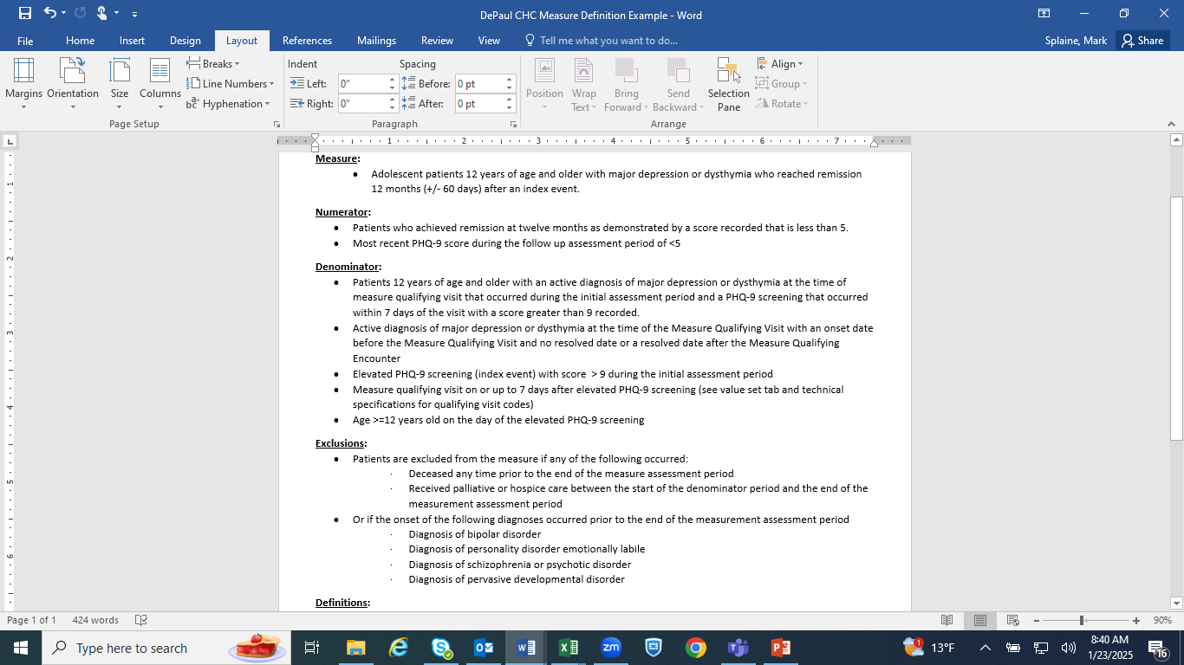
Example – DePaul CHC

Slide 19
Evaluation of Psychiatric Re-Hospitalization at a Federally Qualified Health Center
DNP Project Defense

Slide 20



Break!
Take five minutes to recharge and refresh.
20

Slide 21
Measure Discussion
We will break into team-based groups (15 minutes)
Each group will discuss one measure you think will be critical to your project
Questions:
Why is this measure critical?
Are the data for this measure currently available?
If yes, what is the source for the data?
If no, how are you thinking you might gather these data?
What issues or questions does you have related to gathering data for this measure?
Be prepared to share your answers with the large group
21

Slide 22
Small Groups for Measure Discussion
We will break into project groups:
CHC Meriden
CHC PMHNP’s
DePaul CHC
CHC Hartford
Montefiore MG
Holyoke HC
CHC Middletown
Yakima NHS
CHC Stamford
Open Door
CHC New London

Slide 23
Highlights from Project Groups
Reporter’s summary from some groups -- share 1 or 2 highlights from the discussion

Slide 24
Developing a data collection plan
Be clear about who does what when
Consider what is needed to collect the data
Try to build the data collection into the process of work
Pilot the data collection and then revise it as needed
24

Slide 25
Data Collection Plan Questions
What data will you collect?
How will the data be analyzed?
Will the data be stratified? If so, what will be the strata?
How much data will be collected?
When will data collection start and stop?
Who will collect the data and where?
Who needs what training to collect these data?
When will the data collection be piloted?
25

Slide 26
Issues that often come up…
Deciding how much data you need
Understanding who might need training to collect the data
How to display the measure
Doing a pilot test
26

Slide 27
What haven’t we figured out yet?
Questions or issues that remain unclear?
27

Slide 28
Take-home Thoughts
Garrett or Emma – share 1 or 2 ideas you will take away from our discussion
28

Slide 29
Summary
Attention must be given to selecting, defining and collecting data for any measure
This always sounds easier than it actually is, so one should leave time to do this well
Practice is helpful, and even more useful when applied to something specific on which you are working
29

Slide 30
Session VII Assignment
Focus for next session on January 31st is understanding variation
We will discuss how to identify different patterns of variation and what these patterns mean
We will learn about run charts as a new way to display data over time and analyze the data for the type(s) of variation present
Please read the following
Perla article on run charts (BMJ Quality and Safety)
http://qualitysafety.bmj.com/content/20/1/46.abstract
30
Notes:
www.clinicalmicrosystem.org
30

Slide 31
Upcoming Office Hours
The next office hours will be on 2/6 from 11:00am-12:00pm EST
Email Mark if this time does not work for your team and you would like to meet at another time.
Have had several very productive conversations with teams thus far and welcome the opportunity to continue to help each team move forward in their work.
31
Notes:
www.clinicalmicrosystem.org
31

Slide 32
References
Langley GJ, Moen R, Nolan KM, Nolan, TW, Norman CL, and Provost LP. The Improvement Guide: A Practical Approach to Enhancing Organizational Performance (2nd Edition). San Francisco, CA: Jossey-Bass, 2009. Chapter 1, pp 23-25.
Nelson EC, Splaine ME, Batalden PB, Plume SK. Building measurement and data collection into medical practice. Ann Intern Med 1998; 128(6): 460-466.
George ML, Rowlands D, Price M, and Maxley J. The Lean Six Sigma Pocket Toolbook. New York, NY: McGraw-Hill, 2005. Chapters 6 and 7, pp 104-118.
32
Notes:
www.clinicalmicrosystem.org
32

Slide 33
Ideas for Team Measures

