Slide 1

STRATEGIC
FOCUSED
Quality Improvement Seminar
Mark Splaine & Emma Warshauer
January 30, 2025
RELEVANT
INTERACTIVE
TEAM WORK
INFORMATIVE
FUN
SKILL BUILDING
Nurse Practitioner & Physician Assistant
Training Programs

Slide 2
Session Goals
Demonstrate the value of displaying data over time
Introduce the distinction between random (common cause) and non-random (special cause) variation
Review a temporal display and analysis method -- the run chart
Offer examples in practice of using time plots and run charts
2

Slide 3
Roles
Theory burst presenter
  Mark
Facilitator, timekeeper & technical genius
  Emma
Take-home thoughts
  Emma and Mark
3

Slide 4
Agenda
Welcome (5 minutes)
Three theory bursts
  Displaying data over time & example (10 minutes)
  Types of variation (5 minutes)
  Overview of run charts (10 minutes)
Application exercises
  Interpreting a run chart example (15 minutes)
  Case study and discussion (15 minutes)
  Using the templates (10 minutes)
Summary and take-home points (5 mins)
4

Slide 5
Curriculum Plan
  An overview of Quality Improvement (10/10/24)
  Care Observations & Stakeholder Considerations (10/24/24)
  Organizing your Improvement Project (11/14/24)
  Global Aim and Fishbone Diagram (12/12/24)
  Process Mapping (Flowcharts) (1/9/25)
  Measurement to Inform Change (1/23/25 & 1/30/25)
  An Approach to Testing a Change (2/13/25)
  Communication about your Improvement Effort (2/27/25)
  Stakeholder Analysis & Conflict Management (3/13/25)
  Managing Up and Gaining Leadership Buy-In (3/27/25)
  Negotiation (4/10/25)
  Negotiation and More About Cycles of Change (4/24/25)
  Sustaining your Improvement Effort (5/8/25)
  Resident Presentations (5/22/25, 6/12/25, 6/26/25)

Slide 6
Model for Improvement
What are we trying to accomplish? (Aim)
How will we know that a change is an improvement? (Measures)
What change can we make that will result in improvement? (Change)
Three questions...
…coupled with
an approach for
testing change.
Act
Plan
Study
Do
Langley GJ, et. al. The Improvement Guide (2nd Edition), 2009.
6

Slide 7
Displaying Data Over Time
7

Slide 8
Diabetics & Flu Shots
8

Slide 9
Time Plot
A graph of data in time order
Often kept to identify if and when problems appear (proactive)
Also used to see trends over time (reflection)
Especially helpful when you implement a change to follow the result
9

Slide 10
Diabetes Stratified Time Plot
Blood Sugar (mg/dl)
Morning Readings
Days
Before Bed Readings
Goal
10

Slide 11
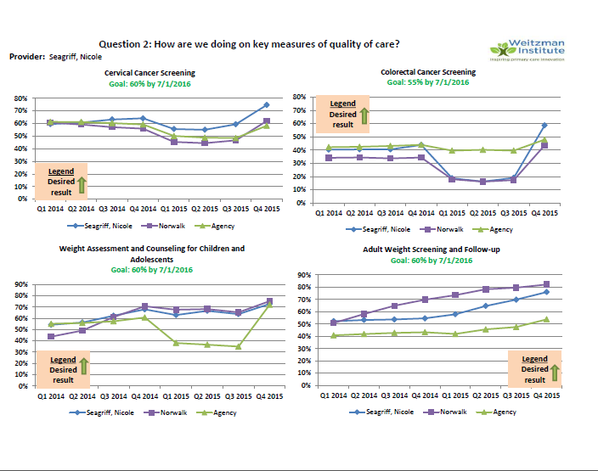
Example from Nicole Seagriff, DNP

Slide 12
Two Types of Variation
Random (common cause) variation
Non-random (special cause) variation
12

Slide 13
Random Variation
Typically due to a large number of small sources of variation
  Example: Variation in arrival time of a patient might include: weather, vehicle problems, parking issues
Usually requires a deep understanding of the process to change
13
Notes:
www.clinicalmicrosystem.org
13

Slide 14
Non-Random Variation
Are not part of the process all the time. Arise from special circumstances
  Example: Patients arrive late for appointments due to a bus strike
Usually best uncovered when monitoring data in real time (or close to that)
14
Notes:
www.clinicalmicrosystem.org
14

Slide 15
How to React to Variation
Process result
Action
Identify the cause:
If positive, then can it be replicated or standardized.
If negative, then cause needs to be eliminated
Target the special causes - to get the process predictable
Process with non-random variation
Not satisfied with result: redesign process to get a better result
Reduce variation:
make the process even more predictable or reliable
Process with only random variation
15

Slide 16
Run Charts
Detecting non-random (special cause) variation
16

Slide 17
Anatomy of a Run Chart
Center line is MEDIAN
Variable “y”
Time
17
Notes:
www.clinicalmicrosystem.org
17

Slide 18
Run Chart Example
Median
Fasting Blood Sugar (mg/dl)
Days
18

Slide 19
What is a Run?
A “run” is one or more consecutive points on the same side of the median
The presence of runs is where the chart gets it name
Perla, Provost, and Murray. BMJ Qual Saf. 2011;20:46-51
19

Slide 20
A Run is a point or group of consecutive points that fall on one side of the median
How to Count Runs
Fasting Blood Sugar (mg/dl)
Days
20

Slide 21
Non-Random Patterns on Run Charts
The presence of a shift in the process
  A run that is too long (6 or more consecutive points on one side of the median)
The presence of a trend
  A run with consecutive increases or decreases in data (5 or more consecutive points)
The presence of too much or too little variability
  Too few or too many runs (depends on number of points on the chart)
Perla, Provost, and Murray. BMJ Qual Saf. 2011;20:46-51
21

Slide 22
Table. Runs Rule Guidance
Number of observations excluding points on the median | Lower limit for the number of runs | Upper limit for the number of runs
13 | 4 | 11
14 | 4 | 12
15 | 5 | 12
16 | 5 | 13
17 | 5 | 13
18 | 6 | 14
19 | 6 | 15
20 | 6 | 16
21 | 7 | 16
22 | 7 | 17
23 | 7 | 17
24 | 8 | 18
25 | 8 | 18
26 | 9 | 19
27 | 10 | 19
28 | 10 | 20
29 | 10 | 20
30 | 11 | 21
31 | 11 | 22
22
Source: Perla, Provost, and Murray. BMJ Qual Saf. 2011;20:46-51

Slide 23
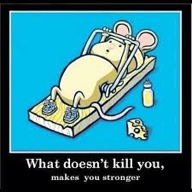
Run Chart Interpretation
Exercise
Work with your site colleagues or alone if needed
Use the slide handouts (slides #18, #21, #22)
Answer the questions on the next slide
Be prepared to discuss your answers
in a couple of minutes
23

Slide 24
Questions
What does the blue line on the graph represent?
How many runs are there?
How many shifts do you see?
How many trends are in the data?
How many non-random patterns (special cause signals) are met in this run chart?
What is your interpretation of the chart?
24

Slide 25
Discussion of Answers to Questions
What did you decide?
25

Slide 26
Q1. What does the blue line represent?
The Median
Run charts use the Median as the central tendency measure
Fasting Blood Sugar (mg/dl)
Days

Slide 27
There are 14 Runs
Q2. How many runs are there?
Fasting Blood Sugar (mg/dl)
Days

Slide 28
There is ONE Shift
Q3. How many shifts do you see?
Fasting Blood Sugar (mg/dl)
Days

Slide 29
There are NO Trends
Q4. How many trends are in the data?
Fasting Blood Sugar (mg/dl)
Days

Slide 30
There is ONE Signal
Q5. How many non-random patterns?
Non-random pattern (Shift)
Fasting Blood Sugar (mg/dl)
Days
Runs = 14
Shifts = 1
Trends = 0

Slide 31
Q6. What is your interpretation of the chart?
Non-random pattern (Shift)
Fasting Blood Sugar (mg/dl)
Days
There is non-random (special cause) variation present. One would need to investigate why this occurred. Since the cause is in the wrong direction, one would ideally like to eliminate this cause from the system.
Note: upon talking to the patient, the special cause was related to him eating dessert every night while on vacation. Some education about diet could then eliminate the cause.

Slide 32



Break!
Take five minutes to recharge and refresh.
32

Slide 33
Interpreting of Run Charts
Diabetes Foot Care Case
33

Slide 34
Diabetes Case Introduction
Already made improvements (hemoglobin A1c and cholesterol blood tests)
Focusing now on diabetic foot care
Providers checking feet, but documentation of a complete foot exam is not often present
Challenges – lack of monofilaments, lack of knowledge about where to check, lack of time
Made a couple of changes
  Reviewed how to do the foot exam properly
  All exam rooms are stocked with monofilaments
34

Slide 35
Initial Run Chart
What type of variation do you see (random or non-random)?
What do you think about the median (% receiving a exam)?
35

Slide 36
Initial Run Chart Interpretation
What type of variation do you see (random or non-random)?
  No non-random patterns
What do you think about the median (% receiving a exam)?
  Median is very low (~17%). Need to change process to change the results
36

Slide 37
Case Part 2 (Group Activity)
New Information
  The LNAs on the team received training to perform the monofilament exam
  They take on responsibility for doing these exams beginning in May 2013.
  In addition, some members of the team developed a flowsheet for diabetic patients which began use in November 2013.
Review the updated data on the next slide

Slide 38
Case Part 2 Run Chart
Questions:
Do you see and non-random variation patterns?
What do you conclude about this team’s improvement efforts?
38

Slide 39
Case Part 2 Discussion
Random or non-random variation?
  4 non-random patterns (too few runs, 2 shifts, 1 trend)
Conclusion about improvement efforts?
  Successful based on shift and trend; see where it will plateau

Slide 40
Prospective Monitoring of Data Using a Run Chart
Pneumonia Vaccine for Outpatient Diabetes Care
(Optional Review – view video of this demonstration using the link: https://us02web.zoom.us/rec/play/p4CzoW_25ZN3l3BWddwGsHqmQ5cJTfSwhu9teIzVBYfiWEU7sOPYPqPkgj-A_bo4f1phlk2hiinnfZUe.1ajuhtOHQ5e88uT0)
40

Slide 41
Using the Templates
Time Plot & Run Chart
41

Slide 42
What haven’t we figured out yet?
Questions or issues that remain unclear?
42

Slide 43
Take-home Thoughts
Emma and Mark – share 1 or 2 ideas you will take away from our discussion
43

Slide 44
Summary
Variation over time is intrinsic to all health care & other work processes.
Displaying data over time can help visualize the variation present.
Understanding that variation can help monitor, adjust and improve processes.
Studying variation with run charts can offer insights about possible cause of that variation and offer clues to the design of change.
44

Slide 45
Session VIII Assignment
You have learned about a tools for displaying data over time (time plot & run chart)
Now it is your turn to use the tool(s)
  Templates sent by email previously
Assignment for next time
  Pick a measure for your project and display it on a time plot or run chart (the data can be real or what you hope to collect), then interpret the results
  A second option is to display de-identified clinical data on a run chart or time plot and interpret the results
  Send your display and interpretation to Mark and Emma by Wednesday (2/12/25) before the next session
45
Notes:
www.clinicalmicrosystem.org
45

Slide 46
Help With Data
We know this is hard, and we want to assist you with this part of your project
If you would like some assistance with data, please reach out to us or come to Office Hours (next is Feb 6th from 11:00am-12:00pm ET)
46
Notes:
www.clinicalmicrosystem.org
46

Slide 47
References
  Langley GJ, Moen R, Nolan KM, Nolan, TW, Norman CL, and Provost LP. The Improvement Guide: A Practical Approach to Enhancing Organizational Performance (2nd Edition). San Francisco, CA: Jossey-Bass, 2009. Chapter 1, pp 23-25.
  Perla RJ, Provost LP, and Murray SK. The run chart: a simple analytical tool for learning from variation in healthcare processes. BMJ Qual Saf. 2011;20:46-51.

Slide 48
Ideas for Team Measures

