Slide 1

Health Professions Student Training Learning Collaborative
Quality Improvement Training
Monday February 10th, 2025

Slide 2
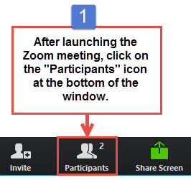
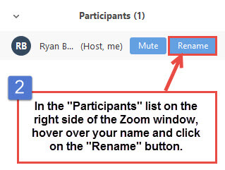
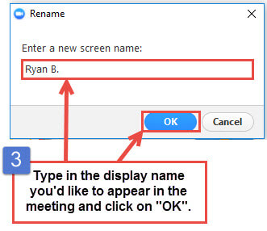
Get the Most Out of Your Zoom Experience
Please keep yourself on MUTE to avoid background/distracting sounds
Use the CHAT function or UNMUTE to ask questions or make comments
Please change your participant name to your full name and organization
  “Meaghan Angers CHCI”
Notes:
Meaghan

Slide 3
Quality Improvement Training Agenda
3:00-3:05pm | Welcome and Review Agenda
3:05-3:15pm | Foundation for Effective Meetings
3:15-3:35pm | How to Make Your Team Work
3:35-3:50pm | Communication Plan and Stakeholder Analysis
3:50-4:00pm | Activity: Stakeholder Analysis and Communication Plan
4:00-4:10pm | Introduction to Playbooks
4:10-4:15pm | Wrap Up, Next Steps, and Evaluation
Notes:
Meaghan

Slide 4
Quality Improvement Training Objectives
Understand the effective use of quality improvement tools during participation in the learning collaborative opportunity
Use skills with their teams during their participation in the learning collaborative opportunity
Gain knowledge on how to use a playbook to standardize and spread processes and tools
Notes:
Meaghan

Slide 5
Quality Improvement Trainers
Deborah Ward, RN, Quality Improvement Consultant WardD@mwhs1.com
Kathleen Thies, PhD, RN, Consultant, Researcher ThiesK@mwhs1.com
Notes:
Meaghan

Slide 6


Community Health Center, Inc.
A leading Federally Qualified Health Center based in Connecticut.
ConferMED
A national eConsult platform improving patient access to specialty care.
The Consortium for Advanced Practice Providers
A membership, education, advocacy, and accreditation organization for
APP postgraduate training.
National Institute for Medical Assistant Advancement
An accredited educational institution that trains medical assistants for
a career in team-based care environments.
The Weitzman Institute
A center for innovative research, education, and policy.
Center for Key Populations
A health program with international reach, focused on the most vulnerable among us.
Notes:
Meaghan

Slide 7

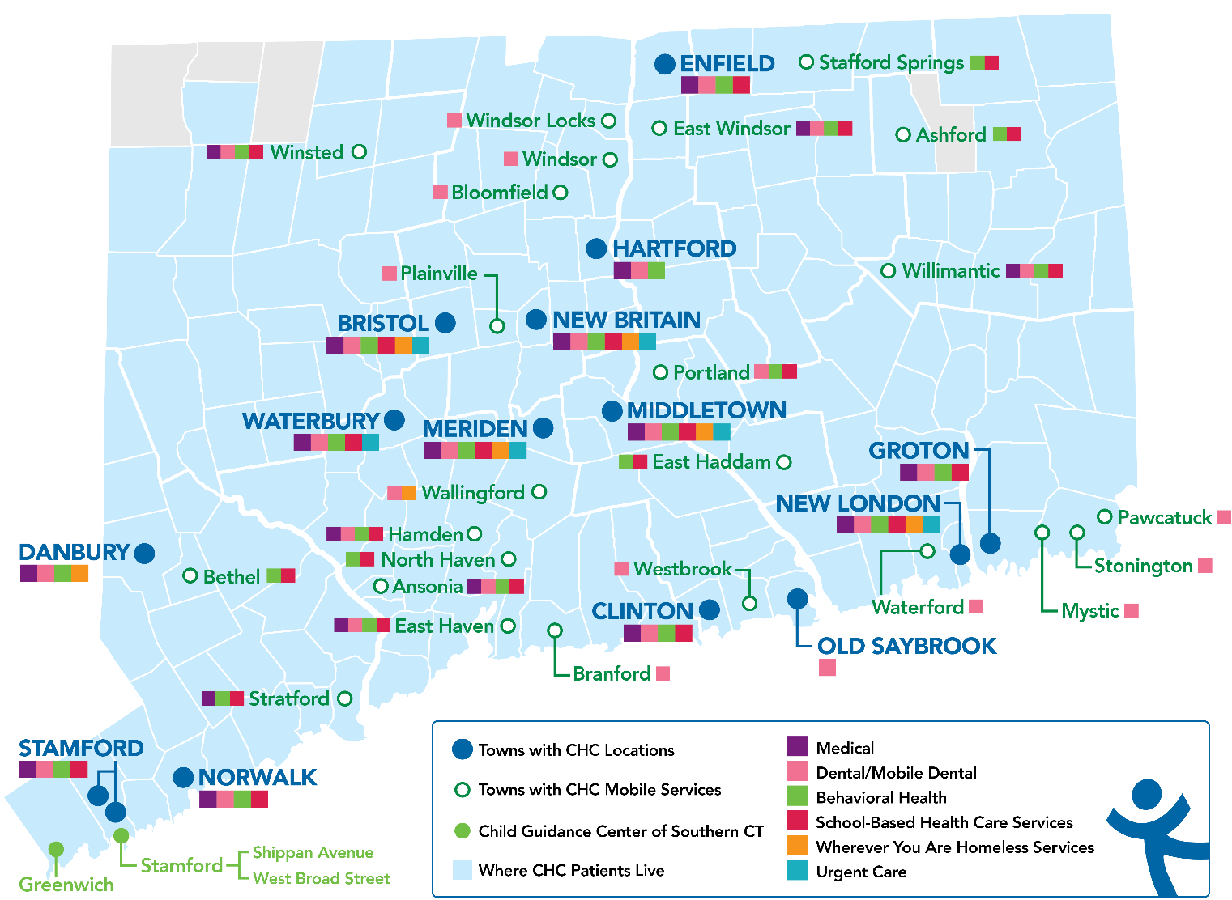
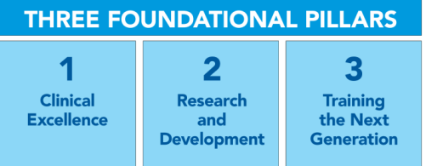
Locations & Service Sites
Profile
Founding year: 1972
Annual budget: $140M
Staff: 1,140
Active Patients: 150,000
SBHCs across CT: 153
Students/year: 14,522
Year | 2021 | 2022 | 2023
Patients Seen | 99,598 | 102,275 | 107,225
Notes:
Meaghan

Slide 8
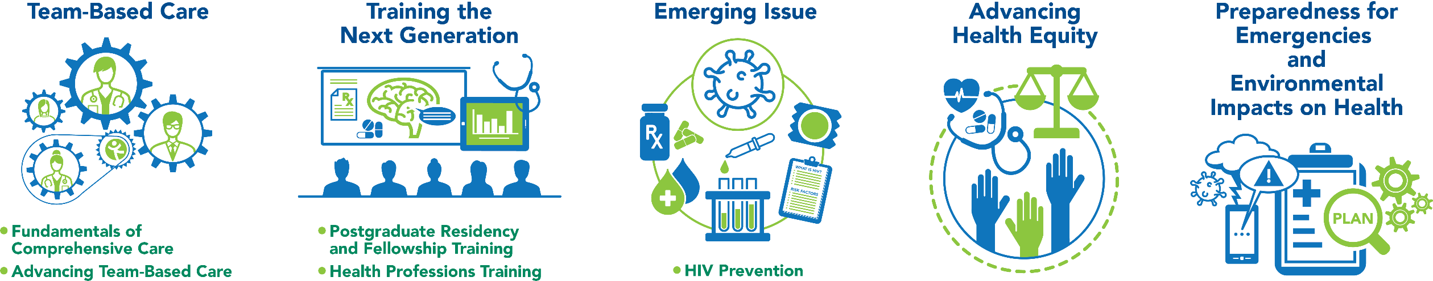
National Training and Technical Assistance Partners (NTTAP)
Clinical Workforce Development
Provides free training and technical assistance to health centers across the nation through national webinars, learning collaboratives, activity sessions, trainings, research, publications, etc.
Notes:
Meaghan

Slide 9

Foundation for Effective Meetings
Effective Meeting Skills for Effective Meetings

Slide 10
Discussion Question
What are some common frustrations you’ve experience during a group meeting?
Insert answer in the chat or unmute yourself
Notes:
Deb

Slide 11
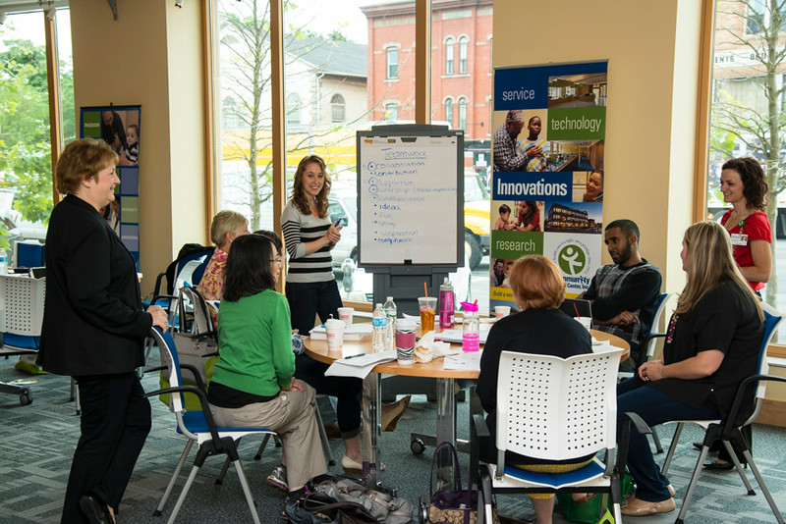
Define Teams and Roles
Who should be on the team?
Establish meeting times and days
Video or in-person?

Slide 12

Assume good intent
Phones on mute
Keep laptops closed
Meeting Norms
Ground Rules
Use specific examples
Be kind/ Respectful
Equal airtime
Notes:
Deb

Slide 13

Meeting Roles
Facilitator/Coach
Time Keeper
Recorder
Leader
Notes:
Deb

Slide 14

Knowing the Difference
Content
Process
What
Topics
Agenda
Outcomes
How
Tools
Flow
Interaction
Notes:
Deb

Slide 15
Questions to ask yourself BEFORE every meeting:
What do I need from this meeting?
What do I already know about this topic?
What do I expect I/we can do/have after the meeting that I cannot do/have now?
What do I need from other members from this team?
What can I personally contribute to this team/project?
Notes:
Deb

Slide 16
Questions to ask yourself AFTER every meeting:
My expectations were met by…
These are the things I can improve for the next meeting…
I was surprised to discover…
I commit to improving these skills…
My personal action items to improve future meetings…
Notes:
Deb

Slide 17
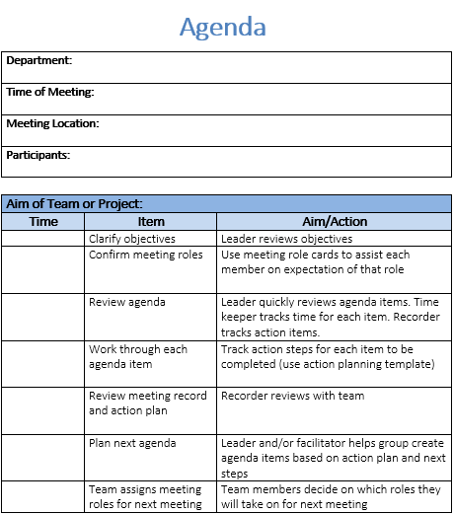
Notes:
Deb

Slide 18
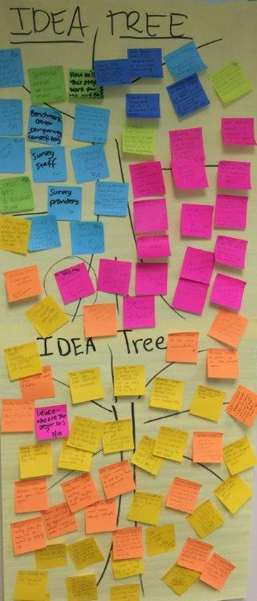
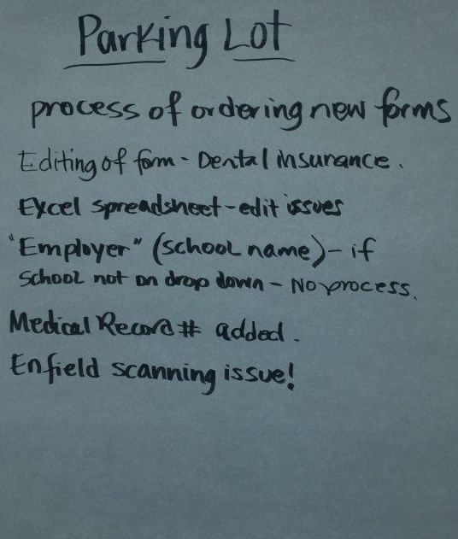
Other Helpful Tools
Notes:
Deb

Slide 19

How to Make
Your Team Work

Slide 20
Discussion Question
What committees/teams have you been on that worked well and why?
Insert answer in the chat or unmute yourself
Notes:
Kathleen

Slide 21
Discussion Question
What committees/teams have you been on that did not work well and why?
Insert answer in the chat or unmute yourself
Notes:
Kathleen

Slide 22
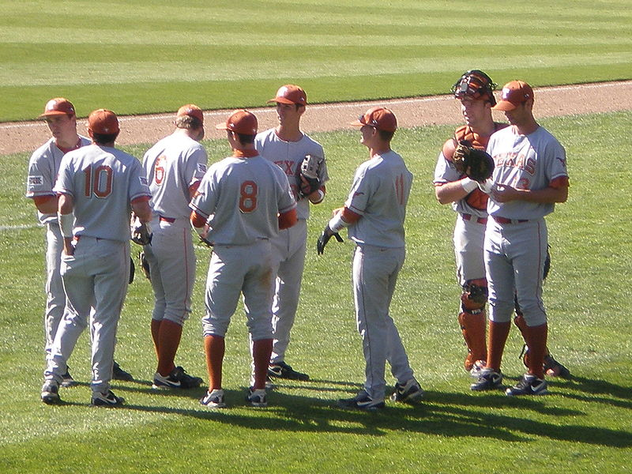
Baseball Teams
Know the roles of the pitcher, catcher, basemen, outfielders…and the umpire.
They have a manager.
They have a coach.
Batters have studied how pitchers pitch;
pitchers have studied how batters bat.
They know their scores. And the scores of other teams.
They know different ball parks and where the boundaries for a home run are.
They know their fans.
They practice….a lot.
They stay in shape.
Notes:
Kathleen

Slide 23
Team Development
Team
Handbook
Normalization
Process Theory
  Forming
  Storming
  Norming
  Performing
  Coherence
  Cognitive Participation
  Collective Action
  Reflexive Monitoring
Notes:
Kathleen

Slide 24
Stages of Team Growth
Forming
  Getting started, excitement and anxiety; seek clarity of purpose but going off on tangents; setting boundaries and expectations
Storming
  Conflict arises, work/purpose different or more difficult than expected; dissatisfaction with progress, different points of view emerge, pecking order and factions emerge
Norming
  Competition yields to cooperation; members build confidence, trust, a sense of cohesion; delve into the work; tolerate missteps
Performing
  Settled into relationships and expectations, better understanding of each other’s strengths and weaknesses; can “revise on the fly”
Notes:
Kathleen

Slide 25
Normalizing Change: What We Know
Before you can change practice, you must change the individuals who work in the organization--that is, their values, attitudes, relationships, skills, and behavior. NOT a linear process!
Start with changing their minds [values, attitudes] about the work ahead….coherence.
Build relationships and ownership about how the work will be done….cognitive participation.
Get into the weeds of the work together, develop new skills, try new ways of working….collective action.
Track your progress and revise as needed….reflexive appraisal.
Notes:
Kathleen

Slide 26

Establish Coherence About Work Ahead
Coherence is about clarity of purpose, expectations and value.
Why are we here? How is the learning collaborative different from other projects?
  Be clear that the collaborative is only a kick start to advancing team-based care. This is a long term commitment!!! It will not end in 8 months.
Who is in charge?
  Differentiate between “meeting role leader” and “project leader” who is the person responsible for driving the work and reports to leadership.
Notes:
Kathleen
Be clear that the collaborative is only a kick start to implementing your program. This is a long term commitment!!! It will not end in 6 months.
Differentiate between “meeting role leader” and “project leader” who is the person responsible for driving the work and reports to leadership.

Slide 27

Establish Coherence About Work Ahead
What is expected of us? Of me?
  Clarify expectations, explain meeting rules and role of coach, set regular time to meet, expect members to be at meetings and to contribute.
Is this worth my time?
  Build value. Create a vision. Earn trust.
Failure to build coherence from the start leads to conflict, and will make it impossible to move forward. People will stop coming to meetings.
Notes:
Kathleen
Be clear that the collaborative is only a kick start to implementing your program. This is a long term commitment!!! It will not end in 6 months.
Differentiate between “meeting role leader” and “project leader” who is the person responsible for driving the work and reports to leadership.

Slide 28
Promote Cognitive Participation
Cognitive participation (really relational participation) is the relational work of team-work: Do we have the right people? How do I fit in?
Develop ownership for doing the work of the collaborative and for advancing team-based care, not “buy-in.” Looking for “buy-in” is to sell an idea people may not want to “buy.” Do we all want the same thing?
Everyone has something to offer so be sure they do or help them develop new skills.
Notes:
Kathleen

Slide 29
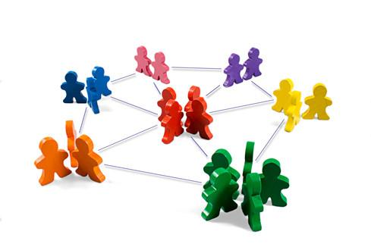
Promote Cognitive Participation
Manage conflict in the meeting. No “hall meetings.”
Use a shared mental model for how the work will be done: the Improvement Process is a highly effective systematic approach. Are we on the same page?
Without ownership and a shared mental model for how to do the work, the team lacks direction and gets frustrated. The loudest voice wins.
Notes:
Kathleen

Slide 30
Engage in Collective Action
Collective action is the operational work of teams: important to have a shared mental model, a systematic approach— Improvement Ramp!
The team is delving into the work, “in the weeds” of change, which is always more detailed oriented than people expect.
What does the data tell us? Is it valid? Is this the right specific aim?
Trust each other’s expertise and commitment, are accountable for assigned tasks. Progress is being made. Is everyone engaged?
Split up the work as needed: Are the right people doing the right tasks?
Develop new skills as needed. The team has access to resources: technology, time, data, key personnel (like IT) — managing up to get it.
Notes:
Kathleen

Slide 31

Engage in Collective Action
If some people are doing all of the work, some are not doing their share, if the systematic approach isn’t used, if resources are not available—trust erodes and work doesn’t get done.
Notes:
Kathleen

Slide 32
Practice Reflexive Monitoring
Reflexive Monitoring is the appraisal work that people do to assess and understand how change is working. It does not end.
The team measures and tracks results, talk about spread to other parts of the organization. Is this working out?
As they evaluate the work, they may make changes to refine it, or to adapt it to other settings. What fine-tuning do we need to do to make sure it is sustainable?
The appraisal is both personal as well as collective. Individuals may express personal pride in what they’ve learned, the team as a whole might feel good, and see growth in their ability to work as a team. Their efforts were worthwhile. We make a good team. I got a lot out of this.
Notes:
Kathleen

Slide 33
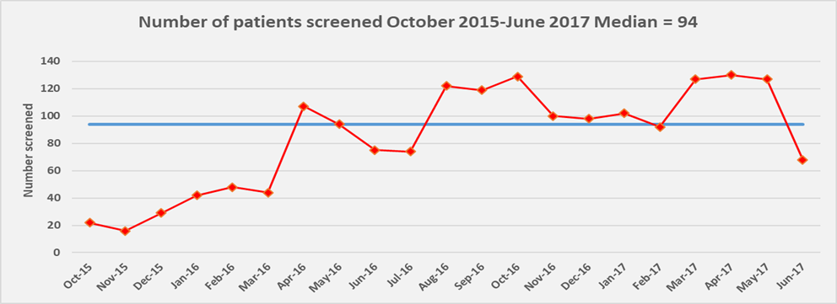
Practice Reflexive Monitoring
Without reflexive monitoring, the work cannot spread, be sustained, or be revised/improved as needed.
Notes:
Kathleen

Slide 34
Sources of Conflict
Lack of Coherence
  I don’t know who is in charge. I don’t understand the purpose. I don’t know what is expected. I don’t value this.
  Lack of Relational Work/Cognitive Participation
    No ownership. Not on the same page. No shared mental model of how to do the work. Jumping to solutions before determining what the issue is. No direction. Too many loud voices. I don’t know where I fit in. Insecurity about being a team member.

Slide 35
Sources of Conflict
  Lack of Collective Action
  Insufficient resources and administrative support. Failure to use shared mental model/systematic approach. Wrong set of skills/won’t develop new ones. Slackers and the overworked. Lack of engagement.
  Lack of Reflexive Monitoring
  No tracking. Pilot becomes policy without testing spread. No sense of accomplishment —I wasted my time.

Slide 36

Developing a Stakeholder Analysis & Communication Plan

Slide 37
Why do you need a plan to engage and communicate with stakeholders?
Control the narrative: drive the story of the work you are doing by being proactive; don’t leave it to others to guess.
Communicate on a regular basis with stakeholders in different parts of your organization
Make sure that the group implementing the innovation shares a consistent message
Anticipate/address concerns, questions and challenges.
Notes:
Kathleen

Slide 38
Step 1. Identify stakeholders
A stakeholder is someone/some department who has something to gain or lose when change is introduced.
Who is currently involved in the work that will change?
Who currently oversees this work? Who currently is accountable for the outcomes of the work?
Who will be affected by changing how this work is done and how? New roles? New workflows? New responsibilities?
What departments or sites need to be involved? Who are their leaders and how to you get to them? (Site Directors, HR, IT, etc.)
What is the opinion of the stakeholders regarding the planned change: Against? Supportive? Doesn’t matter one way or the other.
Notes:
Kathleen
who needs to know about the change efforts, what their positions and interests are, and how the change should be presented and framed so that the positive impact of their influence can be maximized. Different stakeholders need different types of information about your work, and with different levels of detail.

Slide 39
Table 1. Example of identifying stakeholders
Stakeholder | Strongly against | Moderately against | Neutral | Moderately supportive | Strongly supportive
Providers |  |  |  | C | D
IT |  | C |  | D
HR |  |  | C D
Nursing |  |  | C |  | D
Reception | C |  |  | D
Other stakeholder
C= current position D= desired position Who do you need to influence in what direction?
Notes:
Kathleen

Slide 40
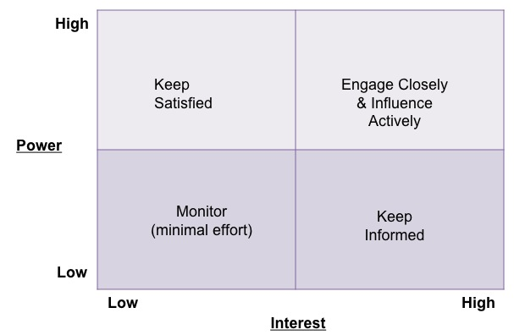
Step 2. Analyze the position of stakeholders relative to their power and interest.
What are the formal channels through which each stakeholder gets important information? The informal channels?
Notes:
Kathleen

Slide 41
COMMUNICATION PLAN FOR IMPORTANT PROJECT DATE: November 2023 PROJECT LEAD: Mrs. Peacock
Who: Stakeholder | Why communicate with this person? | What: Message(s) for this person | Who: Who in your project group is in the best position to communicate with this person? | When and how often? | How: What venues or media will be used?
Mr. Green, CEO | Has invested in time for us to meet. Will need his/her support to implement the innovation. | Assure him/her that we are using time well. Update on progress of group, lessons learned from other groups, ideas for implementation and application. Keep good energy. | Colonel Mustard, Director of Big Department and Project Lead | Monthly meeting of directors. One-on-one meetings as appropriate to request resources as needed or ask advice. | Oral report monthly but written report added to meeting minutes.
Step 3. Communication plan:
Who, what, when, where, why, how
Notes:
Kathleen

Slide 42
Final Advice
Managing up: communicating with someone above you in leadership
Be clear about expectations
Manage their expectations about your work
Manage the relationship between this leader and your work group
Leaders often move on to the next BIG Thing and suddenly promised resources disappear
Leaders want things to move more quickly and are convinced they have the solutions—you need to explain how your group works and why
Your boss has a boss: don’t leave your boss out on a limb
Speak with one voice and stay on message
Don’t gossip or complain about your work group: it erodes trust
Ask for advice, suggest solutions
Notes:
Kathleen

Slide 43
Activity
Stakeholder Analysis & Communication Plan

Slide 44

Introduction to Playbooks
Notes:
10 minutes
Deb

Slide 45
What is a Playbook?
Collection of processes and tools that have been tested using improvement science and resulted in a ‘way we want process done’.
Playbook serve as repository for standard processes (SDSAs), ensuring improvement does not ‘slip’.
The purpose is to provide a common and easy to access place to post and search all standardized processes and tools – using technology.
Quality by Design, 2007
Notes:
Deb

Slide 46
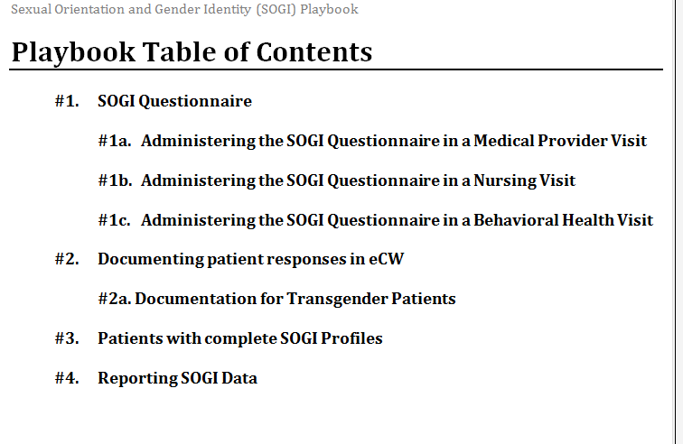
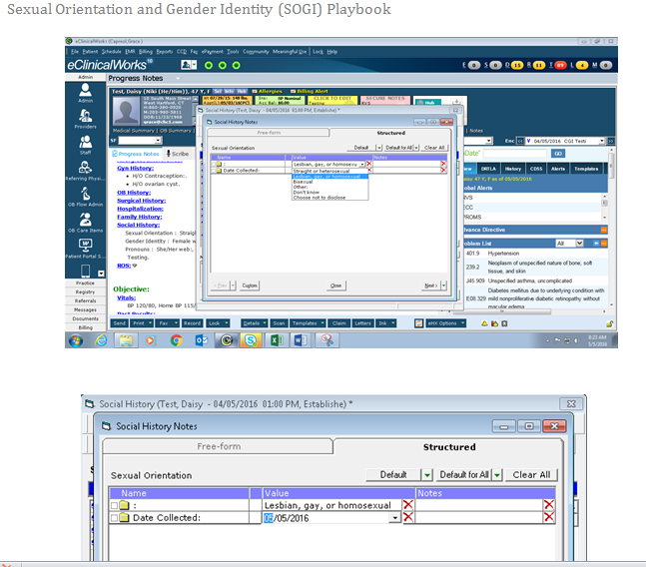
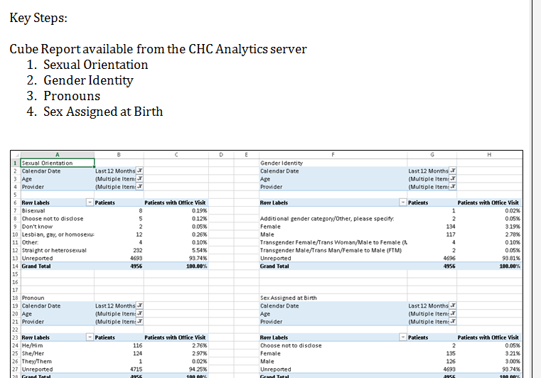
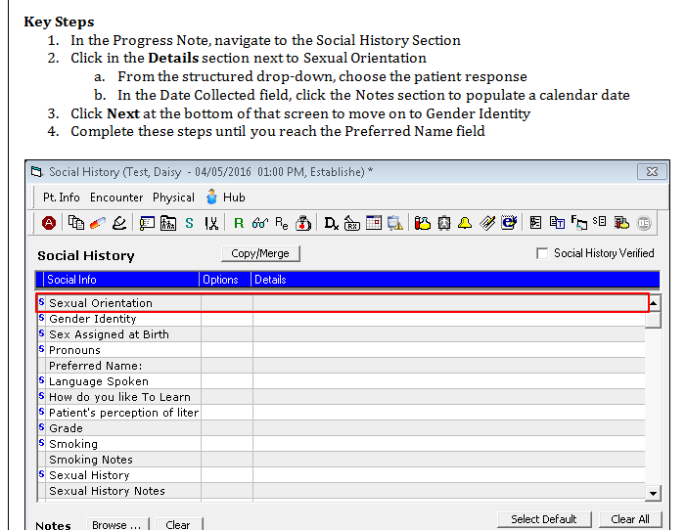
What is a playbook & Why is it important?
IHI.org
Geisinger Quality Institute
Notes:
Deb

Slide 47
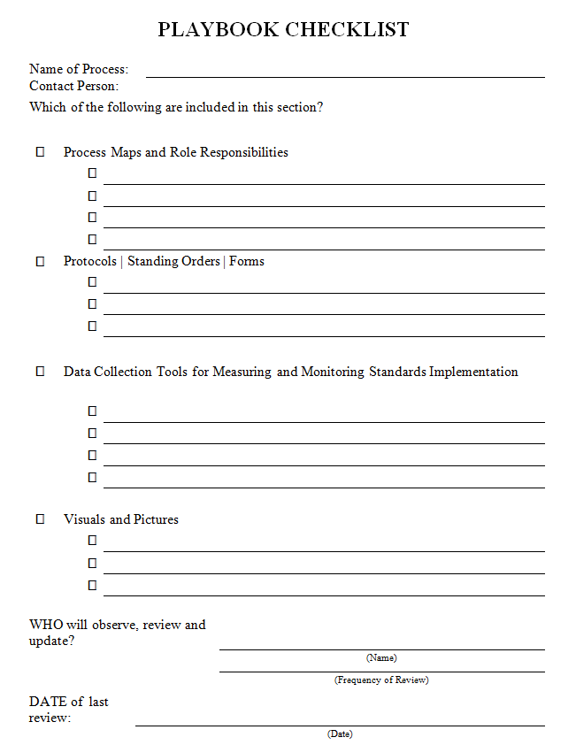
Playbook Checklist
Process Maps
Role Responsibilities
Protocols
Standing Orders
Data Collection Tools
Pictures or Visuals
Quality by Design, 2007
Notes:
Deb

Slide 48
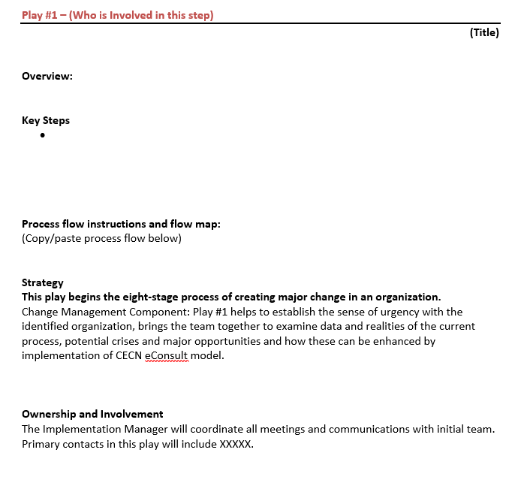
Playbook Template
Notes:
Deb

Slide 49
Questions?
Notes:
Meaghan

Slide 50
Wrap-Up
Notes:
Meaghan

Slide 51
Pre-Work: Introduction & Assessments
Collaborative begins on Friday February 14th!
Prepare a brief introduction slide deck (2 slides/2 min) about your team and your goals for participation in the Collaborative to present in Session 1; Send slides to angersm@mwhs1.com by Wednesday February 12th
As a team, review and complete Readiness to Train Assessment Tool (RTAT): https://Qualtrics.ca1.qualtrics.com/jfe/form/SV_dcBcYq89sq4KMHI
Ask each team member to complete the Organizational Readiness to Implement Change (ORIC): https://Qualtrics.ca1.qualtrics.com/jfe/form/SV_3dR57DJTbtIxpfo

Slide 52
Weitzman Education Platform
Weitzman Education Platform – this will serve as the platform to receive CE credits for each learning session and access recordings/slide decks/resources:
  Register for the course here: https://education.weitzmaninstitute.org/content/nttap-health-professions-student-training-learning-collaborative-2025
  Access Code: HPS2025
  If you do not have an account, follow these instructions: https://education.weitzmaninstitute.org/user/register
    Choose a username, password (save it somewhere safe so you can continue to use it!), and fill out some basic user information.
    Click Create New Account.
    If you encounter any technical difficulties, please reach out to myself or submit a ticket.

Slide 53

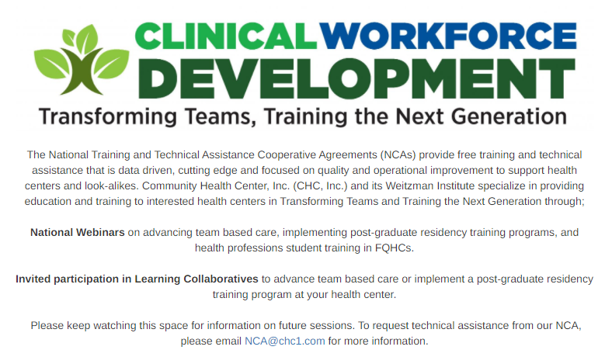

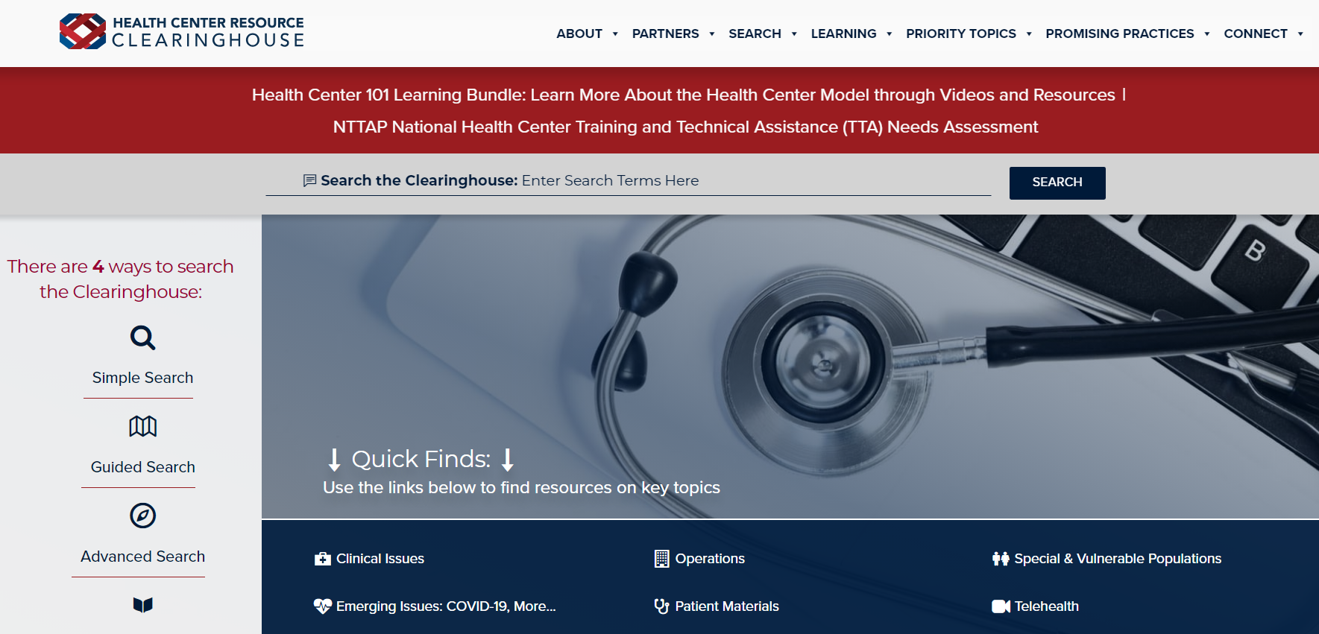
Explore more resources!
National Learning Library:
Resources for Clinical Workforce Development
Health Center
Resource Clearinghouse
https://www.weitzmaninstitute.org/ncaresources
https://www.healthcenterinfo.org/
Notes:
Meaghan

Slide 54
Contact Information
For information on future webinars, activity sessions, and learning collaboratives: please reach out to nca@chc1.com
or visit https://www.chc1.com/nca

