Slide 1
Opioid use for chronic pain
Dan Wilensky MD
Chief Preceptor
2024-2025

Slide 2
Continuing Education Credits
In support of improving patient care, Moses Weitzman Health Center is jointly accredited by the Accreditation Council for Continuing Medical Education (ACCME), the Accreditation Council for Pharmacy Education (ACPE), and the American Nurses Credentialing Center (ANCC), to provide continuing education for the healthcare team.
This series is intended for Registered Nurses
Please complete the survey and claim your post-session certificate on the WeP after today’s session.
You will be able to claim a comprehensive certificate on the WeP at the end of the series in December, 2023.
Notes:
Moses Weitzman Health Center is jointly accredited to provide continuing education credits for your participation in these live ECHO sessions.

Slide 3
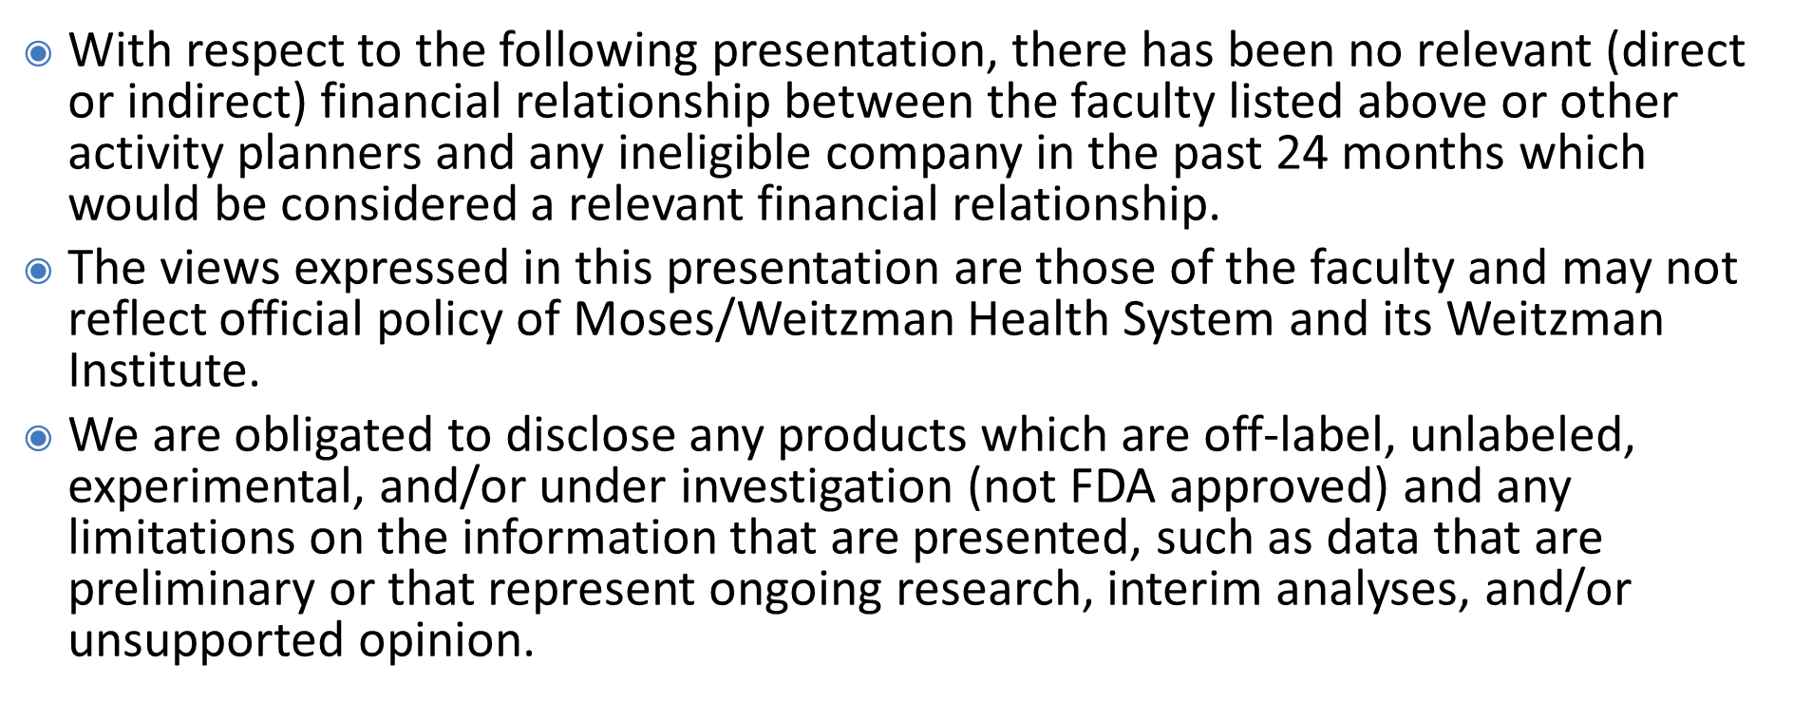
Disclosures
Notes:
The faculty members have no disclosures to report.

Slide 4
Learning Objectives
To gain better understanding of the benefits and risks of opioid prescribing for chronic pain
To recognize that we in primary care are the experts here
To lower our threshold (a bit) toward trials of opioids

Slide 5
Goals of Chronic Pain Treatment
Decrease pain
Increase function
Contribute to patient understanding and promote reasonable expectations
Use medications that do not have unacceptable side effects

Slide 6
Opioid Use Disorder is Characterized by:
Loss of control (compulsive use)
Continuation despite adverse consequences
Obsession or preoccupation with obtaining and using the substance.
Adapted from DSM V, 2013, p. 541, “Opioid Use Disorder.”

Slide 7
Physical Dependence
A property of opioids - and other drug classes
Withdrawal symptoms occur with abrupt cessation
Withdrawal symptoms are usually preventable
Tolerance
The need for increasing doses to get the same effect
Tolerance to sedation and nausea is common
Tolerance to constipation and pain relief is uncommon

Slide 8
Opioid Side Effects
Nausea & vomiting – rapid tolerance.
Sedation & respiratory depression –same
Euphoria, mood alteration – same
Constipation- ongoing. Need bowel regimen
Decreased testosterone level - Treat

Slide 9
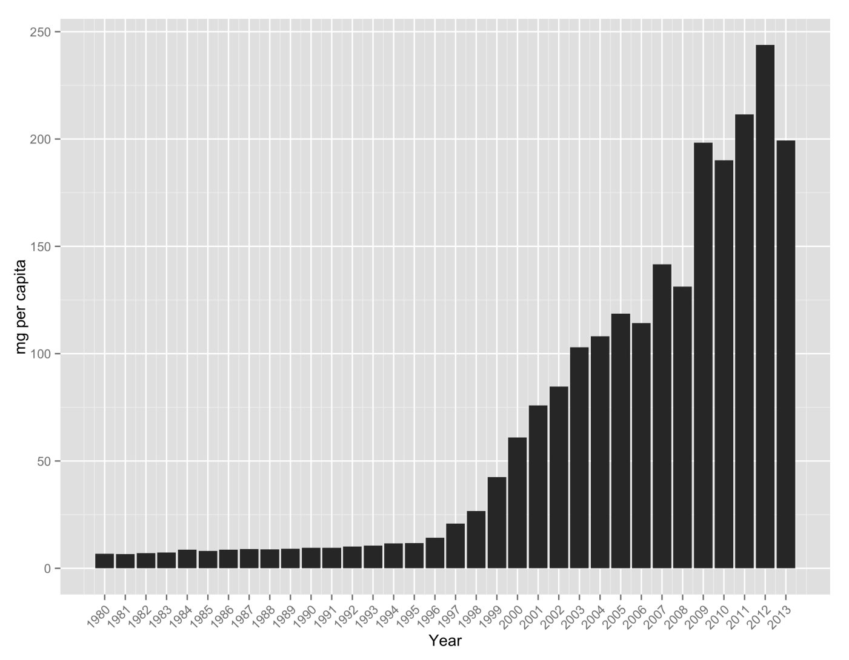
Oxycodone Consumption (mg/capita) 1980-2013

Slide 10
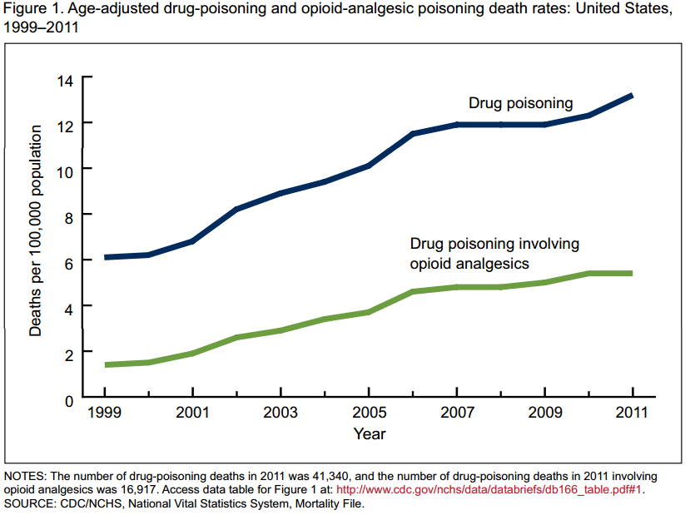
CDC: Drug Poisoning Death Rates
Notes:
Every day in the United States, 44 people die as a result of prescription opioid overdose.¹
1. Centers for Disease Control and Prevention. National Vital Statistics System mortality data. (2015) Available from URL: http://www.cdc.gov/nchs/deaths.htm.

Slide 11
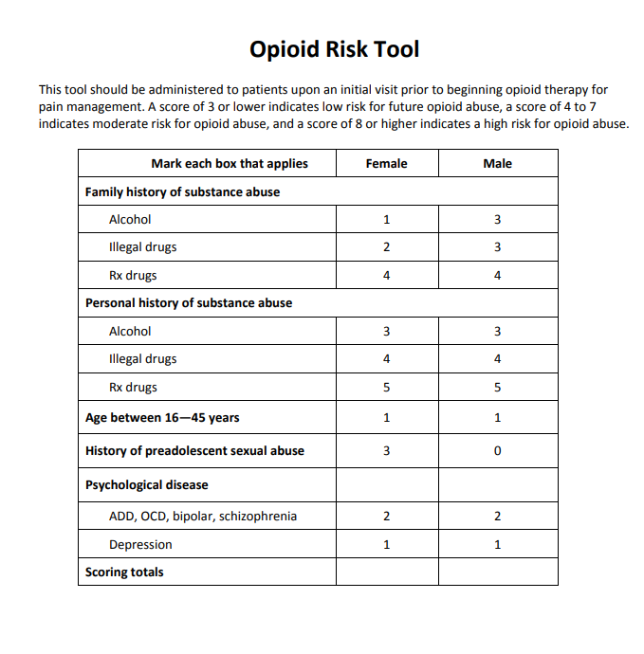
Risk Factors Associated with Misuse
History of addiction or substance misuse
Current risky use of alcohol
Current use of any illicit substance
Concurrent psychiatric illness
Family history of addiction
History of incarceration
Major social, financial, or legal stressors
Savage, S et al. J Pain Symptom Manag 2003;26:655-667.
.

Slide 12
Some reassurance
Using data from 2000-2005 found that patients on COT had a substantially higher odds ratio (14.92) of developing opioid use disorder compared with patients not prescribed opioids, but the absolute rate was 0.72%.
Schuchat et al, 2017 [JAMA,318(5):425]
“Of people with pain who take prescribed opioids, the great majority never become addicted or misuse the medications”
Lynn Webster MD, former Pres of Amer Pain Society, in “The Painful Truth,” 2017.
“Addiction occurs in only a small % of people exposed to opioids, even among those with preexisting vulnerabilities.”
Norma Volkow MD of the NIH, NEJM 2016:374:1253-1263.

Slide 13
How do these reassurances fit with what we see?-1
Initial patients are higher risk
H/o incarceration is a risk
Someone living in poverty is more likely to be tempted to divert opioids for income
But our patients are indigent and less likely to have a stable home/PCP
Black Americans: 13% of population/38% of incarcerated people
Systemic racism (think crack vs. powder cocaine)
People suffering with poverty are more likely to be incarcerated
We take care of impoverished patients and communities

Slide 14
How do these reassurances fit with what we see?-2
Those who just want an opioid for their pain are at higher risk
Those who can’t comply with a controlled substances agreement are at higher risk
Our patients have greater obstacles to getting high quality, comprehensive, multi-disciplinary care
Patients who get the initial care they require are less likely to transform to a chronic state
Our patients are more likely to be “out of minutes” when called and less likely to have transportation for a pill count

Slide 15
How do these reassurances fit with what we see?-3
The more the pain etiology resides within the central nervous system, the more likely that opioids will trigger further disruption
Complex Chronic pain
NSAID risks rise with meds for chronic metabolic comorbidities
Our patients are more likely to have experienced developmental trauma, PTSD, stress, ongoing dietary injury, and physically punishing jobs,
Less likely to have positive experiences with behavioral health
Which our patients are more likely to suffer from

Slide 16
How do these reassurances fit with what we see?-4
Our patients have a higher likelihood of having a diagnosis of SUD than average
One might argue that those with means and the same level of SUD wind up avoiding the diagnosis
They also have a higher likelihood of being harmed by elicit opioids when they don’t get them from us

Slide 17
Putting that all together
Our patients are at higher than average risk for the dangers of opioids
Yet they’re more likely to benefit from opioids and to suffer harm when we don’t rx them.
Their life situations are often caused by injustice in our system
Are we then compounding the injustice when we use these situations to restrict the type of treatment we provide?

Slide 18
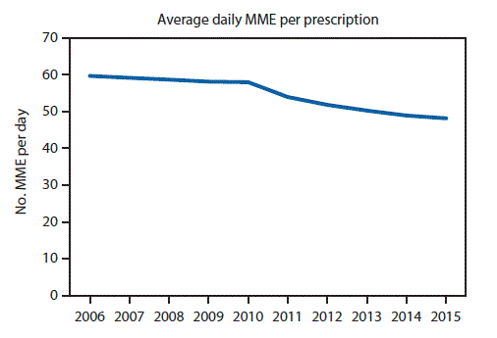
Vital Signs: Changes in Opioid Prescribing in the United States, 2006–2015 CDC Weekly / July 7, 2017 / 66(26);697–704

Slide 19
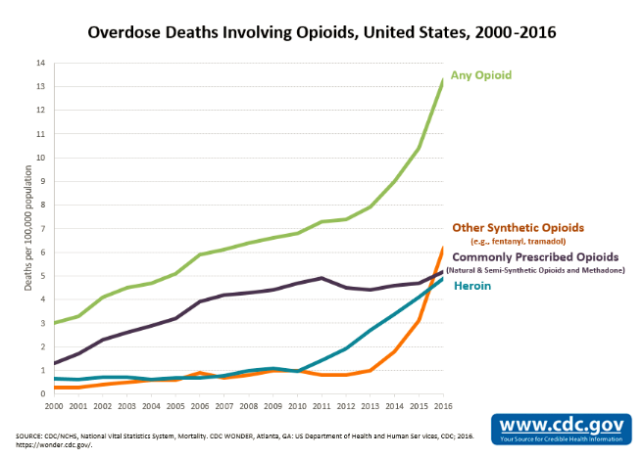

Slide 20
Opioid Initiation and Titration
At onset, focus on side effects rather than pain relief
Consider starting with IR opioid, then converting to SR
Educate patients about tolerance to nausea & sedation
Increase as tolerated, and no more than 50% at a time
Increase more slowly if opioid has longer half-life
Ask about degree of pain relief at each visit
Expect a need for higher dose as activity level rises
If pain level is unchanged as dose rises, reassess.

Slide 21
Anticipatory guidance: The “honeymoon effect”
“We can’t try to relieve all pain with opioids alone.
That is impossible and is where most of the opioid dangers come from
The meds are to improve your ability to recover your lost function
We hope that we can get a sustained 30% improvement in pain from this med
BUT---the first week or two, you are likely to have nearly 100% pain relief.
Just remember that we can’t chase that”

Slide 22
IR and ER Opioids
Most chronic patients on opioids require both extended-release (ER) opioids on a scheduled basis, and immediate-release (IR) opioids as needed for breakthrough pain.
The typical dosing of IR opioids per dose is 5-15% of the total daily dose of the ER opioid.
IR opioids and ERs which can be crushed to produce IRs have greater appeal in OUD (and when “taking the med for the wrong reason”).
Argoff et al, 2009, Mayo Clin Proc 84:602-612; Rauck, 2009. “Pain Practice” 9:468-479.

Slide 23
Advantages of Extended-release Opioids
No acetaminophen or aspirin, so avoids toxicity of these drugs
Smoother blood levels
Better adherence, less clock-watching, better sleep, and are less euphoria.
Less of a “roller coaster”
Stable pain relief
Less breakthrough pain
Longer duration/fewer doses
Lower street value

Slide 24
Disadvantages of Extended-release Opioids
Insurance companies deny PAs
When your patient is stable on one, the insurance may take it away
Pharmacies may not stock them
A patient expecting a certain quick effect may think “these pills are weak”
And take a dangerous amount, leading to OD
Some people with chronic pain would rather be in pain at some times than be on an opioid 24-7.

Slide 25
Poll
58 yr old with severe complex regional pain syndrome (CRPS) after a crush injury to the left leg in mid 20s
They were on chronic opioids since shortly after that
By last year, they had gotten to Oxycodone ER 120mg TID and Oxycodone IR 30 mg 1-2 tabs QID prn
Utox had never been inappropriate
Patient engaged well with recommended care
Pill counts every few years were fine
Also on Duloxetine, Lyrica, Tylenol 650mg TID, and a spinal stimulator, go to a BH pain group, and have 1-on-1 therapy

Slide 26
Poll
They became overly sedated, used the nasal narcan and called 911.
Unconscious but breathing on arrival and aroused with narcan
Later, they admit that they have always withheld how much alcohol they drink and they’ve gotten unable to control it.
They think that’s why they overdosed
They have now also disclosed this to their group and therapist have cut down

Slide 27
Poll
How will you manage this 58 yo w/ newly diagnosed SUD, w/ recent opioid overdose, who has profound pain?
A: “Strike One”. Warn them that you might have to “cut them off” if this happens again and continue current regimen
B: “You have 6 weeks to show me a negative utox for alcohol and then I’ll only continue the meds if you stay negative”
C: “It is now clear that high doses of oxycodone going forward are not going to be in your best interest. But you need opioid medication for your intense pain. So, I’m going to transition you to Buprenorphine……no, this is not a negotiation”
D: “You should be ashamed of yourself for lying to me for years. You will need to seek a new clinician. I will prescribe half of your previous dose for 30 days.”

Slide 28
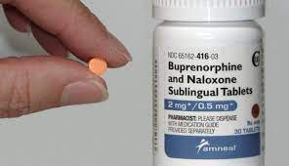
Buprenorphine Embracing the Gray Zone
The designer SUD/Pain crossover drug
Or not.

Slide 29

What may distinguish Buprenorphine from the other opioid analgesics?
Commonly recognized
Ceiling effect on respiratory depression
It decreases OD risk from other opioids
If it is diverted, it is less likely to kill an opioid naïve patient
Milder withdrawal symptoms and less drug dependence
Seems to cause less cognitive dysfunction

Slide 30

What distinguishes Buprenorphine from the other opioid analgesics?
Lesser known features
Full kappa antagonist
Opioid receptor-like 1 (ORL1) agonist
NOP: Nociceptin Opioid Receptor
Reduced supraspinal analgesia
Enhanced spinal analgesia
Paradoxically blocks analgesic tolerance
Diminished opioid-rewarding effects
? Importance, as binding is low --- Reference: Dr. Bennet Davis

Slide 31
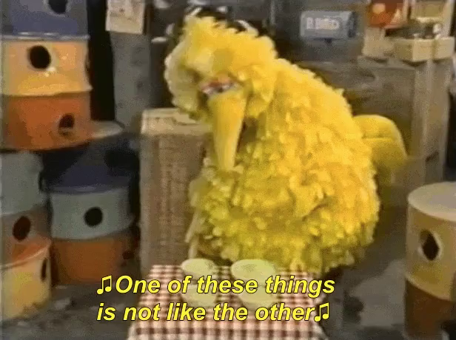
Lesser known (continued)
Delta antagonist
10 times weaker than effect on mu
Lutfy et.al. “Buprenorphine: A Unique Drug with Complex Pharmacology” Curr Neuropharmacol. 2004 Oct; 2(4): 395–402. https://www.ncbi.nlm.nih.gov/pmc/articles/PMC2581407/
Safe use in patients with renal failure and on dialysis
Can be combined with other mu agonists

Slide 32
Bup: when used for pain
Consider buprenorphine a long acting opioid with a reasonably quick onset of analgesia induction
Benefit of ER and IR
When treating pain, dividing the dose to BID or TID is usually preferred.

Slide 33
When should we think about buprenorphine for pain instead of other opioids?
When there is substantial risk of aberrancy
When there is an event of concern on other opioids
When managing both pain and opioid dependence disorder
When opioid adverse effects prevent functional improvement
When p.o. and transdermal administration cause problems with extended release opioids
When insurance won’t pay for other long acting opioids
Or even make it our first line choice

Slide 34
“A 2023 US Department of Veterans Affairs and US Department of Defense Clinical Practice Guideline on the use of opioids in the management of chronic pain suggested using buprenorphine rather than other opioids as the first line option for patients started on opioids for chronic pain, because of lower risk for misuse and overdose”
UpToDate
VA/DoD Guideline Development Group , The Use of Opioids in the Management of Chronic Pain: Synopsis of the 2022 Updated U.S. Department of Veterans Affairs and U.S. Department of Defense Clinical Practice Guideline. Ann Intern Med. 2023;176(3):388.
Dr. Davis points out that evidence failed to support the VA position

Slide 35
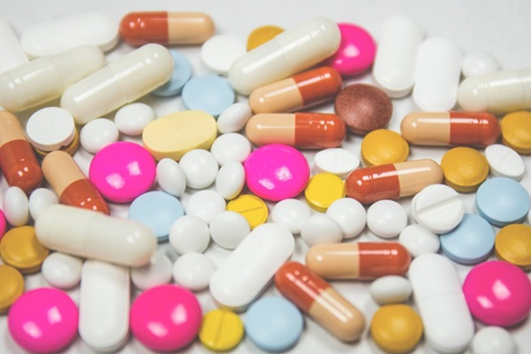
From Pain Med 2014: Daitch et al.
35 chronic pain patients on 200 to 1370(!) mg of morphine equivalents daily
Switched to Buprenorphine (ave: 28 mg/day)
2 months later:
Pain scores dropped 51% (from 7.2 to 3.5)
Quality of life improved (from 6.1 to 7.1)
https://pubmed.ncbi.nlm.nih.gov/25220043/
Can also consider micro-dosing for transition

Slide 36
What are the options?
Belbuca buccal film (75-900 mcg doses) usually BID
Often the best choice, but unlikely to be covered ☹
Butrans (and generic) weekly transdermal [5-20 mcg/hr]
Buprenorphine (Subutex) and Buprenorphine/Naloxone (Suboxone) SL tabs/films
2 mg, 8 mg, 2/0.5 mg, 4/1 mg, 8/2 mg, 12/3mg
So your dosage range could be:
75mcg (0.075mg) to maybe as high as 48mg/day
!

Slide 37

Don’t use opioid maintenance doses for opioid naïve pain patients!
Deaths have been reported on the 2 mg!
Buprenorphine is about 10 times more potent than morphine orally, but this is debatable and is sometimes reported as up to 110 times

Slide 38
A micro-dosing option
I usually go much slower and could start lower with Belbuca
https://doi.org/10.1503%2Fcmaj.74018
Buprenorphine–naloxone “microdosing”: an alternative induction approach for the treatment of opioid use disorder in the wake of North America’s increasingly potent illicit drug market, Randhawa et al, CMAJ 2020 Jan 20; 192(3): E73
Outpatient microdosing induction schedule for buprenorphine–naloxone
Day 1: 0.5 mg once a day
Day 2: 0.5 mg twice a day
Day 3: 1 mg twice a day
Day 4: 2 mg twice a day
Day 5: 3 mg twice a day
Day 6: 4 mg twice a day
Day 7: 12 mg (stop other opioids)

Slide 39
Buprenorphine references
Understanding Buprenorphine for Use in Chronic Pain: Expert Opinion; Webster et.al. Pain Med. 2020 Apr 1;21(4):714-723 [https://pubmed.ncbi.nlm.nih.gov/31917418/ ]
A Narrative Pharmacological Review of Buprenorphine: A Unique Opioid for the Treatment of Chronic Pain; Pain Ther. 2020 Jun; 9(1):41-54 [https://www.ncbi.nlm.nih.gov/pmc/articles/PMC7203271/ ]
“When Opioids Fail: Treating the patient trapped on high dose opioids” – Slideset 2017 Conference on Pain. Feb, 2017 – Ann Arbor
“Twelve Reasons for Considering Buprenorphine as a Frontline Analgesic in the Management of Pain” Mellar Davis MD; www.SupportiveOncology.net 2012
UNM Project ECHO Pain: didactic on buprenorphine

Slide 40
More bup/pain references
Pharmacist’s Letter: PL Detail Document #320203 Feb, 2016
“Buprenorphine-Naloxone Therapy in Pain Management”
Kelly Yan Chen, BS, et al Anesthesiology, V 120 . No 5, May 2014
“To Stop or Not, That is the Question: Acute Pain Management for the Patient on Chronic Buprenorphine” T.Anthony Anderson et.al Anesthesiology 2017: 126(6): 1180-1186
“Safety, Tolerability, and Clinical Effect of Low-Dose Buprenorphine for Treatment-Resistant Depression in Mid-Life and Older Adults” Jordan Karp et.al, J Clin Psychiatry 2014 Aug: 75(8): e785-793

Slide 41
Methadone
Methadone has some features that make it the ideal opioid for chronic pain management
But it also has some features that make it the worst choice
I no longer prescribe it for pain and I don’t suggest that you start.
But I am including Dr. Schneider’s slides for your reference

Slide 42
Methadone
Once-daily dose prevents withdrawal, but need 3-4 doses/day for pain relief
Inexpensive
Requires careful upward titration
Non-linear conversion from other opioids
High doses may cause torsade de pointes
To prescribe for pain, need only DEA license
Increased risk of death when initiating methadone rx

Slide 43
Methadone Conversion
<100 mg morphine: 4-1
100-300 mg morphine: 8:1

Slide 44
Methadone Mortality Causes
Single-dose overdose (?inappropriate conversion)
Accumulated toxicity (bec of long half-life)
Drug-drug interactions
torsade de pointes

Slide 45
Abuse-Deterrent Opioids
May be co-formulated with antagonist such as naloxone, naltrexone, or aversive agent e.g. niacin – activated when crushed.
May be tamper-resistant: difficult to crush or dissolve so as to prevent chewing, snorting, or injecting.
In 2010 abuse-deterrent OxyContin replaced the original version. As a result, OxyContin’s street value and abuse dramatically decreased

Slide 46
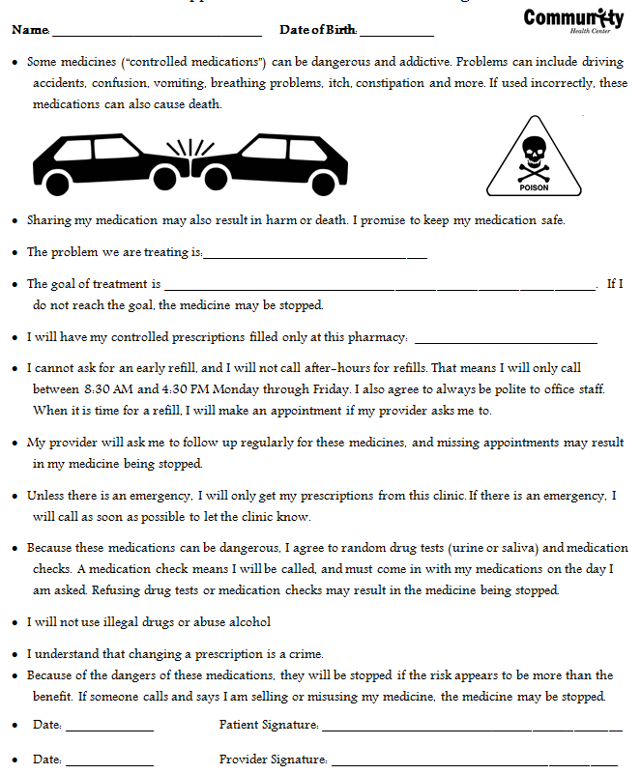
Use an Opioid Agreement

Slide 47
Monitor Compliance with Routine Drug Screens
Order frequent, but irregularly timed drug screens without forewarning
Utilize the nurse visit for surprise tox screen and pill count
Know how to correctly order urine screens from your local lab
Know how to correctly interpret urine drug tests
Recognize patient scams to defeat drug testing

Slide 48
Adopt Standard Policy for Opioid Prescribing
CHC Inc: All patients receiving COT* must have
Signed opioid agreement scanned and saved in the EHR
Drug screen at least once every 6 months
Follow up visit every 3 months using pain template and functional assessment
Review of State PDMP
Behavioral Health co-management encouraged
*COT defined as receipt of 90 days or more of prescription opioid analgesic medication

Slide 49
Further REMS (Risk evaluation mitigation strategies)
Educate patient/family about risks
Mention driving safety
Rescue Naloxone (Narcan) when appropriate
Be liberal!
Require Lockbox
“Always answer your phone. If you are unreachable for a pill count, I must consider that a failed pill count just as if you have heroin in your urine.”

Slide 50
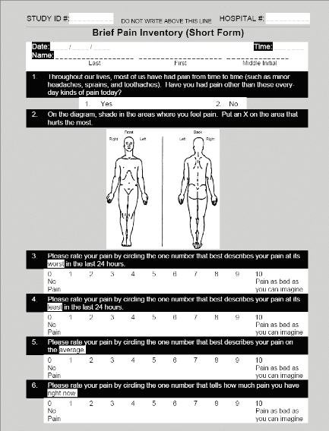
Ongoing Assessment: The 5 A’s
Analgesia: Level of pain 1-10 etc.
Activities of Daily Living: the patient’s function
Adverse events: Side effects
Aberrant drug-related activities
Affect: Depression, anxiety, etc

Slide 51
Opioid Conversion
Inadequate pain relief may reflect genetic variability in opioid responsiveness. Consider changing opioids.
Conversion tables are only a guide.
After calculating equipotent dose, initiate at 50% while supplementing with previous drug as needed.
Example: morphine: oxycodone = 3:2.
60 mg oxycodone is 90 MME (milligrams of morphine equivalent).
https://www.uptodate.com/contents/search?search=opioid%20equivalence%20table&sp=0&searchType=PLAIN_TEXT&source=USER_INPUT&searchControl=TOP_PULLDOWN&autoComplete=true

Slide 52
Aberrant Drug-Taking Behaviors More Predictive of Addiction
Selling prescription drugs
Forging prescriptions
Stealing drugs
Frequent prescription “loss”
Injecting oral/topical formulations
Concurrent abuse of illicit drugs

Slide 53
Aberrant Drug-Taking Behaviors Less Predictive of Addiction
Aggressive demand for more drug
Drug hoarding (e.g., obtaining drug from more than one source)
Unsanctioned dose escalation
Unapproved use of drug

Slide 54
Differential Diagnosis of Aberrant Drug-Taking Behaviors
SUD
“Pseudoaddiction” [undertreated pain]
Other psychiatric diagnoses and personality disorders
Criminal intent [diversion]
They didn’t take the rules seriously

Slide 55
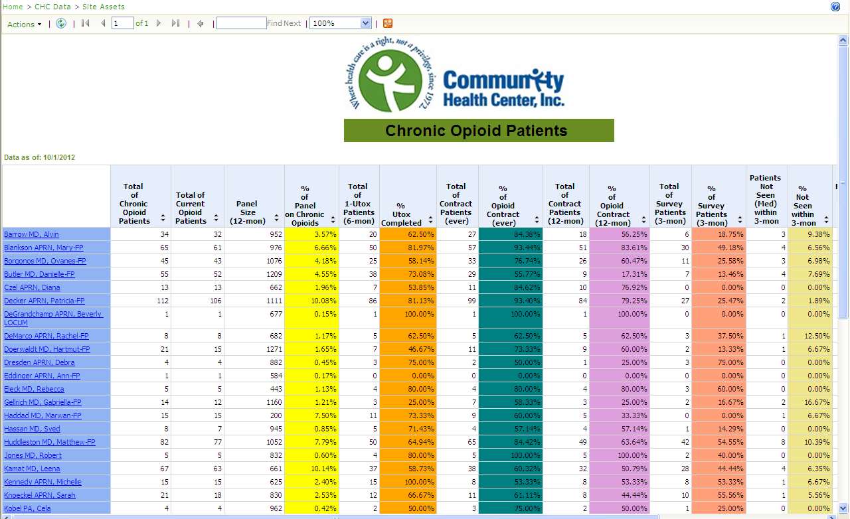
Opioid Management Dashboard
Provider Names

Slide 56
The dreaded (and common) opioid “legacy” patient

Slide 57
Opioid legacy patients: early sorting/general approach
Most patients who take chronic opioids are not abusing them
Though many of them are “taking them for the wrong reason”
But initial patients for “continuation” of opioid treatment are much less likely to be acting in good faith than an average chronic pain patient on opioids
Different attitude for where they’ve come from?
Your respected, reasonable work colleague retires and you absorb some of her panel
Patient is discharged after 1 year in an ECF after a train crash. No prior medical care
A local provider known as “Doctor Feelgood” got arrested, has lost his license to practice and all of his patients on high dose opioids are seeking new prescribers
Expect this to be a long visit
But if the patient seems to be intentionally dragging the visit out, recognize that as a strategy of those who are not acting in good faith to get the med they expect

Slide 58
First visit: don’t get behind!
Who was the last prescriber?
Will last prescriber keep prescribing until your evaluation is complete?
Why are they changing?
Get a clear story/ Use quotation marks.
Ask them what they are still taking, whether they use drugs, have a hx of SUD, how they use alcohol, what they took today, yesterday
Make sure they are clear and chart it.
Use normalizing questions: “when did you last use marijuana, cocaine, or heroin?”
Get a tox screen.
Yes…get a tox screen at the first visit
Yes…even if you are not prescribing

Slide 59
More first visit actions for legacy patients
Have them sign an ROI for last regular prescriber and anybody else you think might be helpful
Call that person! Soon!
Have the provider specifically confirm or refute the patient’s story
Follow all standard policies mentioned earlier
“We do not prescribe controlled substances here at CHC on the first visit”
But be willing to break your policy when clinically warranted

Slide 60
Legacy patient: continued
What are we looking for?
Lies
You will find them quickly in half of these patients.
Half truths/misrepresentations
Inconsistencies
History of abusive behavior
Patient responses to being asked for utox/ROI, changing of story when realizing they will be caught
“I gotta tell the truth doc, I’ve never done cocaine but I rubbed some on my sore tooth yesterday and this urine might show a little bit”
Anger/Threats/accusations of racism, incompetence and malfeasance/begging/negotiating/manipulating

Slide 61

When you suspect diversion

Slide 62
When you suspect substance use d/o, or When risk of accidental poisoning is high
Narcan
Stop prescribing controlled substances
Refer to addiction medicine/BH
Halt active pain treatment until addiction and/or behavioral health treatment is established and pt is engaged
Consider Buprenorphine

Slide 63
Management of Opioid Withdrawal Symptoms
Clonidine. 0.1-0.2 q4-6 hours, or 0.1 mg patch/wk
Lomotil (diphenoxylate, for diarrhea)
Bentyl (dicyclomine, anticholinergic for muscle spasm)
Hydroxyzine 25-50 mg HS
Gabapentin 100 – 3,600 mg daily in divided doses

Slide 64
Stuck on pills?
Patient using analgesics for pain, but…
Function is not good, even when dosage increased
It is not clear that pain meds are helping
Patient is often not engaged in self care
Patient often has behavioral health issues that are not addressed and which undermine the rescue effort
Concerning yellow flag behaviors may be present
Running out early, lost meds

Slide 65
When the medication hasn’t met expectations. When the dose has been escalated too far and psychosocial factors aren’t significant
Slow wean:10-30% decrease each month, slower as dose gets < 60mg/D MS, 30mg/D oxycodone, 30mg/D methadone
Fast wean: 10-30%/D until limits above reached then 10-20% of the limit dose every 3-5 days.
Ease the burden
Accupuncture
Clonidine patch
Hydroxyzine, trazadone HS

Slide 66
When opioid is a “psychotropic adjuvant” for a patient with psychological pain: Patience, integration of BH, and one-step-at-a-time approach
Patients are on guard about being told the pain is “in your head”
Patients may be very resistant or highly ambivalent to behavioral health approaches and lifestyle changes
Patient’s life circumstances can be very challenging, interfering with lifestyle change and access to care

Slide 67
“Psychotropic adjuvant”
Honesty
Go the extra mile
Care coordination
Peer pressure
Groups for CBTI
Leverage pharmacotherapy
The opioid can be used as the “anchor” of a complete management program
“Continuing the opioid makes sense only if……”

Slide 68
It’s harmful to remove opioids without replacing them with something
Sequence them based on “low hanging fruit”
NSRIs | Attention to sleep (sleepers w/ pain properties) Sleep apnea? – find/treat
Gabapentinoids | Assist with smoking/drug/EtOH cessation
Other AEDs | Exercise program
Behavioral Health (Therapy, CBT, Trauma tx, Pain group) | Social engagement
Physical Therapy | Weight loss
Chiropracty | Gaining control of a disease that makes you feel bad Diabetes, Thyroid, vitamin D deficiency, anemia
Nutritionist --Superfoods | Involving a caring friend/family member in visits

Slide 69
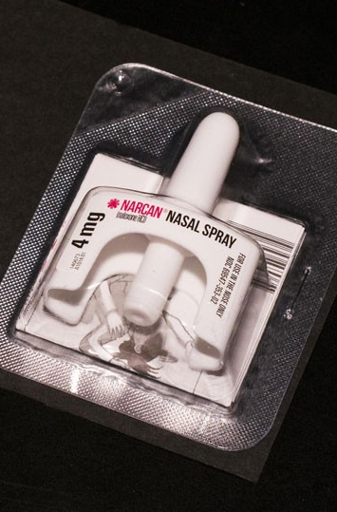
Narcan for everybody!
If you think about it, the patient and family should probably have it.
And if you don’t think about it…think about it.
Nasal narcan is now readily available, much more affordable and covered by most insurance.
Most patients who should have it don’t
This prescription is more likely to save a life than any you prescribe

Slide 70
Disposal of unused opioids:
Local or national take-back programs.
Pharmacies
Police or Fire stations
Flush down the toilet

Slide 71



