Slide 1

Postgraduate NP and/or PA Training Programs Learning Collaborative
Session Five: Tuesday February 11th, 2025
Notes:
Meaghan

Slide 2
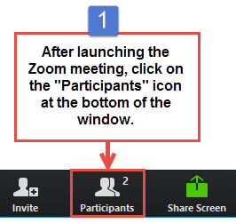
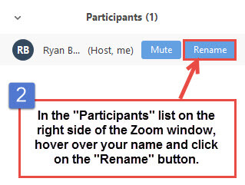
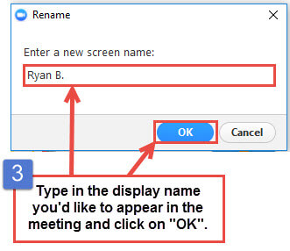
Get the Most Out of Your Zoom Experience
Please keep yourself on MUTE to avoid background/distracting sounds
Use the CHAT function or UNMUTE to ask questions or make comments
Please change your participant name to your full name and organization
  “Meaghan Angers CHCI”
Notes:
Meaghan

Slide 3
Session 5 Agenda
1:00-1:05pm Introduction
1:05-1:40pm Evaluation of the residency program & resident learner
1:40-1:50pm Orientation
1:50-2:00pm Graduation
2:00-2:15pm Introduction to Accreditation
2:15-2:25pm Questions?
2:25-2:30pm Wrap-Up and Evaluation
Notes:
Meaghan

Slide 4
Learning Collaborative Faculty
Margaret Flinter, APRN, PhD, FAAN
  Co-PI, NTTAP
  CHCI’s Senior Vice President/Clinical Director
  Founder of America’s first nurse practitioner residency program
Kerry Bamrick, MBA
  Executive Director, Consortium for Advanced Practice Providers
  Coach Mentor
Charise Corsino, MA
  Program Director, CHCI Postgraduate NP Residency Program
  Coach Mentor
Amanda Schiessl, MPP
  Chief of Staff, MWHS
  Co-PI & Project Director, NTTAP
Meaghan Angers
  Senior Program Manager, NTTAP
Bianca Flowers
  Program Manager, NTTAP
Notes:
Meaghan

Slide 5


Community Health Center, Inc.
A leading Federally Qualified Health Center based in Connecticut.
ConferMED
A national eConsult platform improving patient access to specialty care.
The Consortium for Advanced Practice Providers
A membership, education, advocacy, and accreditation organization for
APP postgraduate training.
National Institute for Medical Assistant Advancement
An accredited educational institution that trains medical assistants for
a career in team-based care environments.
The Weitzman Institute
A center for innovative research, education, and policy.
Center for Key Populations
A health program with international reach, focused on the most vulnerable among us.
Notes:
Meaghan

Slide 6

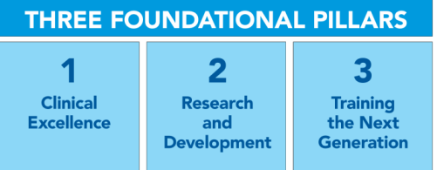
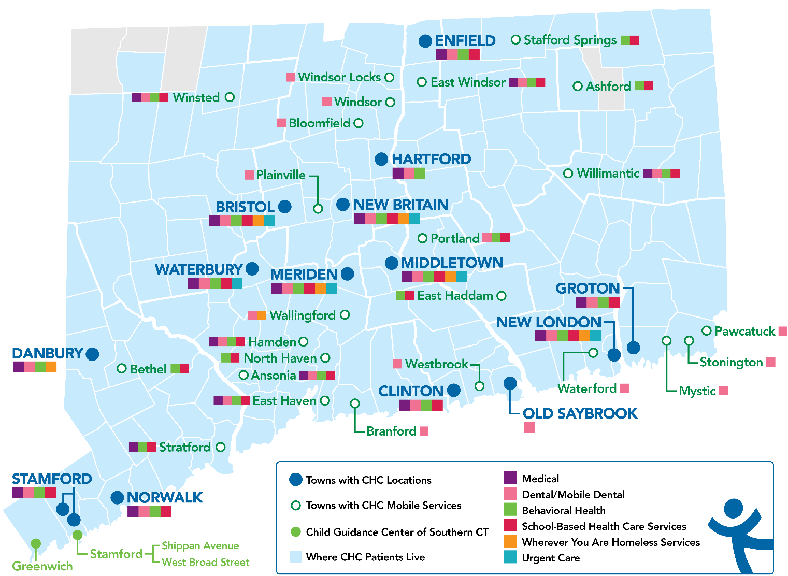
Locations & Service Sites
Profile
Founded: May 1, 1972
Staff: 1,400
Active Patients: 150,000
Patients CY: 107,225
SBHCs across CT: 152
Year | 2021 | 2022 | 2023
Patients Seen | 99,598 | 102,275 | 107,225
Notes:
Meaghan

Slide 7
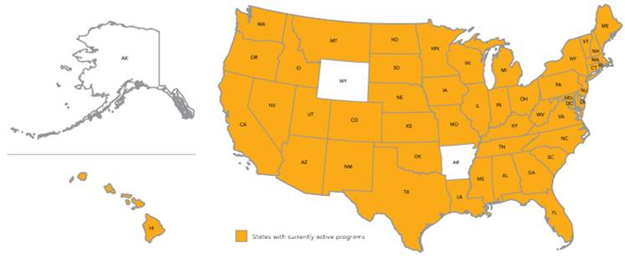
Primary Care, Psychiatric/MH and Specialty Postgraduate Training Programs –
Total: 548 Programs Nationally
7
Notes:
Meaghan

Slide 8

National Training and Technical Assistance Partners (NTTAP)
Clinical Workforce Development
Provides free training and technical assistance to health centers across the nation through national webinars, learning collaboratives, activity sessions, trainings, research, publications, etc.
Notes:
Meaghan

Slide 9
Learning Collaborative Structure
Six 90-minute Learning Collaborative video conference sessions
Bi-weekly 60-minute calls between coach mentors and team coach
Internal team workgroup meetings
Access resources via the Weitzman Education Platform
Use Google Drive to share your work
Learning Session Dates
Learning Session 1 | Tuesday October 8th
Learning Session 2 | Tuesday November 12th
Learning Session 3 | Tuesday December 10th
Learning Session 4 | Tuesday January 21st
Learning Session 5 | Tuesday February 11th
Learning Session 6 | Tuesday March 11th
Notes:
Meaghan

Slide 10
2024-2025 Cohort
Alivio Medical Center | Chicago, Illinois
Arkansas Primary Care Association | North Little Rock, Arkansas
Blue Ridge Community Health Services, Inc. | Hendersonvlle, North Carolina
Brockton Neighborhood Health Center, Inc. | Brockton, Massachusetts
Children’s Primary Care Medical Group | San Diego, California
Esperanza Health Center | Philadelphia, Pennsylvania
Family Health Centers of San Diego | San Diego, California
Greater Philadelphia Health Action, Inc. | Philadelphia, Pennsylvania
Indian Health Service Headquarters | Rockville, Maryland
Marin Community Clinic | Novato, California
ND Systems Inc. | Fairbanks, Alaska
Ozark TriCounty Healthcare Consortium dba ACCESS Family Care | Neosho, Missouri
Tennessee Primary Care Association | Nashville, Tennessee
Umpqua Community Health Center dba Aviva Health | Roseburg, Oregon
Notes:
Meaghan

Slide 11
Evaluation – Postgraduate Resident
Notes:
Charise

Slide 12
Purpose of Evaluation
Be anchored in your program’s mission
Integrated throughout the Program – from recruitment to graduation
Create explicit expectations for trainee
Document programmatic success and challenges
Foster improvement positive growth, creativity and innovation
Notes:
Charise

Slide 13

Characteristics of Good Evaluation
Systematic formative (on-going) and summative (final) data collection
Designed before the program begins
Clearly communicated to all program participants
Bi-directional
Overall program review
Identify strengths and opportunities for improvement
Notes:
Charise

Slide 14

Questions Guiding the Evaluation Process
What will be evaluated?
What criteria will be used to judge program performance?
What standards of performance on the criteria must be reached for the program to be considered successful?
What evidence will indicate performance on the criteria relative to the standards?
What conclusions about program performance are justified based on the available evidence?
Notes:
Charise

Slide 15
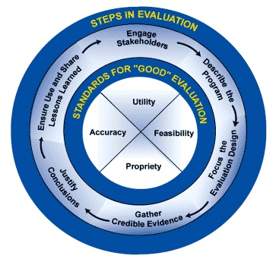
Evaluation Process: How Do You Do It?
Steps in Evaluation
  Engage stakeholders
  Describe the program
  Focus the evaluation design
  Gather credible evidence
  Justify conclusions: Analyze, synthesize and interpret findings, provide alternate explanations
  Feedback, follow up and disseminate: Ensure use and share lessons learned
Notes:
Charise

Slide 16
Evaluation – General Guidelines
Must use an objective, systematic and cumulative evaluation process that is based on the Program’s core elements, competencies and curriculum components
Notes:
Charise

Slide 17
Core Evaluation Components
Assessing the Postgraduate Trainee
Organizational Evaluation
Clinical Faculty Evaluation
Ongoing Program Evaluation
Notes:
Charise

Slide 18

Fitting the Pieces Together: Program Evaluation
Trainee
Overall Program
Preceptor
Faculty
Staff
Program Curriculum
Institution
Notes:
Charise

Slide 19
Evaluating the Postgraduate Trainee
Assess the performance and development of each trainee
Periodic, objective assessment focused on core competencies in clinical and professional areas
Include identification of deficiencies or performance concerns
Develop clear process for promptly identifying and addressing trainee’s issues including a performance improvement plan with measurable outcomes
Notes:
Charise

Slide 20
The Postgraduate Trainee
Trainee’s self-assessment of competency
Trainee’s evaluation of all core program components:
  Preceptors for continuity and specialty clinics
  Weekly didactic sessions, etc.
Preceptors’ assessments of the trainee’s performance
Trainee’s reflective self assessment of their experience
Final programmatic evaluation
Assist the trainee in assembling the assessment elements
  Learning portfolio
  Coaching sessions
Notes:
Charise

Slide 21
Clinical Faculty Evaluation
Established process to regularly evaluate all clinical faculty, including preceptors and didactic faculty
  Evaluators include (but not limited to) trainees and program director
Have clear process for promptly identifying and addressing any faculty performance issues including performance improvement plan with measurable outcomes
Notes:
Charise

Slide 22
Organizational Evaluation
The Program must review and assess the operational impact of the Program on the overall organization and evaluate for improvements or efficiencies in the business operations
  Financial
  Administrative
  Operational
A documented process for initial and on-going evaluation of all sites used for trainees’ clinical practice experiences
  The site itself (resources provided, staff, etc.)
  The trainee’s experience at the site
Residency Advisory Committee – required for accreditation
Notes:
Charise

Slide 23
Ongoing Program Evaluation
Established process
Periodic, at least annual evaluation
Postgraduate trainee completion rates; withdrawals or dismissals
  Preceptor evaluations of trainees’ performance
  Graduate employment data
  Alumni satisfaction
  Employer satisfaction (if possible)
  Program staff turn over
Suggested areas for documentation of evaluation process and subsequent action plan - Identified strengths and weaknesses, opportunities for improvement
  Structural or content program adjustments to address areas needing improvement
  Evidence of improvement resulting from implementation of action plan
Notes:
Charise

Slide 24
Importance of Evaluation
Helping to clarify program plans
Links the curriculum to outcomes
Improving communication among participants and partners
Gather feedback needed to improve and be accountable for program outcomes/effectiveness
Gain insight about best practices and innovation
Determine the impact of the program
Empower program participants and contribute to organizational growth
Notes:
Charise

Slide 25
Conclusion –
5 Basic Steps to Program Evaluation
Use the accreditation standards as a roadmap
Develop a written plan linked to program curriculum
Collect data
Analyze data
Communicate and improve
Notes:
Charise

Slide 26
Evaluation – Postgraduate Residency Program
Notes:
Charise

Slide 27
Evaluations – What We Evaluate
Competency Domains
Evaluation is planned, ongoing, and bi-directional
Regular assessments of NP Residents
Resident evaluation of program including experiences and preceptors
Ongoing internal program evaluation
Patient Care
Practice-Based Learning and Improvement
Interpersonal and Communication Skills
Systems-based Practice
Knowledge for Practice
Inter-professional Collaboration
Personal and Professional Development
Technology and Telehealth*
Diversity, Equity, and Inclusion*
Professionalism
Resident
Program
Faculty
* New competency domains 2023 Accreditation Standards
Notes:
Charise

Slide 28
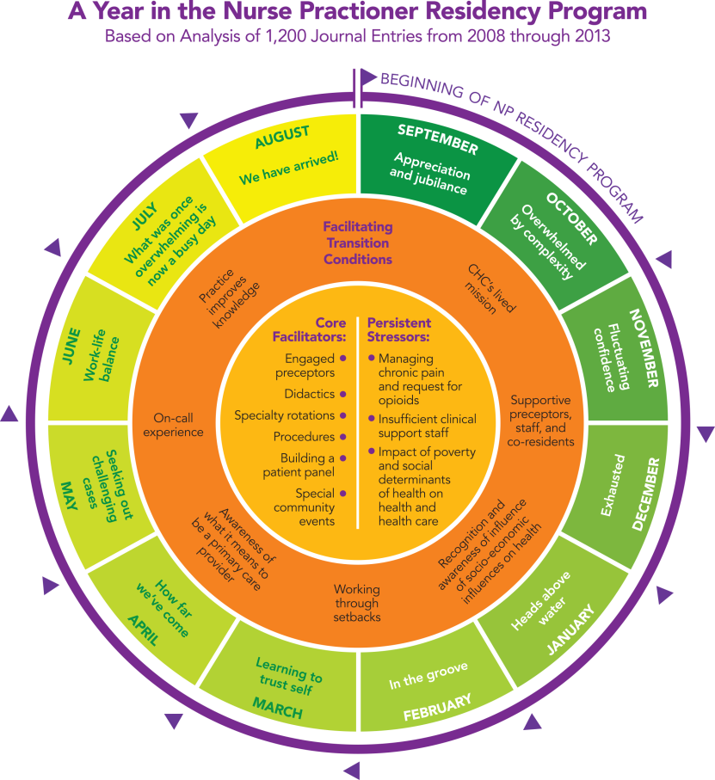
Residency Experience and Outcomes
Focus on managing complex patients, expert use of data, specialty training in priority areas, full scope of practice, and preparing for careers as PCP.
Develop a panel of approximately 300-400 patients/1,000 visits
Portfolio of clinical procedures commonly seen in primary care
Quality Improvement project focused on improvement within practice setting
Notes:
Charise

Slide 29
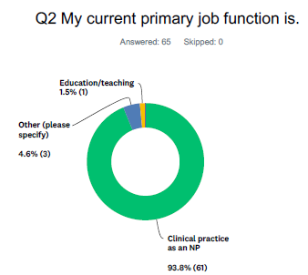
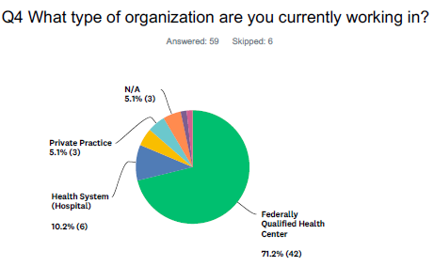
Evaluation of Program – Alumni
Demonstrate achievement of program goals and objectives
Provides overall outcome measures for your training program
Recommend collecting annual data on your cohort of alumni
Notes:
Charise

Slide 30
Residency Program Management & Evaluations
There are many strategies for approaching program management and evaluations:
  Microsoft products - Word, Excel, One Note
  Survey monkey, Qualtrics, My Evaluations
  Larger Platform- Medical Education Management Software (Med Hub/New Innovations)
  Allows for greater program management capabilities
Notes:
Charise

Slide 31
Factors to Consider When Choosing
Program Management Tools
Does your organization have any existing education management software/residency management software?
How large is your program?
Are you looking for a free resource or do you have the budget to purchase a platform?
What are your priorities in a system – having a single system? Simplicity? Automation?
Notes:
Charise

Slide 32
Questions?
Notes:
ALL

Slide 33
Orientation
Notes:
Kerry

Slide 34

Orientation Overview
Intensive orientation
To the PROGRAM
To the ORGANIZATION
To the SITE
To the COMMUNITY
The basics
Takes place over the course of 3 to 4 weeks
Includes both organizational and clinical trainings
Completed in person at the service delivery site
Notes:
Kerry

Slide 35
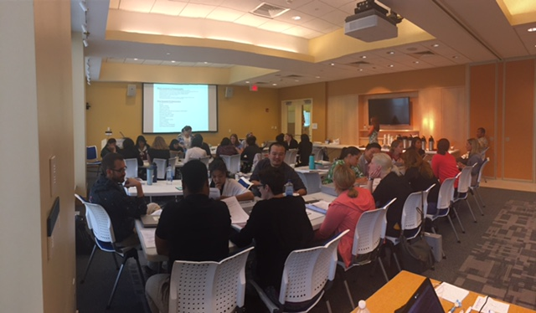
Employee Orientation
Residents should go through your normal employee orientation that all new staff go through
Will cover organizational trainings, policies and procedures, technical training
Coordinate with your HR team to know what they cover in orientation – reduce any redundancies between program and employee orientation
Should include intensive EMR training
Notes:
Kerry

Slide 36
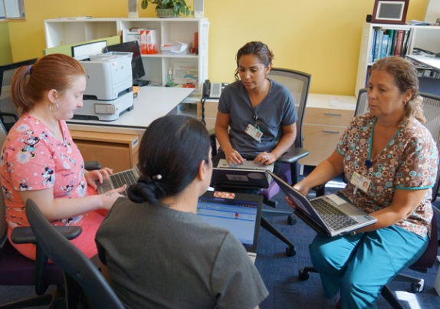

Site Orientation
Shadowing all positions on staff
  Front desk staff
  Nurse, Medical Assistant, PCP
  Behavioral Health
  Dental
  Other services: nutritionist, pharmacist, diabetes educator lactation consultant
Notes:
Kerry

Slide 37
Community Orientation
Introduction to UDS data
Community Tours – meetings with community leaders and key stakeholders
Community Immersion Excursion – walking tour of community
Community Event
Notes:
Kerry

Slide 38
Graduation
Notes:
Kerry

Slide 39


Graduation Planning Overview
Start planning early
Assemble a team
Create a task list with timeline
Document everything
Notes:
Kerry

Slide 40
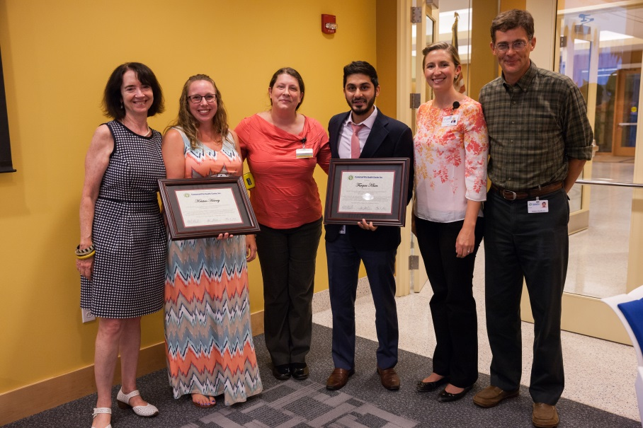
Graduation Planning Considerations
3-4 Month Check-list
Set a date and time
Send Save-the-Date
Budget
Venue
Guest List
Food
Begin thinking about Program & Gift
Notes:
Kerry

Slide 41
6 - 8 Week Check-List
Collect RSVPs
Continue working on Program
1-2 Week Check-List
Confirm with all vendors/contributors (caterer, photographer, venue)
Send reminders to all guests
Finalize program/event briefing and confirm with all contributors
Notes:
Kerry

Slide 42
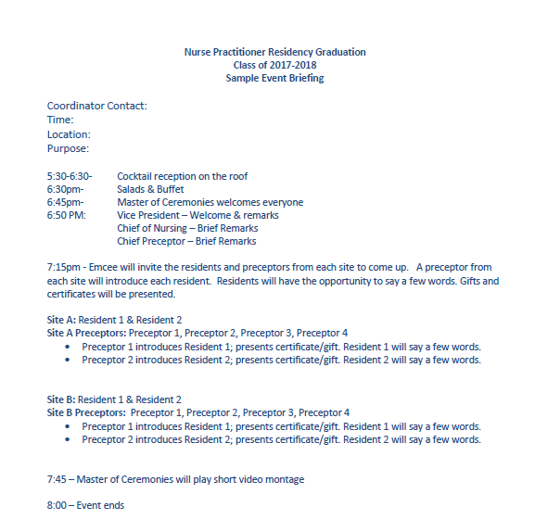
Sample Program
Notes:
Kerry

Slide 43
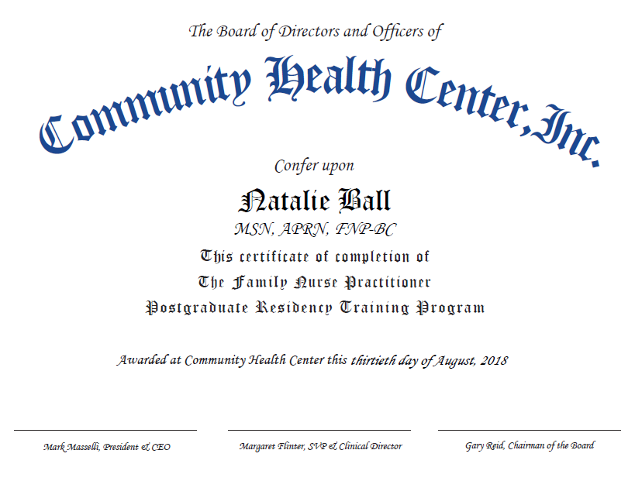
Sample Certificate
Notes:
Kerry

Slide 44
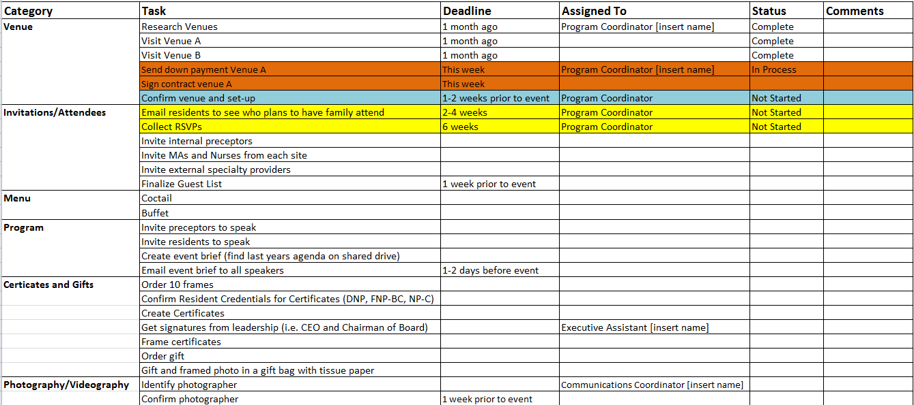
Timeline Example
Notes:
Kerry

Slide 45
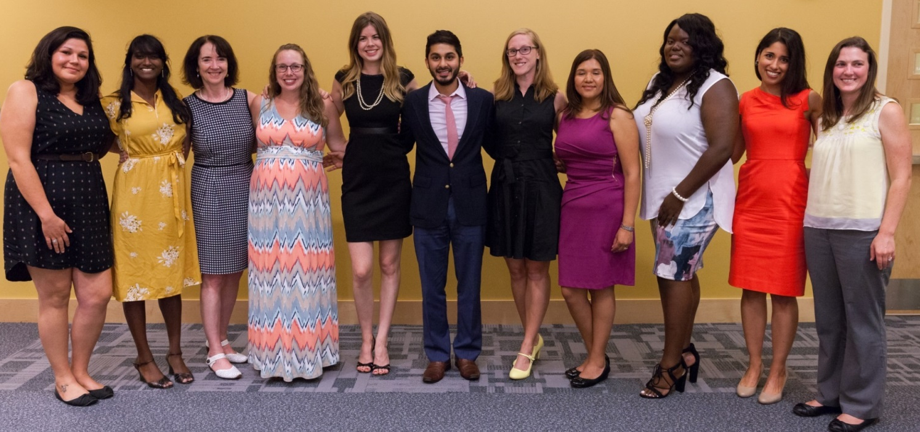
After the Event
Debrief – Meet with key individuals to celebrate successes and review lessons learned for next time.
Notes:
Kerry

Slide 46
NP Residents’ Portfolio
Residents receive a portfolio that includes all of their patient visit data, as well as all of their reflective journals.
  Number of visits
  Number of procedures
  Panel size
  Breakdown of patient by age, common conditions, etc.
  Reflective Journals
  Evaluation data
  CME and QI certificates
Notes:
Kerry

Slide 47
Questions?
Notes:
ALL

Slide 48

Anchoring Your Program Around the Accreditation Standards
Notes:
Kerry

Slide 49
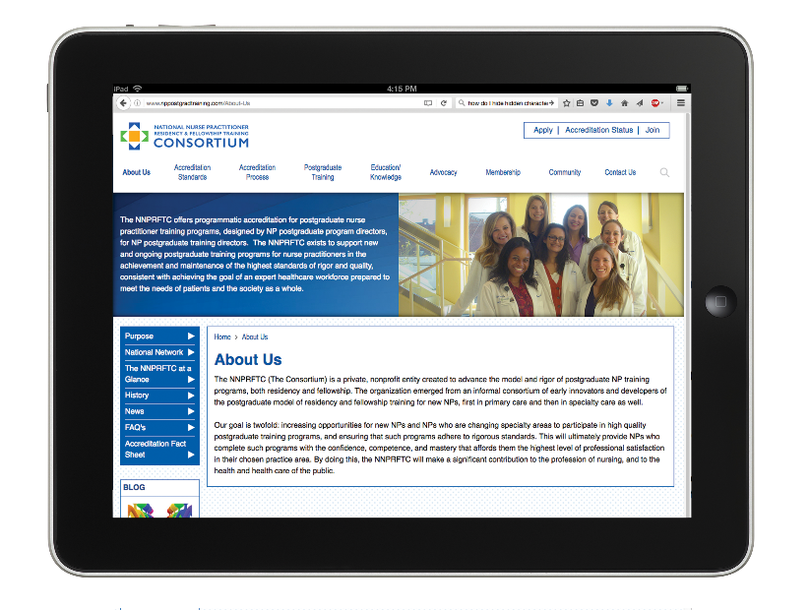
History of the Consortium
2010: Convened as informal consortium in 2010 by 4 FQHC-based postgraduate NP
training programs
2013: Identified accreditation as a goal early on; no available existing sources of accreditation at the time; committed to developing program that is eligible for US Dept. of Education Federal recognition
2013–2015: Accreditation Standards: authored by 10 NP nationally recognized expert authors—written by NP program directors for NP program directors; Self Study Guide
2015: CHCI formally incorporated a new 501c3, the NNPRFTC, to advance the postgrad NP training movement, including developing of accreditation program
2016: Accreditation action for first 2 programs
2017-Present: 17 accredited programs, others in the pipeline
2019: U.S. Department of Education Petition for Federal Recognition as an Accreditor
2020: 3 programs received renewal of accreditation. Awaiting US Dept. of Education on next step in the recognition process.
2022: The consortium receives Federal Recognition by the United States Department of Education
2023- Consortium Name Change, 2023 Accreditation Standards Released and Expansion of Scope petition submitted to the U.S. Department of Education.
2024- Expansion of Scope Approval to become Federally recognized for NP/PA Postgraduate Training Programs
Notes:
Kerry

Slide 50
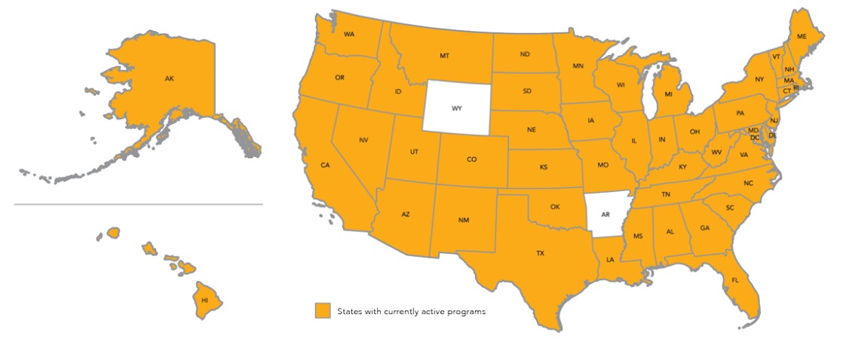
APP Postgraduate Training Programs
Total 549 Programs Nationally (continues to grow)
Notes:
Kerry

Slide 51
Accreditation Defined
External, independent review of a health care training program against nationally-accepted Standards and its own policies, procedures, processes, and outcome (AAAHC)
Peer-reviewed, voluntary program evaluation
Practice-based determination of adherence to National Standards
National acknowledgement of quality
Notes:
Kerry

Slide 52
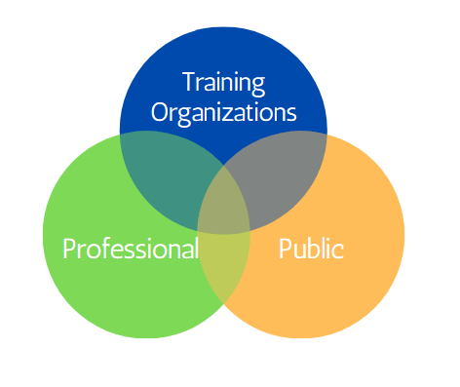
Benefits of Accreditation
Notes:
Kerry

Slide 53

Consortium’s Standards Driving
Excellence in Program Design
Standard 1: Mission, Goals, Objectives
Standard 2: Curriculum
Standard 3: Evaluation
Standard 4: Program Eligibility
Standard 5: Administration
Standard 6: Operations
Standard 7: Staff
Standard 8: Postgraduate Trainee Services
Notes:
Kerry

Slide 54
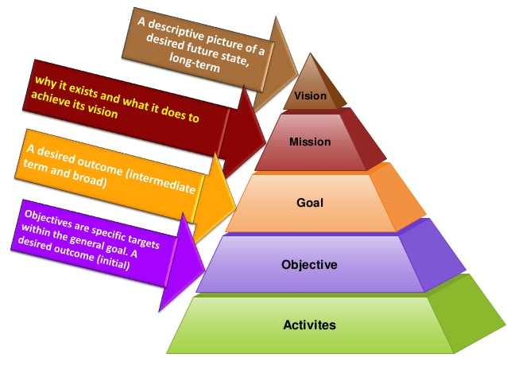
    - Recruitment and retention of PCPs are crucial in patient care
    To educate and retain NPs
    Prepare NPs for post-graduate autonomy
    Improve confidence and competence
    Improve job satisfaction
    Specific objectives within general goals
    Detailed curriculum
Notes:
Kerry

Slide 55
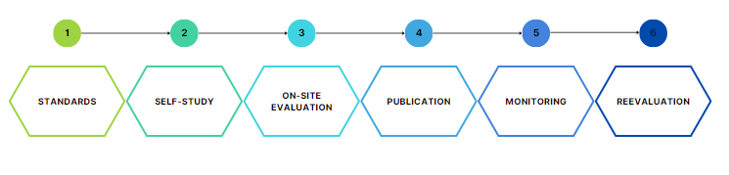
US. Department of Education
Accreditation Process
6 Major Steps
Notes:
Kerry

Slide 56
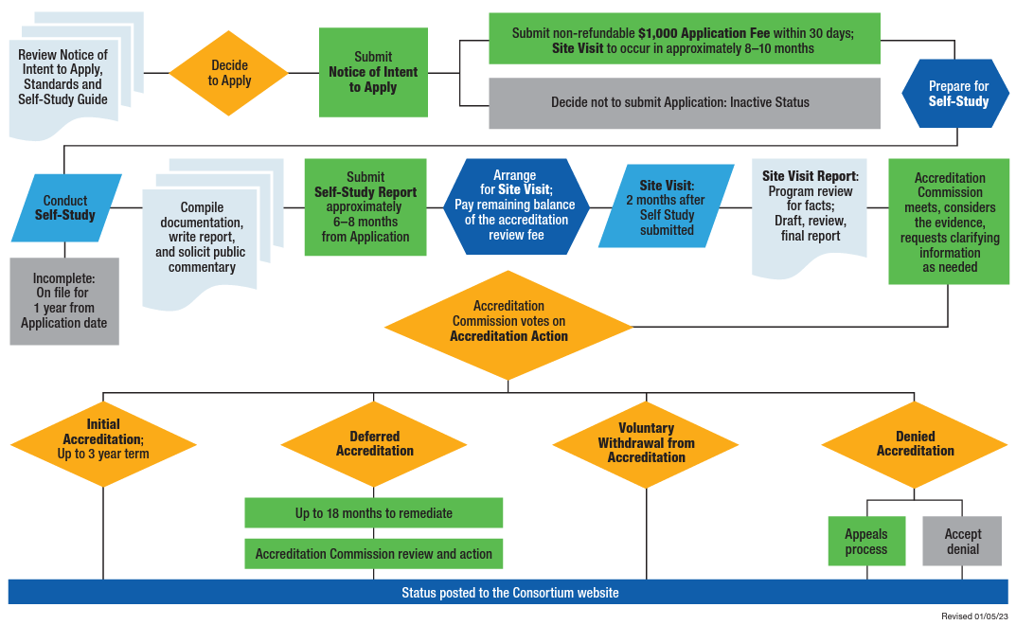
Accreditation Process
Notes:
Kerry

Slide 57
Consortium Accreditation Sample Timeline
General Timeframe, Application to Decision (10-12 months)
Intent to Apply
Application
Self Study: internal program evaluation
1.5 day On-site Visit: external program evaluation (completed by 2 trained site visitor peers (educator, administrator, clinician)
Site Visit Report: reviewed by program, submitted to Accreditation Commission for accreditation consideration
Decision: Accredited, Deferral, or Denial of Accreditation
Posted to Consortium website
Annual and Interim Reports
Extensive technical support available throughout the process
Notes:
Kerry

Slide 58
Consortium Accreditation Costs
Total Cost: $11,000
$1,000 non-refundable application fee
$10,000 review fee: due prior to the site visit (discounted fee schedule for Federal Programs)
For programs with multiple tracks:
  $10,000 plus $6,500 for each additional track (possible travel costs)
Notes:
Kerry

Slide 59

Accreditation Anchors Program Development
Notes:
Kerry

Slide 60
Accredited Programs
As of February 2025: Consortium has accredited 37 APP Postgraduate Training Programs with several in the pipeline pursuing accreditation.
View Accredited Programs here: https://www.apppostgradtraining.com/accreditation/accreditation-status-and-public-commentary/
Notes:
Kerry

Slide 61
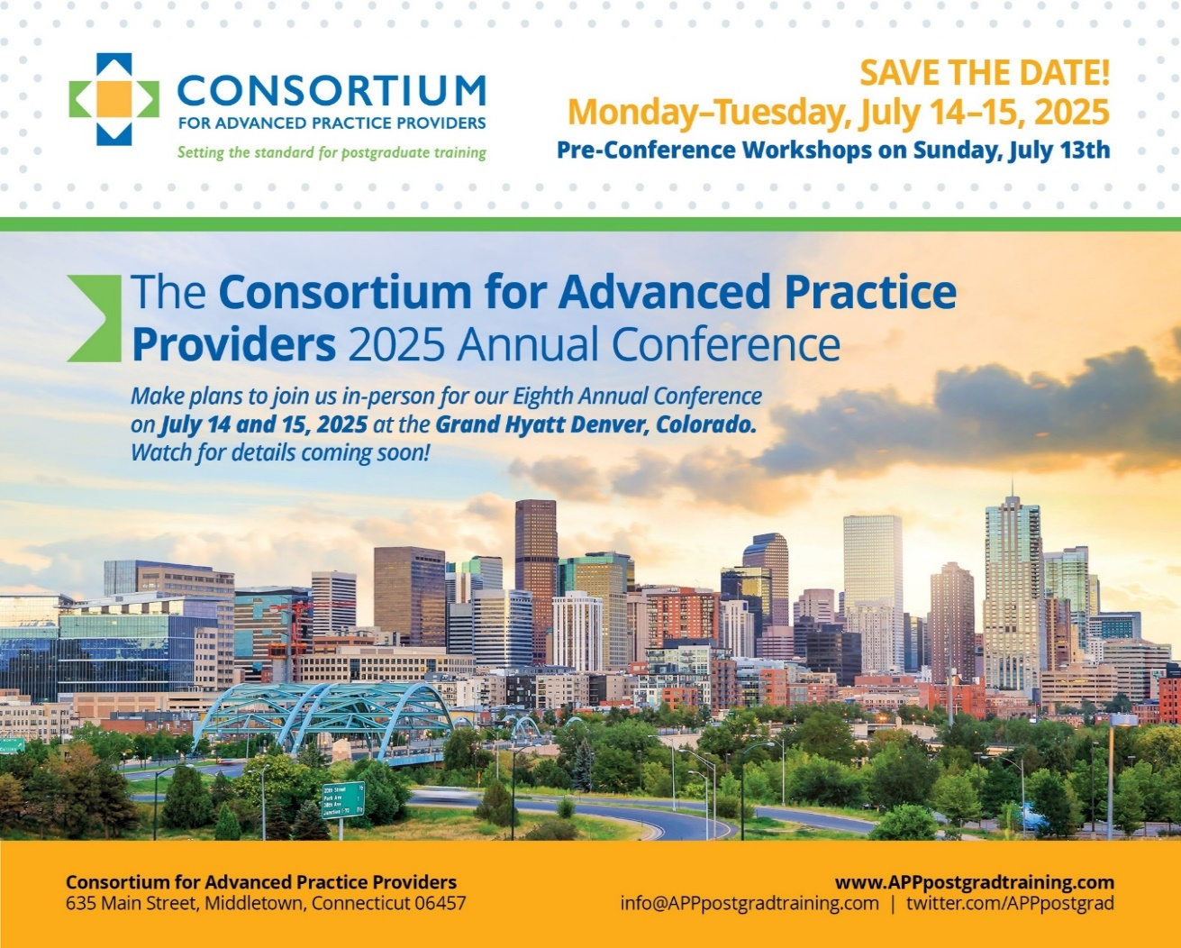
2025 Annual Conference
Mark your calendars and “Save the Date”!
Dates: July 13 – 15, 2025
Location: Grand Hyatt Denver, CO
  Pre-Conference Workshop Offerings on 07/13
    APP Leadership Workshop
    Administration and Operations Workshop
    Preceptor Development and Training Workshops
  2 Day General Conference on 07/14 – 07/15
Link to the 2024 conference highlights video:
https://vimeo.com/1002782981/a40432e368?share=copy
Notes:
Kerry
The Annual Conference is designed to bring together a community of 250+ innovators, leaders, and emerging leaders in leading and developing formal postgraduate programs as well as a cadre of tomorrow’s leaders (today’s NP/PA trainees and students) to learn from each other, but also from external stakeholders and experts in healthcare systems and policy.
This conference is an opportunity for a relatively short but intense burst of continuing education in evolving best practices in APP postgraduate training, strategies for the planning, implementation, and success of service-delivery based postgraduate training, anticipated relevant future policy developments, and health care trends related to the movement. Breakout sessions will provide opportunity for specialized focus on critical elements of curriculum, evaluation, faculty development and accreditation.
Join us with program directors, managers, coordinators, and trainees from postgraduate APP training programs across the country. The Consortium’s 8th Annual Conference will provide valuable insights and resources to elevate your programs and enhance your impact in the field.
This is a great highlights video from the conference you could also share with NTTAP participants. Its talks about new programs and getting support. J Thanks for your help promoting. Kerry
https://vimeo.com/1002782981/a40432e368?share=copy

Slide 62
Questions?
Notes:
ALL

Slide 63
Wrap-Up
Notes:
Meaghan

Slide 64
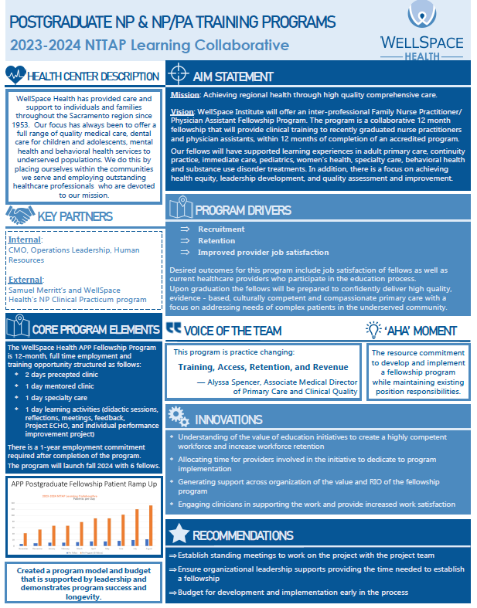
Showcase Overview
Showcase Template Due Date: Friday February 28th Please let me know if you need an extension.
Showcase Presentation Date: Tuesday March 11th
Showcase Purpose
  Tell the story of your health center’s work during this learning collaborative in a clean, crisp, visual format
  Generate reflection among you and the other team members about your involvement in this learning collaborative
  Share your work in future meetings with other health center staff including leadership and external stakeholders such as the health center board, community partners, and funders
Notes:
Meaghan

Slide 65
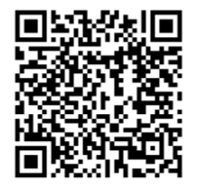
Deliverables
Continue to work on Progress Checklist
Work on Showcase Presentation
Access the Google Drive to upload deliverables:
Notes:
Meaghan

Slide 66
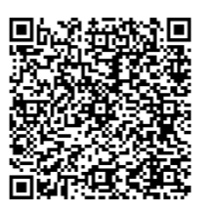
Next Steps
Coach Calls
  Tuesday February 18th 1:00pm Eastern / 10:00am Pacific
  Tuesday March 4th 1:00pm Eastern / 10:00am Pacific
Session 6: Tuesday March 11th 1:00pm Eastern / 10:00am Pacific
  Showcase Presentation
Register for the Weitzman Education Platform to receive CME, resources, and more!
Notes:
Meaghan

Slide 67
Health Professions Student Training Learning Collaborative Overview
Free six-month participatory experience designed to provide knowledge, tools, and coaching support to help health centers and look-alikes implement an effective and sustainable health professions student training program.
The goal for the learning collaborative is dedicated time for your organization to draft your own Health Professions Student Training Programs Playbook for your organization to follow when operating student training programs.
Participating health centers are asked to identify a team to focus on the implementation of their health professions student training playbook.
  Suggested team members include: Human Resources, Education Department, Operations, Medical Director(s), Administrative
  Team members may differ dependent on the organization’s staffing
Begins Friday February 14th, 2025
To express interest or for questions, please reach out to Meaghan Angers (angersm@mwhs1.com)
Notes:
Meaghan

Slide 68

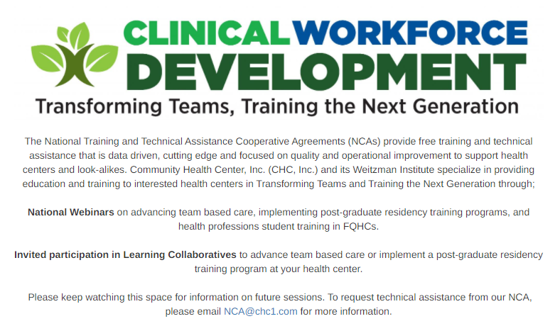

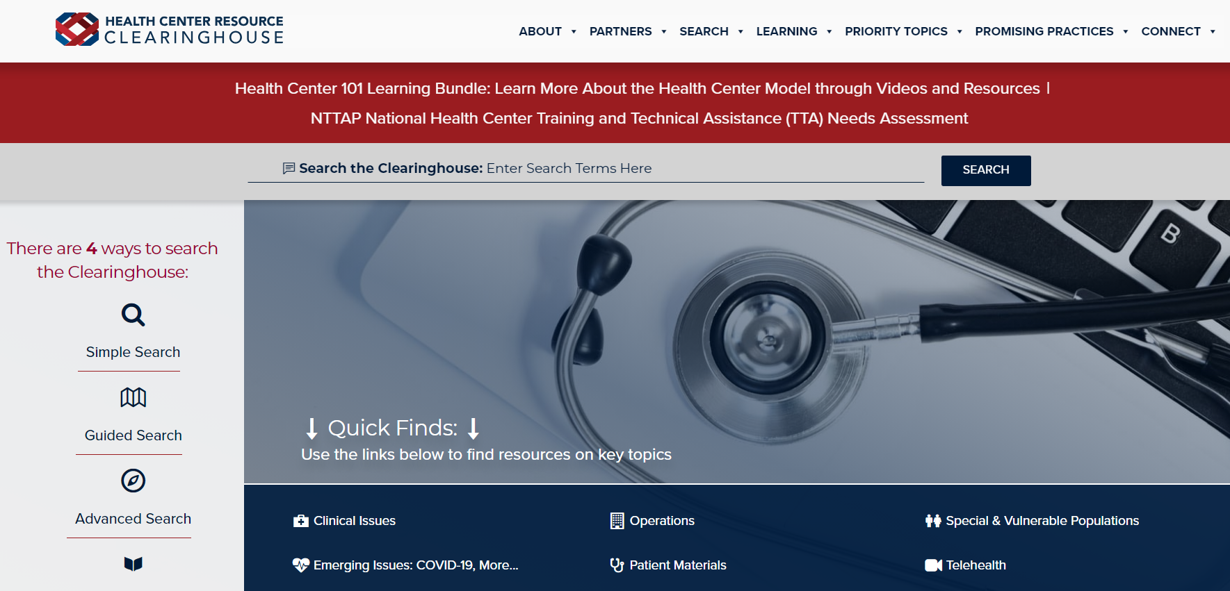
Explore more resources!
National Learning Library:
Resources for Clinical Workforce Development
Health Center
Resource Clearinghouse
https://www.weitzmaninstitute.org/ncaresources
https://www.healthcenterinfo.org/
Notes:
Meaghan

Slide 69
Contact Us!
Amanda Schiessl
Program Director/Co-PI
Amanda@mwhs1.com
Meaghan Angers
Senior Program Manager
angersm@mwhs1.com
Bianca Flowers
Program Manager
flowerb@mwhs1.com
REMINDER: Complete evaluation in the poll!
Next Learning Session is Tuesday March 11th!
Notes:
Meaghan

