Slide 1

STRATEGIC
FOCUSED
Quality Improvement Seminar
Mark Splaine & Emma Warshauer
February 27, 2025
RELEVANT
INTERACTIVE
TEAM WORK
INFORMATIVE
FUN
SKILL BUILDING
Nurse Practitioner & Physician Assistant
Training Programs

Slide 2
Session Goals
Review strategies for planning a Plan-Do-Study-Act (PDSA) cycle
Share examples of PDSA approaches from your projects
Hear an example from a leader regarding work with stakeholders
Review tools for communication plans and stakeholder analysis
Practice developing a stakeholder analysis plan
2

Slide 3
Roles
Theory burst presenter
Mark
Timekeeper & technical genius
Emma
Take-home thoughts
Mark and Emma
3

Slide 4
Agenda
Welcome (5 minutes)
Another data display example (7 minutes)
PDSA case discussion (8 minutes)
A PDSA example (10 minutes)
Stakeholder examples (10 minutes)
Theory burst (10 minutes)
Stakeholder Analysis/Influencing Strategy/Communication Plan
Summary and take-home points (5 minutes)
Break (5 minutes)
Project team work (15-30 minutes minutes)
4

Slide 5
Curriculum Plan
An overview of Quality Improvement (10/10/24)
Care Observations & Stakeholder Considerations (10/24/24)
Organizing your Improvement Project (11/14/24)
Global Aim and Fishbone Diagram (12/12/24)
Process Mapping (Flowcharts) (1/9/25)
Measurement to Inform Change (1/23/25 & 1/30/25)
An Approach to Testing a Change (2/13/25)
Communication about your Improvement Effort (2/27/25)
Stakeholder Analysis & Conflict Management (3/13/25)
Managing Up and Gaining Leadership Buy-In (3/27/25)
Negotiation (4/10/25)
Negotiation and More About Cycles of Change (4/24/25)
Sustaining your Improvement Effort (5/8/25)
Resident Presentations (5/22/25, 6/12/25, 6/26/25)

Slide 6
Another Data Display Example
6

Slide 7
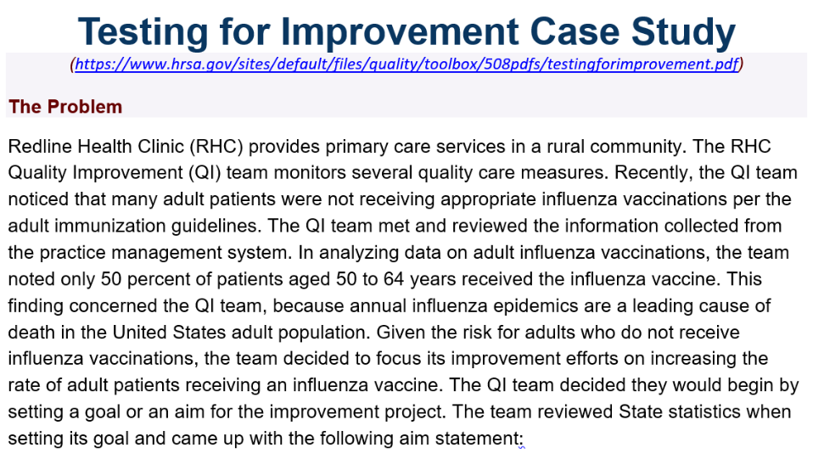

Slide 8
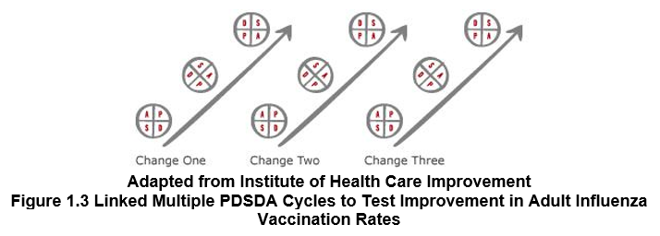
Change 1 – initial query of patients
Change 2 – develop scripting for MA’s
Change 3 – provider education about vaccine risks and benefits
Change 4 – educate staff

Slide 9
PDSA Case Study
Any questions or issues about the case?
9

Slide 10
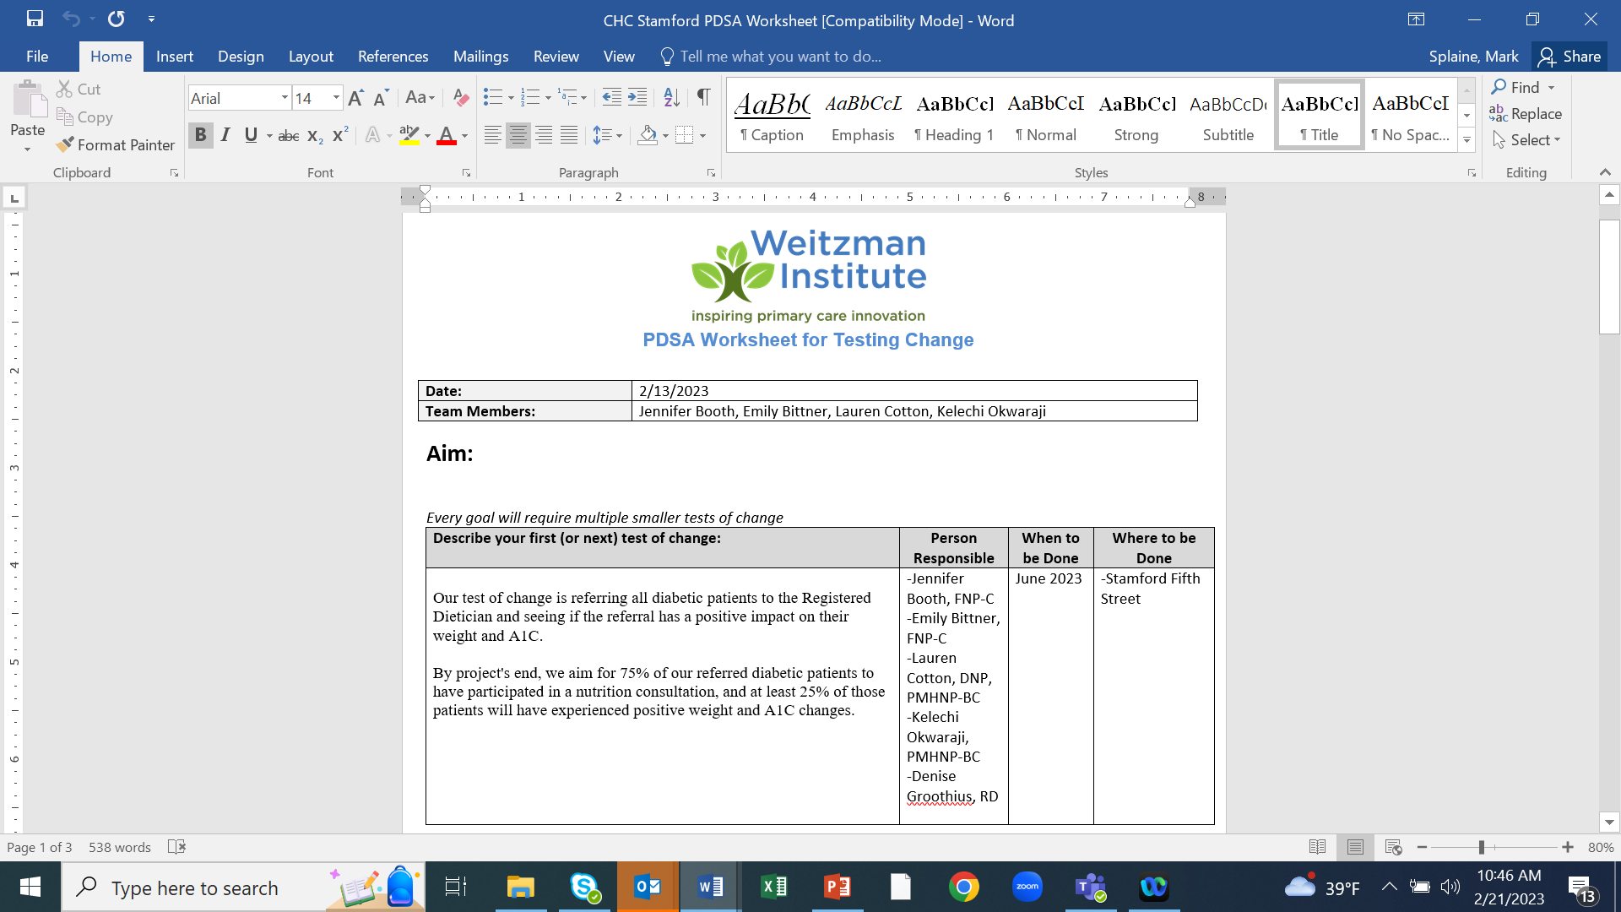
PDSA Example (2023)

Slide 11
Using a Flowchart to Show PDSA
Person w Diabetes
Provider
Visit
Refer to RD
RD
Visit
Follow-up
Provider
Visit
Outcome

Slide 12
Possible Additional PDSA’s
Person w Diabetes
Provider
Visit
Refer to RD
RD
Visit
Follow-up
Provider
& RD Visit
Provider & RD
Confer
Additional
RD Visit(s)
Provider & RD
Confer
Follow-up
Provider Visit
Outcome

Slide 13
Stakeholder Example: Garrett Matlick

Slide 14
Garrett’s DNP Project
Goal was to get patients into the clinic faster after hospital discharge since, at the time, our time to intake for therapy was about 6-8 weeks, which meant that by the time they were able to get 1-2 sessions in, it might be 2-3 months before they got into psych med management.
One idea was to establish a workflow of a new therapy group where the therapist would do an intake to determine fit for group and then would do an 8 week, weekly group.
The group would focus on utilizing resources and how to avoid going back to the ED and when they should go back to the ED.
At the same time, they’d see either a primary care provider who was comfortable with psych or a psychiatry provider who would see them 1-2 times as a consult and provide feedback to the PCP on recommendations for meds, med changes, etc.
14
Notes:
www.clinicalmicrosystem.org
14

Slide 15
Garrett’s DNP Project
In order to make this happen, it required
Having meetings with the Chief BH Officer, the On-Site BH Director for Stamford
Surveying the therapists to see who would be interested
Surveying psychiatry providers and PCPs to see who would be interested/have availability in their schedule
Then working with the two individuals to come up with a plan.
It involved a lot of meetings to put into place.
The key component for these conversations though wasn’t the logistics, it was getting buy in from key stakeholders at the organization.
15
Notes:
www.clinicalmicrosystem.org
15

Slide 16
Garrett’s DNP Project
Finding a way to deliver your message in a way that shows the importance of the change and that you’ve thought through how it might work and that you have interested parties will make a big difference.
You also need to find ways to show that it will improve workflows and not simply add to responsibilities and slow things down.
And once you have buy in, you also get the added benefit of multiple minds adding their input!
16
Notes:
www.clinicalmicrosystem.org
16

Slide 17
Additional thoughts on stakeholders

Slide 18
Stakeholder Analysis
Stakeholder | Strongly against | Moderately against | Neutral | Moderately supportive | Strongly supportive
Providers |  |  |  | C | D
IT | C |  |  | D
HR |  |  | C D
Nursing
Reception
Other stakeholder
How to use this tool
Plot where individuals currently are with regard to change (C = current)
Plot where individuals need to be (D = desired) in order to successfully accomplish change. Identify gaps between current and desired with horizontal arrows.
Indicate which individuals may influence others by drawing arrows between them.
Action steps for closing gaps will be discussed in the “Influencing Strategy.”
Not all stakeholders need to be “strongly supportive” for successful change
Notes:
Understand where your stakeholders currently stand on their understanding and support of your project and test of change

Slide 19
Stakeholder Analysis Example
Stakeholder | Strongly against | Moderately against | Neutral | Moderately supportive | Strongly supportive
Providers |  | C |  | D
PSAs |  |  |  | C | D
Patients |  |  | C
Nursing |  |  |  | C | D
Medical Assistants |  |  | C |  | D
Finance |  |  |  | CD
IT |  |  |  | CD
Jane Smith |  |  | C
Dental |  | C |  |  | D
Behavioral Health |  | C |  |  | D
Senior Leadership |  |  |  | C | D
Trainers/HR |  |  | C
Current State = C
Desired State = D
Notes:
Example

Slide 20
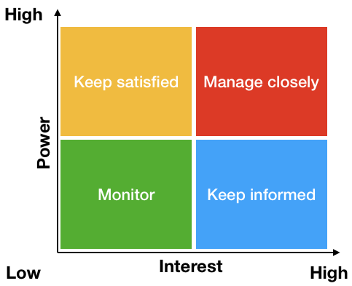
Prioritization Matrix
Notes:
Organize your stakeholders into categories to help you prioritize which stakeholders need more or less communications and how much information.

Slide 21
Communication Plan
Audience | Communication Objectives | Message(s) | Media & Methods | Timing & Frequency | Who/When Where
Media Method Examples to Consider:
Email.
Newsletter.
Teleconference.
Notice boards.
CEO briefing.
Posters.
Lunchtime meeting.
Intranet article.
Launch event.
Team meeting.
Notes:
Understand the best way to communicate with your stakeholders

Slide 22
What haven’t we figured out yet?
Questions or issues that remain unclear?
22

Slide 23
Change Can Be Hard
“The status quo feels comfortable and steady because much of the choice has been squeezed out. You have your routines, your ways of doing things.”
Chip Heath, Switch: How to Change Things When Change Is Hard
23

Slide 24
Summary
Many people approaching an improvement effort underappreciate the importance of the Plan step of the PDSA cycle.
The fishbone diagram can be a helpful tool for brainstorming ideas for possible changes to test. Once generated, you can prioritize the list of change ideas and begin testing those of highest priority.
Input from stakeholders is critical throughout any improvement effort. It is particularly informative when selecting an effort, developing an understanding of a process, and considering what change to test.
Because stakeholder input is important throughout an improvement effort, it is useful to have a strategy for communicating with stakeholders.
24

Slide 25
Session X Assignment
Interview a stakeholder for your planned change with whom you have not had regular interaction regarding the change
Use the template we used today to guide your interview (see separate Word document)
Contact Mark or Emma if you have questions
Be prepared to discuss your interview next session on 3/13/25
25
Notes:
www.clinicalmicrosystem.org
25

Slide 26



Break!
Take five minutes to recharge and refresh.
26

Slide 27
Small Group Discussion
We will use Zoom Breakout Rooms to allow you to gather as a project team
You will discuss the questions on the following slide related to a stakeholder for your project (also see the Word document template)
Answer as many of the questions as you are able
Have one member of your team record the answers
27
Notes:
www.clinicalmicrosystem.org
27

Slide 28

Stakeholder Considerations
What is their level of interest in the project and/or test?
What is their level of influence on the project and/or test?
How do they want to contribute and be involved in the project?
What are their expectations for this project or test of change?
What challenges do you predict might come up regarding this stakeholder?
28

Slide 29
References
HRSA.org - Health Resources and Services Administration, agency of U.S. Department of Health and Human Services, Rockville, Maryland: Testing for Improvement
Warrick DD. Developing Organization Change Champions: A High Payoff Investment! OD Practitioner. 2009;41(1):14-19.
29
Notes:
www.clinicalmicrosystem.org
29

