Slide 1
Comprehensive and Team-Based Care Learning Collaborative
Session Four: February 12th, 2025
Notes:
Meaghan

Slide 2
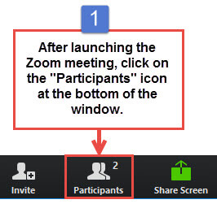
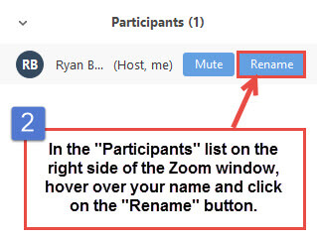
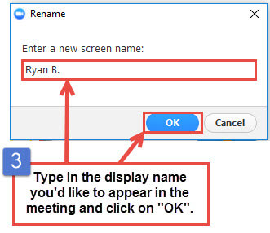
Get the Most Out of Your Zoom Experience
Please keep yourself on MUTE to avoid background/distracting sounds
Use the CHAT function or UNMUTE to ask questions or make comments
Please change your participant name to your full name and organization
“Meaghan Angers CHCI”
Notes:
Meaghan

Slide 3
Session 4 Agenda
1:00-1:05pm Introduction
1:05-1:35pm Team-Based Care: Understanding Barriers
1:35-1:50pm Team Reports: Cherry Health and Primary Health Network
1:50-2:05pm Quality Improvement Refresh: Specific Aim Statements
2:05-2:10 Quality Improvement Refresh: Solution Storming
2:10-2:25pm Quality Improvement Refresh: PDSA Cycles
2:25-2:30pm Q/A, Next Steps, and Evaluation
Notes:
Meaghan

Slide 4
Learning Collaborative Faculty
Tom Bodenheimer, MD
Physician and Founding Director, Center for Excellence in Primary Care
Deborah Ward, RN
Quality Improvement Consultant
Kathleen Thies, PhD, RN
Consultant, Researcher
Margaret Flinter, APRN, PhD, FAAN
Co-PI, NTTAP
CHCI’s Senior Vice President/Clinical Director
Amanda Schiessl, MPP
Chief of Staff, MWHS
Co-PI & Project Director, NTTAP
Meaghan Angers
Senior Program Manager, NTTAP
Bianca Flowers
Program Manager, NTTAP
Notes:
Meaghan

Slide 5
Community Health Center, Inc.
A leading Federally Qualified Health Center based in Connecticut.
ConferMED
A national eConsult platform improving patient access to specialty care.
The Consortium for Advanced Practice Providers
A membership, education, advocacy, and accreditation organization for
APP postgraduate training.
National Institute for Medical Assistant Advancement
An accredited educational institution that trains medical assistants for
a career in team-based care environments.
The Weitzman Institute
A center for innovative research, education, and policy.
Center for Key Populations
A health program with international reach, focused on the most vulnerable among us.
Notes:
Meaghan

Slide 6
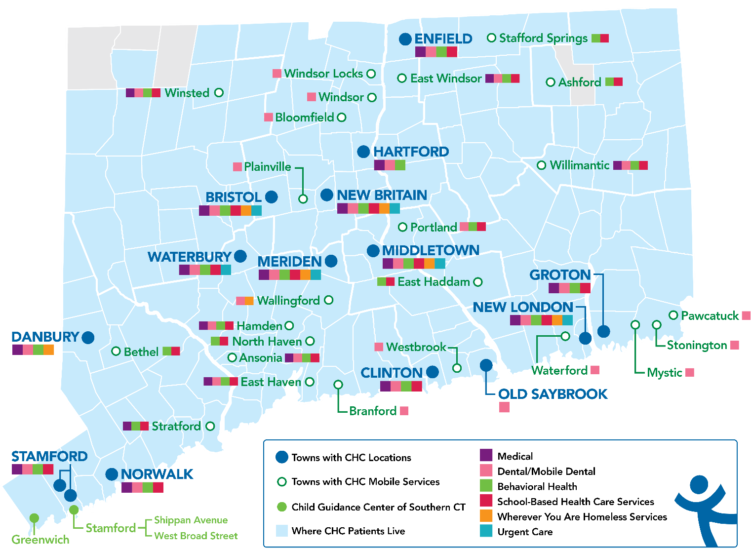
Locations & Service Sites
Overview
Founded: May 1, 1972
Staff: 1,400
Active Patients: 150,000
Patients CY: 107,225
SBHCs across CT: 152
Year | 2021 | 2022 | 2023 | 2024
Patients Seen | 99,598 | 102,275 | 107,225 | 104,917*
Notes:
Margaret
Overview of Community Health Center, Inc.

Slide 7
National Training and Technical Assistance Partners (NTTAP)
Clinical Workforce Development
Provides free training and technical assistance to health centers across the nation through national webinars, learning collaboratives, activity sessions, trainings, research, publications, etc.
Notes:
Meaghan

Slide 8
Learning Collaborative Structure
Eight 90-minute Learning Collaborative video conference sessions
Weekly 60-minute calls between coach mentors and team coach
Internal team workgroup meetings
Access resources via the Weitzman Education Platform
Use Google Drive to share your work
Learning Session Dates
Learning Session 1 | Wednesday November 13th
Learning Session 2 | Wednesday December 11th
Learning Session 3 | Wednesday January 8th
Learning Session 4 | Wednesday February 12th
Learning Session 5 | Wednesday March 12th
Learning Session 6 | Wednesday April 9th
Learning Session 7 | Wednesday May 14th
Learning Session 8 | Wednesday June 11th
Notes:
Meaghan

Slide 9
2024-2025 Cohort
Cherry Health | Grand Rapids, Michigan
Chestnut Family Health Center | Bloomington, Illinois
Community Health & Wellness Center of Greater Torrington | Torrington, Connecticut
Community Health Service Inc. | Moorhead, Minnesota
Complete Health DBA Community Health Center of Black Hills, Inc. | Rapid City, South Dakota
Excelth Inc. | New Orleans, Louisiana
HCCH Medical Clinics (Harrison County Community Hospital) | Bethany, Missouri
North Shore Community Health Inc. | Salem, Massachusetts
Primary Health Network | Sharon, Pennsylvania
Notes:
Meaghan

Slide 10
Team-Based Care: Understanding Barriers Tom Bodenheimer Center for Excellence in Primary Care University of California, San Francisco
Notes:
Tom (30 minutes)

Slide 11
What is a powerful team?
Learning Session 1 Recap:
Primary care patient access is poor and getting worse
Panel sizes are too large because few clinicians choose primary care careers
Poor access and large panels are major contributors to burnout
Powerful teams can help solve these challenges; poorly functioning teams cannot
Notes:
Tom

Slide 12
What is a powerful team?
A powerful team is a team that adds capacity to see more patients, thereby improving access and reducing burnout
Interprofessional team members add capacity by seeing patients independently, taking little or no clinician time
Interprofessional team members help over paneled clinicians care for their panels, thereby reducing clinician burnout
When interprofessional team members have standing orders to see patients independently, they often have greater work life satisfaction
Medical assistants can also add capacity, saving clinician time by providing panel management functions
Notes:
Tom

Slide 13
What is a powerful team? Examples:
In many states, pharmacists can independently care for patients with diabetes or hypertension -- including ordering and interpreting labs and adjusting medications – under collaborative practice agreements.
Health centers can organize RN co-visits with the RN doing most of the visit and the clinician coming in at the end to check the RN’s work and complete the orders the RN entered into the EMR. RN co-visits can add substantial capacity.
Notes:
Tom

Slide 14
Barriers to building powerful interprofessional teams
We can’t recruit the personnel we need
Only practitioners are reimbursed
Who knows when the alternative payment model will actually arrive
No time to train and mentor staff in their enhanced roles
Scope of practice laws
Will patients accept their care?
The barriers are real and need to be addressed. In making goals and action plans, consider the barriers and which would be the most difficult to overcome. But don’t let barriers paralyze you.
Notes:
Tom

Slide 15
Chat Activity: 10 Minutes
Let’s pretend that you have set an overall goal to build a powerful interprofessional team. One specific goal focuses on RNs.
You would like your RNs to become care managers for patients with diabetes who see patients independently and can change medication doses under standing orders. Your first action plan is to hold a meeting with the RNs in the clinic to discuss their work, whether they are satisfied with their roles, what they might think about RN care management.
Write in the chat: What barriers you would need to overcome to move toward the goal of RNs becoming care managers?
15
Notes:
Tom

Slide 16
RN care management for patients with diabetes:
Barriers and who is causing the barrier
 | Federal/ state government, professional associations, professional schools | Health system leaders | Physician reluctance | Team member reluctance | Patient reluctance
We can’t recruit RNs | Nursing associations and nursing schools emphasize hospital nursing. Lack of RN faculty restricts number of slots in nursing schools | Leaders prioritize the number of hospital nursing jobs over ambulatory jobs. They pay clinic RNs 60% of what hospital RNs make.
RNs are not trained in primary care functions | Nursing schools usually don’t teach ambulatory care nursing | Not interested in developing in-house ambulatory training for RNs | Providers may want RNs to only do phone triage, which shields physicians from patients wanting same-day care | RNs may be satisfied with more traditional RN functions such as triage, wound care, and patient navigation | Patients may want to see their doctor rather than an RN care manager
RNs are not allowed to do care management (especially adjusting medication doses) | State nursing boards may not allow RNs to adjust medication doses | Even when the state allows medication adjustment under standing orders, health system leaders may say No | Providers may not trust RNs to adjust medications and may refuse to write standing orders | RNs may not feel comfortable adjusting medication doses
Lack of a business case. Only clinicians (doctors, NPs, PAs) are reimbursed. RNs are an expense and don’t generate revenue | Medicare and Medicaid generally set payment rules, which insurance companies follow | Health system leaders may take a narrow view of business case. They want revenues to equal expenses each month. Rather than getting revenue from P4P for better metrics, or greater patient satisfaction bringing new in more patients.
Notes:
Tom

Slide 17
Clinician and staff satisfaction leads to less turnover. Turnover is a huge expense to the clinic
Cost
Quality/Safety
Patient experience
Work experience
Increase in visits or panel size
Billable services by RNs, PTs, Pharmacists
Redeployment of staff to higher value activities
Metrics to watch for team-based care
Don’t just look at revenue vs. expense
Patient experience surveys; good performance can lead to P4P money and can attract new patients
Improvements screening rates or disease control
Reduced readmissions
Reduced ED use
Notes:
Tom

Slide 18
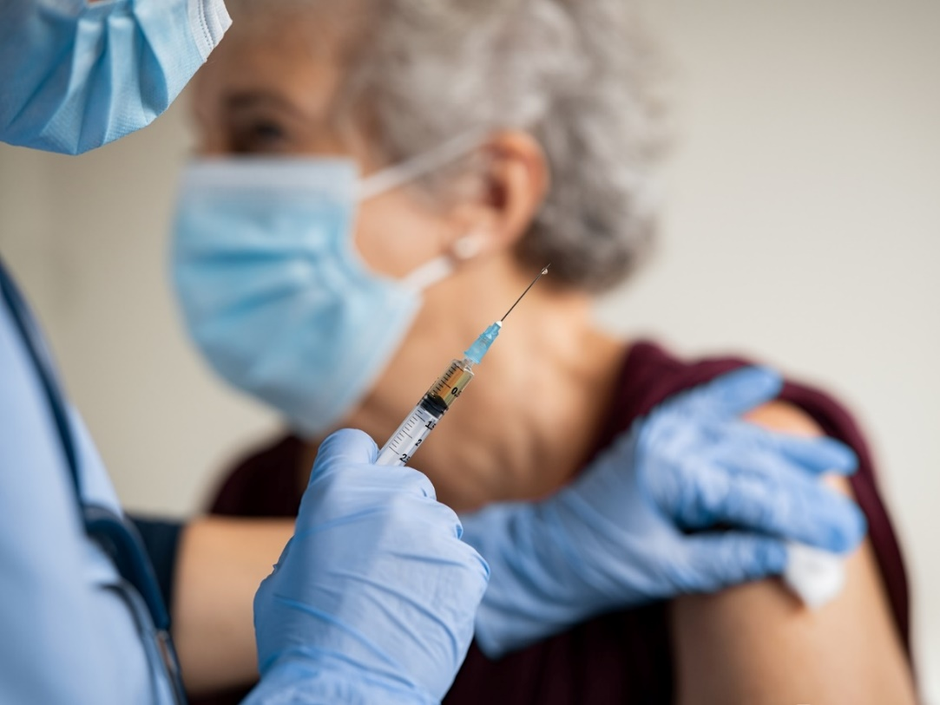
Regulatory Barriers: Case Study
California allows MAs to give injections for immunizations
San Francisco General Hospital:
MAs give immunizations
Standing orders enable MAs to identify and administer immunizations without patient-specific clinician orders
UCSF Health System:
MAs cannot give injections at all. RNs or LVNs give the injections.
Many UCSF residents work at both SF General and UCSF hospitals; in one place they can rely on MAs to take care of immunizations by themselves while in another place the MAs cannot even give the shots
Who is causing the barrier?
Notes:
Tom

Slide 19
Empowering MAs to give childhood vaccinations independently: Barriers and who is causing the barrier
 | Federal/ state government, professional associations, professional schools | Health system leaders | Physician reluctance | Team member reluctance | Patient reluctance
We can’t recruit enough MAs | The economy is in a worker-shortage period | MAs are poorly paid and don’t choose medical assistant careers
MAs are not trained to identify which kids need which vaccines; how to administer the vaccines safely | Low-quality commercial MA training programs. Better community college MA programs may have limited curriculum. | Health system lawyers may be overly cautious | Providers feel only they can decide which vaccines to give, even though there is a standard vaccine schedule. MAs would consult if there were questions for particular patients | MAs may be reluctant, feeling uncomfortable with the responsibility, or because they are already working too hard | Less of an issue because patients are used to staff giving vaccines
MAs are not authorized to decide on which vaccines and to give the injection | State regulations may require that only clinicians and nurses can administer injections | Even when the state allows MAs to give injections, health system leaders may say No | Providers may not trust RNs to decide which vaccines to give to which patients, and refuse to create standing orders | MAs may not feel comfortable with this responsibility
Lack of a business case. | Medicare, Medicaid and insurance may pay little for vaccine administration | Health system leaders may worry that they would need to hire more MAs. Even though the time it takes clinicians, or the expense of using RNs, would cost more. Taking a narrow view of business case. Rather than saving clinician time and thereby increasing access and market share.
Notes:
Tom

Slide 20
Take Home Points
Powerful teams can make primary care more do-able: more trained people to care for overly large panels
There are a number of barriers to building these teams. The big ones are:
Business case
Restrictive laws and regulations
Difficult to recruit team members
Training and mentoring is key and takes personnel and time
It is necessary to analyze where is the barrier: government, health system leaders, physicians, staff, patients
The business case is more complex than having revenues = expenses each month. Leaders should take a longer view and see improvements as an investment
Notes:
Tom

Slide 21
Questions?
Notes:
ALL

Slide 22
Team Reports
Notes:
ALL

Slide 23
NTTAP Team Report
February 12, 2025

Slide 24
Agenda
Program Focus & Overview
Successes
Challenges

Slide 25
Project Focus & Overview
Durham Senior Health Center: serving patients 60 and older at our Heart of the City location.
Extended team composition: 2 team co-coaches, Site Manager, RN Supervisor, MA, 2 RN Care Managers, BHC, CHW, Pharmacy, Provider, Quality Specialist
Quality Improvement Focus: Colorectal Cancer Screenings
Current completion rate: 57%
Organizational goal: 71%

Slide 26
Successes
Consistent participation and buy-in from extended team members
Successfully achieved consensus on quality focus measure
Began process mapping which led to collaborative round table discussion generating questions that team will answer together
Role Assessment Tool has identified duplication in work and allowed team to visualize inefficiencies
Allowed staff across service lines the opportunity to get to know one another building stronger relationships organizationally.

Slide 27
Challenges
Initially difficult to identify key staff to drive the learning collaborative forward
Lack of understanding from some team members about their role in the QI project specifically surrounding colorectal cancer screening.
Time commitment is significant
Challenges

Slide 28
QUESTIONS?

Slide 29
Team-Based Care Collaborative 2025

Slide 30
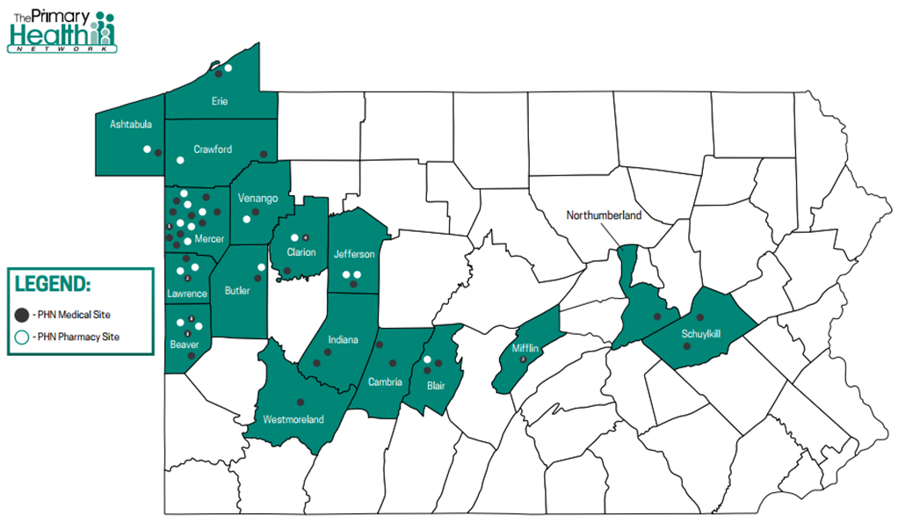
Founded in 1984
Largest FQHC in Pennsylvania
16 counties in PA
1 county in OH
130+ Providers
500+ Employees
75,000+ patients

Slide 31
Progress Update: 2/12/25
Problem identified – A1c above goal or not done
Global aim
Process map
Fish bone
Next step…identifying intervention
Revision of standing orders

Slide 32
Problem Statement
Problem: We aim to improve the current process for diabetes screening and improve diabetic control rates, as our current measures have decreased from previous years and are also in the 4th quartile for ranking. There are several issues that could be contributing to the rates which include: 1) A1c is not ordered/completed at visit with diabetic patient or with patient meeting screening criteria, 2) Patient compliance with completing ordered testing, lack of testing being received and recorded appropriately from outside facilities, 3) Patient compliance with appointments/medication/diet regimens, and 4) Lack of efficacy with current regimen.

Slide 33
Global Aim
Deliverable – Global Aim Template
Theme for improvement: UDS measure for diabetes management.
We aim to improve: A1c screening and diabetes management.
In: PHN’s patients who have known diabetes and meet screening criteria.
The process begins with: Identifying patients who meet screening criteria and patients who are diabetic.
The process ends with: Documentation of completed A1c in EMR.
By working on the process, we expect: to improve the UDS measure for A1c screening and management.
It’s important to work on this now because: Our current rate UDS data for the 2023 year of the network’s A1c control and screenings have decreased from previous year. Currently we are integrating a team based care model which through this model new responsibilities of staff members to empower more staff involvement in patient care and improve outcomes. As a network we need to do better with screening and managing diabetes as the disease has detrimental outcomes if not addressed or managed appropriately. As an FQHC our patient population has a higher risk of developing complications requiring a multidisciplinary approach and integration of the team based model to address decreased rate of screening and control of diabetes in our patient population.

Slide 34
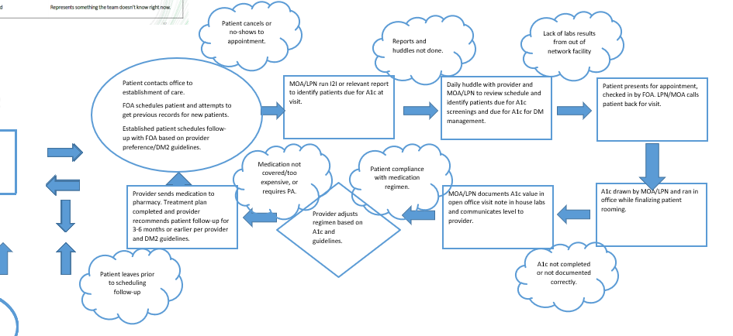
Process Map

Slide 35
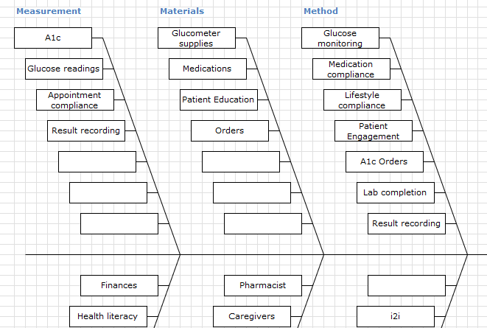
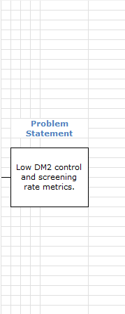
Fishbone

Slide 36
Project Successes
Team cohesive
Easily incorporating additional team members as we learn more
Alignment surrounding metric
Organization is ready for this change
Great energy and momentum

Slide 37
Project Challenges
Identifying state-specific scope definitions for members of team (RN, LPN, MOA)
Resources identified
Time
Getting lost in the “weeds”

Slide 38
Questions?
Notes:
ALL

Slide 39
Developing & Using a Specific Aim Statement
Notes:
Kathleen

Slide 40
The Stages of Improvement
Step #5: Specific Aims and Measures
On-Going Data Collection & Review
Notes:
Kathleen

Slide 41
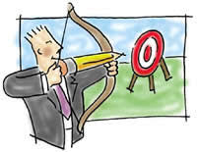
What is a Specific Aim Statement?
A good specific aim states what you plan to accomplish and how you will know it when you do. Or don’t.
What you plan to accomplish should be something in your control, i.e., it does not require permission.
Notes:
Kathleen

Slide 42
A good specific aim…
…is based on baseline data;
….has measures that are clearly defined:
what is being measured,
how it will be measured (numbers, percentages, rates),
when it will be measured,
….is doable, that is, you can get the data and change the process that results in the data, and
….is the foundation for multiple PDSA(s) as you test changes in the multi-step process that you identified in your Global Aim.
Notes:
Kathleen

Slide 43
Specific Aim Statement Template
We aim to ___________ (improve, increase, decrease) the _____________ (quality, number/amount, percentage) of___________________ (name the process) by _____ percent
OR
from ________ (baseline data number/amount/percentage) to __________ (number/amount/percentage)
by _______ (date)
in ___________ (location)
Notes:
Kathleen

Slide 44
From the Workbook
Definition of UDS measure | Percentage of women 50 –74 years of age who had a mammogram to screen for breast cancer in the 27 months prior to the end of the measurement period
Population (denominator) | Number of women 50 –74 years of age who were eligible for a mammogram to screen for breast cancer in the 27 months prior to the end of the measurement period (N=100)
Subsets | A: number of women whose mammogram is documented in EMR (n=42) B: number of women whose mammogram is NOT documented in EMR (n=58)
Measurement period | First quarter of 2025: January/February/March
Source of data/evidence | As documented in the EMR
Numerator | Subset A: Number of women 50 –74 years of age who were eligible for a mammogram to screen for breast cancer in the 27 months prior to the end of the measurement period whose mammogram is documented in EMR* (n=42)
Denominator | Population: Number of women 50 –74 years of age who were eligible for a mammogram to screen for breast cancer in the 27 months prior to the end of the measurement period (N=100)
Rate | Numerator/Denominator=42/100=42%
Notes:
Kathleen

Slide 45
Example: Weak specific aim
We aim to increase screening rate for breast cancer in women patients by 15% from January to March.
Important? Yes.
Clear/Specific enough? In whom? 15% of what?
Doable? Not sure yet. Strategy? Staff? Time? Where does the data live? Can we get it out?
Notes:
Kathleen

Slide 46
Example: Better and more specific
We aim to increase screening rate for breast cancer in female patients ages 50-74 from 22%* as of as of December 31, 2024 to 37%* by March 31, 2025.
Who: eligible female patients ages 50-74
Who: eligible patients enrolled in the clinic based on at least one visit the past year.
When: December 31 to March 31
Where is the data: electronic health record
What dates will you ask BI to collect? December 31 – March 31
Where: Clinic A
How much: Does this reflect the current baseline and an achievable goal?
*KEY POINT: Percentage points are cleaner and easier to work with.
Notes:
Kathleen

Slide 47
Percent vs. Percentage Points
We aim to increase screening rate for cervical cancer in eligible female patients by 15% from January to February).
If baseline is 22%, then 15% increase is a new target: 25.3%.
We aim to increase screening rate for cervical cancer in eligible female patients by 15 percentage points from 22% from January as of January 1 to 37% by February 28.
If baseline is 22%, then 22% = 15 points = new target 37%.
Big difference!
Notes:
Kathleen

Slide 48
How many more patients do you need to screen to hit your target?
Month | # eligible patients: | # screened eligible patients: Subset A | 15% Percent increase | 15 Percentage points increase
December 31, 2024 Baseline | 150 | 33 | Baseline 22% | Baseline 22%
June 30, 2025 Target | 150† | Target ??? | 22% * 1.15 =Target 25.3% | 22% + 15 points = Target 37%
How many more patients need to be screened by March 31, 2025? |  |  | Target 38 patients which is 5 more patients | Target 56 patients, which is 23 more patients
†Challenge: The baseline of 150 patients is as of December 31, the end of the fourth quarter. But you don’t know yet how many eligible patients will keep their appointments in the first quarter of 2025. What will you use for your denominator? You can use 150 or you can estimate the denominator based on previous quarters.
Notes:
Kathleen

Slide 49
Data Plan
Name of data | Definition: Numerator | Definition: Denominator | Dates of interest | How to get the data
Breast cancer screening | Number of patients who were eligible for a mammogram and have the results documented in the chart | Number of patients who were eligible for a mammogram and DO NOT have the results documented in the chart | January 1, 2025-March 31, 2025 | Where does the data live? Who has it? When to get it?
Notes:
Kathleen

Slide 50
Key Takeaways
Clear definitions of population (denominator) and subset of interest (numerator)
Percentage points are cleaner: how many patients is that?
Data plan
There can be multiple specific aims and points for data collection in the screening process:
How many eligible patients were identified?
How many who were identified received an order for a mammogram?
How many reports of patients who had a mammogram get back to us?
Notes:
Kathleen

Slide 51
Questions?
Notes:
ALL

Slide 52
Solution Storming & Change Ideas
Notes:
Deb

Slide 53
The Stages of Improvement
Step #6: Solution Storming & Change Ideas
On-Going Data Collection & Review
Notes:
Deb

Slide 54
What can YOU change? Examples:
Workflow and Time:
Who does what when how and why?
How can we be proactive instead of reactive?
Eliminate Redundancies:
Why are some tasks done twice and some are not done at all?
Data: the right data at the right time in the right hands
What data do we need and when do we need it?
How do we get it?
Responsibilities and Roles: clarify, retrain
Why are several people doing the same task?
Why are they all doing it differently?
Notes:
Deb

Slide 55
What can YOU change? Examples for Breast Cancer Screening:
Who identifies the patients who are due for a mammogram, and how do they do that?
Can you create standing orders for mammograms? Can you allow Medical Assistants to place the order for the mammogram?
Is the mammogram off-site? Who makes the referral for an appointment for the mammogram?
Do you have a system for follow-up to see if the patient made and/or attended the appointment for their mammogram?
How do you receive the report and get the results recorded into the electronic health record?
Who communicates the results to the patient?
Notes:
Deb

Slide 56
Change Ideas
Facilitator
Identify the Goal – What are you trying to SOLVE?
Time Limit
Brain-Write
Quantity vs. Quality
Write EVERYTHING
Don’t Judge
Embrace the Ridiculous
Start general & basic – end specific
Look for themes
Avoid Group Think
Fresh Eyes – Someone Outside of the Group
Notes:
Deb

Slide 57
Questions?
Notes:
ALL

Slide 58
Plan
Do
Check/
Study
Act
Developing &
Using PDSAs
Notes:
Deb

Slide 59
The Stages of Improvement
Step #7: PDSA
On-Going Data Collection & Review
Notes:
Deb

Slide 60
Model for Improvement
What are we trying to accomplish? (Aim)
How will we know that a change is an improvement? (Measures)
What change can we make that will result in improvement? (Solution/Change)
Three questions...
…coupled with
an approach for
testing change.
Act
Plan
Study
Do
Langley GJ, et. al. The Improvement Guide (2nd Edition), 2009.
Notes:
Deb

Slide 61
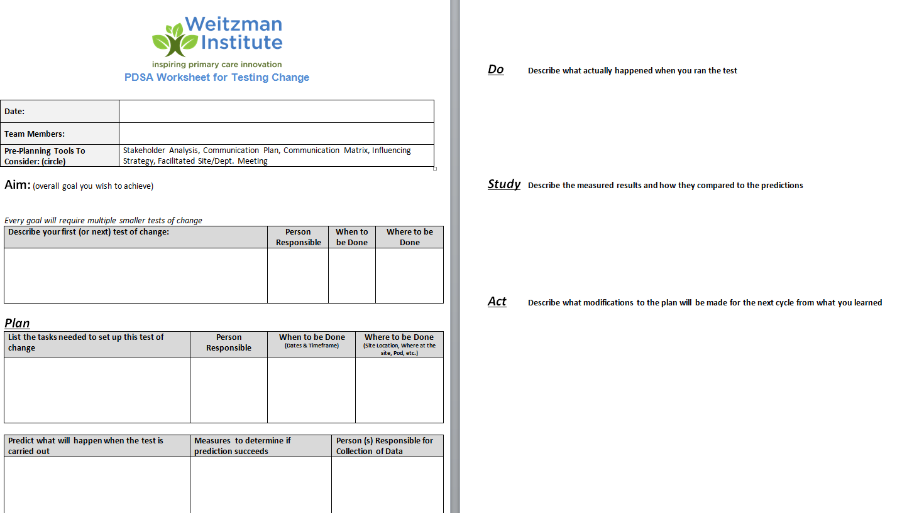
Notes:
Deb

Slide 62
PLAN: Comes from Specific Aim Statement
WHAT are we striving to accomplish?
WHAT will we do?
WHEN will this occur (what is the timeline)?
HOW MUCH? What is the specific, numeric improvement we wish to achieve?
FOR WHOM? Who is the target population?
Notes:
Deb
An aim statement is essentially a specific, measurable objective, that answers the questions what, when, how much and for whom are we looking to improve?

Slide 63
DO
Implement the improvement
Collect and document the data
Document the problems, unexpected observations, lessons learned, and knowledge gained
Notes:
Deb
The “Do” phase is as it sounds – just do it! This marks the implementation of the improvement, and during this phase it’s important to not only collect and document data around the improvement, but also to document the other things listed. QI efforts generate many learnings and it’s important to capture these.

Slide 64
STUDY
Analyze the results: was an improvement achieved?
Document lessons learned, knowledge gained, and any surprising results that emerged.
Notes:
Deb
This phase involves analyzing the effect of the intervention.
Compare the new data to the baseline data to determine whether an improvement was achieved, and whether the measures in the aim statement were met.
And again – document!

Slide 65
ACT
Take action:
Adopt - standardize
Adapt – change and repeat
Abandon – start over
Notes:
Deb
This phase marks the culmination of the planning, testing, and analysis regarding whether the desired improvement was achieved as articulated in the aim statement, and the purpose is to act upon what has been learned.
If the improvement was achieved, it’s time to adopt it as standard practice
If the improvement wasn’t quite achieved, but we feel it was close, we will adapt our “test,” and either extend the testing period or revise something and repeat the testing cycle
If the improvement simply wasn’t achieved, we need to start back at the planning phase and reconsider the problem at hand.
Once we have adopted and standardized the improvement, we still need to monitor the situation and make sure the improvement holds.

Slide 66
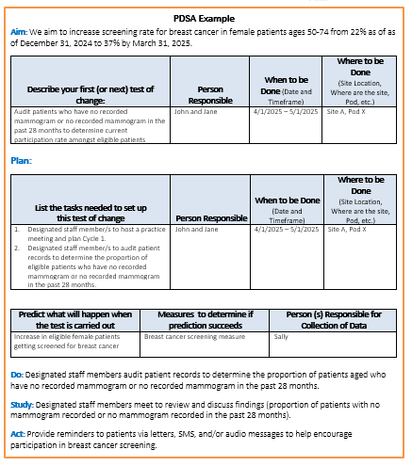
PDSA
Example
Notes:
Deb

Slide 67
SUSTAIN
Once you’ve adopted:
Monitor – reports, dashboards, quarterly meetings
Maintain – who is the owner, process for looking into measures when they fall below?
Check-In – conversations, connections, accountability, transparency, trust
Develop a playbook – a recipe to perform the new process, training tool
Notes:
Deb

Slide 68
Questions?
Notes:
ALL

Slide 69
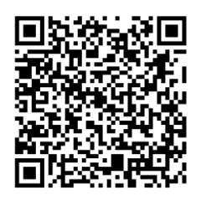
Action Period 4 Deliverables
Conduct your weekly team meetings
Coaches attend weekly coaching calls
Complete Step 5 in the Quality Improvement Workbook
Complete Step 6 in the Quality Improvement Workbook
Access the Google Drive to upload deliverables:
Notes:
Meaghan

Slide 70
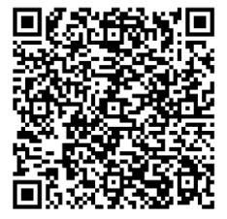
Next Steps
Coach Calls
Wednesday February 19th 1:00pm Eastern / 10:00am Pacific
Wednesday February 26th 1:00pm Eastern / 10:00am Pacific
Wednesday March 5th 1:00pm Eastern / 10:00am Pacific
Session 5: Wednesday March 12th 1:00pm Eastern / 10:00am Pacific
Register for the Weitzman Education Platform to receive CME, resources, and more!
Notes:
Meaghan

Slide 71
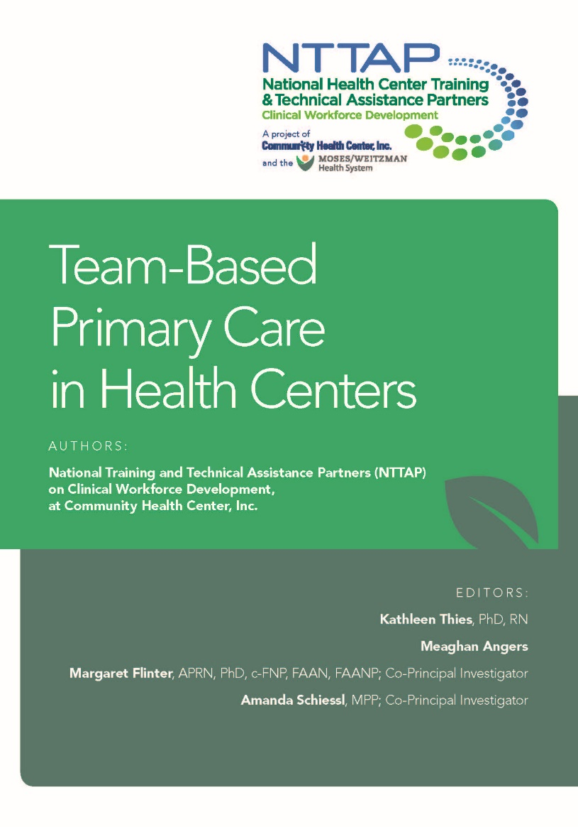
Download our new book, Team-Based Primary Care in Health Centers!
https://www.weitzmaninstitute.org/wp-content/uploads/2024/09/Team-BasedPrimaryCareinHealthCenters.pdf
Notes:
Meaghan

Slide 72
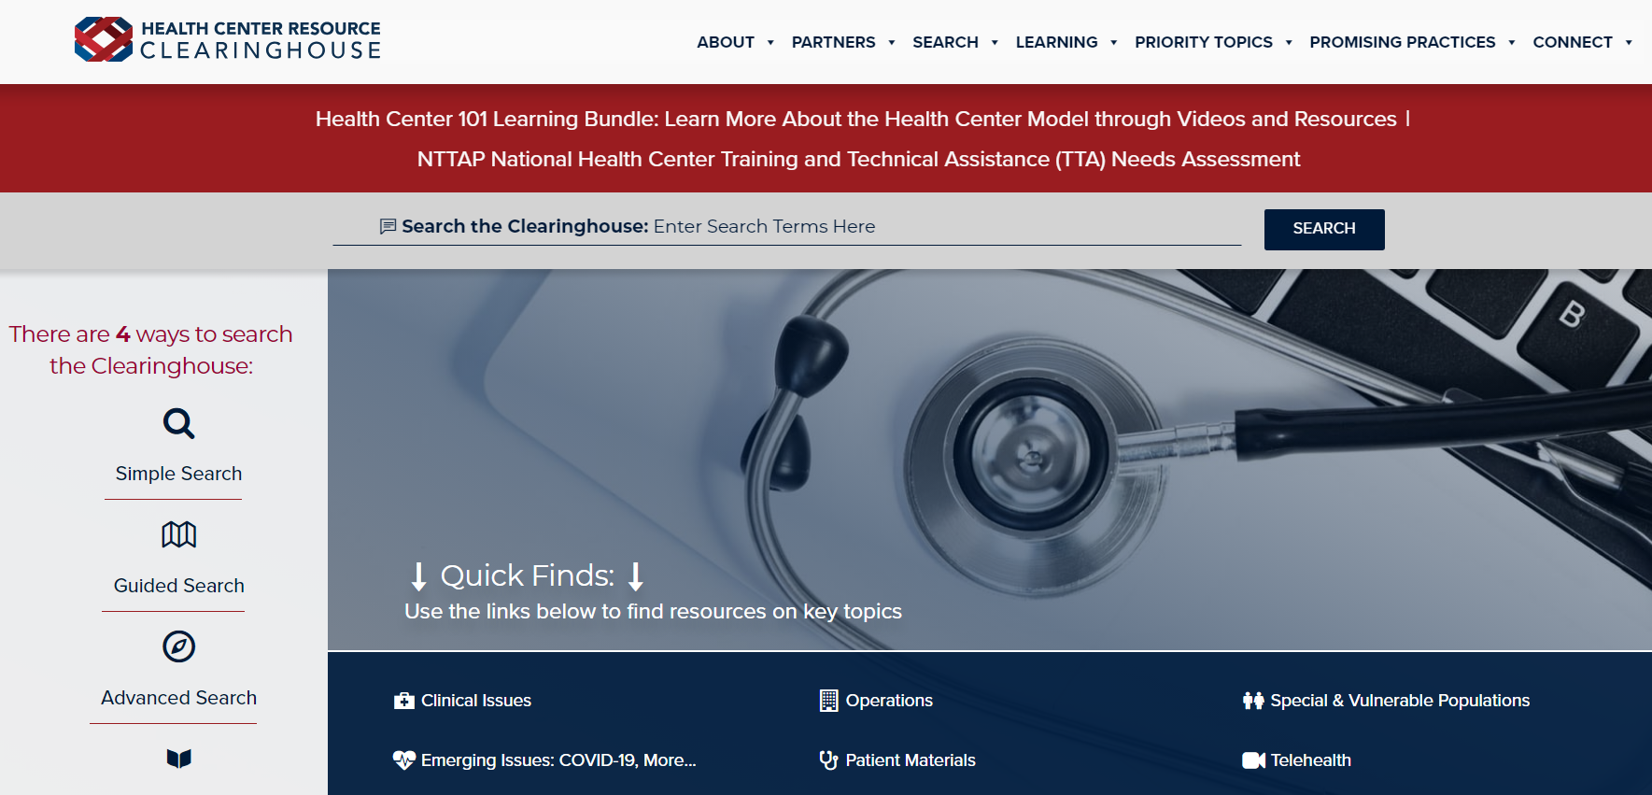
Explore more resources!
National Learning Library: Resources for Clinical Workforce Development
Health Center
Resource Clearinghouse
https://www.weitzmaninstitute.org/ncaresources
https://www.healthcenterinfo.org/
Notes:
Meaghan

Slide 73
Contact Us!
Amanda Schiessl
Program Director/Co-PI
Amanda@mwhs1.com
Meaghan Angers
Senior Program Manager
angersm@mwhs1.com
Bianca Flowers
Program Manager
flowerb@mwhs1.com
REMINDER: Complete evaluation in the poll!
Next Learning Session is Wednesday March 12th!
Notes:
Meaghan

