Slide 1
Nonsteroidal Anti-inflammatory Drugs (NSAIDs)
Amy K. Kennedy, PharmD, BCACP
2025

Slide 2

Disclosure
With respect to the following presentation, there has been no relevant (direct or indirect) financial relationship between the party listed above (or spouse) and any for-profit company in the past 12 months which would be considered a conflict of interest.
The views expressed in this presentation are those of the presenter and may not reflect official policy of Community Health Center, Inc. and its Weitzman Institute.
I am obligated to disclose any products which are off-label, unlabeled, experimental, and/or under investigation (not FDA approved) and any limitations on the information that I present, such as data that are preliminary or that represent ongoing research, interim analyses, and/or unsupported opinion.

Slide 3
Objectives
Describe the mechanism of action for NSAIDS
Describe recommendations for use of NSAIDS for the treatment of pain
Discuss recent cardiovascular risk data related to NSAID use
Discuss ways to mitigate GI risk with NSAID use

Slide 4
Prevalence of NSAID use
In 2019, 29 million adults took aspirin daily
In 2020, more than 30 million adults
Each year approximately 70 million prescriptions for NSAIDs are written

Slide 5
Mechanism of Action
Non-steroidal anti-inflammatory drugs (NSAIDs)
All NSAIDs inhibit the cyclooxygenase required for conversion of arachidonic acid to endoperoxide intermediate (PGG2 and PGH2).
NSAIDs inhibit prostaglandin and thromboxane synthesis, they are potent inhibitors of cyclooxygenase and eliminate all prostaglandins and thromboxanes in every cell they reach.

Slide 6
COX 1 and COX 2
The key enzyme in the cyclooxygenase pathway is the enzyme cyclooxygenase (COX).
There are two forms of cyclooxygenase, COX1 (the predominant form) and COX2.
Cyclooxygenase-1 (COX-1):
-constitutively expressed in wide variety of cells all over the body.
-"housekeeping enzyme"
-ex. gastric cytoprotection, hemostasis
Cyclooxygenase-2 (COX-2):
-inducible enzyme
-immediate-early gene product in inflammatory and immune cells
-dramatically up-regulated during inflammation (10-18X)

Slide 7
Mechanism of Action of Typical
Nonsteroidal Anti-inflammatory Agents
Arachidonic
acid
COX-1
COX-2
X
X
Typical NSAIDs
Prostaglandins/ thromboxane
Prostaglandins
Primarily protect
gastroduodenal mucosa
Primarily mediate inflammation, pain, and fever
Primarily support platelet function
7
Notes:
7
2

Slide 8
Efficacy
Level 1 medications on the WHO analgesic ladder
Cochrane review for low back pain without sciatica indicates statistically significant symptomatic improvement
American Pain Society recommends NSAIDs as a first line treatment option for low back pain
Chou et al. Diagnosis and Treatment of Low Back Pain: A joint clinical practice guideline from the American College of Physicians and the American Pain Society. Ann Intern Med. 2007;147:478-491.

Slide 9
Efficacy in Osteoarthritis
Conditional recommendation in hand OA for both topical and oral NSAIDs
Patients >75 prefer topical products
Knee OA has similar recommendations
Conditional recommendation in hip OA for oral NSAIDs
No recommendation on the use of topical NSAIDs
Hochberg et al. American College of Rheumatology 2012 recommendations for the use of nonpharmacologic and pharmacologic therapies in osteoarthritis of the hand, hip and knee. Arthritis Care and Research. 2012;64(4):465-474.

Slide 10
Efficacy in Rheumatoid Arthritis
2012 update is recommending early DMARD use over NSAIDs in the latest guidelines
NSAIDs can be effective adjunctive therapy for the pain and inflammation associated with RA
2012 update of the 2008 American College of Rheumatology Recommendations for the Use of Disease-Modifying Antirheumatic Drugs and Biologic agents in the treatment of rheumatoid arthritis. Arthritis Care and Research. 2012;64(5):625-639.

Slide 11
Zoom poll
If a patient has a failed trial of ibuprofen, which of the following NSAIDs would be the best option to try next?
Ketoprofen
Oxaprozin
Naproxen
Piroxicam

Slide 12
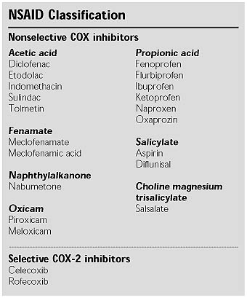

Slide 13
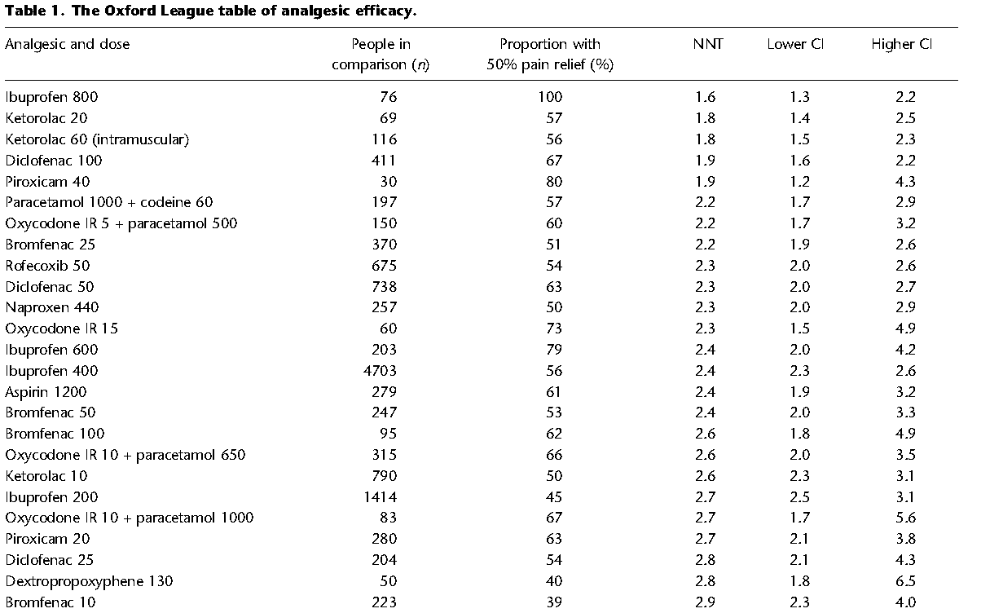

Slide 14
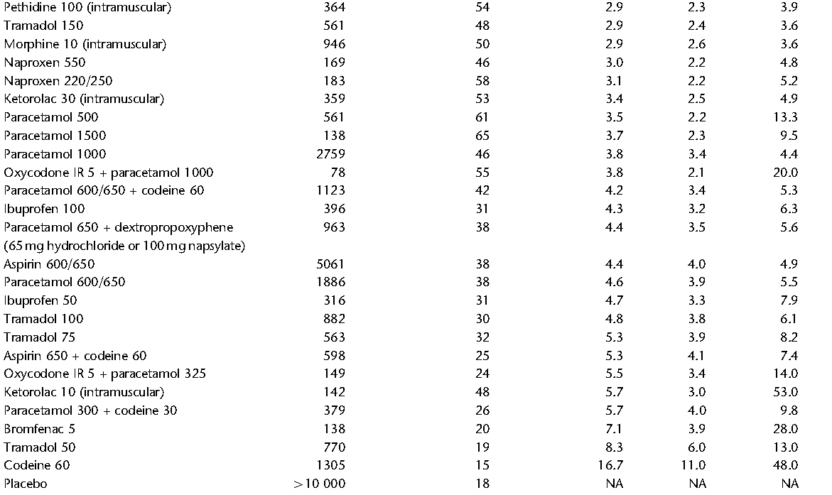

Slide 15
Selective COX-2 Inhibitors
Anti-inflammatory with fewer adverse effects, especially GI events.
Potential toxicities: kidney and platelets - ? increased risk of thrombotic events.
Celecoxib, etoricoxib, valdecoxib – selective COX-2 inhibitors.
Have similar efficacies to that of the non-selective inhibitors, but the GIT side effects are decreased by ~50%.

Slide 16
Other NSAIDs
Indomethacin:
Indole derivative
Common adverse rxns: gastric bleeding, ulceration, CNS most common: hallucinations, depression, seizures, headaches, dizziness.
25 mg 2-3 times daily
Propionic acids:
better tolerated
Differ in pharmacokinetics
ibuprofen, fenoprofen, naproxen widely used for inflammatory joint disease and few side-effects.
Ibuprofen 400-800 mg 3-4 times daily
Naproxen 250-500 mg twice daily

Slide 17
Other NSAIDs
Sulindac:
-inactive pro-drug closely related to indomethacin
-must be metabolized by hepatic microsomal enzymes to active form
-long duration of action (half-life = 8h)
-adverse effects less severe than other NSAIDS (ex. GI and renal)
-ex. Clinoril
Ketoprofen:
-inhibits both cyclooxygenase and lipoxygenase (decreases PGs, TXs, and LTs)
-may be desirable for asthmatics or inflammation plus allergic response
-ex.Orudis
25-75 mg every 6-8 hrs max 300 mg daily
Piroxicam:
-half-life = 45 hours
-administer once a day ( increased convenience)
-some GI disturbance

Slide 18
Topical vs. Oral NSAIDs
Cochrane review in 2012 for chronic musculoskeletal pain
7688 patients in 34 studies
Topical diclofenac superior to placebo and equivalent to oral nsaids for hand and knee osteoarthritis
54% vs. 55% with good or better clinical response
Local site reactions more frequent with topicals: fewer serious adverse effects
Derry S, Moore RA, Rabbie R. Topical NSAIDs for chronic musculoskeletal pain in adults. Cochrane Database Syst Rev 2012;9:CD007400.

Slide 19
Zoom poll-free response
What are some adverse effects to be mindful of if using NSAIDs?

Slide 20
Common Adverse Effects
Heartburn, nausea, dyspepsia, and abdominal pain
Platelet Dysfunction
Gastritis and peptic ulceration with bleeding (inhibition of PG + other effects)
Acute Renal Failure in susceptible patients
Sodium+ water retention and edema
Analgesic nephropathy
Prolongation of gestation and inhibition of labor.
Hypersensitivity (not immunologic but due to PG inhibition)

Slide 21
Why the increase in CV risk?
Platelets:
Inhibition of platelet COX-1-derived TxA₂ with the net effect of increasing bleeding time (inhibition of platelet aggregation)
Endothelial COX-2 derived PGI₂ can inhibit platelet aggregation (inhibition augments aggregation by TxA₂).
Blood vessels/smooth muscle
COX-2 derived PGI₂ can antagonize catecholamine- and angiotensin II-induced vasoconstriction (NSAIDs can elevate bp).
Atherosclerosis
Inhibition of COX-2 can destabilize atherosclerotic plaques (due to its anti-inflammatory actions)

Slide 22
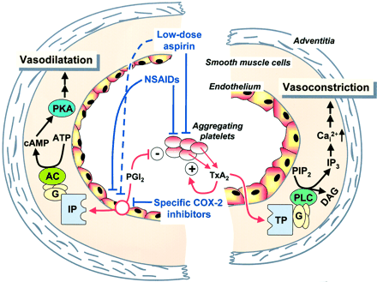
Effect of NSAID’s on Platelet-Endothelial Interactions

Slide 23
VIGOR - Confirmed Thrombotic Cardiovascular Events
Patients with Events (Rates per 100 Patient-Years)
Rofecoxib
N=4047
Naproxen
N=4029
Relative Risk
(95% CI)
Event Category
Confirmed CV events
45 (1.7)
19 (0.7)
0.42
(0.25, 0.72)
Cardiac events
28 (1.0)
10 (0.4)
0.36
(0.17, 0.74)
Cerebrovascular events
11 (0.4)
8 (0.3)
0.73
(0.29, 1.80)
Peripheral vascular events
6 (0.2)
1 (0.04)
0.17
(0.00, 1.37)
Source: Bombardier, et al. N Engl J Med. 2000.

Slide 24
Investigator-Reported Thrombotic Cardiovascular Events in the VIGOR Study Compared with Phase IIb/III OA Study
3.5
3.0
Rofecoxib (VIGOR)
2.5
Ibuprofen, Diclofenac, Nabumetone (OA)
2.0
Rofecoxib (OA)
Cumulative Incidence %
1.5
1.0
Naproxen (VIGOR)
0.5
0.0
0
2
4
6
8
10
12
14
Months of Follow-up
FDA files

Slide 25
CV risk in rheumatoid arthritis
Lindhardsen et al conducted a longitudinal cohort study in Denmark with RA patients
Combined endpoint of MI, stroke, or CV mortality
Results
6,283 events overall
CV risk RA lower than controls (HR 1.22 (95% CI 1.09-1.37) vs.. 1.51 (1.36 to 1.66, p<0.01)
Individually rofecoxib and diclofenac increased risk
Lindhardsen et al. Non-steroidal anti-inflammatory drugs and risk of cardiovascular disease in patients with rheumatoid arthritis: a nationwide cohort study. Ann Rheum Dis. Published online June 8, 2013.

Slide 26
CV risk Associated with NSAIDs in MI patients
Patients >30 years of age post first MI and subsequent NSAID use
Assessed risk of three CV endpoints: CV death, coronary death and fatal MI and fatal and nonfatal stroke
97,698 patients were included and 44% received an NSAID
Overall use increased risk of cardiovascular death (HR 1.42, 95% CI 1.36-1.49)
Schjerning Olsen et al. Cause-specific Cardiovascular risk associated with Nonsteroidal anti-inflammatory drugs among myocardial infarction patients. Circulation. 2011;123:2226-2235.

Slide 27
PRECISION trial
AHA presentation November 13th, 2016
Compared prescription doses of celecoxib, naproxen, ibuprofen for RA/OA patients
100-200 mg daily
600-800 mg tid
375-500 mg bid
All patients received esomeprazole for duration of study
CV events: 2.3%, 2.5%, 2.7%
GI events: 1.1%, 1.5%, 1.6%

Slide 28
Vascular and GI effects of NSAIDs
Major vascular events increased in coxibs but not naproxen (RR 1.41, 1.12-1.78, p=0.0036 vs.. RR 0.93, 0.69-1.27)
Heart failure risk was roughly doubled by all NSAIDs
All regimens increased GI complications (coxibs RR 1.81, 95% CI 1.17-2.81, p=0.007, ibuprofen 3.97, 2.22-7.1, p<0.0001, naproxen 4.22, 2.71-6.56, p<0.0001)
Vascular and upper gastrointestinal effects on non-steroidal anti-inflammatory drugs: meta-analyses of individual participant data from randomized trials. Lancet. Published online May 30,2013.

Slide 29
GI Mortality Associated With Typical
NSAIDs vs. Other Causes in the United States
Annual risk of death (%)
0.00
0.05
0.10
0.15
0.20
0.25
0.30
0.35
0.40
Cigarette smoking
Cancer
NSAID use
Motor vehicle accident
Home accident
Airplane crash (frequent flyer)
Fries et al. Am J Med. 1991;91:213–222;
Wilson, Crouch. Science. 1987;236:267–270.
Notes:
29

Slide 30
Why the increase in GI risk?
PGs (generated via COX-1)
inhibit stomach acid secretion,
stimulate mucus and HCO₃⁻ secretion, vasodilation
cytoprotective for the gastric mucosa
NSAIDs with COX-1 inhibitory activity will produce opposite effects
Gastric distress, gastric bleeding, sudden acute hemorrhage (effects are dose-dependent)

Slide 31
PUD: NSAID ulcers
Primary prevention
Prevention of peptic ulceration and mucosal injury
Cotherapy with PPI, High dose H2RA’s, or misoprostol
Replace NSAID with COX-2 inhibitor

Slide 32
PUD: NSAID ulcers
GI Risk factors
Medications
Anticoagulants, corticosteroids, antiplatelets
H. pylori +
Hx of ulcer or complications
Age >65
CV risk factors
Requirement of low dose aspirin
Individuals with established CVD or 10 year risk of CV event >10-20%

Slide 33
PUD: NSAID ulcers
GI Risk | CV Risk
 | Low | High
Low | NSAID alone | Naproxen + PPI or misoprostol
Moderate | NSAID + PPI or misoprostol | Naproxen + PPI or misoprostol
High | Alternative therapy if possible or COX-2 inhibitor + PPI/misoprostol | Avoid NSAID or COX-2 inhibitors

Slide 34
Pharmacologic agents
Misoprostol
Dose: 800 mcg 4 times daily
Adverse effects: GI particularly diarrhea and cramping
PPIs
Significantly reduce development of ulcers and related complications
Other concerns: bone health, infection, mineral absorption
COX-2 inhibitors
Dose: 200 mg daily
Adverse effects: similar to nsaids, CV events
H2RA’s
Dose: Double
Prevention of duodenal ulcers only

Slide 35
Treatment NSAID ulcers
Other considerations
Concurrent use of NSAIDs and antiplatelet agents (aspirin and clopidogrel)
Bleeding risk increased
Gastroprotective strategies warranted when high risk
Communication amongst team for patients with high GI risk requiring antiplatelet therapy
Circulation. 2008:118:1894-1909.

Slide 36
PUD: NSAID ulcers
Secondary prevention
Risk factor modification
Reduce or eliminate NSAID therapy
Test for H pylori, treat as necessary
First line therapy: PPI
Other options
Same agents used for prevention
Consider same limitations

Slide 37
Zoom poll
Patient is a 58 year old male with low back pain. His PMH hx include dyslipidemia, diabetes and anxiety. His ASCVD risk score is 12% and his current medications are metformin xr 1 gm bid and atorvastatin 40 mg daily. He was recently diagnosed with h. pylori and his renal function is WNL. What is the appropriate approach to using NSAIDs in this patient?
NSAID alone
Avoid oral NSAIDs
COX2 inhibitor + misoprostol
Naproxen + PPI

Slide 38
NSAIDS in the news
COVID-19
Initial cause for concern was for increased strokes and MI among those with acute respiratory distress
Follow up information has not demonstrated difference in outcomes in treating COVID fever compared to patients treated with acetaminophen
Does not exacerbate symptoms or worsen outcomes
Continue to use NSAIDS if they are being used to treat other conditions
Zhou Q, Zhao S, Gan L, et al. Use of non-steroidal anti-inflammatory drugs and adverse outcomes during the COVID-19 pandemic: a systematic review and meta-analysis. EClinicalMedicine. Published online April 7, 2022. doi:10.1016/j.eclinm.2022.101373

Slide 39
NSAIDS in the news
UK BioBank database review
NSAIDS and steroids linked to transition to long term pain
Not seen with acetaminophen or antidepressants
Proposed mechanism is overly reducing inflammation in the acute pain phase makes it more likely to have long term issues
No prospective data, studies in mice only at this time

Slide 40
NSAIDS in the news
Study from Yale Medicine
Long thought that COX inhibition was main driver of effects
The researchers found that NSAIDs actions were all related to a protein called nuclear factor erythroid 2-related factor 2 (NRF2)
They also observed that NSAIDS could help reduce inflammation in a way that was dependent on this specific protein.
No prospective data, studies in mice only at this time

Slide 41
NSAIDS in the news
277 participants from the Osteoarthritis Initiative cohort with moderate to severe osteoarthritis and sustained NSAID treatment for at least one year between baseline and four-year follow-up
793 control participants who were not treated with NSAIDs. All participants underwent 3T MRI of the knee initially and after four years. Images were scored for biomarkers of inflammation.
Cartilage thickness, composition and other MRI measurements served as noninvasive biomarkers for evaluating arthritis progression.
Results showed no long-term benefit of NSAID use. Joint inflammation and cartilage quality were worse at baseline in the participants taking NSAIDs, compared to the control group, and worsened at four-year follow-up.

Slide 42
Summary
Lowest dose for shortest duration
Consider use of topical agents when possible/appropriate
Balance risks with appropriate pain treatment
Choose lower CV risk NSAIDS and protect GI tract when possible

Slide 43
NSAIDS in the news
A study in the Journal of the American Geriatrics Society suggests that long-term NSAID use may be associated with a lower risk of dementia, particularly for those without a genetic predisposition.
Specifically, the study found that long-term NSAID use (over 2 years) was linked to a lower risk of dementia, while shorter timeframes were associated with a slight increase in risk.
However, it's important to note that the study also found that the cumulative amount of NSAID use did not decrease the risk of dementia, suggesting that the duration of use is more important than the total dose.

