Slide 1

Postgraduate NP and/or PA Training Programs Learning Collaborative
Session Six: Tuesday March 11th, 2025
Notes:
Meaghan

Slide 2
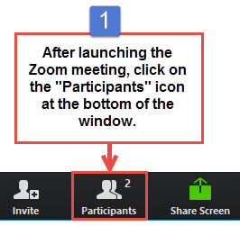
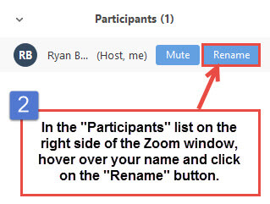
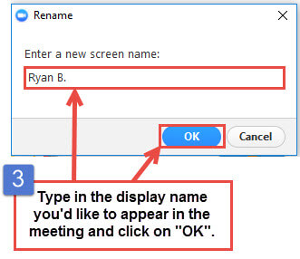
Get the Most Out of Your Zoom Experience
Please keep yourself on MUTE to avoid background/distracting sounds
Use the CHAT function or UNMUTE to ask questions or make comments
Please change your participant name to your full name and organization
“Meaghan Angers CHCI”
Notes:
Meaghan

Slide 3
Session 6 Agenda
1:00-1:10pm Welcome
1:10-2:25pm Showcase Presentations
2:25-2:30pm Questions, Wrap-Up, and Evaluation
Notes:
Meaghan

Slide 4
Learning Collaborative Faculty
Margaret Flinter, APRN, PhD, FAAN
Co-PI, NTTAP
CHCI’s Senior Vice President/Clinical Director
Founder of America’s first nurse practitioner residency program
Kerry Bamrick, MBA
Executive Director, Consortium for Advanced Practice Providers
Coach Mentor
Charise Corsino, MA
Program Director, CHCI Postgraduate NP Residency Program
Coach Mentor
Amanda Schiessl, MPP
Chief of Staff, MWHS
Co-PI & Project Director, NTTAP
Meaghan Angers
Senior Program Manager, NTTAP
Bianca Flowers
Program Manager, NTTAP
Notes:
Meaghan

Slide 5


Community Health Center, Inc.
A leading Federally Qualified Health Center based in Connecticut.
ConferMED
A national eConsult platform improving patient access to specialty care.
The Consortium for Advanced Practice Providers
A membership, education, advocacy, and accreditation organization for
APP postgraduate training.
National Institute for Medical Assistant Advancement
An accredited educational institution that trains medical assistants for
a career in team-based care environments.
The Weitzman Institute
A center for innovative research, education, and policy.
Center for Key Populations
A health program with international reach, focused on the most vulnerable among us.
Notes:
Meaghan

Slide 6
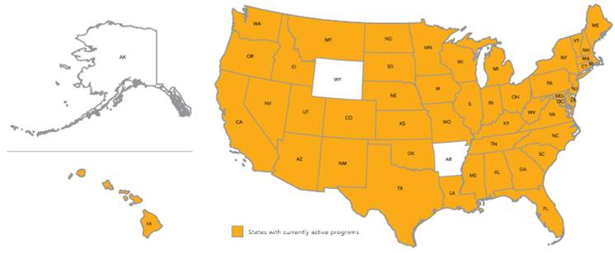
Primary Care, Psychiatric/MH and Specialty Postgraduate Training Programs – Total: 548 Programs Nationally
6
Notes:
Meaghan

Slide 7

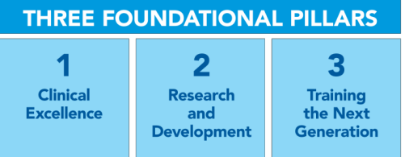
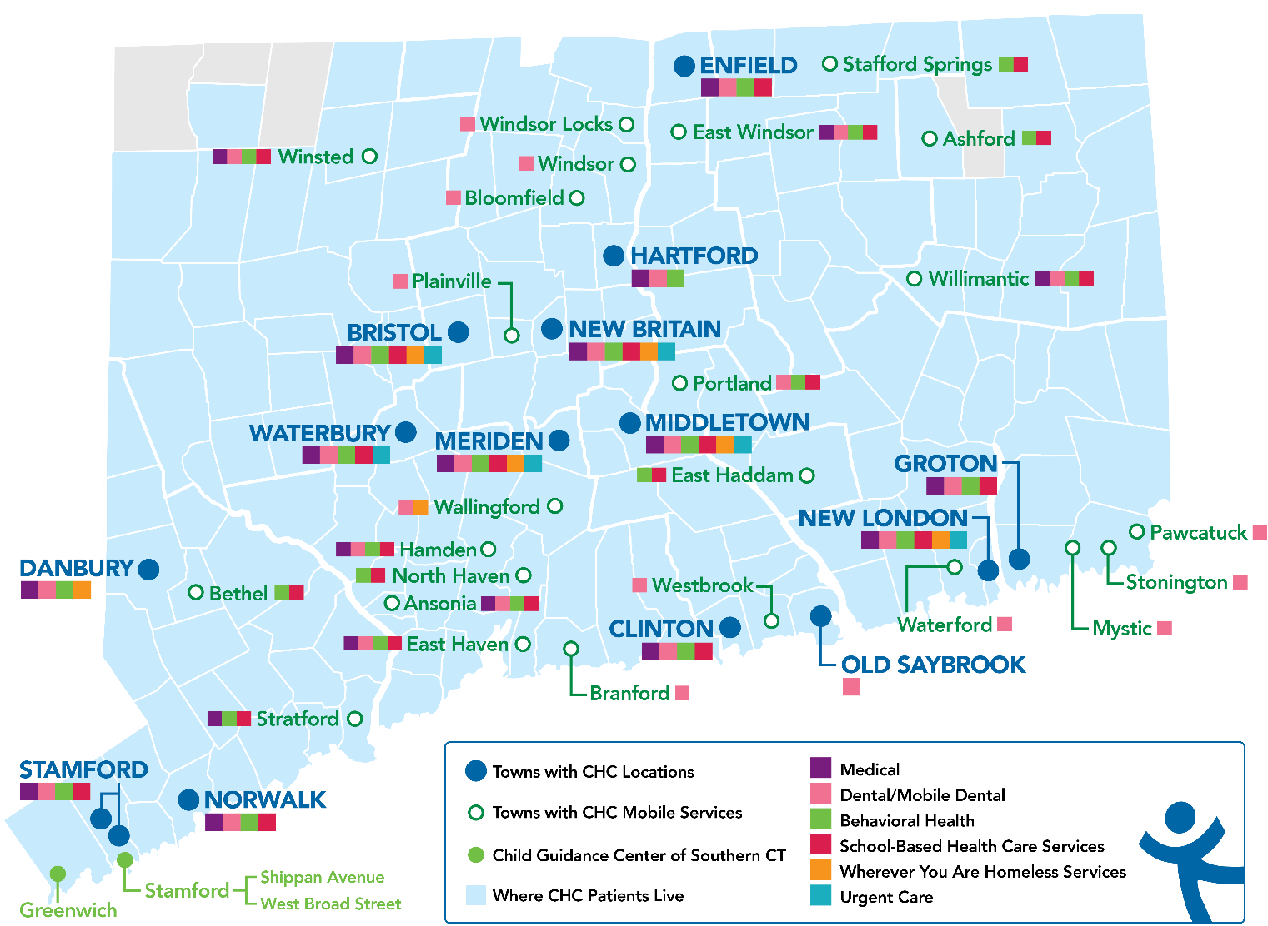
Locations & Service Sites
Profile
Founded: May 1, 1972
Staff: 1,400
Active Patients: 150,000
Patients CY: 107,225
SBHCs across CT: 152
Year | 2021 | 2022 | 2023
Patients Seen | 99,598 | 102,275 | 107,225
Notes:
Meaghan

Slide 8
National Training and Technical Assistance Partners (NTTAP)
Clinical Workforce Development
Provides free training and technical assistance to health centers across the nation through national webinars, learning collaboratives, activity sessions, trainings, research, publications, etc.
To learn more, please visit: https://weitzmaninstitute.org/nca
Notes:
Meaghan

Slide 9
Learning Collaborative Structure
Six 90-minute Learning Collaborative video conference sessions
Bi-weekly 60-minute calls between coach mentors and team coach
Internal team workgroup meetings
Access resources via the Weitzman Education Platform
Use Google Drive to share your work
Learning Session Dates
Learning Session 1 | Tuesday October 8th
Learning Session 2 | Tuesday November 12th
Learning Session 3 | Tuesday December 10th
Learning Session 4 | Tuesday January 21st
Learning Session 5 | Tuesday February 11th
Learning Session 6 | Tuesday March 11th
Notes:
Meaghan

Slide 10
2024-2025 Cohort
Alivio Medical Center | Chicago, Illinois
Arkansas Primary Care Association | North Little Rock, Arkansas
Blue Ridge Community Health Services, Inc. | Hendersonvlle, North Carolina
Brockton Neighborhood Health Center, Inc. | Brockton, Massachusetts
Children’s Primary Care Medical Group | San Diego, California
Esperanza Health Center | Philadelphia, Pennsylvania
Family Health Centers of San Diego | San Diego, California
Greater Philadelphia Health Action, Inc. | Philadelphia, Pennsylvania
Indian Health Service Headquarters | Rockville, Maryland
Marin Community Clinic | Novato, California
ND Systems Inc. | Fairbanks, Alaska
Ozark TriCounty Healthcare Consortium dba ACCESS Family Care | Neosho, Missouri
Tennessee Primary Care Association | Nashville, Tennessee
Umpqua Community Health Center dba Aviva Health | Roseburg, Oregon
Notes:
Meaghan

Slide 11
Let’s Review:
Session 1 October 8th, 2024 | Session 2 November 12th, 2024 | Session 3 December 10th, 2024 | Session 4 January 21st, 2025 | Session 5 February 11th, 2025 | Session 6 March 11th, 2025
Team Introductions Program Drivers Program Mission and Vision Statement Resource Assessment Support from Leadership and Board of Directors Communication Within Your Organization Overview of Program Structure | Overview of Program Structure Key Program Staff Value of Academic Clinical Partnerships Using a Progress Checklist | Finances, Sustainability, and Return on Investment of Postgraduate APP Training Programs Marketing and Recruitment Reviewing Candidate Applications & Interviewing and Selecting Candidates Contracts/ Agreement | Preceptors, Mentors, and Faculty: Roles and Responsibilities Preceptor Panel Program Policies & Procedures Curriculum Development Overview | Evaluation of the residency program & resident learner Orientation Graduation Introduction to Accreditation by the Consortium for Advanced Practice Providers | Showcase

Slide 12

Showcase Presentations!

Slide 13
Showcase Objectives
Tell the story of your health center’s work during this learning collaborative in a clean, crisp, visual format
Generate reflection among you and the other team members about your involvement in this learning collaborative
Share your work in future meetings with other health center staff including leadership and external stakeholders such as the health center board, community partners, and funders

Slide 14
Showcase Order
1:10-1:17pm Alivio Medical Center
1:17-1:24pm Aviva Health
1:24-1:31pm Blue Ridge Health
1:31-1:38pm Brockton Neighborhood Health Center, Inc.
1:38-1:45pm Children’s Primary Care Medical Group
1:45-1:52pm Esperanza Health Center
1:52-1:59pm Indian Health Service Headquarters
1:59-2:06pm ND Systems, Inc.

Slide 15
Questions?
Notes:
ALL

Slide 16
Wrap-Up
Notes:
Meaghan

Slide 17
Next Steps
Due Friday March 28th:
Submit Progress Checklist and all completed/drafted work to Google Drive
Complete Post-Collaborative Surveys
Each team member, please complete the Post-Collaborative Evaluation Survey: https://Qualtrics.ca1.qualtrics.com/jfe/form/SV_8bI4JvBIglrD9TE
As a team, please complete the Post-Collaborative Readiness to Train Assessment Tool (RTAT): https://Qualtrics.ca1.qualtrics.com/jfe/form/SV_6JSr5MUhF0CjGlM
Ask each team member to complete the Post-Collaborative Organizational Readiness to Implement Change (ORIC): https://Qualtrics.ca1.qualtrics.com/jfe/form/SV_7Pb6DqH5KdPDkbA
Reminders
Final Coaching Call: Tuesday March 18th from 1:00-2:00pm Eastern / 10:00-11:00am Pacific
6-month Check-in Call: Tuesday September 9th from 1:00-2:00pm Eastern / 10:00-11:00am Pacific
Please reach out to schedule 1-on-1 calls as needed about your program implementation.
Notes:
Meaghan

Slide 18
Weitzman Education Platform
Weitzman Education Platform – this will serve as the platform to receive CE credits for each learning session and access recordings/slide decks/resources:
Register for the course here: https://education.weitzmaninstitute.org/content/nttap-postgraduate-nurse-practitioner-np-andor-physician-associate-pa-training-programs
Access Code: PGR2024
If you do not have an account, follow these instructions: https://education.weitzmaninstitute.org/user/register
Choose a username, password (save it somewhere safe so you can continue to use it!), and fill out some basic user information.
Click Create New Account.
If you encounter any technical difficulties, please reach out to myself or submit a ticket.
Notes:
Meaghan

Slide 19
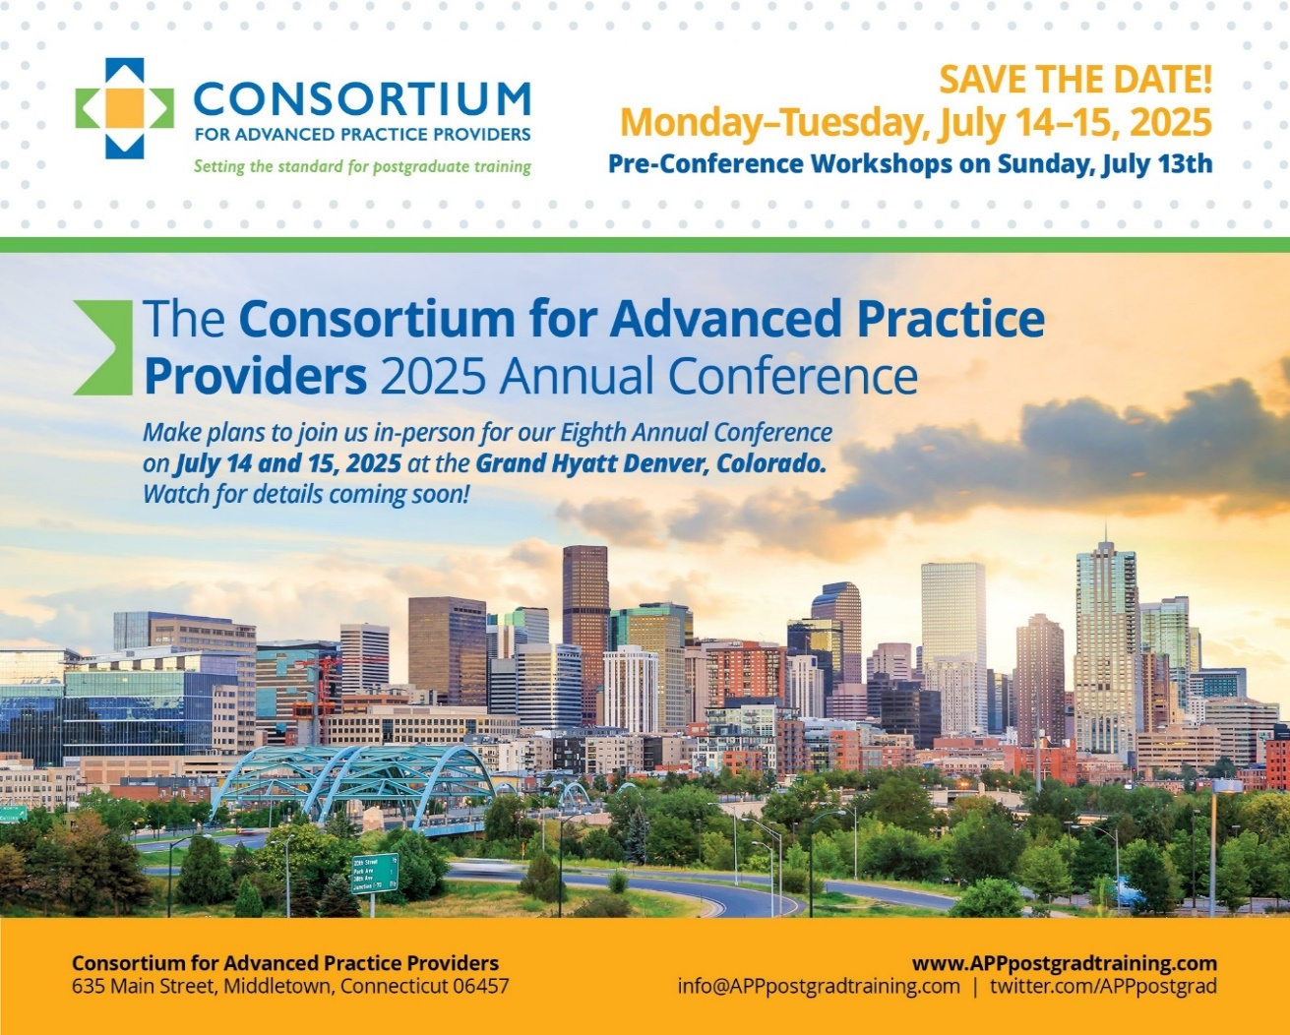
2025 Annual Conference
Mark your calendars and “Save the Date”!
Dates: July 13 – 15, 2025
Location: Grand Hyatt Denver, CO
Pre-Conference Workshop Offerings on 07/13
APP Leadership Workshop
Administration and Operations Workshop
Preceptor Development and Training Workshops
2 Day General Conference on 07/14 – 07/15
Link to the 2024 conference highlights video:
https://vimeo.com/1002782981/a40432e368?share=copy
Notes:
Kerry
The Annual Conference is designed to bring together a community of 250+ innovators, leaders, and emerging leaders in leading and developing formal postgraduate programs as well as a cadre of tomorrow’s leaders (today’s NP/PA trainees and students) to learn from each other, but also from external stakeholders and experts in healthcare systems and policy.
This conference is an opportunity for a relatively short but intense burst of continuing education in evolving best practices in APP postgraduate training, strategies for the planning, implementation, and success of service-delivery based postgraduate training, anticipated relevant future policy developments, and health care trends related to the movement. Breakout sessions will provide opportunity for specialized focus on critical elements of curriculum, evaluation, faculty development and accreditation.
Join us with program directors, managers, coordinators, and trainees from postgraduate APP training programs across the country. The Consortium’s 8th Annual Conference will provide valuable insights and resources to elevate your programs and enhance your impact in the field.
This is a great highlights video from the conference you could also share with NTTAP participants. Its talks about new programs and getting support. J Thanks for your help promoting. Kerry
https://vimeo.com/1002782981/a40432e368?share=copy

Slide 20

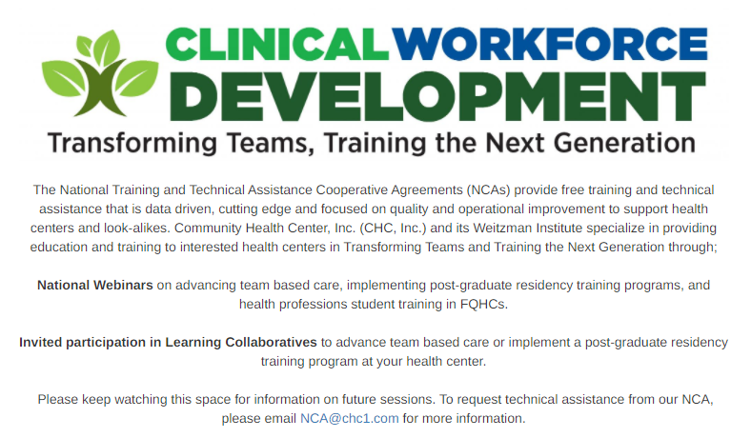

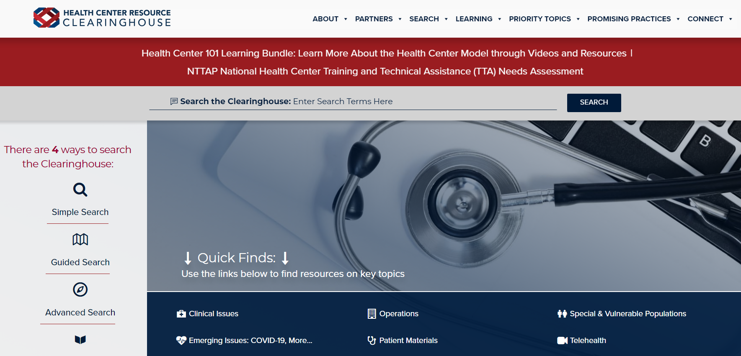
Explore more resources!
National Learning Library: Resources for Clinical Workforce Development
Health Center
Resource Clearinghouse
https://www.weitzmaninstitute.org/ncaresources
https://www.healthcenterinfo.org/
Notes:
Meaghan

Slide 21
Contact Us!
Amanda Schiessl
Program Director/Co-PI
Amanda@mwhs1.com
Meaghan Angers
Senior Program Manager
angersm@mwhs1.com
Bianca Flowers
Program Manager
flowerb@mwhs1.com
REMINDER: Complete evaluation in the poll!
Notes:
Meaghan

