Slide 1
Comprehensive and Team-Based Care Learning Collaborative
Session 5: March 12th, 2025
Notes:
Meaghan

Slide 2
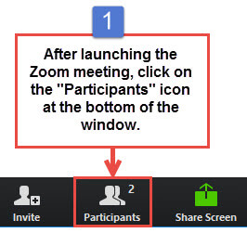
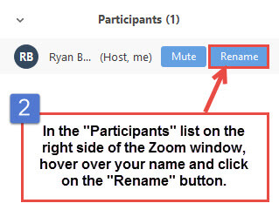
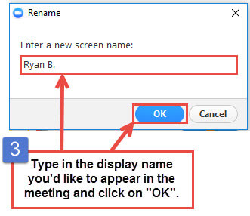
Get the Most Out of Your Zoom Experience
Please keep yourself on MUTE to avoid background/distracting sounds
Use the CHAT function or UNMUTE to ask questions or make comments
Please change your participant name to your full name and organization
“Meaghan Angers CHCI”
Notes:
Meaghan

Slide 3
Session 5 Agenda
1:00-1:05pm Welcome
1:05-1:45pm Integrated Behavioral Health
1:45-1:55pm Role of Business Intelligence
1:55-2:25pm Role of Population Health Management
2:25-2:30pm Q/A, Wrap Up, and Evaluation
Notes:
Meaghan

Slide 4
Learning Collaborative Faculty
Tom Bodenheimer, MD
Physician and Founding Director, Center for Excellence in Primary Care
Deborah Ward, RN
Quality Improvement Consultant
Kathleen Thies, PhD, RN
Consultant, Researcher
Margaret Flinter, APRN, PhD, FAAN
Co-PI, NTTAP
CHCI’s Senior Vice President/Clinical Director
Amanda Schiessl, MPP
Chief of Staff, MWHS
Co-PI & Project Director, NTTAP
Meaghan Angers
Senior Program Manager, NTTAP
Bianca Flowers
Program Manager, NTTAP
Notes:
Meaghan

Slide 5
Community Health Center, Inc.
A leading Federally Qualified Health Center based in Connecticut.
ConferMED
A national eConsult platform improving patient access to specialty care.
The Consortium for Advanced Practice Providers
A membership, education, advocacy, and accreditation organization for
APP postgraduate training.
National Institute for Medical Assistant Advancement
An accredited educational institution that trains medical assistants for
a career in team-based care environments.
The Weitzman Institute
A center for innovative research, education, and policy.
Center for Key Populations
A health program with international reach, focused on the most vulnerable among us.
Notes:
Meaghan

Slide 6
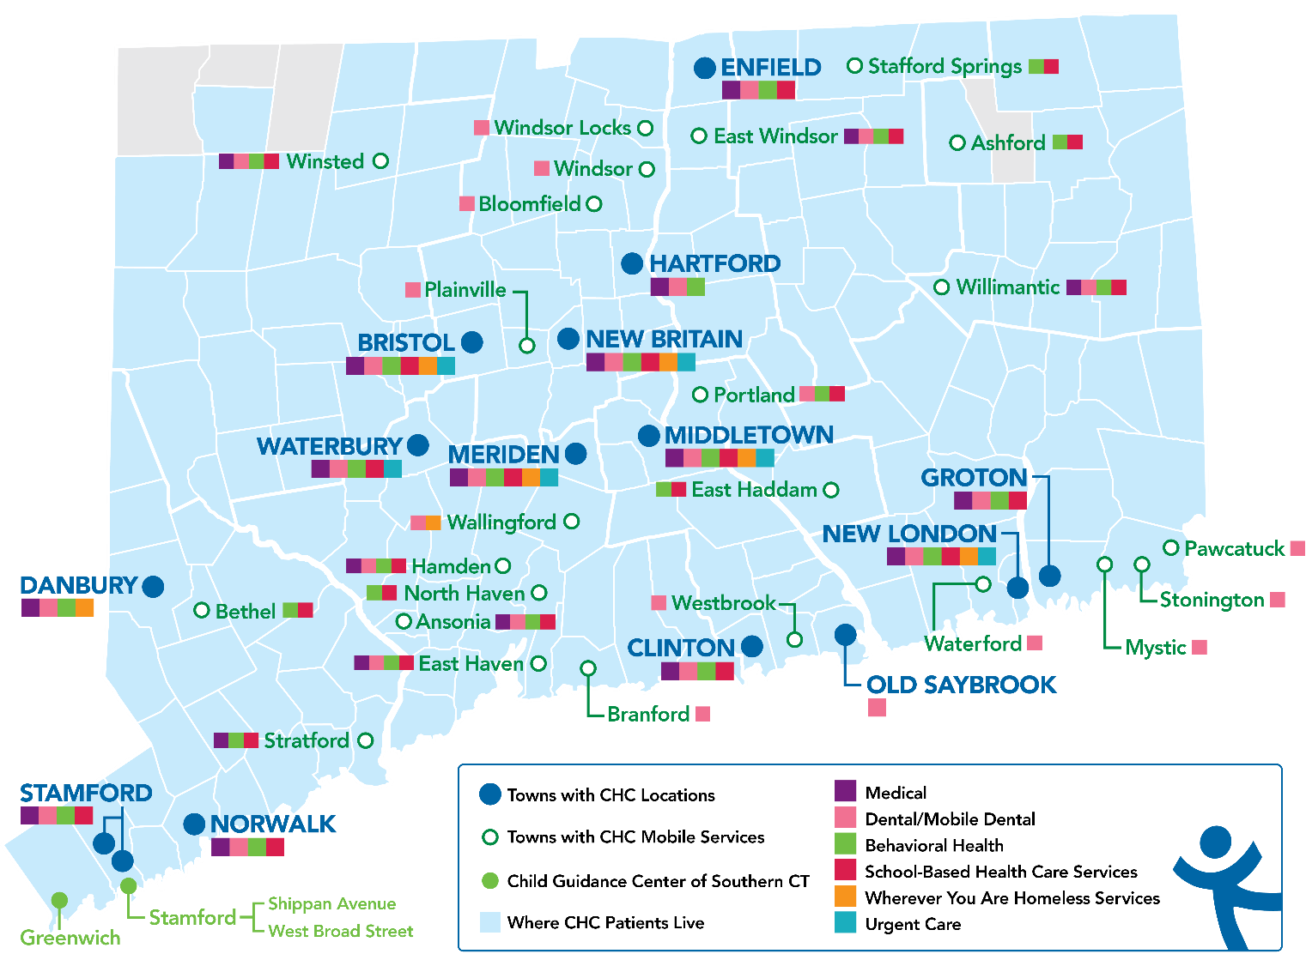
Locations & Service Sites
Overview
Founded: May 1, 1972
Staff: 1,400
Active Patients: 150,000
Patients CY: 107,225
SBHCs across CT: 152
Year | 2021 | 2022 | 2023
Patients Seen | 99,598 | 102,275 | 107,225
Notes:
Margaret
Overview of Community Health Center, Inc.

Slide 7
National Training and Technical Assistance Partners (NTTAP)
Clinical Workforce Development
Provides free training and technical assistance to health centers across the nation through national webinars, learning collaboratives, activity sessions, trainings, research, publications, etc.
To learn more, please visit: https://weitzmaninstitute.org/nca
Notes:
Meaghan

Slide 8
Learning Collaborative Structure
Eight 90-minute Learning Collaborative video conference sessions
Weekly 60-minute calls between coach mentors and team coach
Internal team workgroup meetings
Access resources via the Weitzman Education Platform
Use Google Drive to share your work
Learning Session Dates
Learning Session 1 | Wednesday November 13th
Learning Session 2 | Wednesday December 11th
Learning Session 3 | Wednesday January 8th
Learning Session 4 | Wednesday February 12th
Learning Session 5 | Wednesday March 12th
Learning Session 6 | Wednesday April 9th
Learning Session 7 | Wednesday May 14th
Learning Session 8 | Wednesday June 11th
Notes:
Meaghan

Slide 9
2024-2025 Cohort
Cherry Health | Grand Rapids, Michigan
Chestnut Family Health Center | Bloomington, Illinois
Community Health & Wellness Center of Greater Torrington | Torrington, Connecticut
Community Health Service Inc. | Moorhead, Minnesota
Complete Health DBA Community Health Center of Black Hills, Inc. | Rapid City, South Dakota
Excelth Inc. | New Orleans, Louisiana
HCCH Medical Clinics (Harrison County Community Hospital) | Bethany, Missouri
North Shore Community Health Inc. | Salem, Massachusetts
Primary Health Network | Sharon, Pennsylvania
Notes:
Meaghan

Slide 10
Integrated Behavioral Health
Tim Kearney, Chief Behavioral Health Officer
Community Health Center, Inc. .
Notes:
Tim

Slide 11
Principles of Integrated Behavioral Health Care
Team care: Primary care and behavioral health providers, whether co-located or not, share care.
Population-based: The care team shares a defined group of patients tracked in a dashboard to ensure no one ‘falls through the cracks.’ Practices track and reach out to patients who are not improving.
Treat-to-Target: Each patient’s treatment plan clearly articulates personal goals and clinical outcomes that are routinely measured. Treatment continues and objectives are updated as patients improve until the clinical goals are achieved and the episode of behavioral health care ends.
Evidence-based care: Patients are offered treatments for which there is credible research evidence to support their efficacy in treating the target.
Notes:
Tim

Slide 12
Overview of BH Landscape
Clinical Providers:
Therapists
Social worker, marriage and family therapist, counselor, psychologist, drug and alcohol counselor
Medication providers
Psychiatrist, psychiatric nurse practitioner, prescribing psychologists
Level of licensure
Licensed Independent Practitioners (LIP)
Licensed to Practice Under Supervision
Student or Resident Under supervision of appropriately credentialed LIP
Notes:
Tim

Slide 13
Behavioral Integration & Primary Care Team
Screening for depression | Medical assistant, Medical Provider, Behavioral Health Provider
Care management | RN
Crisis management | Behavioral Health Provider
Brief Psychotherapy | Behavioral Health Provider
Referral for longer-term psychotherapy | BH Provider, Referral Coordinator
Psychotropic Medication | PCP or PMHNP, Psychiatrist
Psychiatric Consultation | Consulting Psychiatrist, PMHNP, Psychiatry
SBIRT | Trained staff to screen, refer, and treat.
Notes:
Tim I changed all the BH Specialist to BH providers and I changed SBIRT words to line up with the order of the letters

Slide 14
Best Practices for Optimizing
Integrated Behavioral Health
Shared Electronic Health Record between all disciplines on the team to allow greater coordination of patient care.
Physical and virtual co-location with the other disciplines to provide patient-centered care and communicate seamlessly.
All patients are “CHCI patients”, not “medical patients” or “behavioral health patients” or “dental patients.
Having the right people and orienting them to an integrated model of care
Notes:
Tim

Slide 15
Shared Electronic Health Record
Patient signs an informed consent for behavioral health care treatment where they are informed that the shared EHR is a standard practice.
BH Provider notes the type of session (individual, family, group) and whether the patient was seen in real life, via phone, or via video and gives a brief summary of the session.
Screen for suicide at every session
All providers treating the patient have access to records from all disciplines
Notes:
Tim
- Speak to screening for depression and suicide

Slide 16
Co-Location
Physical and virtual co-location with other clinical disciplines
Move towards telehealth eliminated the greatest challenge – adequate physical space and introduced a new one – team based care when parts of the team are remote
Offer a wide-range of behavioral health services: brief assessments; individual, family and group therapy; short-term and long term behavioral health care; and Medication Assisted Treatment (MAT) programs with relapse prevention support group
Notes:
Tim

Slide 17
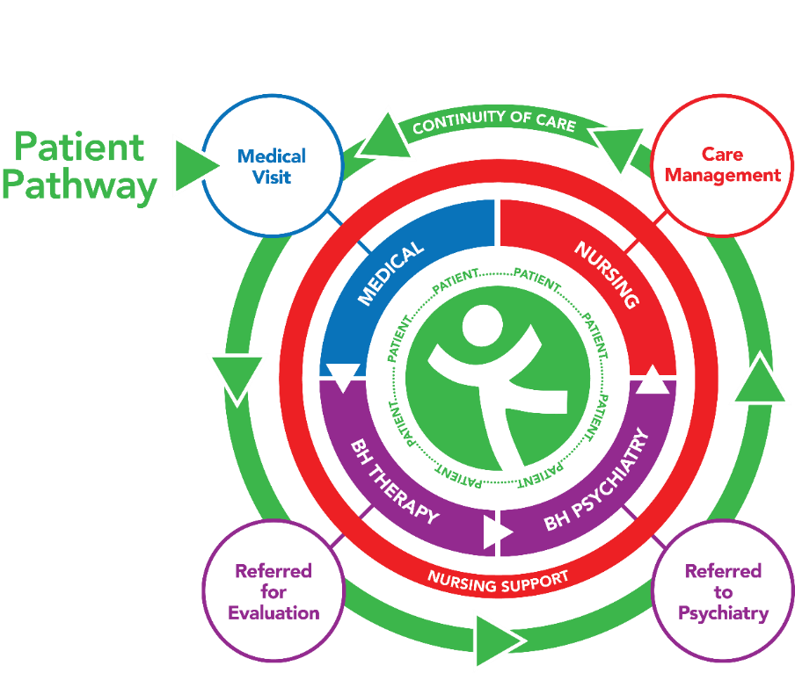
Warm Hand Off
Warm Hand Off can be maintained in a hybrid team:
On Site:
If a member of the team thinks a patient needs to see a behavioral health provider before leaving the appointment, it is flagged for the MA
MA briefs the BH provider
Every effort is made for patient to meet a BH provider before patient leaves
E-WHO (Electronic Warm Hand Off)
Leverage EHR to do this virtually
Notes:
Tim
PH2 and PH9 – send 9 to behavioral health; talk about our process

Slide 18
All Patients are “CHCI Patients”
In 2023, 12.0% of CHC Primary Care Patients were also CHC BH Patients, and 65.3% of CHC BH Patients were also CHC Primary Care Patients.
All patients enter through the same doorway to be greeted by the same patient service associate, avoiding the stigma associated with seeing a therapist.
Getting behavioral health care outside of our integrated team-based care system does not disqualify a patient from getting medical care at CHCI, though it makes coordination of services more difficult.
Medical patients were more likely to keep initial appoints for behavioral health than those who had no previous connection to CHCI.
Notes:
Tim

Slide 19
Having the Right People on the Team
Behavioral health clinicians continue to focus on the interplay between a patient’s inner world and social reality.
The 45 minute session or weekly sessions that are often the norm in free standing BH programs are often not needed, and the opportunity to have other team members provide parts of the care that the BH provider would need to do if they were a solo practitioner can lead to more effective and efficient care.
Strong pod identify to build camaraderie
Inform candidates of unique opportunities, responsibilities, and obstacles of integrated care at time of hire
Training opportunities
Notes:
Tim
A lot of people asking things from you – patient, primary care provider, telephone encounters: competing demands; need to have the skills to handle all the moving parts
Talk through different disciplines / state laws

Slide 20
Upcoming Webinar: Optimizing the Role of Integrated Behavioral Health Providers in Health Centers
Description: Join Behavioral Health experts from CHCI for an informative 60-minute webinar on the role of integrated behavioral health providers in health centers. This webinar will discuss best practices for optimizing integrated behavioral health including the electronic health record, physical and virtual co-location, and timely warm handoffs. Through a practical case study, Dr. Kearney, Chief Behavioral Health Officer, will explore the importance of PHQ-9 and other screening tools in team-based care settings to refer medical patients to behavioral health services. Participants will gain knowledge and strategies to enhance their health center’s integrated behavioral health care model.
When: Tuesday, April 29th, 2025
Time: 1:00 - 2:00pm Eastern / 10:00 - 11:00am Pacific
Register Here: https://education.weitzmaninstitute.org/content/webinar-%E2%80%93-advancing-team-based-care-optimizing-role-integrated-behavioral-health-providers
Notes:
Meaghan

Slide 21
Questions?
Notes:
Tim

Slide 22
Role of Business Intelligence
Nick Ciaburri, Director of Business Intelligence
Moses/Weitzman Health System
Notes:
Nick

Slide 23
What is Business Intelligence?
“BI systems combine data gathering, data storage, and knowledge management with analytical tools to present complex internal and competitive information to planners and decision makers. Implicit in this definition is the idea (perhaps the ideal) that business intelligence systems provide actionable information delivered at the right time, at the right location, and in the right form to assist decision makers”
(Negash, 2004, p. 178).
Notes:
Nick

Slide 24
Dashboards and Reports
The end-users (executives to MAs) see customized reports and dashboards produced by BI.
These dashboards and reports are built in collaboration with the end-users, and there are many iterations tested until all parties are satisfied that these products are usable and the data is actionable.
To get this end product: BI team had to build the data warehouse which transforms and cleans the data from the EHR to make it more usable for reporting.
Notes:
Nick

Slide 25
Best Practices for Actionable Data
You can collect all the data you want, but if it is not structured in a way that is useful and meaningful, staff will not be able to use it in a timely manner to provide or to improve patient care.
BI Team works closely with the clinical chiefs, senior administrators and the population health team to identify what data are most important to them and their staff, what they are trying to improve, and when/how often they need to see the information.
For data validity – conduct chart reviews.
Notes:
Nick

Slide 26
Challenges to Data Accessibility and Validity
Biggest challenge to data validity: ensuring that the denominator in a measure is correct.
It is one thing to count how many patients were screened/not screened for cancer (numerator); it is another to count how many were supposed to be screened based on eligibility criteria (denominator).
Biggest challenge to data integrity: invalid and/or inaccurate data entry by end-users
For our BI team, end-users include every staff person who enters any kind of data into the electronic health record and other HIT systems, such as billing and coding. That is, data integrity involves everyone with access to these records.
Notes:
Nick

Slide 27
Questions?
Notes:
Nick

Slide 28
Role of Population Health Management
Tierney Giannotti, MPA, Senior Program Manager for Population Health
Moses/Weitzman Health System
Notes:
Tierney

Slide 29
Defining Population Health
Kindig and Stoddart’s definition (2003) “the health outcomes of a group of individuals, including the distribution of such outcomes within the group.”¹
Focuses on populations “within specific geopolitical area” and goes beyond their clinical health to include “social, economic, environmental, and individual behavioral and genetic traits.”
CDC: Population health brings significant health concerns into focus and addresses ways that resources can be allocated to overcome the problems that drive poor health conditions in the population²
Kindig D, Stoddart G. What is population health? American Journal of Public Health 2003 Mar;93(3):380-3.
Center for Disease Control and Prevention. What is Population Health? https://www.cdc.gov/pophealthtraining/whatis.htm l
Notes:
Tierney

Slide 30
Population Health Management
It is not a department or job description.
It is the combined efforts and use of data, systems, and processes that occur across several levels of functioning within a health center
Everyone contributes to population health, beginning with individual patient encounters using a team-based approach to care, and extending out to value-based contracts with external agencies.
Tools and Strategies: (1) Identifying gaps in care, (2) Documenting clear processes for closing care gaps, (3) Stratifying patients by risk, and (4) Ongoing feedback loops/reporting
Notes:
Tierney

Slide 31
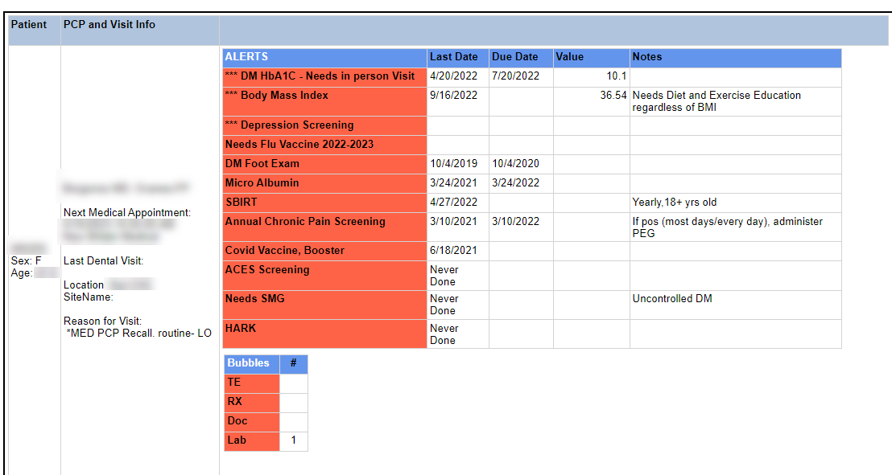
Clinical Dashboard: Identifying Gaps in Care
Key piece of population health management are clinical dashboards, specifically the Planned Care Dashboard which is the engine driving all visits in primary care at CHC.
MA does the pre-visit planning by reviewing the dashboard to identify what preventive services a patient is due to receive.
Notes:
Tierney

Slide 32
Job Tools to Support Care Gap Closure
More than 40 care gaps on the Planned Care Dashboard
Provides instructions on the process and who is responsible for each segment of the process
Dashboards are not useful if there are no clear workflows in place for how to provide the care that the dashboard flags as needed.
Notes:
Tierney

Slide 33
Beyond the Dashboards: Closing Care Gaps & Patient Outreach
Population health extends beyond the primary health care teams.
Three primary ways to close care gaps at CHCI
Close care gaps in real time when the opportunity arises (i.e. when a patient is seen for an acute visit, order the HbA1c that is due)
Identify patients for whom the care gap has been addressed, but for whom we do not have a record indicating it was addressed (i.e. receive care elsewhere, go to at outside lab or radiologist for screenings and tests)
Reach out to patient by text or phone to schedule a visit or remind them of one so that they get the care they need to receive.
Notes:
Tierney

Slide 34
Discussion Question
How do you close your care gaps at your health center? Who does it?
Please type your answer in the chat or unmute.
Notes:
Tierney

Slide 35
Lessons Learned for Clinical Dashboards
Conduct chart reviews and site visits to learn from the clinical team what is and what is not working.
Consider all of the various ways staff learn:
Email written instructions
Screenshots of the process
Video of the rationale for addressing the care gap and the process for completing it
Notes:
Tierney
Not everyone has BI Department; not everyone can build planned care dashboard
Understanding who patients with diabetes are, registry of patients with different conditions – making full use of information and disseminate data to those who need it
Dashboard is only as good if people use it.

Slide 36
Risk Stratification and Strategies to Mitigate Risk
In Connecticut, the HUSKY Medicaid PCMH+ program uses the Johns Hopkins Adjusted Clinical Groups (ACG) System to assign risk scores to patients, which are in turn available to providers who care for those patients
Use risk score for integrated care meetings
Provide that information to call center staff
Notes:
Tierney
Talk about risk score and what we do with it; integrated care meetings, when patients calls call center, if high risk, put in front of call center staff (prior behavior predicts future behavior)

Slide 37
Quarterly Chronic Disease Management Report
Reports sent to care team (MA, Nurse and Provider) quarterly and compares rates of key measures to their own site and agency-wide.
Notes:
Tierney

Slide 38
Polling Question
Is your health center engaged with value-based contracts?
(Yes/No/Unsure)
Notes:
Tierney

Slide 39
Defining Value-Based Care
Value-based care is a healthcare delivery model in which providers, including physicians and hospitals, are paid based on patient care outcomes.
Under value-based care agreements, providers are rewarded for helping patients improve their health, reduce the effects and incidence of chronic disease, and live healthier lives in an evidence-based way.
The “value” in value-based care is derived from measuring health outcomes against the cost of delivering the outcomes. The value extends to all—patients, providers, payers, suppliers, and society as a whole.
https://catalyst.nejm.org/what-is-value-based-care
Notes:
Tierney

Slide 40
Value-Based Contracts
Give careful consideration to the requirements of the payer
Quality Measures; Hierarchical Condition Categories
Timelines
Portals; Data Accuracy
Philosophy for your agency that is well articulated and understood:
Crosswalk metrics so that internal clinical expectations are understood in the context of value based metrics
Benefits: Additional data about your patients you may not have – can enhance quantitative knowledge about patients; Supports targeted investments to achieve optimal health outcomes
Pitfalls: Takes considerable work and dedicated staff to make it effective and worth time and effort
Notes:
Tierney
“We do not do something for a patient based on value-based plan. We will do for all patients”
How to pay for TBC
Not necessarily ready to dive into contracts
But, might be worthy to mention

Slide 41
Examples of Elements of Value-Based Contracts
Incentive to implement certain visit types (i.e. Annual Wellness Visits, Transition Care Management)
Per member per month payment
Lump sum for financial savings
Bonus payment for each care gap you close
Notes:
Tierney

Slide 42
Questions?
Notes:
Tierney

Slide 43
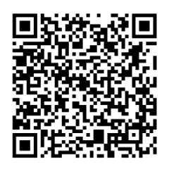
Action Period 5 Deliverables
Conduct your weekly team meetings
Coaches attend weekly coaching calls
Complete Step 7 in the Quality Improvement Workbook
Access the Google Drive to upload deliverables:
Notes:
Meaghan

Slide 44
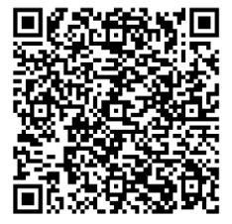
Next Steps
Coach Calls
Wednesday March 19th 1:00pm Eastern / 10:00am Pacific
Wednesday March 26th 1:00pm Eastern / 10:00am Pacific
Wednesday April 2nd 1:00pm Eastern / 10:00am Pacific
Session 6: Wednesday April 9th 1:00pm Eastern / 10:00am Pacific
Register for the Weitzman Education Platform to receive CME, resources, and more!
Notes:
Meaghan

Slide 45
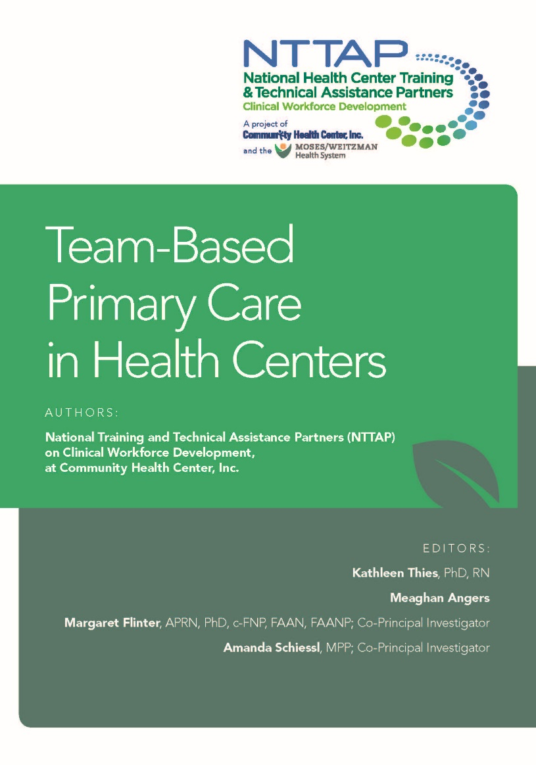
Download our new book, Team-Based Primary Care in Health Centers!
https://www.weitzmaninstitute.org/wp-content/uploads/2024/09/Team-BasedPrimaryCareinHealthCenters.pdf
Notes:
Meaghan

Slide 46
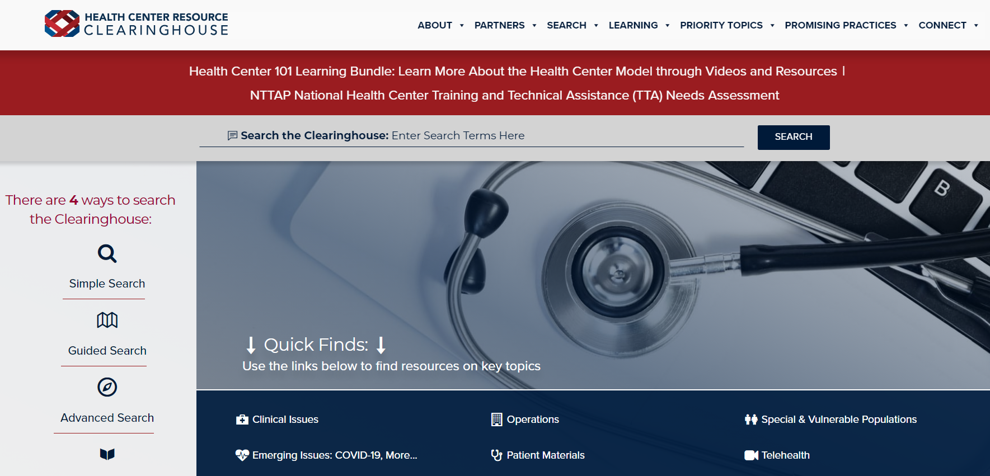
Explore more resources!
National Learning Library: Resources for Clinical Workforce Development
Health Center
Resource Clearinghouse
https://www.weitzmaninstitute.org/ncaresources
https://www.healthcenterinfo.org/
Notes:
Meaghan

Slide 47
Contact Us!
Amanda Schiessl
Program Director/Co-PI
Amanda@mwhs1.com
Meaghan Angers
Senior Program Manager
angersm@mwhs1.com
Bianca Flowers
Program Manager
flowerb@mwhs1.com
REMINDER: Complete evaluation in the poll!
Next Learning Session is Wednesday April 9th!
Notes:
Meaghan

