Slide 1


Evaluation of Musculoskeletal Pain: Rheumatology Perspective
April 8th, 2025
www.ConferMED.com

Slide 2

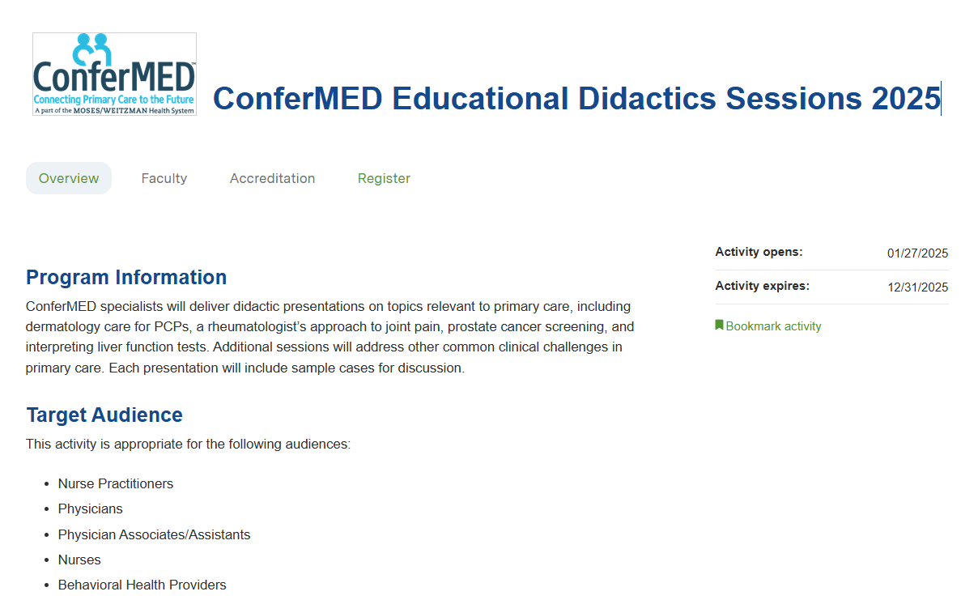
Claiming CME
Create an account on Weitzman Education Platform if you do not have one already.
Navigate to activity: ConferMED Educational Didactics Sessions 2025
Under Register, select session you attended. Within that session, select Continue to navigate to activity instructions.
Select the Start Activity or Session Evaluation in the left-hand navigation bar.
Complete the session evaluation and select the Submit at the bottom of the evaluation.
You will be able to view your credits awarded and download your certificate.

Slide 3

MSK pain in Primary Care
10-20% of all primary care office visits are for MSK conditions
25-40% of adults have some MSK condition
20+% have chronic Neck/Back pain
20+% have Osteoarthritis
Est 10-20% Tendonitis/Bursitis/Nerve compression
3-8% Fibromyalgia/Myofascial pain syndrome
5% Crystalline arthritis (gout, pseudogout)
0.7-0.8% Rheumatoid arthritis
0.2-0.3% Polymyalgia Rheumatica (PMR)
<0.1-0.3% SLE

Slide 4
Initial Questions
1. Urgent or Not? Sepsis or acute neurologic signs
2. Pattern: Inflammatory-quality / Mechanical / Neurogenic ?
3. Time line: Acute (Days-Week) / Subacute (2-6 weeks) / Chronic (>6 weeks)
4. Are there abnormal exam findings?
5. Is an adequate history & exam actually possible now?

Slide 5

RED FLAGS: Urgent intervention needed
Septic arthritis
Fever, Non-weight bearing and/or severe pain with passive range of motion
Single peripheral joint (80%) or or focal axial pain (Spine, SI joint, SternoClav)
Risks: history of IV drug use, recent infection, immunosuppressed status
Cauda Equina
Bowel/bladder signs, saddle anesthesia, weakness
Acute Disc hernatiation / Neurogenic Claudication
Weakness, foot drop, radiating pain / radiculopathic pattern
Compression Fracture
Acute, focal bony tenderness, low bone density, age >70, prolonged steroid use, cancer

Slide 6
Inflammatory-quality Musculoskeletal Pain
# Pain worse in the morning and improved with activity after 1-2 hours
Stiffness is subjective and often normal
# Present daily with a persistent pattern or episodic
Daily: Rheumatoid arthritis, Inflammatory spondyloarthritis (Psoriatic arthritis, AS)
Episodic: Palindromic rheumatism, crystalline arthritis (gout/pseudogout)
# Abnormal Exam
Joint effusion +/- tactile warmth
Reduced range of motion

Slide 7
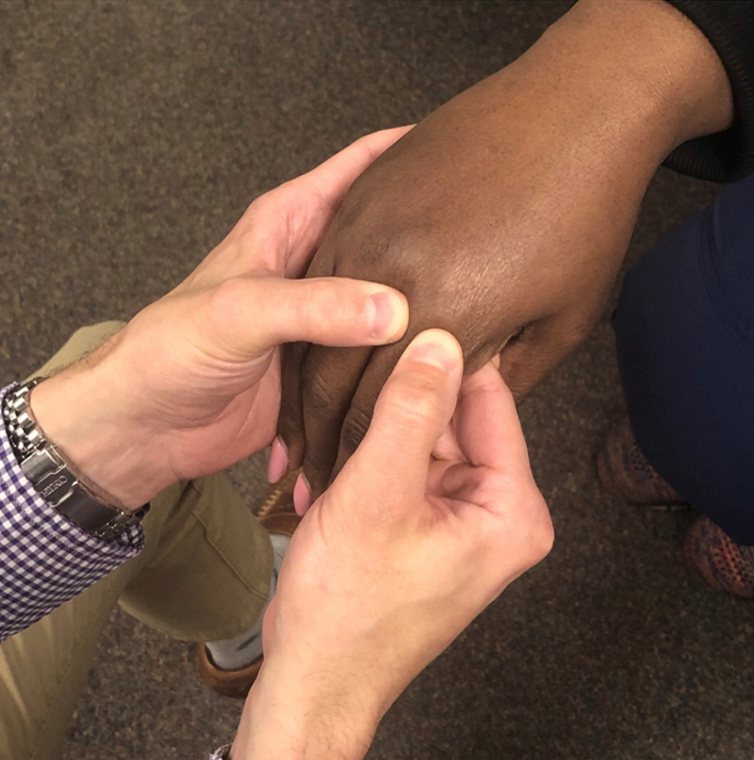
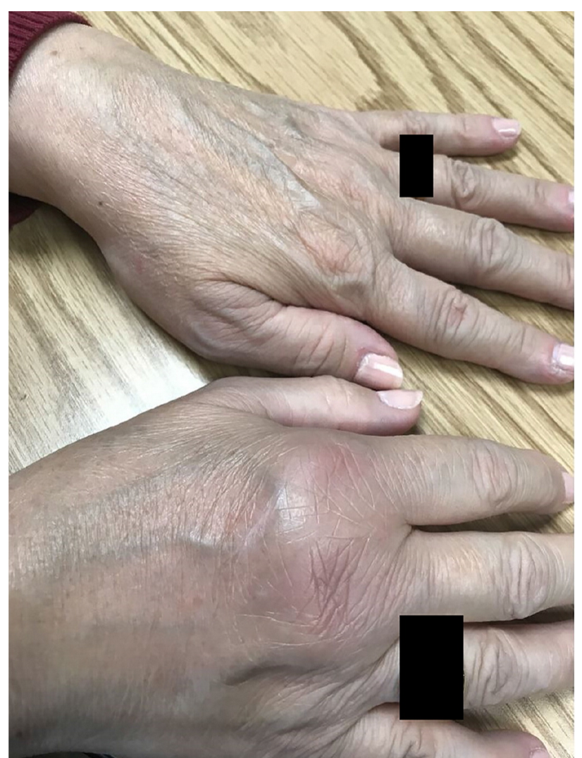
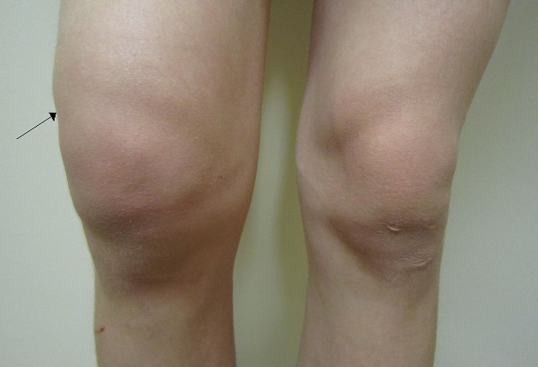
Inflammatory Arthritis
Inflammatory Arthritis

Slide 8
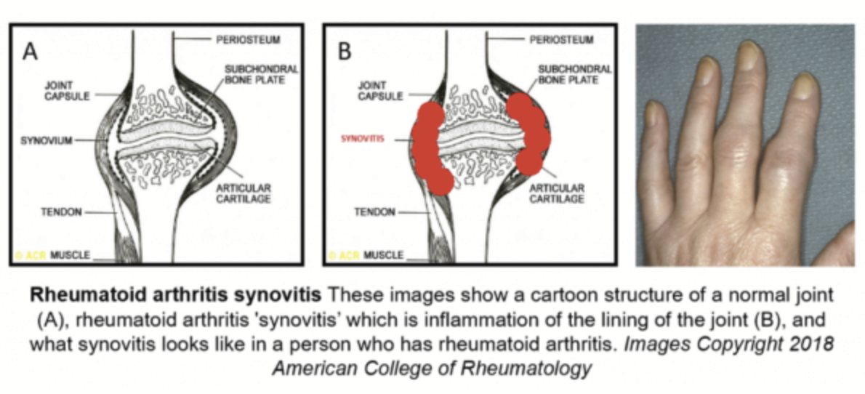
Synovitis = inflammation of the synovial membrane that lines certain joints.
Tenosynovitis = inflammation of the tendon sheath (a type of synovium)
Commonly extensor tendons of the fingers/wrists and less so feet/ankles

Slide 9
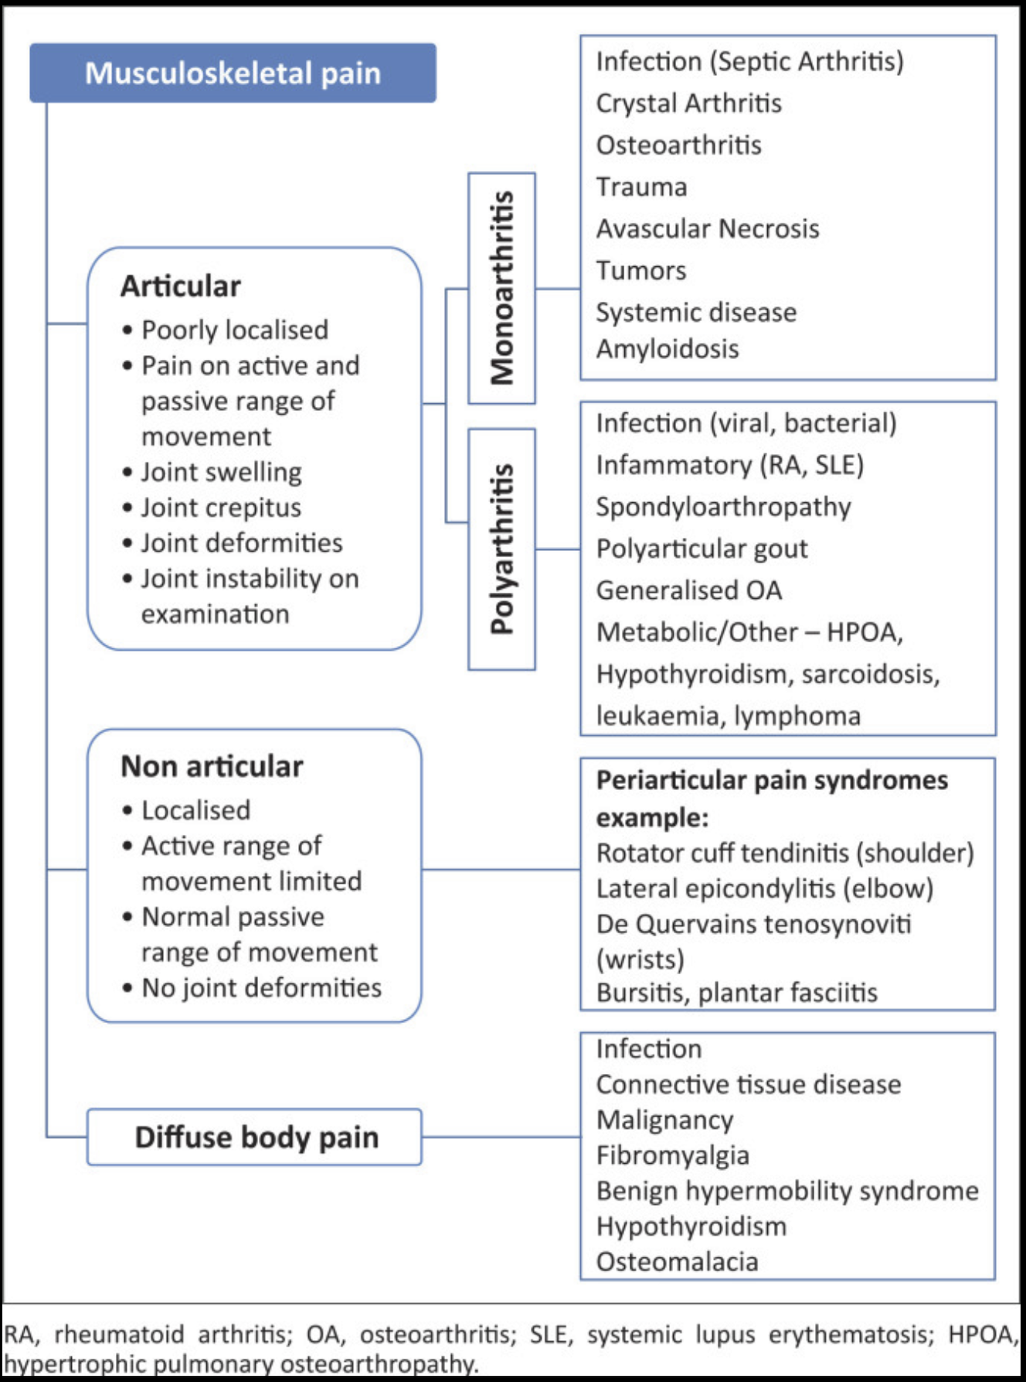
Additions to this Differential Diagnosis
Viral / Post-Viral Arthritis
- EBV, CMV, Hep B and C, HIV, ParvoB19, COVID, Flu, can be any
Reactive arthritis
Check for GC/Chlamydia, History of enteritis symptoms.
Peri-/Menopausal pain syndrome
Rangiah S, Govender I, Badat Z. A primary care approach to the management of Arthritis. S Afr Fam Pract (2004). 2020 Feb 17;62(1):e1-e7.

Slide 10
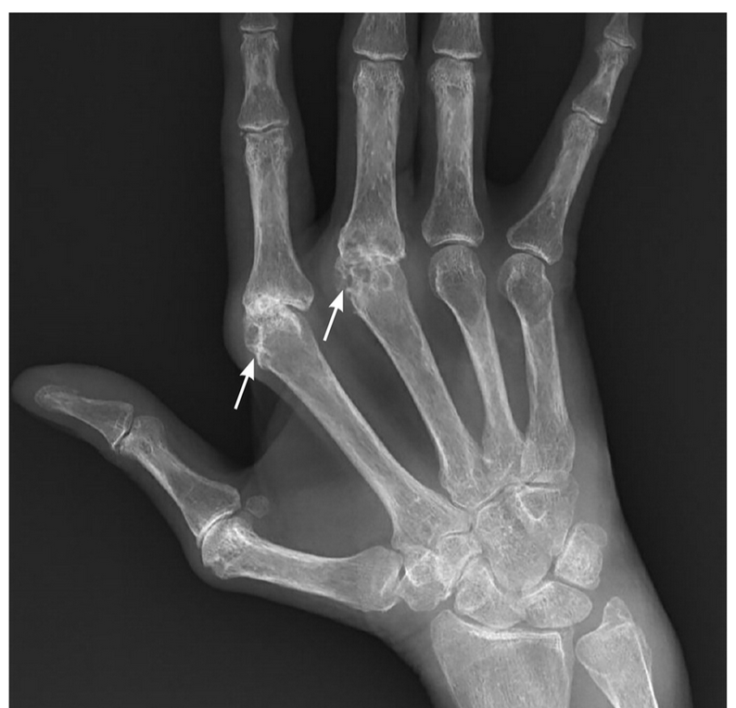
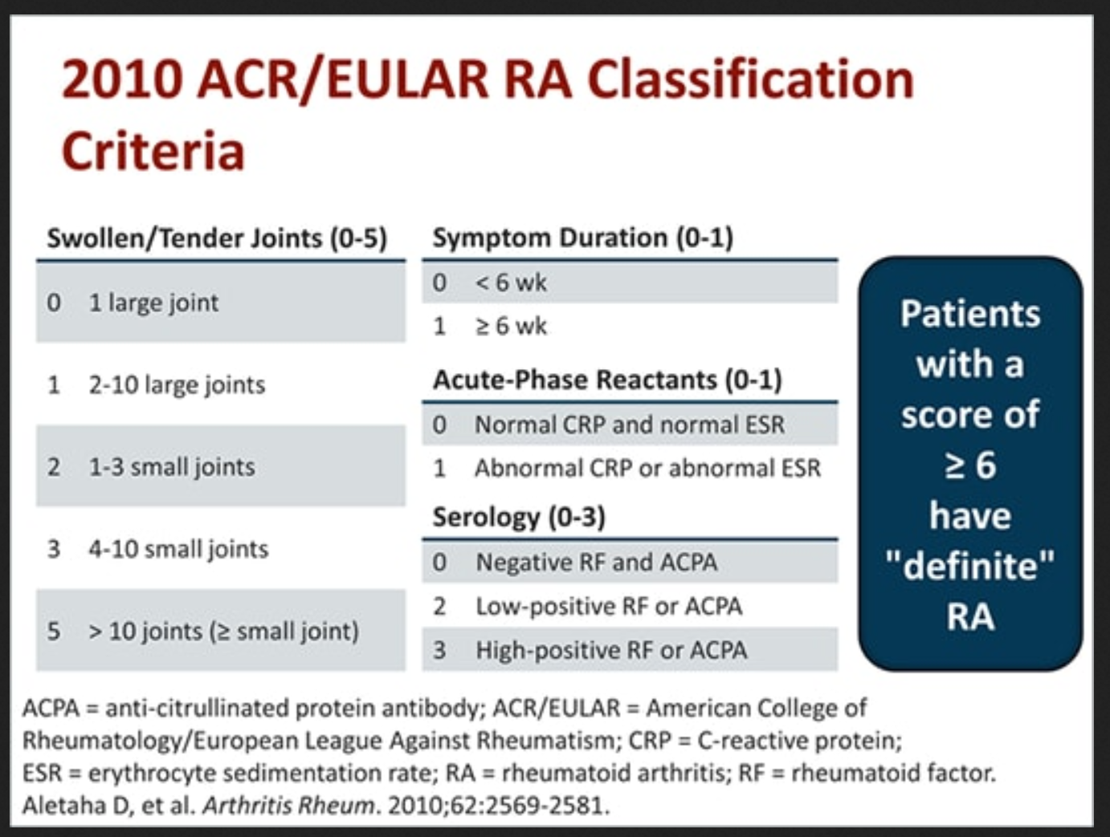
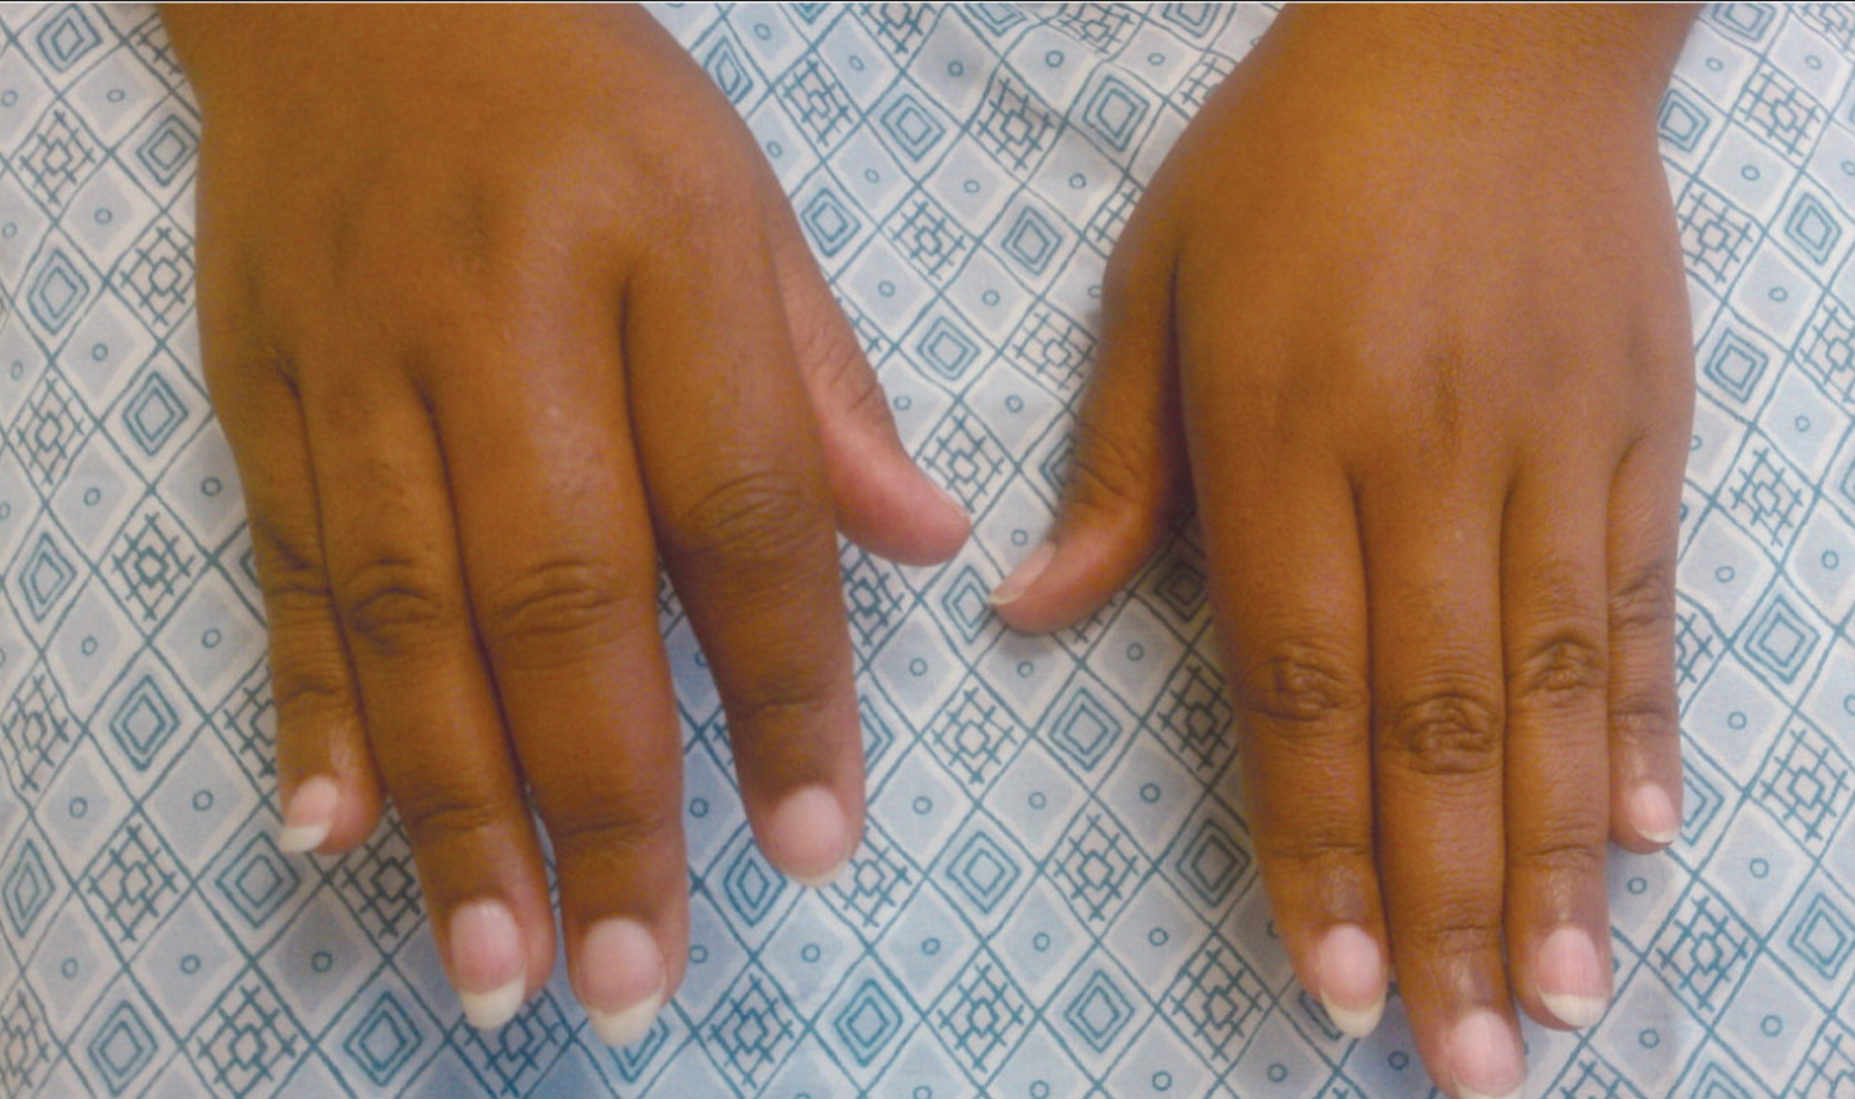
Rheumatoid Arthritis
Polyarticular, largely symmetric, small and medium > large joints
Present > 6 weeks

Slide 11
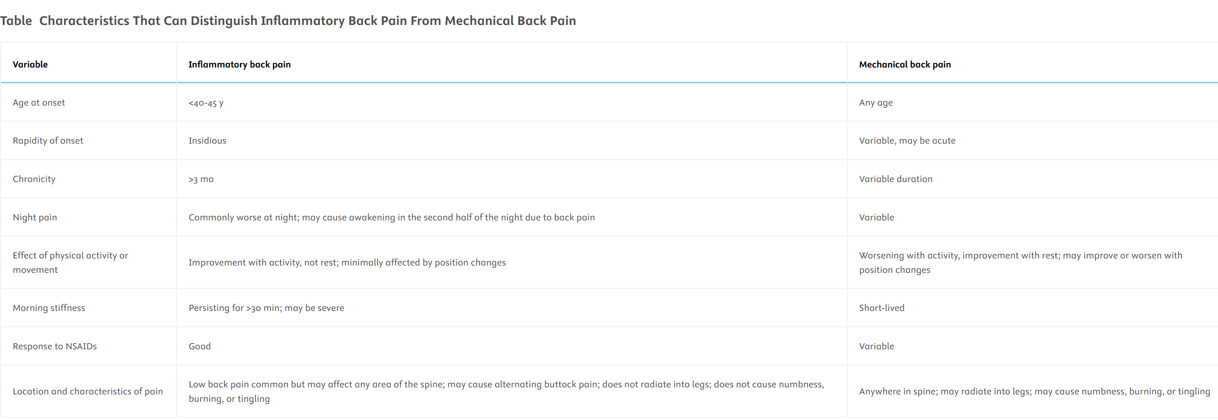
Inflammatory back pain or Mechanical back pain
Magrey MN, Danve AS, Ermann J, Walsh JA. Recognizing Axial Spondyloarthritis: A Guide for Primary Care. Mayo Clin Proc. 2020 Nov;95(11):2499-2508.

Slide 12
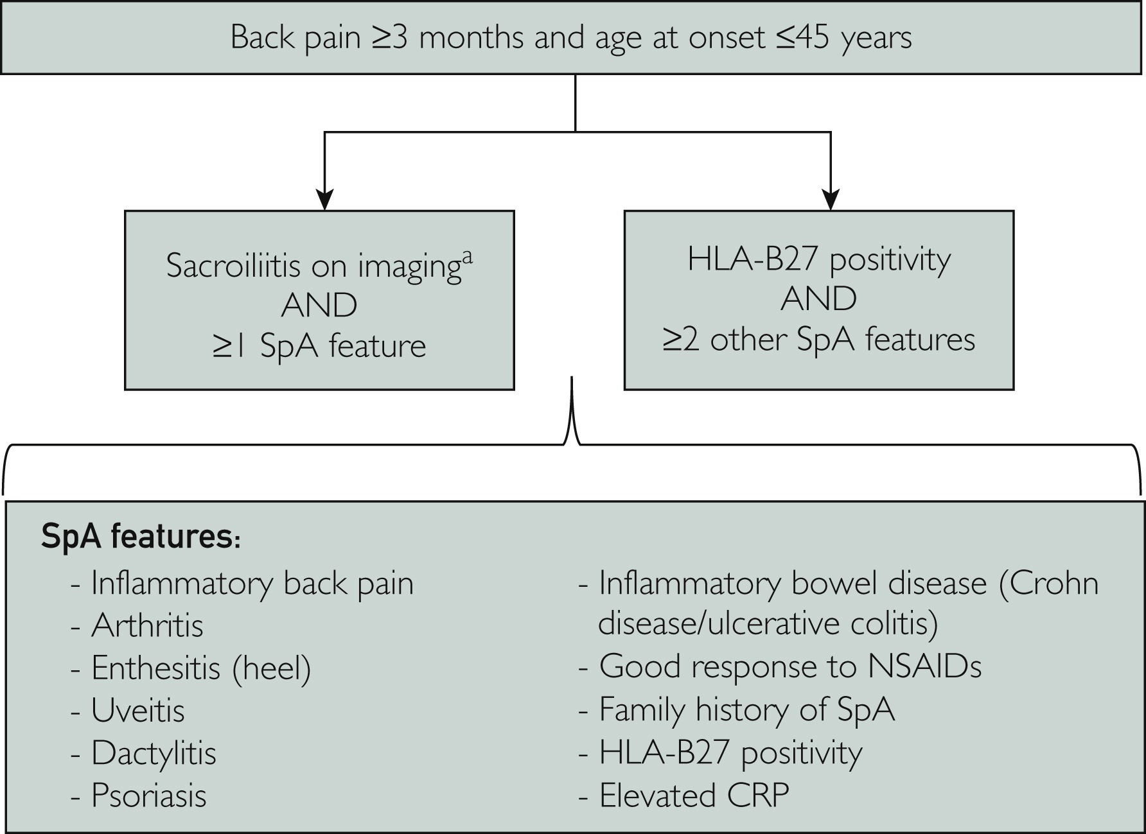
Inflammatory spondyloarthropathies
Ankylosing Spondylitis
Non-radiographic SpA
Psoriatic Arthritis
IBD-associated Arthritis
Magrey MN, Danve AS, Ermann J, Walsh JA. Recognizing Axial Spondyloarthritis: A Guide for Primary Care. Mayo Clin Proc. 2020 Nov;95(11):2499-2508.

Slide 13
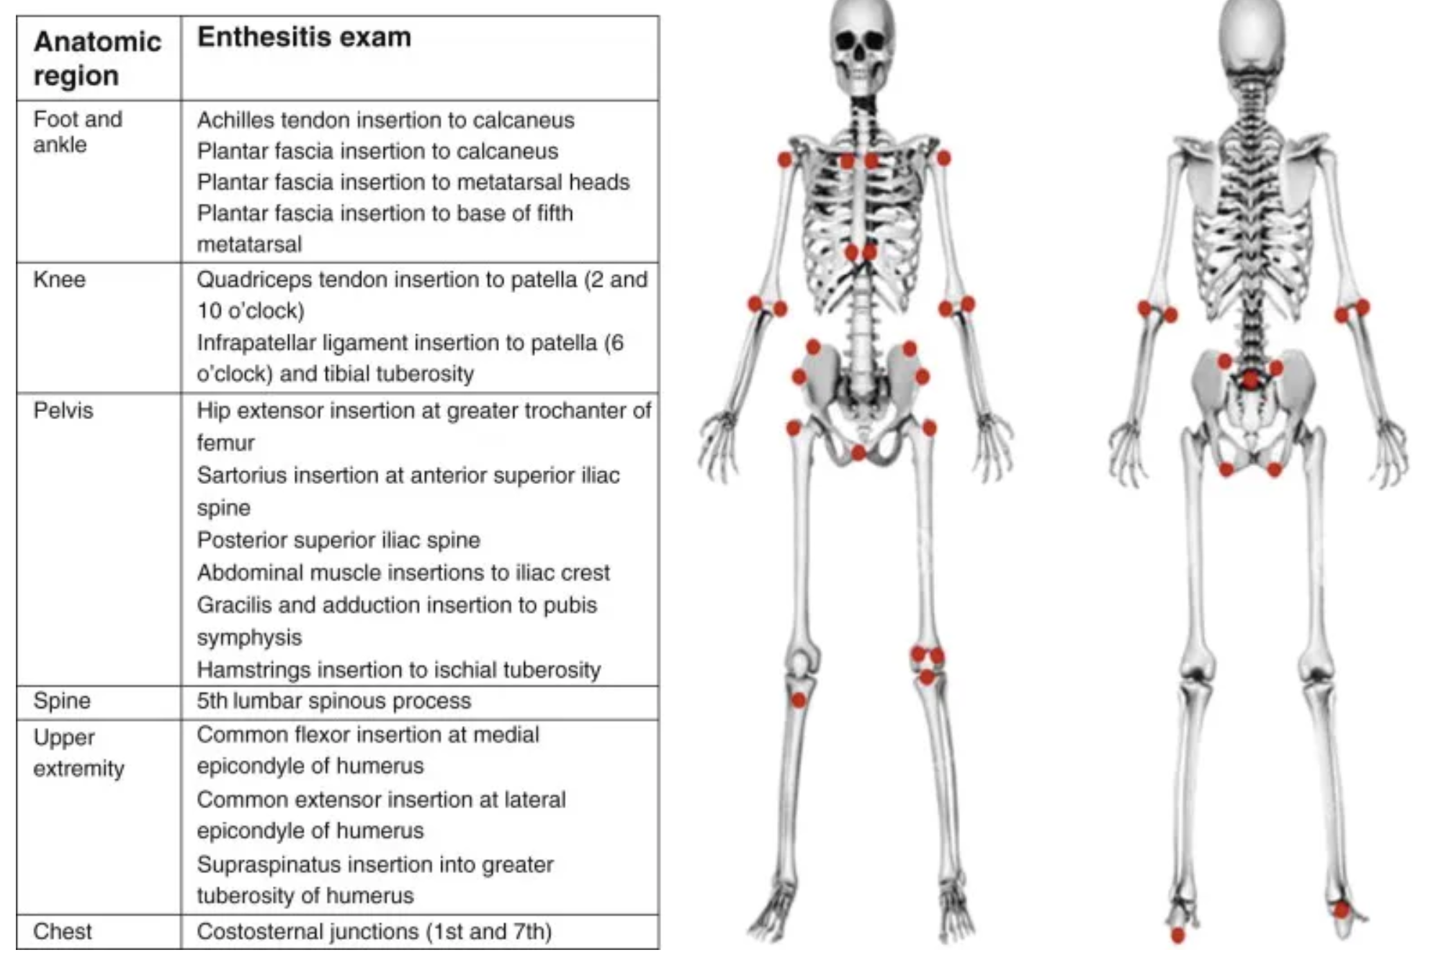
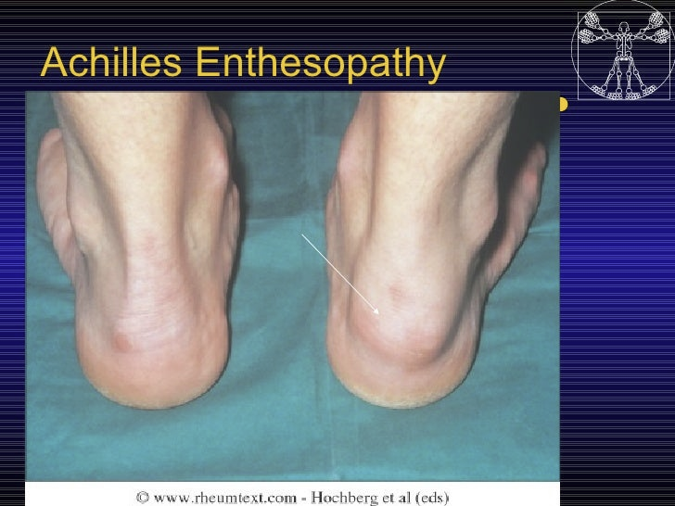
Enthesitis = Inflammation at sites of tendon/ligament attachment to bone
Associated with Psoriatic arthritis, Ankylosing spondylitis/Inflammatory Spondyloarthropathy
Major DDx: Tendonitis/Tendinosis, Fibromyalgia

Slide 14
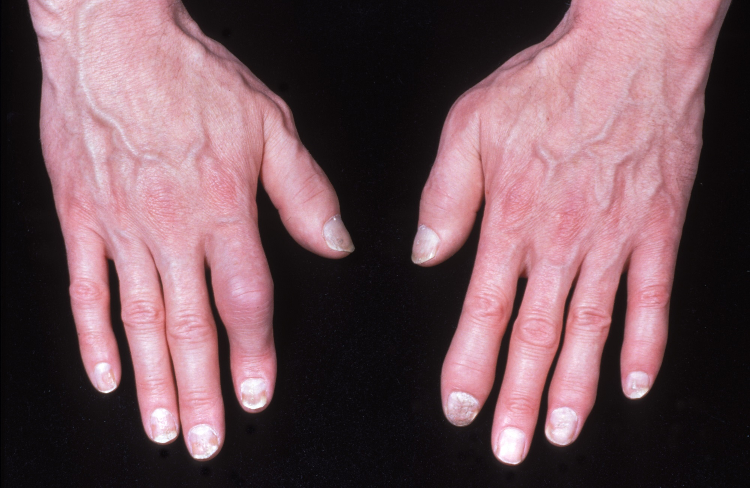
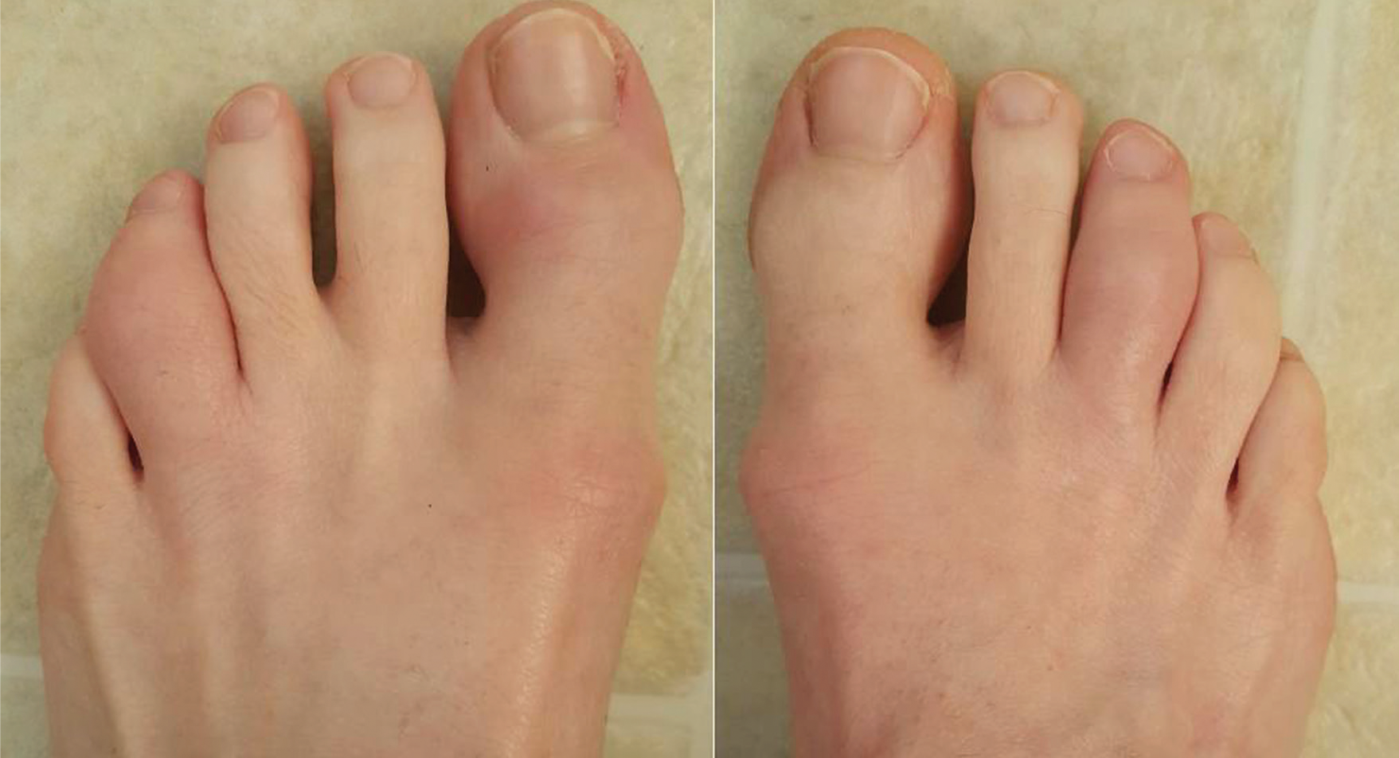
Dactylitis = inflammation of multiple joints + tendons of a digit
Differential Dx: Psoriatic arthritis, AS/SpA, Sarcoidosis, Infection or reactive arthritis, TB, Sickle cell

Slide 15
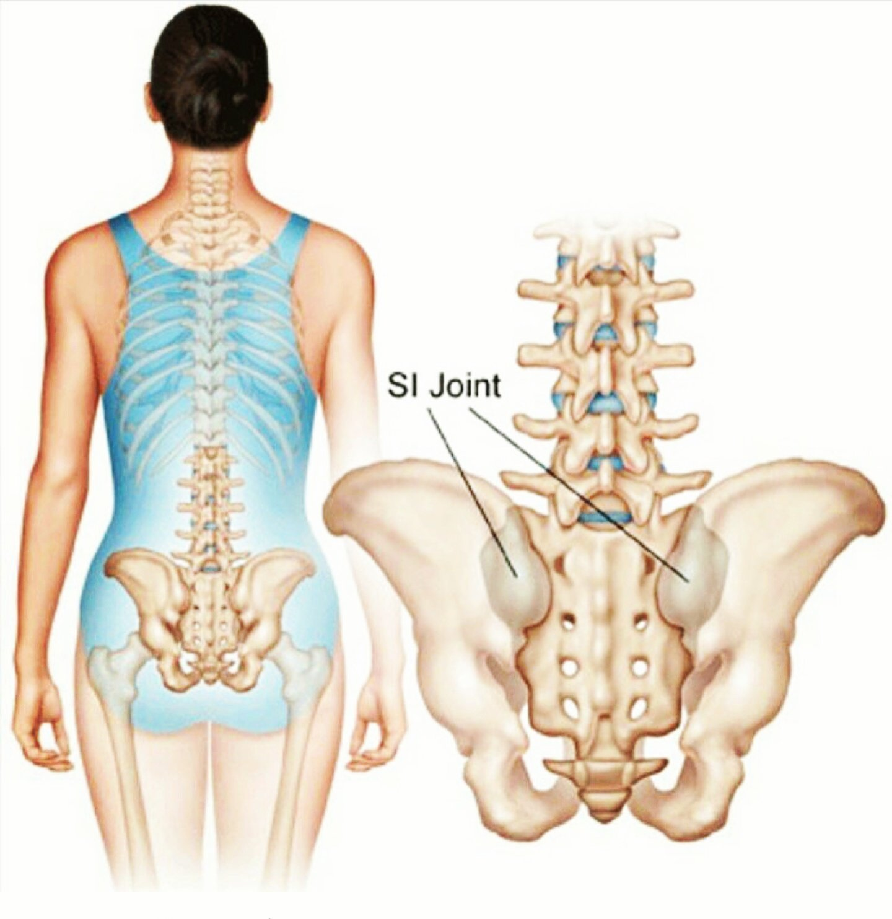
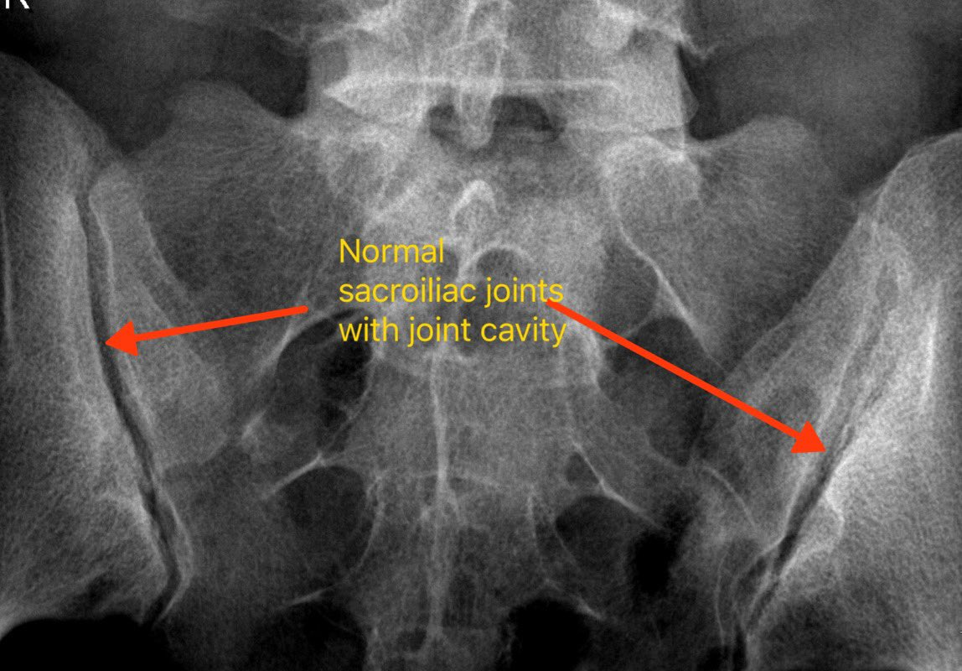
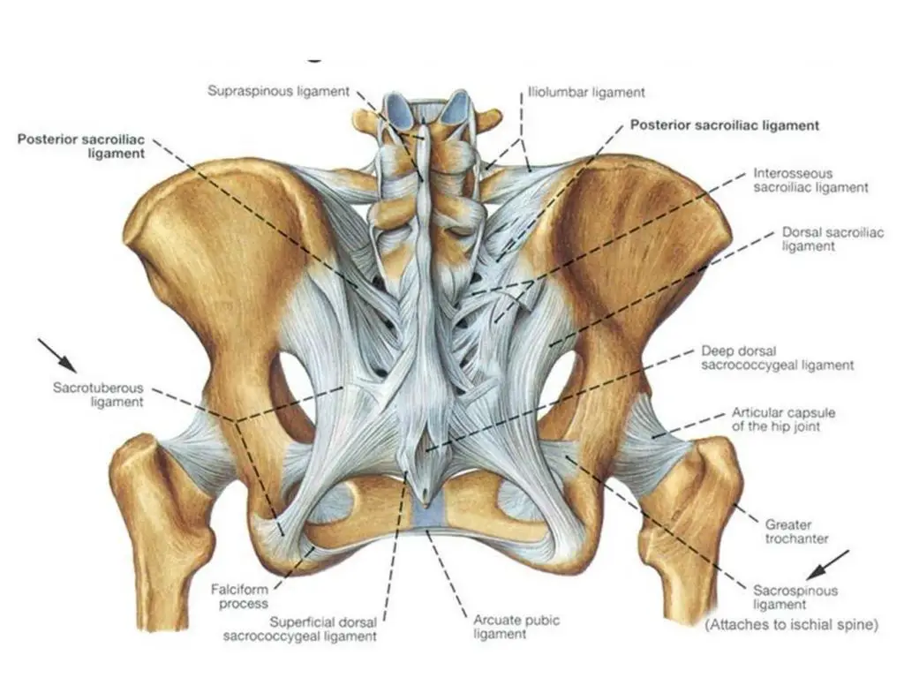
Sacroiliitis = Inflammation in one or both SI joints. Commonly causes pain in the low back/buttock area, may radiate to the hip
DDx: Inflammatory spondyloarthritis (AS, PsA), OA/DJD, Joint instability (pregnancy), gluteal tendonitis

Slide 16
Musculoskeletal Pain: History and findings unlikely to be inflammatory
Pure Mechanical Quality: Pain worse with activity, better with rest
Widespread / diffuse pain and tenderness
Joint+muscle symptom involvement, significant muscle tension
Concurrent clinical features of fibromyalgia: Non-restorative sleep, prominent fatigue, cognitive changes “brain fog”
Fibromyalgia risk factors: depression/anxiety, chronic headache or other chronic localized pain, poor quality sleep (primary insomnia, children/pets, OSA), history of generalized flexibility/ligament laxity, family history

Slide 17

A good history + exam will usually provide the answer
Time and attention is a therapeutic intervention
If the pain pattern is unclear and exam is unremarkable,
Consider conservative measures and a 2-week pain journal.
Scheduled OTC or Rx NSAID trial or scheduled acetaminophen at appropriate dose
Trials of rest, heat / ice, common topicals (diclofenac gel, lidocaine)

Slide 18
When to order Lab testing: High index of suspicion
Lab tests are rarely, if ever, diagnostic.
Context is critical: Be aware of confounding factors
Illness within 2-3 weeks, recent vaccinations, procedures
Obesity/Metabolic inflammation/Uncontrolled diabetes and OSA
Dysregulated adipocytes produce inflammatory cytokines (TNFa, IL-6 → elevated CRP)
Hypoventillation and/or hypoxemia overnight → physiologic stress, inflammation, fluid retention
Antibody tests are non-specific
20% of the adult population has a positive ANA screen and NO active autoimmunity
20% of the adult population >age 65 has a positive Rheumatoid factor (<1% of adults have RA)
3% of adults have a positive CCP (cyclic citrullinated peptide) Ab

Slide 19
When are X-rays helpful?
Concern for fracture
Chronic symptoms present >6-12 weeks
Determine if osteoarthritis is present and severity
Look for changes consistent with chronic inflammation
Disease specific Xray findings: Gout, Pseudogout
Include a Radiology order note with patient symptoms, your differential Dx and what you want them to comment on.
“chronic knee pain, intermittent swelling, please assess degree of OA, chrondrocalcinosis”
“6 weeks of b/l hand pain, variable swelling. Please assess DJD, central vs marginal erosions”
“chronic low back pain, AM stiffness. degenerative changes vs inflammatory SpA / sacroiliitis
“Recurrent toe pain and swelling. OA vs gout”

Slide 20
Rheumatology Pearls and Pitfalls
Rheumatoid Arthritis
Rheumatoid Arthritis is NOT a lab-based diagnosis
20% of patients with RA are RF and CCP antibody negative
Symptoms must be present for >6 weeks for a diagnosis
Damage on X-rays may be seen as early as 12-16 weeks of active inflammation
Untreated OSA is a surprisingly common mimic → fluid retention and pain amplification
Osteoarthritis can cause synovitis (Inflammatory OA, Erosive OA)

Slide 21
Rheumatology Pearls and Pitfalls
Inflammatory Spondyloarthopathy
Ankylosing Spondylitis, Psoriatic Arthritis, IBD-associated arthritis
Review both personal and family history: Psoriasis, Inflammatory Eye disease (uveitis, episcleritis), Inflammatory bowel disease
Chronic low back pain with onset <age 45, usually much younger. Present daily. Consistently improves with activity, stretching.
Look for sacroiliitis
Expect at least a partial positive response to NSAIDs
May not respond well to corticosteroid
HLAB27 Antigen is never diagnostic, but does increase suspicion

Slide 22
Key References
Abend AH, He I, Bahroos N, Christianakis S, Crew AB, Wise LM, Lipori GP, He X, Murphy SN, Herrick CD, Avasarala J, Weiner MG, Zelko JS, Matute-Arcos E, Abajian M, Payne PR, Lai AM, Davis HA, Hoberg AA, Ortman CE, Gode AD, Taylor BW, Osinski KI, Di Florio DN, Rose NR, Miller FW, Tsokos GC, Fairweather D. Estimation of prevalence of autoimmune diseases in the United States using electronic health record data. J Clin Invest. 2024 Dec 12;135(4)
Jafarzadeh SR, Felson DT. Updated Estimates Suggest a Much Higher Prevalence of Arthritis in United States Adults Than Previous Ones. Arthritis Rheumatol. 2018 Feb;70(2):185-192. doi: 10.1002/art.40355. Epub 2018 Jan 3.Urgent or Not?
Barbour KE, Helmick CG, Boring M, Brady TJ. Vital Signs: Prevalence of Doctor-Diagnosed Arthritis and Arthritis-Attributable Activity Limitation - United States, 2013-2015. MMWR Morb Mortal Wkly Rep. 2017 Mar 10;66(9):246-253.
Magrey MN, Danve AS, Ermann J, Walsh JA. Recognizing Axial Spondyloarthritis: A Guide for Primary Care. Mayo Clin Proc. 2020 Nov;95(11):2499-2508.
Rheumatology Secrets, 4th Edition. 2020. Editors: Sterling West MD, Jason Kolfenbach MD
Foster ZJ, Day AL, Miller J. Polyarticular Joint Pain in Adults: Evaluation and Differential Diagnosis. Am Fam Physician. 2023 Jan;107(1):42-51.
Rangiah S, Govender I, Badat Z. A primary care approach to the management of Arthritis. S Afr Fam Pract (2004). 2020 Feb 17;62(1):e1-e

Slide 23

Questions?

