Slide 1
Headache in Primary Care
Dan Wilensky MD
Senior Faculty, Moses/Weitzman Health System
May, 2025

Slide 2
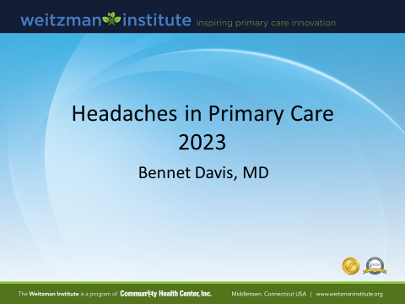
Giving credit where credit is due
And, when not otherwise identified, the reference is UpToDate

Slide 3
Disclosure
With respect to the following presentation, there has been no relevant (direct or indirect) financial relationship between the party listed above (or spouse) and any for-profit company in the past 12 months which would be considered a conflict of interest.
The views expressed in this presentation are those of the presenter and may not reflect official policy of Community Health Center, Inc. and its Weitzman Institute.
I am obligated to disclose any products which are off-label, unlabeled, experimental, and/or under investigation (not FDA approved) and any limitations on the information that I present, such as data that are preliminary or that represent ongoing research, interim analyses, and/or unsupported opinion.

Slide 4
Learning Objectives
Distinguish between primary and secondary headache
Become more familiar with common and less common primary headaches
Review some treatment options
Recognize the chronic headache as a component of complex chronic pain

Slide 5
Pediatric Headache
By 18 y.o.a, more than 90% of people will report having had a headache
20% with recurrent HA over past year
Frequency increases with age
Female:Male approx. 3:1 (over age 12)
  No difference below 12
Childhood headaches are rarely caused by a serious underlying disorder
  815 patients assessed (mean 10.8 y.o)
  3 children with intracranial pathology
    2 predictable on clinical findings, 1 was unexpected
      Abu-Arafeh, “Serious neurological disorders in children with chronic headache”, Arch Dis Child. 2005;90(9):937
Source: UpToDate

Slide 6
Primary Headache Disorders
Migraine
Tension type HA
Cluster
Other
  Primary cough HA
  Primary stabbing HA (“icepick headache”)
  Primary Exertional HA
  Hypnic HA (during sleep)
  Hemicranias
  Thunderclap HA
  New Daily Persistent HA (NPDH)
http://ihs-classification.org/en/02_klassifikation/01_inhalt/

Slide 7
Secondary Headache disorders – Related to:
OSA
Head and/or neck trauma
Cranial or cervical vascular disease
Nonvascular intracranial disorder
Substance or its withdrawal
  Inc: MOH (Medication Overuse Headache)
Infection
Disorder of homeostasis
Disorder of cranial structures
Psychiatric disorder

Slide 8
General approach to diagnosis
Know migraine and tension-type headache well.
Know the uncommon and rare primary headaches enough to know to look them up when a zebra walks in
  “You only find what you look for and you only look for what you know”
Respect all new headaches
Take a relentless headache history.
  “Recall what the headaches were like before they became like this”
Keep in mind that headaches are often part of a bigger picture of complex chronic pain, Pain related to psychosocial factors, Multiple somatic complaints, etc.

Slide 9
Secondary headache? Emergency?
To ED for: worst HA of life, thunderclap HA, somnolence/MS change, new focal neuro findings, fever/meningismus, seizure, syncope
Emergency evaluation of the adult with new nontraumatic headache: UpToDate
    https://www.uptodate.com/contents/evaluation-of-headache-in-adults?search=secondary%20headache%20hpi&source=search_result&selectedTitle=6%7E150&usage_type=default&display_rank=6

Slide 10
How not to miss the secondary headache: HPI
Sxs: sudden onset, new/progressive/changing pattern, eye pain/vision change, positional, exertional (cough/exercise/intercourse), associated neck pain
Patient history: Cancer, recent trauma, >50 yrs old, Pregnant/postpartum, Immunosuppressed, Anticoagulant or bleeding diathesis, Hypercoagulable state, known aneurysm/AVM, Obesity.
Family history: brain aneurysm

Slide 11
How not to miss the secondary headaches: Exam
Basic neurological exam
  Mental status
  Basic function – speech, comprehension, short/long term memory, gait
  Long tract signs? UMN
  CN, pupils
Fundoscopic – papilledema, absence of venous pulsations
Head and face (myofascial pain), neck (masses, nodes, bruits), occiput, and cervical spine (painful AROM, myofascial pain).
General medical exam, vital signs, hydration status

Slide 12
A brief discussion of brain imaging
We should image everybody with a headache that is not clearly a primary headache disorder
  Be liberal …. Once
MRI with and without contrast for most headaches
  Choosing Wisely: Clinicians should not order CT imaging for headache when MRI is available, except in emergency settings
        Loder et. Al, “Choosing wisely in headache medicine:the American Headache Society’s list of five things [clnicians] and patients should question”, Headache. 2013 Nov;53(10)1651-9 https://www.uptodate.com/contents/evaluation-of-headache-in-adults/abstract/36
When might I add an MRA to initial imaging?
  Very worried and vascular-sounding headache
  FH aneurysm

Slide 13
Ordering in specific scenarios
Concern about GCA/Temoral Arteritis?
  Temporal HA in older folks, PMR, tender t.artery…low threshold!
    To ER if TIA/CVA sxs or amaurosis fugax
  ESR/CRP, Steroids, send for temporal artery biopsy
    You need to do this unless you have a Rheumatologist who will take the case urgently
    Risk of preventable vision loss, disabling CVA if you dawdle
    If available, you can rule GCA IN with U/S or MRA
Concern about IIH (Idiopathic Intracranial Hypertension)
  the artist formerly known as Pseudotumor Cerebri
  Clinically-severe obesity, non-reassuring fundoscopic, young female>>others
  You can order a lumbar puncture….yes you can (probably)
    Interventional Radiology
    MUST BE WITH AN OPENING PRESSURE!
      I write that everywhere and call to assure

Slide 14
A healthy suspicion about “Sinus Headache”
Sinus headache is not a diagnostic term recognized by the International Headache Society (IHS) but the IHS does recognize frontal headache as a symptom resulting from acute rhinosinusitis.
  A patient presenting with recurrent headaches being attributed to “sinuses” should be carefully evaluated for migraine
  A unique headache, first time, presenting with signs and symptoms of acute infective sinusitis, is the only time the diagnosis of “Acute sinus headache” should be made in the primary care clinic.
IHS does not acknowledge headache as a symptom of chronic sinusitis, it falls under “facial pain”
CT scan and MRI are frequently over interpreted as demonstrating sinus disease.

Slide 15
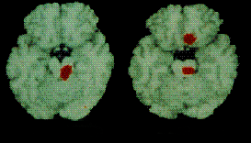
CNS Activation During Migraine
Dysfunction of brainstem pain and vascular control centers
Pain Perception*
Anterior cingulate cortex
Migraine Generator*
Raphe nuclei
Locus coeruleus
Periaqueductal gray
–16 mm
–18 mm
*Areas of red indicate cerebral blood flow increases (P<0.001).
Notes:
The development of migrainelike episodes in patients undergoing surgery to implant electrodes in the periaqueductal gray and the raphe nuclei for the treatment of chronic pain generated the hypothesis that dysfunction in the central nervous system early in a migraine attack could provoke changes in these brain stem nuclei.³ Weiller and colleagues⁴ used positron emission tomography to examine the changes in regional cerebral blood flow, an index of neuronal activity, during spontaneous migraine attacks. The left panel in the above slide is a positron emission tomography scan from an individual during a migraine attack treated acutely with sumatriptan. The scan depicts neuronal activity in a section through the brain stem. The authors of this study report that monoaminergic brain stem regions (raphe nucleus [serotonergic neurons] and locus coeruleus [noradrenergic neurons]) and periaqueductal gray are selectively activated during a migraine attack. When this patient used subcutaneous sumatriptan to acutely relieve his headache pain, the brain stem centers continued to appear active on follow-up positron emission tomography scans. By contrast, the anterior cingulate cortex (right panel), a region thought to be involved in processing affective components of pain, was also activated during spontaneous migraine attacks, and this activation was reduced concomitant with headache pain relief after administration of sumatriptan. Taken together, these observations suggest that the raphe nucleus, the locus coeruleus, and the periaqueductal gray are regions that may be involved in the generation of headache pain and associated symptoms during a migraine attack.⁴

Slide 16
Migraine Diagnosis
Migraine is under-diagnosed
  94% of patients presenting to a PCP with recurrent headache met IHS criteria for migraine or probable migraine
  Nearly 90% of “sinus headache” patients met IHS criteria for migraine or probable migraine
  Nearly 90% of “tension/stress” headache patients met IHS criteria for migraine or probable migraine
“Migraine: Diagnosis and assessment of disability”
Lipton, R . Reviews in Contemporary Pharmacotherapy, 11(2), 63-73.

Slide 17
Migraine Without Aura IHS Diagnostic Criteria
At least five attacks fulfilling the following criteria:
  Headache lasts 4 to 72 hours (untreated or unsuccessfully treated)
  Headache has at least 2 of the following characteristics:
    Unilateral location
    Pulsating quality
    Moderate or severe intensity (inhibits or prohibits daily activities)
    Aggravation by walking stairs or similar routine physical activity
  During headache at least 1 of the following occurs:
    Nausea and/or vomiting (“a sick headache”)
    Photophobia and phonophobia

Slide 18
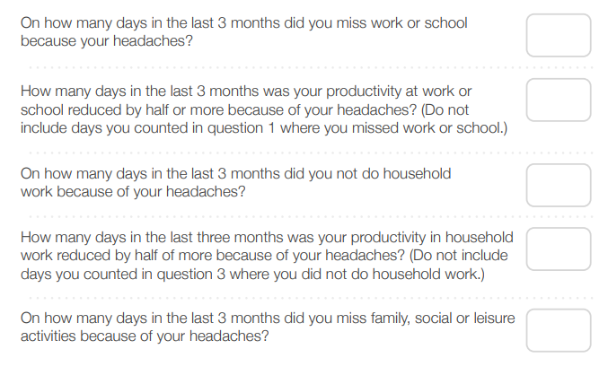
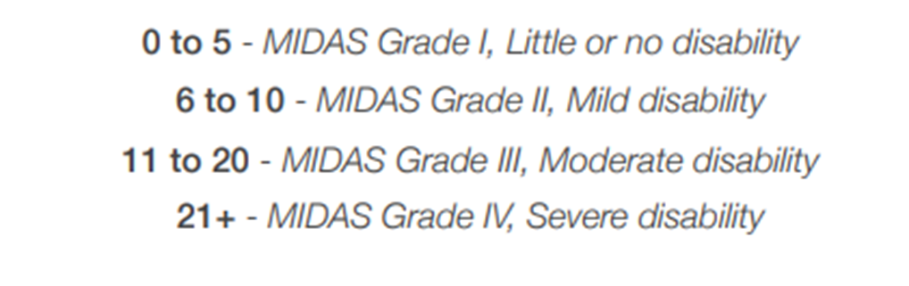
How severe is the Migraine: MIDAS
(MIgraine Disability ASsessment)
https://www.mdcalc.com/calc/10521/migraine-disability-assessment-midas

Slide 19
Migraine: Common Abortive Treatments
Aspirin/Acetaminophen/Caffeine combinations (e.g. Exedrin products)
NSAIDS
  Naproxen half-life may be best since migraines may last many hours
  In-office IM Toradol injection (if available)
Retreating to a dark, quiet room

Slide 20
Migraine: Less common Abortive Treatments
Anti-emetics/Anti-histamines/Phenothiazines/GI pro-kinetics
  IV works best, but we don’t have access to that
  Metaclopromide (Reglan)
  Prochlorperazine (Compazine)
  Ondansetron (Zofran)
Opioids
Butalbital combinations:
  Barbiturate, 35 hour halflife, big cause of MOH, risk of dependence and Acetaminophen toxicity.
    Butalbital/APAP/Caffeine: 50/325/40mg (Fioricet)
    Butalbital/ASA/Caffeine: 50/325/40mg (Fiorinal)
    Caffeine free: Acetaminophen/Butalbital: 300-650/25-50mg (Phrenilin is off the market)

Slide 21
Triptans: the first designer drugs for migraine
Introduced to US (as Imitrex injection) in 1993, 5HT1b & 5HT1d agonists
  Now they are cheap and generic
Avoid MOH (limit to 3 headaches per week or 10 headaches per month)
Better effect if taken with NSAID
Contraindications: Uncontrolled HTN, ischemic stroke/heart dz, Prinzmetal’s angina
    As CV risks rise, relative contraindications become more alarming.
    Due to vasoconstrictive properties
Ignore the dire warnings of Serotonin Syndrome
    http://www.americanheadachesociety.org/assets/1/7/AHS_Shapiro.pdf
Choice of triptan: https://www.uptodate.com/contents/acute-treatment-of-migraine-in-adults?search=triptan%20failure&sectionRank=1&usage_type=default&anchor=H6&source=machineLearning&selectedTitle=1%7E150&display_rank=1#H6

Slide 22

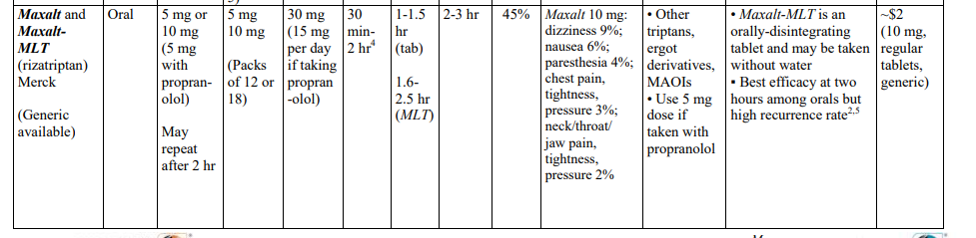
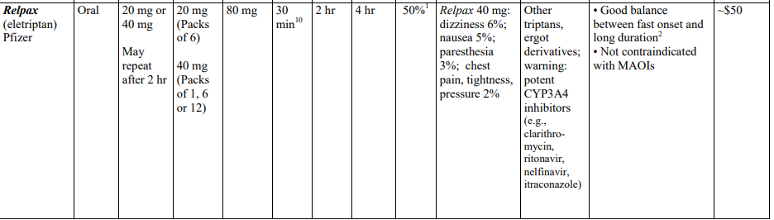
My favorite triptan choices

Slide 23
Challenge the case of “triptan failure”
It is possible to get zero response to triptans the first couple of times
They are the #1 choice, so encourage your patients
  Be mindful they may be pushing for opioids or have unrealistic expectations
Retry the Triptan at max dose for at least one more migraine
Encourage them to take it earlier in the migraine
Try a different triptan
I like to also give Naproxen and Metaclopramide to synergize the triptan
Try a subQ triptan
      Tepper, “Lack of Response to One Triptan Does Not Preclude Response to Another”, Journal Watch. 2006;5(6) https://www.medscape.com/viewarticle/540976
      Sacco et.al. European Headache Federation (EHF) consensus on the definition of effective treatment of a migraine attack and of triptan failure. The Journal of Headache and Pain 133(2022) https://thejournalofheadacheandpain.biomedcentral.com/articles/10.1186/s10194-022-01502-z

Slide 24
The latest-greatest designer agents
Gepants: CGRP antagonists
(Calcitonin gene-related peptide)
Ubrogepant (Ubrelvy) oral tablet
Rimegepant (Nurtec) ODT
Zavegapant nasal (Zavzpret)
Indicated when triptans and ditans are not effective or are contraindicated
Efficacy may be less than triptans
  e.g. Ubrogepant 21% pain free at 2hrs vs 11.8% w/ placebo
      Reference: UpToDate
$$$$$$$$

Slide 25
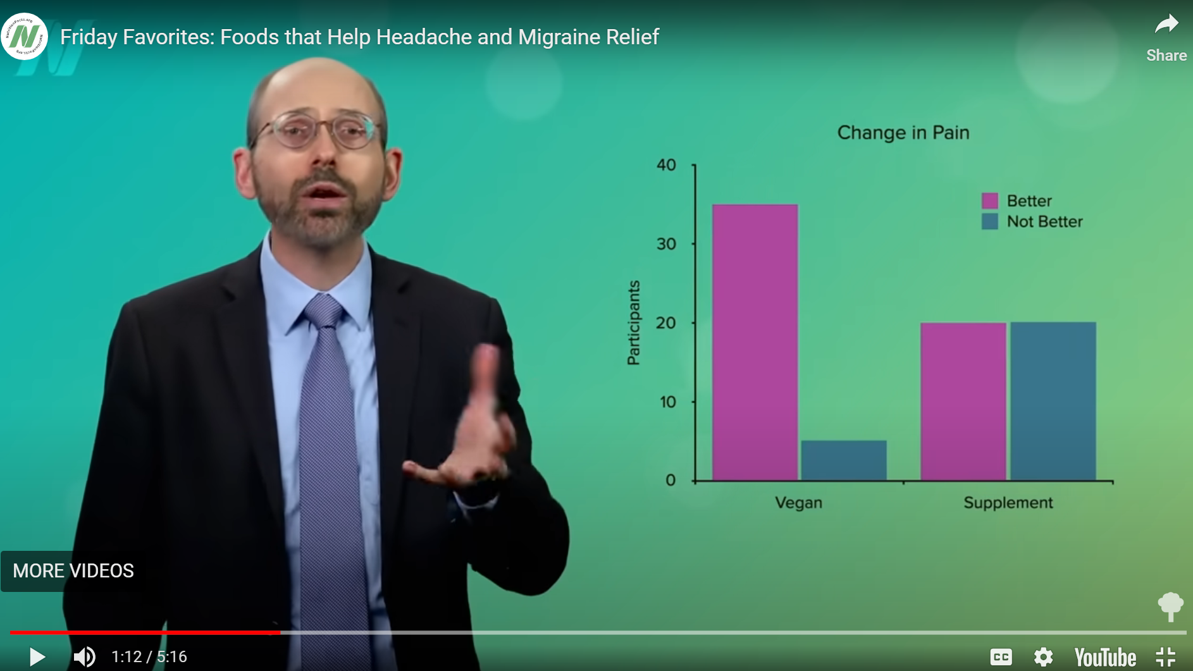
But what does Dr. Greger Say?
“Cut the cola”
Ginger 1/8-1/4 tspn as good as Sumatriptan
Dietary magnesium>supplement
Vegan and low saturated fat
    https://nutritionfacts.org/video/friday-favorites-foods-that-help-headache-and-migraine-relief/
    https://nutritionfacts.org/video/flashback-friday-ginger-for-migraines/

Slide 26
Consider Migraine Prevention/stabilization/maintenance/prophylaxis
Significantly interferes with patient’s daily routine despite acute treatment
Frequency attacks >2/week with risk of acute medication overuse
  Or less frequent but profoundly distressing/disruptive
Contraindication to, failure, adverse events, or acute medication overuse
Patient preference
We can’t cover everything today:
    https://www.uptodate.com/contents/search?search=migraine%20prophylaxis&sp=0&searchType=PLAIN_TEXT&source=USER_INPUT&searchControl=TOP_PULLDOWN&autoComplete=true

Slide 27
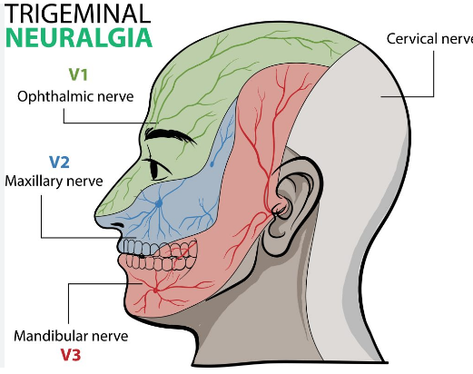
Trigeminal Neuralgia
What/Where?: Paroxysms of severe, sudden unilateral pain in trigeminal pattern
Who?: Female>Male, more common as people age, 4-13/100,000 people
When?
  Paroxysms may be 0-50 times/day
  Triggered by light touch, chewing, talking, brushing teeth, cold air, smile/grimace
  Often with continuous pain between attacks

Slide 28
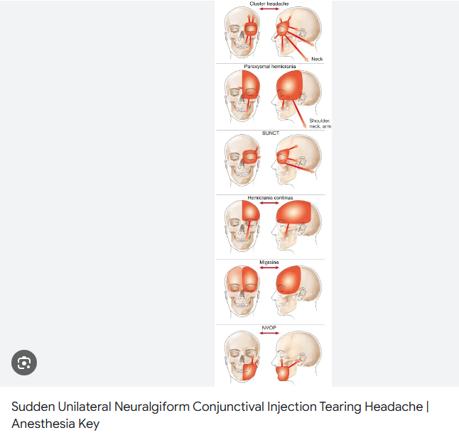
Trigeminal Autonomic Cephalalgias (TACs)
Cluster Headache
Paroxysmal Hemicrania
Short-lasting Unilateral Neuralgiform Headache Attacks with Conjunctival Injection and Tearing (SUNCT)
Short-lasting Unilateral Neuralgiform Headache Attacks with Cranial Autonomic Symptoms (SUNA)
Hemicrania Continua

Slide 29
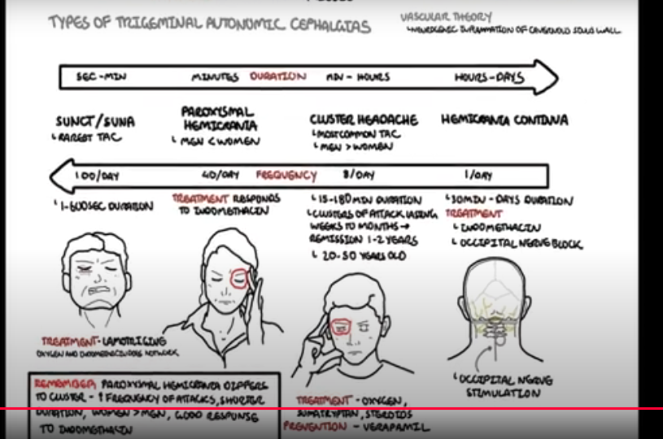
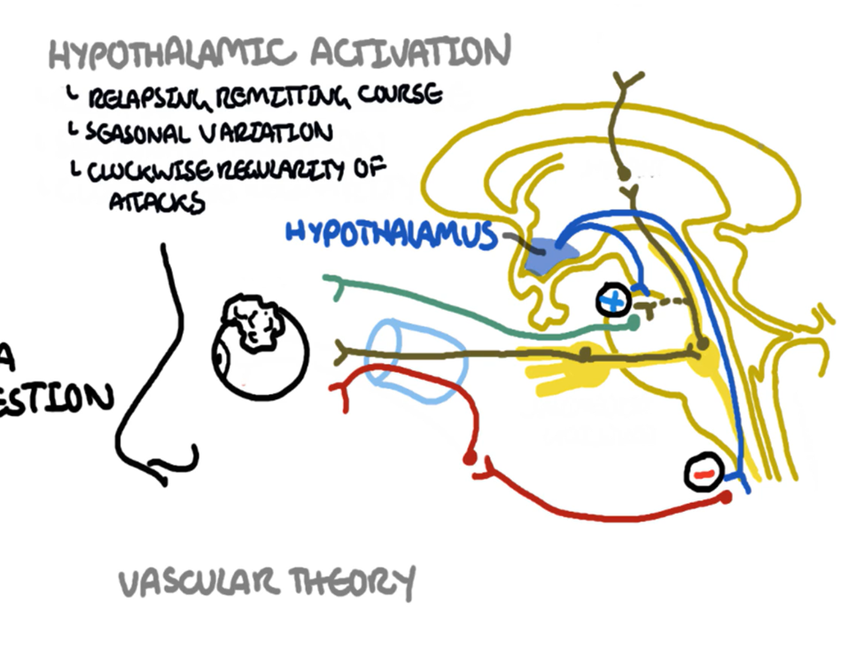
This guy knows it way better than I do
https://www.youtube.com/watch?v=hUy4sPAotmQ
It’s 9 minutes. If you ever get a case that fits, watch this video before deciding on which is most likely

Slide 30
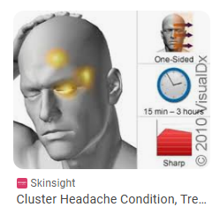
Cluster headache
When?:
  1-2 cluster periods per year, each lasting 2 weeks-3 months
  Often during sleep and early AM
  Quick onset, peaking in 10-15 min
  Duration 5 minutes to 3 hours
  Frequency: 1-8 times daily with circadian regularity ½ the time
Who?: Male>Female, Age 20-50, approx. 1/500
What?: Excruciating, stabbing
  Often assoc. w/ ipsilateral cranial autonomic features
    lacrimation/eyelid edema/ptosis/perspiration/nasal stuffiness/conjunctival injection/flushing
Where?: Unilateral eye/temporal region, sometimes lower

Slide 31
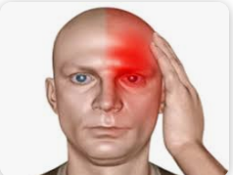
Paroxysmal Hemicrania
When?: Abrupt onset/offset.
  Usually 13-17 minute duration (range: 10 seconds to 4 hrs),
  Ave. 6 times daily (range 2-40)
What?: Excruciating, sharp, throbbing, boring, burning
  With ipsilateral cranial autonomic features
Where?: Unilateral
Who?: Rare, mean age 27 yrs

Slide 32
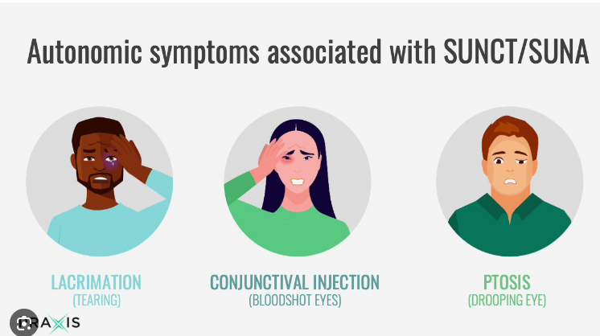
SUNCT & SUNA
What?: Sudden, severe, stabs of pain with ipsilateral ophthalmic features
When?: Duration 1 second to 10 minutes, single stab, repetitive stabs, “saw-tooth” attacks, or plateau type attacks. Sometimes pain is present in between episodes. May be triggered (similar to TGN)
Where?: Unilateral, Trigeminal, usually V1 (Ophthalmic) or V2 (Maxillary)
Who?: 30-60 years old (range 5-88), Female>Male (but more men that TGN), Rare.

Slide 33
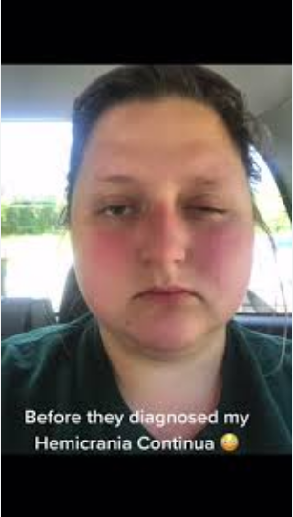
Hemicrania Continua
When?: Continuous pain at baseline with exacerbations
Where?: Unilateral
What?: Often with cranial autonomic symptoms, a sense of restlessness/agitation during exacerbations
Who?: Uncommon, up to 2% of pts in headache/Neuro clinic, Common onset at age 30-70, but all ages possible, Female>Male

Slide 34
Break the case with Indomethacin!
We aren’t going to review treatment of less common headache syndromes
  But you really should know about Indomethacin
Exquisite sensitivity to Indomethacin defines a few headaches and can bring patients back quickly from a chronic state.
  So unique that this can be helpful with diagnosis
  Hemicrania Continua
  Paroxysmal Hemicrania
  Primary Stabbing Headache
  Primary Cough Headache
  Exertional Headache

Slide 35
Indomethacin details
“It is proposed that indomethacin is more effective than other NSAIDs, probably due to the highest central nervous system penetration, central serotonergic effects, and inhibition of nitrous oxide-dependent vasodilation.”
    Prakash S, Adroja B. “Hemicrania Continua.” Ann Indian Acad Neurol. 2018 Apr;21(Suppl 1):S23-S30. [PMC free article] [PubMed]
    Summ O, Andreou AP, Akerman S, Goadsby PJ. “A potential nitrergic mechanism of action for indomethacin, but not of other COX inhibitors: relevance to indomethacin-sensitive headaches.” J Headache Pain. 2010 Dec;11(6):477-83. [PMC free article] [PubMed]
Most will have great relief within 24 hrs of low dose (25mg TID)
If necessary, titrate up every couple of days to max of 100mg TID
Harder on the UGI tract than most other NSAIDS

Slide 36
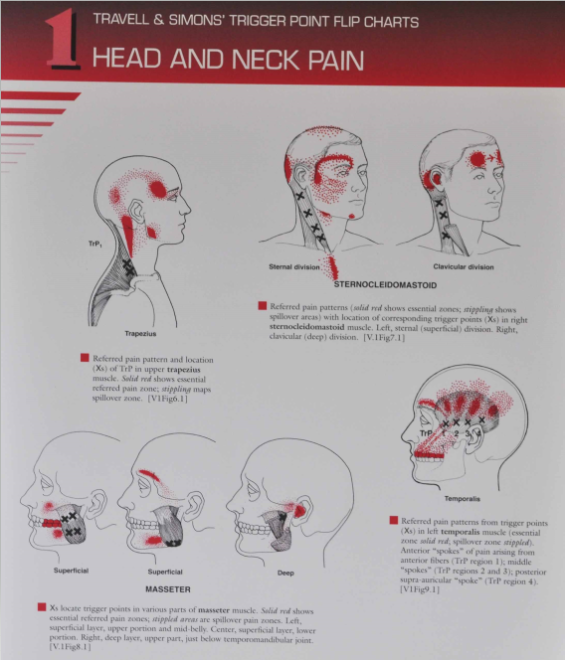
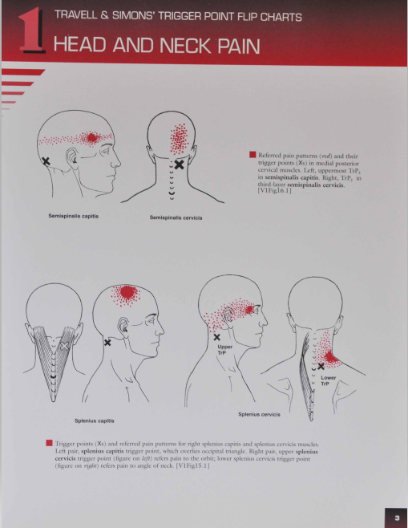
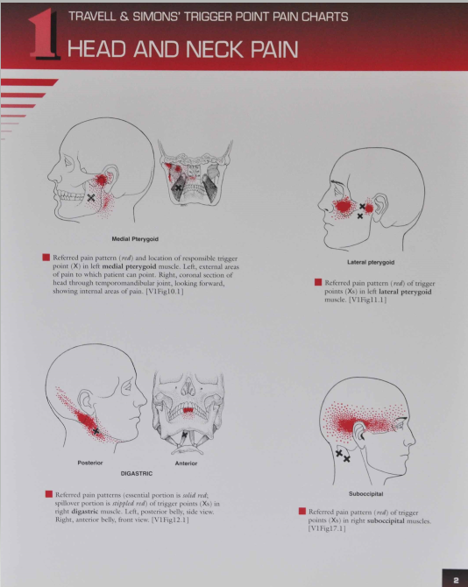

Slide 37
  Medication-Overuse Headache (MOH)
  Previously used terms: rebound headache, drug-induced headache, medication-misuse headache
Common cause of headaches ≥15 days/month
Headache has developed or is markedly worse with regular use of medications
Diagnosis important: patients often do not respond to preventive Rx until the overused medication is withdrawn
Discontinuation of acute medication usually results in
  Withdrawal symptoms (increased headache)
  Later improvement (5-14 days)
  Topirimate 200 mg/day and maybe amitriptyline 50 mg and prednisone taper starting at 60mg/d ameliorate symptoms during withdrawal
Treatment of medication overuse headache – guideline of the EFNS headache panel Evers S. 2011 http://www.efns.org/EFNSContinuing-Medical-Education-online.301.0.html.

Slide 38


Mind-body therapy
Biofeedback
  Frequency of migraine attacks and perceived self-efficacy demonstrated the strongest improvements Pain 2007 Mar;128(1-2):111-27
Self hypnosis
Accupuncture
    Acupuncture for migraine prophylaxis Editorial Group: Cochrane Pain, Palliative and Supportive Care Group Published Online: 21 JAN 2009
    Acupuncture for Tension Headache Editorial Group: Cochrane Pain, Palliative and Supportive Care Group Published Online: 21 JAN 2009
Treat your body right for the best outcome
  Good nutrition/hydration, stable sleep pattern, exercise, stress management
Fancy stuff:

Slide 39
