Slide 1
Steps for Successful Survey Sample
Distribute survey to student’s academic email within one week of the student’s last day of their placement
  CC Program Coordinator or Field Instructor on communication as well
Follow up on any pending off-boarding items (equipment, preceptor evaluations, etc.)
Ensure no double barreled questions for surveys
1
Notes:
Victoria

Slide 2
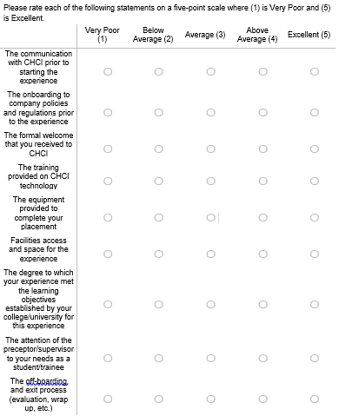
Notes:
Victoria

Slide 3
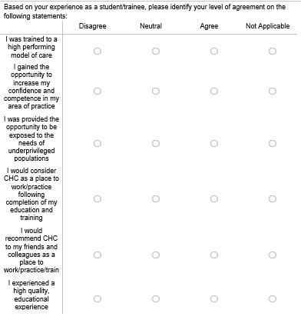
Notes:
Victoria

Slide 4
Notes:
Victoria

