Slide 1
Sustaining the Coaching Model
Making Your Team Work:
1
Notes:
Deb

Slide 2

CHCI Quality Improvement
How QI works at CHC
Performance Improvement Committee
Teams and Coaching
2
Notes:
Deb
How CHCI QI processes work

Slide 3
We use Clinical Microsystems approach to QI:
Data-driven, team-based, systems oriented
Begins with assessment of current practice, not PDSA cycles
Provides a data-based systematic approach to changing practice—the improvement ramp
Improvement ramp provides a shared mental model of improvement for the team
Uses many of the same tools as Lean/Six Sigma
Utilizes coaches to guide frontline teams through the improvement process
3
Notes:
Deb

Slide 4
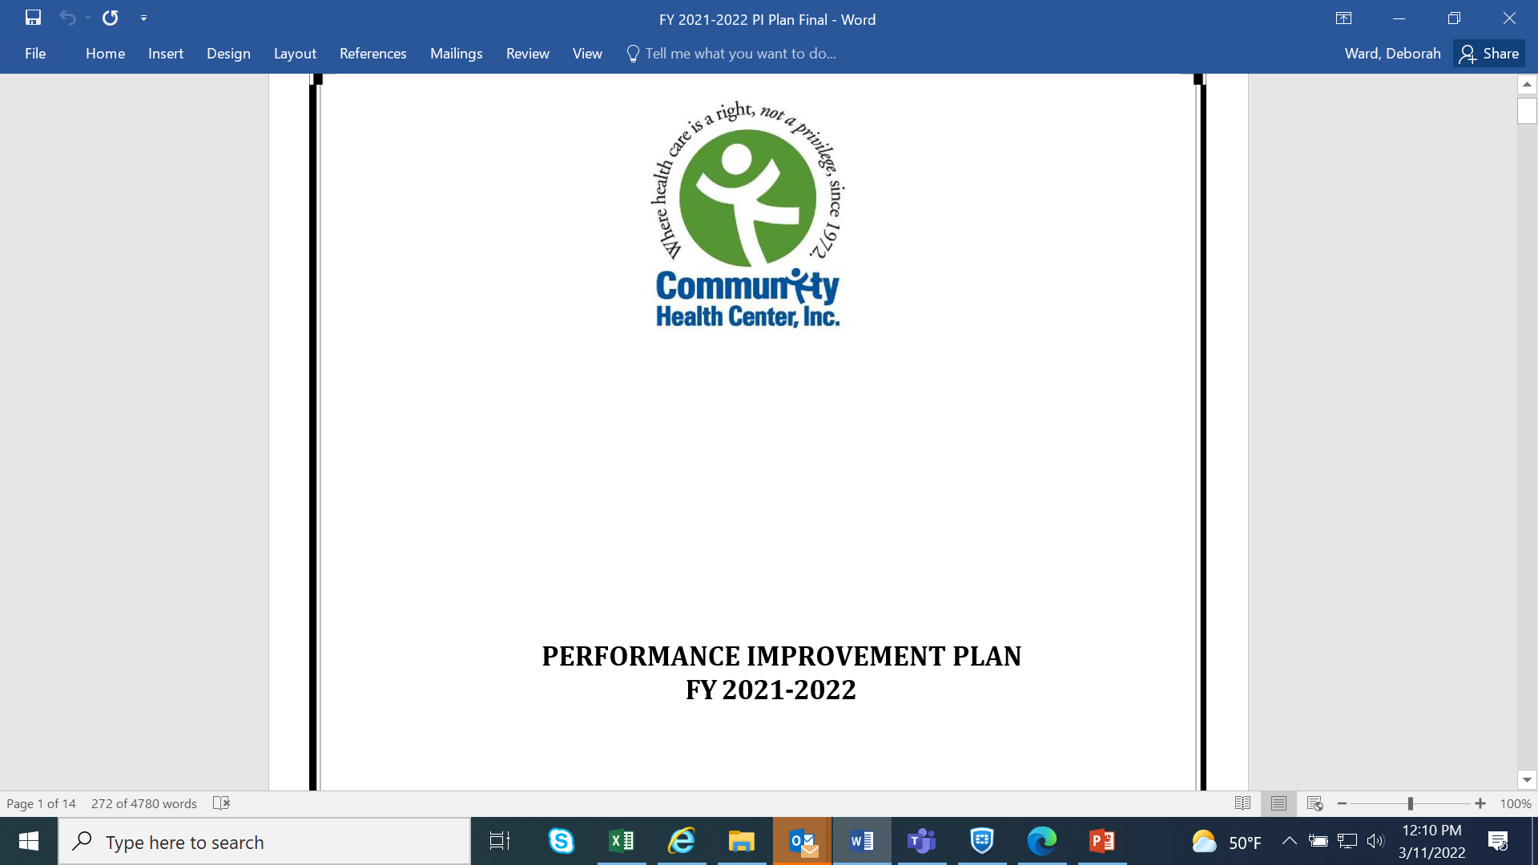
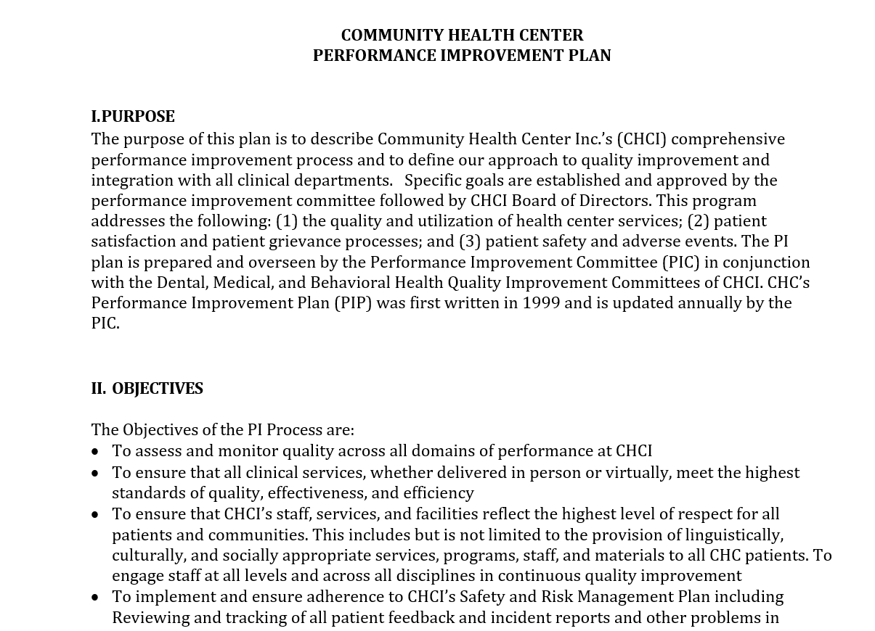
CHC’s Performance Improvement Structure
4
Notes:
Deb
Talk about meetings, attendance, standard report outs,

Slide 5
Performance Improvement Goals
Category | Goal topic | Specific Goal | Source | 2020 Rate | Current rate (11/21) | Current Goal | Recommended Goal
Chronic disease care | Diabetes control | Increase the number of patients with an A1c (HbA1c) less than 9.0 percent | UDS | 57.97% | 65.39% | 70% | 70%
 | A1C testing | Reduce the number of patients with diabetes who have not had an A1c completed in the last 12 mo. | CHC | 22.00% | 13.54% | 5% | 5%
 | HTN control | Increase the number of patients with hypertension whose BP is controlled (less than 140/90) | UDS | 46.82% | 51.47% | 70% | 60%
 | BP documentation | Reduce the number of patients with hypertension who have NOT had a BP documented in the last 12 months | CHC | 26.30% | 17.00% |  | 10%
 | Home BP cuff use | Increase the number of patients with HTN who have a home BP cuff | CHC | 0.7% (last 12 mo) |  | 11% | New goal: input from Team
Category
Goal topic
Define Specific goal
Source
2020 Rate
Current rate
Current Goal (2021)
Recommended Goal
Chronic Disease
Screening
Behavioral Health
Preventative Care
Population Health
Dental
Medical and Dental
Prenatal
5
Notes:
Deb, equity within POP health, 2020 rate to recommended goal, leave theaders

Slide 6
Next Steps
Existing Teams:
Is the team on track to achieve goal(s) for the year?
Any modifications needed?
New Teams:
What type of team (micro/meso)?
Team composition?
Coach?
Process in Place:
Is the existing process sufficient and likely to achieve the goal(s)?
Any modification(s) needed for the process?
Catchball back to a Microsystem for testing/refinement needed?
6
Notes:
Deb

Slide 7
Goals categorized into three main groups:
New Teams
Existing Teams
Existing Process
How we use it.
7
Notes:
Deb

Slide 8
New Teams
Discussion at PI/Steering Committee meeting
Change idea solution storming
Is it a micro/meso system?
Does this need a coach?
Where to test?
8
Notes:
Deb

Slide 9
Coach Training within Health Centers
Identification of the new coach
Communication with leaders
Commitment from the coach in training and supervisor
Training (six to seven didactic sessions)
Mentor program
Monthly Coach meeting
Reports to Performance Improvement/Steering committee
9
Notes:
Deb (Facilitation, data, leading effective meetings, parking lot, idea tree)

Slide 10
Why CHCI uses it
Data-driven, team oriented
QI happens where the work happens
QI is done by the people who do the work
Builds on unique context of individual staff in specific clinical units in a larger organization
Elevates skill level of staff, ownership of improvement and practice, team-ness
Uses trained coaches to guide staff
Structured, systematic “mental model” for how to improve
10
Notes:
Deb (Facilitation, data, leading effective meetings, parking lot, idea tree)

Slide 11
1. TEAM AND ROLES DEFINED
Coach Assigned, Identify Core and Extended Team Members, Define Roles, Schedule Team Meetings, Communication Plan
TOOLS/SKILLS/PROCESS:
Effective Meeting Tools
Forming/Storming/Norming/
Performing
2. ASSESSMENT AND BASELINE DATA
What is our current state? Describe population of interest, Identify data sources, Drill down to specific areas of focus. Related to other projects?
TOOLS/SKILLS/PROCESS:
Tick & Tally & other data collection
Process Mapping
Role Assessment
Team Practice Assessment
3. GLOBAL AIM
What is our overall goal for advancing TBC Model? Theme, Name process, location, Start/End of Process, Benefits/Imperatives
TOOLS/SKILLS/PROCESS:
Build Consensus
Fishbone Diagram (cause & effect diagram)
4. PROBLEM STATEMENT/THEME
Problem Statement, Importance, Goals/ Objectives, Deliverables, KPIs
TOOLS/SKILLS/PROCESS:
QI Charters as agenda items
Brainstorming/ Brain writing
Multi-Voting
Impact/ Effort Grid
Fishbone Diagram
Five Whys
Process Map
Build consensus
5. SPECIFIC AIMs and MEASURES
What do we want to accomplish in days and weeks ? What will change, by how much & when , How will we know that we accomplished it?
TOOLS/SKILLS/PROCESS:
Specific Aim Tool
Build Consensus
Fishbone Diagram (cause & effect)
Tick & Tally & other data collection
8. SDSA
Standardize the test that was successful. Will it work the same in every day routine? Document.
TOOLS/SKILLS/PROCESS:
Involve all team members
Communication Plan
Playbook – Influence Spread
9. SPREAD, MEASURE & MONITOR
Implement spread strategy and track how it is working.
TOOLS/SKILLS/PROCESS:
Communication Skills
Spread Strategy
Big Picture View
Connecting the dots
QI Process
9
8
7
6
5
4
3
2
1
11
On-Going Data Collection & Review
Notes:
Deb

Slide 12
Continuous Monitoring for Success
12
Notes:
Deb

Slide 13
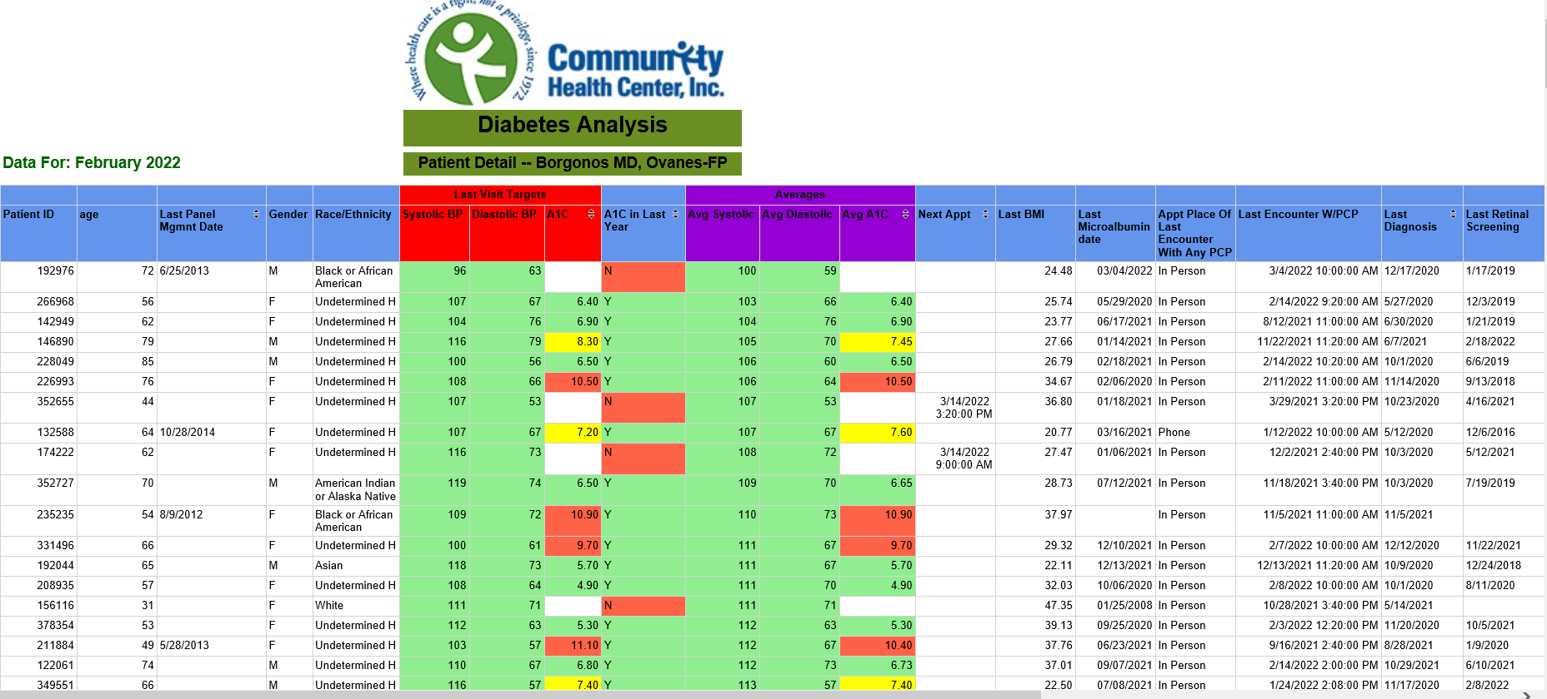
13
Notes:
Deb

Slide 14
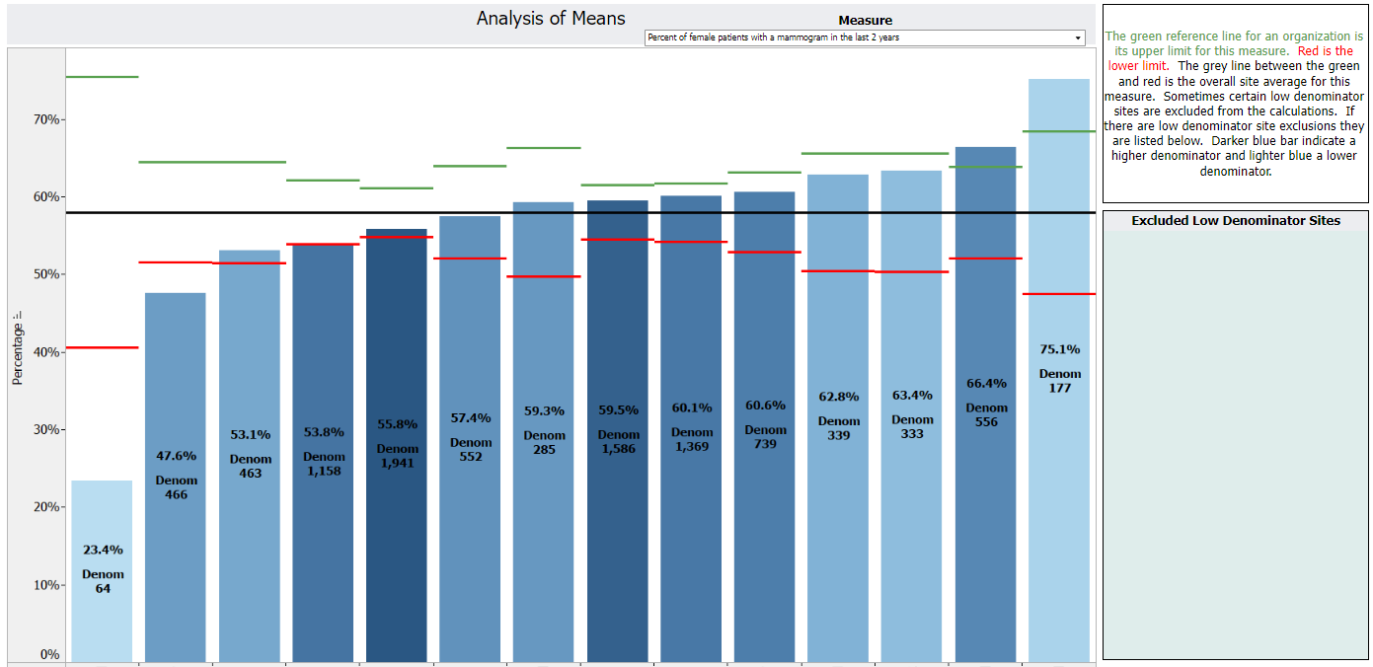
Site A
Site B
Site C
Site D
Site E
Site F
Site G
Site H
Site I
Site J
Site K
Site L
Site M
Site N
14
Notes:
Deb

Slide 15
Questions?

