Slide 1
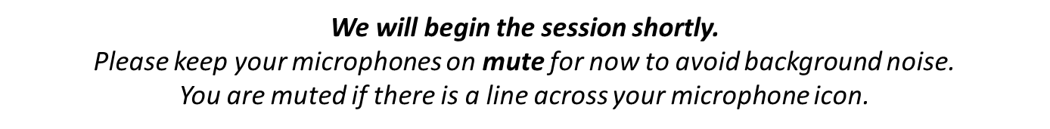

Welcome to the Early Childhood Therapeutic Partnership Learning Collaborative

Slide 2
Building Stronger Systems Together
A Learning Collaborative for Leaders
in Early Childhood Education and Pediatric Mental Health
Session 4: Impacts of a Dynamic IECMH Partnership
August 26th, 2025
Notes:
Emma - Hello and welcome everyone to our third session where we will be covering the Impacts of the model across the IECMH Partnership
Welcome, tech/log, and Emma - 5
Participant introductions - 5
SME Panel - 20
Breakout groups - 15
Come back discussion - 5
Lisa - 10
— 60 total

Slide 3



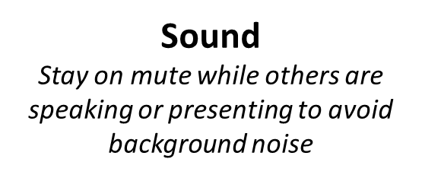
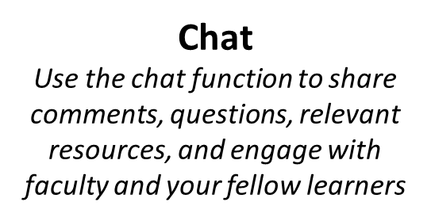
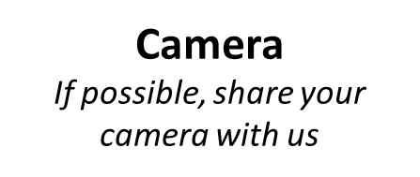
Technology: Your Zoom window
Notes:
Emma-
A few technology reminders. Please remain on mute while others are speaking or presenting to minimize background noise. Feel free to use the chat to share comments, questions, and resources, and to engage with faculty and fellow learners. Finally, if possible, we’d love for you to join us on camera to connect as a learning community.

Slide 4

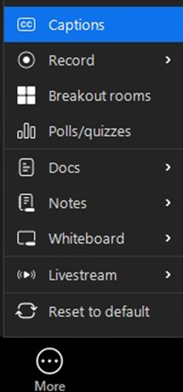
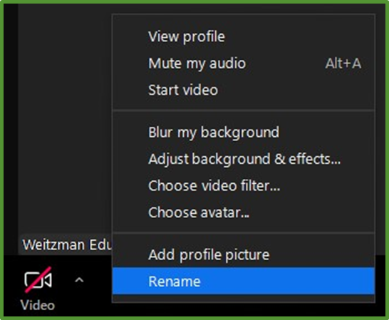
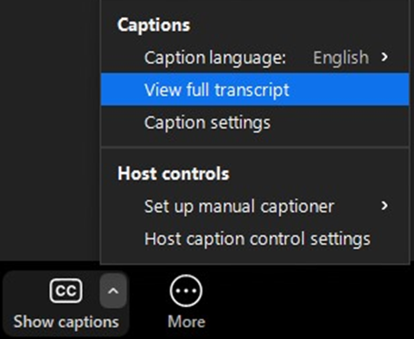


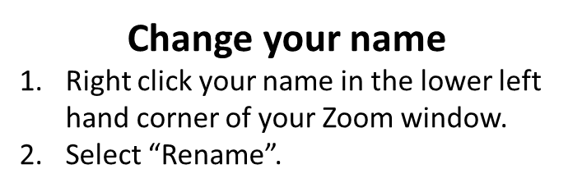
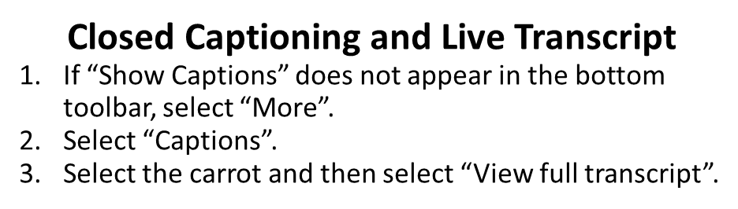
Technology: Your Zoom window, continued
Notes:
Emma-
To update your name, right-click it in the lower left of your Zoom window and select “Rename.” Please take a moment to share your full name, health center, and, if you’d like, your pronouns. Additionally, to help make our activities more accessible, closed captioning and live transcription are also available. (helpful to have this information going into breakout rooms so others know who you are and what organization you are with)

Slide 5

Continuing Education Credits
In support of improving patient care, Moses/Weitzman Health System is jointly accredited by the Accreditation Council for Continuing Medical Education (ACCME), the Accreditation Council for Pharmacy Education (ACPE), and the American Nurses Credentialing Center (ANCC), to provide continuing education for the healthcare team.
This series is intended for Early childhood education leaders, Pediatric behavioral health providers (psychologists, Master's level clinicians, and counselors), and Pediatric medical team members (MDs, DOs, NPs, PAs, RNs).
Please complete the survey and claim your post-session certificate on the WeP after today’s session.
You will be able to claim a comprehensive certificate on the WeP at the end of the series, September 23, 2025.
Notes:
Emma-
The Moses Weitzman Health System is jointly accredited to provide continuing education credits for your participation in these live learning collaborative sessions.

Slide 6
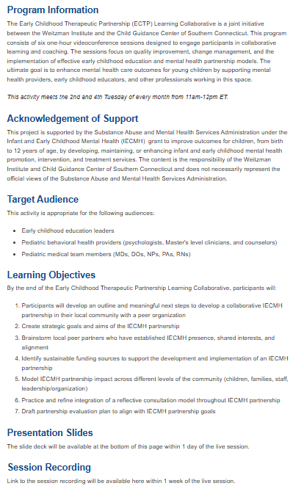

Accessing session recordings and materials
Return to the Overview tab of the live activity, Early Childhood Therapeutic Partnership Learning Collaborative (July 15, 2025)
Scroll down to the Presentation Slides and Session Recording headers
You will then be able to click on Session Recording and Presentation Slides listed below the headers to access the resources.
Notes:
Emma-
Session recordings and materials will be available on the Weitzman Education Platform. To access them, you can…
1.Return to the Overview tab of the live activity,
2.Scroll down to the Presentation Slides, and Session Recording headers
You will then be able to click on Session Recording, and Presentation Slides listed below the headers to access the resources.
Recordings will be uploaded within a week after each live session.

Slide 7
This Early Childhood Therapeutic Partnership Learning Collaborative session has been made available by:
Substance Abuse and Mental Health Services Administration under the Infant and Early Childhood Mental Health (IECMH) Grant
Notes:
Emma-
This Early Childhood Therapeutic Partnership Learning Collaborative session has been made available by the Substance Abuse and Mental Health Services Administration under the Infant and Early Childhood Mental Health (IECMH) Grant

Slide 8
Disclosures
With respect to the following presentation, there has been no relevant (direct or indirect) financial relationship between the faculty listed above or other activity planners and any ineligible company in the past 24 months which would be considered a relevant financial relationship.
The views expressed in this presentation are those of the faculty and may not reflect official policy of Moses Weitzman Health System.
We are obligated to disclose any products which are off-label, unlabeled, experimental, and/or under investigation (not FDA approved) and any limitations on the information that are presented, such as data that are preliminary or that represent ongoing research, interim analyses, and/or unsupported opinion.
Notes:
Emma-
Our faculty have no disclosures to report today

Slide 9

All Are Welcome
Notes:
Emma-
At the Weitzman Institute, we are grounded in community health, focused on improving care for underserved populations, and committed to fostering mutually respectful dialogue. We strive to create learning environments where all participants are welcome, and we promote respectful care settings where patients can be their authentic selves. If there’s anything said in today’s session that makes you feel uncomfortable or doesn’t align with these values, please let us know on our post-session evaluation.
I am now going to turn it over to our quality improvement coach lisa…

Slide 10
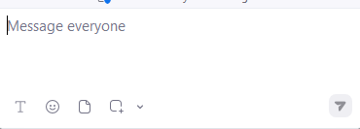
Chat Waterfall
Type your response to the question in the chat, but don’t hit send until we say so.
Question: Choose an Emoji that reflects your mood today
Notes:
Emma - Chat waterfall activity

Slide 11
Session Agenda
Session Objective: Reflection on impact of IECMH model across different levels of the partnership (children, families, staff, leaders, organization)
Subject Matter Expert Panel
Break Out Rooms
Brief Discussion
Quality Improvement Activity
Action Items
Notes:
Emma to go over agenda and then hand it over to Karen to moderate

Slide 12
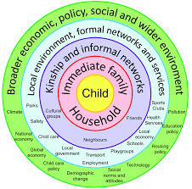
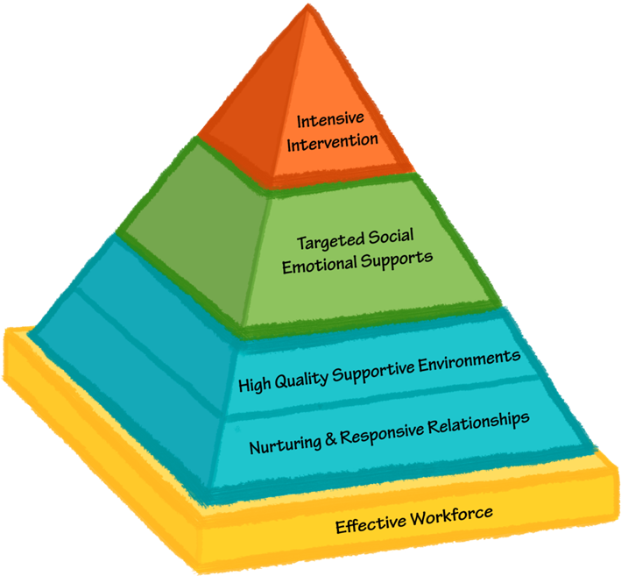
Our Model
Notes:
Kate, orient to IECMH model
Graphic,
IPP
Ecological model
Pyramid

Slide 13
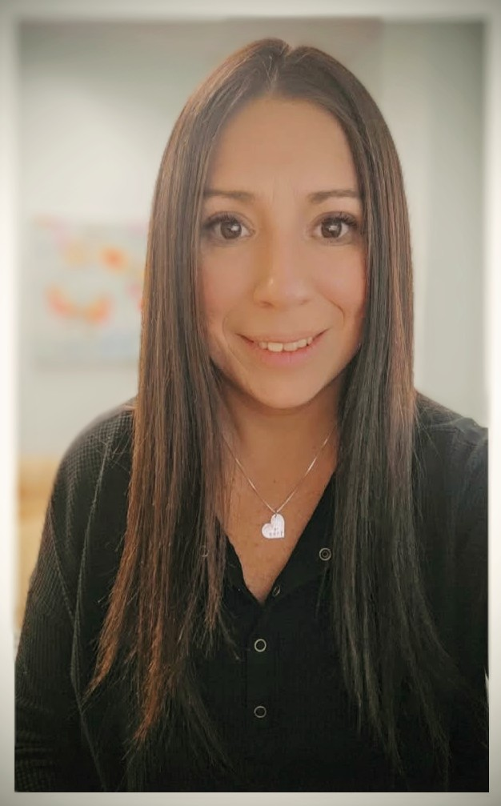
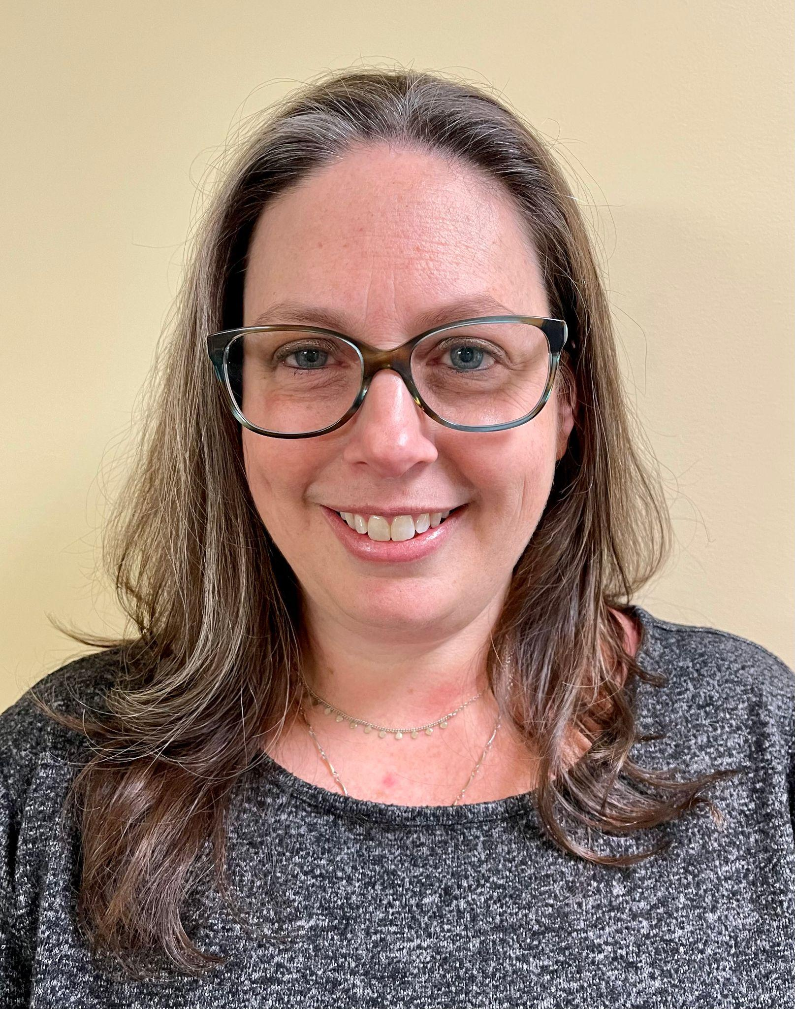
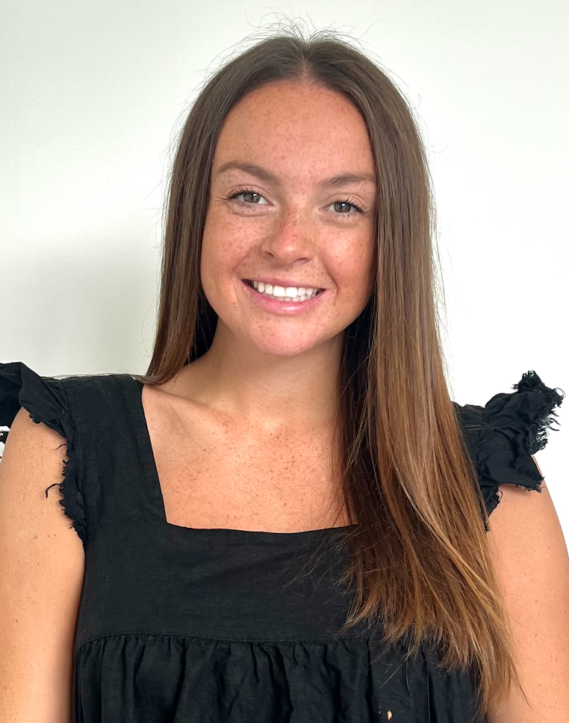
Subject Matter Expert Panel Participants
Emily Goldschmid, MSW
Children’s Learning Centers of Fairfield County (ECE)
Family Service Manager
Tina Miller, LCSW
Child Guidance Center of Southern Connecticut (MH)
Preschool-based
Early Childhood Clinician
Victoria Smith, LMSW
Child Guidance Center of Southern Connecticut (MH)
Preschool-based Early Childhood Clinician and Mental Health Consultant
Notes:
Jaime moderator, provide introductions
We are thrilled to be joined today by our panelists who provide direct support and care to the children in our early childhood community in Stamford.
Emily is the Family Service Manager at CLC and is responsible for overseeing the Family Service team who provides wrap around support to CLC children and family. Emily and her team connect children in need of developmental or behavioral support to additional services, strengthen caregivers ability to advocate for their child’s needs, and facilitate access for families to community resources including food and emergency assistance, ELL classes and other supports as needed.
Tina is a Licensed Clinical Social Worker and Preschool-based Early Childhood Clinician at CGC. She provides outpatient level care, including individual, dyadic, family, parent guidance, and groups onsite at CLC largest preschool location. Tina specializes in IECMH and is a rostered Child-Parent Psychotherapy Clinician, integrating relational, trauma informed care into her practice.
Victoria is a Licensed Masters-level Social Worker and Preschool-based Early Childhood Clinician and a Mental Health Consultant at CGC. In her blended role Victoria splits her time between providing preschool-based mental health services and all levels of Mental Health Consultation. She is in training as an Attachment, Regulation, and Competency (ARC) clinician which is a components-based trauma framework.
How our blended model has impact across levels of population and by type of intervention (prevention, promotion, intervention)

Slide 14
Before the CGC/CLC partnership expanded to include school-based clinical services and mental health consultation for all classrooms…
What needs did you see in the early childhood education setting?
Notes:
Emily

Slide 15
What core principles of early childhood mental health do you ground your practice in as a preschool-based Early Childhood Clinician?
Notes:
For Tina

Slide 16
Can you share an example of how the services within our partnership were connected to support a young child and their family?
Notes:
For Victoria

Slide 17
Describe the impact the CGC/CLC partnership expansion has had for children, families, and CLC staff over the past three years?
Notes:
Emily

Slide 18
How do you effectively work with the CGC Mental Health Consultant at the CLC preschool you support?
Notes:
IF TIME: For Tina

Slide 19
What impact has the CGC/CLC partnership had on teachers, education supervisors, and program leaders?
Notes:
For Victoria

Slide 20

Questions?
Feel free to unmute or put your questions in the chat!

Slide 21
Break Out Room
Reflection Questions
Considering the impact your program has / aspires to have on IECMH in your community, how do you / might you create opportunities to support and engage children, families, teachers, leaders, and organizations?
Notes:
Karen to paste this into the chat

Slide 22
Post-Break Out
Group Reflections
What are you taking away from the conversation that was held in your breakout group?
Notes:
Lisa

Slide 23
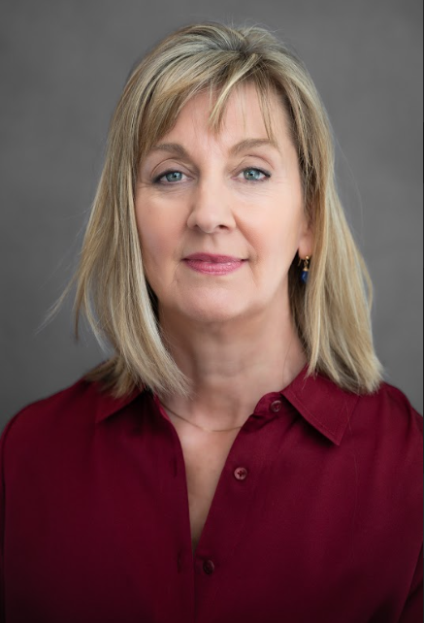
Quality Improvement Consultant
Lisa Leary, MS
Lisa Leary Consulting
Quality Improvement Advisor
Notes:
Lisa- reminder of role, debrief activity from previous LC, take aways from office hours

Slide 24
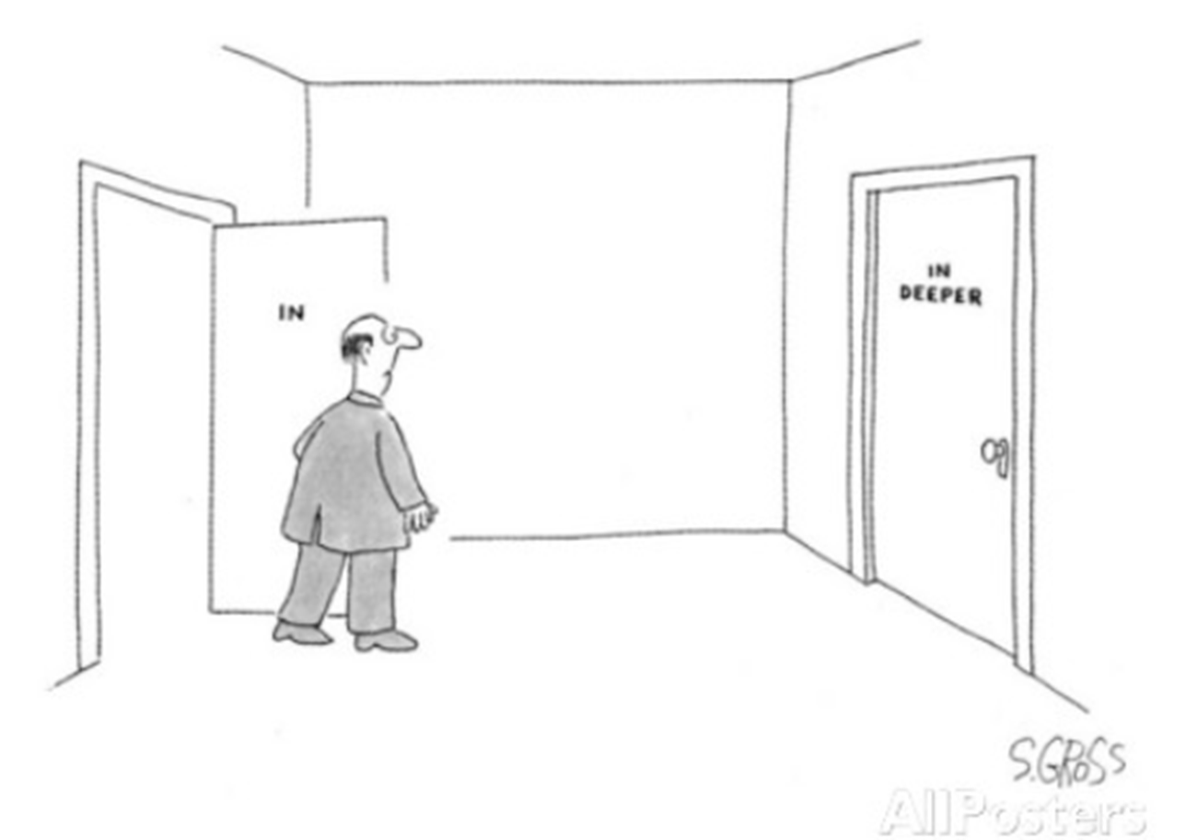

Measurement
Notes:
Some review and why we are spending three sessions on this. The tale of two partnerships in a parallel universe. One has great outcomes, but all of them are anecdotal, one has actual data. Think about funding, think about attracting new talent, think about presenting, think about sharing with staff, board members, etc.

Slide 25
Data Management
Purpose Statement: What you want to achieve
Example: Provide support for local ECE partners by providing trainings and consultation of IECMH management in the classroom.
Aim Statement: How you will achieve it (Post Session Assignment) Example: We aim to increase group training and individual consultation of ECE on IECMH & management of challenging behavior in the classroom. By doing so we expect educators to have improved knowledge of IECHM and a decrease in challenging behavior in the classroom. It’s important to do this now as unresolved mental health issues are negatively impacting early childhood education.
Notes:
What measures do you see here? Look to the aim statement. If you used the template that was provided, you should be able to identify a few. This can get you started.

Slide 26
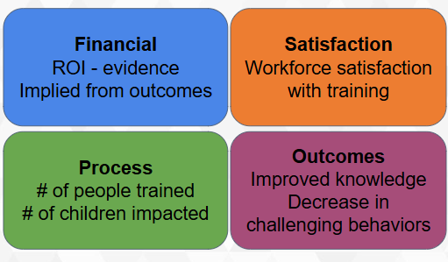
Balanced Measures
Post Session Assignment LC 3
Draft set of balanced measures based on your aim statement
Notes:
It doesn’t have to be complicated, but it does have to consider the interest of your shareholders. (heart, head, wallet) Using a balanced approach makes sure stakeholders interests are considered.

Slide 27
Defining Measures
Metrics (what): Number of people trained
Metric (working definition): Number of people who attend three consecutive training sessions
Metrics (what): Satisfaction with training
Metric (working definition): % of people trained who rate the training as “satisfied”, or “very satisfied” via post session survey link.
Notes:
Stress the importance of having a clear definition. Use example 1. Especially important with repeated measures or multiple data collectors.
Add animation to each example. Ask about process or outcomes measures? Which is desired outcome?

Slide 28
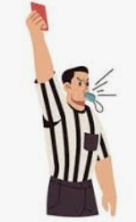
Defining Measures- Hard
Metrics (what): Challenging behavior
Metric (working definition): ?
How would you define challenging behavior to ensure reliability and consistency among the data?
Notes:
facilitated discussion. Outcome measure. Anyone want to share a metric they are considering?

Slide 29
Defining Measures- Hard
Metrics (what): Improved access to behavioral health in a primary care setting.
Metric (working definition):
Notes:
Anyone want to share a metric they are considering?

Slide 30
Post-Work
Worksheet
Select one or two measures from the previously created balanced measure set (or more if you’re ambitious)
Create a working definition for each measure
Due date: September 2nd, 2025
Notes:
Lisa to discuss postwork. Urge not to skip this step, this data tells your story, demonstrates impact and could help secure funding and additional buy-in and support.

Slide 31
Building Stronger Systems Together
Thank you for attending today!
Please complete the survey on the Weitzman Education Platform
Reminders:
Learning Collaborative #5 will be held on September 9th at 11am EDT
Optional office hours are available on September 16th at 11am EDT
Notes:
Emma to close out - Thank you all for attending. Our next learning collaborative session will be on September 9th, and an optional Quality improvement office hour will be held on September 16th! Please remember to complete your session evaluation after we finish to claim your CME and participation credit. If you have any questions between now and our next session, please feel free to reach out.
Thank you again and we will see you next time!

