Slide 1

Welcome to Alcohol Use Disorder ECHO!
We will begin the session shortly.
Please keep your microphones on mute for now to avoid background noise.
You are muted if there is a line across your microphone icon.

Slide 2
Welcome to Alcohol Use Disorder ECHO!
ECHO Session #14:
Special Populations: Adolescent AUD
September 17, 2025
Notes:
Hello and welcome to the 14th Alcohol Use Disorder ECHO. My name is Humyra and I am the Education Specialist for today’s session. Today we will be covering Special Populations: Adolescent AUD. Before we get into the presentation, I’ll be going through our regular ECHO reminders.

Slide 3


Technology: Your Zoom window
Sound
Stay on mute while others are speaking or presenting to avoid background noise
Chat
Use the chat function to share comments, questions, relevant resources, and engage with faculty and your fellow learners
Camera
If possible, share your camera with us
Notes:
A few technology reminders. Please remain on mute while others are speaking or presenting to minimize background noise. Feel free to use the chat to share comments, questions, and resources, and to engage with faculty and fellow learners. Finally, if possible, we’d love for you to join us on camera to connect as a learning community.

Slide 4
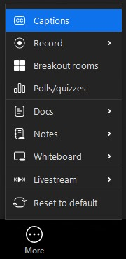
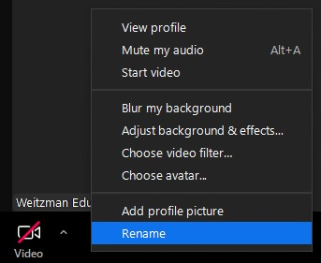
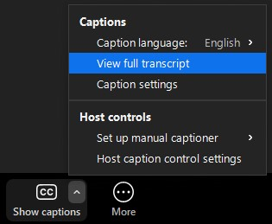
Technology: Your Zoom window, continued
2
3
1
2
1
Change your name
Right click your name in the lower left hand corner of your Zoom window.
Select “Rename”.
Closed Captioning and Live Transcript
If “Show Captions” does not appear in the bottom toolbar, select “More”.
Select “Captions”.
Select the carrot and then select “View full transcript”.
Notes:
To update your name, right-click it in the lower left of your Zoom window and select “Rename.” Please take a moment to share your full name, health center, and, if you’d like, your pronouns. Additionally, to help make our activities more accessible, closed captioning and live transcription are also available.

Slide 5
Continuing Education Credits
In support of improving patient care, Moses Weitzman Health System is jointly accredited by the Accreditation Council for Continuing Medical Education (ACCME), the Accreditation Council for Pharmacy Education (ACPE), and the American Nurses Credentialing Center (ANCC), to provide continuing education for the healthcare team.
This series is intended for primary care providers (MDs, DOs, NPs, PAs), behavioral health providers (psychiatrists, psychologists, social workers, therapists), nurses, and other members of the care team.
Please complete the survey and claim your post-session certificate on the WeP after today’s session. Please note: Pharmacists must claim credits within two weeks following today’s session or we will not be able to award ACPE credits.
You will be able to claim a comprehensive certificate on the WeP at the end of the series, October 1, 2025.
Notes:
The Moses Weitzman Health System is jointly accredited to provide continuing education credits for your participation in these live ECHO sessions.

Slide 6
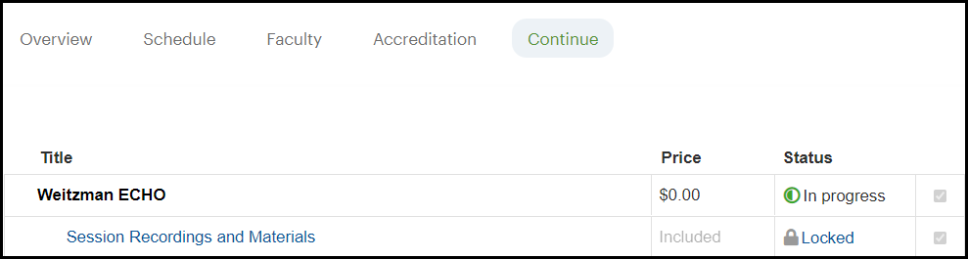
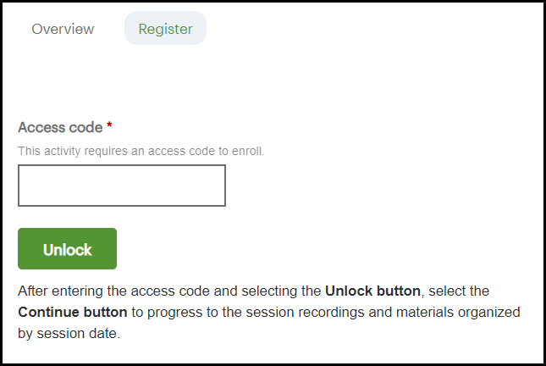
Accessing session recordings and materials
Navigate to the Continue tab of the
activity site within the Weitzman
Education Platform.
Select the Session Recordings and
Materials link. This may appear at
the bottom of the list of the
individual sessions. After reviewing the FAQ's on the Overview tab, select the Register tab.
Enter the access code: WIEd
Select the Unlock button. A Continue button will then display and you will be able to progress to the session recordings and materials organized by session date.
1
2
3
4
Notes:
Session recordings and materials will be available on the Weitzman Education Platform. To access them, go to the activity site's “Continue” tab for this ECHO, scroll down, and select “Session Recordings and Materials.” Use the access code WIEd. Recordings and materials will be uploaded within a week after each live session.

Slide 7
This Weitzman ECHO has been made available by:
NIH R25 Alcohol and Other Substance Use Research Education Programs for Health Professionals
This project is supported by the National Institute on Alcohol Abuse and Alcoholism of the National Institutes of Health under Award Number R25AA031951 to translate research into practice on preventing, screening for, and treating alcohol use disorders in primary care. The content is solely the responsibility of the Weitzman Institute and does not necessarily represent the official views of the National Institutes of Health.
Notes:
This Weitzman ECHO has been made available by the NIH R25 Alcohol and Other Substance Use Research Education Programs for Health Professionals grant.

Slide 8
Disclosures
With respect to this ECHO series, the following disclosure has been made:
Dr. Carolyn Rekerdres, faculty for this ECHO series, is an independent consultant for Johnson & Johnson
Dr. Carlos Tirado, faculty for this ECHO series, owns stock and has a grant or contract with Spark Biomedical
Speakers are obligated to disclose any products which are off-label, unlabeled, experimental, and/or under investigation (not FDA approved) and any limitations on the information presented, such as data that are preliminary or that represent ongoing research, interim analyses, and/or unsupported opinion
The views expressed in this presentation are those of the presenter and may not reflect official policy of Moses/Weitzman Health System.
All disclosures of potential relevant financial relationships have been reviewed and mitigated through Moses/Weitzman Health System’s accreditation review process.
Notes:
Two of our faculty members have disclosures to report. All disclosures of relevant financial relationships have been reviewed and mitigated.

Slide 9

All Are Welcome
Notes:
At the Weitzman Institute, we are grounded in community health, focused on improving care for underserved populations, and committed to fostering mutually respectful dialogue. We strive to create learning environments where all participants are welcome, and we promote respectful care settings where patients can be their authentic selves. If there’s anything said in today’s session that makes you feel uncomfortable or doesn’t align with these values, please let us know on our post-session evaluation.

Slide 10
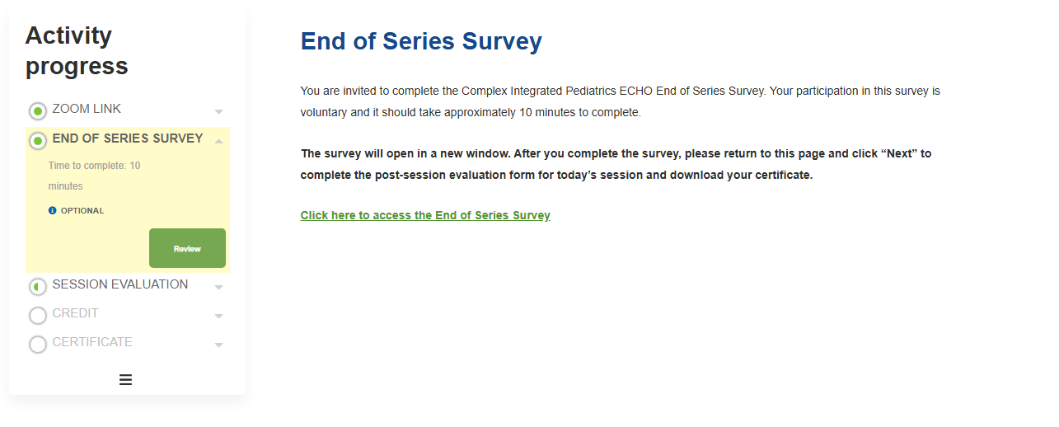
Weitzman Education Platform:
End of Series Survey
After the live session has ended, select the Next button or End of Series Survey in the left-hand navigation bar.
Complete the survey and select the Next button to complete the post session evaluation and download your certificate.
Notes:
I want to take a second to invite you all to complete the optional End of Series Survey. I’ll be dropping the link in the chat shortly, and you can also access it in today’s activity before moving on to the post-session evaluation.

Slide 11
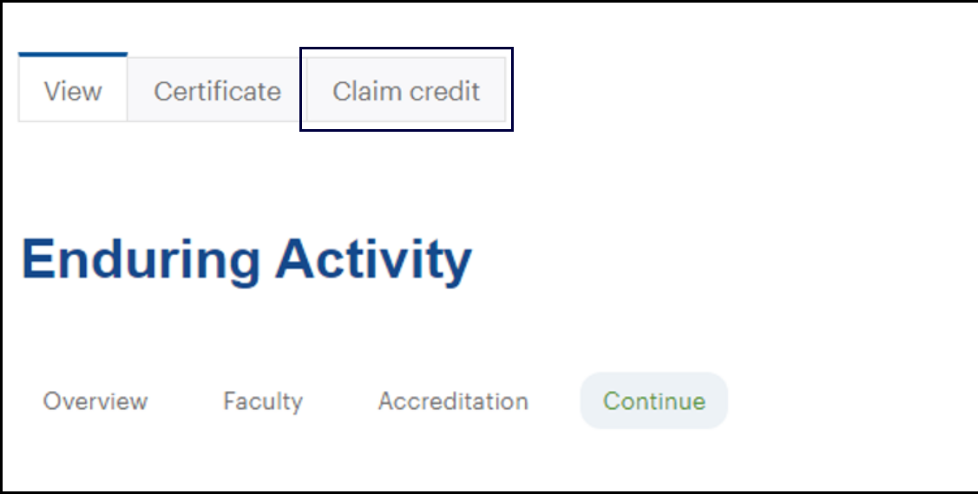
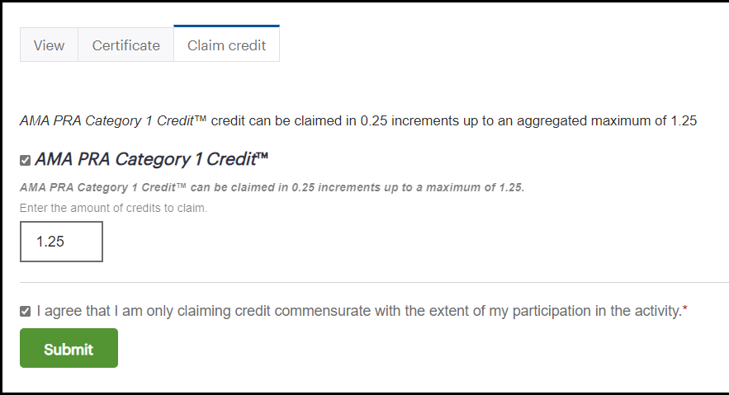
Weitzman Education Platform:
End of Series Credit Claiming
Navigate to your activity home from My Current Activities section on the homepage, or from your Transcript.
Select the Claim Credit tab that is now visible at the top of the activity page.
Enter the number of credit(s) commensurate with your attendance for the activity.
You may only claim credit(s) once, so be sure you have completed all session activities before completing this step.
Then, select Submit. You will then be able to download your certificate.
Notes:
As our series ends today make sure all participants and faculty have the resources needed to claim your continuing education credits and download your certificate before the program closes. In order to claim credit, please go to the Weitzman Education Platform and complete the steps on the slide. Please NOTE: You may only claim credit(s) once, so be sure you have completed all session activities & evaluation surveys before completing these steps.

Slide 12
Weitzman Education Platform:
End of Series Credit Claiming
You MUST claim credit for the series as a whole within 2 weeks of the last session by October 1, 2025. The online course will close after this date and you will not be able to claim and download your certificate.
For additional instructions, please read:
  How do I claim credit at the end of an activity?
  How do I view and download my certificates?
Still have questions?
  Submit a Help Desk Ticket and someone from the WeP team will respond and an assist!
Notes:
You MUST claim credit for the series as a whole within 2 weeks of the last session: October 1st. The online course will close after this date and you will not be able to claim and download your certificate.
There are additional resources listed and a help desk link for any troubleshooting issues. I will also send this information in a follow up email after today’s session.
I will now pass it over to our facilitator: Dr. Rekerdres
Insert EOS into Chat

Slide 13

Thank You!
We invite you to participate in the End of Series Survey.
Please remember to complete the post session survey to claim CE credit.
Notes:
Thank you all for your continued engagement and participation throughout this series. There’s been such a wealth of resources, insights, and personal experiences shared. We will be re-launching the series this next year, so please share with your networks. Thank you again for being part of this community and for all the important work you do!

