Slide 1

Alcohol Use in Adolescents
J. Craig Allen, MD Medical Director, Rushford Chief of Psychiatry, MidState Medical Center Vice President of Addiction Services, Behavioral Health Network

Slide 2
Learning objectives
At the end of this talk you will be able to:
Name at least 3 risk factors for risky alcohol use
Understand basic principals for screening and intervention.

Slide 3
Why This Matters in Clinical Practice
Alcohol is the most used substance among U.S. teens
Early use is associated with:
Higher risk of AUD (Alcohol Use Disorder)
Poor mental health outcomes
Injury, suicide, violence
interdisciplinary impact—primary care, medical specialty, mental health, social work, and education are all impacted and all should play a role in addressing these issues.
Notes:
Highlight interdisciplinary impact—primary care, mental health, social work, and education all play a role

Slide 4
Adolescent Substance Use:
America’s #1 Public Health Problem
A Problem of Epidemic Proportion
90%
75%
46%
Of Americans started
smoking, drinking, or
using other drugs before
age 18
Of high school
Students have
Used addictive
substances
12%
Of high school
Students
are current
users
Of high school
Students are
addicted
Why is Adolescence the Critical Period?
Brain not fully developed =
Increased chance that teens will
Take risks
Addictive substance have a
Greater negative impact on
the developing brain

Slide 5

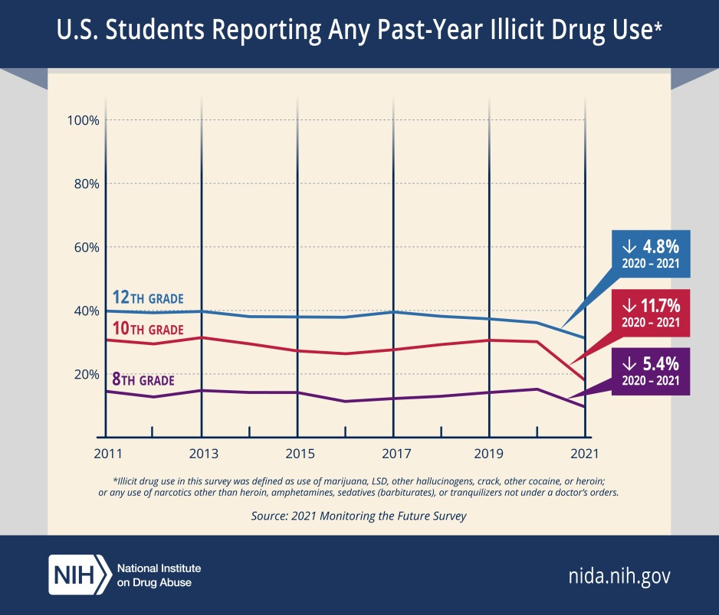
The Majority of American Teens Do Not Drink Alcohol
12th graders 2024 Lifetime 48.7% 92.6% in 1981 Last 12 months 42% 87% in 1981 Last 30 days 22% 70.7% in 1981 Binge drinking 9% 41% in 1981
Notes:
Abstaining teens
Record levels 2024 in no past 30-day use.
67% in 12th grade (53% in 2017)
80% in 10th grade (69% in 2017
90% in 8th grade (87% in 2017).
The increases in abstention from 2023 to 2024 were statistically significant in the 12th and 10th grades.
Negative Harms of Adolescent Binge Drinking
1. Acute / Immediate Risks
Accidents & Injuries: motor vehicle crashes, falls, drownings, burns.
Violence: physical fights, assaults, dating violence.
Risky sexual behavior: unprotected sex, multiple partners, increased risk of STIs and unintended pregnancy.
Alcohol poisoning: dangerously high blood alcohol levels → respiratory depression, coma, even death.
2. Neurological & Cognitive Harms
Brain development disruption: adolescence is a critical window — binge drinking impairs development of the prefrontal cortex (judgment, decision-making, impulse control).
Memory & learning deficits: hippocampal damage and reduced academic performance.
Increased vulnerability to addiction: early binge drinking increases the risk of developing an alcohol use disorder later in life.
3. Mental Health Harms
Depression & anxiety: both worsened by heavy episodic drinking.
Suicidality: AUD is the 2nd most common psychiatric diagnosis in suicide deaths; binge drinking episodes raise risk of suicidal ideation and attempts.
Disinhibition & impulsivity: amplifies self-harm and high-risk behaviors.
4. Social & Educational Harms
Poor academic outcomes: lower grades, absenteeism, higher dropout rates.
Relationship problems: conflict with peers, family, teachers.
Legal consequences: underage drinking citations, criminal charges from associated behaviors (DUI, assaults).
5. Long-Term Health Harms
Neurocognitive impairment that can persist into adulthood.
Higher lifetime risk of alcohol use disorder, nicotine/cannabis use, and polysubstance dependence.
Chronic disease risk: hypertension, liver disease, certain cancers with prolonged heavy use.

Slide 6
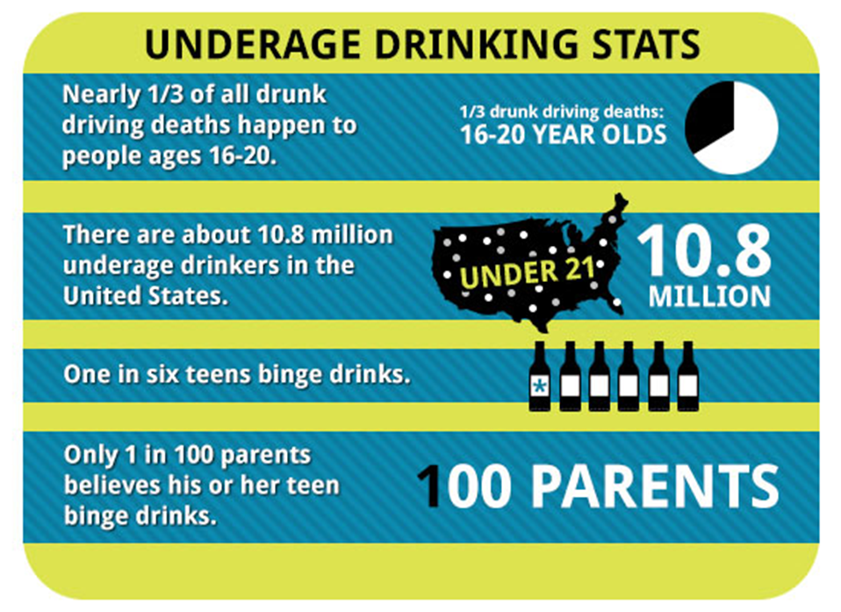
Teens /Young Adult vs Older Adults
Decreased
-sedation
Decreased
-motor impairment
Decreased
-dysphoria with hangover
Increased
-social facilitation
Increased
-memory disruption
Silveri and Spear 1998;Markwiese et al. 1998; Schuckit 1995.
College students
-1,825 die alcohol-related unintentional injuries
-696,000 assaulted by another student who has been drinking.
-97,000 alcohol-related sexual assault or date rape
Notes:
College students
-1,825 die from alcohol-related unintentional injuries, including motor-vehicle crashes.
-696,000 are assaulted by another student who has been drinking.
-97,000 report experiencing alcohol-related sexual assault or date rape

Slide 7
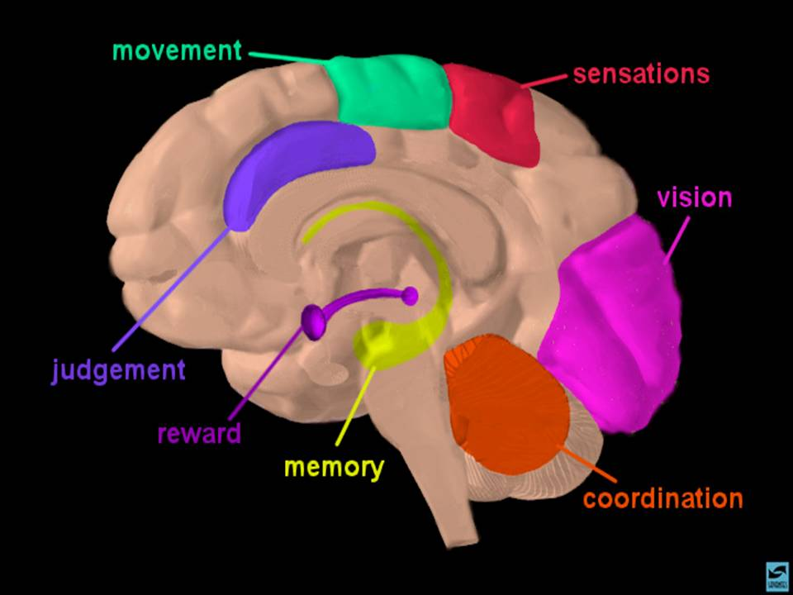

Adolescent Brain Development and Alcohol
Prefrontal Cortex (decision-making, impulse control): still developing → poor impulse control
Limbic system (emotion, reward): More developed → Pleasure, motivate behavior. Highly sensitive to rewards, novelty, risk, and peers
Cingulate Gyrus (detects errors, adjusts behavior)
Amygdala
Hippocampus.
Nucleus Accumbens (ventral striatum)
*STRONG EMOTIONS/POOR JUDGEMENT.
Notes:
Peers Being observed by or interacting with peers amplifies dopamine release → rewards feel more exciting and motivating.
Risky actions are more likely when there’s a chance of peer approval or admiration.
Peers Taking risks in social contexts may have adaptive value:
Exploration (seeking novelty, independence).
Bonding with peers (group belonging).
Reproductive fitness (status, attractiveness).
But in modern contexts, this translates into dangerous driving, substance use, unsafe sex, etc.
Cingulate gyrus
Anatomy & Connections
Part of the limbic system.
Sits just above the corpus callosum.
Connects to the prefrontal cortex, parietal cortex, amygdala, hippocampus, and thalamus.
⚙️ Functions in Adolescents
Because adolescence is a time of heightened emotionality and ongoing prefrontal development, the cingulate gyrus contributes to several processes:
Emotion regulation: Helps balance signals from the amygdala (emotional reactivity) with developing prefrontal control.
Attention & cognitive control: The anterior cingulate cortex (ACC) supports error detection, conflict monitoring, and decision-making—skills that improve during adolescence.
Reward processing: Works with dopaminergic circuits (ventral striatum, VTA) to evaluate rewards and guide motivation—critical in risk-taking and learning.
Social cognition: Involved in empathy, perspective-taking, and processing social pain (like rejection).
Nucleus Accumbens (NAc) and Ventral Striatum
The striatum is divided into dorsal and ventral regions.
Dorsal striatum = caudate nucleus + putamen.
Ventral striatum = nucleus accumbens + olfactory tubercle (and sometimes parts of the ventromedial caudate/putamen, depending on the source).
So, the nucleus accumbens is a core part of the ventral striatum, but the ventral striatum technically includes more than just the NAc.
Functional perspective
Nucleus accumbens is the best-known and most studied part of the ventral striatum.
It plays a key role in reward, motivation, and addiction — especially via dopamine input from the ventral tegmental area (VTA).
The ventral striatum as a whole contributes to goal-directed behavior and reinforcement learning.
1-Between the ages of 15 to 25, the brain under goes its third major growth spurt – developing from the inside out and from the back over the top to the front.
Thus the first thing that adolescents experience is a heightened sense of pleasure and pain – two of the main reasons people become addicted.
This followed by increase sensitivity to visual stimuli, sensation seeking and greater movement.
It should come as no surprise to those of you who have survived teenagers, the last thing to develop is “JUDGEMENT”
Nature made the brains of children and adolescents excitable. Their brain chemistry is tuned to be responsive to everything in their environment. After all, that's what makes kids learn so easily. Addiction has been shown to be essentially a form of 'learning,' " Jensen says. After all, if the brain is wired to form new connections in response to the environment, and potent psychoactive drugs suddenly enter that environment, those substances are "tapping into a much more robust habit-forming ability that adolescents have, compared to adults. http://www.npr.org/templates/story/story.php?storyId=124119468
Cingulate gyrus The cingulate gyrus is functionally a bridge between limbic and cortical systems
Anatomy & Connections
Part of the limbic system.
Sits just above the corpus callosum.
Connects to the prefrontal cortex, parietal cortex, amygdala, hippocampus, and thalamus.
⚙️ Functions in Adolescents
Because adolescence is a time of heightened emotionality and ongoing prefrontal development, the cingulate gyrus contributes to several processes:
Emotion regulation: Helps balance signals from the amygdala (emotional reactivity) with developing prefrontal control.
Attention & cognitive control: The anterior cingulate cortex (ACC) supports error detection, conflict monitoring, and decision-making—skills that improve during adolescence.
Reward processing: Works with dopaminergic circuits (ventral striatum, VTA) to evaluate rewards and guide motivation—critical in risk-taking and learning.
Social cognition: Involved in empathy, perspective-taking, and processing social pain (like rejection).
Nucleus Accumbens (NAc) and Ventral Striatum
The striatum is divided into dorsal and ventral regions.
Dorsal striatum = caudate nucleus + putamen.
Ventral striatum = nucleus accumbens + olfactory tubercle (and sometimes parts of the ventromedial caudate/putamen, depending on the source).
So, the nucleus accumbens is a core part of the ventral striatum, but the ventral striatum technically includes more than just the NAc.
Functional perspective
Nucleus accumbens is the best-known and most studied part of the ventral striatum.
It plays a key role in reward, motivation, and addiction — especially via dopamine input from the ventral tegmental area (VTA).
The ventral striatum as a whole contributes to goal-directed behavior and reinforcement learning.
1-Between the ages of 15 to 25, the brain under goes its third major growth spurt – developing from the inside out and from the back over the top to the front.
Thus the first thing that adolescents experience is a heightened sense of pleasure and pain – two of the main reasons people become addicted.
This followed by increase sensitivity to visual stimuli, sensation seeking and greater movement.
It should come as no surprise to those of you who have survived teenagers, the last thing to develop is “JUDGEMENT”
Nature made the brains of children and adolescents excitable. Their brain chemistry is tuned to be responsive to everything in their environment. After all, that's what makes kids learn so easily. Addiction has been shown to be essentially a form of 'learning,' " Jensen says. After all, if the brain is wired to form new connections in response to the environment, and potent psychoactive drugs suddenly enter that environment, those substances are "tapping into a much more robust habit-forming ability that adolescents have, compared to adults. http://www.npr.org/templates/story/story.php?storyId=124119468

Slide 8
Adolescent Brain Development and Alcohol
Key areas impacted:
Prefrontal cortex → delaying development: decision-making, impulse control
Hippocampus → Memory & learning deficits
Cingulate Gyrus → Impaired error monitoring & decision-making→ riskier choices, poor impulse control. Reduced emotional regulation → greater anxiety, depression, and aggression.
Nucleus Accumbens → decreased dopamine sensitivity for natural rewards
Alcohol disrupts development → greater long-term harm than in adults
Notes:
impairs development of the prefrontal cortex (judgment, decision-making, impulse control).
Memory & learning deficits: hippocampal damage and reduced academic performance.
Increased vulnerability to addiction: early binge drinking increases the risk of developing an alcohol use disorder later in life.
Functional Effects
Impaired error monitoring & decision-making: The ACC is central to detecting mistakes and adjusting behavior. Alcohol-related dysfunction → riskier choices, poor impulse control.
Reduced emotional regulation: The cingulate helps regulate emotional responses; disruption is linked to greater anxiety, depression, and aggression in teens who binge drink.
Reward and craving processing: The ACC interacts with the ventral striatum (including the nucleus accumbens). Alcohol exposure strengthens maladaptive reward pathways, increasing the likelihood of future substance use.
3. Neurodevelopmental Timing
Adolescence is a period of synaptic pruning and myelination in the cingulate cortex.
Alcohol use during this window can interrupt maturation, leaving long-term deficits in attention, cognitive flexibility, and emotional resilience.
Early-onset heavy drinking has been linked to persistent structural differences in the ACC into adulthood.
4. Clinical Implications
Teens with heavy alcohol use often show:
More difficulty in sustained attention tasks.
Poorer academic performance tied to ACC dysfunction.
Greater vulnerability to mood disorders and substance use disorders later in life.
3. Mental Health Harms
Depression & anxiety: both worsened by heavy episodic drinking.
Suicidality: AUD is the 2nd most common psychiatric diagnosis in suicide deaths; binge drinking episodes raise risk of suicidal ideation and attempts.
Disinhibition & impulsivity: amplifies self-harm and high-risk behaviors.

Slide 9
Risk Factors for Adolescent Alcohol Use
Individual: impulsivity, trauma, ADHD, depression
Family: parental use, poor monitoring
ACEs
Peers: peer pressure, social norms
Community: access, lack of engagement, low SES

Slide 10
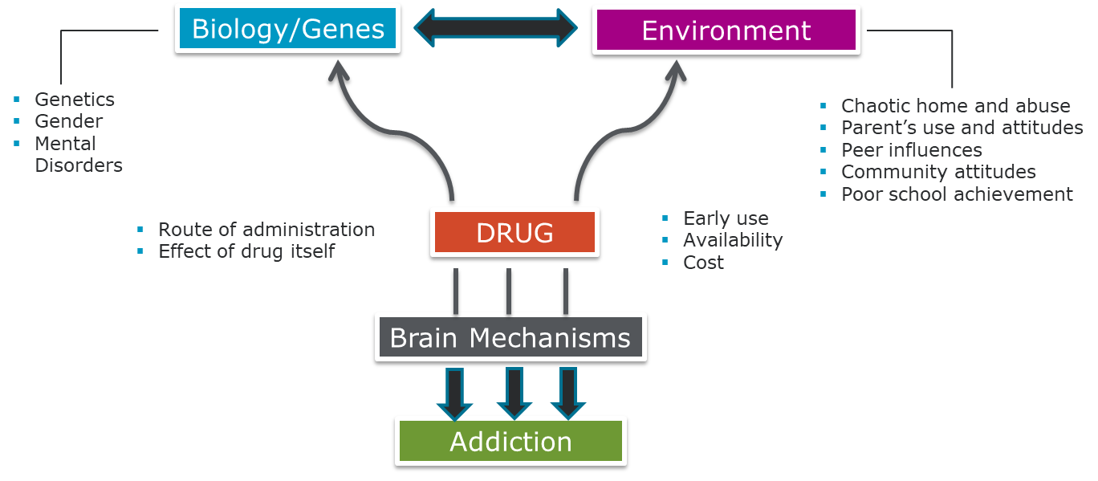
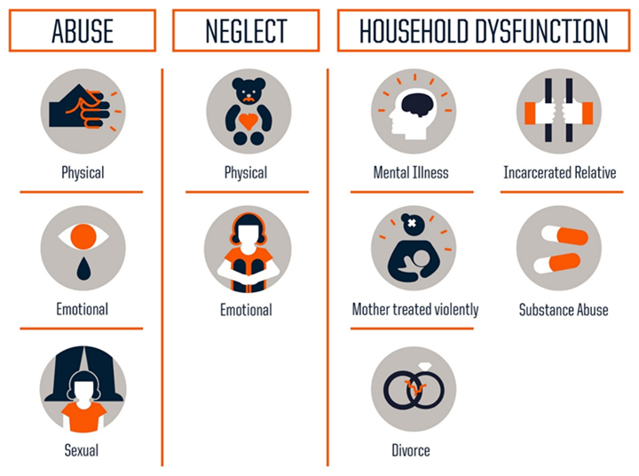
Risk Factors for Use and Addiction
Notes:
With 4 or more ACEs individuals are….
1.6 times more likely to experience skeletal fractures
2.3 times more likely to have hepatitis
1.6 times more likely to have a BMI >35
4.6 times more likely to be depressed
12.2 times more likely to attempt suicide
7.4 times more likely to have an alcohol use disorder
10.3 times more likely to have used injection drugs

Slide 11
Red Flags in Clinical Settings
Mood swings or irritability
Declining academic performance
Risky behaviors, e.g., unsafe sex, reckless driving
Physical signs: sleep issues, fatigue, withdrawal symptoms
Frequent injuries or ER visits
🛑 Tip: Alcohol use often co-occurs with other risk behaviors or mental health concerns.

Slide 12
Screening Tools for Primary Care & Behavioral Health
AAP Periodicity Schedule (year)
Psychosocial/behavioral assessment: every well visit / Depression screening: annually 11–21y / Alcohol/drug use assessment: every visit 11–21y and in any care setting (sick, ED, etc.)
CRAFFT 2.1 – Validated adolescent screening tool
AUDIT-C – For older adolescents
SBIRT approach:
Screening
Brief Intervention
Referral to Treatment
Note: CRAFFT can be self-administered or provider-led; ideal for ages 12–21.

Slide 13
CRAFFT
CAR • RELAX • ALONE • FORGET • FRIENDS • TROUBLE
2+ positive items → brief intervention; consider referral per severity
During past 12 months did you
A. Drink any alcohol?
B. Smoke any marijuana or hashish?
Use anything else to get high?
If NO: Ask if you have ever ridden in a CAR driven by someone who was high or had been using drugs or alcohol?
IF YES – complete CRAFFT → → → →
Notes:
www.ceasar.org for card versions of CRAFFT

Slide 14
Brief Interventions That Work
Motivational Interviewing (MI):
Elicit readiness to change
Explore ambivalence
Normalize discussion of alcohol without judgment
Use “Ask–Advise–Assess–Assist–Arrange” approach
Involve family if appropriate

Slide 15
Brief Intervention with Adolescents
Examine the pros and cons of use
Discuss willingness to change
Identify goals for behavior change.
In the second session, review progress toward goals
Identify high-risk situations associated with drug-use triggers
Generate strategies to deal with peer pressure
Negotiate long-term goals related to substance use

Slide 16
Clinical Pearls for Effective Conversations
Build trust → use confidentiality guidelines clearly
Avoid scare tactics → use facts and developmentally appropriate language
Start early (ages 9–11): normalize asking about substances
Reinforce strengths and goals

Slide 17
Principles of Adolescent AUD Treatment
Identify & Triage: SBIRT; withdrawal risk; match level of care
Whole-Person Plan: co-occurring MH/SUD, sleep, school, SDoH
Evidence-Based Treatments: MI/CBT/CM; family therapies (MDFT/FFT)
Med Management (off-label): naltrexone/acamprosate/disulfiram—select cases
Safety: alcohol poisoning, no driving, polysubstance risk, crisis plan
Engagement & Access: rapid starts, flexible scheduling/telehealth, navigation
Recovery Supports: community programs, peer/mentor, pro-social activities
Monitor & Adjust: ≥3 months active care + ongoing check-ins (Utox respectfully), measurement-based tweaks, plan for relapse/return

Slide 18
Principles of Adolescent AUD Treatment
What to track
Weekly: days used, heavy days, craving (PACS), triggers, safety events, attendance/homework.
q2–4 weeks: CRAFFT follow-up items; PHQ-A, GAD-7; sleep scale; Utox (collaborative).
Quarterly (or as indicated): school attendance/grades, PEth/LFTs if using labs, recovery capital (activities, peer supports).
Practical notes
Change one or two things at a time; document the metric and the tweak.
Use visuals (run charts) so teens/families can see progress.
Keep Utox respectful: preview expectations, discuss results non-punitively, pair with positive reinforcement.

Slide 19
Co-Occurring Conditions
Alcohol use often masks or exacerbates:
Depression & Anxiety
ADHD
Trauma / PTSD
Eating disorders
Interdisciplinary care coordination is critical.

Slide 20
Prevention Strategies for Providers
Anticipatory guidance (e.g., Bright Futures)
Educate parents on safe storage & communication
Advocate for community programs, school-based interventions
Empower youth with coping skills and engagement opportunities
Notes:
Anticipatory guidance is a key prevention strategy in pediatric and adolescent care, and Bright Futures (developed by the American Academy of Pediatrics) provides a well-structured framework for this.
🟦 What Is Anticipatory Guidance?
It’s the practice of giving age-appropriate, developmentally tailored information to help adolescents and families prepare for upcoming physical, emotional, and behavioral changes. The goal is to promote healthy decision-making and prevent risky behaviors—like underage drinking—before they begin.
🟦 Bright Futures on Substance Use (Alcohol-Specific Highlights):
✅ Start Early (as young as age 9):
Evidence suggests children begin forming attitudes about alcohol by age 9.
Early conversations normalize discussions about substances and can build trust for later disclosures.
✅ At Every Visit (Ages 11–21):
Bright Futures recommends:
Screening using tools like CRAFFT
Providing brief counseling even in the absence of substance use
Reinforcing parent-teen communication about alcohol
Discussing peer pressure, coping skills, and goal setting
✅ Provider Actions:
Offer clear, consistent messages that alcohol is harmful during brain development.
Normalize refusal skills: “It’s okay to say no—even if your friends don’t.”
Use motivational interviewing if risk behaviors emerge.
🧠 Examples of Anticipatory Guidance Talking Points:
AgeSample Talking Point9–12“Have your friends talked about drinking? What do you think about that?”13–15“Alcohol can affect how your brain learns and grows—do you ever feel pressure to try it?”16–18“How do you handle situations where there’s drinking? What would you do if a friend needed help?”
🛡️ Why It Matters:
Early, proactive conversations have been shown to delay the initiation of alcohol use.
Adolescents who perceive strong disapproval from parents and providers are significantly less likely to drink.

Slide 21
Emerging Marketing Trends

Slide 22
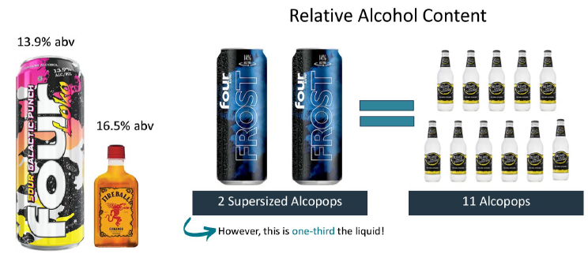
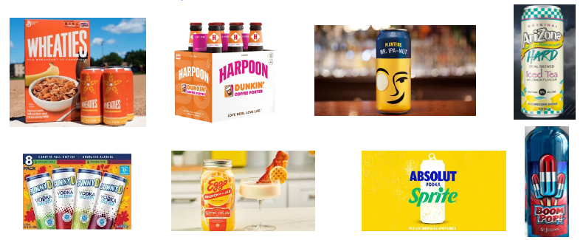
73.6% underage drinkers consumed “flavored alcoholic beverage in the past month.
Notes:
M. Caitlin Anderson, Director, Liquor Control Division
•Caitlin.Anderson@ct.gov
•860-929-6741

Slide 23
Community and Clinical Resources
SAMHSA Treatment Locator
NIAAA Clinician’s Guide
Local adolescent behavioral health services
Telehealth options for rural or underserved areas

Slide 24
Summary & Takeaways
Adolescent alcohol use is common, but not inevitable
Early screening and brief intervention are highly effective
Brain development science supports prevention urgency
Providers across disciplines can collaborate to prevent and treat alcohol misuse

Slide 25
Adolescent Substance Use Resources
Surgeon Generals Office :
E-cigarette Use among Youth and Young Adults
https://e-cigarettes.surgeongeneral.gov/documents/2016_SGR_Full_Report_non-508.pdf
The Surgeon General’s Report on Alcohol, Drugs and Health
https://addiction.surgeongeneral.gov/sites/default/files/surgeon-generals-report.pdf
Spotlight on Opioids
https://addiction.surgeongeneral.gov/sites/default/files/Spotlight-on-Opioids_09192018.pdf
From NIDA:
Downloadable Posters & Stickers
http://teens.drugabuse.gov/interactives-and-videos/downloads
Interactive & Educational Videos
http://teens.drugabuse.gov/interactives-and-videos/videos
https://easyread.drugabuse.gov/
Drug Facts for Teens; how they affect the brain & body
http://teens.drugabuse.gov/drug-facts

Slide 26
Adolescent Substance Use Materials
From PEERx:
Teen Prescription Drug Abuse Prevention information
http://teens.drugabuse.gov/peerx
From Scholastic:
Drugs and Your Body (for students)
http://headsup.scholastic.com/
From NIAAA:
Curricular materials for teachers and other educators to use on the job
http://www.niaaa.nih.gov/publications/classroom-resources
Underage Drinking Brochures and Fact Sheets
http://pubs.niaaa.nih.gov/publications/UnderageDrinking/UnderageFact.htm
Underage Drinking Prevention Poster
http://pubs.niaaa.nih.gov/publications/poster.htm

Slide 27
Adolescent Substance Use Materials
From SAMHSA:
Too Smart To Start; for youth, teens, families, educators, community leaders, professionals, and volunteers
http://www.samhsa.gov/too-smart-to-start
Helping Students Avoid Prescription Drug Abuse – free brochure
http://store.samhsa.gov/product/Helping-Students-Avoid-Prescription-Drug-Abuse/SMA09-4446
Surgeon General's Call to Action to Prevent and Reduce Underage Drinking free manual
http://store.samhsa.gov/product/Surgeon-General-s-Call-to-Action-to-Prevent-and-Reduce-Underage-Drinking/SGCTA-07
Interactive and Educational website for young adults
http://abovetheinfluence.com/
“Talk. They Hear You.” Underage Drinking Campaign for parents and caregivers
http://www.samhsa.gov/underage-drinking
From Hazelden Publishing:
Evidence-based prevention solutions through online subscription available to any school; valuable lesson plans, training guides and videos
http://www.hazelden.org/web/public/tod-for-educators.page
Prevention programs specifically for students in elementary school through high school and beyond; resources that prevent substance abuse
http://www.hazelden.org/web/public/storeeducation.page

Slide 28
Adolescent Substance Use Resources
Uconn SBIRT Training Academy
https://health.uconn.edu/sbirtacademy/
Mass Clearing House
School Health materials; CD/DVD, brochures
http://massclearinghouse.ehs.state.ma.us/category/SCH.html
For Adults Who Work With Children; Preparing Young Children For A Healthy Drug-Free Future booklet
http://massclearinghouse.ehs.state.ma.us/BSASPRO/SA1022.html
Youth-Serving Professionals Can Help Prevent Inhalant Abuse packet
http://massclearinghouse.ehs.state.ma.us/BSASPRO/SA1032R.html
SBIRT: A Step by Step Guide for Screening and Intervening for Unhealthy Alcohol and Other Drug Use toolkit
http://massclearinghouse.ehs.state.ma.us/BSASPRO/SA3522.html
Understanding Substance Abuse Services: A Quick Guide for Young People & Caregivers brochure
http://massclearinghouse.ehs.state.ma.us/BSASPRO/SA3531kit.html

Slide 29

