Slide 1

Experiences from a Quality Improvement Effort
Fiona Hart, APRN, CPNP-PC
Sarah Mitchell, APRN, CPNP-PC
May 22, 2025
Nurse Practitioner & Post-Doctoral
Training Programs

Slide 2
Project Background: Infant Feeding Methods <6mo
Why This Matters:
Exclusive breastfeeding for the first 6 months is the gold standard for infant health, as recommended by WHO and AAP.
What We’re Seeing at Hartford Clinic (Oct–Feb):
  Formula feeding is rising – from 11 infants in October to 13 in February
  Exclusive breastfeeding is declining – dropped sharply from 9 in October to 1 in December, slight rebound to 4 by February
  Mixed feeding increased slightly – from 4 to 6 infants
Key Concern:
There's a clear trend away from exclusive breastfeeding and toward formula reliance.
Why Act Now:
This shift highlights a need for better support, education, and resources to help families start and sustain breastfeeding.
2

Slide 3
Project Goal
To increase exclusive breastfeeding rates and ensure that families who choose mixed or formula feeding do so with:
  Full understanding of their options
  Access to compassionate, evidence-based support,
  No judgment or barriers to care.
Equity Focus: Ensure all families—especially those from underserved backgrounds—receive culturally sensitive, accessible, and empowering infant feeding support
3

Slide 4
AIM Statement Example
By June 30, 2026, the Hartford Clinic aims to increase the rate of exclusive breastfeeding among infants under 6 months from a baseline of 18% (as of February 2025) to 25%, through the implementation of enhanced lactation support services, caregiver education, and structured follow-up during routine pediatric visits.

Slide 5
Associated Factors
Parental Knowledge & Attitudes:
  Lack of awareness about the benefits of exclusive breastfeeding and misconceptions about breastfeeding challenges.
  Parental preferences for formula feeding due to convenience or perceived insufficient milk supply.
Healthcare Provider Support:
  Inadequate lactation support and counseling from pediatricians or nurses during well-child visits.
  Gaps in training for healthcare providers on effective breastfeeding promotion and problem-solving.
Clinic Processes:
  Limited follow-up or lack of structured support for breastfeeding mothers after initial visits.
  Time constraints during well-child visits that may prevent healthcare providers from adequately addressing breastfeeding concerns.
5

Slide 6
Associated Factors cont.
Workplace & Environmental Factors:
  Inadequate workplace accommodations (e.g., breaks for pumping) for working mothers.
  Lack of family or partner support for breastfeeding at home, contributing to a shift toward formula feeding.
Access to Resources:
  Limited availability or affordability of lactation resources, such as breast pumps, nursing bras, or lactation consultants.
  Insufficient educational materials on breastfeeding practices available in the clinic or at home.

Slide 7
Stakeholders
Parents and Caregivers (Primary Stakeholders):
They make decisions about infant feeding. Their feedback helps identify barriers and preferences related to breastfeeding vs. formula feeding.
Pediatricians and Healthcare Providers (Primary Stakeholders):
Often the first point of contact, their advice and support influence parental feeding choices. Their involvement in education and follow-up care is critical.
Lactation Consultants and Support Staff (Secondary Stakeholders):
These experts provide breastfeeding education, support, and counseling, helping parents overcome breastfeeding challenges.
Clinic Administration/Leadership (Key Stakeholders):
Clinic leaders provide resources, policy support, and direction for the initiative, ensuring necessary changes to clinic procedures and staff training.
7

Slide 8
Process
Our process began with a data review, analyzing feeding trends from October to February. This showed a decline in exclusive breastfeeding, with a rise in formula feeding.
Next, we engaged key stakeholders:
Parents and caregivers shared insights on their feeding choices and barriers to breastfeeding.
Healthcare providers (pediatricians, nurses) helped identify gaps in education and support.
Lactation consultants offered expertise on improving breastfeeding support during visits.
8

Slide 9
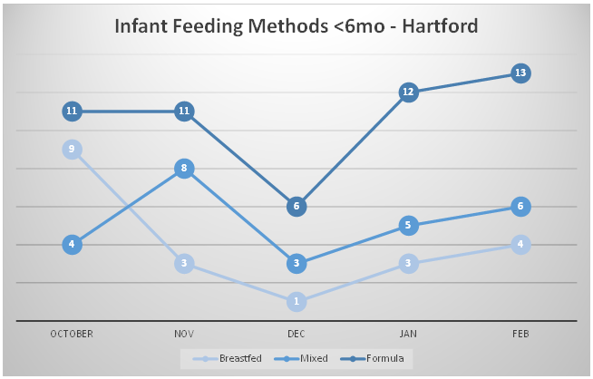
Data
9

Slide 10
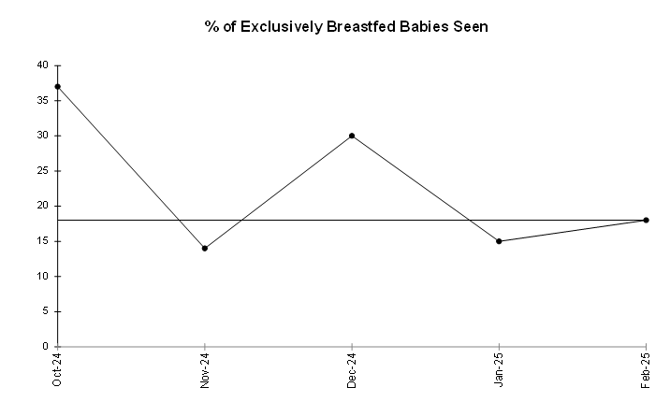

Slide 11
Data Explanation
Over the 5-month period from October to February, the percentage of infants exclusively breastfed (BF) showed a significant decline:
October: 37.5% of infants were exclusively breastfed (9 out of 24).
November: The percentage dropped to 13.6% (3 out of 22).
December: A slight rebound to 30% (1 out of 10).
January: Further decline to 15% (3 out of 20).
February: A small increase to 17.4% (4 out of 23).
Meanwhile, formula feeding remained the predominant method, increasing steadily, while mixed feeding showed slight growth.

Slide 12
Comparing Clinic Exclusive Breastfeeding Rates to U.S. Average
The overall exclusive breastfeeding rate for the clinic from October to February is approximately 22.7%.
This can be compared to the CT average of 36.5% to assess how the clinic is performing in relation to the state
This highlights an opportunity for targeted interventions to improve breastfeeding support and education.

Slide 13
WIC
Infants eligible for and receiving the Special Supplemental Nutrition Program for Women, Infants, and Children (WIC) are less likely to ever be breastfed (75.4%) than infants eligible, but not receiving WIC (84.6%), and infants ineligible for WIC (92.4%)

Slide 14
Approach to Change
Enhance Lactation Support:
  Provide consistent breastfeeding education during visits and train providers on counseling.
Increase Follow-Up:
  Implement follow-up calls after well-child visits to support breastfeeding mothers.
Provide Resources:
  Offer breastfeeding materials and access to lactation consultants or pumps.
Support Workplace Policies:
  Advocate for workplace accommodations like pumping breaks.
Strengthen Clinic Protocols:
  Standardize breastfeeding support across all clinic visits.
14

Slide 15
Future PDSA Cycles
Cycle 1: Lactation Support During Visits
Plan: Implement standardized breastfeeding education during well-child visits.
Do: Pilot the program for a month.
Study: Collect feedback and measure breastfeeding rates.
Act: Adjust and expand if successful.
Cycle 2: Follow-Up Care
Plan: Add follow-up calls 2-3 weeks after visits.
Do: Pilot follow-up calls with a subset of parents.
Study: Compare breastfeeding rates with and without follow-up.
Act: Expand follow-up calls if successful.
15

Slide 16
Conclusions/Implications
Next Steps:
Expand Lactation Support: Roll out education and follow-up calls for all parents.
Integrate Resources: Ensure breastfeeding materials and lactation support are available during every visit.
Monitor and Adjust: Continue tracking breastfeeding rates and gather feedback for improvements.
Advocate for Workplace Support: Push for breastfeeding-friendly policies in local workplaces.
16

Slide 17
Advice for NP Residents:
Engage Stakeholders Early: Build strong relationships with staff and parents from the start.
Start Small and Measure: Begin with manageable changes and measure impact before scaling.
Adapt as You Go: Be flexible and adjust based on feedback.
Consider the Bigger Picture: Think about external factors like workplace policies and community partnerships.

