Slide 1

Experiences from a Quality Improvement Effort:
Colorectal Cancer Screening
Skyla Cedano and Bar Hass
Community Health Center, Inc.
New London, CT
June 12, 2025
Nurse Practitioner & Post-Doctoral
Training Programs

Slide 2

Background
According to the National Cancer Institute, colorectal cancer accounts for 8% of all new cancer cases and 9% of all cancer deaths.
Increased screening rates reduce morbidity and mortality associated with colorectal cancer.
The rate of colorectal cancer screening completion at Community Health Center is below national standards.
‹#›
Notes:
SC

Slide 3
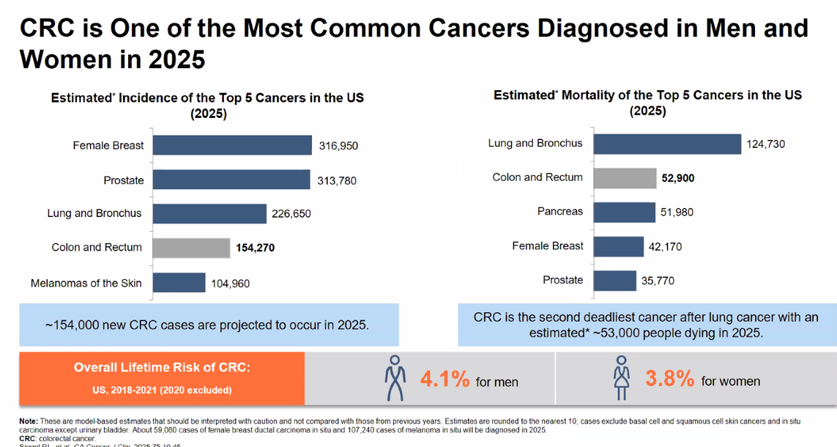
Notes:
SC

Slide 4
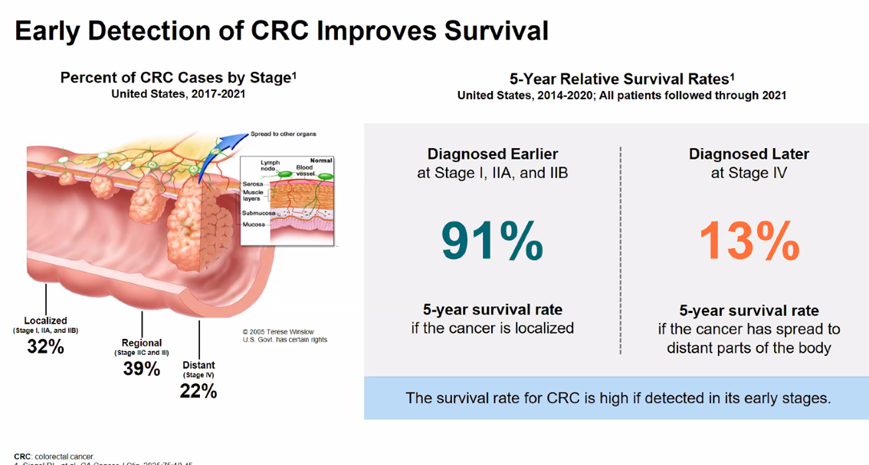
Notes:
SC

Slide 5

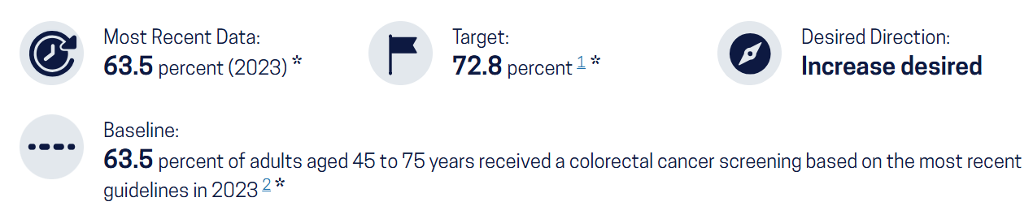
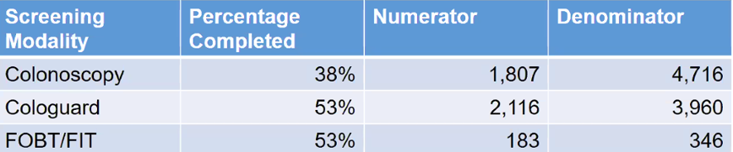
CHC Data for 2024:
Overall CRC screening rate 45.3%
Notes:
SC

Slide 6
Role of Education in Promoting Colorectal Cancer Screening
2010 Philip, DuHamel, and Jandorf
118 African American individuals who had not undergone CRC screening and provided them with educational prints discussing the process and benefit of colorectal screenings
in a 3-month follow up ¼ of the individuals undergone screening and all participants felt more reassured in completing CRC screening
2024 study by Gadd, et al.
Counseling from a trusted healthcare provider had statistically significant impact on increasing likelihood to complete CRC screening
Providing patients with physical educational materials like brochures improved both awareness and screening rates
Notes:
SC + BH
I am ordering it chronologically because I think it makes sense to see what was done previously and a study that directly engaged with participants. Then you coming in with the Gadd study that review multiple studies between 2016 and 2022. A note, Gadd’s and this study https://onlinelibrary.wiley.com/doi/full/10.1002/pon.5997 both review previously done studies, but the link a provided looked at 40 more studies, I think that may strengthen our point of need for education and also add into other barriers we discussed later (clinic-wise)

Slide 7
Aim Statement
The aim is to improve the quality and value of patient health outcomes through increased colorectal cancer screening rates by way of patient education. The process starts with identifying barriers to completion of colorectal cancer screening and ends when these barriers are addressed. By working on this we expect to see improved understanding of the rationale, available options, and process of colorectal cancer screening, and an increase in the percentage of eligible patients who complete screening.
‹#›
Notes:
SC

Slide 8
Stakeholders
Patients
Educated of the options to screen for colorectal cancer
various uncertainties regarding colonoscopy and unsure what other options they have
Primary Care Clinical Staff
Improve screening rates and early intervention for patients - ultimately improving patient outcomes
Institution Leadership
Additional data leadership can use in already established efforts to increase colorectal screening rates
GI specialists
Increase in screening to identify patients needing interventions
‹#›
Notes:
BH

Slide 9
QI Process Flowchart
Identify barriers: health literacy, knowledge, language
Day of visit: MA
information
gathering (need for CRC screening)
Goal: increase CRC screening rates
Create educational handout
Review available options for CRC screening with patient
If declined, provide educational handout of screening methods
Alert clinician to assess reasoning for declining and educate
Document visit and outcome (declined/agreed)
Re-assess willingness and provide additional education at future visits
CRC screening complete/incomplete
Notes:
BH

Slide 10
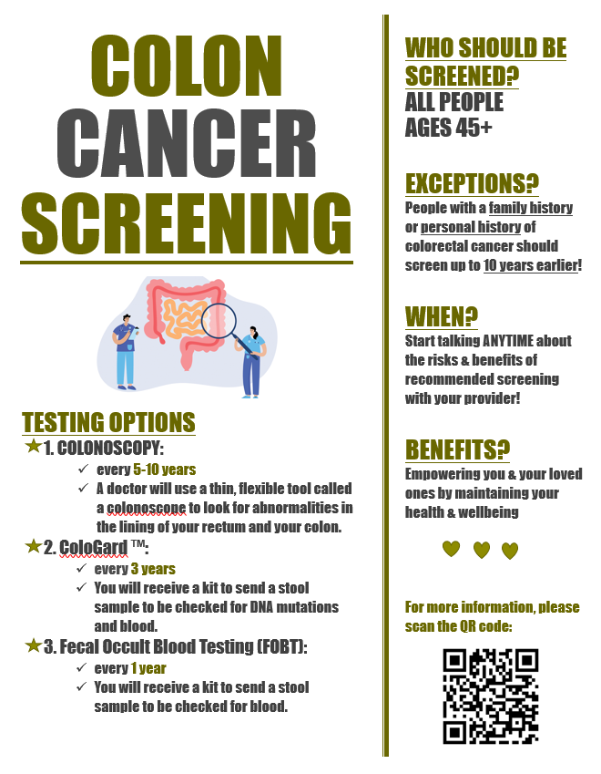
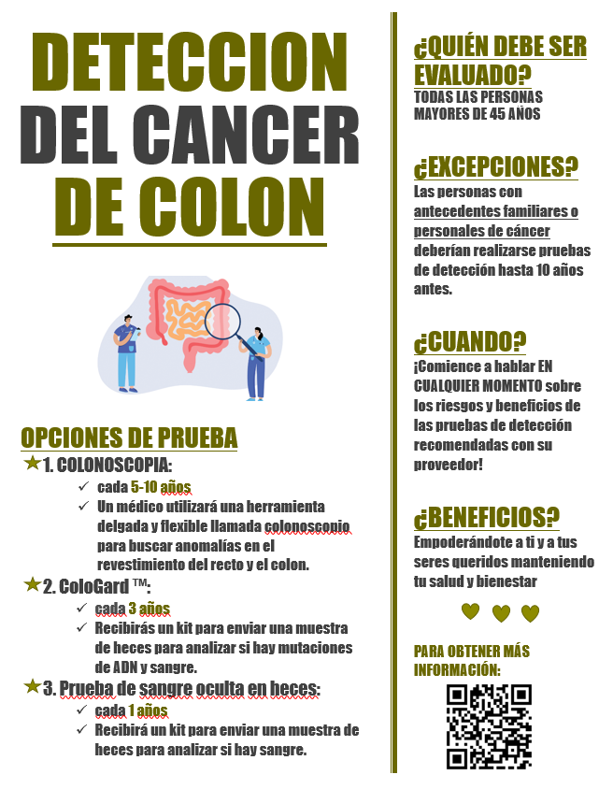
Educational Sheet
Notes:
SC

Slide 11
Data Collection
Data collection efforts were focused on collecting metric data of colorectal cancer screening rates across CHC during the time periods prior to and after implementing our intervention.
‹#›
Notes:
SC

Slide 12
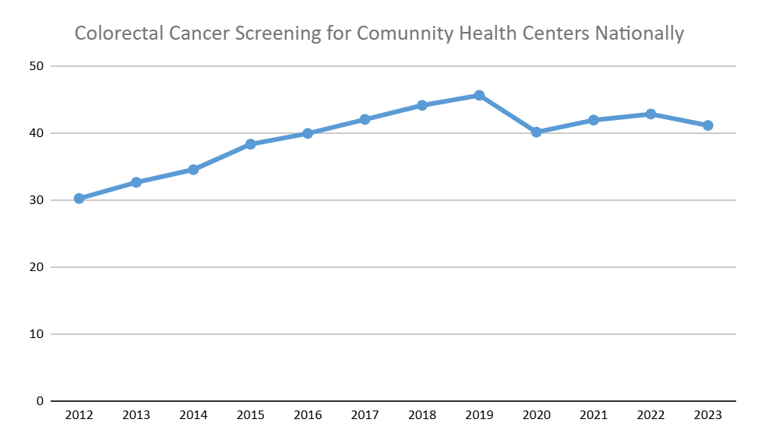
Data Collection
‹#›
Notes:
BH

Slide 13
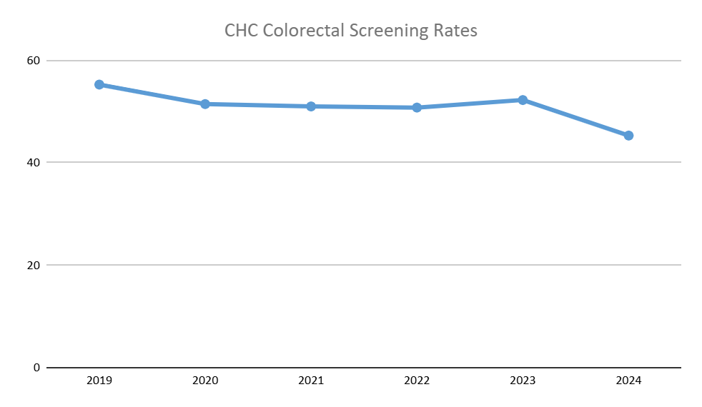
Data Collection
‹#›
Notes:
BH

Slide 14
Data Collection
No site-specific data collected during project due to anticipated barriers and scheduling
Barriers - time, communication, incorporating data-collection input in the EMR
However, the data that is available by CHC’s metrics show steady increases of colorectal screening for our patients
‹#›
Notes:
BH

Slide 15
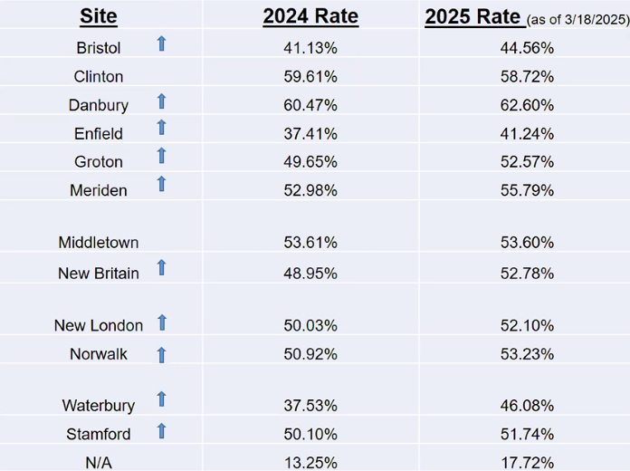
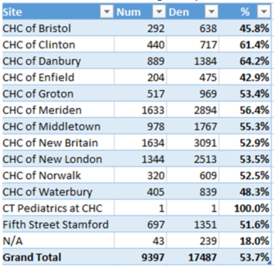
Results
2025 Rate as of 5/6/25:
Notes:
SC

Slide 16
Results
Through our efforts, we not directly observed any increase of colorectal screenings
Barriers and challenges - time, communication, workflow
Success - identifying current in-clinic workflow barriers, connecting with appropriate staff - CHC data analyst Adam Bente
Learning points
QI projects progress more effectively when roles, goals, and means to achieve them are clear
Connecting with leadership would have saved time and would have streamlined efforts QI spearheads and clinical champions are already in the progress of doing
‹#›
Notes:
BH

Slide 17
Ideal Approach to Change
Ideal Changes
More promotion of colorectal screening in high-volume locations (waiting room)
MA alert pcp if patients decline screening
Incorporate a visible alert in the EMR before the pcp comes into appointment
Ideal PDSA cycle
As more barriers would become apparent through the project, we’d observe their effect and adjust the means of promoting the screening within CHC’s confines
Takeaways from our efforts this year
Implementing changes to the clinic workflow is difficult, especially when staff have established habits and ways to complete their part quicker
This kind of effort involves numerous collaborators and would ultimately need establish roles and leadership set
‹#›
Notes:
BH

Slide 18
Conclusions/Implications
Next steps
Implement educational tools at all CHC sites.
Longer term implementation of education and metric data tracking.
Continue to increase visibility of CRC screening and its importance.
Recommendations for next attempt
Connect with leadership to see if efforts to increase colorectal cancer rates were in the works to that our efforts would be streamlined or at least modified to our clinic
Further understand what can be incorporated into the EMR so effort is minimized to clicks
Advice for the next cohort
Look to projects that are applicable to multiple sites and incorporate leadership so more stakeholders get involved and additional data-collection efforts will be picked up by other sites to collect a larger pool of data. That way, when the residency year ends, you would have contributed to an ongoing effort that will continue
‹#›
Notes:
SC - next steps; BH - do differently, future NPs

Slide 19
References
Gadd N, Lee S, Sharman MJ, Obamiro K. Educational interventions to improve bowel cancer awareness and screening in Organisation for Economic Co-operation and Development countries: A scoping review. Prev Med Rep. 2024;39:102653. Published 2024 Feb 13. doi:10.1016/j.pmedr.2024.102653
Philip EJ, DuHamel K, Jandorf L. Evaluating the impact of an educational intervention to increase CRC screening rates in the African American community: a preliminary study. Cancer Causes Control. 2010 Oct;21(10):1685-91. doi: 10.1007/s10552-010-9597-3. Epub 2010 Jun 10. PMID: 20535541; PMCID: PMC3621716.
Health Center Program Uniform Data System (UDS) Data Overview, data.hrsa.gov/tools/data-reporting/program-data?grantNum=H80CS00326. Accessed 22 May 2025.
National Cancer Institute. (n.d.-a). Colorectal cancer screening (PDQ®). Colorectal Cancer Screening (PDQ®) - NCI. https://www.cancer.gov/types/colorectal/hp/colorectal-screening-pdq
National Cancer Institute. (n.d.-b). Common cancer sites - cancer stat facts. Surveillance, Epidemiology, and End Results Program. https://seer.cancer.gov/statfacts/html/common.html#:~:text=Breast%2C%20lung%20and%20bronchus%2C%20prostate,nearly%2050%25%20of%20all%20deaths.
Special thank you to CHC’s data analyst Adam Bente!

