Slide 1
Quality Improvement Project
Deniz Yetil & Neha Malrani
Community Health Center Inc., Stamford, CT
6/26/25

Slide 2
Initial ideas
  “Welcome to CHC” packet for new patients
  Mammogram resources for uninsured patients
  Increased access to patient documents/ financial assistance forms
  Post-procedure instructions for patients and having MAs set up for procedures to increase provider efficiency

Slide 3
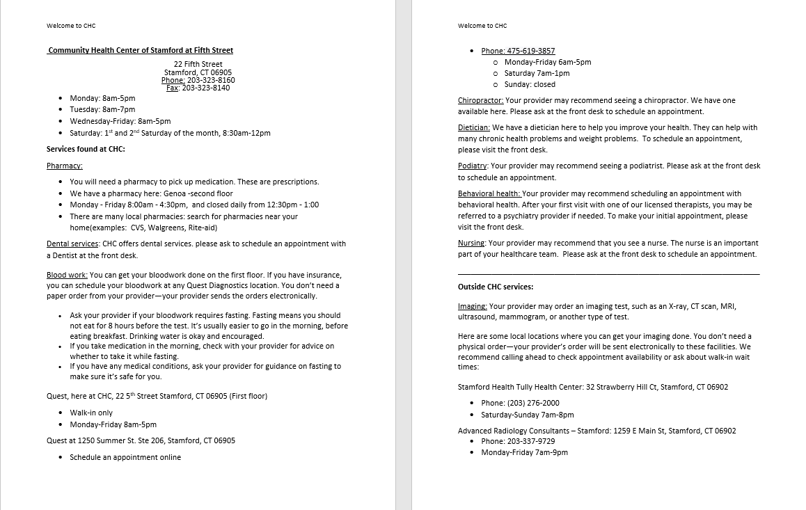
“Welcome to CHC” Packet

Slide 4
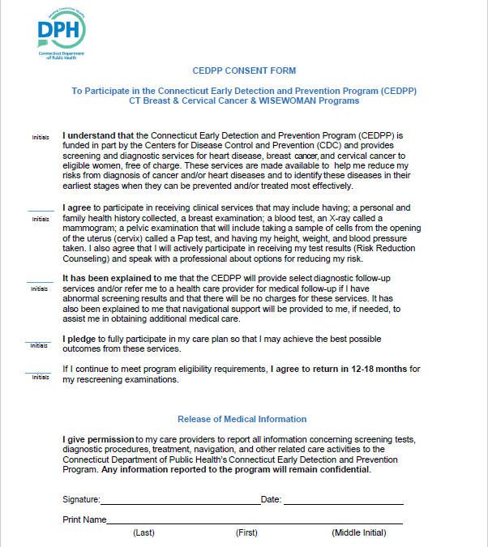
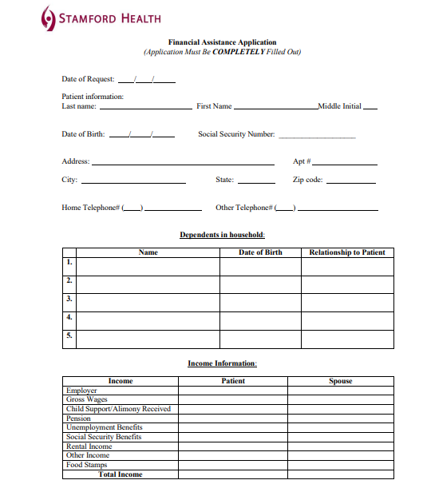
Financial assistance/ patient resources

Slide 5
Challenges to Project Idea
Stamford site has the highest number of uninsured patients across CHC, therefore our goal with this project was to improve access to care and autonomy for new/ uninsured patients
Challenges
  Difficulty getting staffing on board due to part-time nature of medical assistant who is covering both residents
  Limited time during visits and outside of clinic schedule to work on project (Stamford residents have to travel far to other sites for rotations)
  Difficult to get packet approved for distribution by management
  Language barriers/ availability of resources in languages other than Spanish and English
  Difficult to measure data such as follow up care (eg. mammogram completed)
Implementing a sustainable QI project was difficult as we ourselves were navigating a new clinic and environment in our first year of practice

Slide 6
Project Question
To find out if patients that Luma confirmed (AI-native Patient Success Platform) have a higher show rate for their appointments than those that did not confirm
Ultimately our goal was to pre-chart on the patients that were Luma confirmed to assess if this improved our efficiency in locking notes on time
When we were previously pre-charting on all patients that were scheduled, we noticed there was a high no-show rate and this did not improve our overall efficiency

Slide 7
Data Collection
It is important to keep in mind that the no-show rate is ambiguous and that when retroactively collecting data it is hard to tell if the patient that canceled the appointment did not show up to the appointment or if we had to reschedule due to system errors.
  The total no-show rate for Luma confirmed is not really too helpful of the measurement because of this reason.
Plan to start data collection week of April 7th
  Have a 2-week test collection and then have an additional 2 to 4 weeks of “real” data collection

Slide 8
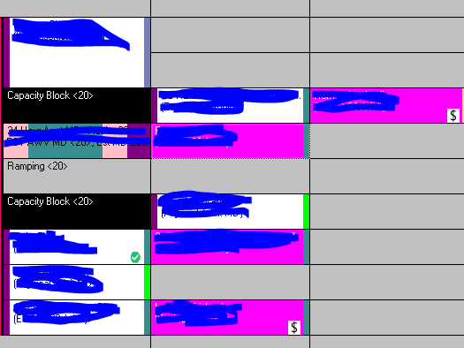
Challenges to data collection
We encountered challenges to data collection due to external factors because the data included all patients that were scheduled for that day (see schedule below)
In reality, we were only able to obtain a few weeks worth of data collection due to the following factors:
  Ramp up schedule
  PTO/ holiday schedules
  Precepted clinics not being at main site

Slide 12
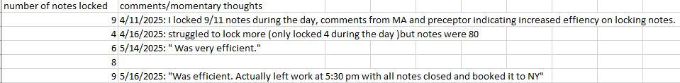

Slide 13
Summary
We faced several challenges in coming up with a project idea for this Quality Improvement project
Though we had many ideas initially that were catered around helping new patients and new providers such as both of us, these were difficult to either get approved by clinic management and/or we did not have the support staff/ time to be able to execute the project ideas we originally came up with
The idea we decided on ultimately was catered more to our efficiency as new providers, which was helpful during the residency year as we transition from students to full time provider roles

Slide 14
Conclusion
In conclusion, we noticed over 50% on average of patients were utilizing the Luma software to confirm and actually attend their visits
This made pre-charting for their visits useful- we felt we were utilizing our time more efficiently considering the high no-show rate in our clinic
Efficiency is key especially within community health where we face challenges such as language barriers, uninsured patients, and low levels of health literacy
This could be useful for incoming residents as a way to increase efficiency as this is something that often takes time for new providers to develop

