Slide 1

ENHANCING DEPRESSION REMISSION IN PRIMARY CARE
DePaul Community Health Center
Presented by:
Clair Brown MSN, APRN, FNP-C
Shani Campbell DNP, APRN, FNP-BC
Tashika Edward, MSN, APRN, FNP-C
Darrielle Santiago, MSN, APRN, FNP-C
June 12, 2025
Notes:
Good morning, we are presenting our QI project focused on enhancing depression remission rates at DePaul Community Health Centers. Our team includes Clair Brown, Shani Campbell, Tashika Edward, and myself, Darrielle Santiago. This presentation reflects our progress so far, as well as our strategy using a PDSA model.

Slide 2

PROJECT OVERVIEW
Project Focus: Improve depression remission rates at DePaul through better PHQ-9 follow-up
Model Used: Plan-Do-Study-Act (PDSA)
Initial Data: 60-chart review from Metairie and Carrollton
Key Finding: Low PHQ-9 follow-up rates, especially at Carrollton
Primary Strategy: Re-educating the staff, providing tip sheets and Implement “5 Asks” intervention and monitor outcomes over 6 months
Notes:
This slide gives a quick snapshot of our project. We’re addressing low depression remission rates through improved PHQ-9 follow-up. We started by reviewing 60 charts at two sites and are now piloting our intervention at Carrollton using the PDSA model.

Slide 3
Background
National remission benchmark: 35%
DePaul baseline (from Azara): 9.7%
Depression affects treatment adherence, quality of life, and chronic illness control
Notes:
Nationally, the target for depression remission is 35%, but at DePaul we’re currently at 9.7% based on Azara data. Depression has major impacts on patient health, so improving follow-up and documentation is key.

Slide 4
NATIONAL EVIDENCE ON DEPRESSION REMISSION RATES
12-Month Remission: The STARD trial showed a 67% cumulative remission rate over 12 months using stepped treatment approaches. (NIMH, STARD Study)
1
6-Month Remission: A multi-site collaborative care study reported a 53.5% remission rate at 6 months using integrated behavioral health models. (Unützer et al., PMC)
2
Measurement-Based Care (MBC): Routine use of tools like the PHQ-9 improves outcomes and supports clinical decision-making. MBC is linked to higher remission rates and treatment adjustments. (Lewis et al., 2019; APA MBC Toolkit)
3
Notes:
We included this to highlight that achieving remission is possible. The STAR*D study showed a 67% rate with stepped treatment, and collaborative care models show over 50% in 6 months. Measurement-based care, using tools like the PHQ-9, is a major factor in improving outcomes.

Slide 5
Project AIM
SMART Goal: Increase remission rates from 9.7% to 18% within 6 months
Improve PHQ-9 follow-up and documentation using the PDSA model
Notes:
Our SMART goal is to raise the remission rate to 18% in 6 months. Our intervention focuses on PHQ-9 follow-up and proper documentation across visits.

Slide 6
PDSA Cycle – Plan & Do Phases
Plan: Chart reviews (60 total), identified workflow gaps, developed "5 Asks"
1
Do: Staff education at pilot site (Carrollton), begin PHQ-9 workflow rollout
2
Notes:
In the Plan phase, we conducted chart reviews and identified workflow gaps. In the Do phase, we began education at Carrollton and rolled out the '5 Asks' as a structured workflow.

Slide 7
PROCESS MEASURES
% of diagnosed patients receiving PHQ-9 follow-up at visits
% of PHQ-9s entered in eCW smart form
% of PHQ-9s delivered in patient’s preferred language
Notes:
Our process measures include: whether PHQ-9s are given at follow-up visits for diagnosed patients, if they’re documented in the smart form, and if they’re delivered in the patient’s preferred language.

Slide 8
Baseline Chart Review Summary
Metairie: 60% PHQ-9 follow-up rate (18/30)
01
Carrollton: 20% PHQ-9 follow-up rate (6/30)
02
Common issues: PHQ-2 used in place of PHQ-9, missing documentation, no remission tracking
03
Notes:
We reviewed 60 charts total. Metairie had a 60% PHQ-9 follow-up rate, while Carrollton had just 20%. Common issues included using only the PHQ-2 after diagnosis and missing documentation.

Slide 9
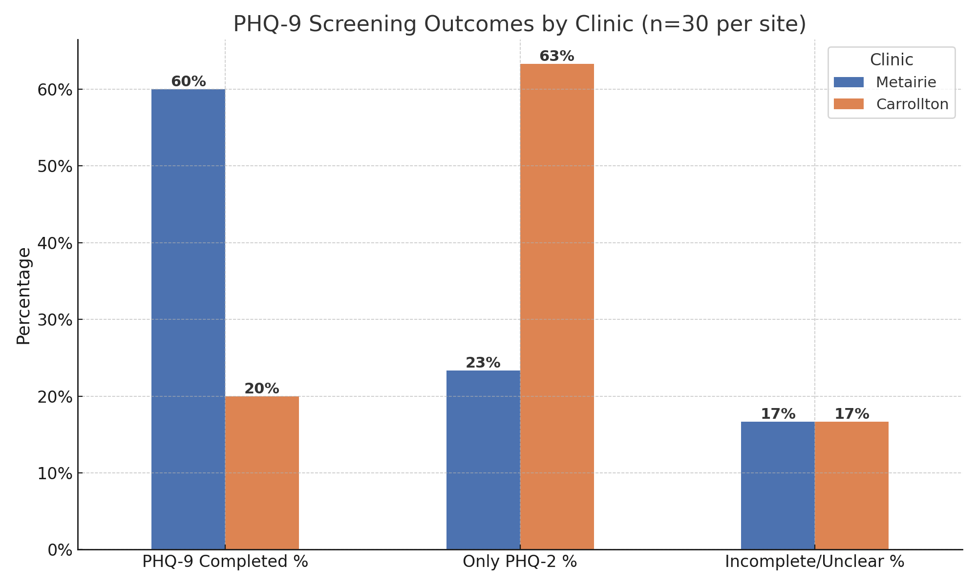
PHQ-9 COMPLETION COMPARISON CHART
Notes:
This bar chart visually compares PHQ-9 follow-up between Metairie and Carrollton. It helped us decide where to start our intervention.

Slide 10
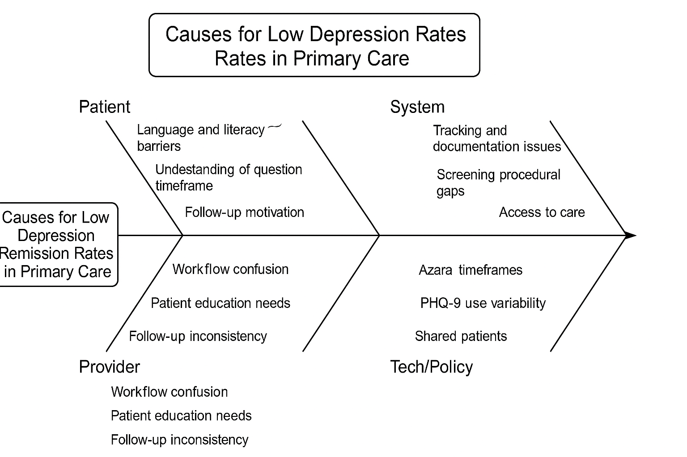
ROOT CAUSES OF LOW DEPRESSION REMISSION RATES AT DEPAUL BASED ON INITIAL CHART REVIEW & WORKFLOW OBSERVATIONS
Notes:
We created this root cause analysis based on our chart review and team discussions. Key factors include provider workflow, system tracking issues, patient literacy, and Azara reporting limitations.

Slide 11
Proposed Intervention #1– Re-education and revamping workflow
Seek informal feedback from MAs on barriers in the workflow.
Provide education module to MA's on PHQ-9s and why they are important.
Re-training MAs to enter PHQ-9 results into the eCW smart form prior to leaving the room.
Provide MAs with one page tip sheet on the 5 asks and who to screen.
Pilot new workflow for 1 week.
Obtain feedback from MAs after pilot is complete.
Notes:
Our first intervention starts with obtaining feedback from the MAs to identify possible barriers in their workflow that is preventing them from not completing the PHQ-9 at all or being unable to enter the results prior to the provider entering the room. We will then re-educate our MAs on what the PHQ-9 is and why it is an important screening in primary care. Secondly, we are re-training the MAs on where the PHQ-9 is in the eClinical Works smart form and emphasizing entering the results prior to leaving the room to give the providers an opportunity to review the PHQ-9 to see if there is any improvement or worsening of the patient’s depression. We will also provide our MA’s a tip sheet to keep as a resource to revisit to know the “5 Asks,” and who to screen. We would then pilot the revamped workflow for one week and obtain feedback from the MAs on what went well and what did not go well.

Slide 12
Proposed Intervention #2– "The 5 Asks"
Give PHQ-9 if PHQ-2 is positive
PHQ-9 at every visit for depression-diagnosed patients
Remind patients to reflect on symptoms over past 2 weeks
Use patient’s reading language for PHQ-9
Enter results into eCW smart form
Notes:
Our second intervention focuses on five workflow points for triage and providers: using PHQ-9 appropriately, ensuring it's done at each visit, clarifying the 2-week timeframe, using the right language version, and documenting in the smart form.

Slide 13
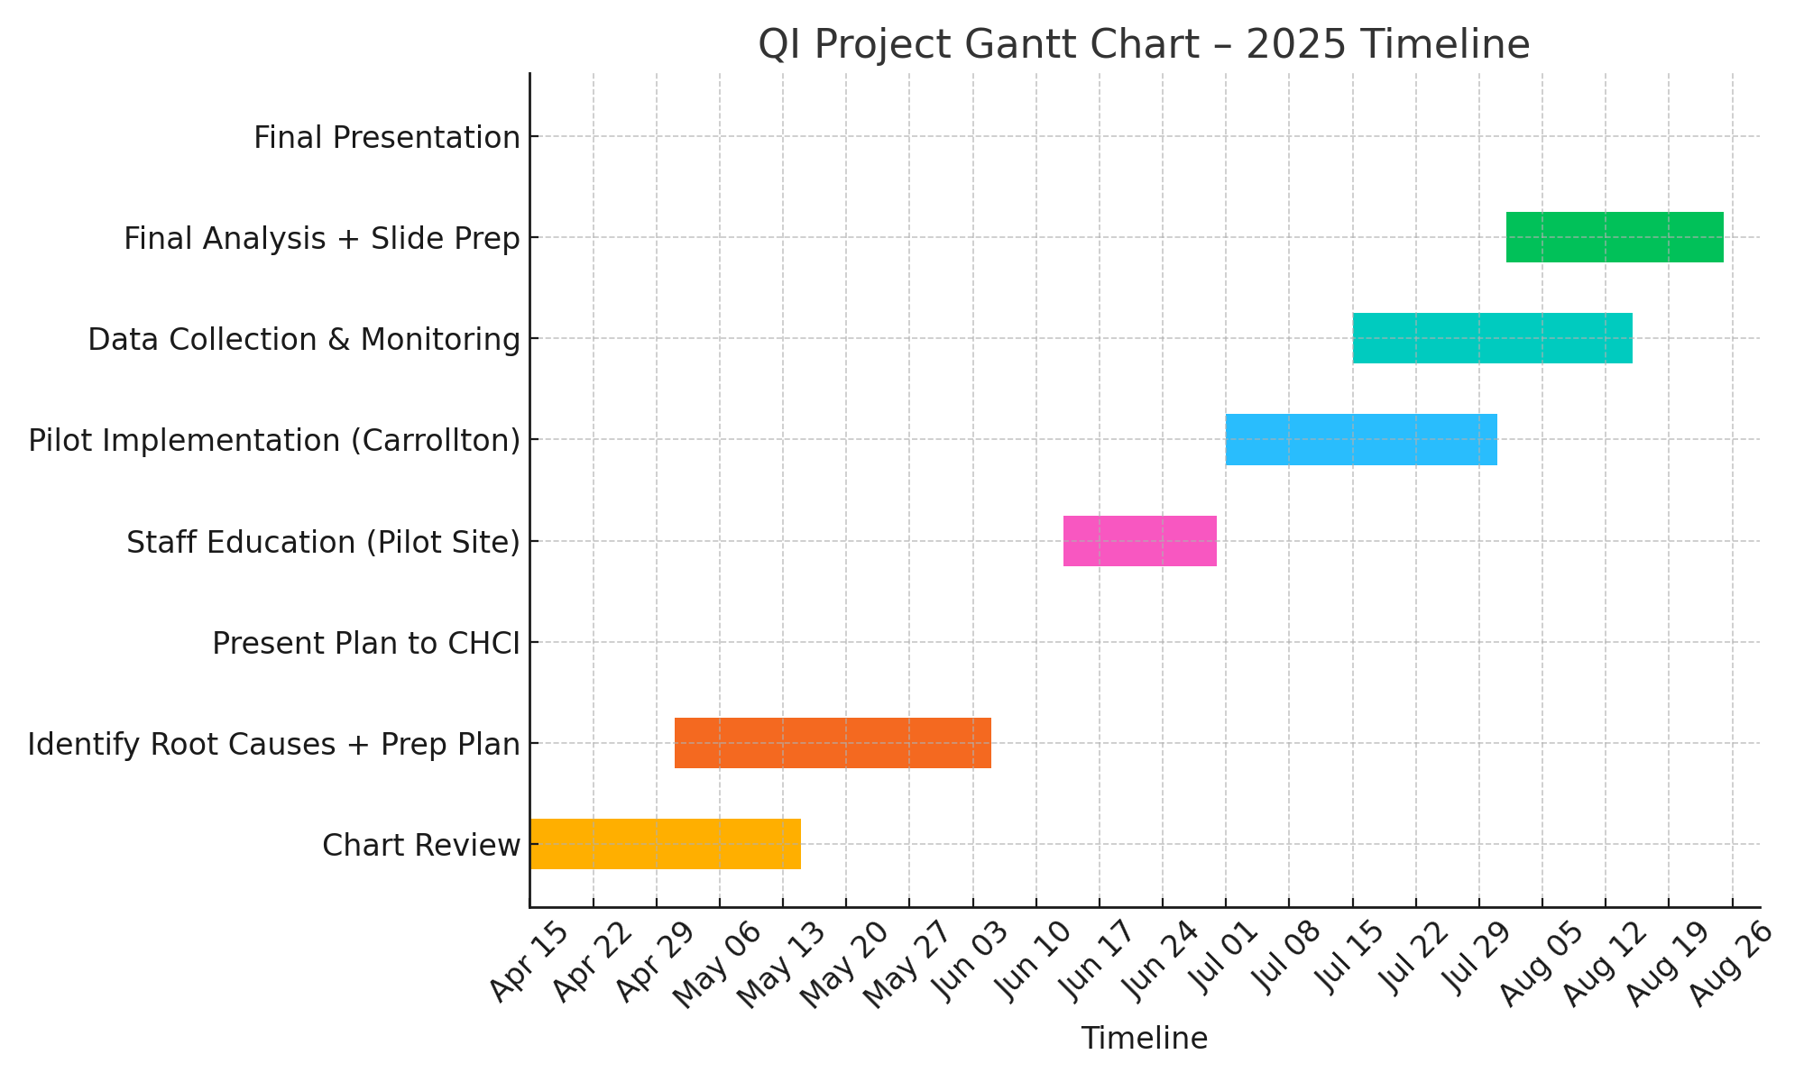
TIMELINE FOR DEPRESSION REMISSION INITIATIVE PROJECT ACTIVITIES FROM APRIL TO AUGUST 2025
Notes:
This chart outlines our timeline—from chart reviews in April through final presentation in August. We're currently in the education and early implementation phase.

Slide 14
Next Steps
Pull Azara data across all DePaul sites
Evaluate effectiveness of "Do" phase in July
Begin planning "Study" and "Act" phases for August final presentation
Notes:
Next steps include expanding data collection across all DePaul sites, completing our Do phase at Carrollton, and preparing to evaluate results and plan the Study/Act phases by August

Slide 15
References
American Psychiatric Association. (2022). Measurement-Based Care Toolkit. https://psychiatry.org
Azara Healthcare. (2024). DRVS Data Reporting and Visualization System. https://www.azarahealthcare.com
Centers for Medicare & Medicaid Services (CMS). (2024). Depression Remission at Twelve Months (CMS159v12).https://ecqi.healthit.gov
Lewis, C. C., Boyd, M., Puspitasari, A., et al. (2019). Implementing measurement-based care in behavioral health: A review. JAMA Psychiatry, 76(3), 324–335. https://doi.org/10.1001/jamapsychiatry.2018.3329
Rush, A. J., et al. (2006). Acute and longer-term outcomes in depressed outpatients requiring one or several treatment steps: A STARD report.* American Journal of Psychiatry, 163(11), 1905–1917.
SAMHSA. (2023). Integrated Care Models: Behavioral Health in Primary Care. https://www.samhsa.gov/integrated-care
Notes:
These are the references supporting our approach, including CMS, Azara, and recent literature on depression management and measurement-based care.

Slide 16
Questions / Discussion
Thank you for listening
Notes:
We’re happy to take questions or hear feedback on our next steps or data approach.

