Slide 1
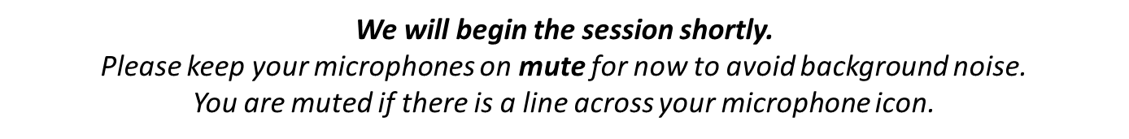

Welcome to the Early Childhood Therapeutic Partnership Learning Collaborative

Slide 2
Building Stronger Systems Together
A Learning Collaborative for Leaders
in Early Childhood Education and Pediatric Mental Health
Session 6: Partnership Evaluation
September 23rd, 2025
Notes:
Emma - Hello and welcome everyone to our third session where we will be covering the Impacts of the model across the IECMH Partnership
Welcome, tech/log, and Emma - 5
Participant introductions - 5
SME Panel - 20
Breakout groups - 15
Come back discussion - 5
Lisa - 10
— 60 total

Slide 3



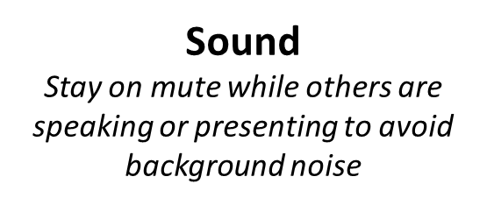
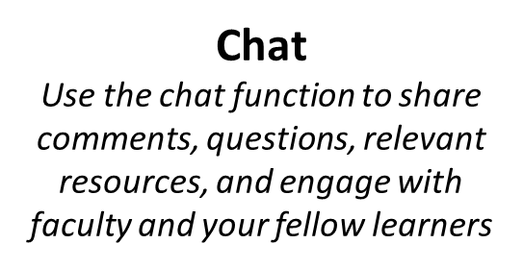
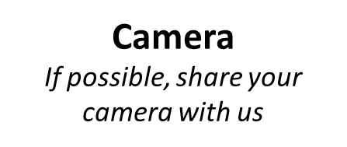
Technology: Your Zoom window
Notes:
Emma-
A few technology reminders. Please remain on mute while others are speaking or presenting to minimize background noise. Feel free to use the chat to share comments, questions, and resources, and to engage with faculty and fellow learners. Finally, if possible, we’d love for you to join us on camera to connect as a learning community.

Slide 4

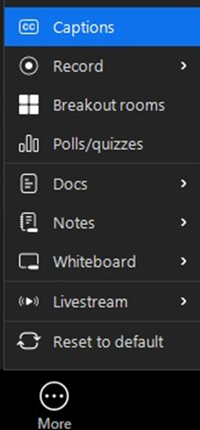
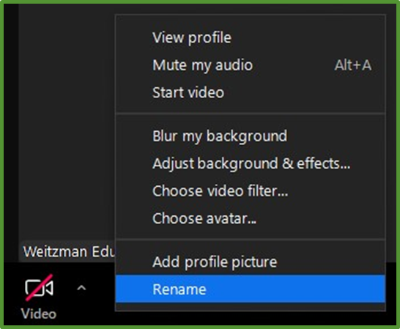
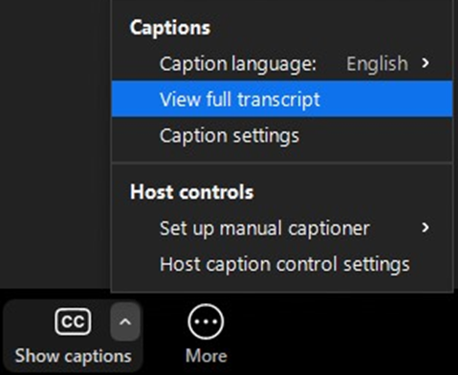


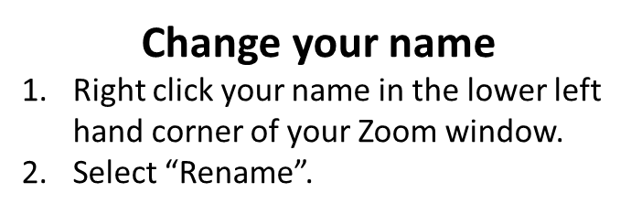
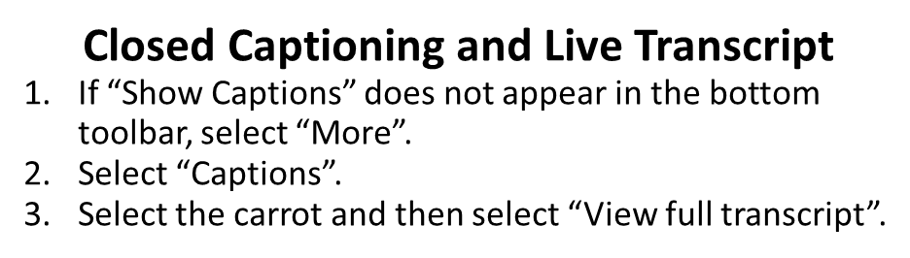
Technology: Your Zoom window, continued
Notes:
Emma-
To update your name, right-click it in the lower left of your Zoom window and select “Rename.” Please take a moment to share your full name, health center, and, if you’d like, your pronouns. Additionally, to help make our activities more accessible, closed captioning and live transcription are also available. (helpful to have this information going into breakout rooms so others know who you are and what organization you are with)

Slide 5

Continuing Education Credits
In support of improving patient care, Moses/Weitzman Health System is jointly accredited by the Accreditation Council for Continuing Medical Education (ACCME), the Accreditation Council for Pharmacy Education (ACPE), and the American Nurses Credentialing Center (ANCC), to provide continuing education for the healthcare team.
This series is intended for Early childhood education leaders, Pediatric behavioral health providers (psychologists, Master's level clinicians, and counselors), and Pediatric medical team members (MDs, DOs, NPs, PAs, RNs).
Please complete the survey and claim your post-session certificate on the WeP after today’s session.
You will be able to claim a comprehensive certificate on the WeP at the end of the series, September 23, 2025.
Notes:
Emma-
The Moses Weitzman Health System is jointly accredited to provide continuing education credits for your participation in these live learning collaborative sessions.

Slide 6
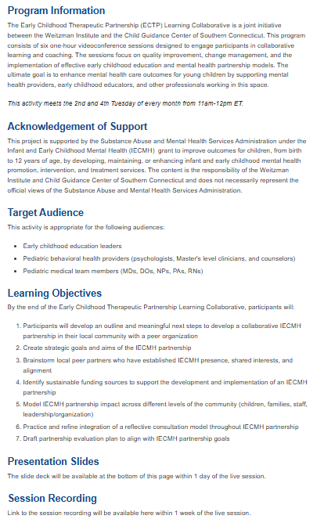

Accessing session recordings and materials
Return to the Overview tab of the live activity, Early Childhood Therapeutic Partnership Learning Collaborative (July 15, 2025)
Scroll down to the Presentation Slides and Session Recording headers
You will then be able to click on Session Recording and Presentation Slides listed below the headers to access the resources.
Notes:
Emma-
Session recordings and materials will be available on the Weitzman Education Platform. To access them, you can…
1.Return to the Overview tab of the live activity,
2.Scroll down to the Presentation Slides, and Session Recording headers
You will then be able to click on Session Recording, and Presentation Slides listed below the headers to access the resources.
Recordings will be uploaded within a week after each live session.

Slide 7
This Early Childhood Therapeutic Partnership Learning Collaborative session has been made available by:
Substance Abuse and Mental Health Services Administration under the Infant and Early Childhood Mental Health (IECMH) Grant
Notes:
Emma-
This Early Childhood Therapeutic Partnership Learning Collaborative session has been made available by the Substance Abuse and Mental Health Services Administration under the Infant and Early Childhood Mental Health (IECMH) Grant

Slide 8
Disclosures
With respect to the following presentation, there has been no relevant (direct or indirect) financial relationship between the faculty listed above or other activity planners and any ineligible company in the past 24 months which would be considered a relevant financial relationship.
The views expressed in this presentation are those of the faculty and may not reflect official policy of Moses Weitzman Health System.
We are obligated to disclose any products which are off-label, unlabeled, experimental, and/or under investigation (not FDA approved) and any limitations on the information that are presented, such as data that are preliminary or that represent ongoing research, interim analyses, and/or unsupported opinion.
Notes:
Emma-
Our faculty have no disclosures to report today

Slide 9

All Are Welcome
Notes:
Emma-
At the Weitzman Institute, we are grounded in community health, focused on improving care for underserved populations, and committed to fostering mutually respectful dialogue. We strive to create learning environments where all participants are welcome, and we promote respectful care settings where patients can be their authentic selves. If there’s anything said in today’s session that makes you feel uncomfortable or doesn’t align with these values, please let us know on our post-session evaluation.
I am now going to turn it over to our quality improvement coach lisa…

Slide 10
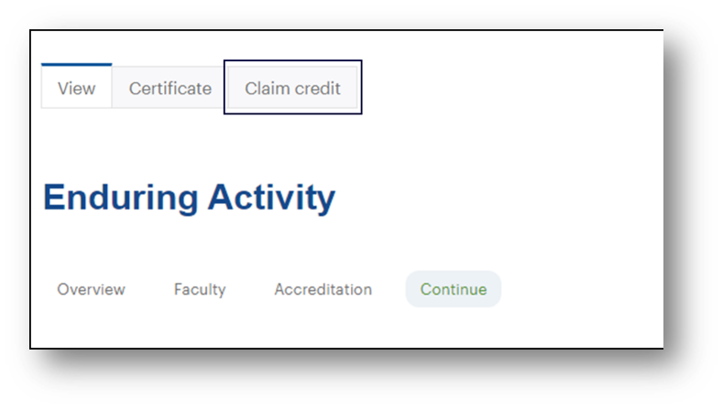
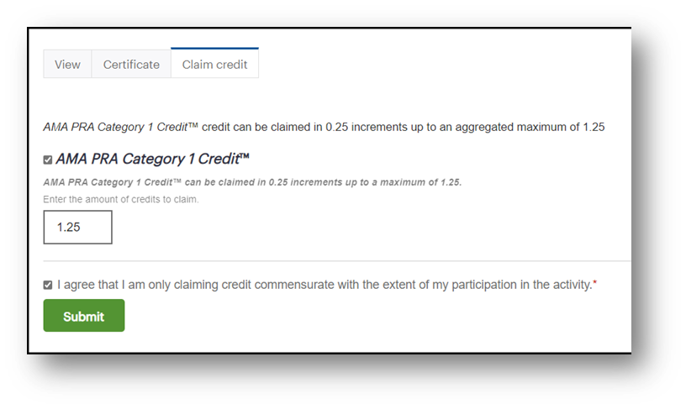
Weitzman Education Platform: End of Series Credit Claiming
Navigate to your activity home from My Current Activities section on the homepage, or from your Transcript.
Select the Claim Credit tab that is now visible at the top of the activity page.
Enter the number of credit(s) commensurate with your attendance for the activity.
You may only claim credit(s) once, so be sure you have completed all session activities before completing this step.
Then, select Submit. You will then be able to download your certificate.
Notes:
As our series ends today make sure all participants and faculty have the resources needed to claim your continuing education credits and download your certificate before the program closes. In order to claim credit, please go to the Weitzman Education Platform and complete the steps on the slide. Please NOTE: You may only claim credit(s) once, so be sure you have completed all session activities & evaluation surveys before completing these steps.

Slide 11
Weitzman Education Platform: End of Series Credit Claiming
You MUST claim credit for the series as a whole within 2 weeks of the last session by October 7, 2025. The online course will close after this date and you will not be able to claim and download your certificate.
For additional instructions, please read:
  How do I claim credit at the end of an activity?
  How do I view and download my certificates?
Still have questions?
  Submit a Help Desk Ticket and someone from the WeP team will respond and an assist!
Notes:
You MUST claim credit for the series as a whole within 2 weeks of the last session: October 7th. The online course will close after this date and you will not be able to claim and download your certificate.
There are additional resources listed and a help desk link for any troubleshooting issues. I will also send this information in a follow up email after today’s session.

Slide 12


Chat Waterfall
Type your response to the question in the chat, but don’t hit send until we say so.
Question: Favorite or dream vacation destination
Notes:
Emma - Chat waterfall activity

Slide 13
Session Agenda
Session Objective: Draft partnership evaluation plan to align with IECMH partnership goals
Subject Matter Expert Panel
Break Out Rooms
Brief Discussion
Quality Improvement Activity
Action Items
Notes:
Emma to go over agenda and then hand it over to Karen to moderate

Slide 14
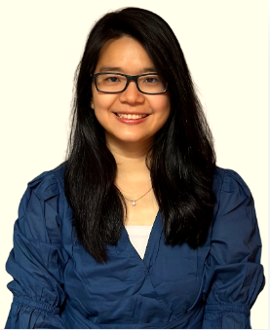
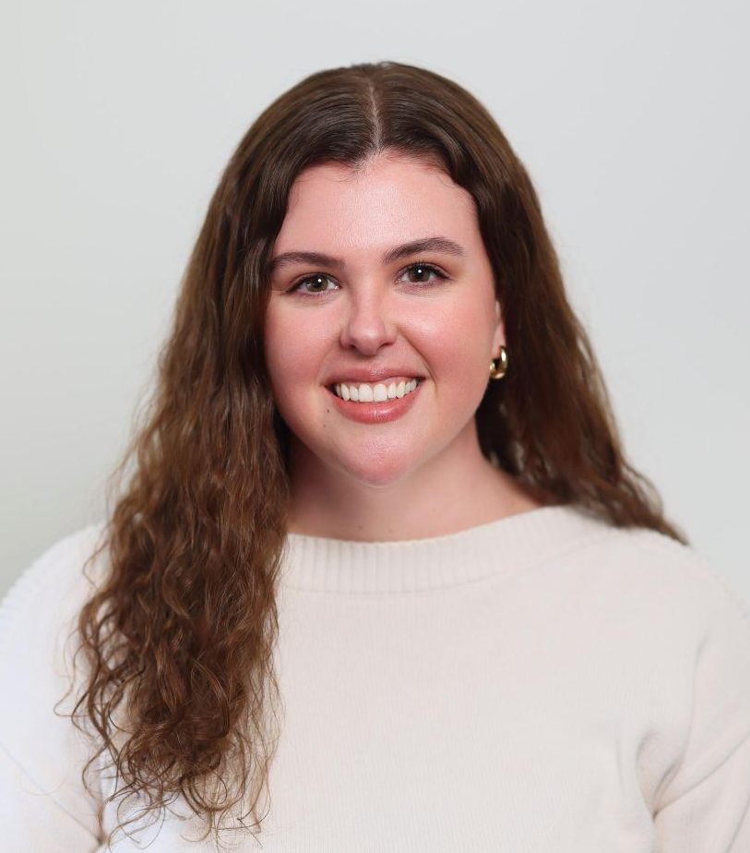
Subject Matter Expert Panel Participants
May Oo, MS, MPH
The Weitzman Institute
Moses/Weitzman Health System
Research Scientist and
ECTP Co-Lead Evaluator
Kate-Lynd Murphy, LCSW, PMH-C, IMH-E®
Child Guidance Center of Southern Connecticut (MH)
Project Director: SAMHSA Early Childhood Therapeutic Partnership
Notes:
Jaime Moderating
May Oo; May is a Research Scientist with the Weitzman Institute and is a Co-Lead Evaluator on CGC’s ECTP grant. She has been with the Weitzman Institute since 2019 supporting research and evaluation on a number of projects, with her focus primarily on the Prescription to Play program coordinated by the LEGO Foundation. May has a masters degrees in public health and business analytics and she is currently pursuing a Doctorate of Health Informatics with a specialization in Health Data Analytics at Rutgers University.
Kate; Kate is a Licensed Clinical Social Worker and CGC’s Project Director of the SAMHSA Early Childhood Therapeutic Partnership. She guides and oversees all aspects of ECTP including grant administration, SBHC and MHC programming, clinical supervision, and partnership sustainability. Kate is a rostered Child Parent Psychotherapy clinician, certified ARC clinician, and maintains advanced certification/endorsement in perinatal, infant, and early childhood mental health.

Slide 15
When initially planning project evaluation, what were the most essential elements to capture within the partnership?
Notes:
May

Slide 16
Many program leaders often feel a sense of pressure when they hear the word “evaluation.” In our project, how have we approached evaluation as a component that supports the work, rather than seeing it as an extra burden?
Notes:
Kate

Slide 17
How did the evaluation team balance the need for measurable outcomes while honoring the relational nature of the work?
Notes:
May

Slide 18
How do you envision partnership leaders will use the findings to strengthen and sustain the project over time?
Notes:
Kate

Slide 19

Questions?
Feel free to unmute or put your questions in the chat!

Slide 20
Break Out Room
Reflection Question
How have you and/or might you balance and capture both the quantitative changes and the qualitative shifts within your partnership?

Slide 21
Post-Break Out
Group Reflection
What are you taking away from the conversation that was held in your breakout group?
Notes:
Jaime
Transiting to Lisa – How do you know those changes are happening? How are we measuring impact

Slide 22
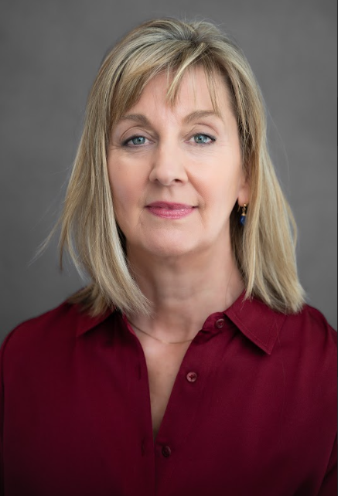
Quality Improvement Consultant
Lisa Leary, MS
Lisa Leary Consulting
Quality Improvement Advisor
Notes:
Session 6
-storytelling
-examples/data mock ups (challenging bx)
– show with annotations, visual
– story telling
-integrating qualitative data (parents, teachers, children)
-value of mixed methods
-how they would share

Slide 23
Using Data to Tell Your Story
The problem you wanted to address: Purpose statement
“We want to create a healthier learning environment by improving educators skills in managing challenging behaviors”
Story Components
2. How you went about addressing the problem: Aim statement
“We will decrease challenging behaviors by providing training and coaching to early childhood educators. By doing this we expect a decrease in challenging behaviors and an increase in educator confidence”
3. What you were able to achieve: Your measures
Challenging behaviors over time
Educator confidence
Notes:
Animate each component

Slide 24
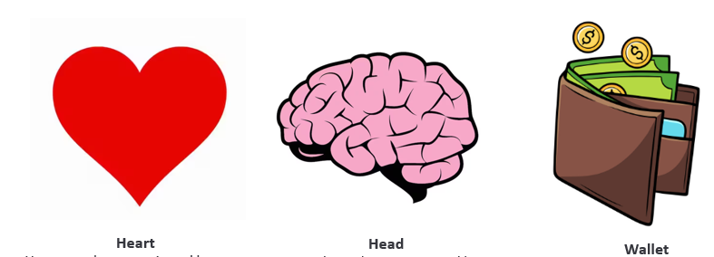
Considerations
Address the multiple perspectives of your audience
Notes:
Earlier we discussed who you would share data with, staff, partners, BoD, funders. Make sure you cover all aspects of these components. Most of these factors are addressed in the balanced measures approach that was discussed in a previous session. What are components/metrics of your story/partnership (potential) that speak to heart, head, wallet? (chat)
What category do you think you lean most towards? What category do you need to put more energy into?

Slide 25
Considerations
2. Consider a “mixed methods” approach
Quantitative - numbers
Qualitative - descriptive (words)
Notes:
Qualitative data has been referred to as being the heart of the data. Creates a richer story, paints a picture. Quantitative can speak to the head (science, outcomes, evidence and ROI)

Slide 26
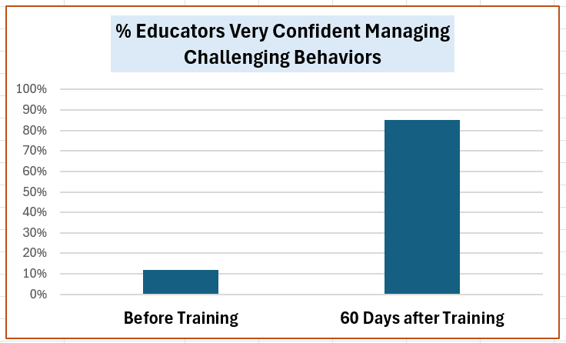
Quantitative

Slide 27
Qualitative
Observation: Participants varied in age and amount of time in their role as early childhood educators.
Direct Quote: “The training program was fantastic, I would highly recommend it to others working in early childhood education.
Notes:
Qualitative data has been referred to as being the heart of the data. Creates a richer story, paints a picture. Quantitative can speak to the head (science, outcomes, evidence and ROI)

Slide 28
More Examples
Quantitative:
  We saw a 65% decrease in challenging behavior
  18 educators were trained
  92% of trainees were “highly satisfied” with the training
Qualitative:
  “I am so grateful for this training. Not only do I have more confidence in managing challenging behaviors, I am experiencing greater joy in my role as an educator.
  “Observations with [MH Consultant] have been helpful in understanding and supporting the emotional needs of my students. It gives me the support and guidance and reassurance as an educator.”
  “The child focused consultation and feedback sessions have been an incredibly valuable part of our work. The strategies are not only rooted in best practice but they focus on the unique strengths of each child.”

Slide 29
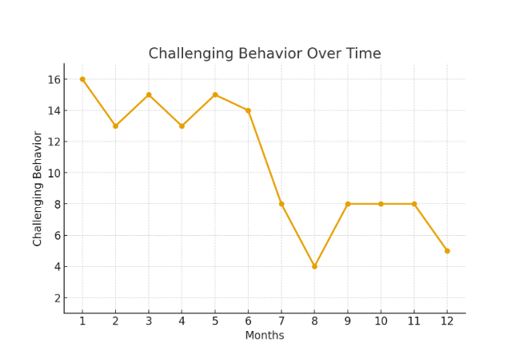
Data Over Time
Don’t forget to collect baseline data (if you are showing before/after changes)
Training started here
Notes:
The annotation is part of the story. Without the annotation you don’t have the full story. As an example, Measurement based care - Kate can jump in here. Great addition for your annual report, fundraising appeal, etc.

Slide 30
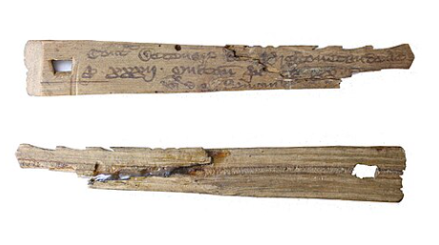
Measurement and the Issue of Time
Refer to your data collection plan (how to)
Check in on the data collection process to avoid rework
Chunk it down into small manageable pieces
Hand tally is perfectly acceptable
5. Use a journal to track quotes and observations
6. Two or three metrics (max) are adequate
7. Stick to the plan - don’t over complicate your story
Notes:
Animate each number, tally sticks come up with #4.

Slide 31

Post-Work
Notes:
Celebrate, you showed up, you contributed, you have new insights and opportunities. Perhaps you made new connections along the way. If there is any time, please provide a single sentence takeaway from this experience

Slide 32

Chat Waterfall
Type your response to the question in the chat, but don’t hit send until we say so.
Question: How will you keep your battery charged as you move forward in your partnership?
Notes:
Jaime -
Example resources - ECHO next year, contact list, they have a community, they have some skills and strategies

Slide 33
Building Stronger Systems Together
Thank you for joining the learning collaborative!
Please complete the survey on the Weitzman Education Platform
Notes:
Kate to close out - Thank you all for your continued engagement and participation throughout this series. There’s been such a wealth of resources, insights, and personal experiences shared. Please remember to complete your session evaluation after we finish to claim your CME and participation credit. As a reminder, you will have 2 weeks to claim your credits and access resources. This access will end on October 7th! Thank you again for being part of this community and for all the important work you do!

