Slide 1
CGM Basics for Individuals with Type 1 Diabetes at FQHC’s
Nancy A. Allen PhD, ANP-BC, FADCES, FAAN
Professor, University of Utah

Slide 2
Objectives
1. Discuss case study
2. Establish the rationale for CGM in Type 1 Diabetes
3. Identify the Libre 2 and Libre 3 components and functionality
4. Compare and contrast CGM with Blood Glucose Monitoring
5. Describe lag time
6. Discuss a final case study

Slide 3
CASE STUDY
Alejandro is a 31-year-old Hispanic male with a 12-year history of type 1 diabetes who receives care at an FQHC. His A1c levels have consistently remained elevated (>10%) since diagnosis, and he experiences 1-2 emergency department visits or hospitalizations per year. He has attempted to work as a roofer and painter but has lost jobs due to episodes of diabetic ketoacidosis requiring hospitalization. Alejandro has developed diabetic retinopathy and neuropathy as complications of his high A1c levels. He rarely monitors his blood glucose because he doesn't want others to know about his diabetes diagnosis. The clinical challenge is determining how to recommend appropriate insulin dose adjustments. He currently takes 30 units of glargine at bedtime and 5 units of Humalog before meals.
What is causing Alejandro’s high glucose levels?
a. The Somogi effect
b. Missing boluses before meals
c. Snacking and not taking insulin
d. He needs more basal insulin
e. Not enough information
f. Other
Notes:
Answer: E

Slide 4
CASE STUDY
Alejandro is a 31-year-old Hispanic male with a 12-year history of type 1 diabetes who receives care at an FQHC. His A1c levels have consistently remained elevated (>10%) since diagnosis, and he experiences 1-2 emergency department visits or hospitalizations per year. He has attempted to work as a roofer and painter but has lost jobs due to episodes of diabetic ketoacidosis requiring hospitalization. Alejandro has developed diabetic retinopathy and neuropathy as complications of his high A1c levels. He rarely monitors his blood glucose because he doesn't want others to know about his diabetes diagnosis. The clinical challenge is determining how to recommend appropriate insulin dose adjustments. He currently takes 30 units of glargine at bedtime and 5 units of Humalog before meals.
Is Alejandro a good candidate for CGM?
1. Yes
2. No
3. Maybe
Notes:
Preface with next we will have an open-ended question and will need your participation!

Slide 5
CASE STUDY
Alejandro is a 31-year-old Hispanic male with a 12-year history of type 1 diabetes who receives care at an FQHC. His A1c levels have consistently remained elevated (>10%) since diagnosis, and he experiences 1-2 emergency department visits or hospitalizations per year. He has attempted to work as a roofer and painter but has lost jobs due to episodes of diabetic ketoacidosis requiring hospitalization. Alejandro has developed diabetic retinopathy and neuropathy as complications of his high A1c levels. He rarely monitors his blood glucose because he doesn't want others to know about his diabetes diagnosis. The clinical challenge is determining how to recommend appropriate insulin dose adjustments. He currently takes 30 units of glargine at bedtime and 5 units of Humalog before meals.
Discussion Questions
1. What concerns do you have about putting him on CGM?
2. What concerns do you think Alejandro might have about CGM?
Notes:
He is doesn’t test his FSBG and you need this information for insurance coverage.
He won’t be able to use the technology because of his visual changes and neuropathy.
He doesn’t want people to know that he has diabetes and it is uncertain if he would wear the CGM on his arm.
He won’t wear the technology because he hasn’t done anything else that he is supposed to do.

Slide 6
Using CGM in Type 1 Diabetes
Primary Benefits:
Shows glucose levels with trends in real time following each scan and resulting in increased awareness
Removes barriers to glucose awareness, allowing for informed decisions
Ability to adjust insulin based on trends
User can evaluate current glucose, direction of change (up or down,) and rate of change
Helps prevent hyper/hypoglycemia.
Extra layer of protection for lows – especially overnight lows
Ability to share glucose and alerts with other family members

Slide 7
Using CGM in Type 1 Diabetes
Benefits of evaluating downloads at each office visit:
Metrics show time in range (TIR), time above/below range, and glycemic variability
Remote downloads
Robust data for intensification of therapy
Potential to avoid hospitalizations due to early recognition of trends
Notes:
Explain TIR etc.

Slide 8
CGM in Low Income Adults with T1D
Low-income individuals with type 1 diabetes (T1D)
  Greater glucose instability
  More complications (hypoglycemia, DKA)
  Higher rates of ED visits, hospitalizations, and deaths
Individuals covered by Medicaid are the least likely to get a CGM, especially if they are people of color
Barriers to CGM in Low-income adults with T1D
  Social Determinants of Health (access to Endocrinologists, insurance, low income)
  Primary care providers (PCP) less confident in insulin titration
  PCP’s less confident in using or interpreting CGM data
American Diabetes Association, 2024

Slide 9
BGM/CGM Comparison
 | Fingersticks (BGM) | CGM
Accuracy | X
Discomfort/Hassle |  | X
Cost/Accessibility | X
Trending Information |  | X
Safety Alerts |  | X
Detailed Data Reports |  | X
Safety/Peace of Mind |  | X
What BGM Misses

Slide 10
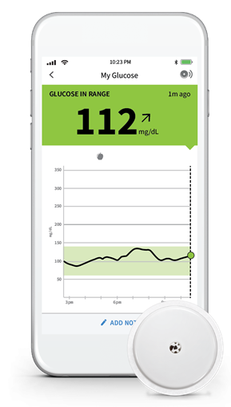
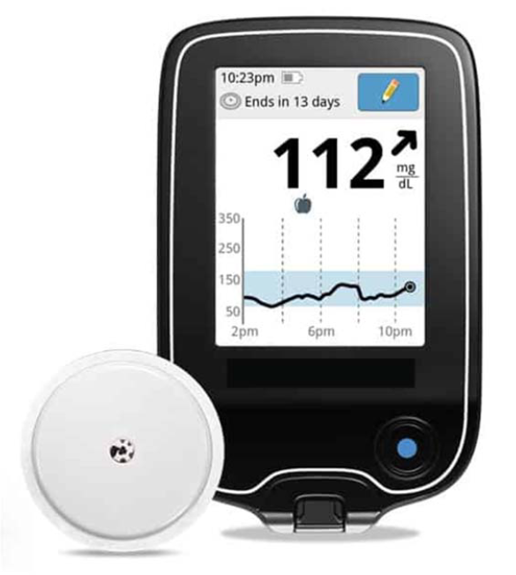
Libre 2 and 3 CGM Components
Glucose sensor is inserted in the subcutaneous tissue in the back of the arm and has a built in transmitter
Sensor generates a minute current when in contact with glucose in the interstitial tissue
Transmitters sends signal wirelessly to a smartphone or to a reader

Slide 11
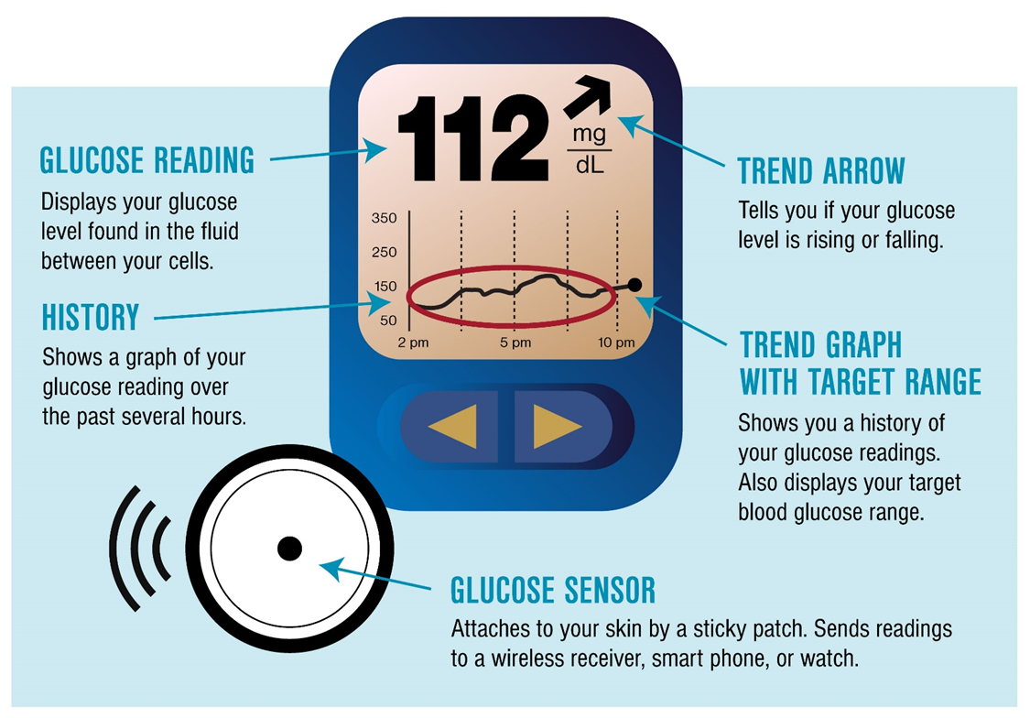
Review Components of CGM to Increase Patient Acceptance
Notes:
When Providers demonstrate familiarity with a new treatment or device, patients indicate they are more likely to accept it, so it is important for providers and other clinicians to understand CGM devices and their displays. Features commonly seen on the display screen of CGM systems are below. The display screen is either the system’s dedicated reader device or a smartphone.

Slide 12
How CGM Accuracy is Determined
Generates new glucose data values every 1 minute
Mean-Absolute-Relative-Difference (MARD)
  MARD is the average of the absolute error between all CGM values and matched reference values.
  Lower MARD values indicate greater device accuracy
Mean Absolute
Relative Difference
Average (mean) percent deviation from a reference (lab) value
Commonly used to evaluate CGM accuracy
Notes:
Pause. CGMs use the metric Mean Absolute Relative Difference (MARD), which is the comparison between CGM readings and BG values measured by the reference measurement device. A lower percent difference reflects a more accurate reading from the CGM.

Slide 13
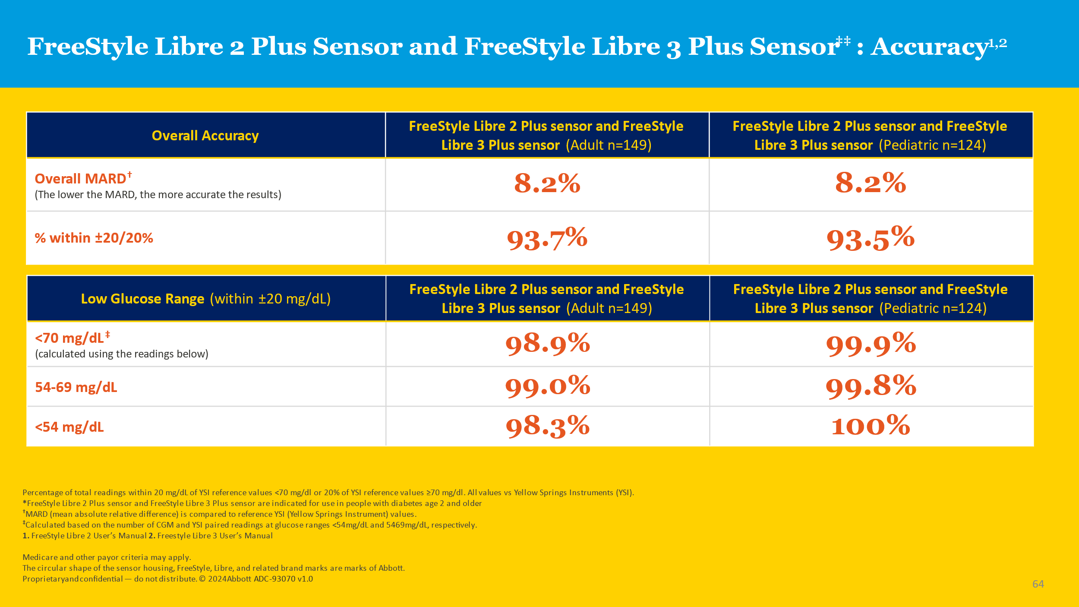
Libre 2 and 3 plus Sensor Accuracy
Notes:
When you look at the accuracy of the CGM’s, you will see the mean absolute difference. This accuracy has improved over time. What this is chart is telling you is that the percent with in plus or minus 20 is 93.7% or 93.5%. And you can see that this range is slightly better in the lower ranges.
Patients will tell you that the CGM isn’t always that accurate when they compare it to their fingerstick blood glucose monitor. They may even ask which one is more accurate. If they wash their hands before they test, and the strips aren’t out of date or exposed to extreme temperatures then the meter should be more accurate then the CGM and I will explain this in the upcoming slides.

Slide 14
CGM functionality
Fingerstick calibration required 0 times daily
  More to come on when to advise patients to check
Sensor changed every 14-15 days
  Although the adhesive often doesn’t last that long more tips later!
Transmitter is disposable

Slide 15
Lag time
Capillary glucose must diffuse
into the interstitial fluid (ISF)
ISF glucose levels lag capillary levels by 3-5 minutes
Longer lag with diminished subcutaneous blood flow (exercise, stress)
Signals averaged every 1 minute to generate data points

Slide 16
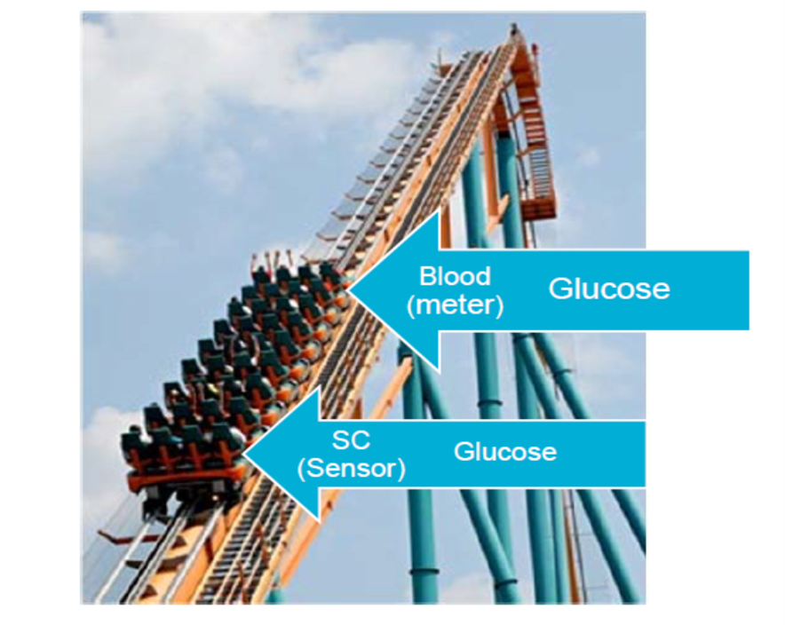
Understanding Lag Time
Glucose Rising:
CGM likely lower than the actual BG

Slide 17
Understanding
Lag Time
Glucose is Falling:
CGM is likely higher than
the actual BG

Slide 18
Understanding Lag Time
Glucose Stable
CGM is in equilibrium with BG
Notes:
This is important because you have to explain this to patients about why their fingersticks are more accurate than their CGM. And the major point here is that if they believe that the CGM is not accurate they need to check a finger stick blood glucose value. The times that the CGM is most inaccurate is on day one of the sensor and when the glucose level is rising or falling.

Slide 19
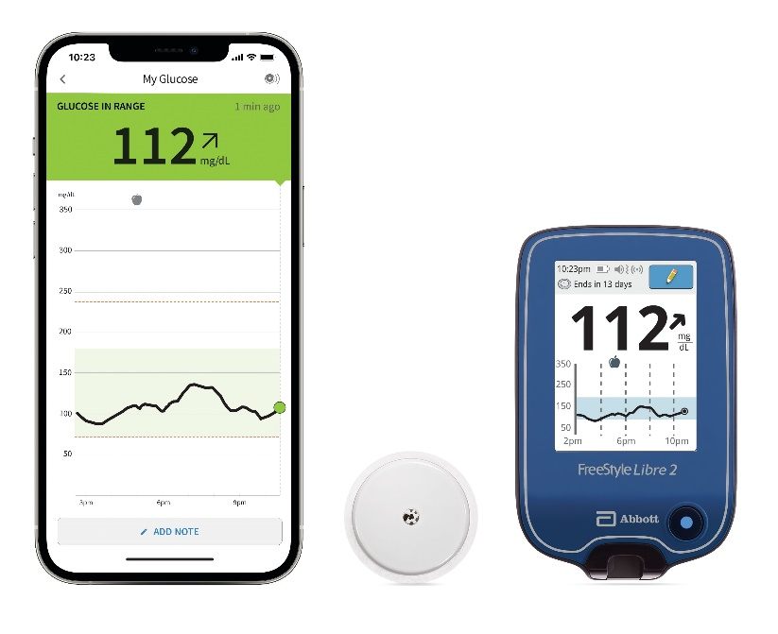

FreeStyle Libre 2 and 3 system components
OVERVIEW
EASY-TO-USE APP AND READER
Scans through clothing within 1.5 inches
Stores 90 days of glucose data so patients can see their patterns and historic trends
Built-in FreeStyle Precision Neo test Strip port on reader for finger stick blood glucose testing
SENSOR
Small, discreet, and easy for patients
Worn up to 14 days on back of upper arm
Water resistant
Patients can scan to get their glucose level as often as they want

Slide 20
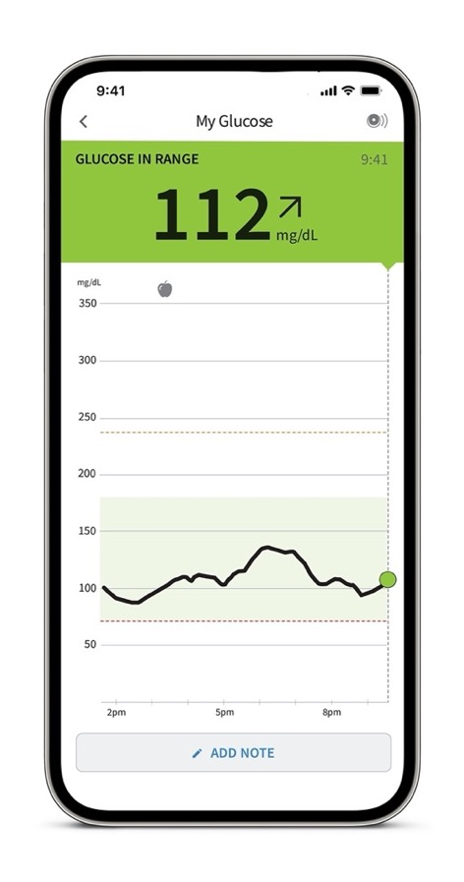
FreeStyle Libre 2 system provides real-time glucose data, trends and patterns for diabetes management
Speaker icon
depicting alarm setting
Trend arrow
showing the direction glucose is heading
Number
representing current glucose reading
Trend graph
depicting the latest 8 hours of glucose history

Slide 21
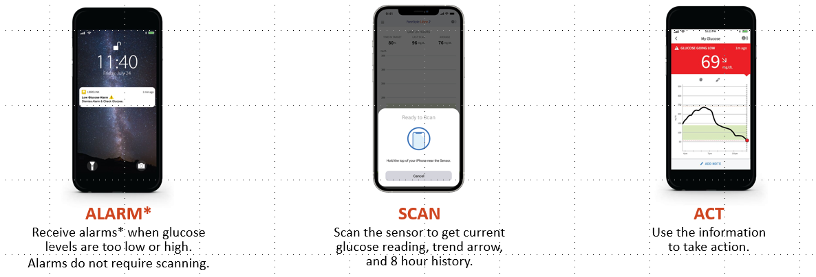
Libre 2 Alarms Require Scanning

Slide 22
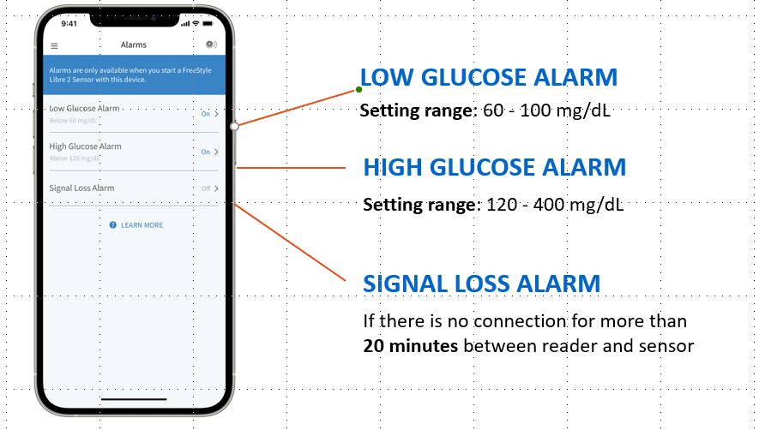
Real-time Low and High Alarms

Slide 23
Summary
CGM plays an important role in the safety and well-being of people with diabetes
Low-income adults with type 1 diabetes are underrepresented in those benefiting from CGM
CGM represents the state-of-the-art in glucose monitoring
CGM offers multiple benefits over blood glucose monitoring and has shown improved clinical outcomes throughout the lifespan.
Let’s do another case study!

Slide 24
Case Study
This is the first day of Alejandro's new sensor. He has experienced problems with sensors giving inaccurate readings during the first 24 hours after insertion. He checks his glucose with the CGM and sees his glucose is 280 mg/dL before lunch with an upward-trending arrow. He feels fine. What should Alejandro do in this situation?
1. Check FSBG
2. Do nothing and take his normal pre-meal insulin dose
3. Increase his pre-meal insulin dose
4. Decrease his pre-meal insulin dose

Slide 25
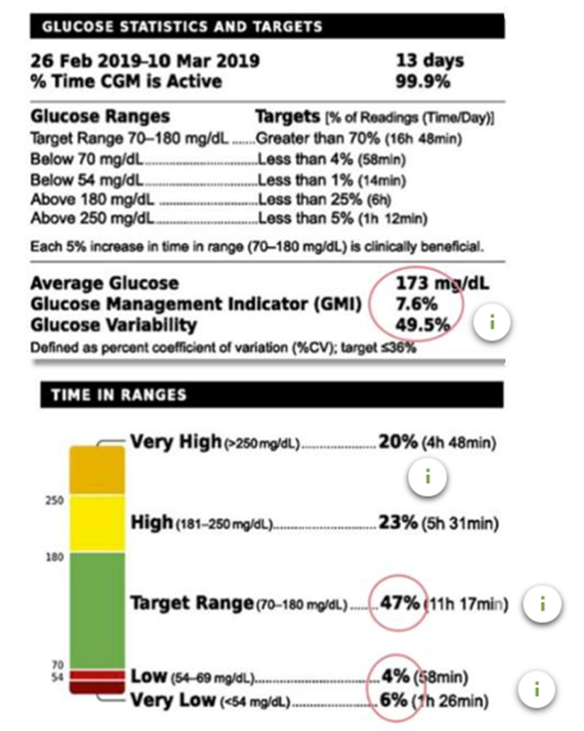
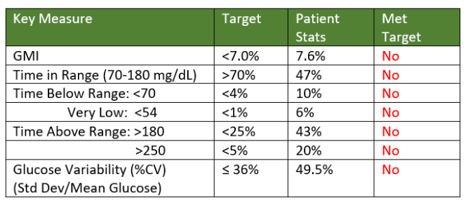
Primer for Next Weeks Echo
Notes:
We are going to go over the AGP report which stands for Ambulatory Glucose Profile report. This is a standardized CGM report no matter what CGM a patient is using. You will be learning about the Glucose Management Indicator (GMI) which approximates the laboratory A1C level expected based on average glucose measured using continuous glucose monitoring (CGM) values. What is considered time in range, time below range, time above range and how to determine if the patient is having a lot of glucose variability.

Slide 26

Questions

