Slide 1
Putting It All Together
Nancy A. Allen PhD, ANP-BC, FADCES
Kelley Newlin-Lew DNS, ARNP-C, FAAN

Slide 2
Objectives
Identify the critical times to refer for diabetes education
Review insulin management strategies
Review CGM analysis
Practice insulin management and CGM analysis with Case Studies

Slide 3
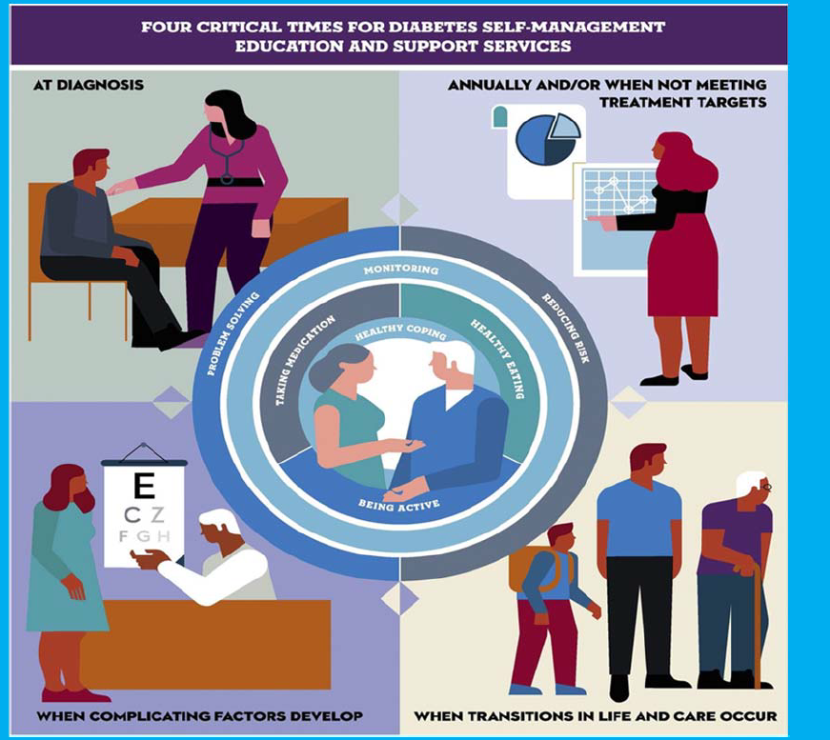
CGM discussions are included
in the Four Critical Times for
Diabetes Self-Management Education and Support (DSMES)

Slide 4
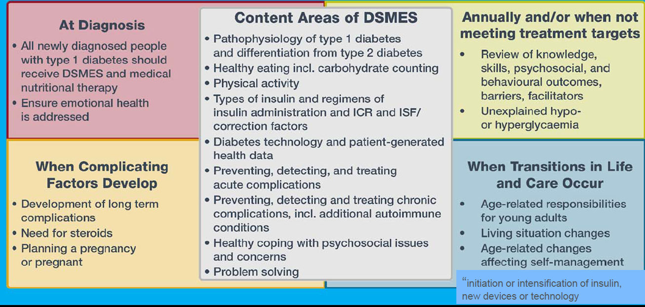
Four critical times for diabetes education and support in Type 1 Diabetes

Slide 5
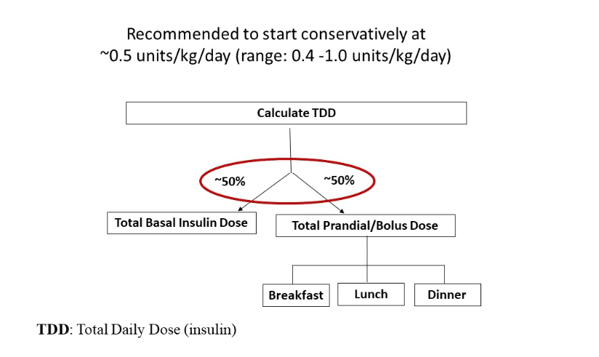
Review of Insulin Initiation

Slide 6
Creating a Correction Dose of Insulin
The 1800 Rule:
Works for Type 1 diabetes
Estimates the point drop in mg/dl per unit of Lispro or Aspart
1800/TDD = point drop per unit of Lispro or Aspart (see Table)
Example: Total Daily Dose of insulin = 30 units 1800/30 u/day = a 60 point drop per unit of Lispro or Aspart

Slide 7
Correction Dose Table
Notes:
The American Diabetes Association standard of care recommends that adults with diabetes and no serious co-morbidities have glucose targets between 70-180 24 hours a day. People with diabetes have different insulin sensitivity throughout the day and may need to take more or less of correction dose of insulin because of that. Therefore, here are some examples of 3 different types of scales.

Slide 8
Creating an Insulin to Carb ratio
This can be calculated using the Rule of “500”: Carbohydrate Bolus Calculation
The carbohydrate coverage ratio:
500 ÷ Total Daily Insulin Dose
= 1 unit insulin covers so many grams of carbohydrate
In this example :
Carbohydrate coverage ratio
= 500 ÷ TDI(40 units)
= 1unit insulin/ 12 g CHO
1:15 insulin to carb ratio is usually a good starting point
https://www.tidepool.org/blog/optimizing-insulin-to-carb-ratios

Slide 9
Stepwise Approach to Interpreting and Using CGM Data
Is there enough data to be analyzed?
Where to find the answer: Look to % Time CGM active on AGP report
Need to have 70% of time worn
What is the problem?
Look to CGM metrics:
Is your patient having Hypoglycemia, Hyperglycemia, or both?
Where is the problem?
Look to the Ambulatory Glucose Profile: Is the time of day Fasting, Postprandial, etc.
How to adjust therapy?
Look to the Daily Glucose Data Patterns and make necessary changes
Emily D. Szmuilowicz & Grazia Aleppo (2022): Stepwise approach to continuous glucose monitoring interpretation for internists and family physicians, Postgraduate Medicine, DOI: 10.1080/00325481.2022.2110507

Slide 10
Treatment Strategies
Hypoglycemia |  | Hyperglycemia
Solution | Pattern | Solution
Decrease basal insulin dose by 10-20% | Fasting/Overnight | Increase basal insulin dose by 10-20%
Reduce meal dose or decrease the Insulin to Carb ratio by 10-20% (e.g. if ratio is 1:10, change to 1:12) | Around mealtime (1-3 hours after a meal snack) | Ask if the meal dose was missed. If yes, educate on giving all meal doses prior to eating. Increase meal dose Insulin to Carb ratio by 10-20% (e.g. if ratio is 1:10, change to 1:8)
If hypos 2-3 hours after correction insulin is given: Reduce correction dose or decrease the correction factor by 10-20% (e.g. if correction factor is 1:50, change to 1:60). | Where low glucose follows a high glucose or Where high glucose follows low glucose | Ask how user is treating low glucose levels and educate: Treat with 10-15 g of fast acting carb.

Slide 11
Treatment Strategies
Hypoglycemia |  | Hyperglycemia
Solution | Pattern | Solution
 | After correction insulin was given (2-3 hours after correction insulin was given) | Increase high glucose correction factor (e.g. if correction factor is 1:50, change to 1:40)
Discuss current exercise strategies educate on: Small snacks as needed before and during exercise with no insulin Reduce meal time insulin dose if meal is within 2 hours of exercise start Use temp basal feature on pump | Around or after exercise

Slide 12
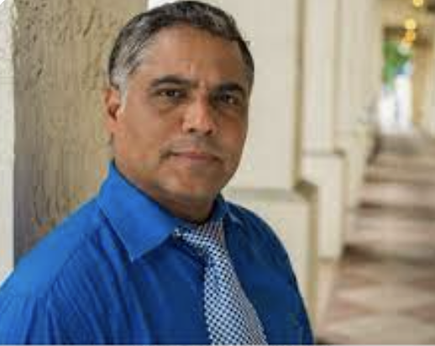
Case Study
Diego is a 53-year-old male with a 40-year history of T1D. PMH significant for HTN, HLD, non-proliferative diabetic retinopathy, neuropathy, amputation of left great toe (2015). His BMI is 30.3 (98.6 kg). He is enrolled in the NIH Type 1 Diabetes CGM Study. Diego had his first study visit with the CDCES. Today, he presents for his second study visit with you (prior to initiating CGM). His A1c today is 8.7%.
What would your priorities be for the first visit? Select all that apply:
Review with Diego his goals for CGM
Assess his current insulin doses and make adjustments if needed
Assess his self-monitored blood glucose (SMBG) data
Determine if Diego has had any hypoglycemia since his last visit with you
Engage family members as appropriate
Notes:
Answer all of the above

Slide 13
Diego’s SMBG Data: Visit 1 with PCP
Result | Wednesday | Thursday | Friday | Saturday | Sunday | Monday | Tuesday
Pre-Breakfast | 220 | 203 | 198 | 217 | 201 | 207 | 202
Pre-Lunch |  | 210 | 206 |  |  |  | 199
Pre-Dinner | 196 | 200 | 196 |  | 214 | 218 | 201
HS |  | 190 | 210 |  | 196 |  | 193
Result | Wednesday | Thursday | Friday | Saturday | Sunday | Monday | Tuesday
Pre-Breakfast | 210 | 197 | 208 | 196 |  | 199 | 196
Pre-Lunch | 221 | 208 | 204 | 201 | 202 | 208 | 201
Pre-Dinner | 198 |  |  | 236 | 208 | 2012
HS |  | 199 | 204 |  | 203 | 202 | 199

Slide 14
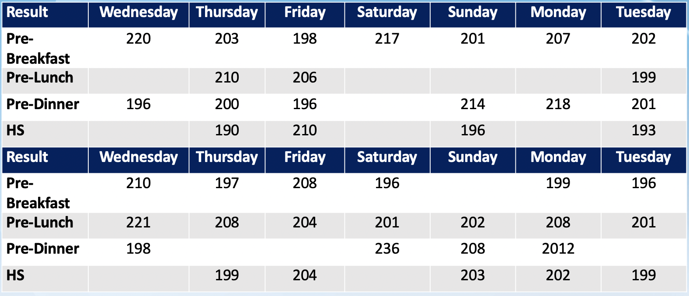
Visit 1
Diego’s regimen:
- Detemir 30 units twice daily
- Aspart 20 units three times
a day before meals
A1c 8.7%
What is Diego’s total daily dose of insulin?
80 units
90 units
110 units
120 units
What change would you make first:
Breakfast bolus dose
Lunch bolus dose
Dinner bolus dose
Basal dose
Notes:
Adjusting bolus will not help with hyperglycemia across the day.
How much of an elevated A1c is responsible for basal vs bolus. Deepika Response: in those with good control, bolus needs contribute more, and in poorly controlled fasting hyperglycemia has an increased effect
Answer is 4

Slide 15
Making Insulin Recommendations
What actions will you take at your visit? (Select all that apply)
Assess Diego’s current amount and daily routines with taking his insulin
Increase bedtime Detemir dose by 15 additional units
Increase Aspart insulin by an extra 10 units before each meal
Increase Detemir dose by 12 units divided into two doses (Breakfast and bedtime)
Increase Detemir dose by 16 units divided into two doses (Breakfast and bedtime)
Notes:
Answer is 1 and 4
If you have confidence that Diego is following his prescribed insulin regimen, increase his basal dose by 20% (12 units). Diego has an elevated. BMI and he is mid-age as opposed to elderly. A1c 8.6. Another approach (more prudent) would be to increase bolus by 10% and then if elevated 3 days later increase by 2 units. Repeat increase in basal q3 days by 2 units to meet pre-breakfast target of 130 mg/dL. This, however, may not be realistic for some patients – too complicated.
If you have confidence that Diego is following his prescribed insulin regimen, increase his basal dose by 20% (12 units). Diego has an elevated. BMI and he is mid-age as opposed to elderly. A1c 8.6.
Another approach (more prudent) would be to increase bolus by 10% and then if elevated 3 days later increase by 2 units. Repeat increase in basal q3 days by 2 units to meet pre-breakfast target of 130 mg/dL. This, however, may not be realistic for some patients – too complicated.

Slide 16
Creating a Correction Factor for High Glucose Levels
Diego now has a total daily dose of
132 units/day
The formula for developing a
correction factor is 1800 /132 U=14
1 unit of bolus insulin will decrease
the glucose level by 14 mg/dL
What pre-meal correction scale will you prescribe for Diego?
1 U:40 points >150
1 U:15 points >130
1 U:40 points >130
1 U:15 points >150
You develop a correction factor scale using Correction Factor ratio of 1:15 >130. How much additional Aspart insulin would he take before a meal for a glucose of 210?
2 additional units of Novolog
4 additional units of Novolog
6 additional units of Novolog
8 additional units of Novolog
Notes:
Answer is number 2 ; Answer is number 2

Slide 17
Diego: Visit 2 with PCP
Diego is a 53-year-old male with a 40-year history of T1D. His BMI is 30.3 (98.6 kg). He is enrolled in the NIH Type 1 Diabetes CGM Study. Diego had his second study visit with the CDCES and started CGM. Today, he presents for his third study visit with you. A1C 7.6%
- Detemir 36 units twice a day
- Aspart 20 units three times a day before meals with a correction factor of 1:15 for a glucose >130 mg/dl
What would your priorities be for the second visit? Select all that apply:
Congratulate Diego on his A1C reduction
Assess progress with goals set at last visit with you, including barriers and facilitators
Assess his current insulin doses and make adjustments if needed, including correction factor and bolus insulin before meals
Assess his CGM data
Determine if Diego has had any hypoglycemia since his last visit with you
Notes:
All of the above.

Slide 18
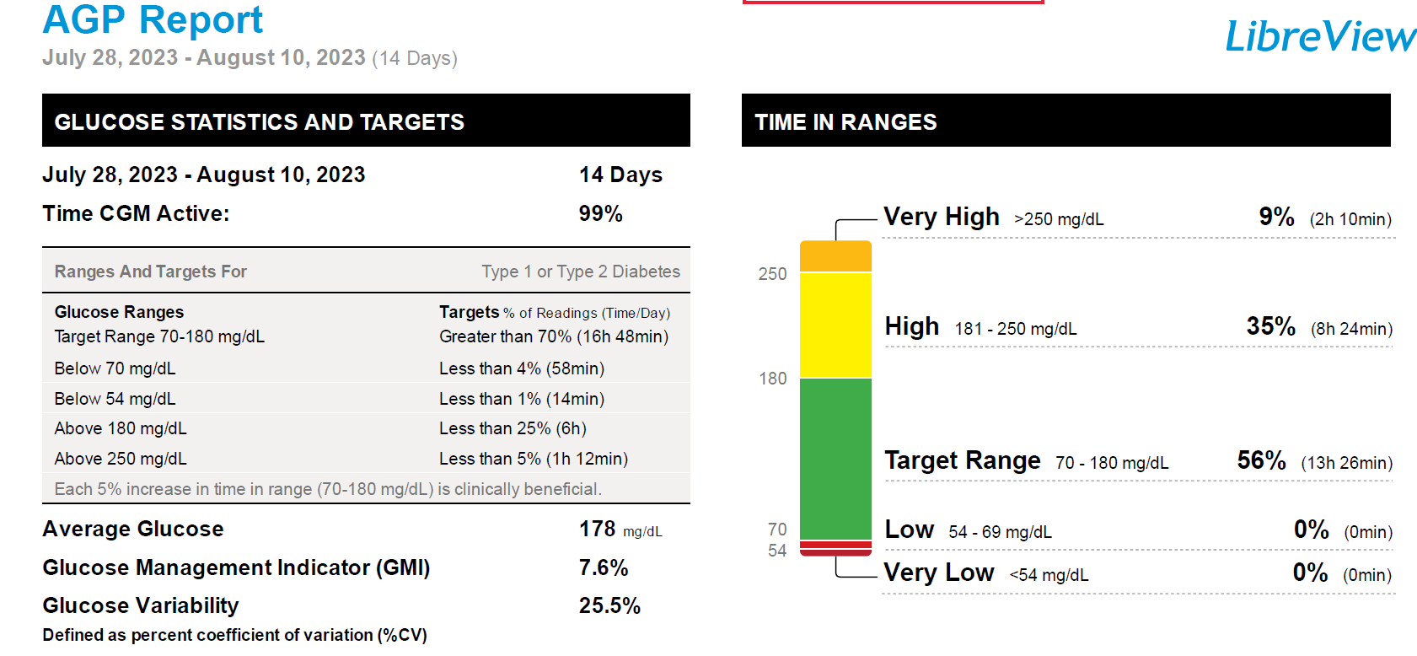
Is there enough data to be analyzed?
1. Yes
2. No
3. I don’t know
What is the problem? Select all that apply
Hypoglycemia
Hyperglycemia
Too much glucose variability
I don’t know
Notes:
Answer is 2. The target for glucose levels between 180 and 250 are less than 25% and he is at 35% and less than 5% time greater than 250 and he is at 9%

Slide 19
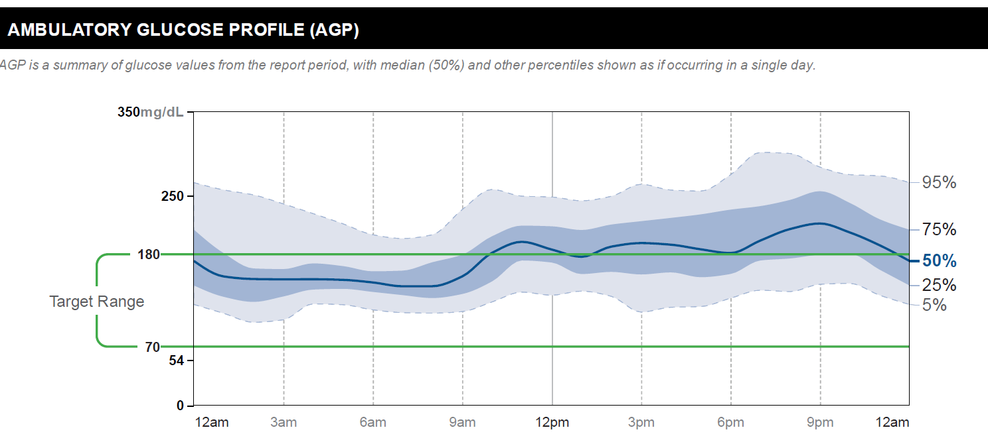
Where is the problem? Select all that apply:
Overnight glucose levels are not stable and drop overnight
Glucose levels are elevated throughout the day & night
3. Glucose levels rise following breakfast
Glucose levels predominately rise following breakfast & supper
Glucose levels predominately rise following breakfast & lunch
Notes:
Answer is 4.

Slide 20
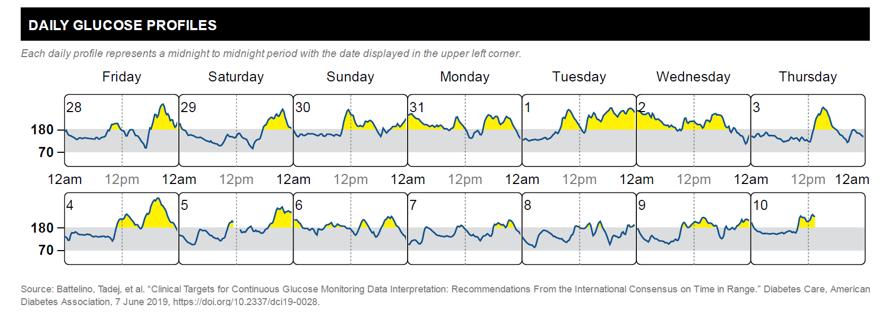
Diego’s Regimen
- Detemir 36 units twice a day
- Aspart 20 units before meals; Correction Factor 1:15 >130 mg/dl
Diego’s B-L-D meal timing
- B ~630am
- L ~11:00 am
- D ~530pm
How to adjust therapy? Select all that apply:
1. Refer to CDCES for dietary education regarding carbs
2. Increase lunch aspart dose by 10%
3. Increase lunch aspart dose by 15%
4. Increase lunch aspart dose by 20%
5. Increase dinner aspart dose by 10%
Notes:
Answer is 1, and 5 (start with supper)

Slide 21
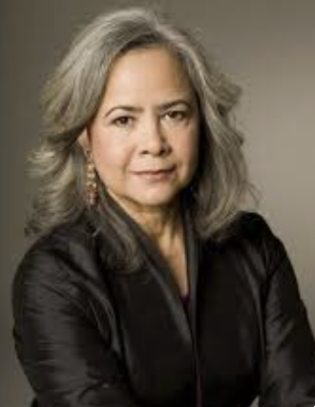
Case Study
Yolanda is a 61 year old female with a 57 year history of T1D. PMH significant for HTN, HLD, CAD, MI, nephropathy, neuropathy, DKA. Her BMI is 26.3 (63.6 kg). She is enrolled in the NIH Type 1 Diabetes CGM Study. Yolanda had her first study visit with Kim Kim, CDCES. Today, she presents for her first study visit with you (prior to initiating CGM). Her A1c today is 8.5%.
What would your priorities be for the first visit. Select all that apply:
Talk with Yolanda regarding CGM and goals
Assess her current insulin doses and make adjustments if needed
Assess her self-monitored blood glucose (SMBG) data
Determine if Yolanda had any hypoglycemia since her last visit with you
Assess her social support system
Notes:
All of the above.

Slide 22
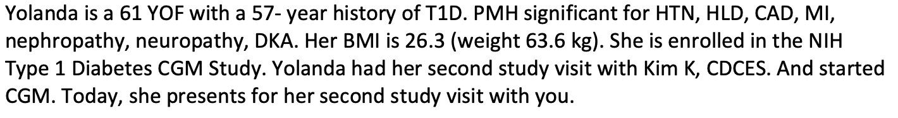
Visit 1 with PCP
Based on Yolanda’s age & past medical history, what should be her target A1C?
<9%
<8%
<7%
Not sure
What should Yolanda’s fasting or pre-meal glucose target?
90-130 mg/dL
90-150 mg/dL
100-180 mg/dL
Not sure
Notes:
Answer is 2. answer is 2

Slide 23
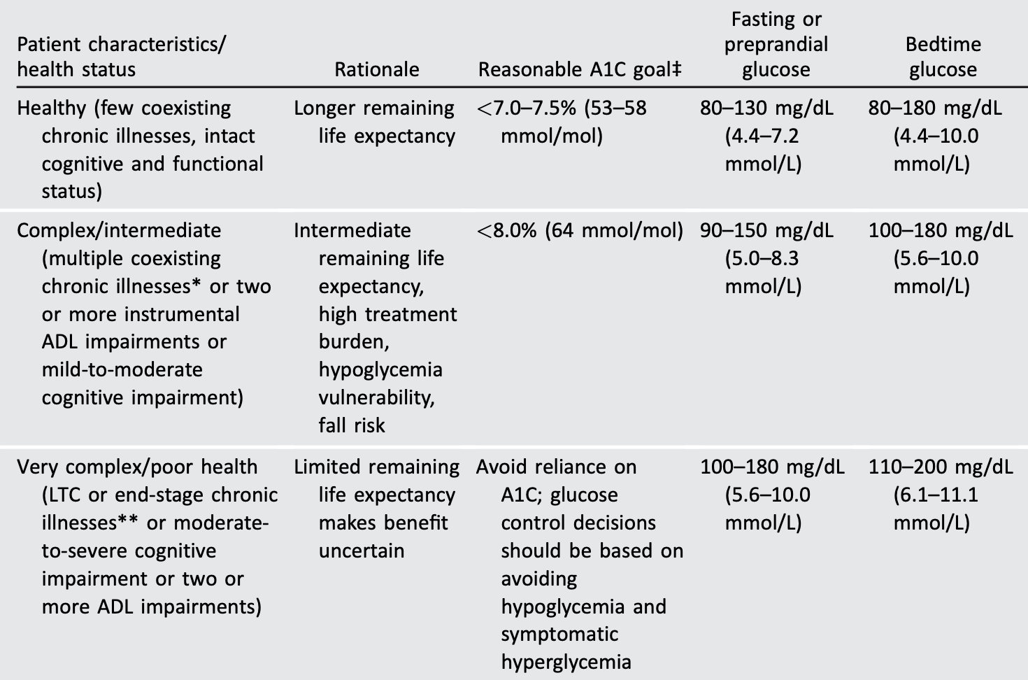
Framework for Considering Glycemic Goals in Older Adults with Diabetes
ElSayed NA, Aleppo G, Aroda VR, et al.
13. Older Adults: Standards of Care in Diabetes-2023.
Diabetes Care. 2023;46(Suppl 1):S216-S229.

Slide 24
Yolanda’s SMBG Data: Visit 1 with PCP
Result | Wednesday | Thursday | Friday | Saturday | Sunday | Monday | Tuesday
Pre-Breakfast | 186 | 151 | 186 | 219 | 201 | 159 | 202
Pre-Lunch | 155 | 161 | 206 |  |  |  | 199
Pre-Dinner | 190 | 200 | 196 |  | 214 | 218 | 201
HS |  | 190 | 210 |  | 196 |  | 193
Result | Wednesday | Thursday | Friday | Saturday | Sunday | Monday | Tuesday
Pre-Breakfast | 189 | 187 | 192 | 150 |  | 192 | 193
Pre-Lunch | 221 | 208 | 204 | 201 | 202 | 208 | 201
Pre-Dinner | 198 |  |  | 236 | 208 | 212
HS |  | 199 | 187 |  | 203 | 202 | 199

Slide 25
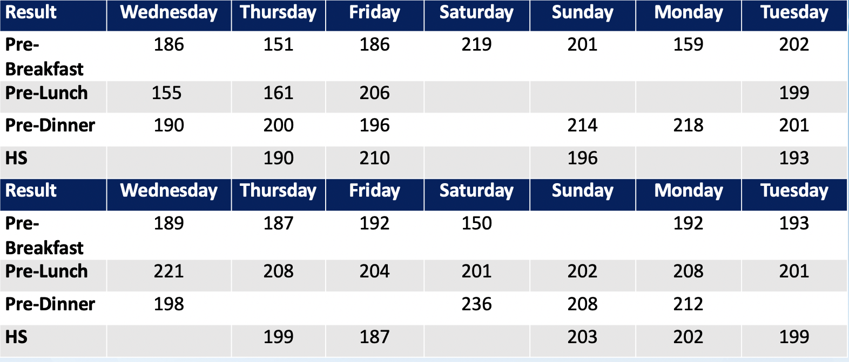
Visit 1 with PCP
Yolanda’s regimen:
- Glargine 25 units bedtime
- Aspart 10 units before meals
A1c 8.5%
What change would you make first:
Breakfast bolus dose
Lunch bolus dose
Dinner bolus dose
Basal dose
Notes:
Number 4

Slide 26
Making Insulin Recommendations
What actions will you take at your visit? (Select all that apply)
Assess the amount and routine that Yolanda uses to take her insulin
Consider use of Degludec U100 in place of Glargine
Increase basal insulin by 8 units
Increase basal insulin by 6 units
Increase basal insulin by 4 units
Notes:
Answer is 5
If you have confidence that Yoanda is following her prescribed insulin regimen, increase her basal dose by 4 units or possibly 5 . Base dose adjustment on lowest fasting values (150,151), fasting goal 100-150 given age and significant comorbidities. A1C goal <8.0%

Slide 27
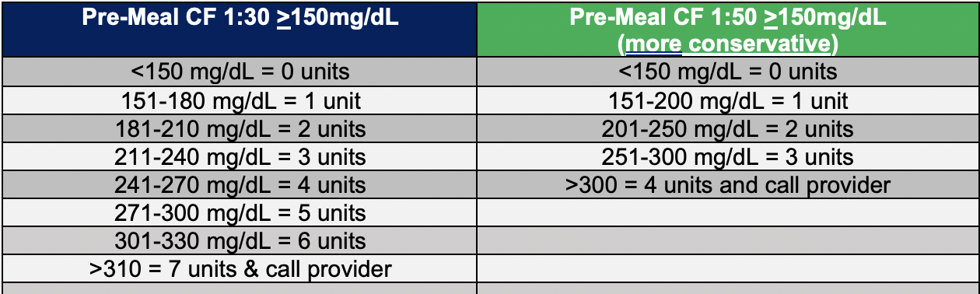
Creating a Correction Factor for High Glucose Levels
Yolanda now has a total daily dose of
59 units/day.
The formula for developing a
correction factor is 1800 /59 U=30.5
1 unit of bolus insulin will decrease
the glucose level by ~30 mg/dL
What may be the optimal pre-meal correction scale for Yolanda?
1:30 >130
1:30 >150
1:50 >130
1:50 >150
You develop a correction factor scale using CF ratio of 1:30 >150. How much additional Aspart insulin would she take before a meal for a glucose of 176?
1 additional unit of Aspart
2 additional units of Aspart
3 additional units of Aspart
4 additional units of Aspart
Notes:
Answer is 2.
Answer is 1.

Slide 28
Yolanda: Visit 2 with PCP
Yolanda is a 61-year-old female with a 57-year history of T1D. PMH significant for HTN, HLD, CAD, MI, nephropathy, neuropathy, and DKA. Her BMI is 26.3 (63.6 kg). She is enrolled in the NIH Type 1 Diabetes CGM Study. Yolanda had her second study visit with the CDCES and started CGM. Today, she presents for her second study visit with you. Her A1c today is 7.5%.
- Glargine 29 units bedtime
- Aspart 10 units before meals; CF 1:30 >150
What would your priorities be for the first visit. Select all that apply:
Congratulate Yolanda on her A1C reduction
Assess progress with goals set at last visit with you, including barriers and facilitators
Assess her current insulin doses and make adjustments if needed, including CF doses and mealtime insulin
Assess her CGM data
Determine if Yolanda has had any hypoglycemia since her last visit with you
Notes:
Answer: 2-5

Slide 29
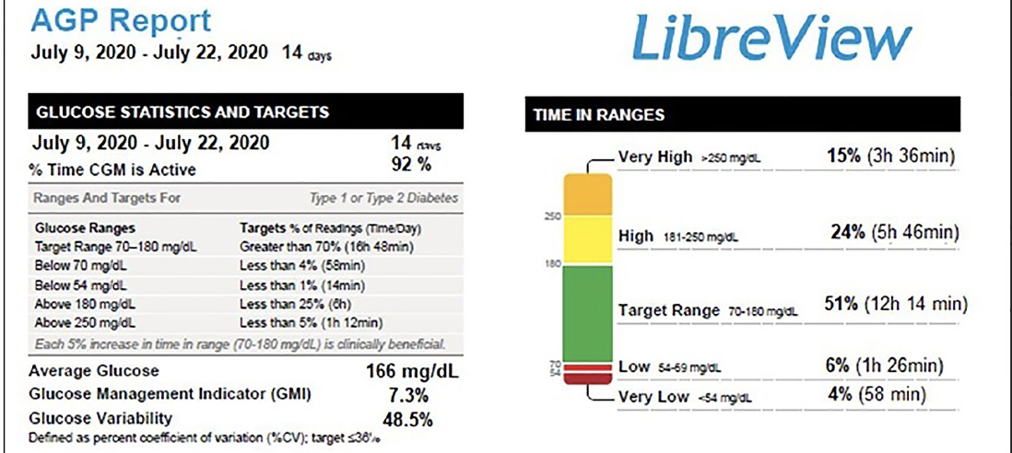
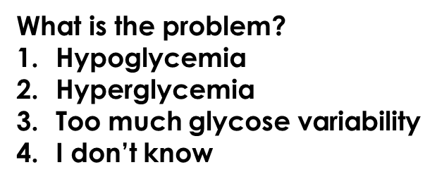
Visit 2 with Yolanda
Is there enough data to be analyzed?
1. Yes
2. No
3. I don’t know
Notes:
It is the hypoglycemia that you will target first especially given history of CAD.
1.

Slide 30
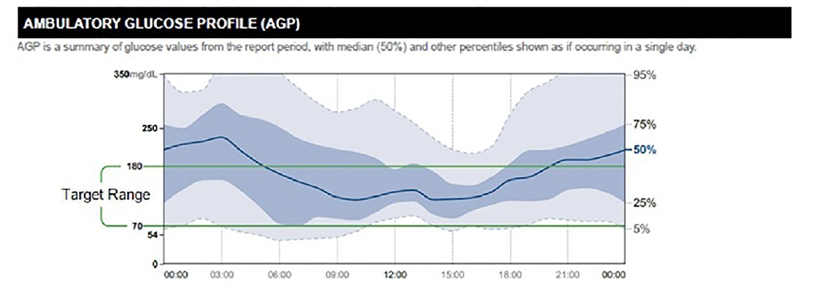
Where is the problem? Select all that apply:
Episodes of early am hypoglycemia
Episodes of pre-dinner (goal 100-150 mg/dL) and bedtime (goal 100-180 mg/dL) hypoglycemia
Marked glucose instability
Glucose levels often elevated overnight and post-dinner hours
5. Profound hyperglycemia throughout daytime hours
Notes:
Asnwer 1 Answer 4
Pre-dinner is goal 100-150 mg/dL and bedtime goal is 100-180 mg/dL

Slide 31
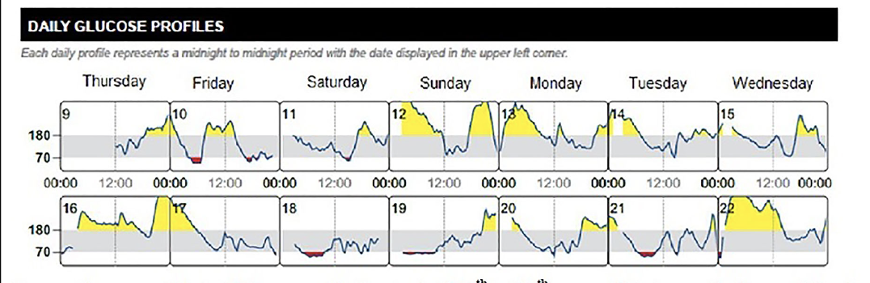
How to adjust therapy?
Yolanda’s Regimen
- Glargine 59 units daily
- Aspart 10 units before meals; CF 1:30 >150
Yolanda’s Diet & Stress
- She reports inconsistent intake & content at meals and HS
- Gives full pre-lunch bolus as prescribed at lunch but may not finish meal when busy during day (e.g., work)
- Sometimes has a few sweetened alcoholic beverages at HS on an empty stomach due to increased work stress
Verifies that bedtime elevations followed by precipitous lows occur after drinking ETOH
Notes:
Frequent elevations post-dinner but also a low (Fri 10)
Inconsistent elevations at HS and early am, which may be related to initial intake of sweetened ETOH or high CHO containing snack or simply a CHO snack not accompanied by protein or healthy fat
Subsequent hypoglycemia over time in early am may reflect ETOH inhibition of gluconeogenesis, which may manifest over several hours
Pre- and post-lunch variability may reflect dietary inconsistency at breakfast and lunch, respectively
A1C at 7.3

Slide 32
How to adjust therapy? Select all that apply:
1.Strongly caution that alcohol intake (especially on an empty stomach) may lead to profound hypoglycemia, possible coma, or death
2. Counsel patient she may have up to 1-2 drinks (unsweetened) per day with a meal(s) only
3. Decrease total basal insulin dose if Yolanda not ready to abstain from ETOH (outside of above recommendation)
4. Prescribe degludec U100 and discontinue glargine
5. Refer to behavioral health for stress management
6. Refer to a CDCES for meal planning with a focus on; (1) consistent, balanced intake; (2) balanced HS snacks; (3) effect of ETOH on BG; (4) effect of physical activity on BG
7. Faster acting Aspart (Fiasp). Immediately following lunch, take Faster Aspart . 100% of meal 10 units; 2/3’s (66%) 6 units, 1/3 (33%) 3 units; <1/3 (<33%) 0 units
Notes:
Frequent elevations post-dinner but also a low (Fri 10)
Inconsistent elevations at HS and early am, which may be related to initial intake of sweetened ETOH or high CHO containing snack or simply a CHO snack not accompanied by protein or healthy fat
Subsequent hypoglycemia over time in early am may reflect ETOH inhibition of gluconeogenesis, which may manifest over several hours
Pre- and post-lunch variability may reflect dietary inconsistency at breakfast and lunch, respectively
A1C at 7.3
INTERVENTIONS LARGELY BEHAVIORAL TO ADDRESS GLUCOSE INSTABILITY
59 units in place of glargine 59 units bedtime if patient high readiness (no equivocation) to only have up to 1-2 drinks (unsweetened) per day with a meal(s) only

Slide 33
Thank you and Questions?

