Slide 1
Counseling Individuals with Type 1 Diabetes on Using CGM
Nancy A. Allen PhD, ANP-BC, FADCES, FAAN

Slide 2
Objectives
1. Identify key concepts when discussing the CGM data
2. Indicate typical psychosocial concerns about CGM
3. Summarize troubleshooting topics
4. Interpret the primary reasons for alarm fatigue
5. State general considerations to preserve skin integrity
6. Discuss device persistence and methods to maintain use

Slide 3
Making the most out of CGM clinic visit
Prior to the visit, encourage patients to:
  Upload data to clinic portal
  Review past 2 weeks/month of data
  Questions to ask during the visit
    Areas that may be above or below target
    General questions to help navigate their data
During the visit:
  Have the patient explain the CGM data in their own words
  Develop goals based on CGM data
  Identify priorities to focus on before the next appointment
Notes:
Incorporate into the conversation of the visit
Encourage patients to come with their questions

Slide 4
Identify key concepts when discussing CGM data
Health Literacy of individuals
Quality of translation service
  Translation is verbatim- it does not always reflect the context
  Translators may lack cultural insight
  Varying educational levels
  Instruction vs. Education
  Less is more
  Diabetes information too difficult- reading level above average person
Inclusion of family when discussing CGM data
  ESL patients may rely on family for vital support in self-managing diabetes
Consider teach-back method

Slide 5
Typical psychosocial concerns about CGM
Individuals may perceive the use of a CGM as a late-stage intervention for T1D vs. a proactive intervention
Negative perception of family discourages use of the CGM
  e.g., annoyance of alarm settings
  Being shamed by family when carb-counting and not embracing the family’s eating habits
Embarrassed to wear and have CGM visible to others, or to have people hear the alarms
Distrust that medical data being collected may be used for other purposes
Notes:
Frame CGM as a prevention strategy vs end stage treatment
Audible alarms or vibration

Slide 6
Assessing psychosocial concerns
Alarm/device fatigue
  Having the alarm thresholds at unrealistic goals
Fear of hypoglycemia
  Past experience
  Misconceptions
  Current glycemic thresholds
Diabetes Distress
  Common and frequent
  CGM use can reduce in diabetes distress
  May need a referral for psychosocial assessment/cognitive behavioral therapy
Quality of life
  Self-management behaviors dictate CGM persistence
  Frustration felt by the person with diabetes when their expectations are not met
  Feelings of being overwhelmed by the increase in data available
  Self-consciousness of wearing a device
Notes:
Diabetes distress is not being measured
QH2 built into documentation; psychosocial referral process

Slide 7
Fear of Hypoglycemia
Fear of hypoglycemia is improved with CGM
Other strategies
  Review potential sources of misinformation, possible cause of hypoglycemia
  Develop a plan for:
    Adjusting insulin doses for higher fat/higher protein meals
    How to handle alcohol use
    Changes needed for different types of physical activity and how duration can affect it
  Refer to CDCES
  Refer for psychosocial counseling
Notes:
Higher Fat/higher protein
Split injection strategy:
Calculate the base dose: Use the standard carb-counting method for the carbohydrate portion of the meal and inject that amount before eating.
Inject additional insulin later: Give a second injection of rapid-acting insulin after the meal to cover the delayed glucose rise from the fat and protein. Regular insulin may be considered for the second dose, as its slower action may be better suited for a delayed glucose peak, though research is limited

Slide 8
Device Use: Alarms and Trends
Why does it alarm so often?
I want my glucose readings to always be 70-120. Can I do that without all of the alarms?
It seems that when it alarms and I do a fingerstick, the numbers are different.
Which alarms are best for me?
Notes:
<70 >240

Slide 9
Alarm/device fatigue
Hypoglycemia:
  Alarm threshold of 75 mg/dl is the optimal cutoff for Hypoglycemia alarms and does not increase the number of alarms for hypoglycemia
Hyperglycemia:
  Patients with lower hyperglycemia alarm settings experience lower average glucose levels and about 40-50% less time with glucose levels > 250 and > 320mg/dl without more hypoglycemia
  Ideal range for hyperglycemia alarms is 180 mg/dl for glucose levels
Starting patients on CGM with high A1c’s consider a liberal hyperglycemia alert initially and then set the alarm lower at each subsequent visit until the high alert alarm is at 180 mg/dl
Ask patients what their usual response is to an alarm
  If they are not taking action, then it’s time for change talk!
Alarm settings are very personal and individualized.
Lin YK etc. Alarm Settings of Continuous Glucose Monitoring Systems and Associations to Glucose Outcomes in Type 1 Diabetes. J Endocr Soc. 2019
Notes:
Check alarms for low and if these alarms can be turned off.
High alarms- best practices when starting a patient that has significant hyperglycemia

Slide 10
Device Use: Insertion Site
FDA approved sensor site for Libre 2 and 3
  Back of arm
Off-label use
  Abdomen
  Upper buttocks
  Legs
Where is the best place?
  2 inches from navel; 1 inch from infusion set or manual insulin injection site
  Avoid areas where clothes may rub against it, i.e. beltline
  Avoid areas that the body bends often
  If in a lean area, pinch up at the site or adjust the angle
  Orientation – horizontally vs. vertically
What happens if the site bleeds?
  Apply pressure for several minutes
  If it stops bleeding, proceed. If bleeding does not stop, remove/replace or else readings may be affected
Litchman ML et. al. Continuous Glucose Monitoring in the Real World Using Photosurveillance of #Dexcom on Instagram
JMIR Public Health Surveill 2019

Slide 11
CGM Sensor Placement
Review site selection and rotation at every visit
1-2 inches away from previous site
Ideally 10 placement sites
1 week for site to heal before attaching new adhesives
Avoid broken skin, unhealed irritation
Consider sleep position, types of sports participation, clothing preferences
Discrete placement
On vs. off-label site selection
Notes:
Compression lows when at night from sleeping on the sensor

Slide 12
CGM Sensor Site Tips
Clean skin with oil-free, anti-microbial soap and dry thoroughly
Gentle exfoliation recommended for oily skin
Trim/shave hair if needed
Alcohol may or may not be used, depending on skin tolerance
Do not place new CGM immediately after shower/bath/steam
Unscented solid or spray antiperspirant may help skin to reduce sweat
  Wait 10-15 min after application, wipe off excess before applying CGM site
To reduce irritation at site, could trial OTC nasal steroid (fluticasone) topically
  1-2 puffs/sprays to skin, let dry completely (unknown consequences with chronic use)
Barrier films/liquid adhesives may help prevent mild skin irritation from adhesives
  Recommended not to insert sensor through barrier films/liquid adhesives
  Leave a small circle untouched for sensor insertion
  Wipe skin and let dry completely before inserting
  Second layer can be added after first layer has dried
Notes:
Get brand of liquid barrier

Slide 13
Sensor Removal
Loosen edge of the adhesive with fingernail or use a removal liquid
Fold back technique
Stretch and relax technique
Use adhesive removal wipes to rub the skin under the tape to loosen the adhesive from the skin
All products leave an oily residue – wash the area with soap, rinse and dry before attempting an insertion in the area
Remind the patient that there are MANY options for barrier films, liquids and removal agents
The best choice is very individualized and may require trying several brands
Some companies may have sample options to send to the patient

Slide 14
Agents That Interfere With Libre 2 Sensor Accuracy
Ascorbic Acid (Vitamin C)- new Libre plus sensor does not have this restriction
  Doses of more than 500mg daily increase readings.
  One study suggests doses of 1-3g daily increased readings 9.3-20 mg/dL
Aspirin
  At high levels (>650 mg)
  Glucose readings may be falsely lower

Slide 15
Device Persistence
Skin irritation
Appearance on the body
Insertion pain
Discomfort wearing
Not as accurate as BGM
Too many false alarms
Adhesive did not hold
Alarmed too frequently
Not enough advice on use
Clinical Diabetes 2018. 36(1): 50-58

Slide 16
Device Persistence- Strategies
Setting the stage BEFORE CGM initiation
Expectations:
  BGM vs CGM
  TIR guidelines vs tighter individualized goals
  Recommendations for setting alarms
  Preparing for possible issues
  Site irritation and adhesion
  Re-assessing after initiation
  Problem-solving for any issues encountered

Slide 17

Case Study
Yolanda is a 61 year old female with a 57 year history of T1D. PMH significant for HTN, HLD, CAD, MI, nephropathy, neuropathy, DKA. Her BMI is 26.3 (63.6 kg). She is enrolled in the NIH Type 1 Diabetes CGM Study. Yolanda had her first study visit with the CDCES. Today, she presents for her first study visit with you (prior to initiating CGM). Her A1c today is 8.5%.
What would your priorities be for the first visit. Select all that apply:
  Talk with Yolanda regarding CGM and goals
  Assess her current insulin doses and make adjustments if needed
  Assess her self-monitored blood glucose (SMBG) data
  Determine if Yolanda had any hypoglycemia since her last visit with you
  Assess her social support system
Notes:
All of the above.

Slide 18
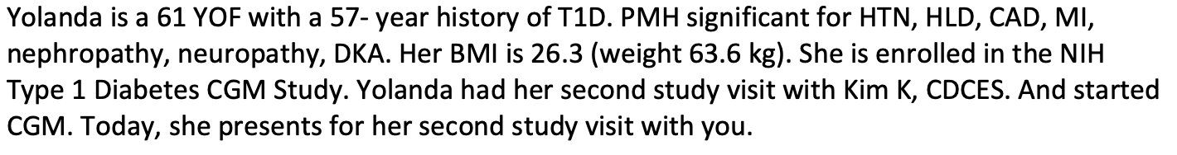
Visit 1 with PCP
Based on Yolanda’s age & past medical history, what should be her target A1C?
  <9%
  <8%
  <7%
  Not sure
What should Yolanda’s fasting or pre-meal glucose target?
  90-130 mg/dL
  90-150 mg/dL
  100-180 mg/dL
  Not sure
Notes:
Answer is 2. answer is 2

Slide 19
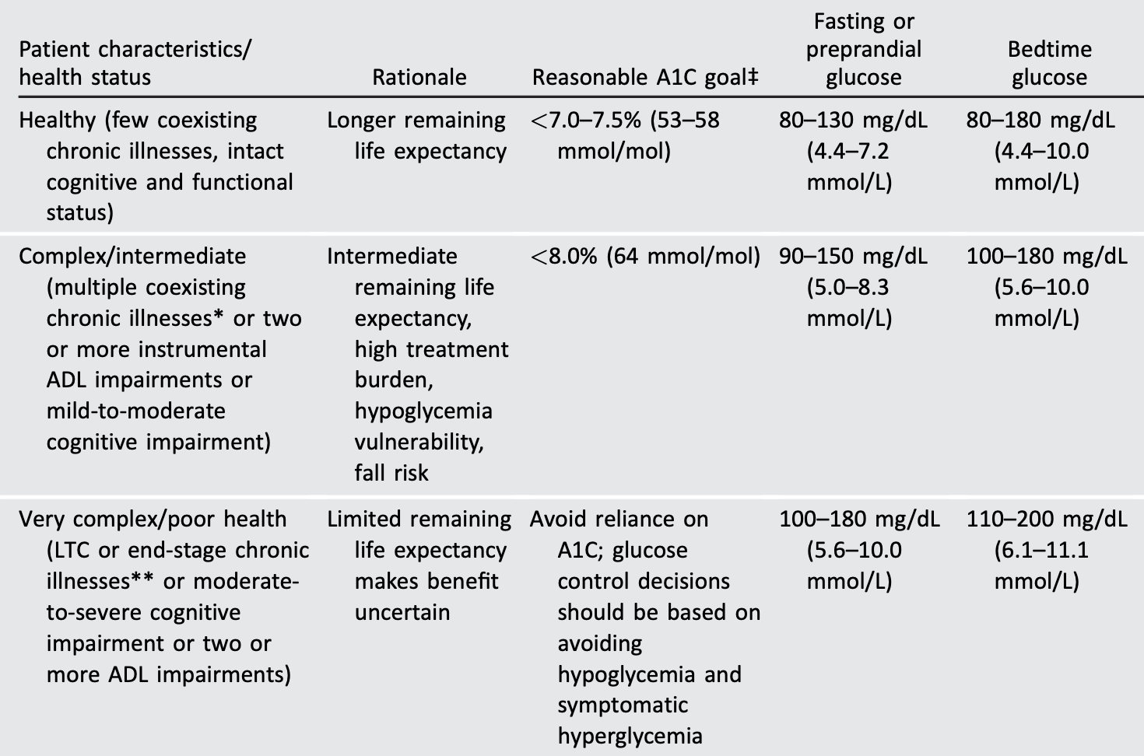
Framework for Considering Glycemic Goals in
Older Adults with Diabetes
ElSayed NA, Aleppo G, Aroda VR, et al.
13. Older Adults: Standards of Care in Diabetes-2023.
Diabetes Care. 2023;46(Suppl 1):S216-S229.

Slide 20
Yolanda’s SMBG Data: Visit 1 with PCP
Result | Wednesday | Thursday | Friday | Saturday | Sunday | Monday | Tuesday
Pre-Breakfast | 186 | 151 | 186 | 219 | 201 | 159 | 202
Pre-Lunch | 155 | 161 | 206 |  |  |  | 199
Pre-Dinner | 190 | 200 | 196 |  | 214 | 218 | 201
HS |  | 190 | 210 |  | 196 |  | 193
Result | Wednesday | Thursday | Friday | Saturday | Sunday | Monday | Tuesday
Pre-Breakfast | 189 | 187 | 192 | 150 |  | 192 | 193
Pre-Lunch | 221 | 208 | 204 | 201 | 202 | 208 | 201
Pre-Dinner | 198 |  |  | 236 | 208 | 212
HS |  | 199 | 187 |  | 203 | 202 | 199

Slide 21
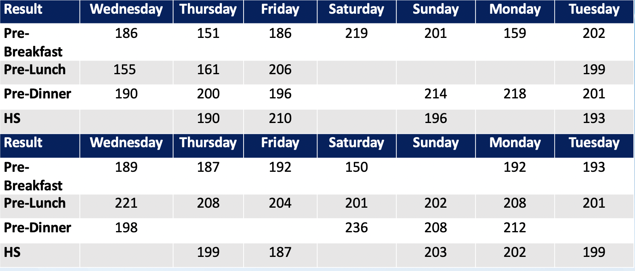
Visit 1 with PCP
Yolanda’s regimen:
- Glargine 25 units bedtime
- Aspart 10 units before meals
A1c 8.5%
What change would you make first:
  Breakfast bolus dose
  Lunch bolus dose
  Dinner bolus dose
  Basal dose
Notes:
Number 4

Slide 22
Making Insulin Recommendations
What actions will you take at your visit? (Select all that apply)
Assess the amount and routine that Yolanda uses to take her insulin
Consider use of Degludec U100 in place of Glargine
Increase basal insulin by 8 units
Increase basal insulin by 6 units
Increase basal insulin by 4 units
Notes:
Answer is 5
If you have confidence that Yoanda is following her prescribed insulin regimen, increase her basal dose by 4 units or possibly 5 . Base dose adjustment on lowest fasting values (150,151), fasting goal 100-150 given age and significant comorbidities. A1C goal <8.0%

Slide 23
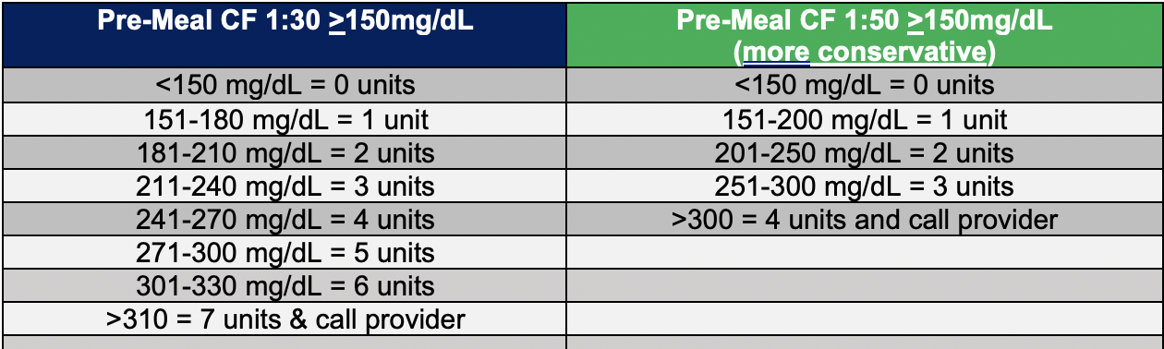
Creating a Correction Factor for High Glucose Levels
Yolanda now has a total daily dose of
59 units/day.
The formula for developing a
correction factor is 1800 /59 U=30.5
1 unit of bolus insulin will decrease
the glucose level by ~30 mg/dL
What may be the optimal pre-meal correction scale for Yolanda?
1:30 >130
1:30 >150
1:50 >130
1:50 >150
You develop a correction factor scale using CF ratio of 1:30 >150. How much additional Aspart insulin would she take before a meal for a glucose of 176?
1 additional unit of Aspart
2 additional units of Aspart
3 additional units of Aspart
4 additional units of Aspart
Notes:
Answer is 2.
Answer is 1.

Slide 24
Yolanda: Visit 2 with PCP
Yolanda is a 61-year-old female with a 57-year history of T1D. PMH significant for HTN, HLD, CAD, MI, nephropathy, neuropathy, and DKA. Her BMI is 26.3 (63.6 kg). She is enrolled in the NIH Type 1 Diabetes CGM Study. Yolanda had her second study visit with the CDCES and started CGM. Today, she presents for her second study visit with you. Her A1c today is 7.5%.
- Glargine 29 units bedtime
- Aspart 10 units before meals; CF 1:30 >150
What would your priorities be for the first visit. Select all that apply:
  Congratulate Yolanda on her A1C reduction
  Assess progress with goals set at last visit with you, including barriers and facilitators
  Assess her current insulin doses and make adjustments if needed, including CF doses and mealtime insulin
  Assess her CGM data
  Determine if Yolanda has had any hypoglycemia since her last visit with you
Notes:
Answer: 2-5

Slide 25
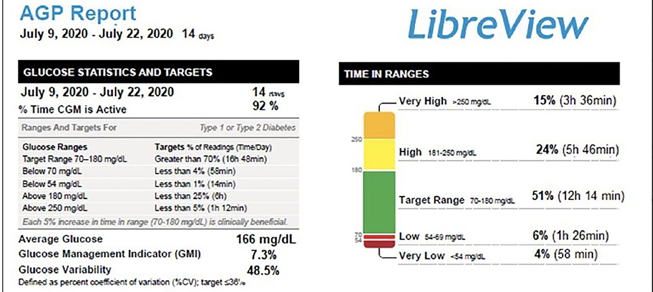
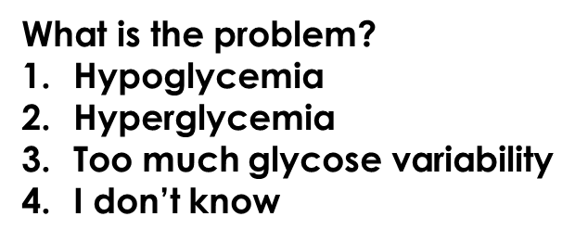
Visit 2 with Yolanda
Is there enough data to be analyzed?
1. Yes
2. No
3. I don’t know
Notes:
It is the hypoglycemia that you will target first especially given history of CAD.
1.

Slide 26
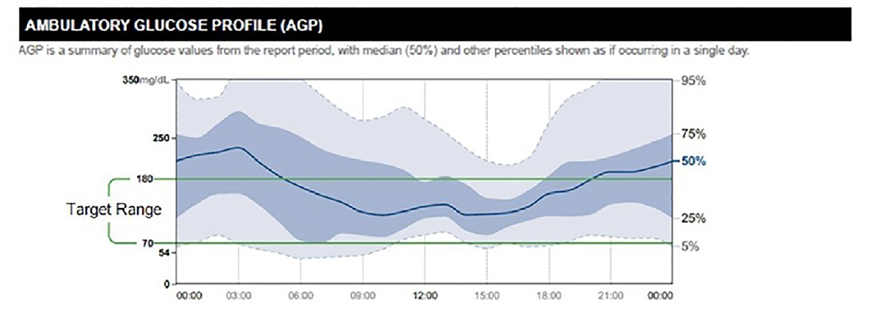
Where is the problem? Select all that apply:
Episodes of early am hypoglycemia
Episodes of pre-dinner (goal 100-150 mg/dL) and bedtime (goal 100-180 mg/dL) hypoglycemia
Marked glucose instability
Glucose levels often elevated overnight and post-dinner hours
5. Profound hyperglycemia throughout daytime hours
Notes:
Asnwer 1 Answer 4
Pre-dinner is goal 100-150 mg/dL and bedtime goal is 100-180 mg/dL

Slide 27
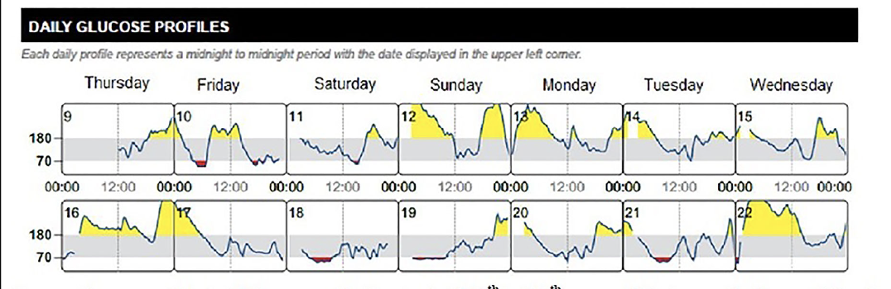
How to adjust therapy?
Yolanda’s Regimen
- Glargine 59 units daily
- Aspart 10 units before meals; CF 1:30 >150
Yolanda’s Diet & Stress
- She reports inconsistent intake & content at meals and HS
- Gives full pre-lunch bolus as prescribed at lunch but may not finish meal when busy during day (e.g., work)
- Sometimes has a few sweetened alcoholic beverages at HS on an empty stomach due to increased work stress
Verifies that bedtime elevations followed by precipitous lows occur after drinking ETOH
Notes:
Frequent elevations post-dinner but also a low (Fri 10)
Inconsistent elevations at HS and early am, which may be related to initial intake of sweetened ETOH or high CHO containing snack or simply a CHO snack not accompanied by protein or healthy fat
Subsequent hypoglycemia over time in early am may reflect ETOH inhibition of gluconeogenesis, which may manifest over several hours
Pre- and post-lunch variability may reflect dietary inconsistency at breakfast and lunch, respectively
A1C at 7.3

Slide 28
How to adjust therapy? Select all that apply:
1.Strongly caution that alcohol intake (especially on an empty stomach) may lead to profound hypoglycemia, possible coma, or death
2. Counsel patient she may have up to 1-2 drinks (unsweetened) per day with a meal(s) only
3. Decrease total basal insulin dose if Yolanda not ready to abstain from ETOH (outside of above recommendation)
4. Prescribe degludec U100 and discontinue glargine
5. Refer to behavioral health for stress management
6. Refer to a CDCES for meal planning with a focus on; (1) consistent, balanced intake; (2) balanced HS snacks; (3) effect of ETOH on BG; (4) effect of physical activity on BG
7. Faster acting Aspart (Fiasp). Immediately following lunch, take Faster Aspart . 100% of meal 10 units; 2/3’s (66%) 6 units, 1/3 (33%) 3 units; <1/3 (<33%) 0 units
Notes:
Frequent elevations post-dinner but also a low (Fri 10)
Inconsistent elevations at HS and early am, which may be related to initial intake of sweetened ETOH or high CHO containing snack or simply a CHO snack not accompanied by protein or healthy fat
Subsequent hypoglycemia over time in early am may reflect ETOH inhibition of gluconeogenesis, which may manifest over several hours
Pre- and post-lunch variability may reflect dietary inconsistency at breakfast and lunch, respectively
A1C at 7.3
INTERVENTIONS LARGELY BEHAVIORAL TO ADDRESS GLUCOSE INSTABILITY
59 units in place of glargine 59 units bedtime if patient high readiness (no equivocation) to only have up to 1-2 drinks (unsweetened) per day with a meal(s) only

Slide 29
Questions?

