Slide 1
Emergency department follow up
Emily Monajjemi,
Anthony Valdez

Slide 2
Background
Medicare patients account for a significant portion of emergency department (ED) visits - 52 visits per 100 people (CDC). This is higher than rates of private insurance and uninsured, but lower than Medicaid patients
Medicare patients are often medically complex: older age, chronic conditions, combine to create patients at high risk for poor outcomes.
Medicare recommends a follow up with PCP appointment within 7 days of ED/hospital discharge.

Slide 3
Timely ED follow up improves mortality
Atzema et al. (2018). Effect of early physician follow up and subsequent hospital admissions after emergency care for heart failure: a retrospective study. CMAJ.
1 year mortality rate of 20% at baseline
Follow up within 7 days of discharge was associated with lower rates of long-term mortality, subsequent hospital admissions, and a trend to lower short term mortality rates.
  Follow up within 30 days showed reduction of long-term mortality but not reduction in subsequent hospital admissions

Slide 4
Transitions of Care Team
What are TCM Services?
Is the coordination of Medicare patient’s transition from a community setting after discharge from an acute care setting. Although Medicare is currently the only insurance that pays for this service, we are following the same process regardless of insurance or payor type.
Post discharge from inpatient setting, the following components are provided to patient
  Face-to-face visit- by PCP
  Non-face-to-face services needed
Why do we do TCM?
Good quality outreach ensures that patients do not become lost to post care hospitalization, decreases the likelihood of an inpatient readmission and supports patient needs.
This is a quality metric that we are monitoring for our Medicare population currently and will likely expand to other payors soon.

Slide 5
Aim Statement
Improve our understanding of provider perspectives on the current use and effectiveness of Emergency Department/Hospital Discharge follow-up appointments.
This will inform actionable strategies to optimize follow-up care coordination, with the long-term aim of enhancing patient outcomes, reducing unnecessary ED revisits, and improving provider satisfaction.

Slide 6
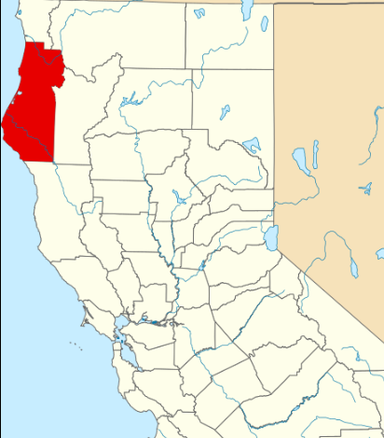
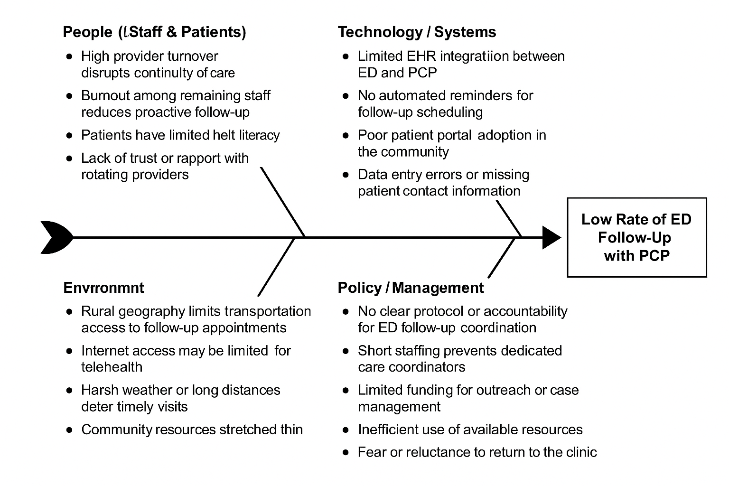
Fishbone diagram

Slide 7
Stakeholders
Clinicians
Care Coordinators / Case Managers
Clinic Administrators / Leadership
Front Desk and Scheduling Staff
Payers (Medicare, Medicaid/Medi-cal)
Patients

Slide 8
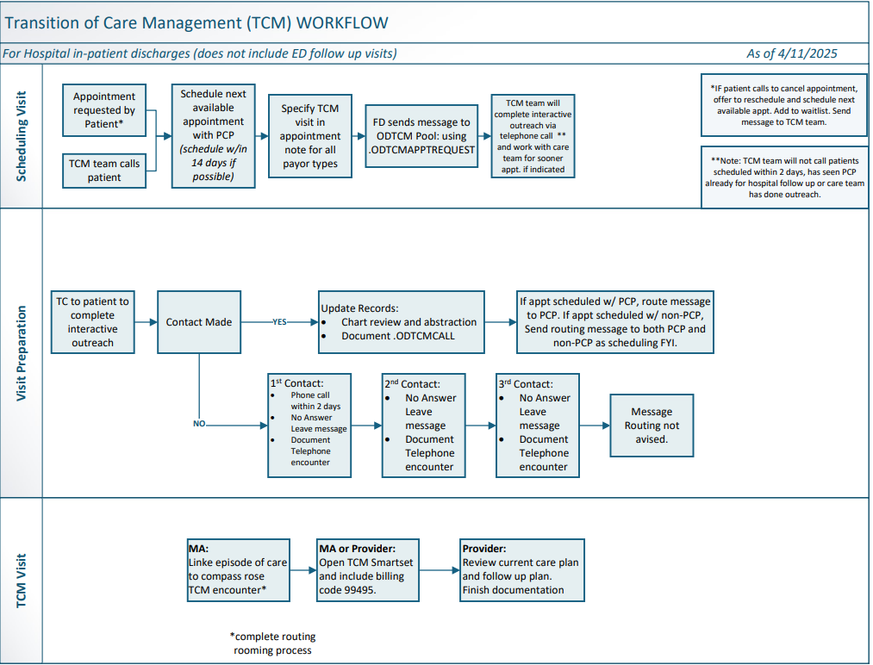
Process Map/flowchart

Slide 9
Current workflow for transitions of care
Interactive Contact
  Review discharge list and call patient within 2 days of discharge
  Document medical complexity
  Schedule appointment with PCP
Face-to-Face Visit
  Must occur within 7-14 business days
  MA must create a "TCM" Episode within the EMR
  Provide must use correct CPT Code
Non-Face-to-Face services needed
  Occur over the 30-day post discharge period
  Include coordination of services and education needed by the patient
  Must be provided unless not medically needed or indicated

Slide 10
Results
Clinician Feedback:
TCM message received before appointment helps give context to patient, as oftentimes clinicians who are not patient’s PCP are doing the follow up due to provider shortage and high turnover.
  what patient was admitted for
  Referrals needed
  Patient clinical condition
  Urgency of follow up
  Medications updated or changed during visit
  New diagnoses

Slide 11
Provider prospectives
Increasing patient complexity
  Patients are discharged with multiple chronic conditions, polypharmacy, and new diagnoses.
  Example conditions: CHF, COPD, diabetes, CKD, dementia, substance use
  PCPs must interpret complex discharge plans and reconcile with ongoing care
  Quote: "It feels like putting together a 100-piece puzzle in 15 minutes."
  Time constraints for PCPs
    Average Open Door Provider needs to see 18-20 patients a day (~ 9-10 pt a clinic)
    TOC appointments require more time:
      Reviewing hospital records
      Reconciling medications
      Managing new specialist instructions
      Coordinating home care or services

Slide 12
Estimated time needed
Estimated time to complete one post-discharge follow up visit:
  Pre-visit review: 15-20 minutes
  Patient Visit: 30-40 minutes
  Care Coordination & Documentation: 20-30 minutes
  Total: 60-90 minutes per hospital discharge
  Reimbursement models do reflect this time

Slide 13
Proposed solution: RN led TOC Model
Proposed Solution: Registered Nurses initiate the post-discharge visit
Before PCP sees the patient, RN completes:
  Medication reconciliation
  Review of discharge summary
  Identification of pending labs/tests
  Scheduling of specialty follow-ups
  Documentation of patient concerns

Slide 14
RN Roles in TOC Visit
Discharge Summary Review
  Flag key diagnoses, procedures, hospital events
Medication Reconciliation
  Confirm patient understanding and compliance
  Identify discrepancies or duplications
Follow-Up Coordination
  Schedule imaging, labs, and referrals
Patient Education
  Reinforce care plan, red flag symptoms, and self-monitoring

Slide 15
recommendations
Define RN scope and protocols
Use EMR templates for discharge documentation
Provide RN training on TOC documentation, med rec, and patient coaching
Track outcomes: readmissions, visit length, follow-up completion.

Slide 16
Summary
TOC visits are high-stakes but time-limited
PCPs need support to deliver high-quality post-discharge care
RNs can play a pivotal role in enhancing safety and efficiency
A team-based approach reduces burnout, improves outcomes, and boosts patient satisfaction

Slide 17

Thank you
Emily Monajjemi, FNP
Anthony Valdez, FNP

