Slide 1

Increasing Sublocade Access at CHC Meriden
Hillary Miller and Martha Darnall
2025
Nurse Practitioner Residency Program
Training Programs

Slide 2
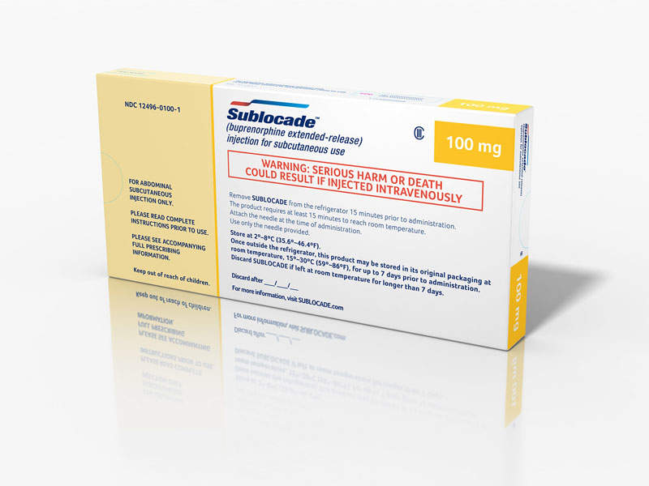
Background
Sublocade= Buprenorphine ER injection
Long-acting injection- Moderate to severe opioid use disorder
Once a month medication
Benefits:
Steady release of Buprenorphine over one month
Reduces the potential of medication diversion
Improves adherence and compliance
Enhances privacy
Supports long- term recovery

Slide 3
Aim Statement
To improve Sublocade access to patients with moderate to severe opioid use disorder in our clinic.
Enhance treatment outcomes
Increase retention in care
Mitigate the risks associated with opioid misuse and relapse
3
Notes:
JD

Slide 4
The Problem
Challenging process for Sublocade ordering
Genoa pharmacy
Currently only 2 patients are treated with Sublocade at CHC Meriden site
Regulatory and operational unknowns
Met with Kara Lewis- Director of clinical pharmacy services- Meriden
Unable to establish a clear process for how Sublocade can be stored at CHC- pharmacy.
4

Slide 5

Stakeholders
Pharmacy director (Kara Lewis)
Pharmacist (Dr. Ching) at CHC Walgreens
CHC Medical providers
RN manager- (Deandra Whalen)
RNs
PSAs
Medical assistants

Slide 6
Approach to Change
Meeting with stakeholders at CHC
Collect information - current Sublocade ordering process at our site
Understand the process and regulations needed to be able to store Sublocade within CHC- pharmacy
Developed a survey to help us understand how providers feel about Sublocade ordering
To collect information about provider interest in prescribing Sublocade
Meet with CHC Sublocade expert – Catherine Hinojosa at New London site
Understand the process utilized at of other sites to be able to deliver Sublocade in a similar way within our organization
To create initiatives that can be implemented to improve Sublocade ordering
Notes:
PDSA Cycle:
Plan: Collect data through survey on current sublocade process,
Do: Meet with stakeholders, discuss at provider meeting adjust expectations
Study: Continue to monitor and re-adjust project to meet the changing needs of the organization
Act: Create a streamline flow sublocade document/protocol with the goal to increase provider subcloade awareness
Increase the number of patients being administered sublocade at CHC Meriden

Slide 7
Outcome Measures
Continuously adjusted throughout our project
Original outcome measure:
Review number of prescriptions for sublocade
Look to review process of storage of sublocade on site at CHC Meriden
Current outcome
Increase the provider awareness of sublocade ordering process
7

Slide 8
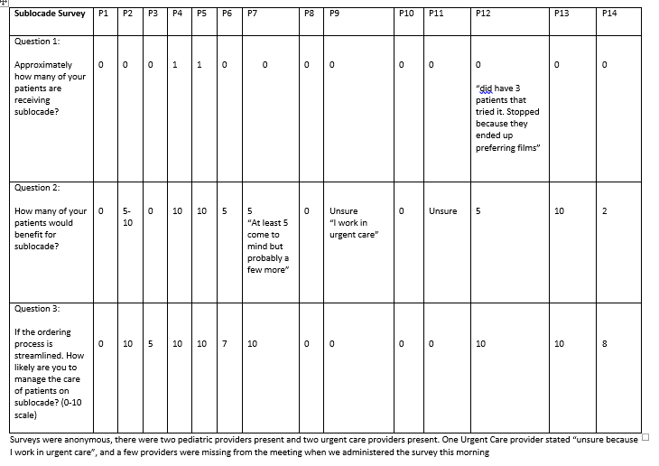
Data Collected Prior to Implementation

Slide 9
Process
Education:
Reviewed provider awareness during meeting with staff
Acknowledged the need for increased education for management of sublocade and how to order at the CHC Meriden site
Resource provision:
Created the CHC Meriden Sublocade Protocol
Will be distributed to the CHC Meriden providers at next staff meeting
9
Notes:
ES

Slide 10
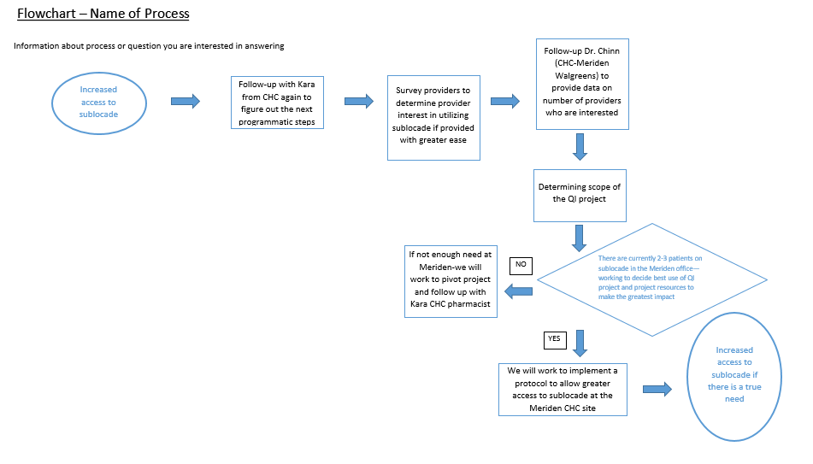
Process

Slide 11
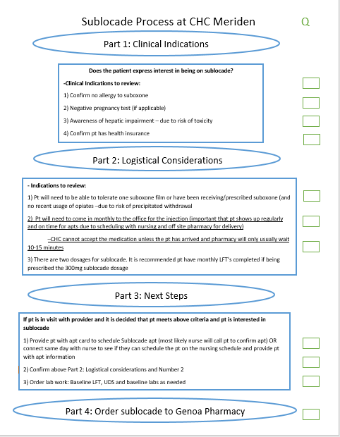
Sublocade Protocal
Notes:
ES

Slide 12
Results
12

Slide 13
Results (cont.)
Challenges:
Access to regulatory and operational requirements for the organization to be able to store Sublocade
Involved many different departments and staff
Limitations:
Time
13

Slide 14
Key Takeaways
Sublocade is a proven and effective way to support harm reduction efforts
To support individuals with substance use hx
CHC Meriden Staff were eager to here about the project and had interest in increasing sublocade access
QI projects can take many turns throughout the process
Importance of ensuring the CHC Meriden site needs are the priority
14

Slide 15
Conclusions/Implications
Next steps: Follow-up on regulatory and operational requirements
Next time: Review providers awareness of sublocade
Next time: Review the number of sublocade prescriptions
Advice for future QI projects in Meriden: Provider meetings are an opportunity to hear concerns for workflow to learn how to best learn and develop future QI projects
15
Notes:
What did you learn

Slide 16
Thank you!
Dr. Mark Splaine, Emma Warshauer CHC QI
Dr. Kara Lewis CHC
Dr. Ching-Hung Chiang CHC Walgreens
Deandra Whalen CHC Meriden Nurse Manager
Dr. Patel CHC- Meriden Medical Director
Dr. Catherine Hinojosa – New London Provider
CHC providers, nurses and MA staff who provided input

Slide 17
References
Greenwald, M. K., Wiest, K. L., Haight, B. R., Laffont, C. M., & Zhao, Y. (2023). Examining the benefit of a higher maintenance dose of extended-release buprenorphine in opioid-injecting participants treated for opioid use disorder. Harm reduction journal, 20(1), 173. https://doi.org/10.1186/s12954-023-00906-7
(June 2025) Prescribing-information.pdf. Available at: https://www.sublocade.com/Content/pdf/prescribing-information.pdf (Accessed: 09 June 2025).
Ling, W., Shoptaw, S., & Goodman-Meza, D. (2019). Depot Buprenorphine Injection In The Management Of Opioid Use Disorder: From Development To Implementation. Substance abuse and rehabilitation, 10, 69–78. https://doi.org/10.2147/SAR.S155843
Rutrick, D. et al. (2023) ‘18-month efficacy and safety analysis of monthly subcutaneous buprenorphine injection for opioid use disorder: Integrated analysis of phase 3 studies’, Journal of Substance Use and Addiction Treatment, 154, p. 209155. doi:10.1016/j.josat.2023.209155.
17
Notes:
What did you learn
Greenwald, M. K., Wiest, K. L., Haight, B. R., Laffont, C. M., & Zhao, Y. (2023). Examining the benefit of a higher maintenance dose of extended-release buprenorphine in opioid-injecting participants treated for opioid use disorder. Harm reduction journal, 20(1), 173. https://doi.org/10.1186/s12954-023-00906-7

