Slide 1
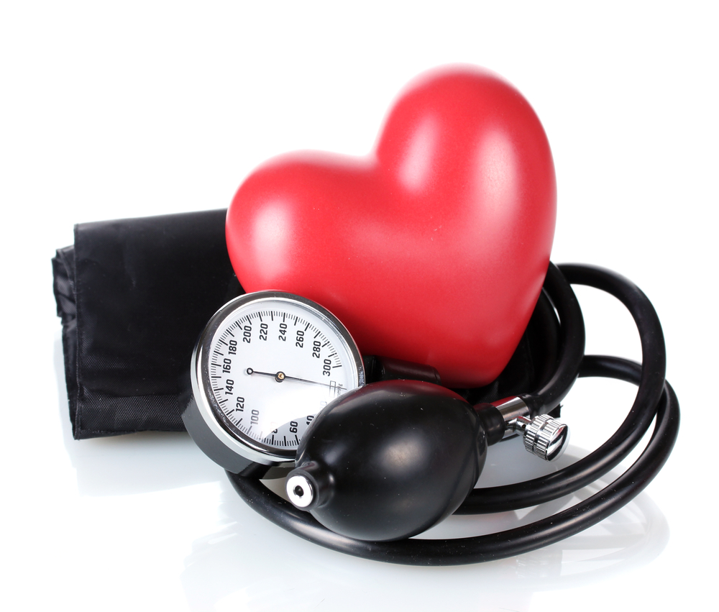

A Quality Improvement Project to Improve BP Control
Elisa Herke & Salvador Rodriguez
05/22/2025

Slide 2
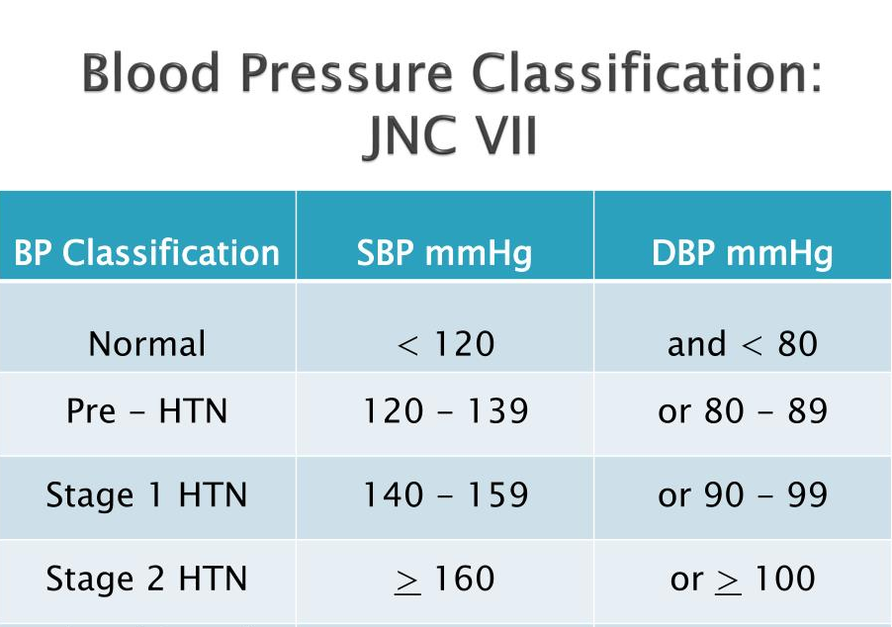
HTN Control: Why?
Consistently high BP damages arteries, causing them to become narrow and stiff. This can lead to stroke, heart attack, heart failure, chronic kidney disease, or kidney failure.
When patients with HTN are not at goal despite treatment, they face more than double the risk of mortality due to CVD and triple the risk of mortality due to cerebrovascular disease compared to patients with normal BP.
2

Slide 3
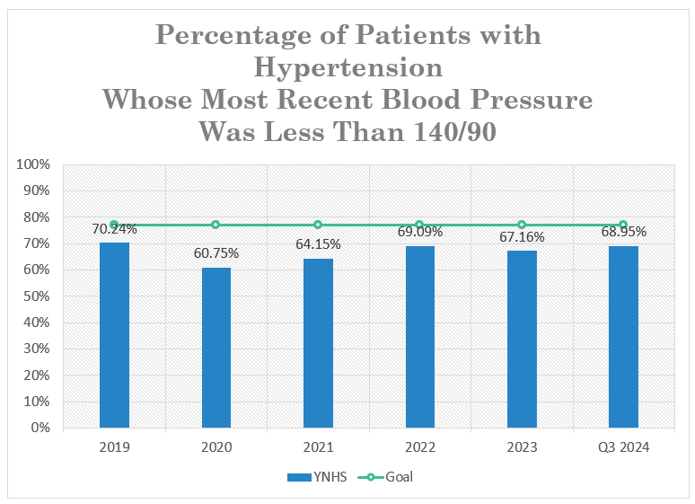
Background
YNHS isn’t meeting quality standards for HTN control
Goal is 77% BP readings <140/70
YNHS has been below the goal for at least the past 5 years
3

Slide 4
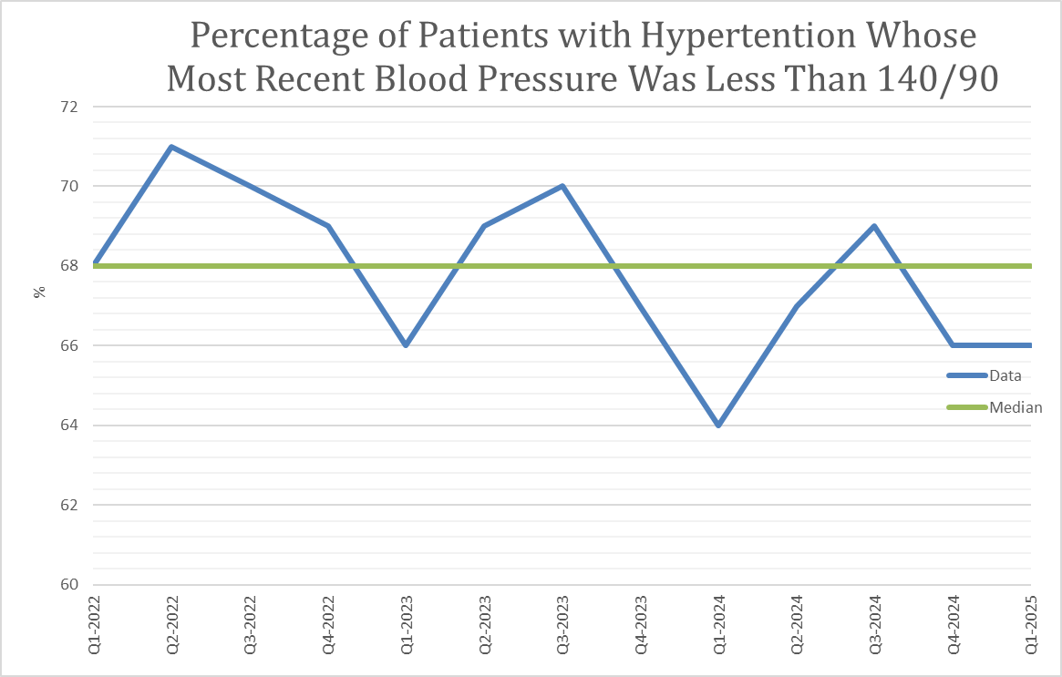
Background
4

Slide 5

Background
If a patient's first blood pressure reading is over 140/90 mmHg, it's important to take a second reading. This is part of our organization’s quality care standards.
The Quality Improvement Team has reported that improved compliance with second BP taking would ultimately help the organization reach a better HTN control.
  Patient conditions/relaxation
  Environment/white coat HTN
  Measurement technique
5

Slide 6
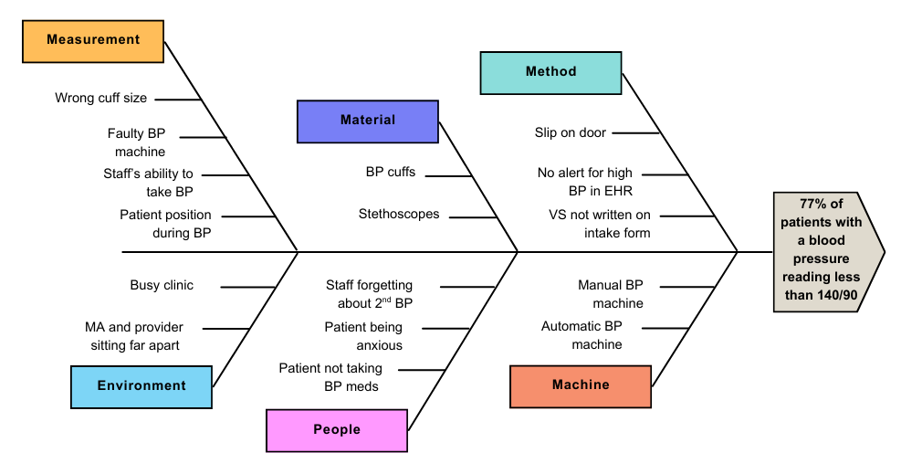
Organizational Process Analysis
6

Slide 7
Organizational Process Analysis
VS are taken & if BP>140/90, sign is placed on the door
HTN control (BP<140/90)
Schedule HTN
appointment
Check-in
MA checks second BP manually after 15 mins
Provider reviews BP readings
Update HTN plan/
adjust medications
Schedule f/u appropriately (MA or provider visit)
Utilize clinic resources if they apply
(pharmacy & dietician)
BP <140/90

Slide 8
Aim Statement
YNHS goal: To achieve BP control (< 140/90 mmHg) for 77% of patients with HTN by the end of the year.
Project Aim: Increase compliance with second BP check by 10%.
8

Slide 9
Stakeholders
MAs - Take blood pressure and agreed a more vibrant sign would be helpful.
Providers - Manage HTN and reported easy to forget about 2nd BP.
Pharmacist - Oversee the HTN medication management program. They would like to see updated guidelines for BP management.
Dieticians - Have been focusing primarily on DM and HLD. Have not had referrals for HTN. They are open to seeing more patients with HTN and potentially starting HTN education classes.
Data analyst – Supplied data to support tracking HTN initiatives.
QI Team – Has contributed project ideas and has provided helpful data to guide our efforts.
9

Slide 10
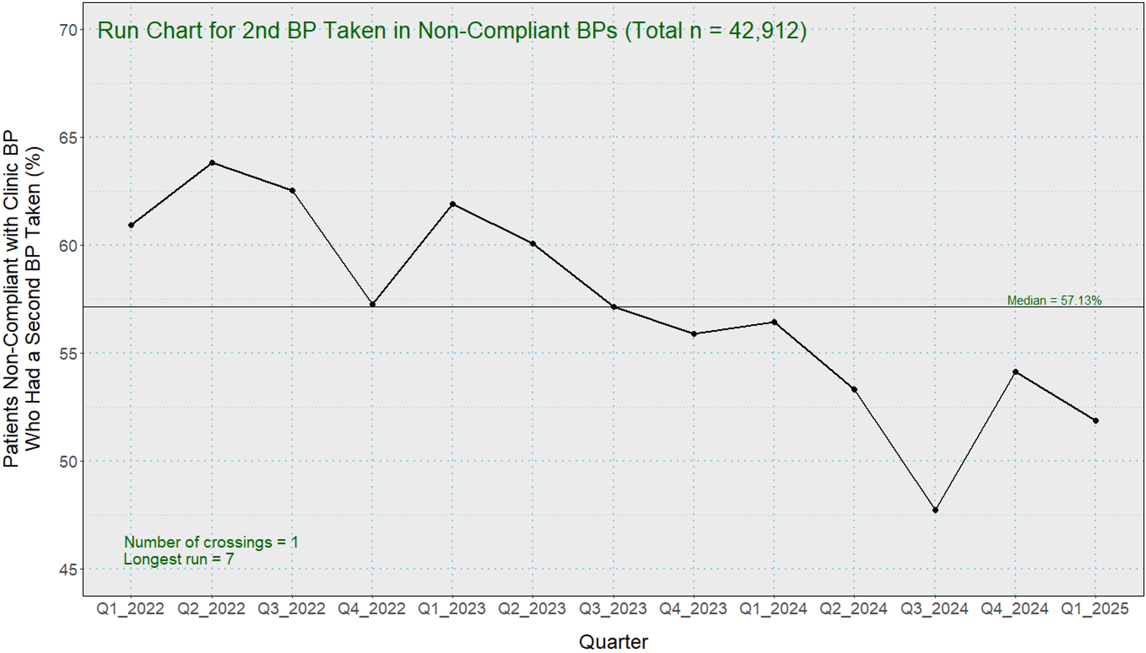
Data
Percentage of second BPs taken when the first reading was over 140/90
10
Notes:
This chart shows how often the second BP was actually taken when the first reading was over 140/90 by quarter. DSP; calculate percentage of cases in each quarter in which a second BP was actually taken (should be 100%, since an initial BP above 140 mmHg SBP or above 90 mmHg DSP should immediately trigger a second BP).

Slide 11
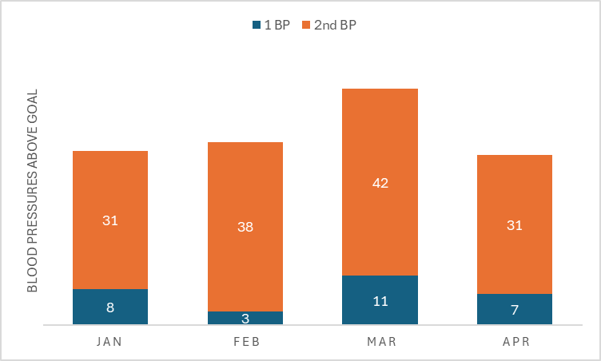
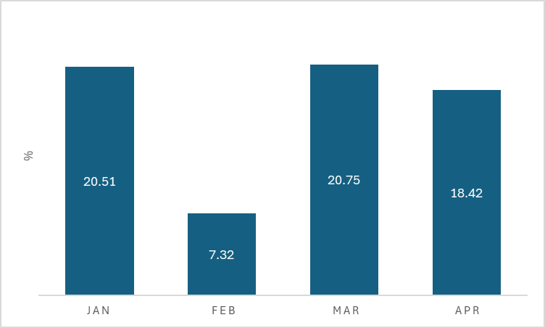
Data
Between 01/01/2025 and 04/30/2025
Salvador’s and Elisa’s visits only
Total BPs above range of 140/90: 171
Percentage of second BP missed: 17%
11

Slide 12
Process
VS are taken & if BP>140/90, sign is placed on the door
HTN control (BP<140/90)
Schedule HTN
appointment
Check-in
MA checks second BP manually after 15 mins
Provider reviews BP readings
Update HTN plan/
adjust medications
Schedule f/u appropriately (MA or provider visit)
Utilize clinic resources if they apply
(pharmacy & dietician)
BP <140/90

Slide 13
Approach to Change
Use of a more visible 2nd BP sign on the door
Plan: Design the sign, Print and laminate signs, inform MA’s, distribute the signs on the door, implement the sign.
Prediction: We should see an increase compliance with taking a 2nd blood pressure when the first one is greater than 140/90 by approximately 10%.
Currently at the “Do” part of the PDSA.
The sign was implemented on 5/19/25
2nd BP
13

Slide 14
Results
We set out to improve how often a second BP is taken when the first BP is greater than 140/90 by implementing a low-tech cost-effective sign.
Charts from the data show a steady decline in the second BP compliance for the organization overall.
The main challenge has been forgetting 2nd BP due to
  Busy clinic environment
  Lack of visual reminders as the current sign blends in with the door
  Competing priorities and comorbidities
Success factors: Everyone of the stakeholders had a different perspectives but there was interest from the entire team.
We just started the test of change, so it will take a few more weeks to get enough data to evaluate it.
What we learned:
  It takes teamwork
  Data can show areas of improvement
  A major changes might come from small little changes
14

Slide 15
Conclusions/Implications
The next steps include
  Continuing to work with the QI team and data analyst to collect and review the data to evaluate the test of change
  Consider expanding the change to the entire clinic
If we had to do this all over again, we would
  Focus less on raw data and utilize the organization resources/departments more
  Try to implement the test of change earlier
Advice for future NP:
  Utilize the organization resources as much as possible
  Ask for help at any point
  Involve different professionals and ask for opinions/ideas
15

Slide 16
References
Shams, P., Tackling, G., & Borhade, M. B. (2025). Hypertensive Heart Disease. StatPearls Publishing. https://www.ncbi.nlm.nih.gov/books/NBK539800/
Sopory, P. (2018, February 26). JNC 8 guideline to management of hypertension [PowerPoint slides]. SlideShare. https://www.slideshare.net/slideshow/jnc-8-guideline-to-management-of-hypertension/88948688
Questions??
16

