Slide 1

Increasing Colorectal Cancer Screening
Anita Pepra
Leona Njoku-Ejiogu
June 12, 2025
Nurse Practitioner & Post-Doctoral
Training Programs

Slide 2
Background
MMG, like many institutions, has a hard time getting our patients screened for colon-rectal cancer.
A barrier we identified was long wait lists for specialty appointments with GI for colonoscopy
FIT testing is an intervention that cuts outs the referral to specialists

Slide 3
Background
The fecal immunochemical test(FIT) is used to screen for colorectal cancer based on its ability to directly detect human hemoglobin in stool using antibodies, which improves specificity for lower gastrointestinal bleeding compared to guaiac-based occult blood tests.
It is recommended by the us multi-society task force on colorectal cancer because of it’s noninvasive, inexpensive, no diet restriction and more patients acceptability rate leading to a higher screening participation rate.
FIT is typically used in organized colorectal cancer screening programs by identifying eligible patients, educating them, distributing FIT kits, collecting returned samples and ensuring timely follow up colonoscopy for positive results. This organized implementation improves screening uptake/ outcomes also decreases mortality and morbidity.

Slide 4
Background continued
Colorectal cancer screening-
The USPSTF recommends screening for colorectal cancer in adults aged 45 to 75
Types of tests offered at MMG
Fecal immunochemical test (FIT) -uses antibodies to detect blood in the stool done yearly
Direct Colonoscopy: "Healthy" patients can receive this type of referral. A nurse in the GI department reviews the chart and, if eligible, sends them the prep and schedules them directly for colonoscopy.
Referral to GI for colonoscopy: "High- risk" patients receives referral to GI to get schedules for an office visit where recommendations are made prior to colonoscopy.
+ Typical waiting time for this appointment at MMG is 6-9 months
4
Notes:
Colorectal cancer is cancer that develops in the colon or rectum, which are parts of the large intestine. Most colorectal cancers begin as polyps, abnormal growths on the lining of the colon or rectum. Some polyps can turn into cancer over time. Regular screening tests like colonoscopies can detect polyps and remove them before they turn into cancer, or find cancer at an early stage when treatment is more effective but some patients are not eligible for direct colonoscopy whether due to illness, lab results, medications , access to transportation or lack of knowledge. FIT testing is recommended for patients who are not eligible for colonoscopy or those with without access who are at risk or of age for screening for colon cancer.

Slide 5
Aim Statement
Aim Statement: To increase CRC screening from 66% to 67% from January 2025 by May 2025
By ordering FIT test for patient who met criterial for CRC screening
5

Slide 6
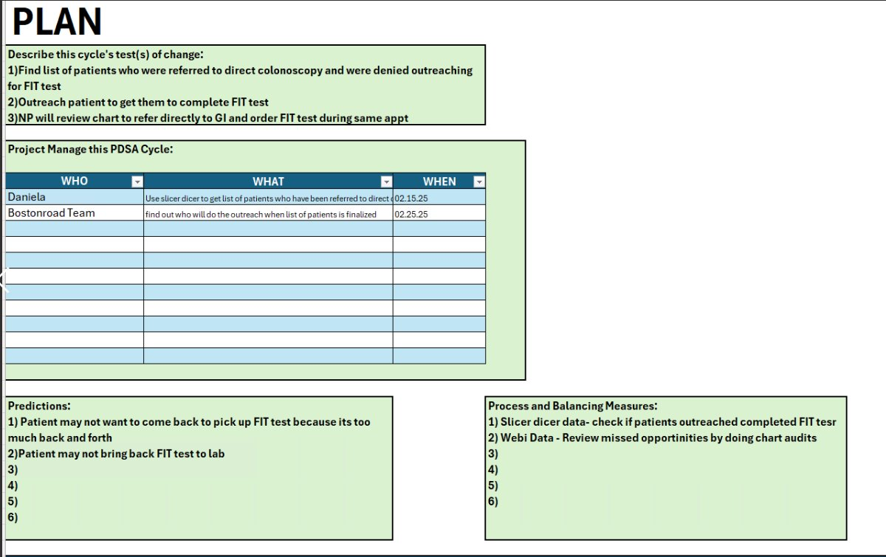
Brainstorming

Slide 7
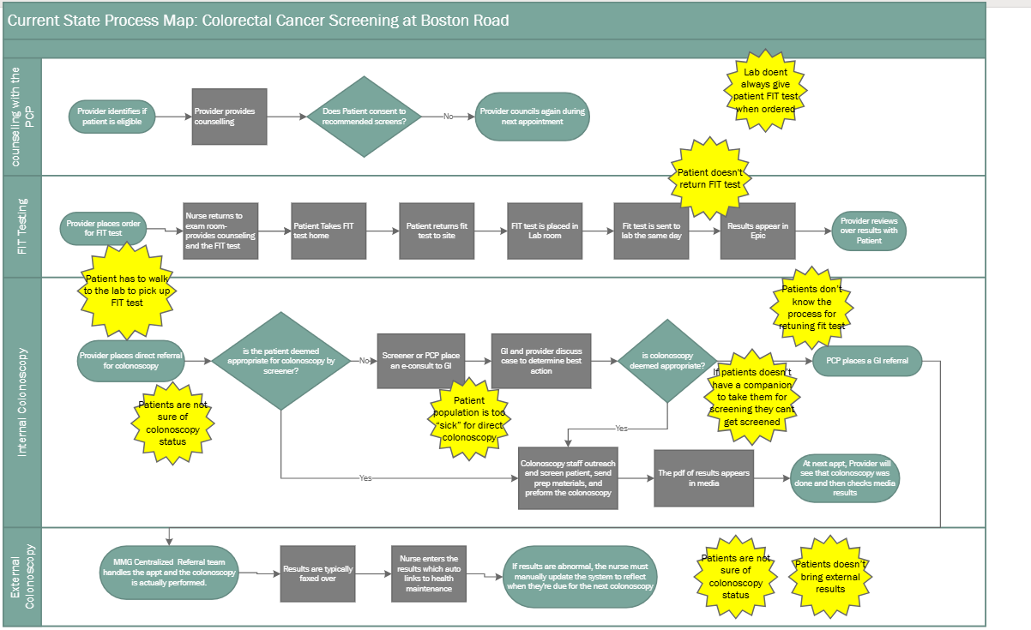
Process
7
Notes:
Share a flowchart and other information about the process on which you focused
(See next slide for a flowchart example that you can adapt)

Slide 8
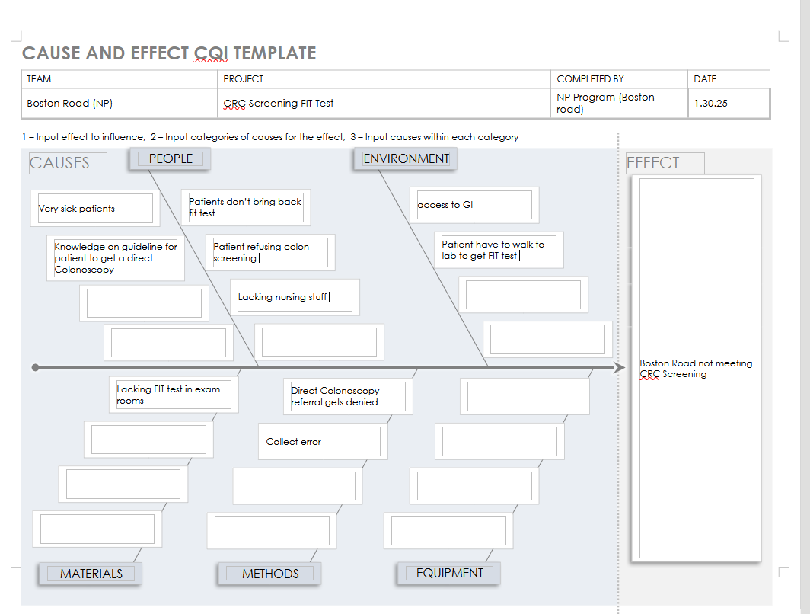
Fishbone Diagram
8
Notes:
What factors did you consider related to the
Pt getting denied and reason for FIT test
problem you are addressing in your project?
To improve access to FIT testing for our patient population who are not qualified for colonoscopy
How did you narrow the focus of your project?
Pt getting denied and reason for FIT test
Share the diagram if you created one.

Slide 9
Stakeholders
Patient, family of patient/ caregiver
  Key stakeholder
Medical provider (MD, NP)
  Key stakeholder
Nurse (RN, LPN) & supportive staff
  Secondary stakeholder
Administration/ Leadership
  Key stakeholder
9
Notes:
If you engaged with any of the stakeholders, what did you learn from them?

Slide 10
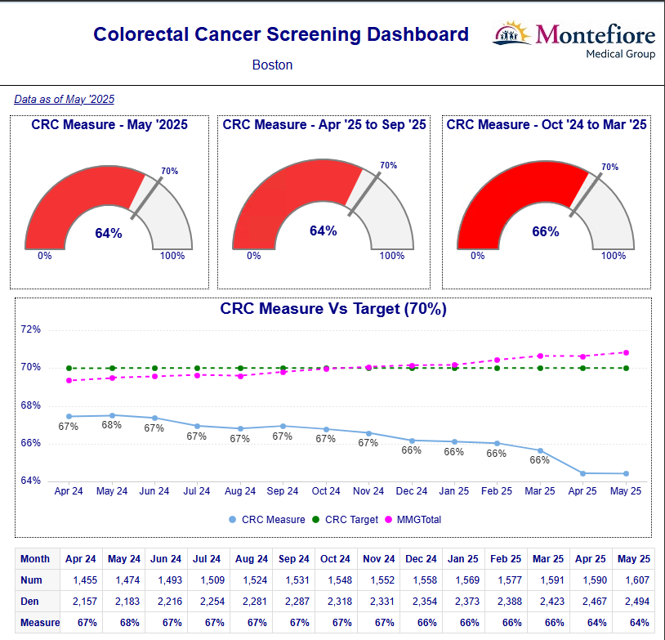
Data
10
Notes:
Provide examples of the data you had or collected during the improvement effort
Going from 66% to 64%
Explain what these data mean

Slide 11
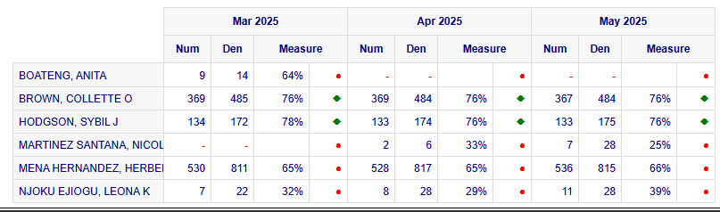
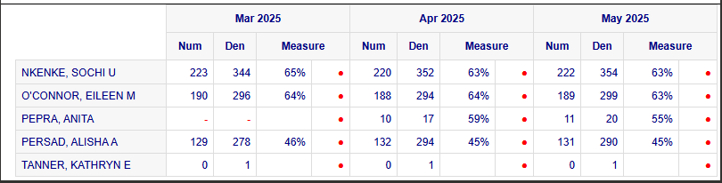
More Data

Slide 12
Approach to Change
Things to change:
  Making sure the FIT testing kits are placed in all the exam rooms
  Using process mapping to identify barriers such as health literacy, language and system level gaps
PDSA cycles
  To increase screening uptake this will allow for early detection and reduce mortality and morbidity rate.
  Improving testing return rate because FIT test is a non invasive, inexpensive screening method to detect blood in stool which is a sign of colon cancer by boosting return rate more people can be screened with potential early detection leading to improved outcomes
12
Notes:
PLAN- Identify the population overdue for CRC screening and specific process to improve/increase FIT kit return rate for example reminder phone call
DO- Implement invention in a small scale. For example calling 2-3 patients who were given the FIT kit.
STUDY- Analyse data to assess impact- Did return rate improve.
ACT- Refine the intervention based on findings and scale up if successful or develop new strategies if unsuccessful.
Lesson learnt- In real time FIT testing is a highly acceptable, effective less invasive inexpensive trackable tool for screening for CRC when implemented in an organized, programmatic way with strong systems for educating, reminding following up patients and tracking results.
Np fellows workload not allowing us to go back and track if patients where given testing kits or returned them.

Slide 13
Results /
Lessons Learned
Barriers
  Clinic flow, lack of staff to track patients, availability of providers at site
Challenges
  Patient adherence, stocking issues, staff being on the same page
  Minimal number of days the fellows making the intervention were at the site
  Only two of the nine providers participated in the intervention
13
Notes:
Describe the results of your improvement effort
-Able to identify some of the weak points in our project
Include barriers- lack of staff to f/u with patients about FIT test, education barrier for pt who did not understand the importance of screening, or cultural practices
challenges, success factors in your description
What did you learn from doing this work?

Slide 14
Conclusions/Implications
What is/are the next steps for the work you initiated?
  To ensure outreach occurs to patients giving FIT tests to remind them to bring back the specimens.
  To ensure patients are well educated about the reason for screening and its importance for early detection and prevention. Example: pamphlets or reading materials.
What would you do differently if you were starting this effort again?
  Getting all the providers on board
  Getting all the exam rooms adequately stocked with the FIT kits
14

Slide 15
Conclusions/Implications continued
Future NP residents
Our advice to future residents would be to focus on the following:
Getting the list of from gastroenterology of the required criteria for direct colonoscopy
Getting all the provider on board to follow in the initiative.

Slide 16
References
Robertson, D. J., et al. (2016, October 19). Recommendations on fecal immunochemical testing to screen for colorectal neoplasia: A consensus statement by the US Multi-Society Task Force on Colorectal Cancer. Gastroenterology. https://pubmed.ncbi.nlm.nih.gov/27769517/

