Slide 1

STRATEGIC
FOCUSED
Quality Improvement Seminar
Mark Splaine & Emma Warshauer
October 23, 2025
RELEVANT
INTERACTIVE
TEAM WORK
INFORMATIVE
FUN
SKILL BUILDING
Nurse Practitioner & Physician Assistant
Training Programs
Notes:
EMMA

Slide 2
Session Goals
Hear about and discuss many of the things you are noticing and wondering about
Review the evidence for the team-based care approach in primary care
Share some examples of team-based care in your setting
2
Notes:
EMMA

Slide 3
Roles
Theory burst presenter
  Mark
Facilitator, timekeeper & technical genius
  Emma
Take-home thoughts
  Garrett
3
Notes:
EMMA

Slide 4
Agenda
Welcome and announcements (10 mins)
Theory burst on team-based care (20 mins)
Examples of team-based care (15 mins)
Brief break (5 mins)
Assignment small group discussion (30 mins)
Summary and take-home points (5 mins)
Preview of next session (5 mins)
4
Notes:
EMMA

Slide 5
Curriculum Plan
  An overview of Quality Improvement (10/9/25)
  Care Observations & Stakeholder Considerations (10/23/25)
  Organizing your Improvement Project (11/13/25)
  Global Aim and Fishbone Diagram (12/11/25)
  Process Mapping (Flowcharts) (1/8/26)
  Measurement to Inform Change (1/22/26 & 1/29/26)
  An Approach to Testing a Change (2/12/26)
  Communication about your Improvement Effort (2/26/26)
  Stakeholder Analysis & Conflict Management (3/12/26)
  Managing Up and Gaining Leadership Buy-In (3/26/26)
  Negotiation (4/9/26)
  Negotiation and More About Cycles of Change (4/23/26)
  Sustaining your Improvement Effort (5/14/26)
  Resident Presentations (5/28/26, 6/11/26, 6/25/26)
Notes:
EMMA

Slide 6
Office Hours
Mark will hold office hours for all residents on the 1st Thursday of each month from 11:00am-12:00pm ET
Mark is available to meet with any resident or team if you need an alternative time – just email to set up a time
6
Notes:
EMMA

Slide 7
More About Projects
Nov-Jan
Charter
Jan-Feb
Data
Feb-Apr
Planning & Making Change
Aim
Fishbone
Stakeholders
Flowchart
Change Ideas
Apr-Jun
  Assess/revise changes
  Collect data
  Prepare presentation
Two expectations – periodic sharing & presentation
As much about the journey as the product
7
Notes:
MARK

Slide 8

Experiences from a Quality Improvement Effort:
Colorectal Cancer Screening
Skyla Cedano and Bar Hass
Community Health Center, Inc.
New London, CT
June 12, 2025
Nurse Practitioner & Post-Doctoral
Training Programs
Notes:
MARK

Slide 9

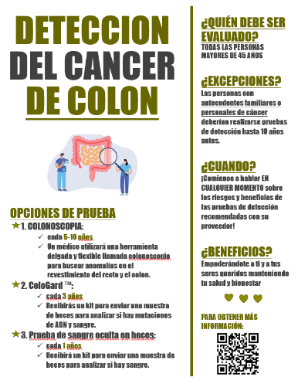
Educational Sheet
Notes:
MARK

Slide 10
Increasing Colorectal Cancer Screening
Anita Pepra
Leona Njoku-Ejiogu
June 12, 2025
Nurse Practitioner & Post-Doctoral
Training Programs
Notes:
MARK

Slide 11
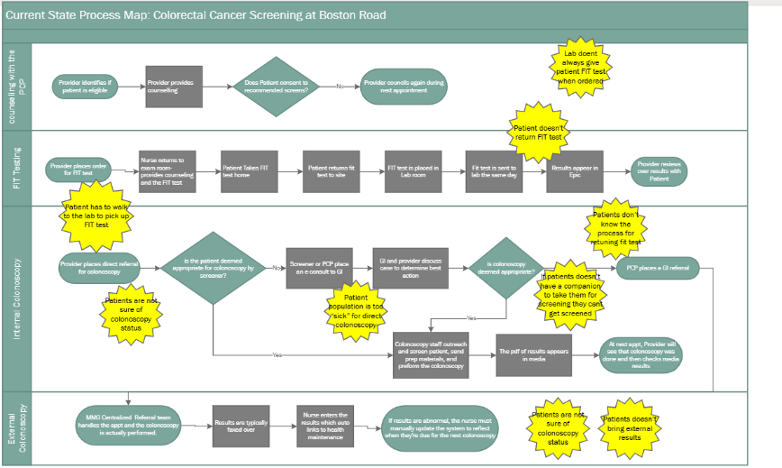
Process
11
Notes:
MARK

Slide 12

Notes:
MARK

Slide 13

ENHANCING DEPRESSION REMISSION IN PRIMARY CARE
DePaul Community Health Center
Presented by:
Clair Brown MSN, APRN, FNP-C
Shani Campbell DNP, APRN, FNP-BC
Tashika Edward, MSN, APRN, FNP-C
Darrielle Santiago, MSN, APRN, FNP-C
June 12, 2025
Notes:
MARK

Slide 14
Exploring Patient Care Continuity with PCP
Quality Improvement Project – CHC NP Residency 2024-25
Alicia Thompson & Gayelan Tietje-Ulrich
FNP Residents at Community Health Center, Middletown, CT
Notes:
MARK

Slide 15

We aim to improve…
Continuity of care between the patient and their assigned primary care provider.
When asked to identify their PCP, patients have responded:
“I have no idea!”
“They always seem to be changing.”
“I’ve seen so many different providers.”
Notes:
MARK

Slide 16

As a clinician, what barriers do you see standing in the way of consistency across patient visits with their assigned primary care provider?
Absence of nursing triage to guide the hierarchy of need or assist with appointment complexity for subsequent scheduling
High turnover rate of clinicians
Patients not scheduling follow-up appointments prior to leaving the clinic
Front desk staff “not caring” how patients are scheduled
Misdirected use of scheduling for 24-hour or 48-hour slots
Provider schedules booking out far in advance
Notes:
MARK

Slide 17
High Performing, Patient-Centered, Team-Based
Primary Care
What does the evidence tell us?
Notes:
MARK

Slide 18
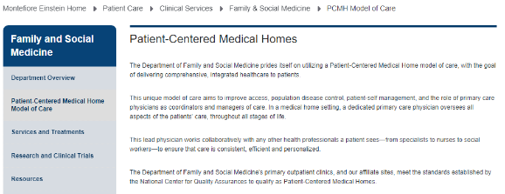






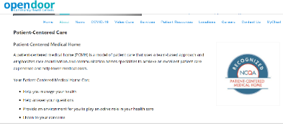


Patient-Centered Medical Home (revise)
18
Notes:
MARK

Slide 19
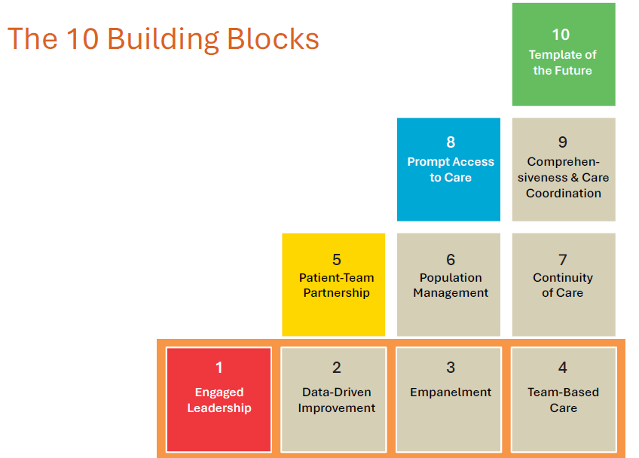

High Performing Primary Care
Bodenheimer T, et. al. Ann Fam Med 2014;166-171. doi:10.1370/afm.1616
Notes:
MARK

Slide 20
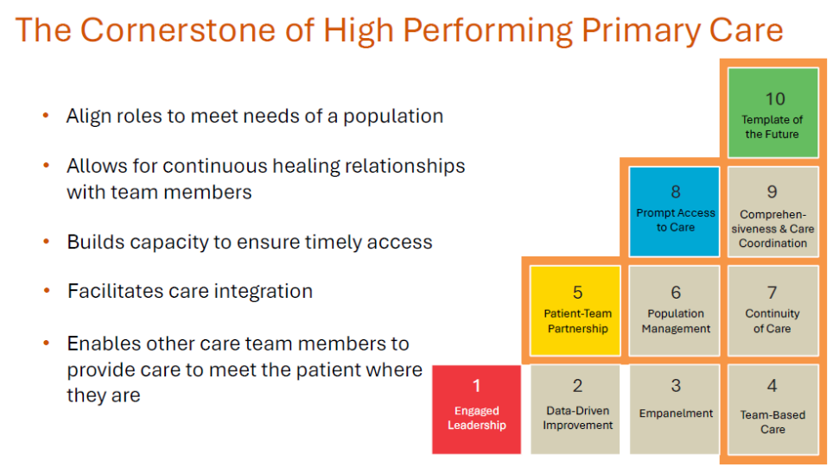
High Performing Primary Care
Notes:
MARK

Slide 21
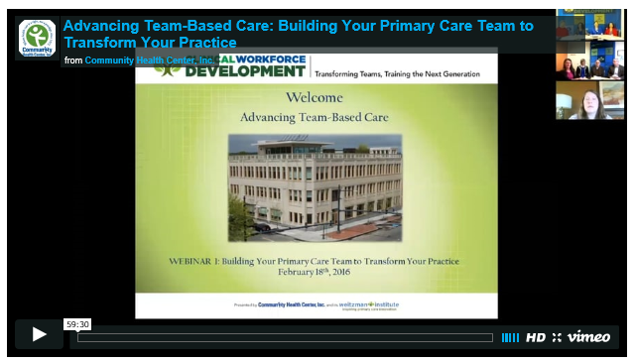
National Cooperative Agreement (NCA) Webinars
https://vimeo.com/635689772/3b16008074
21
Notes:
MARK

Slide 22
Advancing Team-Based Care Webinar
Why are teams important?
What do the data show about impact of teams?
What lessons were learned from studying 30 high-performing practices?
What is the composition of teams?
How do teams enable practices to become high performing?
What are the key functions/competencies of excellent primary care?
Additional webinars on many of the above topics can be accessed using the link below
  https://learn.chc1.com/course/view.php?id=6
22
Notes:
MARK

Slide 23
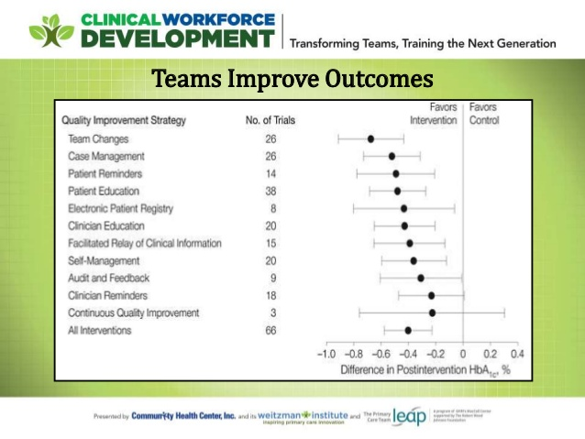
23
Notes:
MARK

Slide 24
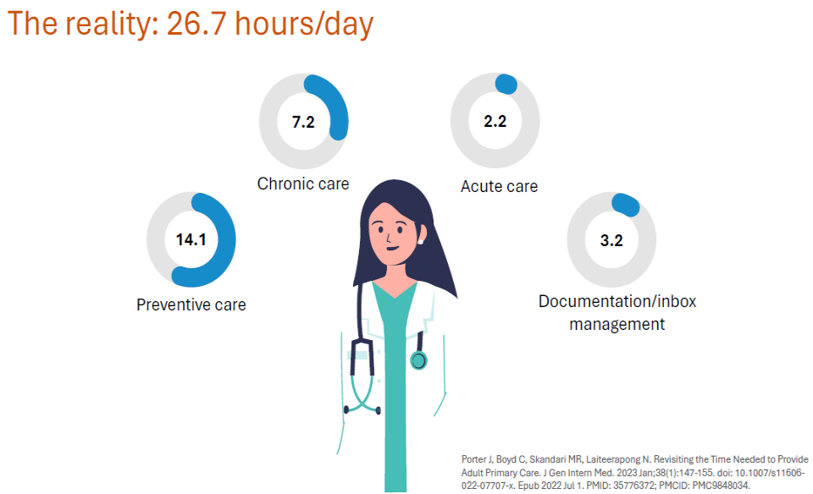
24
Notes:
MARK

Slide 25
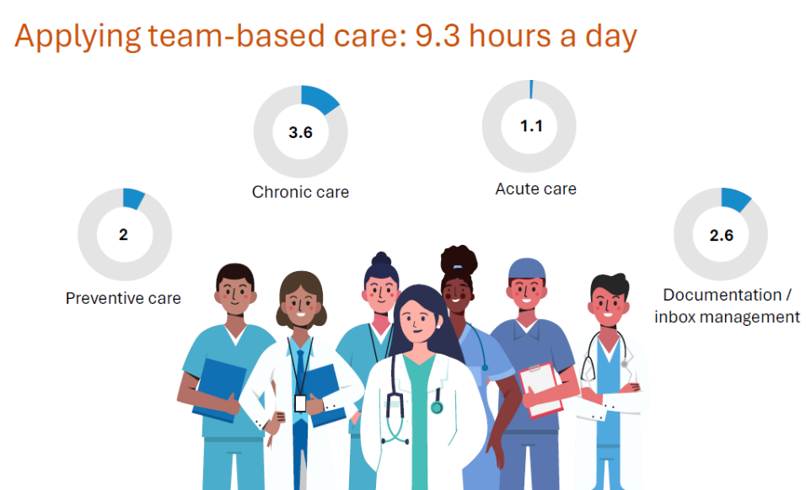
25
Notes:
MARK

Slide 26

26
Notes:
MARK

Slide 27
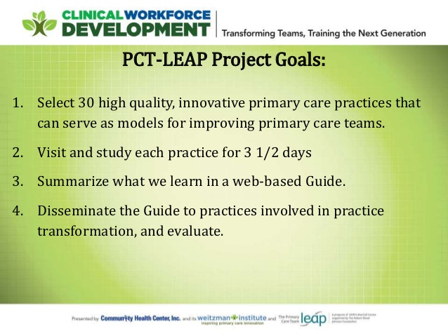
27
Notes:
MARK

Slide 28
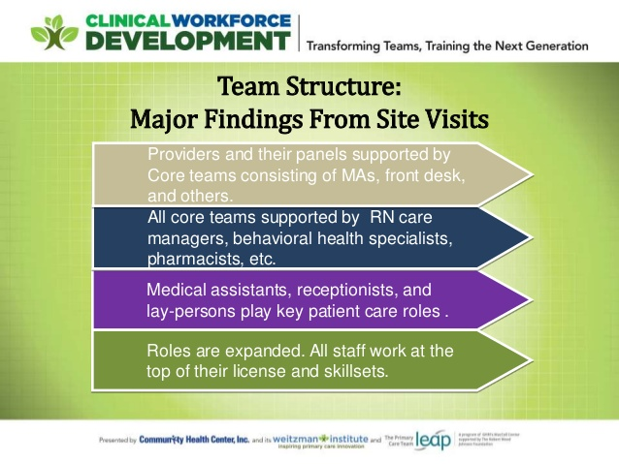
28
Notes:
MARK

Slide 29
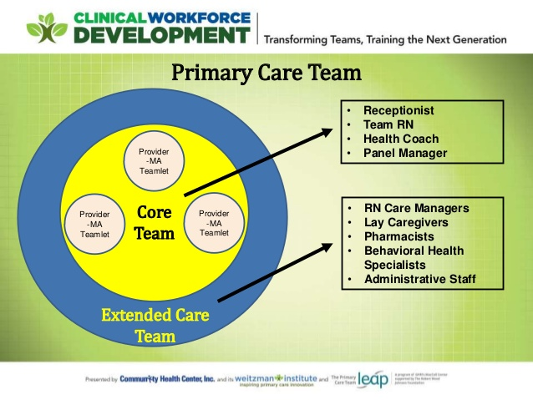
29
Notes:
MARK

Slide 30

https://improvingprimarycare.org
30
Notes:
MARK

Slide 31
Poll Questions
Have you experienced team-based care at your health center? (choose one)
  Yes, No, Maybe, but not sure
In your clinical work, do you work with any of the following (select any that apply)
  Medical Assistant, Nurse, Behavioral Health Provider, Nutritionist, Pharmacist, Social Worker, Other
31
Notes:
MARK

Slide 32
Examples from Sites
We will ask for volunteers to share an example of team-based care you have seen at your site
  DePaul
  CHC New London
  Sun River Health
  Montefiore
  CHC Hartford
In your response, please include any information you may have regarding:
  Who you work with directly when you provide care
  Which health professional disciplines are available at your site
We will hear from as many sites as time allows
32
Notes:
MARK

Slide 33



Break!
Take five minutes to recharge and refresh.
33
Notes:
MARK

Slide 34
Session II Assignment
Now we will focus on your assignment for today’s session
We will divide into two breakout rooms
  Emma and Mark will facilitate the discussion in each room
When in your group please share about either
  A quality improvement priority for your organization
  An example of something you noticed and are wondering about in their clinic setting
Each group will ask for a volunteer to report on highlights of the discussion
After the small group discussion, we will return to the large group to hear each reporter’s summary ideas
34
Notes:
www.clinicalmicrosystem.org
34
MARK

Slide 35
Small Group Discussion
Emma/Garrett’s Group
DePaul CHC
Holyoke HC
Sun River Health
CHC Hartford
CHC Meriden
CHC Middletown
Mark’s Group
Montefiore Medical Group
UC Irvine
Yakima NHS
Open Door
CHC New London
CHC New Britain
35
Notes:
www.clinicalmicrosystem.org
35
MARK

Slide 36
What haven’t we figured out yet?
Questions or issues that remain unclear?
36
Notes:
MARK

Slide 37
Take-home Thoughts
Garrett – share 1 or 2 ideas you will take away from our small group discussion
37
Notes:
MARK/GARRETT

Slide 38
Summary
You have learned about frameworks to guide your thinking about how to organize improvement work
You have identified some of your organization’s priorities for improvement
You have begun to investigate processes in the clinical environment that you think can be improved with quality improvement interventions
  Consider using one of these processes for your team’s QI project
We have discussed the person-centered, team-based approach to primary care and emphasized the great opportunity at health centers to provide integrated care
38
Notes:
EMMA

Slide 39
Assignment for Session III
Send a list of who you will be working with and what you will focus on for your QI project to Mark & Emma by 11/7/25
Work with your project team to make a draft of the project charter
Send your draft project charter to us by Wednesday, 11/12/25 at 6pm EST
39
Notes:
www.clinicalmicrosystem.org
39
EMMA

Slide 40

Notes:
MARK

Slide 41

A PROJECT CHARTER adds structure as you plan
What are we trying to accomplish? & Why?
Will we know if the change made an impact?
  A tool for training and/or communication
  Baseline data
  Goals
  Measures
  Stakeholders
  Barriers
  Expectations
  Ideas
41
Notes:
MARK

Slide 42
Date charter revised
Problem Statement
Create this statement with team
Team Members
Central Question/ Why work on this now?
Include coach, sponsor and each member (core and extended)
Measures
What is the impact anticipated OR what are the current losses
Scope
Goal Statement
Measurement from PI Goals
Milestones/ Dates
Goals from PI Goals spreadsheet – baseline and follow up.
Date team first meeting and date project charter created
Document first & last process steps.
Deliverables and when they are due
If implementation goal –evidence that it is implemented?
List areas of exclusion for this project
Create this statement with team
Date each PDSA launched, completed.
Project Charter Template
Notes:
MARK

Slide 43
Session III Highlights
We will hear reports from several groups about their draft project charter for their project idea
We will introduce and briefly discuss the templates for creating:
  A global aim statement
  A fishbone diagram
43
Notes:
www.clinicalmicrosystem.org
43
MARK

Slide 44
References
The Primary Care Team Guide (https://improvingprimarycare.org)
Bodenheimer T, Ghorob A, Willard-Grace R, Grumbach K. Ann Fam Med 2014;166-171. doi:10.1370/afm.1616
NCA Implementing Team-Based Care Webinar (https://vimeo.com/635689772/3b16008074)
44
Notes:
www.clinicalmicrosystem.org
44
MARK

