Slide 1

STRATEGIC
FOCUSED
Quality Improvement Seminar
Mark Splaine & Emma Warshauer
December 11, 2025
RELEVANT
INTERACTIVE
TEAM WORK
INFORMATIVE
FUN
SKILL BUILDING
Nurse Practitioner & Physician Assistant
Training Programs
Notes:
EMMA

Slide 2
Session Goals
Hear about and discuss your efforts to draft a global aim statement from your project idea
Draft a problem statement related to a global aim example
Brainstorm ideas to begin populating a fishbone diagram
2
Notes:
EMMA

Slide 3
Roles
Theory burst presenter
  Mark
Facilitator, timekeeper & technical genius
  Emma
Take-home thoughts
  Emma and others
3
Notes:
EMMA

Slide 4
Agenda
Welcome (10 minutes)
Theory burst (5 minutes)
  Global aim tips
Global aim examples (25 minutes)
Break (5 minutes)
Theory burst (5 minutes)
  Fishbone diagrams
Fishbone example & discussion (30 minutes)
Summary and take-home points (5 minutes)
Preview of next session (5 minutes)
4
Notes:
EMMA

Slide 5
Curriculum Plan
  An overview of Quality Improvement (10/9/25)
  Care Observations & Stakeholder Considerations (10/23/25)
  Organizing your Improvement Project (11/13/25)
  Global Aim and Fishbone Diagram (12/11/25)
  Process Mapping (Flowcharts) (1/8/26)
  Measurement to Inform Change (1/22/26 & 1/29/26)
  An Approach to Testing a Change (2/12/26)
  Communication about your Improvement Effort (2/26/26)
  Stakeholder Analysis & Conflict Management (3/12/26)
  Managing Up and Gaining Leadership Buy-In (3/26/26)
  Negotiation (4/9/26)
  Negotiation and More About Cycles of Change (4/23/26)
  Sustaining your Improvement Effort (5/14/26)
  Resident Presentations (5/28/26, 6/11/26, 6/25/26)
Notes:
EMMA

Slide 6
Global Aim Statements (Tips)
Some things to consider (from NICHQ):
  The concrete goals you want to achieve
  Who will benefit from this improvement? Whose interests are served?
  What will be done? Is it supported by evidence or experience?
  Where will the change occur?
  When will it start and stop?
  What are the boundaries of the processes? What is in, what is out?
6
https://www.nichq.org/insight/qi-tips-formula-developing-great-aim-statement
Notes:
MARK

Slide 7
Global Aim Assignment
Decide on the topic for the project you would like to develop at your site (agree together as a group on this)
Session preparation:
  Review templates
  Watch the two videos on brainstorming
Work with your site colleagues to generate a draft of a global aim statement for your project topic
If you have time, draft a problem statement and begin filling in your fishbone diagram
7
Notes:
www.clinicalmicrosystem.org
7
MARK

Slide 8
Poll Question
Which of the following best describes your team’s experience in drafting your global aim statement? (select one)
  We followed the template and found it pretty easy.
  We followed the template, but had 1 or 2 aspects we were not sure about.
  We tried to use the template, but had a hard time translating our project idea to this format.
  We appreciate the template, but we are still struggling to decide on our project topic.
  Our experience is not captured in any of the options.
Notes:
MARK

Slide 9
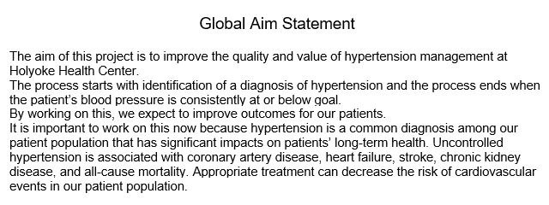
Holyoke Health Center

Slide 10
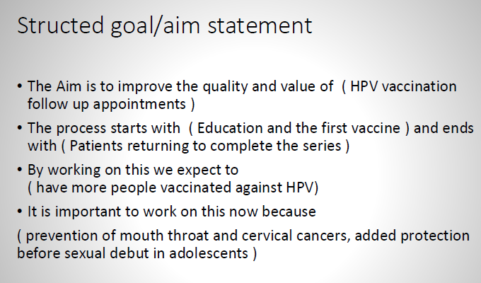
Montefiore Medical Group – Via Verde

Slide 11
Sun River Health
Aim Statement:
The aim of this project is to improve the quality and consistency of follow-up for patients with positive PHQ-9 screenings.
Process Description:
The process begins with PHQ-9 screening of all patients aged 12 years and older and ends with completion of a documented follow-up plan within 48 hours for any patient with a PHQ-9 score of 10 or higher.
Providers must complete four required steps to appropriately address a positive PHQ-9 screen:
  Prescribe an antidepressant, when clinically indicated
  Place a referral to Behavioral Health
  Behavioral Health visit
  Include standardized behavioral health follow-up text in the treatment plan
Expected Outcome:
By improving this process, we expect to ensure patients are appropriately connected to available behavioral health resources and to increase timely follow-up completion by 3%.
Rationale / Importance:
Positive PHQ-9 scores are a critical signal for potential depression, functional impairment, or suicide risk. Missed follow-ups can compromise patient safety and health outcomes. By standardizing and improving the follow-up process, we enhance early intervention, support patient well-being, and strengthen collaboration between primary care and behavioral health services.
Notes:
MARK

Slide 12
CHC Meriden
The aim is to improve the quality and value of continuity of care for patients with their PCPs.
The process starts with... collecting data at the Meriden CHC site including providers/PSAs who have been present for >3 years and the process ends when… at least one attainable intervention that would address provider concerns and improve continuity of care with PCPs .
By working on this we expect to:
  Improve provider satisfaction
  Improve patient satisfaction
  Improve work flow, both administrative and clinical
It is important to work on this now because…. This topic comes up frequently during staff meetings and provider conversations. It also appears to be a patient concern based on our limited experience at Meriden CHC.
Notes:
MARK

Slide 13
Camino Health Center

Slide 14



Break!
Take five minutes to recharge and refresh.
14
Notes:
MARK

Slide 15
Poll Question
Do you have any prior experience using a fishbone (cause-and-effect) diagram? (select one)
  Yes, I have used this may times.
  Yes, I have used this once before.
  Somewhat, I am familiar with the tool but have not used it before.
  No, this is a new tool for me.
Notes:
MARK

Slide 16
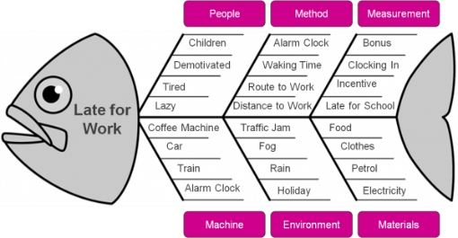
Fishbone Diagram or
Cause & Effect Diagram
A tool to help a team work together using a structured approach to brainstorming a list of causes of a problem
The head of the fish is the problem:
Late for work
The bones are causes grouped by category.
Notes:
MARK

Slide 17
Steps to Follow
Team must agree on the problem statement related to the global aim first
Decide on which general categories you will use. Typical ones include:
  Equipment/supplies
  Technology
  Staff
  Processes/procedure
  Environment
  Patients
Begin brainstorming contributing causes (within a category or as a whole)
Focus on current state!! No solutions yet!
Don’t worry about messiness
Notes:
MARK

Slide 18
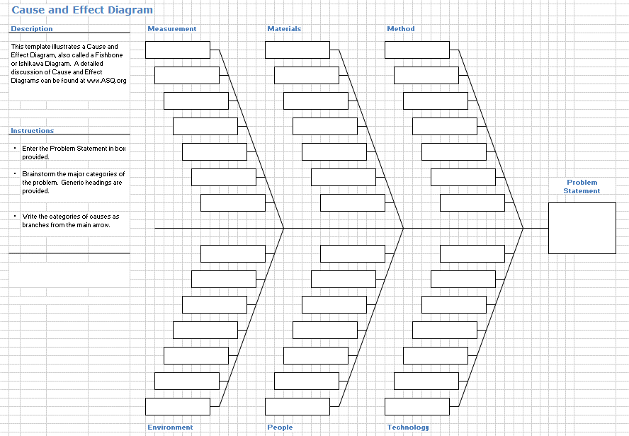
Template
Notes:
MARK

Slide 19
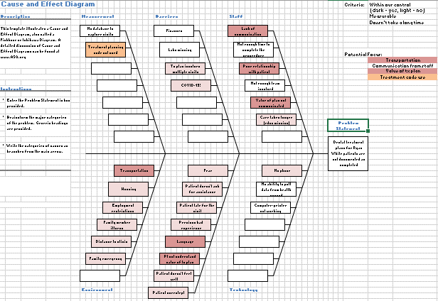
Completed Template
Notes:
MARK

Slide 20
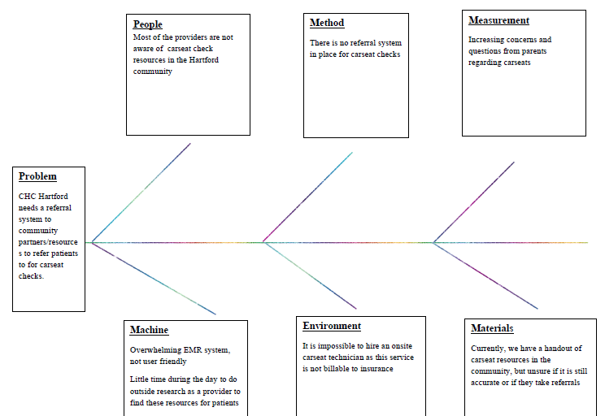
CHC Hartford Example
Notes:
MARK

Slide 21
Work on a Fishbone
We will break into two small groups to complete the fishbone template for one team’s project
For this activity, we will do the following:
  Identify a team (we need a volunteer)
  Select a problem statement based on the team’s aim statement (goal)
  Brainstorm contributing causes and place the ideas in the template
21
Notes:
MARK

Slide 22
Fishbone Diagram Small Groups
Emma/Garrett’s Group
DePaul CHC
Holyoke HC
Sun River Health
CHC Hartford
CHC Meriden
CHC Middletown
Mark’s Group
Montefiore Medical Group
UC Irvine
Yakima NHS
Open Door
CHC New London
CHC New Britain
22
Notes:
www.clinicalmicrosystem.org
22
MARK

Slide 23
What haven’t we figured out yet?
Questions or issues that remain unclear?
23
Notes:
MARK

Slide 24
Take-home Thoughts
Garrett – share 1 or 2 ideas you will take away from our small group discussion
24
Notes:
GARRETT

Slide 25
Summary
You have learned about a framework to guide your thinking about how to organize improvement work
Also, we have reviewed some important tools for quality improvement work – global aim and fishbone diagram
Based on your submissions, it is clear you are already formulating some very good ideas for your projects.
Our next step will be to better understand the process related to your project topic.
25
Notes:
EMMA

Slide 26
Upcoming Office Hours & Teams
The next office hours will be on 12/18 and 1/15 all from 11:30am-12:30pm EST.
We would like to meet with each project team once during December or January. Please let us know when your team would like to confer.
Email us if none of the times work for your team and you would like to meet at another time.
This discussion will be for us to learn a bit more about your project plan and to think together how we can assist you in your work.
26
Notes:
www.clinicalmicrosystem.org
26
EMMA

Slide 27
Session V Highlights
We will discuss tips and strategies for using flowcharts to enhance your understanding of an improvement effort
We will break into small groups to discuss draft examples of flowchart related to your projects
27
Notes:
www.clinicalmicrosystem.org
27
EMMA

Slide 28
Assignment for Session V
Revise your global aim statement, if needed, based on today’s discussion or additional ideas you have about your project
Next, review your initial fishbone diagram draft, and brainstorm as a group about additional factors that contribute to your problem statement
Session preparation (background on flowcharting):
  Watch the two videos on flowcharting
  Read the document on flowcharting
Work with your site colleagues to generate a draft of the actual process for your project topic
If you have time, review your ideas about the process with others involved in the process for their feedback
Contact Emma or Mark if you have questions or need assistance
Send a summary of your draft process by Tuesday (1/6/26)
Our next session will be on Thursday, 1/8/26
28
Notes:
www.clinicalmicrosystem.org
28
EMMA

Slide 29
Resources to Review
The two video links provided below will give you a brief but helpful introduction to developing a process map (flowchart)
  https://www.youtube.com/watch?v=GoEP4dTAmAQ (simple overview, roughly 4 minutes)
  https://www.youtube.com/watch?v=JENOhSXzi2U (more detailed info, roughly 8 minutes)
We will send you an additional reading to provide more detailed insights about flowcharting
29
Notes:
www.clinicalmicrosystem.org
29
EMMA

Slide 30
Additional Template
Process Map / Flowchart
30
Notes:
MARK

Slide 31
References
Science of Improvement: Setting Aims. Institute for Healthcare Improvement Website. (http://www.ihi.org/resources/Pages/HowtoImprove/ScienceofImprovementSettingAims.aspx)
Global Aim Statement Document. Society of Teachers of Family Medicine Resource Library Website. (https://resourcelibrary.stfm.org/HigherLogic/System/DownloadDocumentFile.ashx?DocumentFileKey=27fc6113-ab04-4100-966c-8d2349b4494c&forceDialog=1)
QI Tips: A Formula for Developing a Great Aim Statement. National Institute for Children’s Health Quality Website. (https://www.nichq.org/insight/qi-tips-formula-developing-great-aim-statement)
American Society for Quality Website. (https://asq.org/quality-resources/fishbone)
31
Notes:
www.clinicalmicrosystem.org
31
MARK

Slide 32

We wish you all a wonderful and safe holiday season!
32
Notes:
MARK

