Slide 1

STRATEGIC
FOCUSED
Quality Improvement Seminar
Mark Splaine & Emma Warshauer
January 22, 2026
RELEVANT
INTERACTIVE
TEAMWORK
INFORMATIVE
FUN
SKILL BUILDING
Nurse Practitioner & Physician Assistant
Training Programs
Notes:
EMMA

Slide 2
Continuing Education Credits
In support of improving patient care, Moses/Weitzman Health System is jointly accredited by the Accreditation Council for Continuing Medical Education (ACCME), the Accreditation Council for Pharmacy Education (ACPE), and the American Nurses Credentialing Center (ANCC), to provide continuing education for the healthcare team.
This series is intended for Postgraduate Nurse Practitioners - Family, Psychiatric Mental Health, Adult-Gerontology, and Pediatric.
Please complete the survey and claim your post-session certificate on the WeP after today’s session.
You will be able to claim a comprehensive certificate on the WeP at the end of the series, July 9, 2026.
Notes:
EMMA

Slide 3
Disclosures
With respect to the following presentation, there has been no relevant (direct or indirect) financial relationship between the faculty listed above or other activity planners and any ineligible company in the past 24 months which would be considered a relevant financial relationship.
The views expressed in this presentation are those of the faculty and may not reflect official policy of Moses Weitzman Health System.
We are obligated to disclose any products which are off-label, unlabeled, experimental, and/or under investigation (not FDA approved) and any limitations on the information that are presented, such as data that are preliminary or that represent ongoing research, interim analyses, and/or unsupported opinion.
Notes:
EMMA

Slide 4
Session Goals
Appreciate the value of using balanced measures in quality improvement work
Construct a value compass of measures for a specific clinical example
Recognize the difference between a conceptual and an operational definition
Develop an operational definition for a measure
Formulate a plan for collecting data for a specific measure and identify potential associated challenges in the data collection
4
Notes:
EMMA

Slide 5
Roles
Theory burst presenter
  Mark
Facilitator, timekeeper & technical genius
  Emma
Take-home thoughts
  Garrett or Emma
5
Notes:
EMMA

Slide 6
Agenda
Welcome (5 mins)
Balanced measures (5 mins)
Measure examples from teams (15 mins)
Defining measures (15 mins)
Measure Example from Garrett (10 mins)
Break (5 mins)
Small group discussion in teams (25 mins)
Data collection plans (5 mins)
Summary and take-home points (3 mins)
Preview of next session (2 mins)
6
Notes:
EMMA

Slide 7
Curriculum Plan
  An overview of Quality Improvement (10/9/25)
  Care Observations & Stakeholder Considerations (10/23/25)
  Organizing your Improvement Project (11/13/25)
  Global Aim and Fishbone Diagram (12/11/25)
  Process Mapping (Flowcharts) (1/8/26)
  Measurement to Inform Change (1/22/26 & 1/29/26)
  An Approach to Testing a Change (2/12/26)
  Communication about your Improvement Effort (2/26/26)
  Stakeholder Analysis & Conflict Management (3/12/26)
  Managing Up and Gaining Leadership Buy-In (3/26/26)
  Negotiation (4/9/26)
  Negotiation and More About Cycles of Change (4/23/26)
  Sustaining your Improvement Effort (5/14/26)
  Resident Presentations (5/28/26, 6/11/26, 6/25/26)
Notes:
EMMA

Slide 8
Model for Improvement
What are we trying to accomplish? (Aim)
How will we know that a change is an improvement? (Measures)
What change can we make that will result in improvement? (Change)
Three questions...
…coupled with
an approach for
testing change.
Act
Plan
Study
Do
Langley GJ, et. al. The Improvement Guide (2nd Edition), 2009.
8
Notes:
MARK

Slide 9
Value Compass Diabetes Care
Functional Status
Emotional functioning
Days missed from work
Clinical Outcomes
Satisfaction
Hemoglobin A1C
Patient’s perspective
Medication changes
Costs
Medications
Admissions
Clinic visits
ED visits
9
Notes:
MARK

Slide 10
Poll Question?
Tell us about your experience in drafting some possible measures related to your project (select one).
  It was pretty straightforward; we have a few in mind.
  It was a bit challenging; we came up with one or two.
  It was hard; we are not sure about how to do this.
  Our team did not get that far in our work.
Thanks for sharing!
Notes:
MARK

Slide 11

Examples from Teams
  We will hear from some teams:
    Yakima NHS (Heather, Laura)
    CHC Meriden (Brenna, Shenell)
  Share your summary in roughly 3 minutes so we have time for questions and discussion
Notes:
MARK

Slide 12
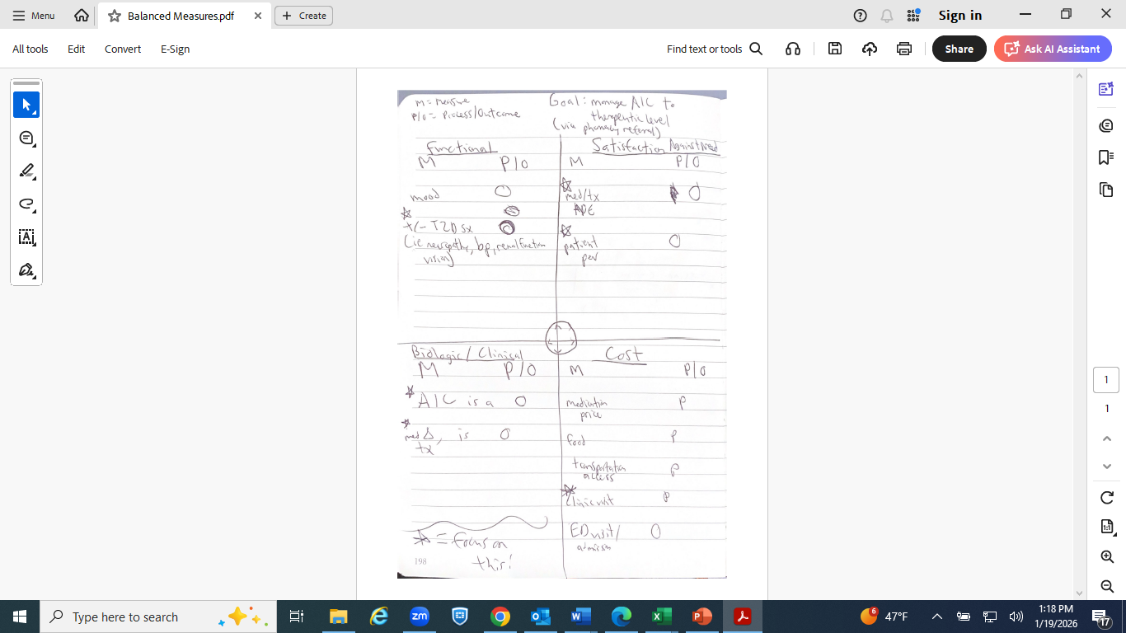
Example – Yakima NHS
Notes:
MARK

Slide 13
Example – CHC Meriden
Notes:
MARK

Slide 14
Approach to Developing Measures
Understand your process
Know what question(s) you are trying to answer to achieve your aim
Develop a set of possible measures
Choose one (or a couple) of measures
Define the measures and develop a method for collecting the data
14
Notes:
MARK

Slide 15
Measure Definitions
Conceptual
  Brief statement describing a variable of interest
  Tells what you want to measure
Operational
  A clearly specified method for reliably sorting, classifying or measuring a variable
  Tells how a variable should be measured
15
Notes:
MARK

Slide 16
Clean Room Example
Think about the concept of room cleanliness
  Defined as a room that is clean in the context of where the room is and what purpose the room serves.
Provide examples of an operational definition for a clean room for :
  Teenager’s Bedroom
    (Montefiore, Middletown, New Britain, Open Door, Holyoke, Yakima)
  Luxury Suite at Ritz Carleton Hotel
    (DePaul, Sun River, New London, Meriden,
    Hartford, UC Irvine)
16
Notes:
MARK

Slide 17
Questions for operationally defining a measure
What is the phenomenon?
What aspect will you measure?
How do you know the measure reflects the phenomenon faithfully?
How will measurement be made?
How will the measure be displayed?
Who will do the measurement and display?
17
Notes:
MARK

Slide 18
Diabetes Examples
Measure | Conceptual Definition | Operational Definition
HbA1c | Measure of average blood sugar control | Lab test ordered on all diabetic patients every three months; results of last test entered into diabetic flowsheet before office visit by medical assistant; if test not up-to-date, patient is called by medical assistant and asked to have test done before next visit.
Emotional Function | Patient’s self-assessment of depression symptoms | Survey (PHQ9) given to patient upon check-in to appointment by receptionist; medical assistant computes score for completed survey and enters value into diabetes flowsheet; done every six months for all diabetic patients.
ER Visits | Patient use of Emergency Room for care | Medical record review by a patient care technician confirms date of and reason for any Emergency Room visit in the previous six months; results of review entered into the diabetes flowsheet prior to office visit; done prior to every office visit for all diabetic patients.
18
Notes:
MARK

Slide 19
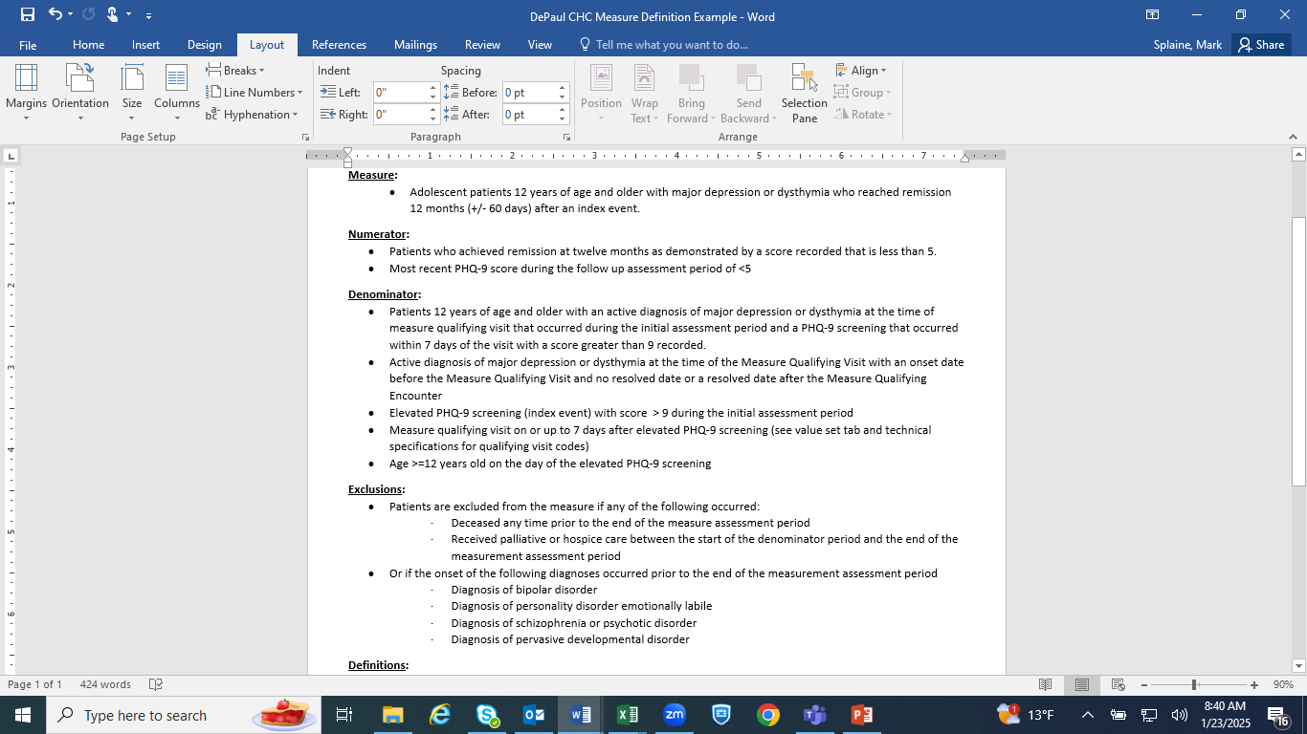
Example – DePaul CHC
Notes:
MARK

Slide 20



Break!
Take five minutes to recharge and refresh.
20
Notes:
MARK

Slide 21
Measure Discussion
We will break into team-based groups (12 minutes)
Each group will discuss one measure you think will be critical to your project
Questions:
  Why is this measure critical?
  Are the data for this measure currently available?
    If yes, what is the source for the data?
    If no, how are you thinking you might gather these data?
  What issues or questions does you have related to gathering data for this measure?
Be prepared to share your answers with the large group
21
Notes:
MARK

Slide 22
Small Group Measure Discussion
We will use breakout
DePaul CHC
Holyoke HC
Sun River Health
CHC Hartford
CHC Meriden
CHC Middletown/NB
rooms for each team:
MMG Via Verde
MMG Group II
Camino HC (Irvine)
Yakima NHS
Open Door
CHC New London
CHC PMHNP
22
Notes:
www.clinicalmicrosystem.org
22
MARK & EMMA

Slide 23
Highlights from Project Groups
  Reporter’s summary from some groups -- share 1 or 2 highlights from the discussion
Notes:
EMMA, GARRETT, MARK

Slide 24
Developing a data collection plan
Be clear about who does what when
Consider what is needed to collect the data
Try to build the data collection into the process of work
Pilot the data collection and then revise it as needed
24
Notes:
MARK

Slide 25
Data Collection Plan Questions
What data will you collect?
How will the data be analyzed?
Will the data be stratified? If so, what will be the strata?
How much data will be collected?
When will data collection start and stop?
Who will collect the data and where?
Who needs what training to collect these data?
When will the data collection be piloted?
25
Notes:
MARK

Slide 26
Issues that often come up…
Deciding how much data you need
Understanding who might need training to collect the data
How to display the measure
Doing a pilot test
26
Notes:
MARK

Slide 27
What haven’t we figured out yet?
Questions or issues that remain unclear?
27
Notes:
MARK

Slide 28
Take-home Thoughts
Garrett – share 1 or 2 ideas you will take away from our small group discussion
28
Notes:
GARRETT

Slide 29
Summary
Attention must be given to selecting, defining and collecting data for any measure
This always sounds easier than it actually is, so one should leave time to do this well
Practice is helpful, and even more useful when applied to something specific on which you are working
29
Notes:
EMMA

Slide 30
Upcoming Office Hours & Teams
The next office hours will be on 2/19 from 11:30am-12:30pm EST.
We have met with several project groups already.
We would like to meet with the remaining project teams once by the end of February.
Please let us know when your team would like to confer.
This discussion will be for us to learn a bit more about your project plan and to think together how we can assist you in your work.
30
Notes:
www.clinicalmicrosystem.org
30
EMMA

Slide 31
Session VII Assignment
Focus for next session on January 29th is understanding variation
  We will discuss how to identify different patterns of variation and what these patterns mean
  We will learn about run charts as a new way to display data over time and analyze the data for the type(s) of variation present
Please read the following
  Perla article on run charts (BMJ Quality and Safety)
  http://qualitysafety.bmj.com/content/20/1/46.abstract
31
Notes:
www.clinicalmicrosystem.org
31
EMMA

Slide 32
References
  Langley GJ, Moen R, Nolan KM, Nolan, TW, Norman CL, and Provost LP. The Improvement Guide: A Practical Approach to Enhancing Organizational Performance (2nd Edition). San Francisco, CA: Jossey-Bass, 2009. Chapter 1, pp 23-25.
  Nelson EC, Splaine ME, Batalden PB, Plume SK. Building measurement and data collection into medical practice. Ann Intern Med 1998; 128(6): 460-466.
  George ML, Rowlands D, Price M, and Maxley J. The Lean Six Sigma Pocket Toolbook. New York, NY: McGraw-Hill, 2005. Chapters 6 and 7, pp 104-118.
32
Notes:
www.clinicalmicrosystem.org
32
EMMA

