Slide 1

Motivational Interviewing
Daniel Bryant, MSEd, LPC
March 23, 2026

Slide 2
Learning objectives
By the end of this session, participants will be able to…
Define motivational interviewing (MI)
Identify both barriers to and benefits of MI
Describe the motivational interviewing style
Describe the role of ambivalence in the MI process

Slide 3
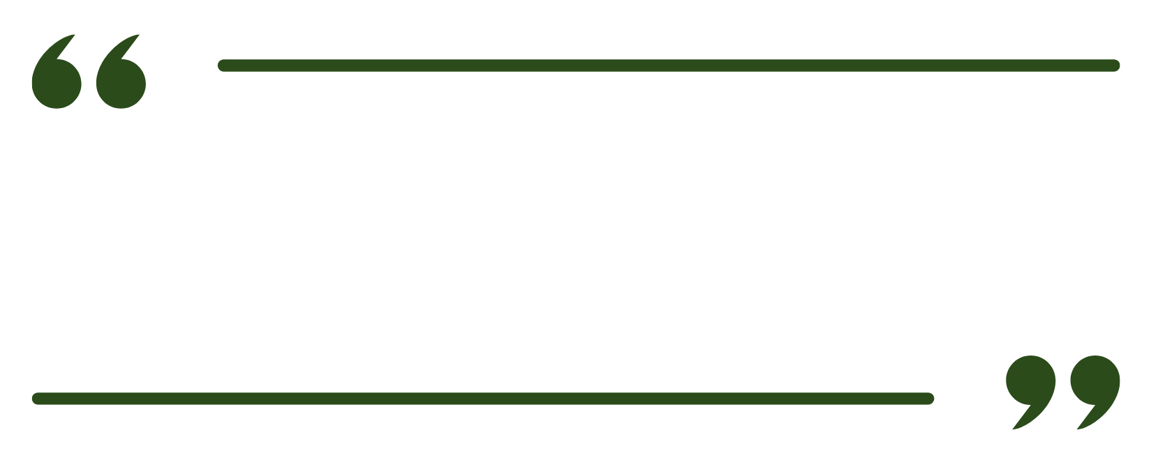


Motivational interviewing is a client-centered, yet directive method for enhancing intrinsic motivation for positive behavior change by exploring and resolving ambivalence.
  Miller, W.R. & Rollnick, S. (2002)

Slide 4

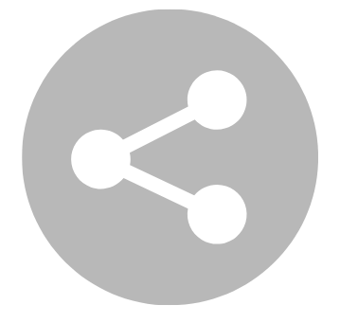
Challenges of effective MI
Qualitative studies found providers identified the following challenges:
Lack of time
“I would love to spend 30 minutes with each patient but it’s not feasible.”
Staff resistance
“We ask patients to change all the time but, it is us who find it difficult to change.”
Cost
“Time is money in general practice.”
Training
“If I was offered training in dermatology or communication, I would choose dermatology. We like medicine so we tend to focus on that not communication.”
Share in the chat: What is your and/or your center’s biggest barrier to effective motivational interviewing?

Slide 5

The righting reflex
One challenge is our natural response to
self-destructive behavior.
Our natural response to seeing and discussing these unhealthy behaviors is to try and change them.
We often believe that our role is to convince or persuade.
Our efforts to advise and change clients creates the natural response to defend their behavior and do the opposite of what we’re rightly recommending.

Slide 6
Benefits of MI
Increases readiness to change
Increases retention to treatment
Decreases substance use at short, medium, and long term follow up
Long term follow up was a significantly lower effect size than short term follow up but still significant

Slide 7
Defining Motivation

Slide 8

Motivation
Motivation is often seen as an either/or
Clients are considered motivated if they…
Agree with a recommended course of treatment
Comply with treatment activities
Accept the label of “addict” or “alcoholic”
Clients are considered unmotivated if they…
Resist a diagnosis
Struggle or decline to adhere to a treatment recommendation or protocol

Slide 9
Motivation, cont.
Motivation is better understood as on a continuum and having multiple manifestations and properties. Motivation is…
Key to change
Multidimensional
Dynamic and fluctuating
A state not a trait
Influenced by social interaction
Modifiable
Influenced by clinician style

Slide 10

Clinician style
Motivation is heavily influenced by clinician style
Better predictor of client outcome than any characteristic of the client
Most important predictor of response to interventions
Specifically, the helping alliance and good interpersonal skills are better predictors of success than a clinician’s education, license, or experience

Slide 11
Motivational Interviewing Style

Slide 12
Principles of MI
ACE
Autonomy versus Authority
Collaboration versus Confrontation
Evocation versus Explanation

Slide 13

MI style
Express empathy and acceptance of current behaviors
Develop discrepancies between current behaviors and personal goals
Avoid direct confrontation so as not to increase resistance
Roll with resistance when identified by using reflective statements and by reframing an individual’s statement towards increasing the discrepancy

Slide 14
MI basics
You achieve this by…
Attending to specific language of change (DARN-CAT)
Using OARS to drive the conversation towards the client self-describing their motivation
  Weighting reflective statements and summaries with the change talk at the end
Identifying the stage of change a client is in
Using specific skills that match specific stages of change

Slide 15
Identifying change talk: DARN-CAT
Desire: I want/wish/prefer
Ability: I can/could/able/possible
Reason: What’s good about a choice? Why do it?
Need: I must/have to/got to/important/matters
Commitment: I will/am going to
Actuation: I’m ready to, I will start tomorrow
Taking Steps: I tried, I started

Slide 16
Proficiency in Person Centered Counseling: The OARS
Open ended questions: cannot be answered with a “yes” or “no”
  Open ended questions can elicit significant change talk
Affirmations: direct statements of support
  Affirmations help enhance positive attitudes about the change
Reflective Listening: listen carefully, then paraphrase what you have heard
  Reflecting what you hear can help resolve ambivalence
Summarize: describe the key points that the patient has made
  Summaries can redirect the conversation when the patient gets off track

Slide 17
Example MI questions
Miller and Rollnick developed questions meant to exemplify MI:
“Why would you want to make this change?”
“How might you go about it in order to succeed?”
“What are the three best reasons for you to do it?”
“How important is it for you to make this change, and why?”
“So, what do you think you’ll do?”

Slide 18
Ambivalence

Slide 19
Ambivalence
People have reasons to change and reasons not to
Ambivalence is a normal experience and part of the change process
Public education enhances ambivalence
  “Just say no”
  #Truth
  D.A.R.E.
Alcohol has less public education than other drugs and tobacco and misinformation is still prevalent
The fact that people still have motivations to do unhealthy things is normal

Slide 20

Ambivalence
Ambivalence is simultaneously two things at once: change talk and sustain talk.
“I know I need to quit drinking…”
“…but I’ve tried to quit so many times and it never works.”

Slide 21
Stages of Change

Slide 22
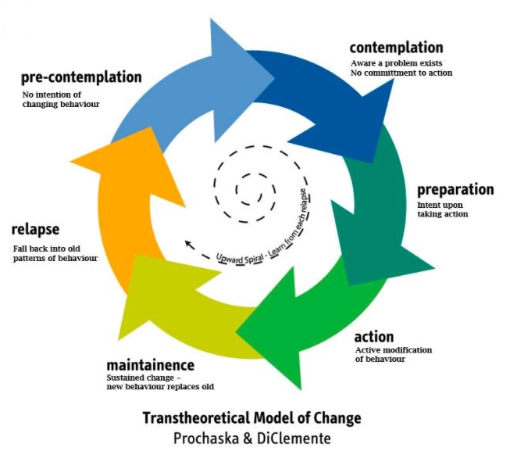
Stages of Change

Slide 23
Stages of Change
Precontemplation: General belief that a problem does not exist
Contemplation: Acknowledgement of a problem but general unwillingness to do anything about it within the next month
Preparation: Plan and intent to address the problem within the next 30 days
Action: Change has been made for less than 6 months
Maintenance: Change has been sustained for greater than 6 months

Slide 24
Stages of Change: Zoom Poll
Which stage of change do you find most challenging to support patients through?
Precontemplation: General belief that a problem does not exist
Contemplation: Acknowledgement of a problem but general unwillingness to do anything about it within the next month
Preparation: Plan and intent to address the problem within the next 30 days
Action: Change has been made for less than 6 months
Maintenance: Change has been sustained for greater than 6 months

Slide 25
Stages of Change: Precontemplation
Marked by the client not considering making a change or not seeing that a problem exists
Denial
“______ is not a problem for me.”
“I’ve got _____ under control.”

Slide 26
Stages of Change: Contemplation
Client recognizes there is a problem but is unsure what to do or whether they want to do it.
General timeline of unwillingness to make a change within the next month or so.
“It’s just not the right time.”
“Yes, _______ is a concern for me, but I’m not sure I’m ready to deal with it yet.”

Slide 27
Stages of Change: Preparation
Moving to preparation is the hard work
Now you’ve got the task of identifying next steps and building a plan the patient agrees to
Offer a menu of options with possible choices
Ask open ended questions that elicit statements about the future, such as the following:
  “Where do we go from here?”
  “What do you think you will do?”
  “What are some good things about making this change?”
  “How are you going to do it?”

Slide 28
Listening for change talk
Reflective listening is a fundamental MI skill
When we hear change talk, we want to reflect it back to the person
Change talk sounds like the DARN-CAT
  Desire
  Ability
  Reason
  Need
  Commitment
  Actuation
  Taking steps

Slide 29
Stages of Change and You
As a provider, you have a different job with each stage of change.
Precontemplation: Increase and develop ambivalence
Contemplation: Highlight and explore the ambivalence and increase motivation for action
Preparation: Develop plans that are likely to succeed
Action: Encourage and support progress, plan for challenges ahead
Maintenance: Relapse prevention

Slide 30
Stages of Change quiz
“I really don’t need a program to help me manage my alcohol use. I only drink when people try to control me or tell me what to do.”
“I’ve been using the stuff that I learned in group so that I don’t drink as much or as often. I haven’t gotten drunk in over a month. I think I’ll keep this up.”
“People are always on my case to do something with my life. But I know what I have to do to get my kids back. I can take care of myself – I just have to stay clear of my old friends.”
“My doctor has been telling me how important it is for me to quit drinking. I want to quit and I know I’ve got to start somewhere.”
“I’ve been really prioritizing my sobriety, going to meetings usually 5 times a week. It’s been almost a year now and I feel great. I can’t imagine falling out of this routine.”

Slide 31
Phases of MI

Slide 32
Four Phases of MI
Engaging
Accurate empathy
Autonomy
Acceptance
OARS
Focusing
Negotiating and agreeing on goals
Guiding client to goals they may not yet have
Evoking
Using the OARS to elicit and evoke direct change language from the client
Planning
The preparation stage of change
Developing realistic, achievable, and specific plans to move client towards behavior change

Slide 33

Making it work in your setting
Each phase can take place over time
Attention to language and moving quickly to reflections of change talk when you hear it (shorten their discussion)
Ask permission to discuss this again next time and then actually do it

Slide 34

Questions?
Feel free to unmute or put your questions in the chat!

Slide 35
References
Aujoulat, P., Manac’h, A., Le Reste, C. et al. Investigating assumptions in motivational interviewing among general practitioners: a qualitative study. BMC Prim. Care 26, 15 (2025). https://doi.org/10.1186/s12875-025-02706-3
Hatch, M. R., Carandang, K., Moullin, J. C., Ehrhart, M. G., & Aarons, G. A. (2021). Barriers to implementing motivational interviewing in addiction treatment: A nominal group technique process evaluation. Implementation Research and Practice, 2. https://doi.org/10.1177/26334895211018400 (Original work published 2021)
Smedslund G, Berg RC, Hammerstrøm KT, Steiro A, Leiknes KA, Dahl HM, Karlsen K. Motivational interviewing for substance abuse. Cochrane Database Syst Rev. 2011 May 11;2011(5):CD008063. doi: 10.1002/14651858.CD008063.pub2. Update in: Cochrane Database Syst Rev. 2023 Dec 12;12:CD008063. doi: 10.1002/14651858.CD008063. pub3. PMID: 21563163; PMCID: PMC8939890.

