Slide 1
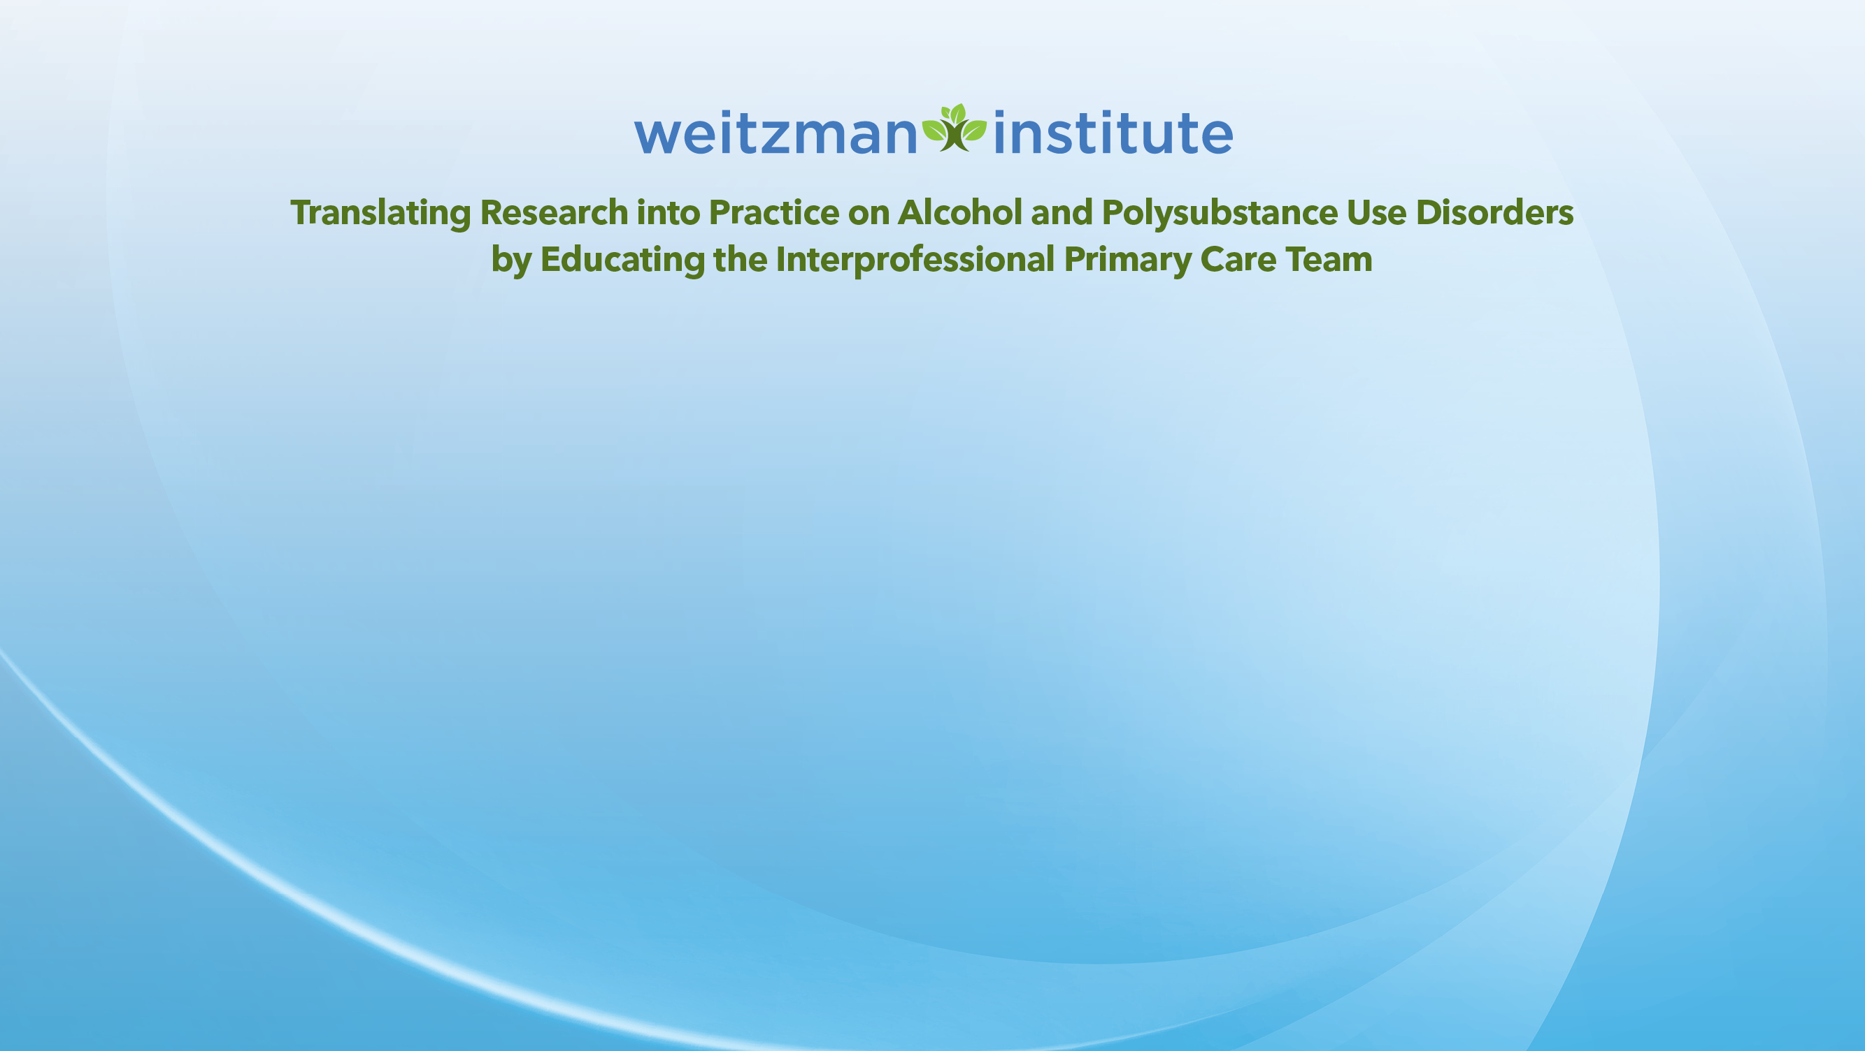
Screening and Diagnosis
Jack Todd Wahrenberger, MPH, MD
Chief Medical Officer at Pittsburgh Mercy Health System
March 09, 2026

Slide 2
Learning objectives
By the end of this session, participants will be able to…
Define unhealthy alcohol use, alcohol use disorder (AUD), and brief intervention according to DSM-5 and USPSTF guidelines.
Articulate at least three reasons why alcohol screening is essential in primary care, including its impact on morbidity and mortality.
Describe at least three validated alcohol screening tools (e.g., AUDIT-C, SASQ, CAGE) and determine which tool is most appropriate for different patient
Perform alcohol screening using a validated tool and interpret screening results accurately. populations (e.g., adolescents, pregnant people, older adults)

Slide 3
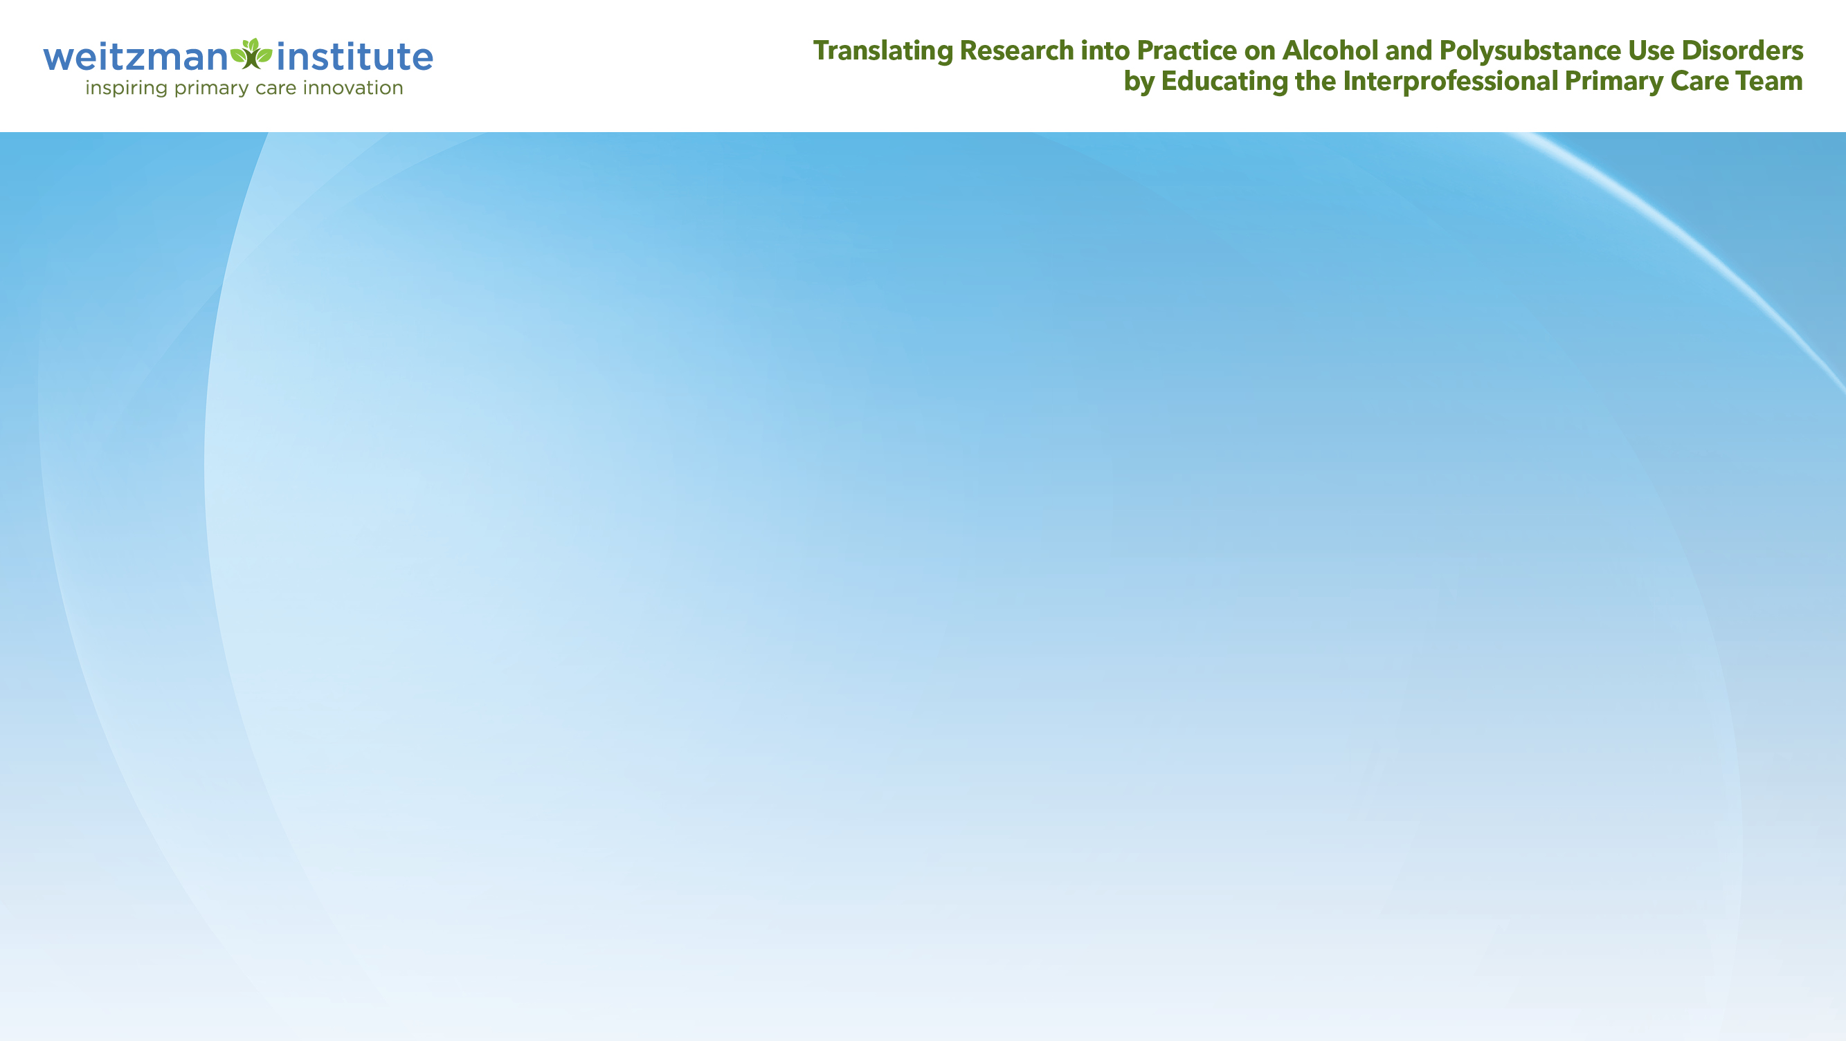
Pragmatic considerations
1
2
3
4
This is not very glamorous work – would you rather be a fire marshal or a fire fighter?
Screening can be a schedule wrecker in a busy practice – “open up a can of worms”
Prevention is not a revenue generator - primary care is volume driven in many markets
My patient might get upset and not return for care
(Johnson et al., 2010); (Williams et al., 2016)

Slide 4

But we should screen anyway!
Alcohol use contributes to common health problems
Screening and intervention can reduce drinking levels
Early detection averts greater harm
Asking about alcohol may help an entire family
(Mertens et al., 2003); (Mertens et al., 2005); (Scott et al., 2016); (Bertholet et al., 2005); (Bien et al., 1993); (D’Onofrio et al., 2002); (Kaner et al., 2009); (Kaner et al., 2007); (Ray et al., 2009)

Slide 5

KT is a 16 year old male planning to attend a local university this fall. He presents to discuss follow up for his JRA treatment and to get a physical for a driver’s permit. His parents are also your patients and have expressed concerns about his moodiness and change in friend groups.

Slide 6

TW is a 37 year old female who presents this morning to get a pregnancy test. She has been your patient for the past few years and struggles with depression. She has failed multiple medications and inconsistent follow up with a therapist. Today, she won’t stop crying during the interview stating that her depression has become much worse.

Slide 7

KU is a 56 year old male with advanced liver disease due to alcohol use. He drinks a bottle of vodka daily for many years. His partner drinks heavily but was recently arrested and incarcerated. KU is now homeless and thinks he needs to detox again. He really doesn’t want to go to the hospital because they are a “bunch of A holes” and he ends up signing out AMA the last few times.

Slide 8
Zoom poll: Finding out a little more
Answer the following questions:
Do you routinely screen for alcohol use?
Have you had training in SBIRT (Screening, Brief Intervention, and Referral to Treatment)?
Do you feel comfortable with brief interventions?
Do you have reliable referral resources in your practice or area?
Do you screen for alcohol withdrawal syndrome (AWS) in individuals with AUD?

Slide 9
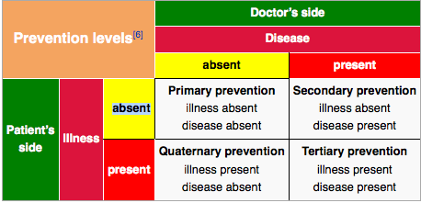
Preventative care: Screening
Notes:
Normally, we are thinking about vaccinations, cancer screening, cardiovascular screening etc.

Slide 10
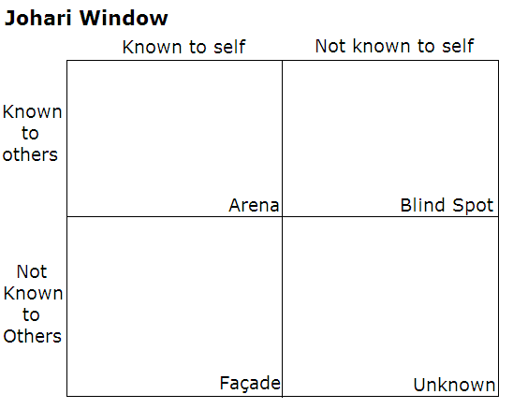
Johari Window
Notes:
For screening is something is heavily behavioral, the Johari window framework is more important since insight is essential in getting better.

Slide 11
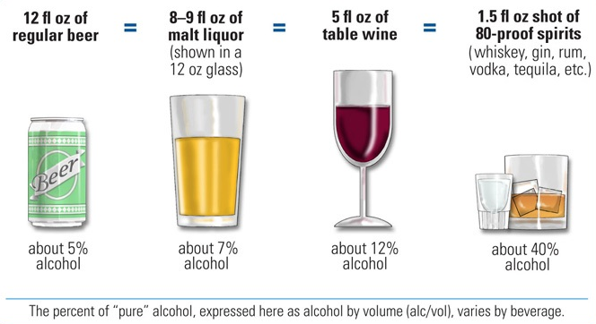
Standard drink
Thresholds for increased health risk
Men under age 65: more than 14 standard drinks per week or more then 4 drinks on any day
Women and adults 65 years and older: more than 7 standard drinks per week or more then 3 drinks on any day

Slide 12
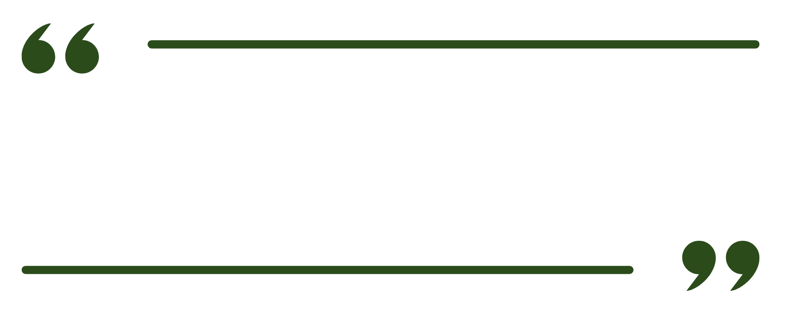
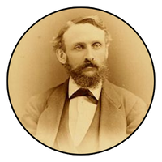
First the man takes a drink.
Then the drink takes a drink.
Then the drink takes the man!
Edward Rowland Sill

Slide 13
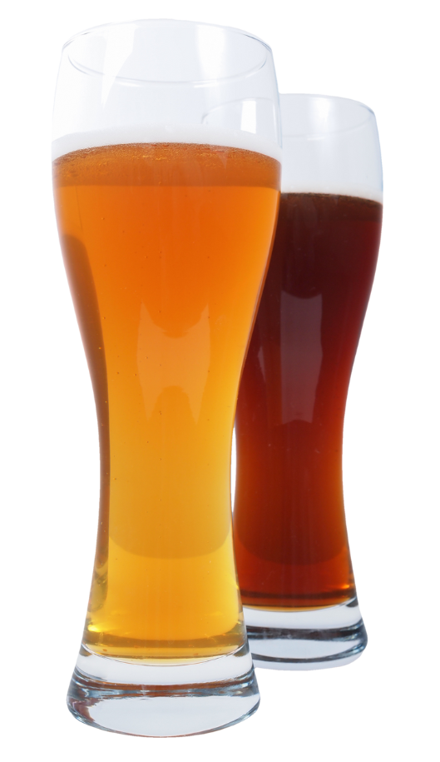
Risky use, unhealthy drinking, and alcohol use disorder A SPECTRUM
Risky use of alcohol means that you consume amounts that increase the likelihood of health consequences (injury, interpersonal problems, medical consequences etc.)
Unhealthy alcohol use
Use amounts that risk consequences
Use has already resulted in consequences (problem use, misuse, hazardous use)
Some features of DSM-5 Alcohol Use Disorder
Alcohol Use Disorder (mild, moderate and severe)

Slide 14
Alcohol Use Disorder DSM-5 (Early, sustained, controlled environment)
A problematic pattern of alcohol use leading to significant impairment or distress, with at least 2 of the following in a 12-month period:
Drinking more or longer than intended
Unsuccessful efforts to cut down or control use
Spending excessive time obtaining, using, or recovering from alcohol
Craving or strong urge to drink
Failure to fulfill major obligations (work, school, home)
Continued use despite social or interpersonal problems
Giving up important activities due to alcohol use
Drinking in hazardous situations
Continued use despite physical or psychological harm
Tolerance (need more to get same effect)
Withdrawal symptoms or drinking to avoid withdrawal
Severity Levels
Mild: 2-3 symptoms
Moderate: 4-5 symptoms
Severe: 6+ symptoms
Notes:
In early remission – After full criteria for alcohol use disorder were previously met, none of the criteria for alcohol use disorder have been met (with the exception of craving) for at least 3 months but less than 12 months.
● In sustained remission – After full criteria for alcohol use disorder were previously met, none of the criteria for alcohol use disorder have been met (with the exception of craving) during a period of 12 months or longer.
● In a controlled environment – If the individual is in an environment where access to alcohol is restricted.
● Mild: Two to three criteria
● Moderate: Four to five criteria
● Severe: Six or more criteria
American Psychiatric Association. Alcohol-Related Disorders. In: Diagnostic and Statistical Manual of Mental Disorders, 5th Edition: DSM-5. 5th edition. American Psychiatric Publishing; 2013.

Slide 15
Why screen for alcohol use?
Unhealthy alcohol use is one of the most common causes of preventable death. From 2020-2021, an estimated 178,000 alcohol-attributable deaths occurred annually in the US. Alcohol associated liver disease mortality has increased significantly post COVID
Unhealthy alcohol use is found in 28% of adults in the US. Alcohol Use Disorder is found in 13% of adults in the US.
Without screening, unhealthy alcohol use goes unrecognized
Screening when combined with brief interventions has been shown to reduce complications in unhealthy alcohol use
Screening helps as the first step to identify AUD
Alcohol use during pregnancy is also one of the major preventable causes of birth defects and developmental disabilities
Esser MB et al. MMWR 2022;71:409–413.
CDC ARDI (2023 update).
White AM et al. JAMA 2022.

Slide 16
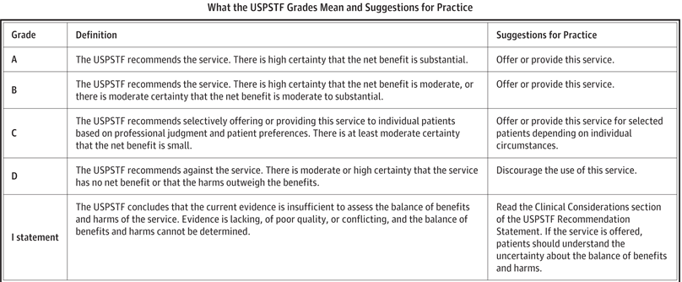
US Preventive Services Task Force (USPSTF) recommendations
All adults (age 18 and older including pregnant persons) in primary care be screened to identify unhealthy alcohol use, AND that those with unhealthy use receive a brief counseling intervention: Grade B
What screen do we use?
What about just screening? (Not effective)
Frequency? (Annual)
12-17 age range? (No amount is safe!)
What is a brief intervention? (Not clearly defined)
Benefits? (Yes) Harms? (No)
(Curry et al., 2018)

Slide 17

Who should do the screening?
Any healthcare professional in medical or mental health field (Physician, APP, RN, MA Peer)
Patient through self reporting tools (paper, tablet, patient portal online)
(Mertens et al., 2015); (Sterling et al., 2015); (McNeely et al., 2021)

Slide 18



Screening tools
Single Alcohol Screening Question (SASQ)
AUDIT-C
AUDIT
CAGE
CARET (older populations)
T-ACE (pregnancy)
CRAFFT (adolescents)
The best recommendation is to keep it simple and consistent
(Curry et al., 2018)

Slide 19
Single Alcohol Screening Question (SASQ)
How many times in the past year have you had five (four for women) or more drinks in a day?
(Smith et al., 2009)
Notes:
SASQ A positive test is 82 percent sensitive and 79 percent specific for unhealthy alcohol use.

Slide 20
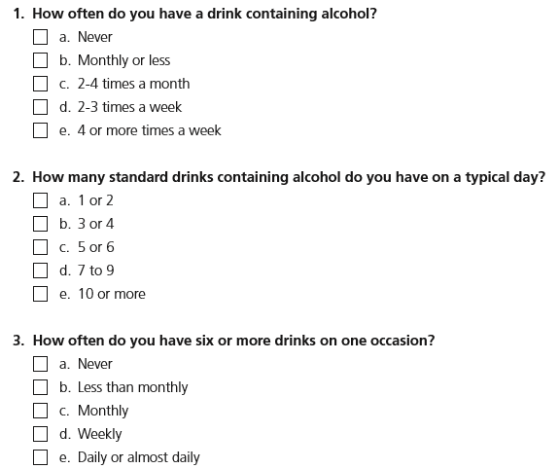
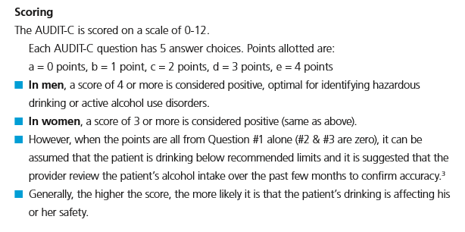
AUDIT-C
(Bush et al., 1998)
Notes:
AUDIT C Three or more in women, with 73 percent sensitivity and 91 percent specificity
Four or more in men, with 86 percent sensitivity and 89 percent specificity

Slide 21
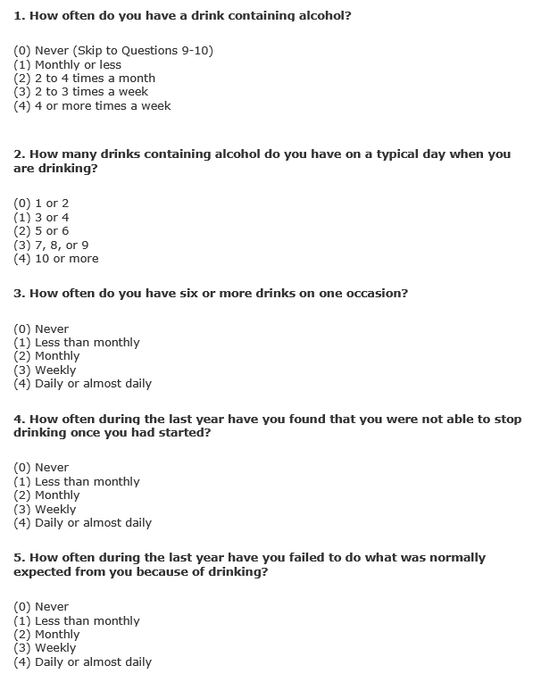
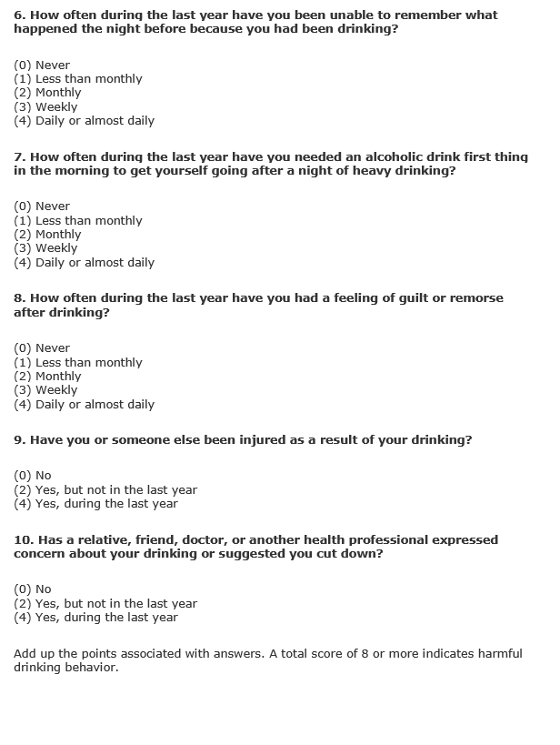
AUDIT
(Babor et al., 2001)
Notes:
A score of 8 or greater on the AUDIT is generally considered a positive test for unhealthy alcohol use, with greater than 90 percent sensitivity and 80 percent specificity

Slide 22
In the past year, on how many days have you had more than a few sips of beer, wine, or any drink containing alcohol?
If your friends drink, how many drinks do they usually drink on an occasion?
For Youth

Slide 23
Labs and physical examination
Liver Function Tests (LFTs): AST:ALT ratio of 2:1 is indicative of alcohol-induced liver disease.
Gamma-glutamyltransferase (GGT) elevated
Serum phosphatidyl ethanol (PEth) and urinary ethyl glucuronide (EtG)
CBC: anemia, pancytopenia, and macrocytosis
Screening for urine alcohol metabolites
BAC/Breathalyzer?
Ultrasound?
Spider angiomata, palmar erythema, hepatic or splenic enlargement
(Hartz et al., 2018); (Griswold et al., 2018); (Dawson et al., 2005)

Slide 24

What do I do with the results of the screen?
If they screen negative for heavy drinking days, advise that the current research indicates, essentially, “the less the better”
Reinforce for those who are pregnant or have underlying health conditions
If they do not currently drink, make sure they know that drinking alcohol will not improve their health
(Hartz et al., 2018); (Griswold et al., 2018); (U.S. Department of Agriculture and U.S. Department of Health and Human Services, 2020)

Slide 25
What do I do if they screen positive for heavy drinking days?
Advise: Give clear feedback - talk about hazards and risks, recommend cutting back or abstinence
Assess: Are they willing to work on change? (Stage of Change)
Assist and Arrange:
“What are some steps you could take to change your drinking?”
Help patient to set a goal to cut down to a specific amount or quit by a specific date.
Assist patient in developing a plan, including how they will quit or cut back, list of potential barriers, plan for overcoming primary barriers, use of support network.
Set specific follow-up date. At each visit monitor current use and progress with plan, reinforce positive change, renegotiate plan, consider need for referral if not meeting goals.
Consider referral for brief therapy for patients with substantial level of use or with difficulty changing use pattern.
Notes:
CONSIDER getting formal SBIRT training for your practice.
SBIRT is an evidence-based, public health approach to identifying and addressing unhealthy alcohol and substance use in medical and community settings. It consists of three key components:
Screening – Quickly assesses alcohol and drug use with standardized tools to identify risk levels.
Brief Intervention – A short, structured conversation using motivational interviewing techniques to raise awareness and encourage behavior change.
Referral to Treatment – Provides a pathway to specialized care for individuals with higher-risk substance use or alcohol use disorder (AUD).

Slide 26
What does Screening look like in a real clinic?
Example:
MA administers AUDIT-C annually
Positive screen auto-flags provider
Provider spends 3–5 minutes with BI
If severe use → assess withdrawal risk
Schedule follow-up within 2–4 weeks

Slide 27
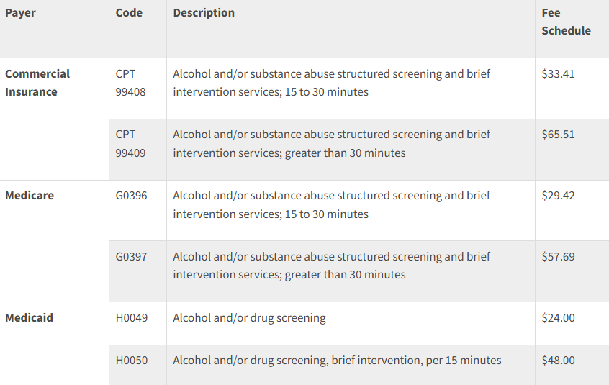
Can I get paid for this? Maybe!
Reimbursement for SBIRT

Slide 28
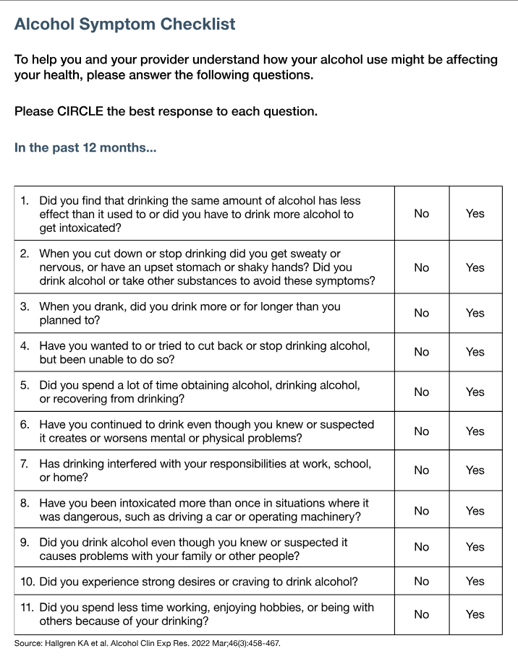
Going further: Alcohol symptom checklist based on the DSM-5 criteria
(American Psychiatric Association, 2013); (Hallgren et al., 2021); (Hallgren et al., 2022)
Notes:
Mild AUD is 2-3 symptoms, moderate AUD is 4-5 symptoms, and severe AUD is 6 or more symptoms

Slide 29
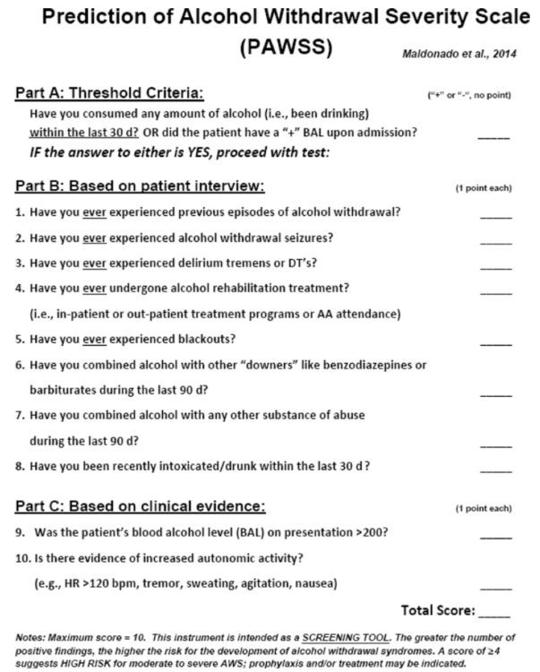
Risk of alcohol withdrawal screen
(Maldonado et al., 2015)
Notes:
The PAWSS has been validated in multiple studies and has shown excellent predictive value for identifying patients at risk for complicated alcohol withdrawal syndrome (AWS), including seizures and delirium tremens. In a prospective validation study, PAWSS demonstrated a sensitivity of 93.1% and a specificity of 99.5% when using a cutoff score of 4, indicating high accuracy in predicting severe AWS among medically ill inpatients

Slide 30
Tips!
Don’t be judgmental (at least don’t appear that way)
Screening is an act of dignity, not suspicion
Language Matters (“person with AUD”, not “Alcoholic”)
Timing in the interview is important
Consider behavioral health environment vs. general PCP practice
Can’t figure out the diagnosis? Put this in the DDX!
Consider SBIRT for your practice
Know the culture in your neighborhoods
Listen to family and friends
Framing: AUD is a chronic relapsing brain disease
Rinse, wash, repeat – this is the long game…

Slide 31
KT didn’t admit to any alcohol use but thought it was cool if others his age decided to drink. We continued to follow him for general care and in his freshman year after two alcohol overdoses, he decided to get help at a residential program.

Slide 32
TW was shocked when I asked her if she was drinking any alcohol (smelled it on her breath) that morning. UHcG was negative. I asked her if she would be willing to use a breath test to confirm and it was 0.20%. We worked over the next 6 months to reduce alcohol use and her depression improved dramatically.

Slide 33
KU was willing to consider and outpatient detox as he had failed multiple inpatient attempts. He scored a 3 on his PAWSS and was willing to follow up daily for ambulatory detox and consider IOP. He has 3 months sobriety and is going to groups.

Slide 34

Influential Journal Articles
Haber, P. (2025). Identification and treatment of alcohol use disorder. New England Journal of Medicine, 392(3), 258-266. https://doi.org/10.1056/NEJMra2306511
Perry, C., Liberto, J., Milliken, C., Burden, J., Hagedorn, H., Atkinson, T., McKay, J. R., Mooney, L., Sall, J., Sasson, C., Saxon, A., Spevak, C., & Gordon, A. J. (2022). The Management of Substance Use Disorders: Synopsis of the 2021 U.S. Department of Veterans Affairs and U.S. Department of Defense Clinical Practice Guideline. Annals of Internal Medicine, 175(5). https://doi.org/10.7326/m21-4011
Notes:
The article "Identification and Treatment of Alcohol Use Disorder" by Paul S. Haber, published in the New England Journal of Medicine in 2025, provides a comprehensive overview of Alcohol Use Disorder (AUD). It emphasizes the importance of early identification and intervention, discussing various screening tools and diagnostic criteria. The article also explores both pharmacologic and behavioral treatment options, highlighting the effectiveness of integrated care approaches. Despite the availability of effective treatments, the article notes that AUD remains underdiagnosed and undertreated, underscoring the need for increased awareness and utilization of evidence-based interventions.
“If you remember one thing from today: Screen annually, treat medically, and never ignore alcohol in depression.”

Slide 35

Questions?
Feel free to unmute or put your questions in the chat!

Slide 36
References
American Psychiatric Association. (2013). Diagnostic and statistical manual of mental disorders (5th ed.). Pearson.‌
Babor, T., Higgins-Biddle, J., Saunders, J., & Monteiro, M. (2001). The Alcohol Use Disorders Identification Test: Guidelines for Use in Primary Care. World Health Organization. https://iris.who.int/bitstream/handle/10665/67205/WHO_MSD_MSB_01.6a.pdf;jsessionid=E006594614B78174AE43B20490F6CBD8?sequence=1
Bertholet, N. (2005). Reduction of Alcohol Consumption by Brief Alcohol Intervention in Primary Care. Archives of Internal Medicine, 165(9), 986. https://doi.org/10.1001/archinte.165.9.986
Bien, T. H., Miller, W. R., & Tonigan, J. S. (1993). Brief interventions for alcohol problems: a review. Addiction (Abingdon, England), 88(3), 315–335. https://doi.org/10.1111/j.1360-0443.1993.tb00820.x
Bush, K., Kivlahan, D., & McDonell, M. (1998). The AUDIT Alcohol Consumption Questions (AUDIT-C): An effective brief screening test for problem drinking. Archives of Internal Medicine, 158(16), 1789. https://doi.org/10.1001/archinte.158.16.1789

Slide 37
References
Curry, S. J., Krist, A. H., Owens, D. K., Barry, M. J., Caughey, A. B., Davidson, K. W., Doubeni, C. A., Epling, J. W., Kemper, A. R., Kubik, M., Landefeld, C. S., Mangione, C. M., Silverstein, M., Simon, M. A., Tseng, C.-W., & Wong, J. B. (2018). Screening and Behavioral Counseling Interventions to Reduce Unhealthy Alcohol Use in Adolescents and Adults. JAMA, 320(18), 1899. https://doi.org/10.1001/jama.2018.16789
Dawson, D. A., Grant, B. F., & Li, T.-K. (2005). Quantifying the Risks Associated With Exceeding Recommended Drinking Limits. Alcoholism: Clinical & Experimental Research, 29(5), 902–908. https://doi.org/10.1097/01.alc.0000164544.45746.a7
D’Onofrio, G. (2002). Preventive Care in the Emergency Department: Screening and Brief Intervention for Alcohol Problems in the Emergency Department: A Systematic Review. Academic Emergency Medicine, 9(6), 627–638. https://doi.org/10.1197/aemj.9.6.627
Griswold, M. G., Fullman, N., Hawley, C., Arian, N., Zimsen, S. R. M., Tymeson, H. D., Venkateswaran, V., Tapp, A. D., Forouzanfar, M. H., Salama, J. S., Abate, K. H., Abate, D., Abay, S. M., Abbafati, C., Abdulkader, R. S., Abebe, Z., Aboyans, V., Abrar, M. M., Acharya, P., & Adetokunboh, O. O. (2018). Alcohol use and burden for 195 countries and territories, 1990–2016: a systematic analysis for the Global Burden of Disease Study 2016. The Lancet, 392(10152), 1015–1035. https://doi.org/10.1016/s0140-6736(18)31310-2
‌

Slide 38
References
Hallgren, K. A., Matson, T. E., Oliver, M., Witkiewitz, K., Bobb, J. F., Lee, A. K., Caldeiro, R. M., Kivlahan, D., & Bradley, K. A. (2021). Practical Assessment of Alcohol Use Disorder in Routine Primary Care: Performance of an Alcohol Symptom Checklist. Journal of General Internal Medicine. https://doi.org/10.1007/s11606-021-07038-3
Hallgren, K. A., Matson, T. E., Oliver, M., Caldeiro, R. M., Kivlahan, D. R., & Bradley, K. A. (2022). Practical assessment of DSM‐5 alcohol use disorder criteria in routine care: High test‐retest reliability of an Alcohol Symptom Checklist. Alcoholism: Clinical and Experimental Research, 46(3), 458–467. https://doi.org/10.1111/acer.14778
Hartz, S. M., Oehlert, M., Horton, A., Grucza, R. A., Fisher, S. L., Culverhouse, R. C., Nelson, K. G., Sumerall, S. W., Neal, P. C., Regnier, P., Chen, G., Williams, A., Bhattarai, J., Evanoff, B., & Bierut, L. J. (2018). Daily Drinking Is Associated with Increased Mortality. Alcoholism: Clinical and Experimental Research, 42(11), 2246–2255. https://doi.org/10.1111/acer.13886
Johnson, M., Jackson, R., Guillaume, L., Meier, P., & Goyder, E. (2010). Barriers and facilitators to implementing screening and brief intervention for alcohol misuse: a systematic review of qualitative evidence. Journal of Public Health, 33(3), 412–421. https://doi.org/10.1093/pubmed/fdq095
‌

Slide 39
References
Kaner, E. F. S., Dickinson, H. O., Beyer, F., Pienaar, E., Schlesinger, C., Campbell, F., Saunders, J. B., Burnand, B., & Heather, N. (2009). The effectiveness of brief alcohol interventions in primary care settings: A systematic review. Drug and Alcohol Review, 28(3), 301–323. https://doi.org/10.1111/j.1465-3362.2009.00071.x
Kaner, E. F. S., Dickinson, H. O., Beyer, F. R., Campbell, F., Schlesinger, C., Heather, N., Saunders, J. B., Burnand, B., & Pienaar, E. D. (2007). Effectiveness of brief alcohol interventions in primary care populations. Cochrane Database of Systematic Reviews. https://doi.org/10.1002/14651858.cd004148.pub3
Maldonado, J. R., Sher, Y., Das, S., Hills-Evans, K., Frenklach, A., Lolak, S., Talley, R., & Neri, E. (2015). Prospective Validation Study of the Prediction of Alcohol Withdrawal Severity Scale (PAWSS) in Medically Ill Inpatients: A New Scale for the Prediction of Complicated Alcohol Withdrawal Syndrome. Alcohol and Alcoholism, 50(5), 509–518. https://doi.org/10.1093/alcalc/agv043
McNeely, J., Adam, A., Rotrosen, J., Wakeman, S. E., Wilens, T. E., Kannry, J., Rosenthal, R. N., Wahle, A., Pitts, S., Farkas, S., Rosa, C., Peccoralo, L., Waite, E., Vega, A., Kent, J., Craven, C. K., Kaminski, T. A., Firmin, E., Isenberg, B., & Harris, M. (2021). Comparison of Methods for Alcohol and Drug Screening in Primary Care Clinics. JAMA Network Open, 4(5), e2110721–e2110721. https://doi.org/10.1001/jamanetworkopen.2021.10721

Slide 40
References
Mertens, J. R., Weisner, C., Ray, G. T., Fireman, B., & Walsh, K. (2005). Hazardous Drinkers and Drug Users in HMO Primary Care: Prevalence, Medical Conditions, and Costs. Alcoholism: Clinical & Experimental Research, 29(6), 989–998. https://doi.org/10.1097/01.alc.0000167958.68586.3d
Mertens, J.R., Chi, F.W., Weisner, C.M., Satre, D.D., Ross, T.B., Allen, S., Pating, D., Campbell, C., Lu, Y.W., & Sterling, S.A. (2015). Physician versus non-physician delivery of alcohol screening, brief intervention and referral to treatment in adult primary care: the ADVISe cluster randomized controlled implementation trial. Addiction Science & Clinical Practice, 10(26). https://doi:10.1186/s13722-015-0047-0
Ray, G. T., Mertens, J. R., & Weisner, C. (2009). Family members of people with alcohol or drug dependence: health problems and medical cost compared to family members of people with diabetes and asthma. Addiction, 104(2), 203–214. https://doi.org/10.1111/j.1360-0443.2008.02447.x
Smith, P. C., Schmidt, S. M., Allensworth-Davies, D., & Saitz, R. (2009). Primary Care Validation of a Single-Question Alcohol Screening Test. Journal of General Internal Medicine, 24(7), 783–788. https://doi.org/10.1007/s11606-009-0928-6

Slide 41
References
Scott, K. M., Lim, C., Al-Hamzawi, A., Alonso, J., Bruffaerts, R., Caldas-de-Almeida, J. M., Florescu, S., Girolamo, G. de, Hu, C., Jonge, P. de, Kawakami, N., Medina-Mora, M. E., Moskalewicz, J., Navarro-Mateu, F., O’Neill, S., Piazza, M., Posada-Villa, J., Torres, Y., & Kessler, R. C. (2016). Association of Mental Disorders With Subsequent Chronic Physical Conditions: World Mental Health Surveys From 17 Countries. JAMA Psychiatry, 73(2), 150–158. https://doi.org/10.1001/jamapsychiatry.2015.2688
Sterling, S., Kline-Simon, A. H., Satre, D. D., Jones, A., Mertens, J., Wong, A., & Weisner, C. (2015). Implementation of Screening, Brief Intervention, and Referral to Treatment for Adolescents in Pediatric Primary Care. JAMA Pediatrics, 169(11), e153145. https://doi.org/10.1001/jamapediatrics.2015.3145
U.S. Department of Agriculture and U.S. Department of Health and Human Services. (2020). Dietary Guidelines for Americans, 2020-2025. https://www.dietaryguidelines.gov/
Williams, E. C., Achtmeyer, C. E., Young, J. P., Rittmueller, S. E., Ludman, E. J., Lapham, G. T., Lee, A. K., Chavez, L. J., Berger, D., & Bradley, K. A. (2016). Local Implementation of Alcohol Screening and Brief Intervention at Five Veterans Health Administration Primary Care Clinics: Perspectives of Clinical and Administrative Staff. Journal of Substance Abuse Treatment, 60, 27–35. https://doi.org/10.1016/j.jsat.2015.07.011

