Slide 1

STRATEGIC
FOCUSED
Quality Improvement Seminar
Mark Splaine & Emma Warshauer
March 12, 2026
RELEVANT
INTERACTIVE
TEAMWORK
INFORMATIVE
FUN
SKILL BUILDING
Nurse Practitioner & Physician Assistant
Training Programs

Slide 2
Continuing Education Credits
In support of improving patient care, Moses/Weitzman Health System is jointly accredited by the Accreditation Council for Continuing Medical Education (ACCME), the Accreditation Council for Pharmacy Education (ACPE), and the American Nurses Credentialing Center (ANCC), to provide continuing education for the healthcare team.
This series is intended for Postgraduate Nurse Practitioners - Family, Psychiatric Mental Health, Adult-Gerontology, and Pediatric.
Please complete the survey and claim your post-session certificate on the WeP after today’s session.
You will be able to claim a comprehensive certificate on the WeP at the end of the series, July 9, 2026.

Slide 3
Disclosures
With respect to the following presentation, there has been no relevant (direct or indirect) financial relationship between the faculty listed above or other activity planners and any ineligible company in the past 24 months which would be considered a relevant financial relationship.
The views expressed in this presentation are those of the faculty and may not reflect official policy of Moses Weitzman Health System.
We are obligated to disclose any products which are off-label, unlabeled, experimental, and/or under investigation (not FDA approved) and any limitations on the information that are presented, such as data that are preliminary or that represent ongoing research, interim analyses, and/or unsupported opinion.

Slide 4
Session Goals
Learn about input from stakeholders related to a planned change
Discuss strategies for further engaging stakeholders
Develop approaches for managing conflict
Practice using a conflict management approach
4

Slide 5
Roles
Theory burst presenter
Mark
Illustrative example
Garrett
Timekeeper & technical genius
Emma
Take-home thoughts
Emma
5

Slide 6
Agenda
Welcome (5 minutes)
Stakeholder interview discussion (25 minutes)
Conflict management styles (5 minutes)
Break (5 minutes)
Conflict management style discussion (20 minutes)
Theory burst - Managing Conflict (20 minutes)
Summary and take-home points (10 mins)
6

Slide 7
Curriculum Plan
An overview of Quality Improvement (10/9/25)
Care Observations & Stakeholder Considerations (10/23/25)
Organizing your Improvement Project (11/13/25)
Global Aim and Fishbone Diagram (12/11/25)
Process Mapping (Flowcharts) (1/8/26)
Measurement to Inform Change (1/22/26 & 1/29/26)
An Approach to Testing a Change (2/12/26)
Communication about your Improvement Effort (2/26/26)
Stakeholder Analysis & Conflict Management (3/12/26)
Managing Up and Gaining Leadership Buy-In (3/26/26)
Negotiation (4/9/26)
Negotiation and More About Cycles of Change (4/23/26)
Sustaining your Improvement Effort (5/14/26)
Resident Presentations (5/28/26, 6/11/26, 6/25/26)

Slide 8
Stakeholder Interview Discussion
We will hear from three teams
Alondra, Aisling, Elizabeth
Eric, Kelly, Mary Lily
Lucienne, Stephanie, Paige, Krystal
In your presentation tell us about
Where things stand with your project
Any stakeholders you have interacted with and what you learned from them
8

Slide 9
DePaul Example
Responses for Quality Project Manager:
The current A1c rate is at 22.9% for the organization.
This is in the top percentile. Some of the barriers I am aware of is:
Patients required to return for a 2 week follow up appointment is time consuming
Patients are not clear that the nurse/health coach follow up visits are not charged
Economic issues and access to fresh fruits and vegetables are always factors
Patients want to know the benefits of attending/compensation
DePaul patients historically adhere to the lab tests when they present to the facilities
Attendance for the diabetic group health visits have been on a decline, possible factors: advertisement/promotion, appointment times, provider referrals, location availability
Working aged patients appreciate text messaging
DePaul has a challenge with phone calls due to the phone number registering as spam
Patients are more prone to participate with recommendations from their PCP, they will remain engaged with developed trust
9

Slide 10
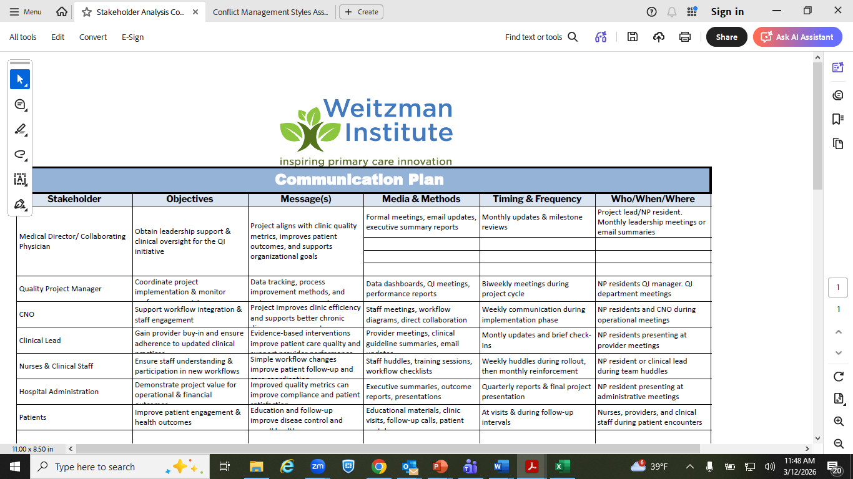
DePaul Example

Slide 11
Stakeholder Considerations from Garrett

Slide 12
Additional Stakeholder Considerations

Slide 13
Influencing Strategy
Areas to consider when approaching those not bought in:
High emotion
Longevity in current process
Creation of current process
Lack of data
Rumor mill
Stakeholder | Desired behaviors | Short term concerns | Short term wins | Influencing strategy Action By who By when
Providers
IT
HR
Nursing
PSA
Other stakeholders
Strategy for building enough support to achieve
successful, lasting change
Notes:
7

Slide 14


Build Relationships to understand perspective, create champions and to collect meaningful reactions
Provide
Facts and data
Transparency
Safe & structured space to interact
Active listening
Acknowledgement of fears
An outline of what will change & what will not
Receive
Engagement in the change process
Input & reaction
Together
Establishment of TRUST
COMMUNICATION IS KEY!

Slide 15
Managing Conflict
Notes:
NATALIE

Slide 16
Poll Question #1
How do you perceive conflict?
Threatening
An Opportunity
Scary
Invigorating
16

Slide 17
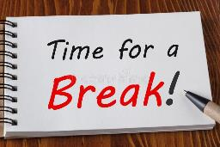


Break!
Take five minutes to recharge and refresh.
17

Slide 18
Exercise
Go on mute and use the following link to complete the ‘What Conflict Animal Are You?’ quiz:
https://www.tryinteract.com/quiz/what-conflict-animal-are-you/
The quiz takes about 2 minutes to complete. Type “I am ready.” in the Zoom chat when you have your result.

Slide 19
Small Group Discussion
We will break into project groups to discuss your quiz results for 10 minutes
In your breakout groups:
First, allow each person to share their result
Next, consider the following questions
Could you predict the result for others in your group?
Do the results help explain how you have approached your project work thus far?
19

Slide 20
Debrief
What did you learn from your group discussion?
Any surprises?
20

Slide 21
Additional Thoughts on Managing Conflict

Slide 22
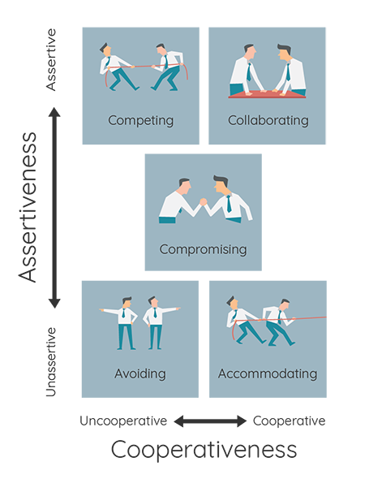
Competing: WIN!
Collaborating: Find a win-win solution together.
Compromising: Find a middle ground
Avoiding: Delay
Accommodating: Yield
Cpp.com. (2015). Thomas-Kilmann Conflict Mode Instrument (TKI).

Slide 23
Approaches to Managing Conflict
Strategy | Description | Example
Forcing/Competing | using formal authority or other power that you possess to satisfy your concerns without regard to the concerns of the party that you are in conflict with. | Leader decides direction based on role, not facts or consensus
Accommodating | allowing the other party to satisfy their concerns while neglecting your own. | Unsure other options will work. Being respectful of role.
Avoiding | not paying attention to the conflict and not taking any action to resolve it. | Afraid of losing a friend, job. No energy for “drama”
Compromising | attempting to resolve a conflict by identifying a solution that is partially satisfactory to both parties, but completely satisfactory to neither. | Deadlocked & need a decision now.
Collaborating | cooperating with the other party to understand their concerns and expressing your own concerns in an effort to find a mutually and completely satisfactory solution (win-win) | Consensus. Facilitated group. Working together.
23

Slide 24
Examples of Team Conflicts
One or more team members who consistently fight the QI Process
Constant disagreement between two or more members on the topic
Leadership does not buy in to a project or team idea

Slide 25
Use the energy positively
Listen actively
Eye Contact
Be confident, not aggressive
Ask questions
Validate the value of the discussion
Acknowledge value of opinion
Provide a safe team environment
Respectful
Encourage Problem Solving
Curious

Slide 26
Positive Reactions
Restate what you have heard to assure what has been understood and ask a clarifying question
“Can you say more about that?”
"Is that the way it usually happens?”
Reflect your own feelings with “I” statements
“I feel disappointed that you don’t see the value in my idea”

Slide 27
Resolving Conflict Successfully
Increased understanding of situation
Expands awareness
Insight into how to achieve goals
Increased group cohesion
Develop stronger mutual respect
Renewed faith in team’s ability to work together
Improved self-knowledge
Conflict can turn into opportunities for growth
Enhances team effectiveness

Slide 28
Poll Question #2
Based on our discussion today about conflict management styles, how likely are you to utilize one of the aspects we discussed?
Very likely
Somewhat likely
Somewhat unlikely
Very unlikely
28

Slide 29
What haven’t we figured out yet?
Questions or issues that remain unclear?
29

Slide 30
Take-home Thoughts
Emma – share 1 or 2 ideas you will take away from our discussion
30

Slide 31
Summary
Many people experience conflict when working within a team and/or with others. It is a completely normative experience!
Conflict can be approached in many different ways, and each way often depends on the individual’s conflict management style and/or the situation at hand.
Conflict does not necessarily have to be viewed as inherently negative. Resolving conflict in a successful way can foster positive growth.
It is important to be aware of your own view on conflict and your conflict management style, and how they might change depending on the situation and with whom you’re working.
It is also equally important to be aware of others’ views on conflict and their specific conflict management style (e.g., by noticing how others respond to each other or by being curious about a specific decision, etc.) as this can help direct how you might respond and/or react to others in the most effective and positive way.
31

Slide 32
Session XI Assignment
Download the Conflict Management Style Assessment document (sent separately with slides)
Complete the questionnaire and score your results
Be prepared to discuss your conflict resolution style at our next session on 3/26/26
Contact Mark or Emma if you have questions
Notes:
www.clinicalmicrosystem.org
32

Slide 33
References
Ronquillo Y, Ellis VL, Toney-Butler TJ. Conflict Management. Treasure Island (FL): StatPearls Publishing; July 2023. (https://www.ncbi.nlm.nih.gov/books/NBK470432/) Accessed August 18, 2025.
Cote, C. 5 Strategies for Resolving Conflict in the Workplace. Harvard Business School Online. September, 2023. (https://online.hbs.edu/blog/post/strategies-for-conflict-resolution-in-the-workplace) Accessed August 18, 2025.
Thomas-Kilmann Conflict Mode Instrument. (https://kilmanndiagnostics.com/overview-thomas-kilmann-conflict-mode-instrument-tki/) Accessed August 18, 2025.
33
Notes:
www.clinicalmicrosystem.org
33

