Slide 1
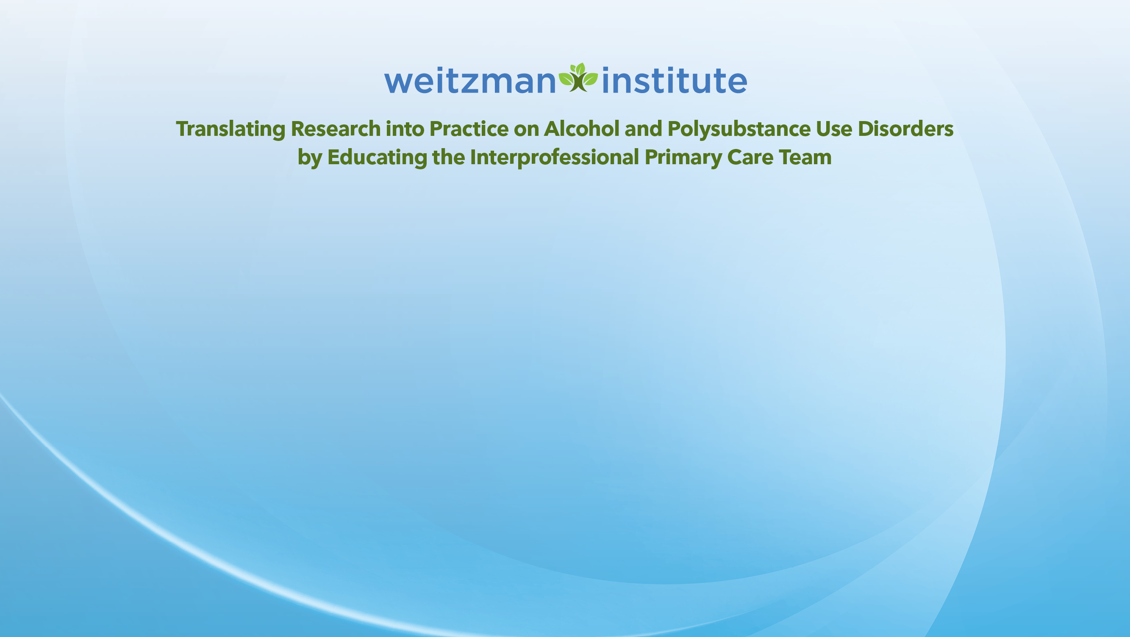
MAT for ETOH
Medication Assisted Treatment for Management of Alcohol Use Disorder
B. Jamie Stevens, APRN, MSN, PMHNP-BC, CARN-AP
12 January 2023
Updated 04 April 2026

Slide 2
Objectives
Understand the importance of screening, evaluation and treatment with MAT for alcohol use disorders (AUD)
Describe the available FDA approved, off label, and other promising treatments for management of AUD

Slide 3
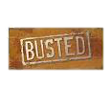
Myths
MAT is just substitution for another addictive drug
MAT is just a short-term solution
MAT is only for people with severe problems
MAT increases the risk for withdrawal, intoxication, or overdose
MAT gets in the way of recovery
MAT is no better than abstinence
MAT isn’t covered by insurance

Slide 4

Facts
MAT provides physiological and psychological support toward recovery from the effects of addictive substances
MAT has been shown to work best for those who stay on it for a period of 2 or more years
MAT is one prong in a multi-pronged approach to meet a person’s individualized needs
MAT reduces the risk of intoxication or continued use and the subsequent morbidity and mortality
MAT has demonstrated the ability to prevent deaths, reduce suffering, and give people an opportunity to handle stress and achieve recovery
MAT is an EBT and recommended by ASAM, IntNSA, AMA, NIDA, AAAP, SAMHSA, NIAAA, CDC, and many other professional organizations and health agencies

Slide 5
Screening for AUD
Adolescents and young adults (age 12-20)
~5.7% have a DSM 5 dx of AUD (NSDUH 2019)
~2.3% of 12-17 year olds have a DSM 5 dx of AUD (NSDUH, 2019)
By asking One question –
"How many days, in the last year, have you had one or more drinks of any alcohol?"
For ages 18-20, 31% who reported >12 drinking days in a year had AUD
For ages 12-17, 44% who reported > 3 drinking days in a year had AUD
If above threshold, follow up with AUDIT-C or CRAFFT
If the AUDIT-C or CRAFFT is positive, implement Brief Intervention and Referral to Tx
Notes:
Turn this into a polling question

Slide 6
Screening for AUD
Adults (18+)
~5.6% likely have DSM 5 dx of AUD (NSDUH 2019)
Audit-C (brief, 3 questions)
If the AUDIT-C is positive, implement Brief Intervention and Referral to Tx
Notes:
Turn this into a polling question

Slide 7
What is Brief Intervention?
Motivational Enhancement
Consciousness raising
Frank statements:
“You are showing problem drinking behaviors.”
”This is likely to lead to serious health problems.”
“There are effective ways of reducing how much you drink.”
Evoking patient self enhancement for change
“You enjoy drinking and you recognize that it’s causing some problems in your life. If you decided to make a change, what might that look like for you?”
Listen for commitment to change
Change statements:
“I can cut down to one drink per day.”
”I’d be willing to try something to help me cut down.”

Slide 8
DEARS of Motivational Interviewing
Develop Discrepancy
"It sounds like you value being a present parent and you also feel that you deserve to drink on weekends. Your ex-spouse won’t let you come around the kids when you do. How do you see those two things fitting together?"
Express Empathy
"It makes sense that you are angry. Being told by others that you 'have a problem' feels incredibly insulting and unfair."
Avoid Argument / Amplify Ambivalence
"You are torn. You're feeling that if you stop drinking, you'll lose your social life, but you're also worried that drinking is causing you to lose your job."
Roll with Resistance
"It's completely up to you whether you decide to drink or not. No one can force you to make a change."
Support Self Efficacy
"You mentioned you managed to stop drinking for three months. What strengths did you use then that you could use now?"

Slide 9
Change Talk to a Plan
Goal: Elicit ideas from your patient and then their plan for what to do about their drinking.
■ What do you make of all this? What are you thinking you’ll do about it?
■ Where does this leave you in terms of your drinking? What’s your plan?
■ I wonder what you’re thinking about your drinking at this point.
■ Now that you’re this far, I wonder what you might do about these concerns. https://www.niaaa.nih.gov/sites/default/files/match02.pdf (pg.29)

Slide 10
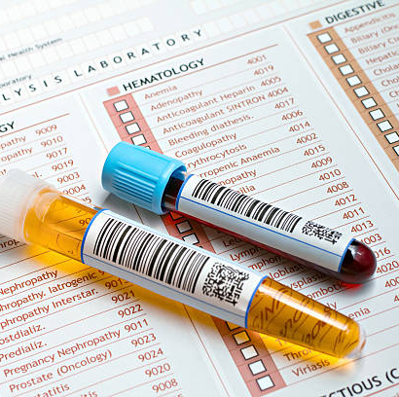
Before starting a medication
Conduct a comprehensive medical assessment
Ensure that the patient is not intoxicated
(they can’t give true consent if they are)
Establish a diagnosis of Alcohol Use Disorder
Alcohol Symptom Checklist
Evaluate for potential of acute withdrawal and Delirium Tremens
CIWA-Ar (more relevant to detox, score >10, refer to detox)
Short Alcohol Withdrawal Scale (SAWS) (score >12 mod-severe, refer to detox)
Time since last drink is also critical
Begin 6-8 hours after last drink of alcohol
Peak from 24 to 72 hours after last drink of alcohol
Complete Blood Count (CBC)
Urine sample (comprehensive toxicology)
Comprehensive electrolyte and metabolic panel
GGT and CDT
indirectly reflect alcohol consumption
Serum phosphatidyl Ethanol (Peth) and Urinary ethyl glucuronide (EtG)
directly measure alcohol metabolites

Slide 11
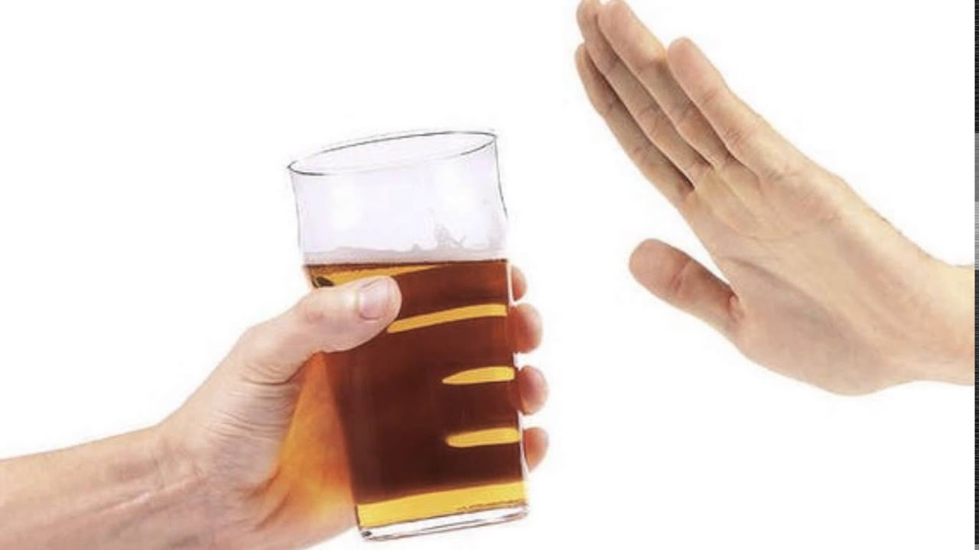
Disulfuram (FDA approved, not first line)
The first medication developed and FDA approved for AUD in 1949.
This is no longer considered a first line treatment choice.
An aversive therapy – causes an uncomfortable physical reaction (N/V, flushing, palpitations) when any form of alcohol is absorbed (blocks oxidation of acetaldehyde)
Must have completed alcohol detox or be alcohol free for >12 hrs
Most effective when administration is supervised and combined with psychosocial supports
Contraindicated in severe heart disease, coronary occlusions, untreated psychoses, pregnancy or breast feeding, active SI, sensitivity to disulfuram or thiuram derivatives (ex. in pesticides)
Caution in patients with chronic or acute liver disease.
Start 500 mg daily x 7-14 days; then 125-250 mg daily maintenance
Severe reactions with alcohol may require emergent medical attention

Slide 12
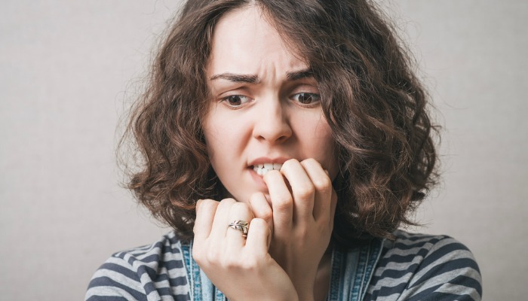
Acamprosate (FDA approved, first line)
As craving and anxiety reduction – thought to counteract the imbalance between glutamatergic and GABAergic systems
Considered most effective when person is abstinent at time of initiation, hasn’t been tested in non-abstinent but hasn’t been shown not to be effective either
Combine with psychosocial supports
Contraindicated in severe renal impairment or hypersensitivity to drug; in mild/mod w/CC of 30-50 mL/min), reduce dose by 50%
Caution in over 65 (renal), pregnancy and breast feeding (no data)
Start and maintain usual dose of 2 tab (333mg) three times daily; pill fatigue can become an issue

Slide 13
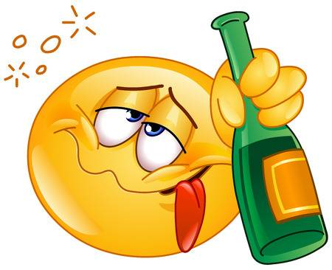

Naltrexone (FDA approved, first line)
Euphoria and craving reduction – by blocking opioid receptors, believed to reduce rewarding effects of alcohol
Only studied in people who abstained from alcohol before starting; no data that it does or doesn’t work for people actively drinking
Contraindicated if receiving or anticipate receiving opioid analgesics, failure of oral challenge, or hypersensitivity to drug/components
Avoid in patients with ALT >5x ULN or severe liver disease
Oral and LAI formulations available
Start naltrexone oral 50 mg daily, can switch to LAI (Vivitrol 380 mg inj q28-30 days) after 3-7 days, or maintain 50 mg oral daily
LAI must be administered DEEP IM as inj site reaction w/tissue necrosis has occurred when not properly administered

Slide 14

The Sinclair Method
Considered evidence based and effective (~ 78%) when it is strictly adhered to for heavy, compulsive, and binge drinking behaviors.
May be helpful for those not seeking immediate total abstinence.
Pharmacologic extinction
reduces the allure of drinking, making it not as enjoyable
Naltrexone is believed to block endorphin release when alcohol is consumed, endorphins drive the desire to drink more
Targeted dosing (dose taken 1 hour before drinking)
Need to have an high enough blood concentration prior to the first drink to block the endorphins (sensation of pleasure)
Intended to create planned drinking, in a safer place, and restore better drinking control at safer levels

Slide 15
The Sinclair Method
Counter-intuitive
A person instructed they may drink alcohol after taking naltrexone for the ‘extinction’ to occur
It is inconsistent with a full abstinence approach
Risk
less risk than taking naltrexone daily or receiving a long-acting injection
Note: While naltrexone alone, with instructions on how to take it, might be adequate for success, most successful trials have included some form of psychotherapy or psychosocial supports structured and targeted on issues r/t alcohol misuse

Slide 16
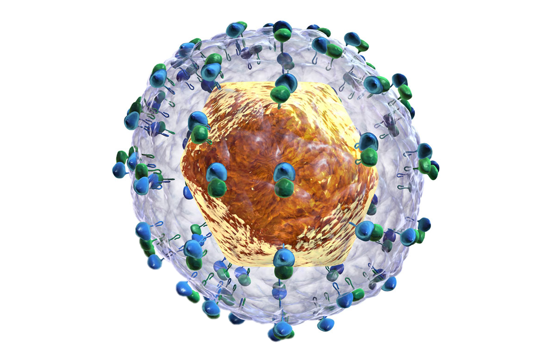
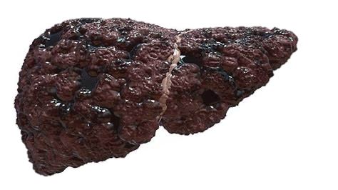
Baclofen (off-label) (Addolorato et al. 2000b, 2002)
Action - as GABA receptor agonist
One 12-week study found it helpful in those with cirrhosis
(Addolorato, Lancet, 2007)
another for persons with HCV
(Leggio, Addictive Behavior, 2012)
12-24-hour period of abstinence from ETOH before starting
Nearly 70% reduction to abstinence in treatment group within first week
Reductions in craving, state anxiety, and obsessive-compulsive thinking
Recommended to be combined with psychosocial supports
(study participants had a supportive family member)
Start 15 mg daily (divided into 3 daily doses) and increased to 30 mg daily on day 4

Slide 17
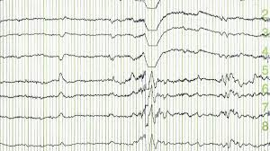
Anticonvulsants (off label)
Grade A designation
Topiramate
Multiple RCTs and a meta-analysis (7 studies, 1,125 participants) have demonstrated efficacy in decreasing heavy drinking days and increasing days of abstinence; combined with psychosocial interventions
2021 VA/DoD clinical guidelines gave strong recommendation
Believed to reduce dopamine release in reward pathways
Some studies only 75 mg daily others dosing up to 300 mg daily
Grade B designation
Gabapentin RCT of 150 participants
NNT=8
Increased abstinence, reduced heavy drinking days, and cravings
300-600 mg TID
Only small studies, no long-term data
Valproic acid
Carbamazepine
Zonisamide
(CNS Drugs. 2015 Apr;29(4):293–311. doi: 10.1007/s40263-015-0240-4)

Slide 18
Promising Therapies
GLP-1s (still considered experimental)
Rodent study in 2023 showed a reduced alcohol drinking, binge-like drinking, and modulated central GABA neurotransmission.
(JCI Insight. 2023 Jun 22;8(12):e170671. doi: 10.1172/jci.insight.170671.)
Phase 2 study
48 non treatment seeking participants,
randomized parallel-arm trial, 9 weeks, outpatient, Sept 2022 – Feb 2024.
Participants received semaglutide (0.25 mg/week for 4 weeks, 0.5 mg/week for 4 weeks, and 1.0 mg for 1 week) or placebo at weekly clinic visits.
Participants were presented with their preferred beverage and brand and could elect to delay drinking for up to 50 minutes for monetary reinforcement.
Thereafter, participants were instructed to consume at their preferred pace to achieve preferred effects over 120 minutes.
Weekly consumption was assessed using calendar-based methods supplemented with daily logs to facilitate recall.
Outcomes included average drinks per calendar day (registered secondary outcome), with additional quantity and frequency outcomes common to AUD trials (drinks per drinking day, number of heavy drinking days, number of drinking vs abstinent days), and weekly craving examined as exploratory and hypothesis-generating outcomes.
The proportion of participants with zero heavy drinking days served as an exploratory outcome relevant to FDA end points.
Cigarettes per day (registered secondary outcome) was assessed during calendar-based assessments.
Findings indicated initial prospective evidence that low-dose semaglutide can reduce craving and some drinking outcomes, justifying larger clinical trials to evaluate GLP-1RAs for alcohol use disorder. (JAMA Psychiatry Vol 82 No 4; Hendershot, Bremmer, Paladino)

Slide 19
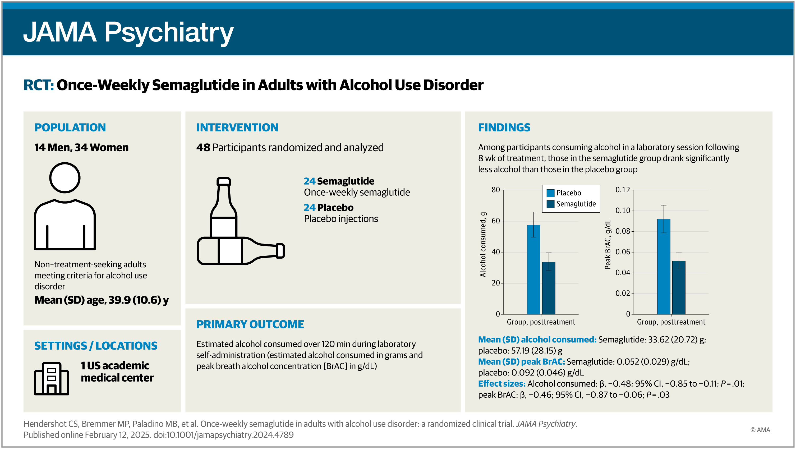

Slide 20
Summary
MAT is not a cure but has been found to be a highly effective treatment strategy, especially when done in combination with a support program, whether formal or informal
Expert consensus supports use of MAT in primary care settings
While not all patients benefit, MOST do
Multiple options exist, offer what your patient believes might work best for them

Slide 21
Resources
Practitioner/Clinician
https://store.samhsa.gov/product/Medication-for-the-Treatment-of-Alcohol-Use-Disorder-A-Brief-Guide/SMA15-4907
https://www.asam.org/
https://www.niaaa.nih.gov/sites/default/files/publications/NIAAA_Alcohol_Screening_Youth_Guide.pdf
https://www.niaaa.nih.gov/sites/default/files/publications/YouthPocketGuide-english.pdf
Patient/Family
https://al-anon.org/
https://ncadd.us/

Slide 22

Questions?
Feel free to unmute or put your questions in the chat!

